Slide 1


Ersilia Vallefuoco
Tutor: Alessando Pepino
XXXII Cycle - I year presentation
IS4Inclusion
The personalization in Serious Game for people with Autism Spectrum Disorder

Slide 2




Background
Graduation: MSc in Biomedical Engineering cum laude.
Fellowship: DIETI and Centre SInAPSi
Dieti Group: Biomedical
Collaborations: Centro Medico Riabilitativo Pompei

Slide 3
Autism Spectrum Disorder (ASD)
Introduction
ASDs are a variety of disorders that affect social and communication skills and, in a different way, motor and language skills.
In America: 1 in 68 children.
In Asia, Europe, and North America: prevalence of between 1% and 2%.
In Italy: North 1/149, Centre 1/94 and South 1/98.
THERE IS NO CURE !

Slide 4
Introduction
Autism and Technology
People with ASD show a natural affinity with technology because:
use visual-spatial communication channel;
use simple and structered language;
reduce the sources of stress caused by relationships.
Several studies evaluated the Serious Games (SG) use as a tool to support traditional therapy for people with ASD.

Slide 5
The Personalization in SG
Research
In the development of a SG aimed at people with ASD:
to carry out a suitable customized intervention based on evolution and changes;
to consider the personalization of accessibility of technologies and content.
Analyze and evaluate the effects of personalization in SG for children and teenager with ASD.

Slide 6
Current Work
Research
Sample: 10 children and teenager with ASD.
In experimental phase, the participants will play two serious games, one personalised and another not personalized.
Elements of personalization:
game scenery,
scene objects,
audio,
type of missions.

Slide 7
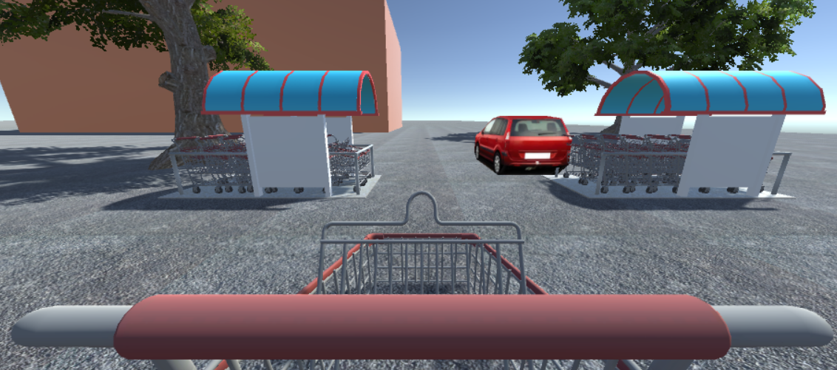
Present and Future
Research
I am developing the two Serious Games
After, the testing phase will start with participants.

Slide 8
Publications
Products
Vallefuoco E., Pepino A. and Bravaccio C. (2017), Strumenti di immersive simulation rivolti a persone con Disturbi dello Spettro Autistico. Modellazione 3D di scenari interattivi, «Autismo e disturbi dello sviluppo», vol. 15, n. 2, pp. 223-252, doi: 10.14605/AUT1521705.
Vallefuoco E., Bravaccio C. and Pepino A. (2017), Serious Games in Autism Spectrum Disorder: An example of personalised design. Proceedings of the 9th International Conference on Computer Supported Education, vol. 1, pp. 567-572.
Pepino A., Vallefuoco E., Cuccaro P. and D’Onofrio G. (2018), Simulation model for analysis and management of the no-show in outpatient clinic. Proceedings of the 10th International Conference on Computer Modeling and Simulation *.
* Award: Best Presentation

Slide 9
Credit Summary
Next years
Credit summary
 | Credits year 1 |  |  |  |  |  |  |  | Credits year 2 |  |  |  |  |  |  |  | Credits year 3
 |  | 1 | 2 | 3 | 4 | 5 | 6 |  |  | 1 | 2 | 3 | 4 | 5 | 6 |  |  | 1 | 2 | 3 | 4 | 5 | 6
 | Estimated | bimonth | bimonth | bimonth | bimonth | bimonth | bimonth | Summary | Estimated | bimonth | bimonth | bimonth | bimonth | bimonth | bimonth | Summary | Estimated | bimonth | bimonth | bimonth | bimonth | bimonth | bimonth | Summary | Total | Check
Modules | 20 | 4 | 3 |  |  | 3 | 6 | 16 | 10 |  |  |  |  |  |  | 0 |  |  |  |  |  |  |  | 0 | 16 | 30-70
Seminars | 5 | 2,8 | 1,4 | 0,2 | 0,2 | 0,4 | 0,4 | 5,4 | 5 |  |  |  |  |  |  | 0 |  |  |  |  |  |  |  | 0 | 5,4 | 10-30
Research | 35 | 5 | 5 | 7 | 7 | 5 | 6 | 35 | 45 |  |  |  |  |  |  | 0 |  |  |  |  |  |  |  | 0 | 35 | 80-140
 | 60 | 12 | 9,4 | 7,2 | 7,2 | 8,4 | 12 | 56 | 60 |  |  |  |  |  |  | 0 | 60 | 0 | 0 | 0 | 0 | 0 | 0 | 0 | 56 | 180

Slide 10
Thanks
for your
Attention!

