Slide 1
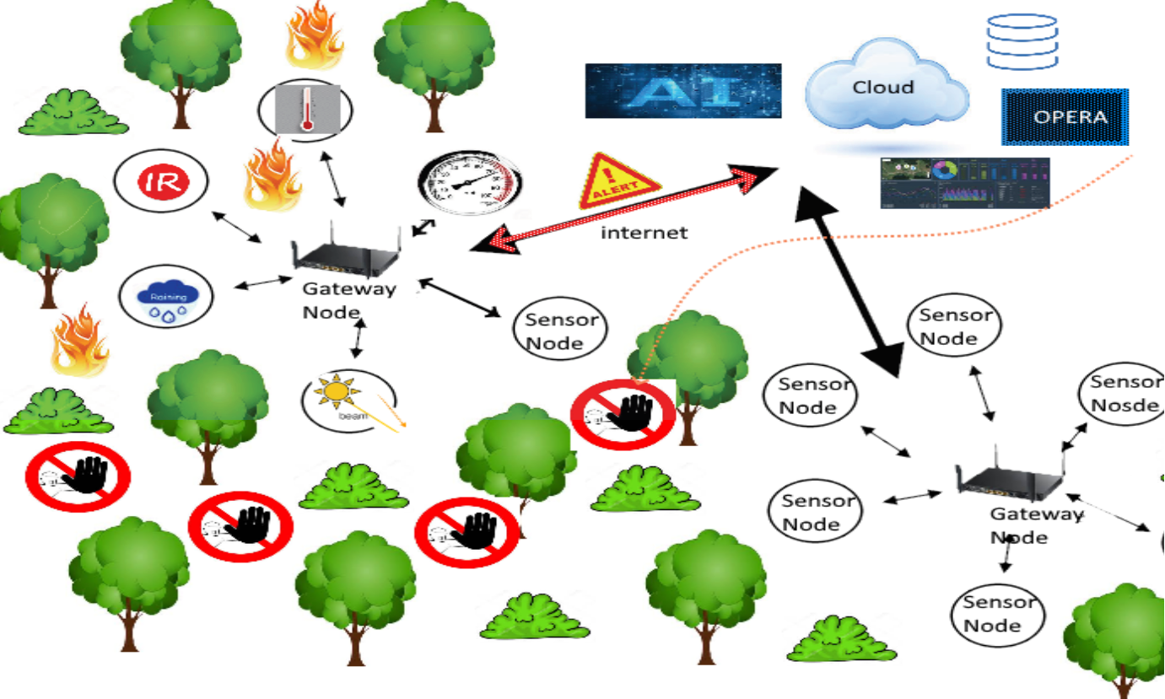
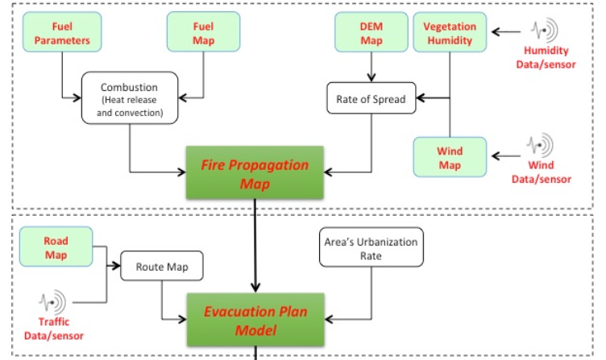
Alessandro Tocchi
Tutor: Prof. Mauro D’Arco
XXXIII Cycle - II year presentation
IoT innovative paradigm in the context of sensor networks and Industry 4.0
The main target of the research is upgrading old traditional monitoring systems and industrial activities, in terms of adoption of new technologies and new approaches. It is possible to improve the existing technological capabilities either by complementing them with value-added features, or enabling new ones; the goal is establishing a cooperative scheme between traditional equipment and most recent ones. To this end, the innovative paradigm enabling Internet of Things (IoT) applications offers advantages in both design and implementation of Distributed Sensor Network (DSN) with respect to more traditional solutions. IoT technologies also allow merging conventional industrial processes with digital technologies and internet. Cloud data management and big data processing mechanisms, typically involved in IoT platforms, can break the barriers related to relevant computational burden. Nonetheless, this paradigm is also capable of simplifying the development of a scalable and flexible network infrastructure.
In the first year of PhD both a cost-effective IoT platform for radiation monitoring and a platform for remote programming automatic test equipment (ATEs) have been investigated to exploit new perspectives for testing computational heavy algorithms and developing new predictive models, overall without too much expensive systems.
In the second year, taking advantages of the results achieved during the first year, the IoT paradigm has been applied to introduce a conceptual framework of an ICT system aimed at granting safety of animals under risk of fire [1] . Different technologies are adopted as to the measurement of the relevant parameters for an early fire detection in risky areas. The ICT system must include a hierarchical Wireless Sensor Networks (WSN) that uses a number of sensing nodes that are capable of effectively gathering information from the surrounding environment and communicating with each other.
The system also requires the interaction with the Geographic Information Systems (GIS) to combine different forest-fire causing factors in order to attain a forest-fire risk-zone map.
Starting from a Fire Propagation Map an Evacuation Plan Model must be figured out, by properly processing anthropic-layered data related to the urbanization rate, the road system development, real time traffic conditions, real time typology and distribution of the animals, available vehicles as well as real time fire sensors specific data.
Data transmission between sensor nodes can be accomplished without claiming for wide bandwidth resources, but relying on low power solutions granting wide area coverage. LoRaWAN (Long Range Wide Area Network), which is an IoT wide range distance communication protocol robust to noise, is capable of offering a coverage radius up to 15 km, and therefore is well suited to this purpose; also, LoRa transceivers are also cheap and characterized by very low power consumption.
[1] O.Tamburis, A. Tocchi, M. D’Arco, et alii … “Guaranteeing safety of animals under risk of fire: conceptual framework and technical issues analysis”, 2019 IEEE International Workshop on Metrology for Agriculture and Forestry, MetroAgriFor 2019.
Contacts: A fruitful collaboration has been established with ST Microelectronics.
STM has provided for free many evaluation kits that have been used both to develop research activities and sustain a variety of didactic laboratory lessons. I had the responsibility of preparing the subsidiary and supplementary activities of the short course “Microcontroller-based measurement laboratory”.
Future activity:
The development of the proposed ICT system becomes somehow critical, as the fire risk has considerably increasing in the last years. The proposal of adding satellite and RFID technologies will be investigated in order to increase the versatility of this system. Also, the analysis of new methodologies for maintenance and troubleshooting of wireless networks sharing the same operating frequency interval, will be carried out.
Notes:
Instructions to fill the poster
Box RGB 22 34 48
Context of your research activity (motivations, needs, trends, activity of your group (if the case)… - describe for self explanatpry)
Box RGB 255 220 0
Your research activity up to the second year (idea, methodology, developments, results, expected validation,… - insert whatever you like, text, images, photos. This box is reserved to your very specific activity, not to your group)
Box RGB 151 23 32
Your contacts
Cooperations with Universities, companies, participations in progrojects and programmes (logos can be included)
Box RGB 79 129 189
Next year
Future developments of your activity
Box width is 80 cm
Box height can be changed according to your needs
The text is written in Calibri font

