Slide 1


Giancarlo Sperlì
Tutor: Antonio Picariello
XXX Cycle - I year presentation
Big Data
-
Multimedia Social Network

Slide 2

PHD Candidate
Graduation: MSC in Computer Engineering
Group: MISLAB
Fellowship: MIUR research Grant
Research Field: Big Data - Multimedia Social Network

Slide 3
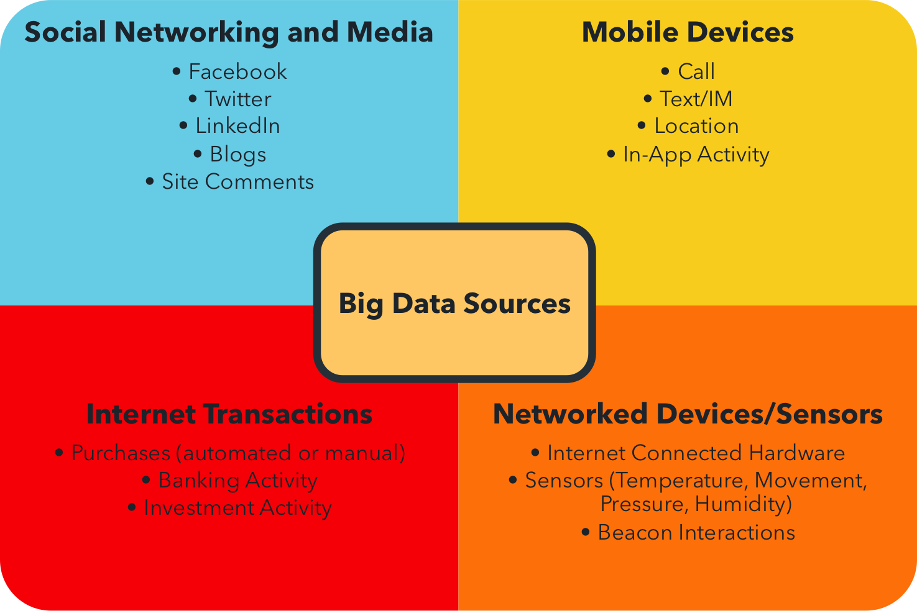
Context (1/2)
According to a report from International Data Corporation (IDC), the amount of data, created and copied, grew nine times in the last five years, reaching the size of 1,8 ZB (10²¹ B).

Slide 4
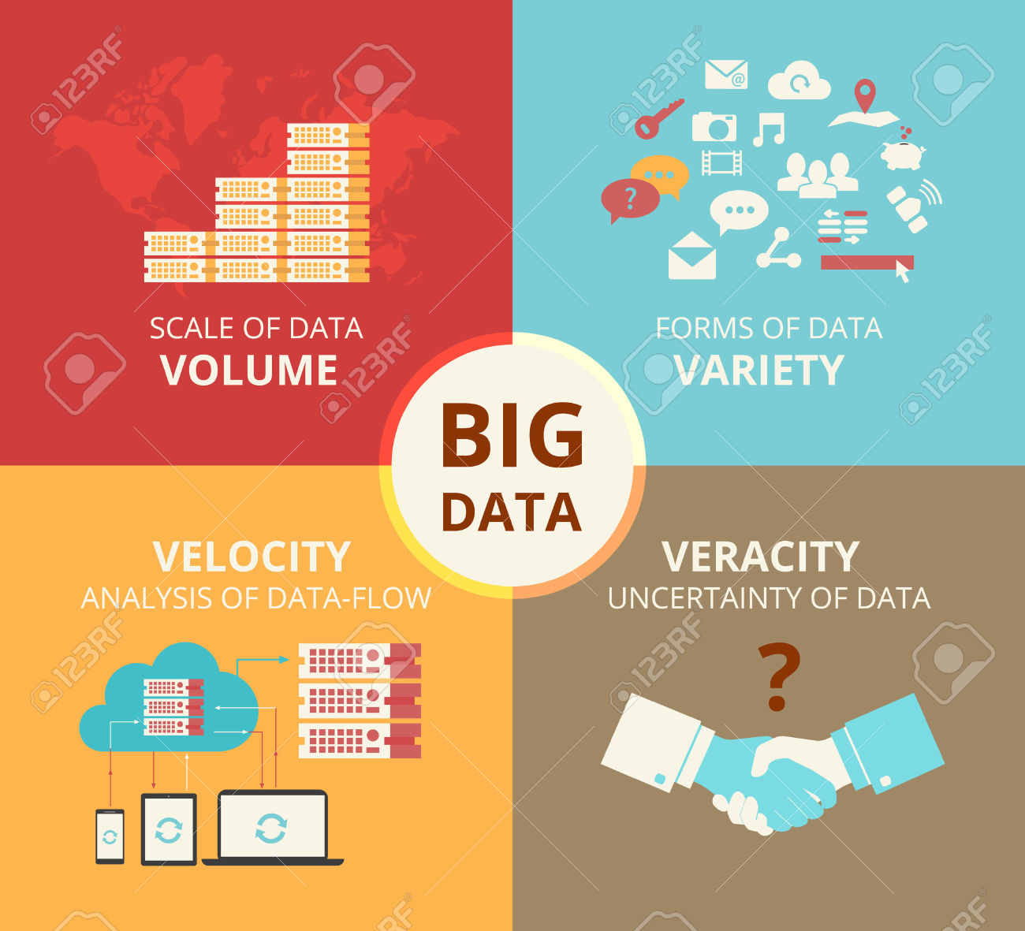
Context (2/2)
Volume refers to the vast amount of data generated by emails, Social Network messages, multimedia data and sensor data that we produce and share every second.
Velocity refers to the speed at which new data is generated and the speed at which data moves around, such as social media messages going viral in minutes
Variety refers to the different types of data we can now use, structured and unstructured data.
Veracity refers to the messiness or trustworthiness of the data.

Slide 5
Big Data Indexing
Many multi-dimensional and high-dimensional indexing are been proposed in literature. It’s possible classify these approaches into following categories:
1-Tree-Based
2-DHTS-Based
3-Skip-based

Slide 6









Multimedia Social Network as Big Data
A social network can be seen as a big data research field given its intrinsic characteristics, described by:
Data Availability
Multiple Authorship
Agent interaction
Temporal Dynamics
Instantaneity
Ubiquity

Slide 7
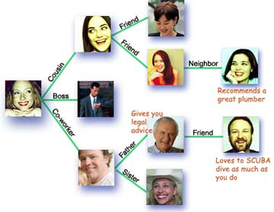
Social Network: Modeling (1/2)
  A social network is represented as a directed graph, with each person (customer) as a node (Kempe et al.)
  A social network is represented as a tri-partite graph, composed by user, social media object and Tag (Qui et al.)

Slide 8
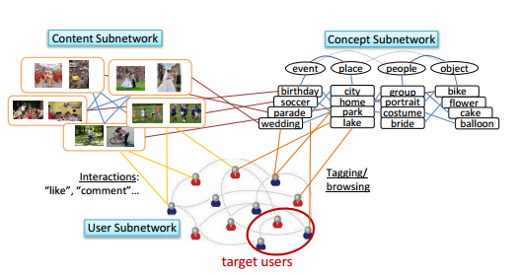
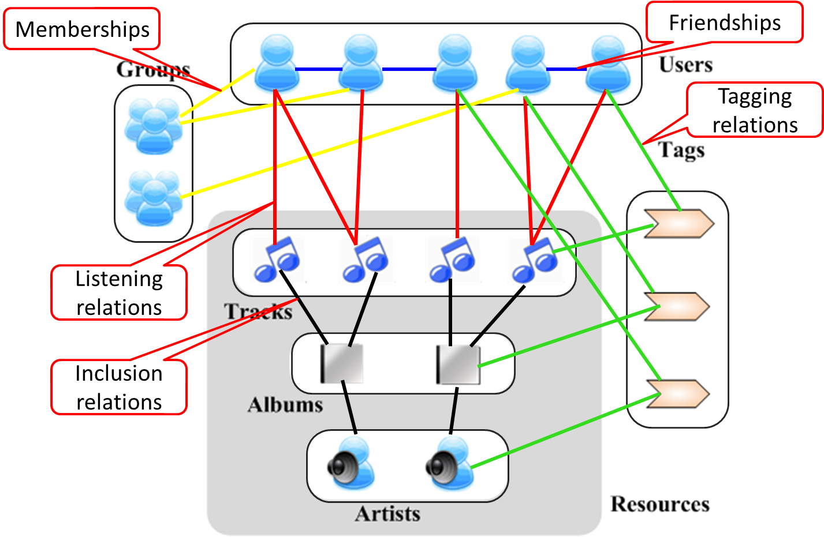
Social Network: Modeling (2/2)
  A social network is represented as a graph in which only the relationships established between users, tags and multimedia object are model through hyperarc (Liu et al.)
  A social network is represented as a unified hypergraph to model multi-type objects and the high-order relations (Bu et al.)

Slide 9
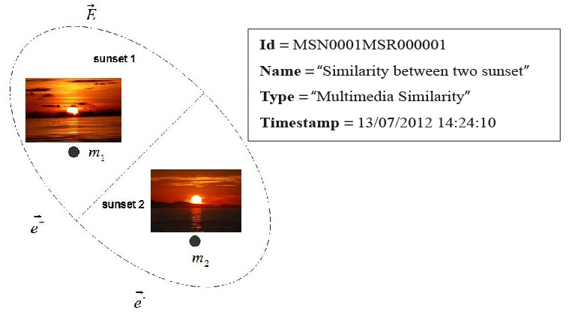
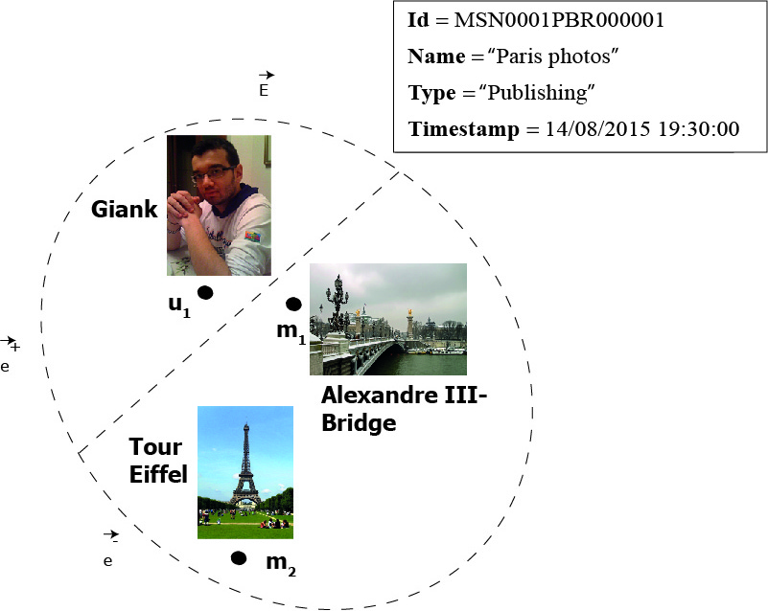
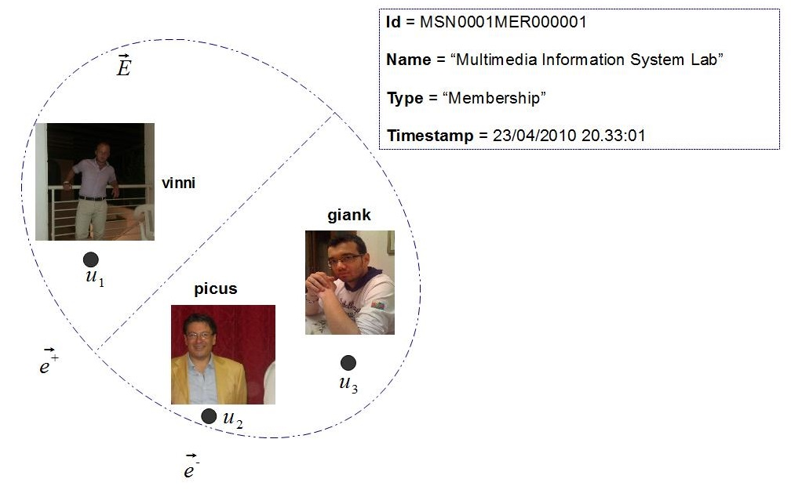
Towards a Multimedia Social Network

Slide 10
Products
F. Amato, A. De Santo, F. Gargiulo, V. Moscato, F. Persia, A. Picariello, G. Sperli: “A Novel Approach to Query Expansion based on Semantic Similarity Measures” (344-353), DATA 2015:
F. Amato, A. De Santo, V. Moscato, A. Picariello, D. Serpico, G. Sperli: “A Lexicon-Grammar Based Methodology for Ontology Population for e-Health Applications”(521-526) CISIS 2015, Blumenau, Brazil
F. Persia, D. D’Auria, G.Sperlì, A. Tufano: “A prototype for Anomaly Detection in Video Surveillance Context”(517-528) Somet 2015, Naples, Italy:
A. D’Acierno, F. Gargiulo, V.Moscato, A. Penta, F. Persia, A. Picariello, C. Sansone, G. Sperlì “A Multimedia Summarizer integrating Text and Images” (21-33) IIMSS 2015, Sorrento, Italy
Flora Amato, Aniello De Santo, Vincenzo Moscato, Fabio Persia, Antonio Picariello, Silvestro Roberto Poccia and Giancarlo Sperlì. “A structure-based approach for ontology partitioning”, SEBD 2015, Gaeta, Italy

Slide 11
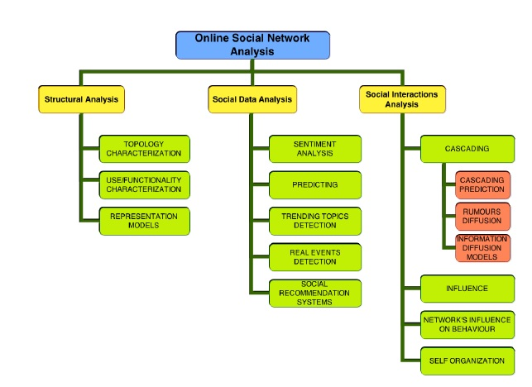
Summary
Topics
CFU
 | Credits year 1
 |  | 1 | 2 | 3 | 4 | 5 | 6
 | Estimated | bimonth | bimonth | bimonth | bimonth | bimonth | bimonth | Summary
Modules | 20 | 0 | 5 | 3 | 7 | 0 | 0 | 15(*)
Seminars | 10 | 1 | 1,5 | 3,8 | 5,2 | 0 | 0 | 11,5
Research | 30 | 9 | 3,5 | 3,2 | 3 | 10 | 10 | 38,7
 | 60 | 10,0 | 10,0 | 10,0 | 15,2 | 10,0 | 10,0 | 60
 | (*) Waiting for perform final exam of "Semantic web reasoners: struttura, uso e ottimizzazioni" (5 CFU) held by Prof. Bonatti

