Slide 1
Salvatore Savarese Tutor: Amedeo Capozzoli XXX Cycle - I year presentation
Advanced Diagnosis Techniques for Radio and Optical Telescopes in Astronomical Applications

Slide 2
Personal Background
Master Science Degree in Electronics Engineering with tesis entitled ‘Fast Marching per Ottica Geometrica su GPU’, 2013
1 year Fellowship at INAF-OAC, from Nov 2013 to Oct 2014
DIETI group: Electromagnetics
Collaborations:
INAF-OAC – Osservatorio Astronomico di Capodimonte (Napoli)

Slide 3
Scientific Problem
The research activity is focused on advanced diagnosis techniques for radio and optical telescopes in astronomical applications. To guarantee the high performance required, a continuous monitoring and reassessment of the system is required to suppress deviations from the nominal behavior.
During the first year, the attention of the PhD course has been focused on the diagnosis of large reflector antennas employed in radio telescopes.

Slide 4
Research Activity
The aim of the activity has been twofold:
Theoretical study to develop an optimized approach to the diagnosis problem minimizing the measurement time.
Secondly, the problem of the numerical and experimental validation of the algorithm has been faced, leading to the definition and realization of an outdoor far field test range.

Slide 5
Scientific Problem
Current diagnosis methods (holography and amplitude only methods) are based on the acquisition of a complete set of Far Field Pattern (FFP) data.
The acquisition of the FFP needs a very large number of field samples to be collected, resulting in a lengthy measurement process. A prolonged acquisition process can become cumbersome due to the idle time forced by the maintenance activity, the need of a continuous tracking of the source and the variations of the environmental conditions.

Slide 6
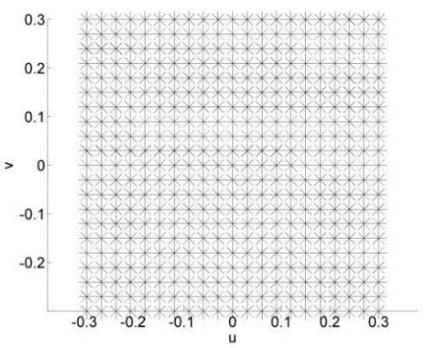
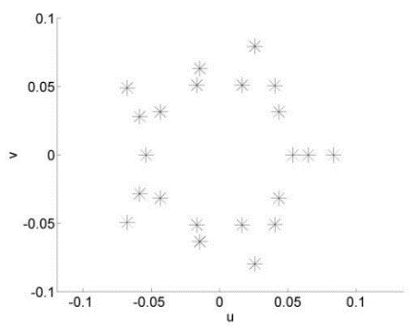
Research Activity
An optimized diagnosis procedure has been developed to reduce the required number of far field sampling points.
Algorithm
Results
Aperture Field Method for the description of the Antenna radiation mechanism
For an antenna with a 1m diameter, 441 sampling points would be required.
With the proposed approach, the grid can be reduced to 20 points.
Linearization of the problem using a PCA
Optimization of the singular values behavior of the relevant linear operator
Standard Measurement Grid
Optimized Grid

Slide 7
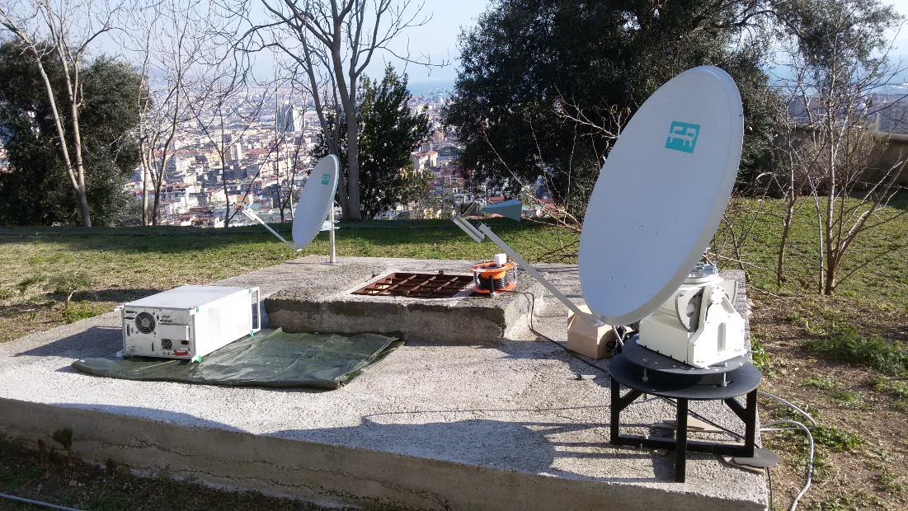
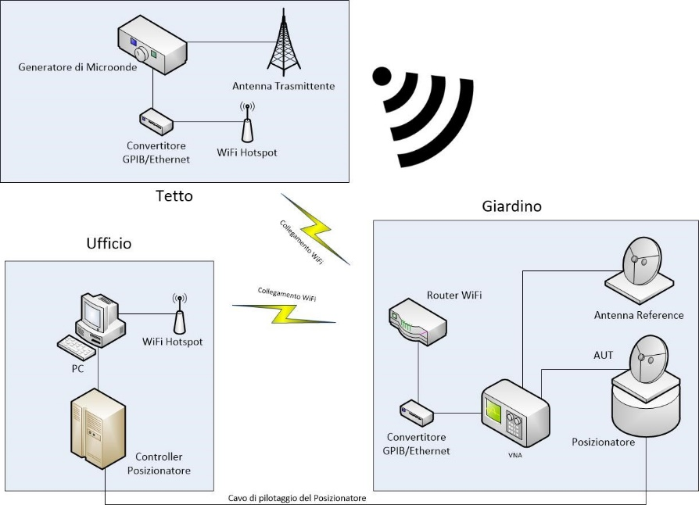
Research Activity
To validate the diagnosis method on an actual antenna system, an experimental far field test range has been set up in collaboration with Istituto Nazionale di Astrofisica (INAF) of Naples

Slide 8
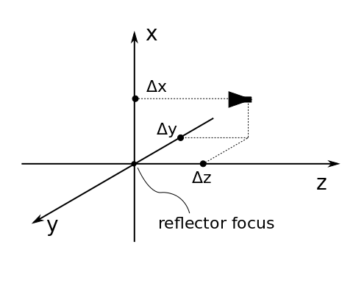
Research Activity
The amplitude only diagnosis method has been successfully tested with the experimental set-up.
Feed misalignment
 | ∆x [mm] | ∆y [mm] | ∆z [mm]
Applied displacement | 14.63 (0.487λ) | 0 (0λ) | 13.64 (0.455λ)
Measured displacement | 13.69 (0.456λ) | 1.38 (0.046λ) | 11.35 (0.378λ)

Slide 9
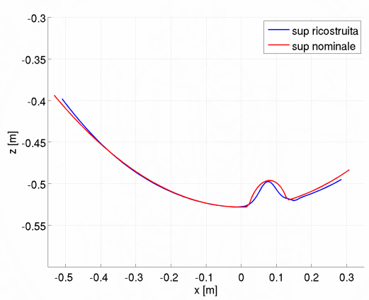
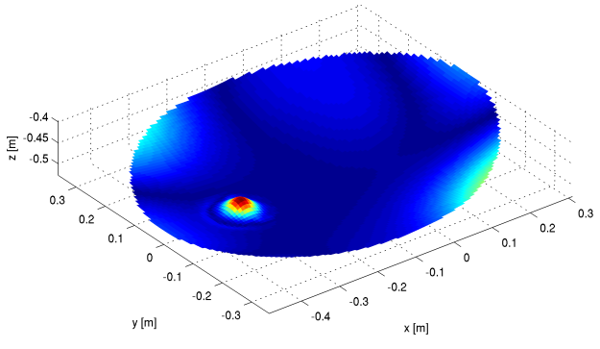
Research Activity
The amplitude only diagnosis method has been successfully tested with the experimental set-up.
Local surface deformation

Slide 10
Products
• "Optimized Diagnosis of Reflectors Misalignements in Radioastronomical Applications",
by A. Capozzoli, C. Curcio, G. D’Elia, A. Liseno, S. Savarese, and P. Schipani, presented at the 9th European Conference on Antennas and Propagation (EuCAP 2015)
• "GO Solutions with Fast Marching",
by A. Capozzoli, C. Curcio, A. Liseno, and S. Savarese, submitted to the 10th European Conference on Antennas and Propagation (EuCAP 2016)

Slide 11
Credits Summary table:
 | Credits year 1 |  |  |  |  |  |  |  | Credits year 2 |  | Credits year 3
 |  | 1 | 2 | 3 | 4 | 5 | 6
 | Estimated | bimonth | bimonth | bimonth | bimonth | bimonth | bimonth | Summary | Estimated |  | Estimated |  | Total | Check
Modules | 20 | 0 | 10 | 0 | 3 | 6 | 6 | 25 | 10 |  | 0 |  | 25 | 30-70
Seminars | 5 | 0 | 0,8 | 2 | 1,6 | 0 | 0 | 4,4 | 5 |  | 5 |  | 4 | 10-30
Research | 35 | 7 | 4 | 6 | 5 | 3 | 6 | 31 | 45 |  | 55 |  | 31 | 80-140
 | 60 | 7 | 15 | 8 | 4,6 | 6 | 6 | 60 | 60 |  | 60 |  | 60 | 180

