Slide 1
Davod Poreh Tutor: Professor Daniele Riccio XXX Cycle - frist year presentation
High resolution SAR techniques in land use application

Slide 2
Outline
Usage of satellite remote sensing on small scale movements of the railways in Campania
Soil moisture retrieval via Polarimertric Two-Scale Model (PTSM+PTSTCM+…)

Slide 3
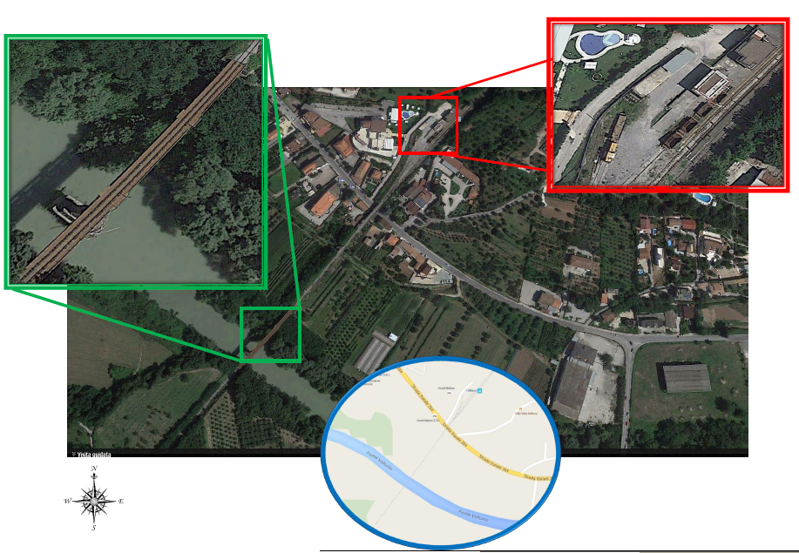
Usage of satellite remote sensing on small scale movements of the railways in Campania

Slide 4
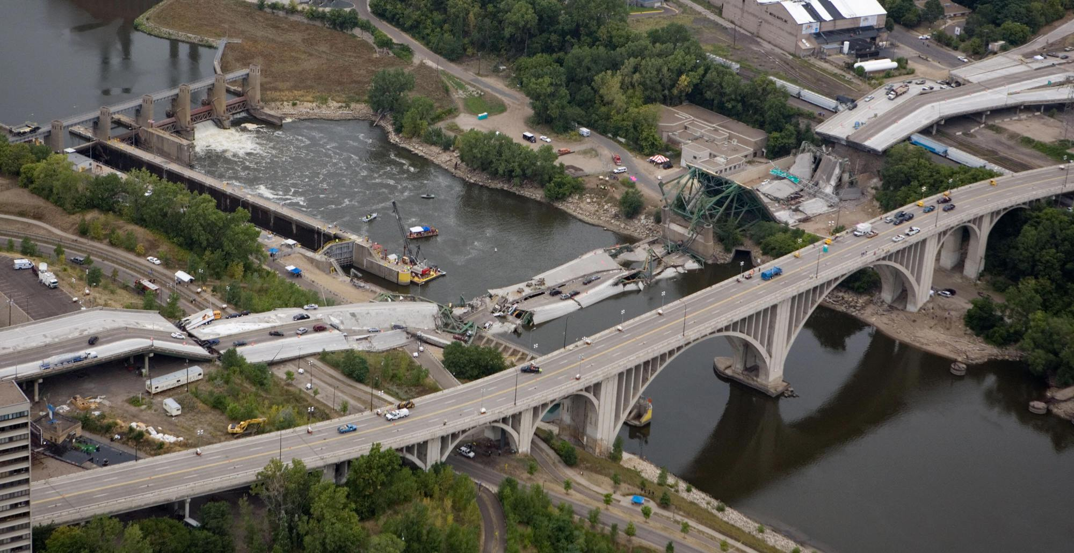
I-35W Mississippi River bridge
San Francisco -Oakland-earthquake

Slide 5
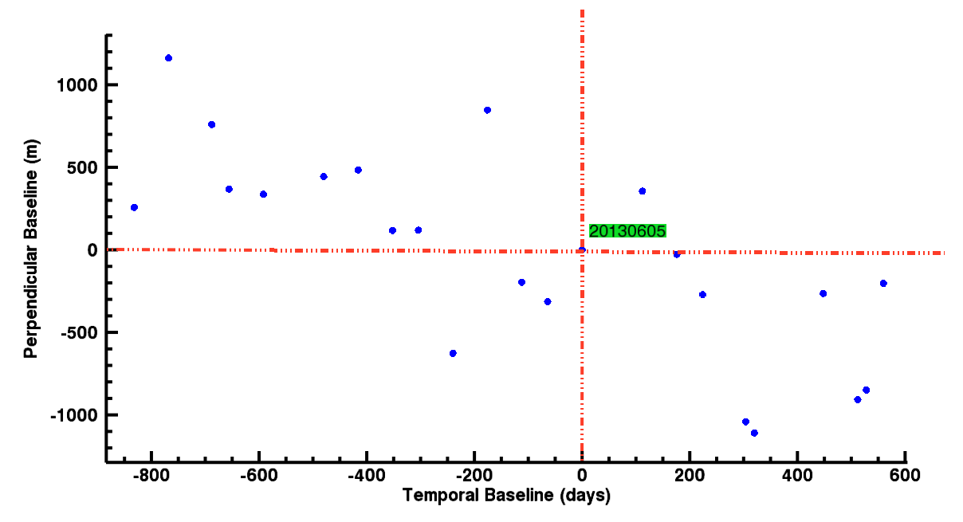
Data, and data analysis
25 CosmoSkyMed images from 2011 until 2015.
One point on the bridge has been selected as a central point, and images were cropped in an area like 7.5*7.5
24 interferograms have been calculated with respect to image 20130605.
193k PSs have been generated.
On the bridge 30 PSs selected.

Slide 6
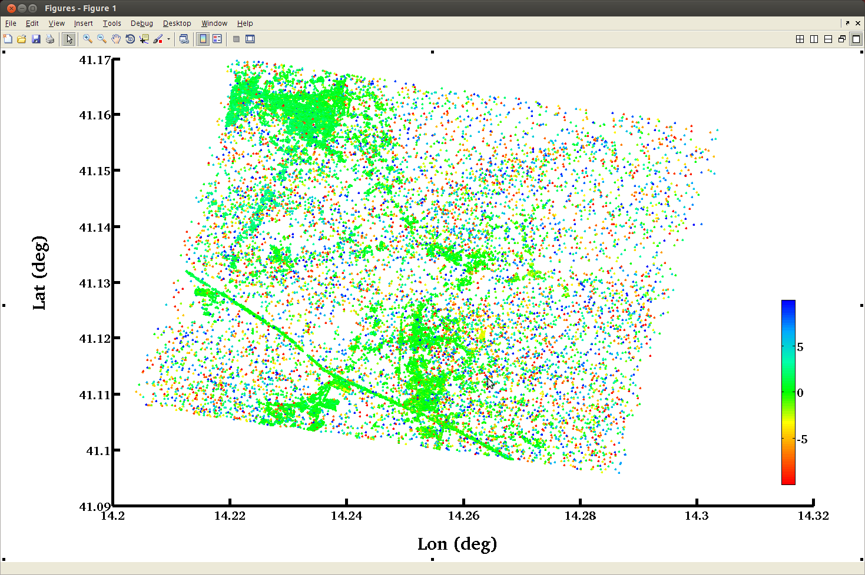

Slide 7
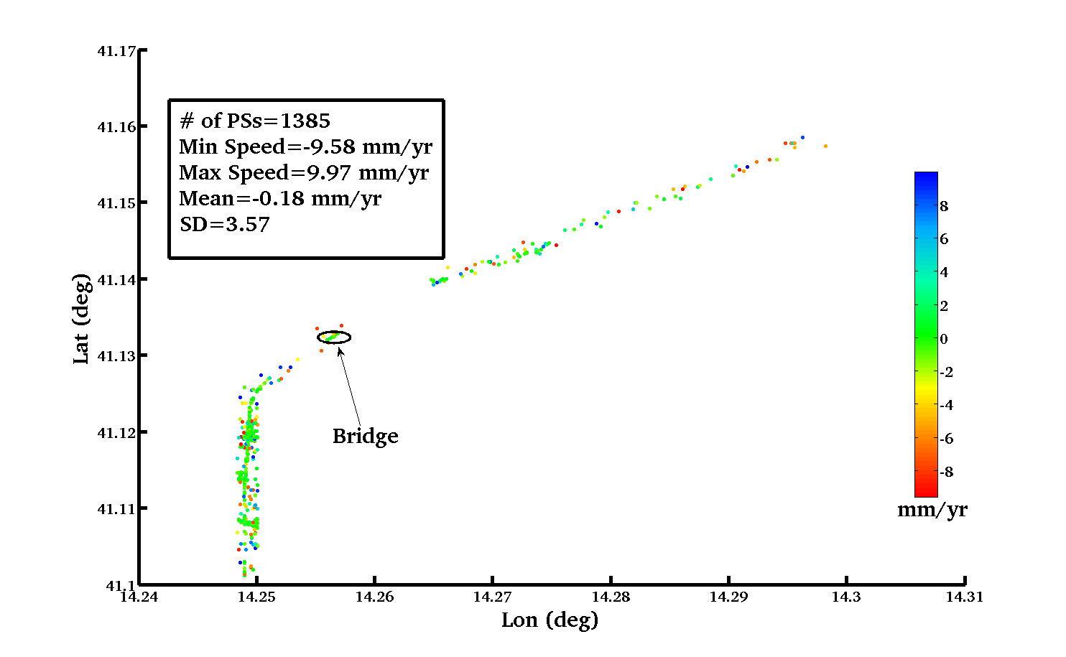

Slide 8
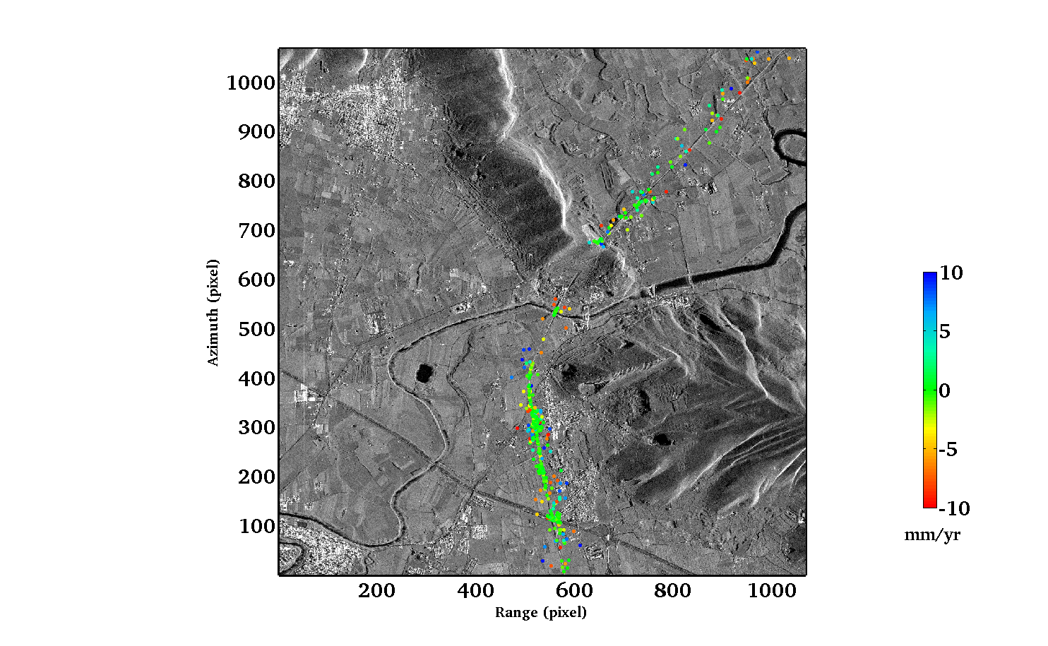

Slide 9
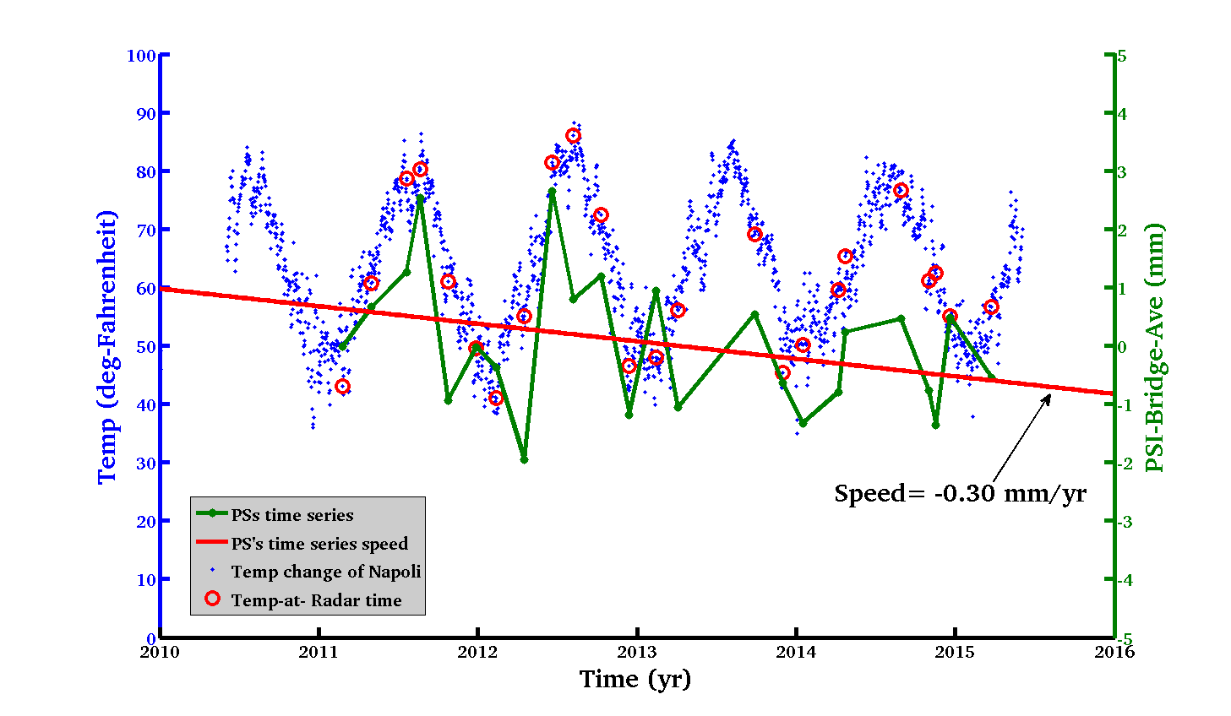

Slide 10
Soil moisture retrival via Polarimertric Two-Scale Model (PTSM+PTSTCM+…)
Soil electromagnetic backscattering depends on soil dielectric constant
Soil dielectric constant depends on soil moisture+ vegetations covers+ roughness
Problem seperation of dependencies on these elements
Freeman and Durden (FD) decomposition .
Polarimetric two-scale model (PTSM) for surface scattering¹
Polarimetric two-scale two-component model (PTSTCM)²
Parametric vegetation volume model³
¹ A. Iodice, A. Natale, D. Riccio, “Retrieval of Soil Surface Parameters via a Polarimetric Two-Scale Model”, IEEE Trans. Geosci. Remote Sens. vol. 49, no. 7, pp. 2531-2547, July 2011.
²A. Iodice, A. Natale, D. Riccio, "Soil moisture retrieval in moderately vegetated areas via a Polarimetric Two-Scale Model", Proceedings of the IEEE International Geoscience and Remote Sensing Symposium, pp. 759-762, Melbourne, Australia, 21-26 July 2013.
³T. Jagdhuber, I. Hajnsek, K.P. Papathanassiou: “Refined Soil Moisture Estimation by means of L-Band Polarimetry,” Proc. of IEEE International Geoscience and Remote Sensing Symposium, July 21-26, Melbourne, Australia, 2013.

Slide 11
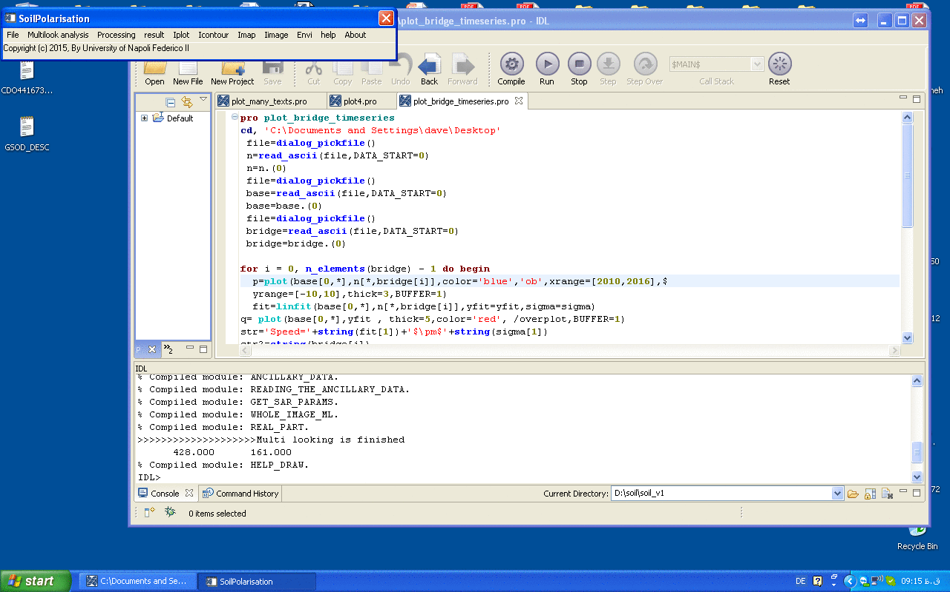
Software for PTSM+PTSTCM+…

Slide 12
List of Conferences
Davod Poreh, Daniele Riccio, Building’s subsidence observed in Mexico City by remote sensing data, 4th November 2015, ESA, Frascati.
Davod Poreh, Antonio Iodice, Daniele Riccio, Giuseppe Ruello, Railways’ stabilities observed in Campania (Italy) by InSAR data. IEEE gold assemblage, 4-6 December 2015, Barcelona.
Gerardo Di Martino, Antonio Iodice, Davod Poreh, Daniele Riccio, Soil moisture retrieval from polarimetric SAR data: a short review of existing methods and a new one, Living planet Praha, May 2016.

Slide 13
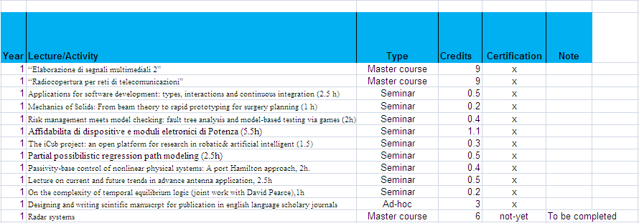
Credit

