Slide 1


Jonas Piccinotti
Tutor: Amedeo Capozzoli co-Tutor: Claudio Curcio, Angelo Liseno
XXIX Cycle - III year presentation
Fast GPU implementation of a multistatic RCS prediction tool based on a GO/PO hybrid algorithm accelerated via pruned NUFFT3, domain decomposition, and BVH data structure technique

Slide 2

Agenda
Personal background
Credit summary
Scientific problem
Research activity
Products
Questions

Slide 3
Personal background
Graduation: M.S. Degree in Telecomunications Engineering with the thesis entitled "MoM per il calcolo di RCS su GPU", cum laude, december 2011
DIETI group: Electromagnetics – Capozzoli, Curcio, Liseno
Cooperations:
  Ingegneria Dei Sistemi - IDS Corporation (Pisa)
  Flight Test Engineer @ Italian Air Force Flight Test Center (Pratica di Mare, Rome)
  Student @ United States Naval Test Pilot School (MD, USA)
Type of felloship: University fellowship refejected due to PhD regulations
Jonas Piccinotti

Slide 4
Credit summary
Credits Summary table:
Specific objects and Experiences abroad:
33 credits for Research Activity
  Development and application of simulation tool
20 credits for External Courses
  “Airborne Systems Test Curriculum” @ United States Naval Test Pilot School, Naval Air Station Patuxent River, Maryland, USA, 25 JUL 2016 – 17 JUN 2017. (Duration: 48 weeks, ~200 hrs - ongoing)
7 credits for Seminars
  “Test and Evaluation Course for Electro-Optics and Infra-Red Airborne Systems” @ National Test Pilot School, California, USA, 11-15 MAY 2016. (Duration: 1 week, 40 hrs)
  “31° Corso Basico Tactical Data Link” @ Reparto Addestramento Controllo Spazio Aereo – Aeronautica Militare Italiana, Pratica di Mare, 23-27 MAY 2016. (Duration: 1 week, 30 hrs)
Jonas Piccinotti

Slide 5
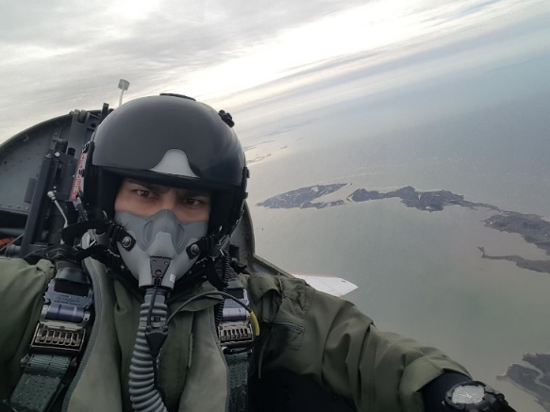
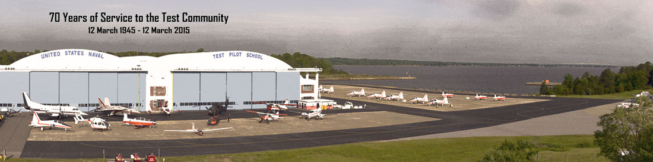
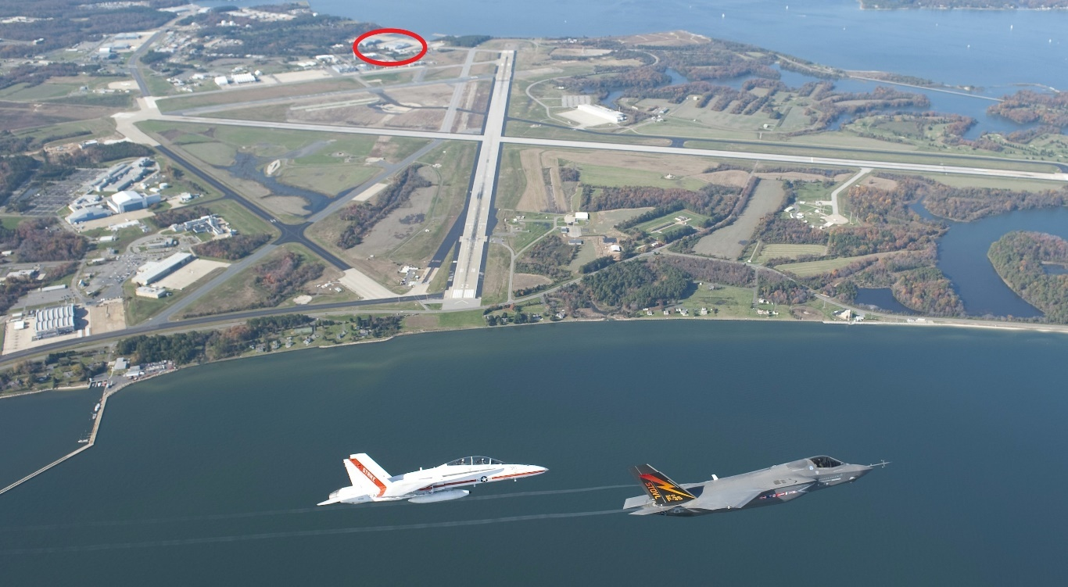
Credit summary
External Course
  Overview:
  US Navy - United States Naval Test Pilot School
  Naval Air Station Patuxent River, Maryland (USA) ~ 1 hr south-east Washington DC
  Airborne Systems Test Curriculum
  25 JUL 2016 – 17 JUN 2017
  Duration: 48 weeks
  ~500 hrs Academics
  ~120 hrs Flight Time
  ~25 Exams
  ~20 Report Writing assignments
  ~12 hrs/day Monday-Friday
  Specifically PhD-related:
  Radar (A/G, A/A, Doppler Navigation)
  SAR, ISAR
  EW (jamming and countermeasures)
  Broadly PhD-related:
  EO/IR
  Data-Link
Jonas Piccinotti

Slide 6
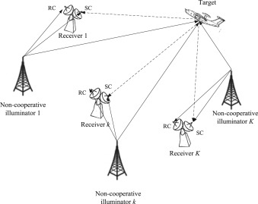
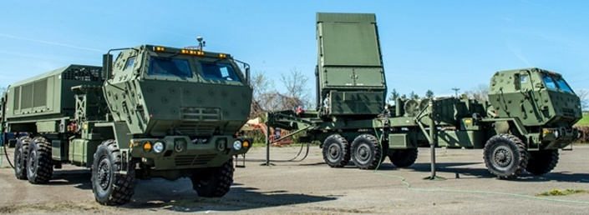
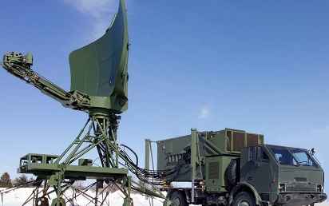
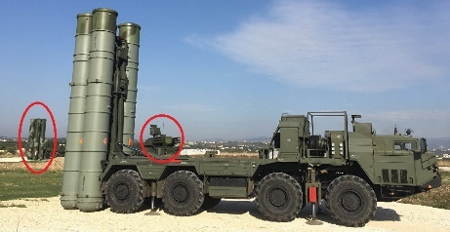
Scientific problem – General perspective
Relevance:
Overall evolution in radar technology applied to military surveillance of controlled air space
Modern GBAD (Ground Based Air Defenses) involve complex radar networks can defeat stealth technology emplyoing bistatic/multistatic configurations taking advantage of non-cooperative illuminators (e.g. DVB, base stations, …)
Jonas Piccinotti

Slide 7
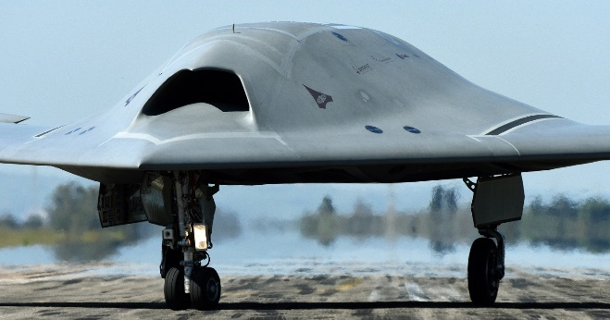
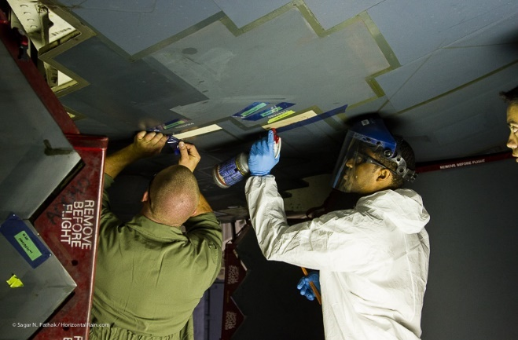
Scientific problem – General perspective
Relevance:
Major interest for very low observable aircrafts (manned and unmanned)
Need to easily predict RCS for
optimization design purposes *
Need to monitor low observability
performance decay due to wear of
stealth features treatments such as
RAM, FSS, golden canopy (e.g. F-22
issues with hot and dusty conditions) *
* interest of Italian Air Force
Jonas Piccinotti

Slide 8
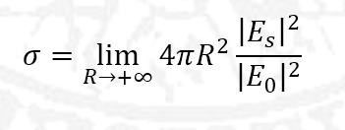
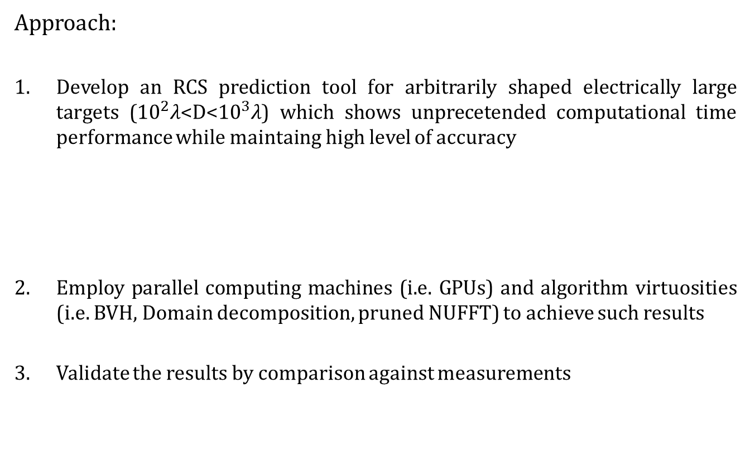
Scientific problem – General perspective
Approach:
Develop an RCS prediction tool for arbitrarily shaped electrically large targets (${10}^{2}$𝜆<D<${10}^{3}$𝜆) which shows unprecetended computational time performance while maintaing high level of accuracy
Employ parallel computing machines (i.e. GPUs) and algorithm virtuosities (i.e. BVH, Domain decomposition, pruned NUFFT) to achieve such results
Validate the results by comparison against measurements
Jonas Piccinotti

Slide 9
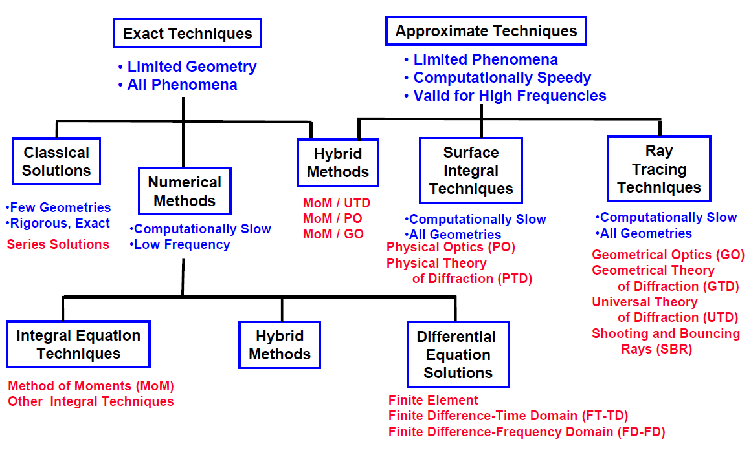
Scientific problem – Specific activity
Jonas Piccinotti

Slide 10
Scientific problem – Specific activity
The tool was developed choosing an asymptotic approach consisting in the hybridization of GO (Geometrical Optics) and PO (Physical Optics). The algorithm is composed by two main steps:
Predicting the equivalent current densities induced on the scatter surface
Calculating the far field radiated by such equivalent currents
Both steps were sped-up using advanced techniques: the BVH and the “pruned” NUFFT respectively.
Jonas Piccinotti

Slide 11
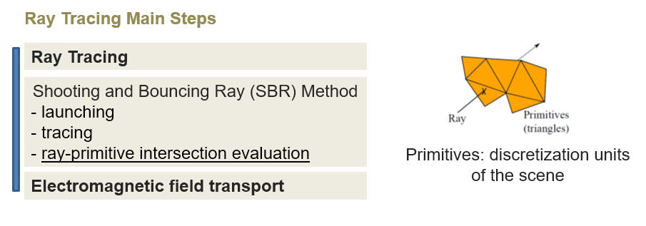
Scientific problem – Specific activity
Step 1: Predicting the equivalent current densities induced on the scatter surface
Jonas Piccinotti

Slide 12
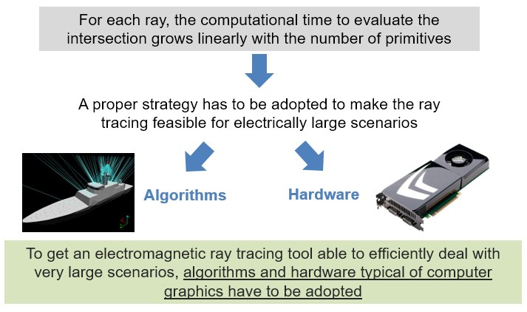
Scientific problem – Specific activity
Step 1: Predicting the equivalent current densities induced on the scatter surface
Jonas Piccinotti

Slide 13
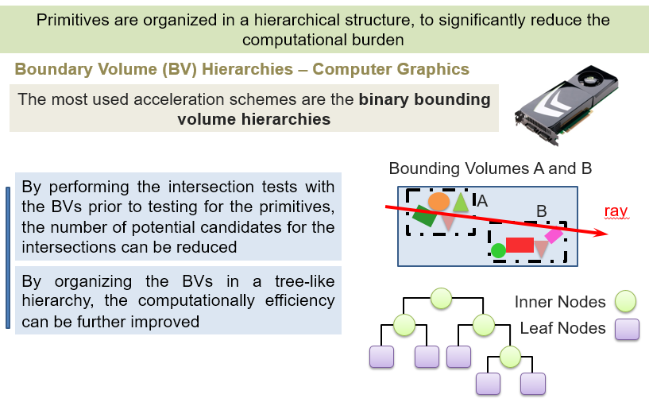
Scientific problem – Specific activity
Step 1: Predicting the equivalent current densities induced on the scatter surface
Jonas Piccinotti

Slide 14
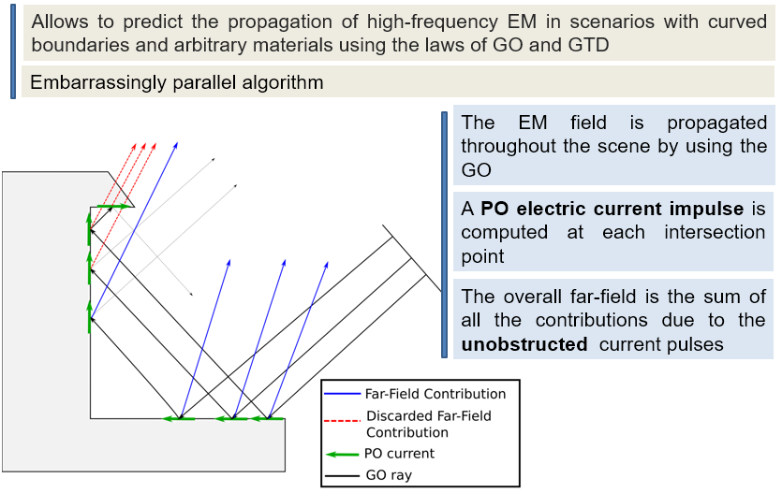
Scientific problem – Specific activity
Step 1: Predicting the equivalent current densities induced on the scatter surface
Jonas Piccinotti

Slide 15
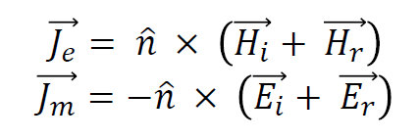
Scientific problem – Specific activity
Step 2: Calculating the far field radiated by such equivalent currents
When a ray hits a surface, it generates an electric current 𝐽𝑒 and a magnetic current 𝐽𝑚 on it, according to the PO relation:
where 𝐸𝑖 , 𝐸𝑟 , 𝐻𝑖 𝑎𝑛𝑑 𝐻𝑟 correspond respectively to the incident and reflected electric and magnetic fields. A reflected ray, and eventually a transmitted ray, with a new polarization and a new direction of propagation is determined by the Descartes-Snell’s law. This ray may be a part of a new grid and launched again.
Jonas Piccinotti

Slide 16
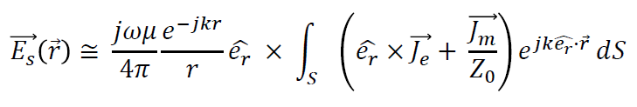
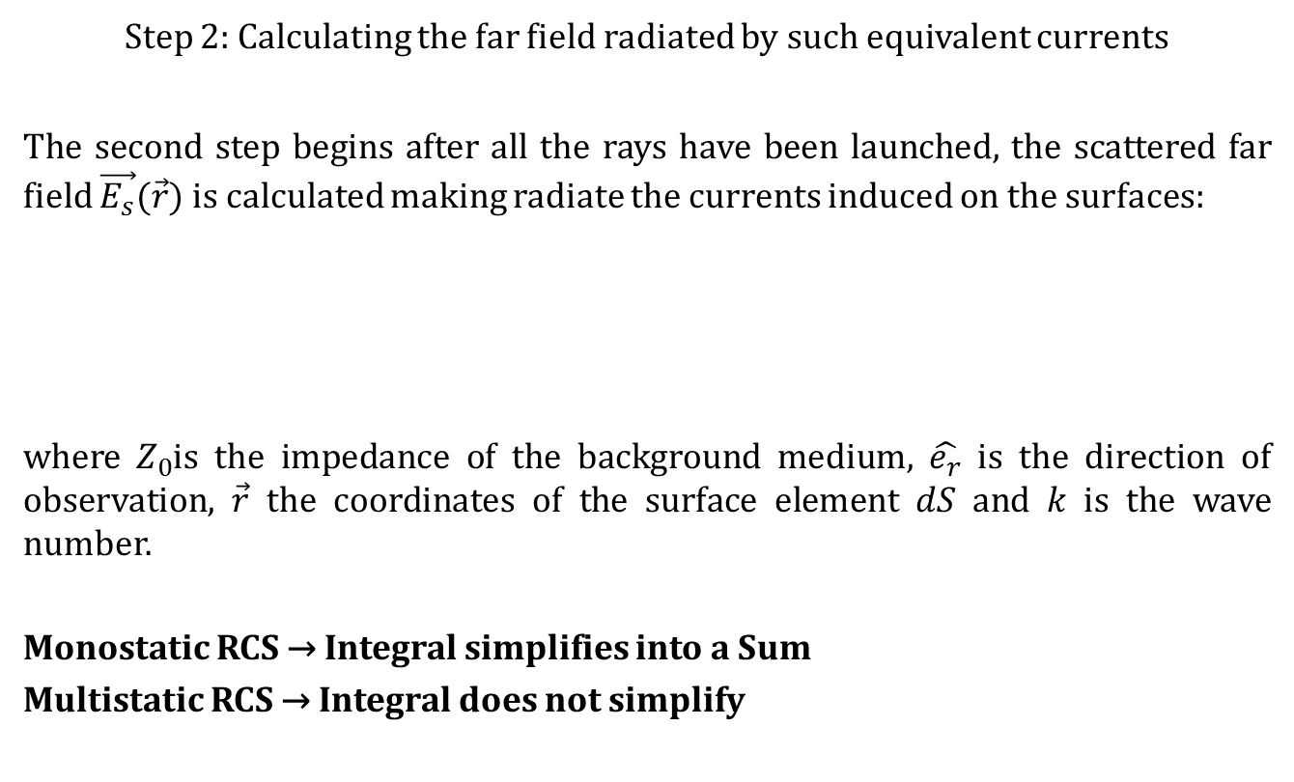
Scientific problem – Specific activity
Step 2: Calculating the far field radiated by such equivalent currents
The second step begins after all the rays have been launched, the scattered far field $\vec{E_{s}}(\vec{r})$ is calculated making radiate the currents induced on the surfaces:
where $Z_{0}$is the impedance of the background medium, $\hat{e_{r}}$ is the direction of observation, $\vec{r}$ the coordinates of the surface element 𝑑𝑆 and 𝑘 is the wave number.
Monostatic RCS → Integral simplifies into a Sum
Multistatic RCS → Integral does not simplify
Jonas Piccinotti

Slide 17
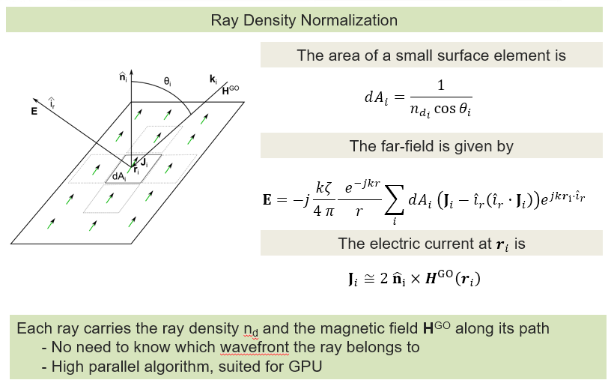
Scientific problem – Specific activity
Calculating the far field radiated by such equivalent currents
Jonas Piccinotti

Slide 18
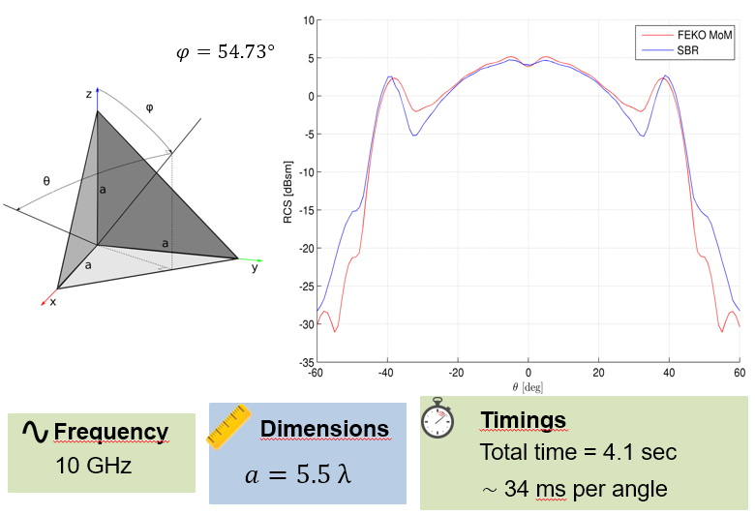
Scientific problem – Specific activity
Calculating the far field radiated by such equivalent currents
Jonas Piccinotti

Slide 19
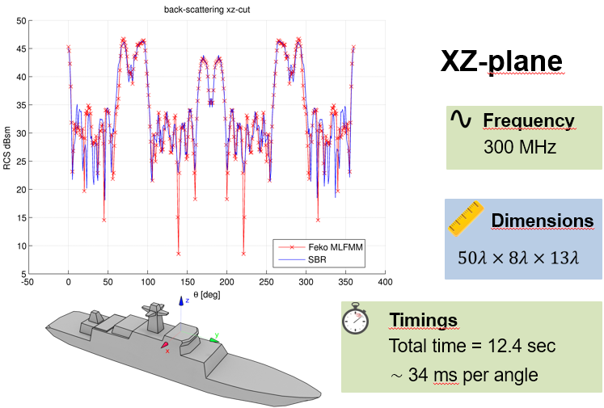
Scientific problem – Specific activity
Calculating the far field radiated by such equivalent currents
Jonas Piccinotti

Slide 20
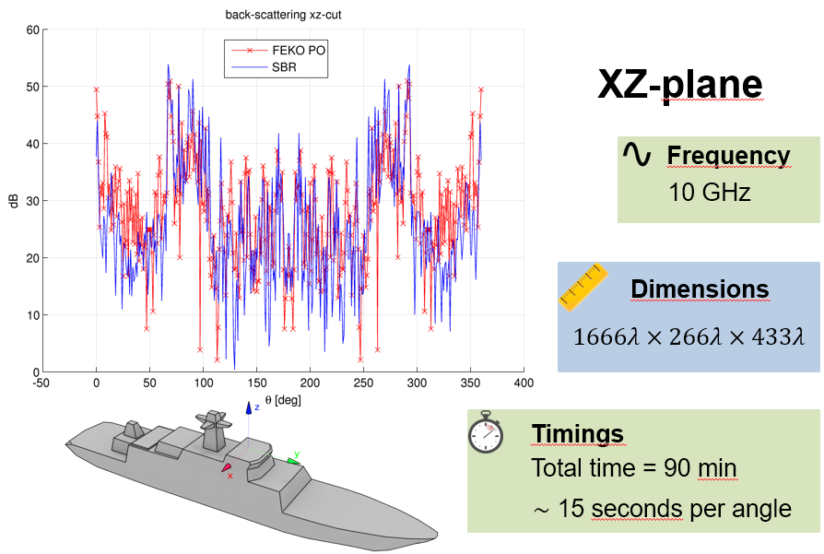
Scientific problem – Specific activity
Calculating the far field radiated by such equivalent currents
Jonas Piccinotti

Slide 21
Scientific problem – Specific activity
Calculating the far field radiated by such equivalent currents
We saw hot to speed up Step 1: BVH.
How can we speed up Step 2? NUFFT.
Chain of implications:
1) PO integrals require…
2) FT
3) 3D (volume or surface → increasing difficulty)
4) 3D FT
5) NU domain: NU spatial lattice (NUFFT 1st type)
6) NU transformed domain: NU spectral lattice (NUFFT 2nd type)
7) The result is a NUFFT 3rd type
8) Only implementation know in literature: Lee-Greengard algorithm
Jonas Piccinotti

Slide 22
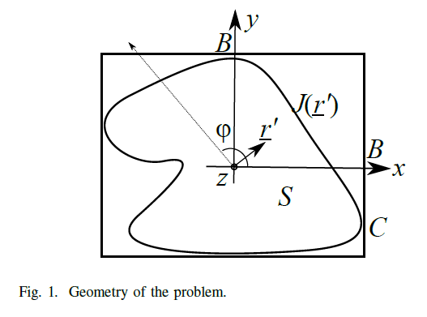
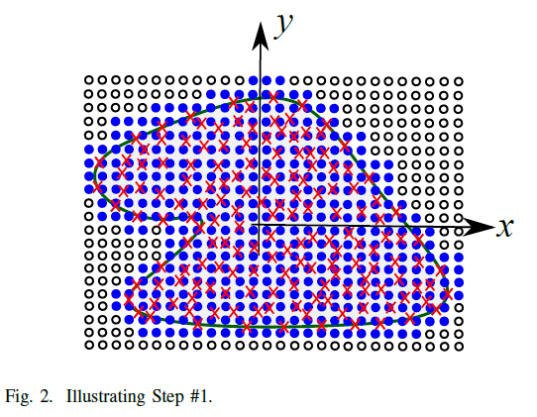
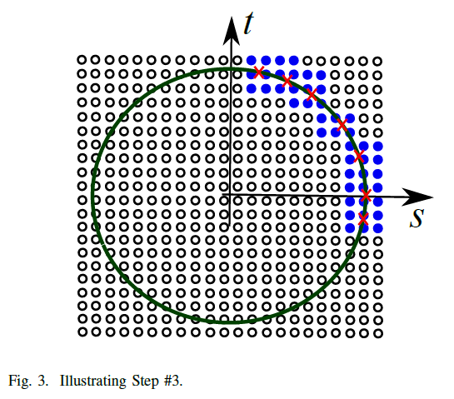
Scientific problem – Specific activity
Calculating the far field radiated by such equivalent currents
Accomplished example: “easiest case”, namely the radiation of currents contained within the volume of a cylindrical objected indefinitely extending along the z-axis (2D case)
Non-transformed domain:
Red crosses → sampled currents
Black dots (uniform) → uniform lattice over non-transformed domain
Blu dot (non uniform) → point of interest of the non-transformed domain
Transformed domain:
Red crosses → direction of interest
Black dots (uniform) → uniform lattice over transformed domain
Blu dot (non uniform) → point of interest of the transformed domain
Pruned FFT
(no existing code prior this work)
Jonas Piccinotti

Slide 23
Scientific problem – Specific activity
Calculating the far field radiated by such equivalent currents
Next step: (to be accomplished during the time-extension)
Follow a build-up approach with increasing algorithmical difficulty
Maintain 2D case
Have the currents radiate just from the surface → this requires the “Domain decomposition”
Overall, within these two 2D examples:
  Domain decomposition: optimize FFT on the non-transformed domain
  “Pruned” FFT optimize FFT on the transformed domain
Jonas Piccinotti

Slide 24
Scientific problem – Specific activity
Calculating the far field radiated by such equivalent currents
Final step: (not likely to be accomplished within the time limits of this PhD)
Follow a build-up approach with increasing algorithmical difficulty
Step up to 3D case
Repeat radiation from within the volume
Step up to radiation from surface
Technical difficulties:
  3D “pruned” FFT does not exist yet
  Significant memory requirements
Jonas Piccinotti

Slide 25

Scientific problem – Specific activity
Acceleration recap:
Tool speed-up
GPU implementation
BVH
Software
NUFFT3 3D
Hardware
Pruning
(trasf domain)
Domain decomposition
(non-trasf domain)

Slide 26
Products
Third year pubblications:
Italian Air Force interest in RCS studies and Low Observability features for airborne assets
Mercurio, Piccinotti
Oral presentation supported by slides
AMTA European Regional Event 2016
Naples
23 MAY 2016
Efficient Computing of Far-Field Radiation in 2D
Capozzoli, Curcio, Liseno, Piccinotti
Letter for the IEEE Antennas and Wireless Propagation Letters
21 FEB 2017

Slide 27
Questions

Slide 28
  RCS monostatica: integrale di radiazione calcolato in un’unica direzione, è una somma di contributi di corrente e quindi è veloce il calcolo. Somma parallela con riduzione. In molto casi questo caso è più he sufficienti e la radiazione delle correnti di ottica fisica non è troppo oneroso (che è il vero termine oneroso, mentre la radiazione è rapida). Nostro codice 98 s, FEKO GO/PO 36h, IDS 1.5 h.
  RCS multistatica (contromisura alle tecnologie stealth> ragion per cui è interessante calcolare la RCS multistatica > giustificare bene questo punto): da ogni direzione di incidenza re-irradio in tutte le altre direzioni. Complicato. Integrale invece di somma. La radiazione qui è onerosa perché uso tutto le direzioni. Qui nel multistatico occorre accelerare il raytrac. Occorre anche accelerare la radiazione. Come si accelera la radiazione? Con la NUFFT. Per ora abbiamo fatto in 2D col caso volumico. Noi vogliamo fare il caso 3D da una superficie. Col PEC le correnti stanno solo su superficie.
  Caso più semplice: solo volume. Trasformo un integrale in sommatoria. Compare kernel per la DFT. Ma le correnti sono conosciute solo in posizioni non uniformi. Da qui entra in gioco la NUFFT. I pallini neri sono il grligliato regolare della FFT. Le crocette rosse sono irregolari sia sul dominio non-trasf che trasf. Allora interpolo le crocette rosse sui pallini blu che stanno sul grigliato reg. trasformo sulla FFT. Esco sui pallini blu e poi torno sulle crocette rosse irregolari. Facendo così guadagno molto da un punto di vista computazionale. N^2 log (N) è la complessità ottenuta. Chiarire che non mi servono TUTTI i pallini neri. Solo quelli blu perché mi interessano le crocette rosse. La FFT va da N ad N elementi. Ma se a me non interessanno tutti gli N elementi di uscita allora faccio una pruned FFT, che è una FFT potata. Nel piano t-s a me servono solo i pallini blu. Da qui mi serve la pruned FFT. Risparmio il 25% dei calcoli con i nostri numeri. Asintoticamente potrei arrivare a risparmiare il 50%.
  Nel caso superficiale le crocette sono solo sul bordo e questo rende più le cose più complesse. Next step: sfruttare la NUFFT 3D cosicchè posso fare la radiazione ancora da volume ma ora anche da superficie. La superficie di un volume cilindrico (volume 2d). Abbiamo precisione macchina, ovvero 10exp-11. i punti non sono regolari. In questa tesi bidimensionale di volume (già fatto) e bidimensionale di superficiale. Mentre il 3d.
  Differenza tra sfoltire il dominio trasformato (pruned FFT) ed invece la «domain decomposition» nel dominio non trasformato
  Invece ll pruned FFT in ingresso non è conveniente
  Tutto ciò perché la complessità computazionale è driven by i punti di ingresso più che da quelli di uscita. Quindi in gresso faccio la decompostion e in uscita la pruned.

