Slide 1
Gaetano Perrone Tutor: Prof. Simon Pietro Romano XXIX Cycle - III year presentation
SecSI: Security Solutions for Innovation

Slide 2
Background
Computer Science Engineering degree in 2017
DSP: A microservices-based platform for the study of Network Security
Security Consultant in NTT Data (2017 - 2018)
Today:
PhD in Information Technology
and Electrical Engineering
Co-founder of SecSI
Collaborations:
NTT Data
Acca Software
Enel
CIOC (Comando Interforze per le Operazioni Cibernetiche)

Slide 3
Study and Training Activities
Lecture / Activity | Type | Credits
Scientific Colloquia at Scuola Superiore Meridionale | Seminars | 5
Age, morbidity, or something else? A residual approach using microdata to measure the impact of technological progress on health care expenditure | Seminar | 0.2
Palo Alto Networks Prisma Access | Seminar | 3.2

Slide 4
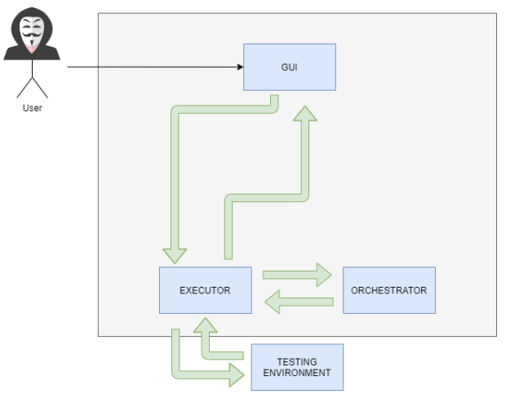
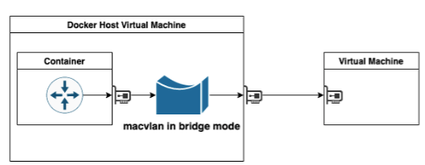
Research Areas and Contributions
Behavioural Models for Attackers
Web Penetration Testing Automation
Virtualization in Cyber Security

Slide 5
Hacking Goals: a goal-centric attack classification framework
Hacking Goals components
An attacker uses several hacking methodologies that can be structured as a set of Hacking Goals
Hacking Tasks fulfil a Hacking Goal
Hacking Actions are executed while performing a specific Hacking Task
Hacking Goal
1
1...N
Hacking Tasks
1
1...N
Hacking Actions

Slide 6
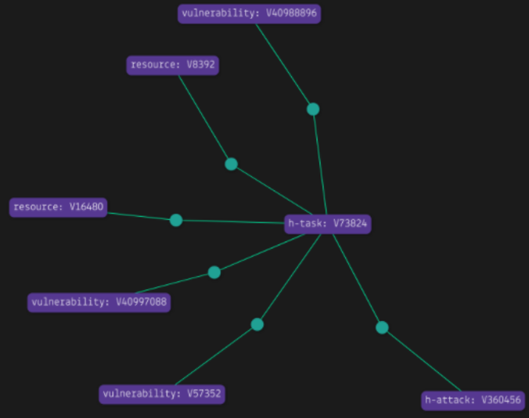
Beyond Hacking Goals: Attacker’s Knowledge Graph
It is possible to model a Web Application Attacker behaviour through Knowledge Graphs
A Knowledge Graph represents a collection of interlinked entities, real-world objects and events
It is possible to query the Knowledge Base and find related tasks according to the current goal.
Hacking Goal is a Knowledge Graph query
Hacking Tasks and Hacking Actions are entities in the database
Hacking Tasks Tree is built by using Knowledge Graph relations

Slide 7
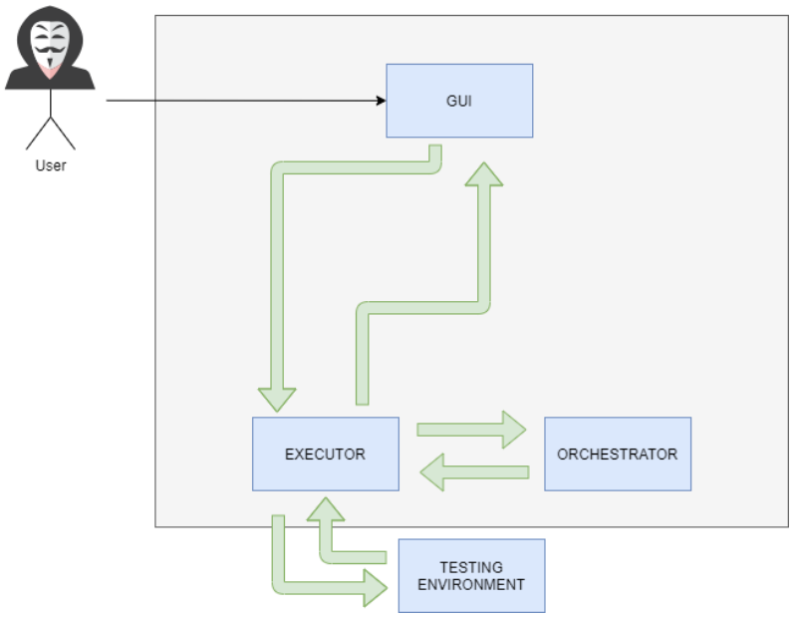
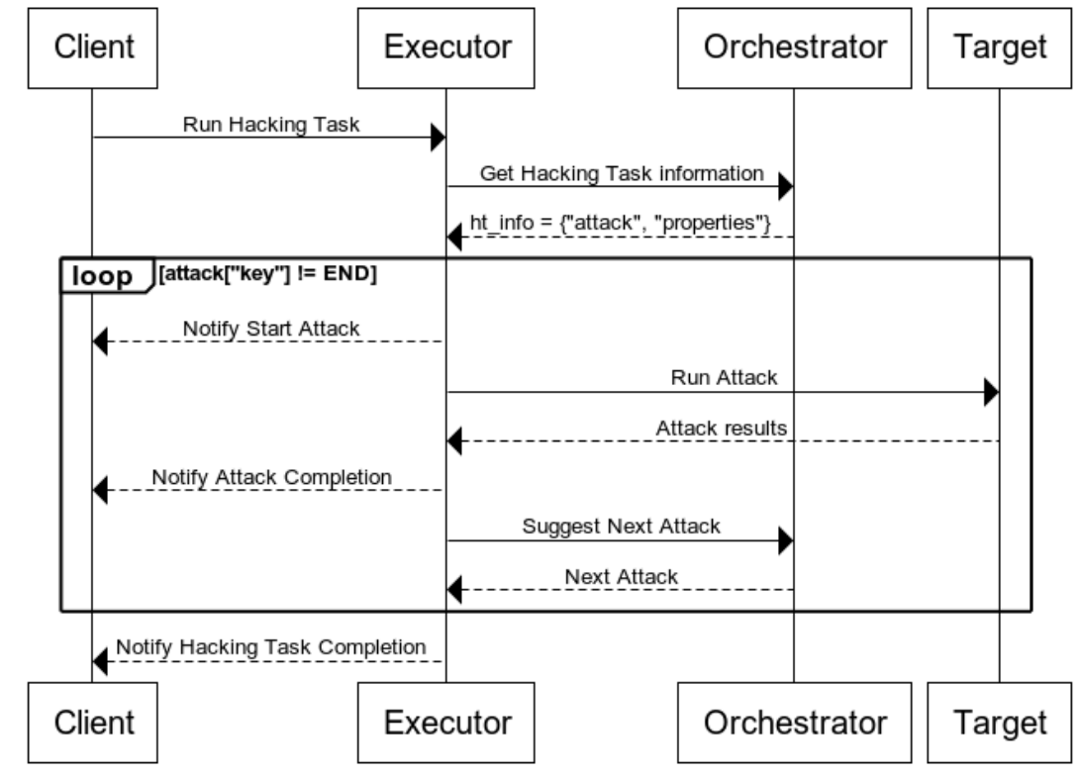
An automated platform for Web Offensive Security
High Level Architecture and Communication Protocol
the Executor holds the implementation of the attacks. It awaits instructions from the Orchestrator for the specific Attack to run. It also reports back to the Orchestrator the results of Attacks;
the Orchestrator tells the Executor to orchestrate the attacks to set off against a target and organizes them as Hacking Tasks;
the Front-End allows users to initiate testing sessions.
A Communication Protocol between the Executor and Orchestrator is defined to regulate communication between the two modules
Users choose the Hacking Tasks. The Executor asks the Orchestrator for instructions. The Orchestrator suggests the attacks to be performed against the target
Eventually, the Orchestrator tells the Executor to end the activities, and the Hacking Task is completed.

Slide 8
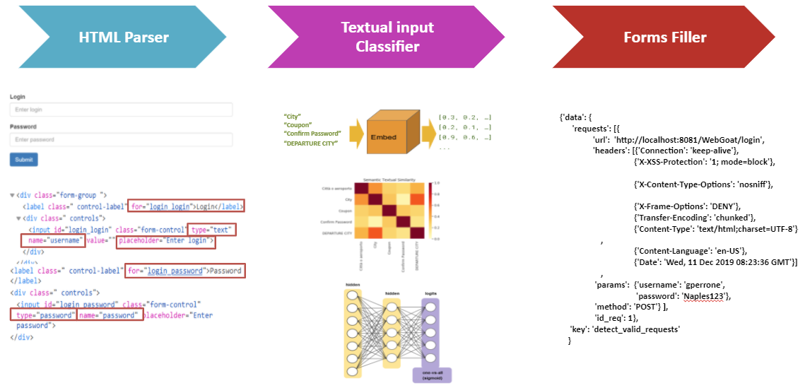
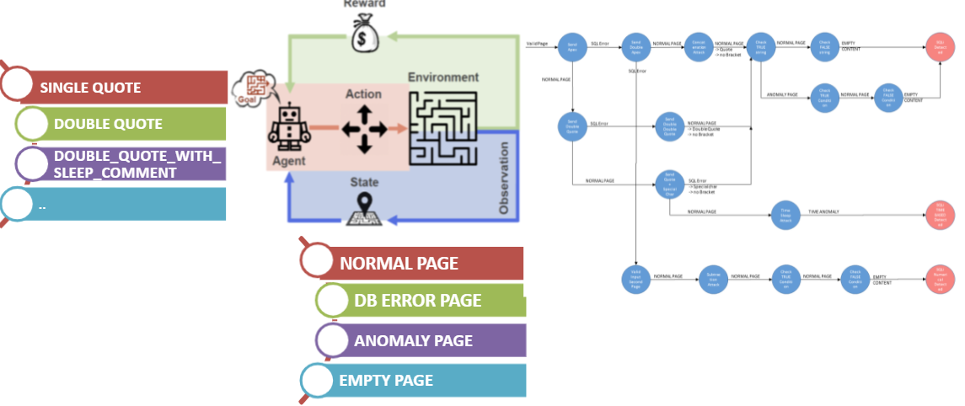
An automated platform for Web Offensive Security
Artificial Intelligence modules to automate tasks
An HTML Analyzer module that uses Natural Language Processing techniques to identify similarities between textual information extracted from the attributes of UI components and predefined data types ( string, number, fiscal code, etc.)
Reinforcement Learning modules that reproduce attackers’ behaviours to find injection flaws such as Reflected Cross-Site Scripting and SQL Injection vulnerabilities

Slide 9
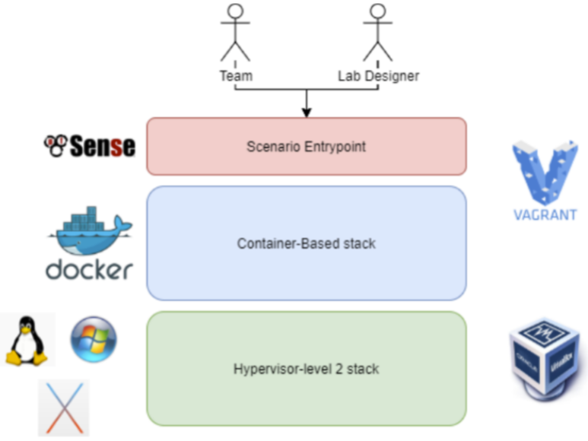
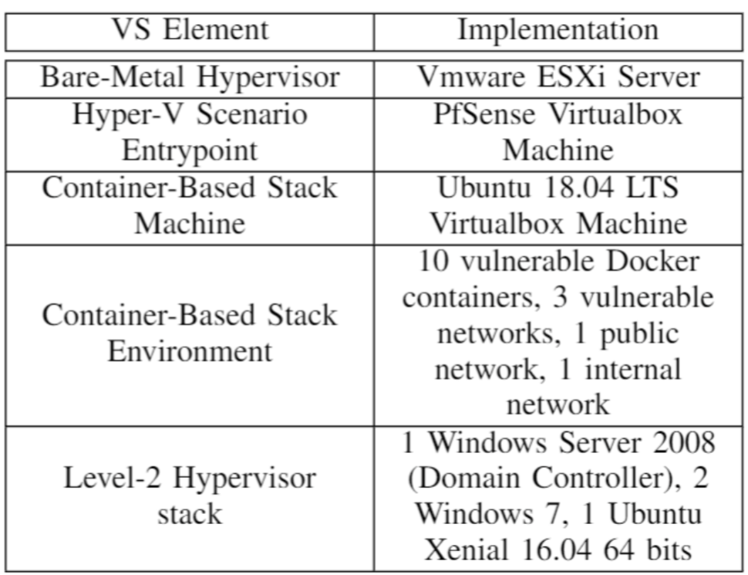
Capturing flags in a dynamically deployed microservices-based
heterogeneous environment
Virtual Scenario Architecture and Virtual Scenario Elements Implementation

Slide 10
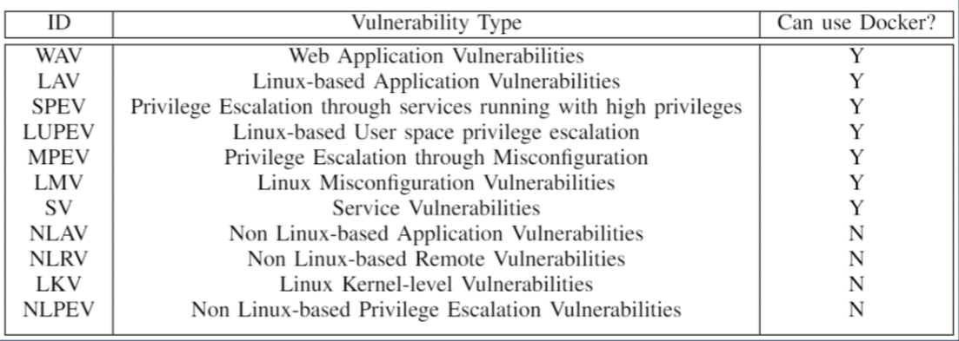
Capturing flags in a dynamically deployed microservices-based
heterogeneous environment
Which vulnerabilities can Docker reproduce?

Slide 11
Publications
Published Papers
F.Caturano, G.Perrone, S.P. Romano, Hacking Goals: a goal-centric attack classification framework, 32nd IFIP International Conference on Testing Software and System IEEE (ICTSS 2020)
F.Caturano, G.Perrone, S.P. Romano, Capturing flags in a dynamically deployed microservices-based heterogeneous environment, 13th IEEE Principles, Systems and Applications of IP Telecommunications (IPTComm2020 )
F.Caturano, G.Perrone, S.P.Romano, Discovering reflected Cross-Site Scripting vulnerabilities using a Multiobjective Reinforcement Learning environment, Computers & Security (2020)
A.P. Luise, G.Perrone, C.Perrotta, S.P.Romano, On-demand deployment and orchestration of Cyber Ranges in the cloud, ITASEC2021 conference
Submitted Papers
D.Antonelli, R. Cascella, G. Perrone, S.P. Romano, A. Schiano, Leveraging AI to optimize website structure discovery during Penetration Testing, Journal of Information Security and Applications (under review)
In Preparation
C.Brandi, F.Caturano, G.Perrone, S.P. Romano A rule-based fuzzer to discover injection vulnerabilities in Web Applications
F. Caturano E. De Martino, G.Perrone, S.P. Romano, Leveraging Knowledge Graphs to model Attackers' Behaviors
F. Caturano A. Ferraiuolo M. Perna G. Perrone S.P. Romano, Recheck Through Ansible: a declarative-based approach to the validation of vulnerability fixes

Slide 12
SecSI Innovation Products
G.Perrone and SecSI Team, Docker Security Playground, a microservices-based platform to learn network security. https://github.com/giper45/DockerSecurityPlayground
E. Galdi: The Phish: phishing email analysis tool, https://github.com/emalderson/ThePhish
A. Delicato, D. Capone: Dockerized Android: a container-based framework to execute mobile cyber-ranges scenarios, https://github.com/cybersecsi/dockerized-android

Slide 13
Thanks for the attention!

