Slide 1
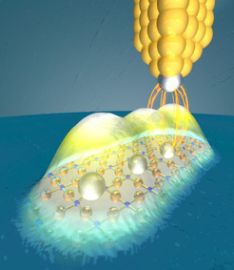
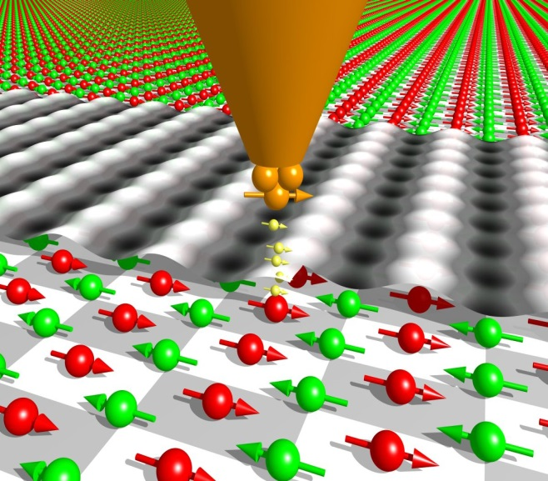
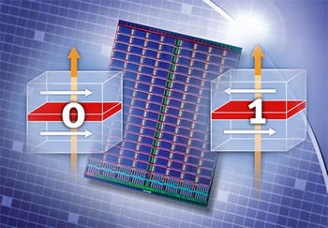
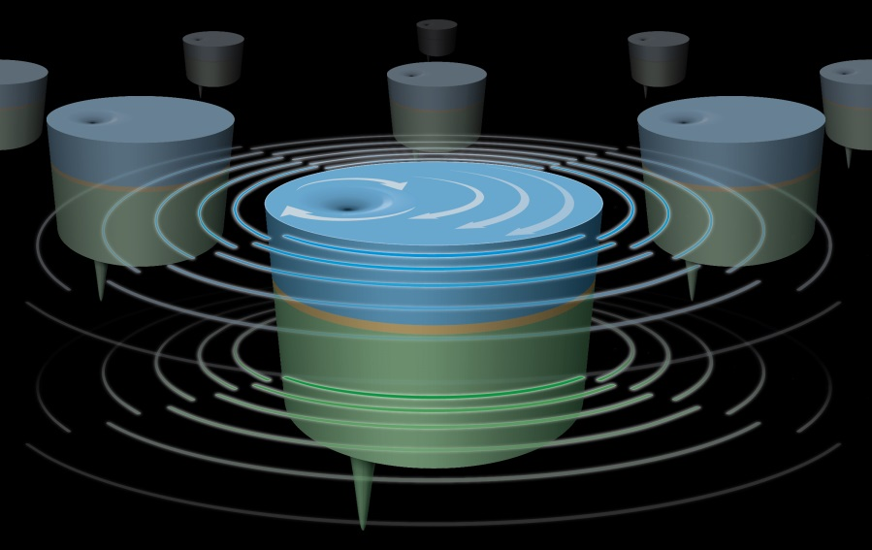
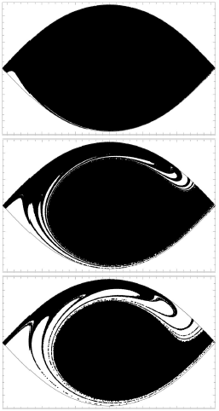
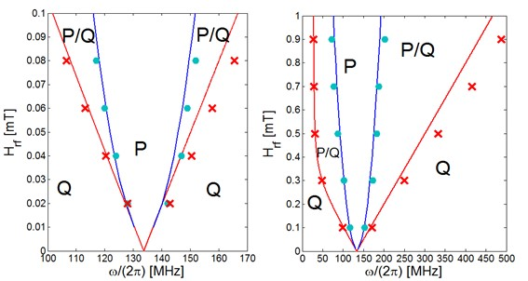
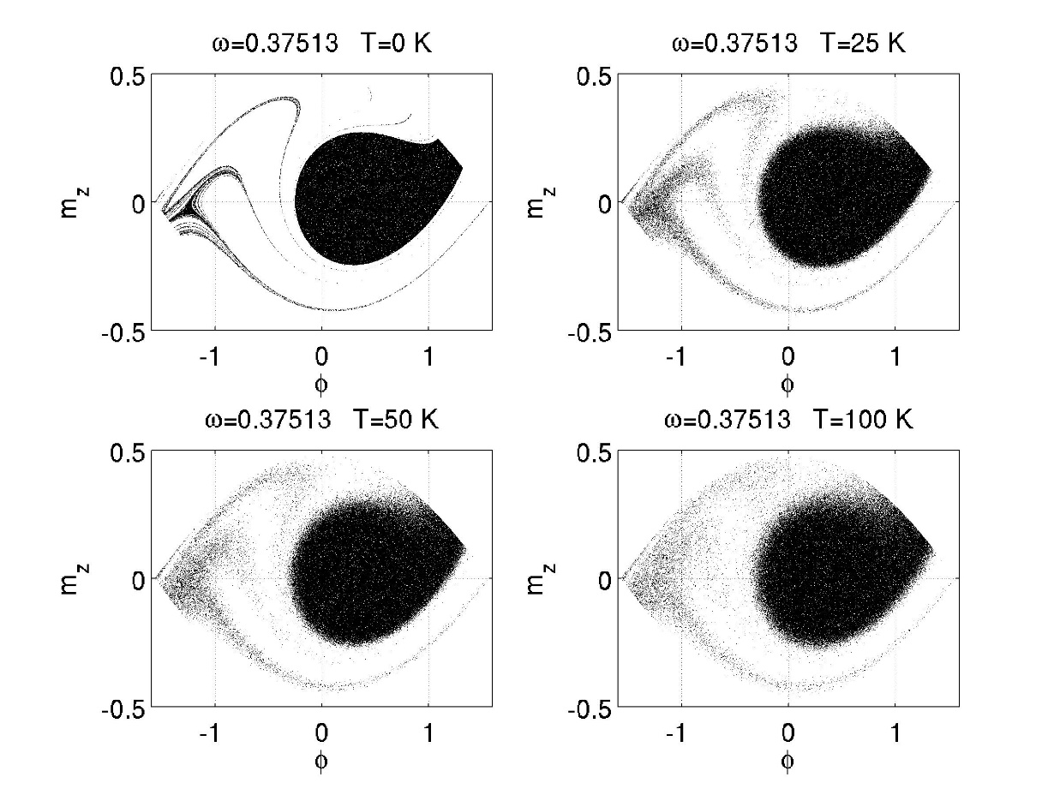
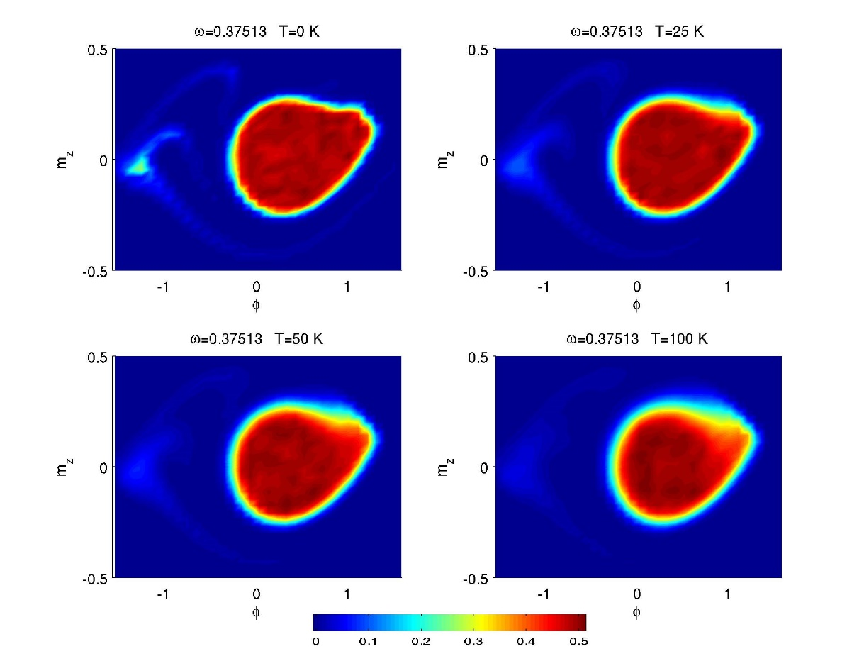
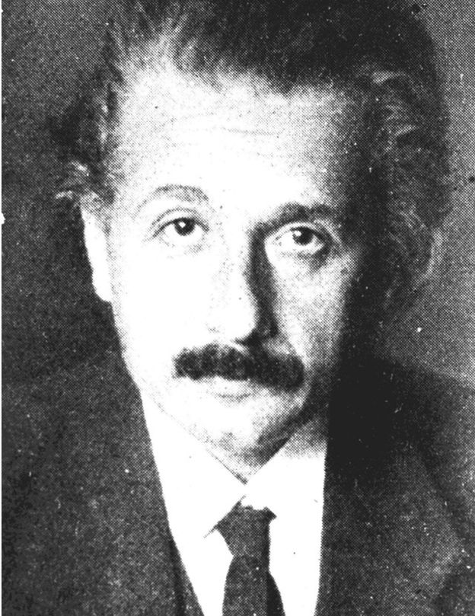
SALVATORE PERNA Tutor: Claudio Serpico¹ – co-Tutor: Massimiliano d’Aquino² 1) University of Naples Federico II , DIETI 2) University of Naples Parthenope, dep. of engineering XXIX Cycle - II year presentation
Spintronics and Nanomagnetism
Study the evolution of the magnetic properties in materials on
nanometric scale, in presence of external excitations such as
magnetic field or spin-polarized currents. In a such scale the magnetization dynamics is described by the Landau-Lifsic-Gilbert-Sloncewski equation[2,3].
In the ICTs field the ability to manipulate the magnetization in a nanostructure opened a wide range of possible applications :
Improve the hard drive techonology ( storage density)
Nanooscillators in the microwave frequencies
Magnetic logic circuits
Nano sensors
……
Research Group Collaborators: C. Serpico, M. d’Aquino, G. Bertotti, I. D. Mayergoyz and A. Quercia
Magnetic solitons dynamics in micronsize ferromagnetic layer : synchronization of vortex oscillations with a rf rotating magnetic field
Microwave assisted magnetic recording in ferromagnetic nanoparticles
$$m_{V}\left(r,X(t)\right)$$
$$J_{dc}$$
MOTIVATION : The capacity of an hard drive storage device fixed the geometry is limited by the information density that is reliably read and written. A way to increase this factor is to novel energy optimized switching techniques.
$$R\sim 1μm$$
RESULTS :
Calculation of the threshold microwave field amplitude in function of the frequency at which the erosion starts
Definition of a safe region for the magnetic state not affected by the progressive erosion of the basin
The inclusion of the temperature destroys the fractal nature of the erosed basin but preserves the safe states
$$X$$
MOTIVATION : one of the proposed solutions to overcome the low output power of magnetic nanoscillators is to synchronize( phase locking) an arbitrary number of them.
$$m_{p}$$
RESULTS :
Synchonizations by means rotating magnetic field
Definition of a synchronization map
Prediction of a region of safe synchronization
Prediction of histeresys in the synchronization process
METHODS :
Perturbative techniques
Parallel computation of ensemble of independent magnetic nanoparticles ( Poincaré map)
METHODS :
Collective variable approach modelling
Bifurcation analysis
Validations by means full micromagnetic simulations ( MUMAX)
OPEN COLLABORATIONS :
UNIVERSIDAD DE SALAMANCA, department of applied physics
UNIVERSITA’ DEGLI STUDI DI MESSINA, department of engineering
PROJECT PARTECIPATION :
PROGRAMMA STAR 2014 LINEA2- Mobilità Giovani Ricercatori
FUTURE DEVELOPMENTS :
MODELLING OF INTERACTION BETWEEN THE MAGNETIC STATE OF A UNIFORMLY MAGNETIZED NANOMAGNET AND A COSTANT TEMPERATURE THERMAL BATH
MAGNETIC VORTEX DYNAMICS IN THIN FILM INTERACTING WIT A THERMAL BATH
CLASSIFICATION AND EXCITATION OF SOLITON DYNAMICS IN MICRONSIZE STRUCTURES
TWO COUPLED VORTEX DYNAMICS IN FERROMAGNETIC MULTILAYER DEVICES
REFERENCES :
[1] G. Bertotti, Hysteresis in Magnetism, ACADEMIC PRESS (1998)
[2] C. Serpico, G. Bertotti and I.D. Mayergoyz Nonlinear magnetization dynamics in nanosystems, ELSEVIER (2008)
[3] M. d’Aquino, Nonlinear magnetization dynamics in thin films and nanoparticles, source : http://wpage.unina.it/mdaquino
"Imagination is more important than knowledge. For knowledge is limited, whereas imagination embraces the entire world, stimulating progress, giving birth to evolution." (Albert Einstein, 1920)
Notes:
Instructions to fill the poster
Box RGB 22 34 48
Context of your research activity (motivations, needs, trends, activity of your group (if the case)… - describe for self explanatpry)
Box RGB 255 220 0
Your research activity up to the second year (idea, methodology, developments, results, expected validation,… - insert whatever you like, text, images, photos. This box is reserved to your very specific activity, not to your group)
Box RGB 151 23 32
Your contacts
Cooperations with Universities, companies, participations in progrojects and programmes (logos can be included)
Box RGB 79 129 189
Next year
Future developments of your activity
Box width is 80 cm
Box height can be changed according to your needs
The text is written in Calibri font

