Slide 1
Domenico Perna
Tutor: Andrea Del Pizzo – co-Tutor: Luigi Fratelli
XXIX Cycle - III year presentation
Control Strategies and Design to range in Light Railway Systems
1
Notes:
Hello everyone, I’am Domenico Perna. At present i’m PhD candidate of XXIX cycle in Information Technology and electrical Engineering.

Slide 2
MY BACKGROUND :
GRADUATED in Electrical Engineering
SCHOLARSHIP SUPPORTED by Hitachi Rail Italy SpA
RESEARCH GROUP : POWER CONVERTERS, ELECTRICAL MACHINES AND DRIVES (ING-IND/32, DIETI – UNINA)
2
Notes:
I’m an electrical engineer and my scholarship was suppported by Hitachi Rail Italy - a Hitachi group and my Tutors are :
Professor Andrea Del Pizzo – group of Power Converters, Electrical Machines and Drives;
- Luigi Fratelli –Innovation and Research &Development Funded – Hitachi Rail Italy;
-- but my boss is Roberta Schiavo – Head of Traction Control – Hitachi Rail Italy.

Slide 3
Credits Summary
 | Credits year 1 |  |  |  |  |  |  |  | Credits year 2 |  |  |  |  |  |  |  | Credits year 3
 |  | 1 | 2 | 3 | 4 | 5 | 6 |  |  | 1 | 2 | 3 | 4 | 5 | 6 |  |  | 1 | 2 | 3 | 4 | 5 | 6
 | Estimated | bimonth | bimonth | bimonth | bimonth | bimonth | bimonth | Summary | Estimated | bimonth | bimonth | bimonth | bimonth | bimonth | bimonth | Summary | Estimated | bimonth | bimonth | bimonth | bimonth | bimonth | bimonth | Summary | Total | Check
Modules | 21 | 0 | 3 | 9 | 6 | 6 | 0 | 24 | 15 | 0 | 7 | 0 | 0 | 0 | 0 | 7 | 0 | 0 | 0 | 0 | 0 | 0 | 0 | 0 | 31 | 30-70
Seminars | 5 | 0 | 0 | 0 | 0 | 0 | 0,4 | 0,4 | 5 | 0,2 | 0,2 | 0 | 0,6 | 2,8 | 0 | 3,8 | 5,8 | 1,2 | 2,3 | 0 | 0 | 0 | 1 | 4,5 | 8,7 | 10-30
Research | 34 | 10 | 7 | 1 | 4 | 4 | 9,6 | 36 | 40 | 9,8 | 2,8 | 10 | 9,4 | 7,2 | 10 | 49 | 54 | 8,8 | 7,7 | 10 | 10 | 10 | 9 | 56 | 140 | 80-140
 | 60 | 10 | 10 | 10 | 10 | 10 | 10 | 60 | 60 | 10 | 10 | 10 | 10 | 10 | 10 | 60 | 60 | 10 | 10 | 10 | 10 | 10 | 10 | 60 | 180 | 180
3
Notes:
The Summary of Credits

Slide 4
RESEARCH ACTIVITY
Electrical Traction Drives and Energy Storage Systems for high energy performance and reliability in Light Railway Systems
4
Notes:
My activity research is focused on Electrical Traction Drives and Energy Storage Systems for high energy performance and reliability in Light Railway Systems

Slide 5
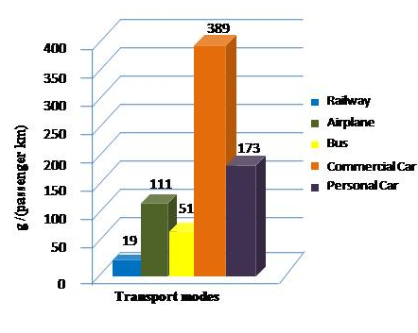
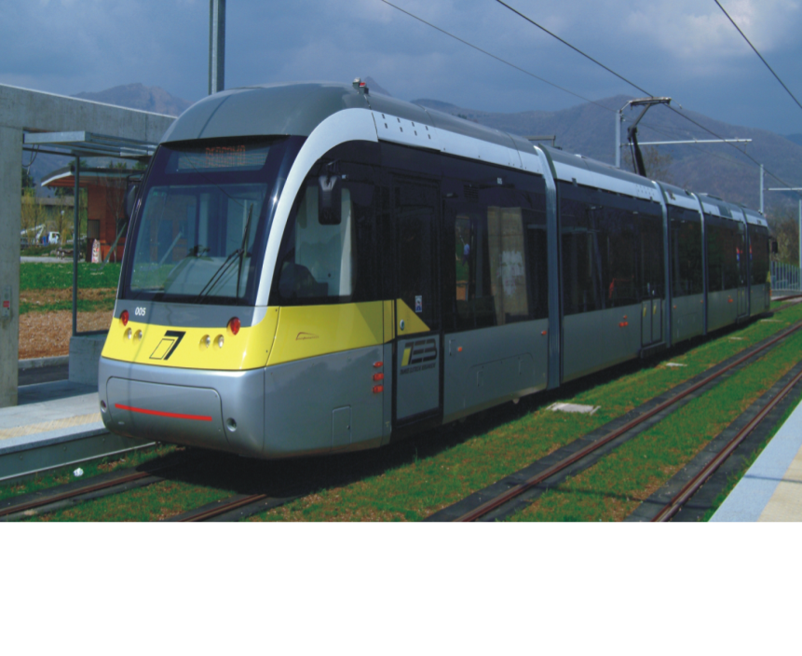
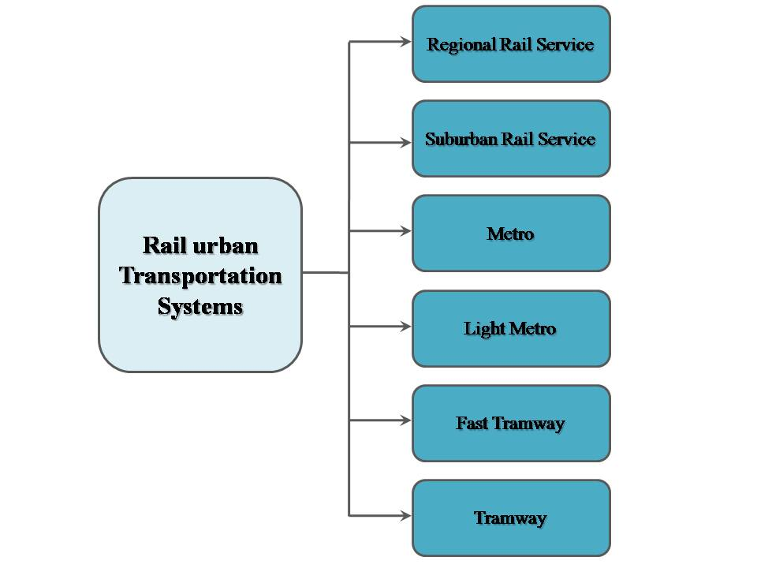

General Context
CO₂ Emissions
5
Notes:
In general, a Transportation System can be defined as the combination of elements and their interactions, which produce the demand for travel within a given area and the supply of transportation services to satisfy this demand.
A substantial advantage of electric railways compared to other modes of transportation is the use of electric energy, which allows the utilization of different primary energy sources ALLOWING THE REDUCTION OF CO₂ EMISSIONS, and then a lower ENVIRONMENTAL IMPACT compared to the others Transportation modes.
From this perspective, PUBLIC TRANSPORT BECOME CRUCIAL and this has lead the spread in all major cities of railway urban transport systems .
To be more specific, Light Rail is a particular tram system, utilized for urban and suburban passengers transport that allows higher speed values and higher flow rates compared to Tram and in Figure is drawn a Light Railway System considered in the next developments .

Slide 6
General Context
Electrical
Substation
Energy
Catenary Losses
Train
Traction Losses
19%
Auxiliary Loads
14%
Mechanical
Motion
Resistance
16%
Kinetic
Mechanical Brakes
9%
Electric
Braking
Traction Losses
15%
67%
51%
42%
27%
Energy reversed
in catenary
Regenerated Energy
Catenary Losses
6
Notes:
Statistic evaluation of a vehicle energy division (UITP - International Association of Public Transport) reports that the available braking energy is the 42% of the overall absorbed one. A part of this energy is recovered by the contact line (27%) and the remaining (15%) could be stored ( with the help of energy storage systems) rather than lost.

Slide 7
General Context
Energy Storage
Reduction of Transducers
Power Chain Optimization
Improvement in Rail Transport
Weight and Size Reduction
Braking losses Reduction
Speed Profile Optimization
7
Notes:
Therefore the introduction of new solutions able to improve efficiency, costs, reliability and security of the various subsystems of the railway vehicles is mandatory in order to meet the continuously evolving market challenges. In Figure are highlighted different ways for improvements concerning energy efficiency and reliability in rail transport, such as: Energy storage Systems or Reduction of Transducers or even Braking losses Reduction or Weight and Size reduction..

Slide 8
MY WORK
Energy Saving and Sensorless Control Strategies for IM and PMSM traction drives in Light Railway Systems
On-board Energy Storage Systems : Design to range in Catenary-free operations of a Light Railway Vehicle
Stationary Energy Storage Systems : Control Strategy for Energy Management in Light Railway Systems
8
Notes:
In my work have been pointed out control strategies and a design method to carry out at different levels improvements in railway field in terms of energy efficiency and reliability ; in particular :
Exploiting the possibility of introduce Speed Sensorless Vector Control Strategies in traditional architectures of a vehicle equipped either with Induction Motor or Permanent Magnet Synchronous Motor drives;
2) To find a way for Design to range of Supercapacitors Energy Storage Systems on board of a real Light Vehicle in conditions of power supply gaps ;
3) Introducing a Control Strategy for Energy Management of Supercapacitors energy storage Systems (SESS) in Stationary configuration for a Light Railway System and validate it through Experimental Tests.

Slide 9
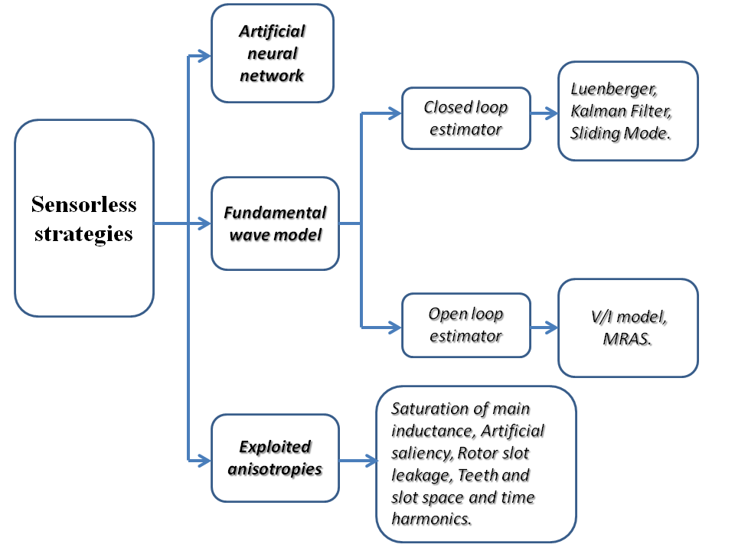
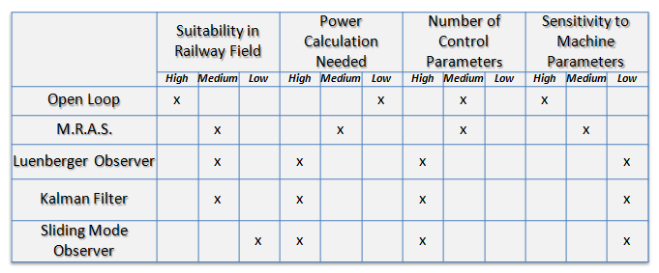
MY WORK
Sensorless Strategies
Energy Saving and Sensorless Control Strategies for IM and PMSM traction drives in Light Railway Systems
Reasons :
Benefits :
Introduction of simple speed estimators in Railway Field
Costs
Improvement of reliability
Cabling Simplicity
Reduction of encumbrance
Construction Constraints
Possibility of increase motor rated power
Reduction of maintenance
9
Notes:
The utility to remove speed or position sensor is usually linked to different reasons as cost , to improve reliability, reduce maintenance and increase motor rated power, taking advantage by the space usually reserved to speed and position sensors and their accessories.
Different sensorless control strategies are commonly used in IM and PMSM drives.
There are schemes that have excellent performance even in open loop. Their operations in open loop implies that their behavior definitely depends on the parameters of the machine.
Otherwise, the performance of closed-loop observers are slightly dependent on the machine parameter variations .
In the next, two simple speed estimator has been proposed because of the standardization of vehicle macro-components and the requirement of reduce the number of transducers.

Slide 10
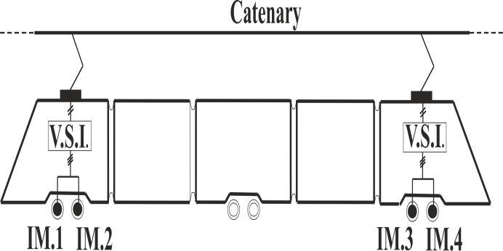
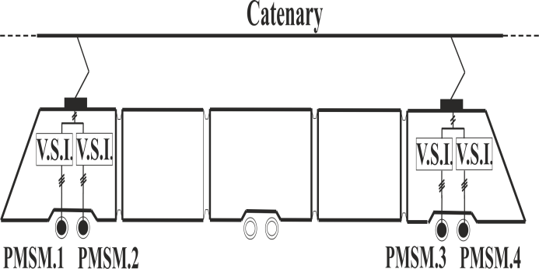
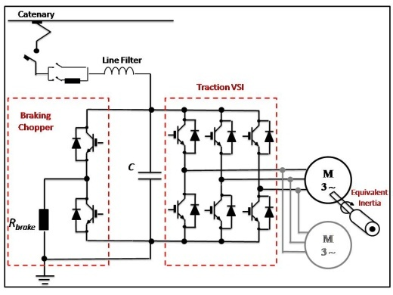
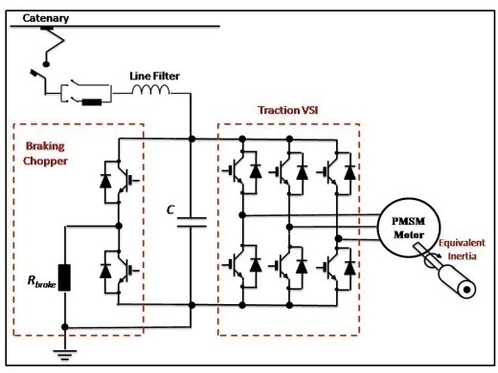
PMSM and IM Vehicles : Configurations
Vehicle data
Propulsion units data
Total Mass (empty ÷ full) | 52÷68 | tons
Maximum Acceleration | 1.1 | m/s²
Maximum Deceleration | 1.1 | m/s²
Maximum Speed | 80 | km/h
Wheel Diameter | 0.68 | m
Mechanical Gear Ratio | 5.5
Mechanical Gear Efficiency | 0.95
 | IM | PMSM
Rated motor power | 127.6 | 127.5 | kW
Rated electromagnetic torque | 647 | 812 | Nm
Rated motor speed | 1884 | 1500 | Rpm
Motor pole-pair number | 2 | 4
Rated armature voltage | 443 | 285 | V(rms)
Rated armature Current | 230 | 314 | A(rms)
Inverter power switches | CM1800HCB34N | CMH1200DC34S
Inverter switching frequency | 1000 | 2000 | Hz
Catenary dc voltage | 750 | 750 | V
10
Notes:
the main characteristics of the vehicle are summarized in Table. The propulsion units are assumed with the two different configurations. Single-inverter dual-motor is the architecture of IM propulsion unit, while single inverter – single motor is the propulsion unit for PM brushless drives, because they cannot be operated in parallel connection in traction applications.

Slide 11
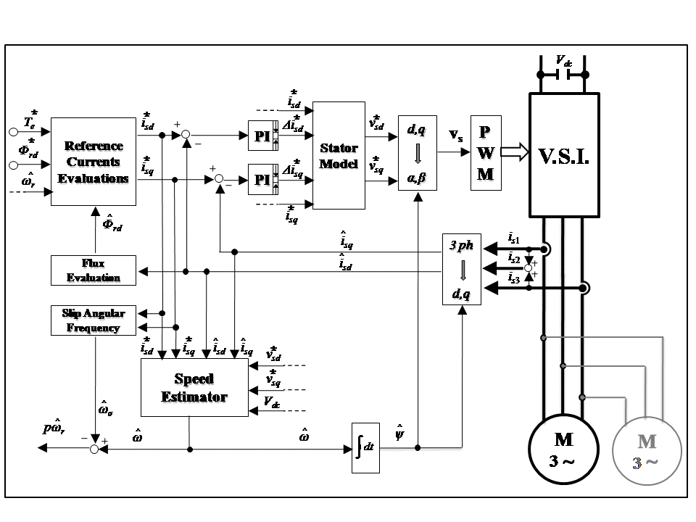
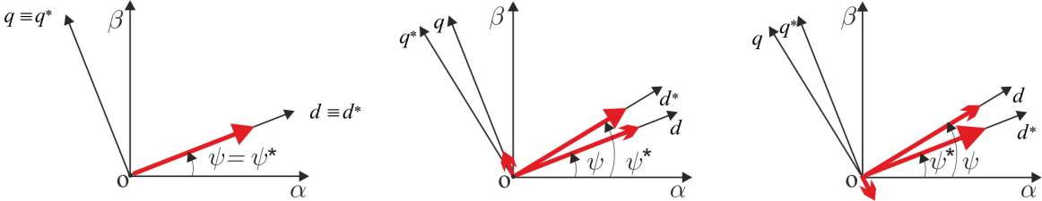
I.M. Sensorless Strategy
IM Speed Estimator
E.m.f. Induced voltages:
Istantaneous angular frequency estimated:
Deviation of angular position of rotor flux from the reference ones :
11
Notes:
The control diagram depicted is an indirect field-oriented torque control scheme. The evaluation of the limit values of currents is made off-line and the results are placed in a look-up table. Current PI controllers are used in d,q frame. Up to the base speed value, the magnitude of the air-gap rotor-flux is imposed constant; for greater speeds the drive operates in a very wide field weakening region. Classical space vector modulation is used.
The estimated speed value is deduced from the instantaneous angular frequency estimated (see equation 2) )and then subtracting the slip angular frequency .

Slide 12
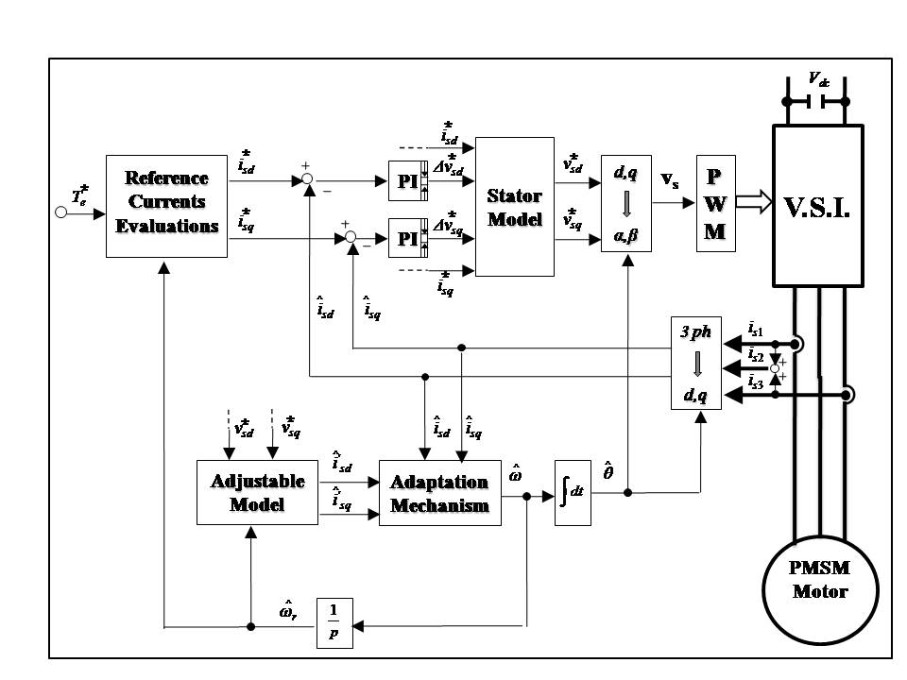
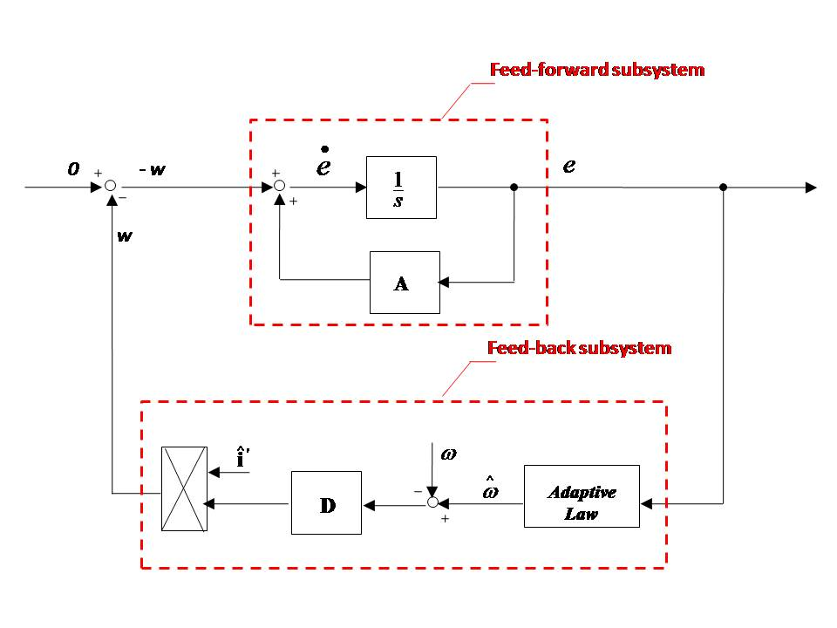
P.M.S.M. Sensorless Strategy
PMSM Speed Estimator
Reference Model:
Adjustable Model:
Adaptation Mechanism:
12
Notes:
Also in this case a field-oriented current-control technique is used. The reference currents are evaluated by imposing the maximization of T_{e}/I_{s} torque/current ratio until the speed base is reached; for greater speed values, a flux weakening strategy is applied.
Model Reference Adaptive scheme is used as speed estimation algorithm. The reference model is represented by the PMSM itself , while as adjustable model is chosen the current model of PM motor , considering angular speed as the adjustable parameter.
Subtracting the system 2) to the system 1), we obtain the state space equation synthesized by the figure on the bottom and according to Popov hyper stability theorem , the adaptation mechanism can be designed as PI style.

Slide 13
Numerical Analysis
Operations along overall speed profile
Case | Coasting | Speed interval [ km/h ]
A1 | Warm | 60 → 30
A2 |  | 60 → 45
B1 | Cold | 60 → 30
B2 |  | 60 → 45
Repowering Control
Starting from uphill conditions
Parameters Variations
13
Notes:
To evaluate the suitability of the Control Strategies previously described, some numerical investigations are carried out with a focus on the specific performance required by railway traction drives, such as: 1) operations on the entire speed-domain; 2) repowering control (which occur in the deceleration phase after the inertial slowing down); 3) starting from uphill conditions; 4) parameter variations of the machine.
In particular the coasting phase (inertial slowing down) may be obtained by using two different strategies for different speed intervals :
Warm :
Cold :

Slide 14
Operations along overall speed profile: case A1
^
ω_{r} - ω_{r}
^
ω_{r} - ω_{r}
Electromagnetic torque, train speed, energy consumption and rotor speed error versus time, for a traction unit with PM brushless ( case A1 )
Electromagnetic torque, train speed, energy consumption and rotor speed error versus time, for a traction unit with IM drive ( case A1 )
Case | Energy consumption | Coasting |  | Braking
 |  | IM | PMSM | IM | PMSM
A1 60→30 km/h | dc-link energy [Wh] | 65.1 | 16.2 | -121.9 | -134.7
 | Electrical energy [Wh] | 59.8 | 6.6 | -125.6 | -139.8
 | Mechanical energy [Wh] | 52.1 | -12.3 | -153.2 | -155.6
A2 60→45 km/h | dc-link energy [Wh] | 29.1 | 8.4 | -283.1 | -304.7
 | Electrical energy [Wh] | 27.4 | 1.9 | -288.6 | -312.3
 | Mechanical energy [Wh] | 24.9 | -13.2 | -330.4 | -337.6
14
Notes:
Also in presence of fast variations of the reference torque with a jerk of 1 m/s³, the speed-sensorless control of PMSM unit carries out good dynamic performance and the used configuration ensures stable operations either in constant flux or in field weakening region.
In Table are detailed values of energy consumption in different sections of the drives.

Slide 15
Operations along overall speed profile: case B1
^
ω_{r} - ω_{r}
^
ω_{r} - ω_{r}
Electromagnetic torque, train speed, energy consumption and rotor speed error versus time, for a traction unit with PM brushless ( case B1 )
Electromagnetic torque, train speed, energy consumption and rotor speed error versus time, for a traction unit with IM drive ( case B1 )
Case | Energy consumption | Coasting |  | Braking
 |  | IM | PMSM | IM | PMSM
B1 60→30 km/h | dc-link energy [Wh] | 0.2 | 0.29 | -118 | -134.3
 | Electrical energy [Wh] | ~ 0 | ~ 0 | -122.2 | -139.6
 | Mechanical energy [Wh] | ~ 0 | ~ 0 | -152.8 | -155.6
B2 60→45 km/h | dc-link energy [Wh] | 0.12 | 0.19 | -279.7 | -304
 | Electrical energy [Wh] | ~ 0 | ~ 0 | -285.9 | -311.8
 | Mechanical energy [Wh] | ~ 0 | ~ 0 | -330.1 | -337.5
15
Notes:
The behavior in acceleration and cruising is the same as the case A1 for IM and PMSM drives, but during the inertial slowing down the estimators involves in deterioration of their performance because the switches are open and the input currents measured decrease instantaneously to zero.

Slide 16
Repowering Control
IM currents, rotor speed and dc-link Voltage versus time, for a traction unit with PM brushless ( case B2 )
IM currents, rotor speed and dc-link Voltage versus time, for a traction unit with IM drive( case B2 )
16
Notes:
Re-powering is a specific situation that may occur after cold coasting operation, in order to re-establish the control.

Slide 17
Uphill start and Machine parameter variations
Uphill start
Machine parameter Variations
^
^
ω_{r} - ω_{r}
ω_{r} - ω_{r}
a
b
Electromagnetic torque and rotor speed versus time for the PM-brushless unit with rail slope of 30‰ and ω_{r0} = - 10 rad/s.
Rotor speed error with the increment of 20% for the machine parameters: a) PMSM unit ; b) IM unit
^
^
ω_{r} - ω_{r}
ω_{r} - ω_{r}
a
b
Electromagnetic torque and rotor speed versus time, for the IM unit with rail slope of 30‰ and ω_{r0} = - 10 rad/s.
Rotor speed error with the decrement of 20% for the machine parameters: a) PMSM unit ; b) IM unit
17
Notes:
Starting uphill: smooth and stable acceleration of the vehicle are guaranteed also when the train starts uphill ;
Machine parameter variations: The increase affect the speed sensorless control more than their decrease; on the contrary, a restricted steady-state error on the torque is ensured in all the conditions.

Slide 18
Conclusive Remarks
Operations along overall speed profile :
case A1 : the sensorless control ensure good dynamic performance and stable operations on the whole speed domain in either configurations ;
case B1 : during the “cold coasting”, the estimators involves in deterioration of their performance;
greater possibility for energy saving are ensured with PM – brushless units.
Repowering Control :
Speed estimator ensure stable response for PM unit;
in case of IM unit, the oscillations of the estimated speed involve in transient on IM currents and dc-link Voltage which disagree with typical threshold values of over-current and over-voltage.
Uphill Start :
In either cases, smooth and stable acceleration of vehicle is guaranteed .
Machine parameter Variations :
During the acceleration, the increase affect the speed sensorless controls more than decrease; on the contrary, a restricted steady state error is ensured .
18
Notes:
Leggere

Slide 19
Integration of Energy Storage Systems
Why EDL Supercapacitors ?
Benefits :
On board of Vehicle
Stationary (along an assigned track)
ESS technologies in Railway Field
Parameters | Li-Ion Battery | Zebra Battery | Double -Layer Supercapacitor | Li – Ion Supercapacitor | Flywheel
Energy Density[Wh/kg] | 100 ÷ 200 | 50 ÷ 150 | 5 ÷ 8 | 10 ÷35 | 5 ÷ 50
Power Density[kW/kg] | 0.1÷1 | 0.1÷0.2 | 2 ÷ 5 | 1÷2 | 0.18 ÷ 1.8
Life time [years] | 4 ÷ 6 | 2.5÷ 5 | 10 ÷ 15 | 10 ÷ 15 | ∼20
Number of cycles | 500 ÷ 2000 | 1000 ÷ 2000 | 0.1 10⁶ ÷ 10⁶ | 0.1 10⁶ ÷ 10⁶ | 3 10⁶
Efficiency[%] | 70 ÷ 85 | 70 ÷ 90 | 85 ÷ 98 | 85 ÷ 98 | 90 ÷ 95
Time of charge/discharge | Minutes to hours | Minutes to hours | 0.3÷30 seconds | 0.3÷30 seconds | Seconds to minutes
Technological Maturity | High | High | Medium | Medium | Medium
Energy Saving
Higher Power Density
Peak Shaving
Sufficient Energy Density
Higher number of cycles
Losses reduction
Shorter times of charge/discharge
Voltage profile Optimization
19

Slide 20

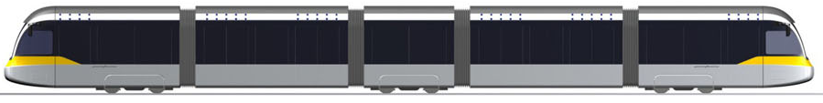
MY WORK
Catenary-free operations
On-board Energy Storage Systems : Design to range in Catenary-free operations of a Light Railway Vehicle
CATENARY
Using energy previously stored while braking or at station stops, in order to fill gaps in Catenary
SUPERCAPACITORS SYSTEM
20
Notes:
Streetcars are sometimes required to cover distances of several hundred meters in catenary-free mode to satisfy two main requirements:
safety, for moving vehicles to a station in case of catenary line fault;
2) conservation of old towns, avoiding the presence of catenary in historical places.
This is possible using the energy previously stored while braking or by the feeding line at station stops, in order to fill gaps without Catenary.
The idea was to find a method for properly sizing a supercapacitor storage system able to supply the energy required by a real streetcar along an assigned track in catenary –free operations which we call “design to range”. In fact oversize must be avoided and the storage capacity must be limited to the minimum value required by the catenary-free path mission.

Slide 21
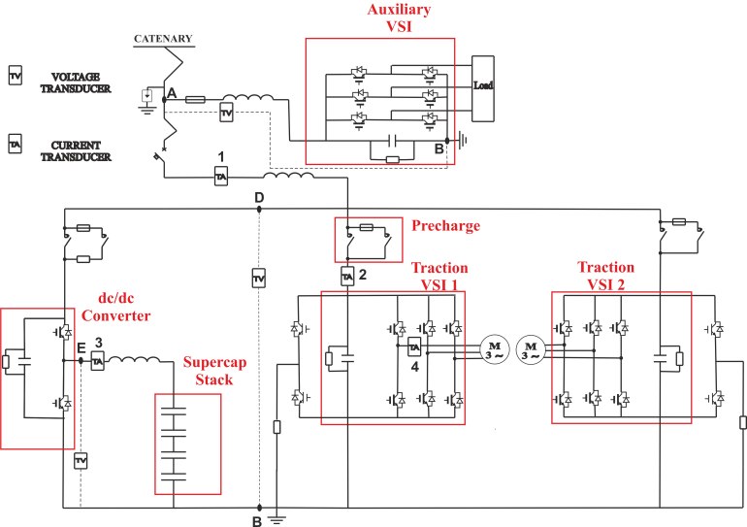
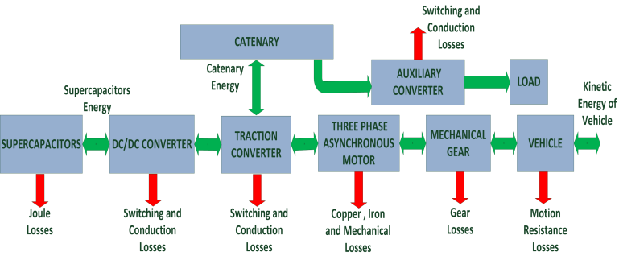
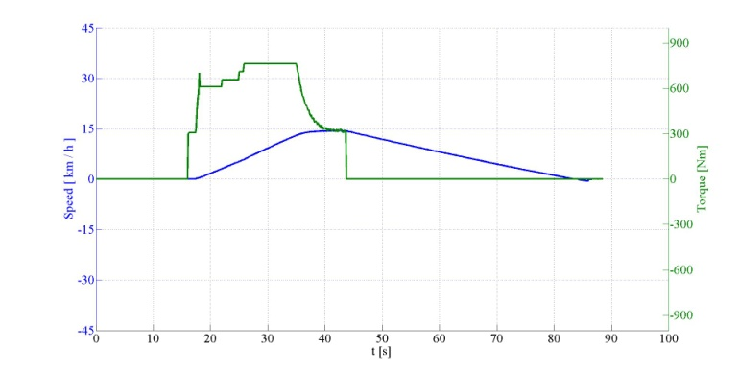
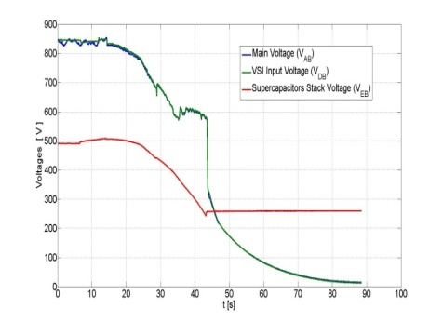
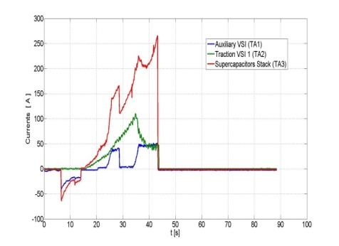
Design to range Procedure
DATA
INPUT
Experimental Test Sections
Motion Resistance
Estimation
Energetic Model of Vehicle
Effort and
Speed Profile
t₀
t₁
t₂
t₃
t₄
For the vehicle considered with a cruise speed of about 15 km/h, with i ‰ = 10 and path length = 1000 m, nine parallel bank of supercaps are needed, with total weight of about 2.15 tons and a volume of about 3.1m³
Sizing of Total Capacitance
Additional Weight
21
Notes:
Several experimental tests have been carried out in catenary-free operation and in figs are shown respectively, measures in terms of currents and voltages vs time;
Thanks to the experimental tests, an energetical model of vehicle have been developed experimentally validated . This was important because in catenary-free operations are accepted low values of speed cruise to fill the gap easily (as is possible to see in the figure on the left), but the losses are far different from the rated ones in this operating conditions; furthermore, for an accurate evaluation of vehicle friction losses, the coefficient of polynomial curve are evaluated experimentally as shown in the figure on the right.

Slide 22
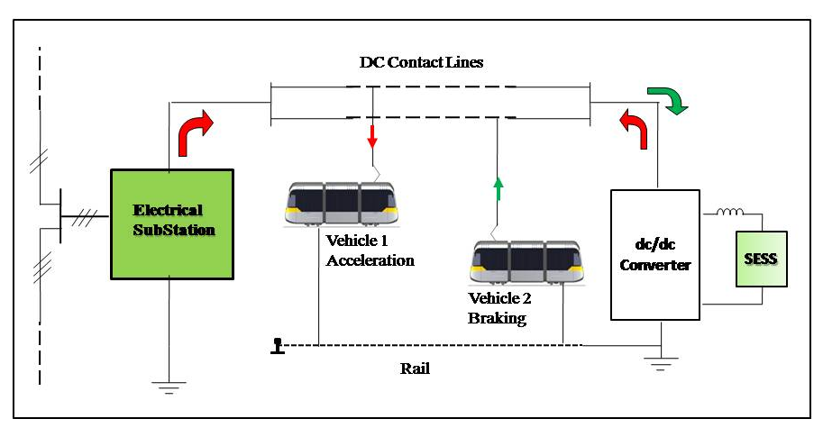
MY WORK
Stationary SESS in Metro Network Section
Problem :
Stationary Energy Storage Systems : Control Strategy for Energy Management in Light Railway Systems
The choice of time periods for storing and providing energy according to the network status which depends mainly by the traffic evolution.
Objective:
The introduction and validation of control strategy able to fullfil the benefits discussed by means of experimental results with a demonstrator of a light railway system.
22
Notes:
The stationary configuration of SESS consists in the installation of one or several SESS placed along railway tracks.
In this slide is shown a simplified example of non-receptive light rail network section with the inclusion of stationary SESS.
The aim is put in evidence the physical connection of different sub-systems and the possible scenarios of power flows exchanged between them during the motion of the vehicles.
It is important to say that the suitability of stationary SESS for the whole electrified transportation system is strictly connected to their size, position and operating conditions. From the point of view of the control, the main difficulties are related to the choice of the time periods for storing and providing energy according to the network status which depends mainly on the traffic evolution.
Hence, the focus of this study is the introduction and validation of a control strategy, able to fulfill the benefits above discussed by means of experimental results obtained by using a prototype of a light rail system.

Slide 23
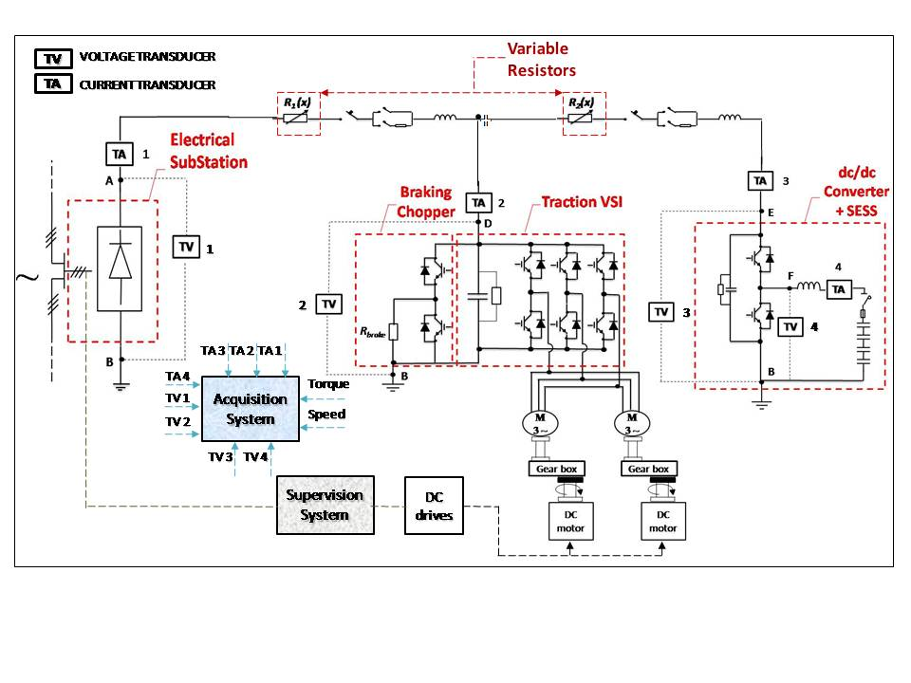
Configuration of the System
23
Notes:
In this figure is pointed out the electrical diagram of the configuration adopted.
ES: single DC electrical non receptive substation located at one terminal, with rated voltage of 750V;
Variable Rheostat: The movement of the vehicle along the line is schematically represented by means of a variable rheostat with center tap which is used to simulate the variation of the electrical resistance of the line both for Electrical Substation and SESS with reference to the position of vehicle;
Propulsion unit - Vehicle: The vehicle is represented by a single propulsion unit of a Metro rail vehicle, where his configuration is made of a 3-ph PWM-VSI feeding two induction motors (IM) in parallel connection, including also the module for the braking chopper.
SESS: A dc-dc converter is used as interface of SESS stack versus the dc-link, where SESS are placed at opposite terminal the of the track

Slide 24
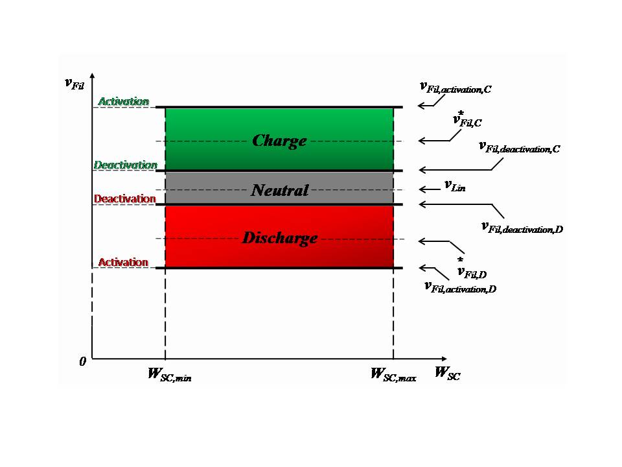
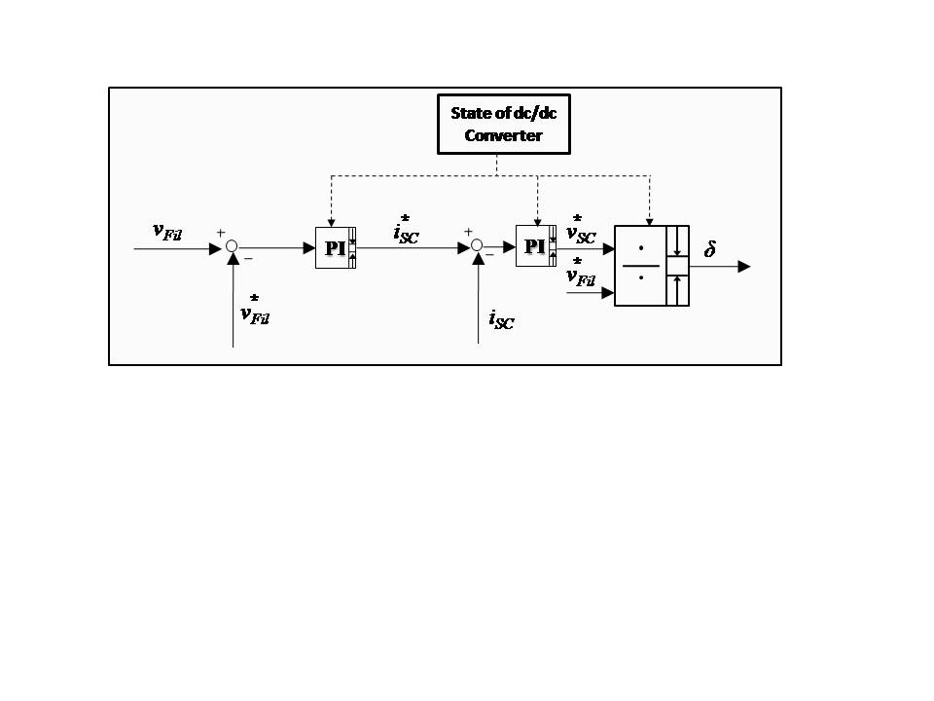
Control Strategy
Working areas of dc/dc Converter ( Charge, Discharge, Neutral)
Voltage PI regulator:
Current PI regulator:
24
Notes:
The measurement of voltage at the dc-link terminals of dc/dc converter, gives the information about the electrical evolution of the network , and the possible states of the dc-dc converter (Figure on the left) are individuated in three different working areas, that is charge, discharge and neutral where they are delimited between minimum / maximum values of energy for SESS and activation / deactivation thresholds on the voltage.
In Figure on the right is pointed out the control scheme of dc/dc converter adopted for the operation of SESS. Two cascade control loops have been developed; a control loop on the dc-link voltage of dc/dc converter and then another control loop on the charge / discharge currents. For either cases, standard PI regulators are used.

Slide 25
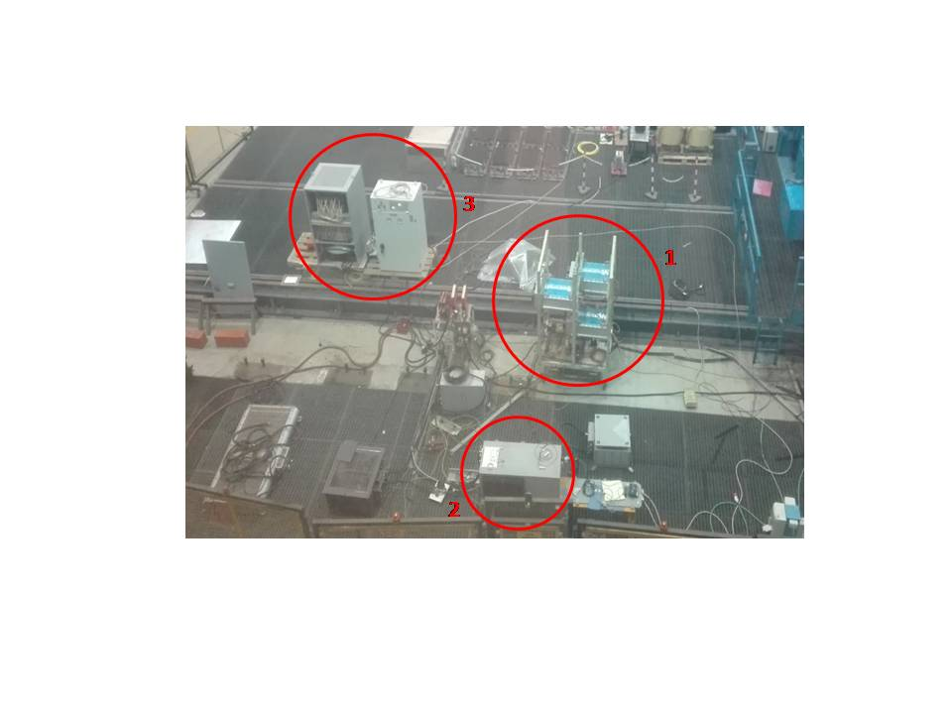
Demonstrator
Electrical Substation |  | Supercapacitors stack |  |  | Propulsion unit |  | Rheostat
Max Voltage [V] | 4000 | N. of modules in series | 4 |  | N. of inverters | 1 | Total resistance [Ω] | 0.6
 |  | Data of eachmodule
Max peak Power [MW] | 16 | Ratedvoltage [V] |  | 125 | N. of motors | 2 | Step resistance [Ω] | 0.06
Max peak Current [A] | 1000 | Capacitance [F] |  | 63 | Type of motors | IM | N. of contactors | 10
Catenary DC Voltage [V] | 750 | Energy [Wh] |  | 136 | Rated power of each motor [kW] | 145 | Max Current [A] | 250
 |  | Weight [kg] |  | 59.5 | VSI switching frequency [kHz] | 1
 |  | Volume [m³] |  | 0.086 | Power devices | IGBT
25
Notes:
In the test room of Hitachi Rail Italy has been set up the demonstrator circuit represented in Figure (slide 19), and the section related to the stationary SESS is shown in Figure on the left, where the numeration indicates: 1) dc/dc converter; 2) SESS stack; 3) variable rheostat; otherwise, in Table are summarized the main data of the whole demo circuit.

Slide 26
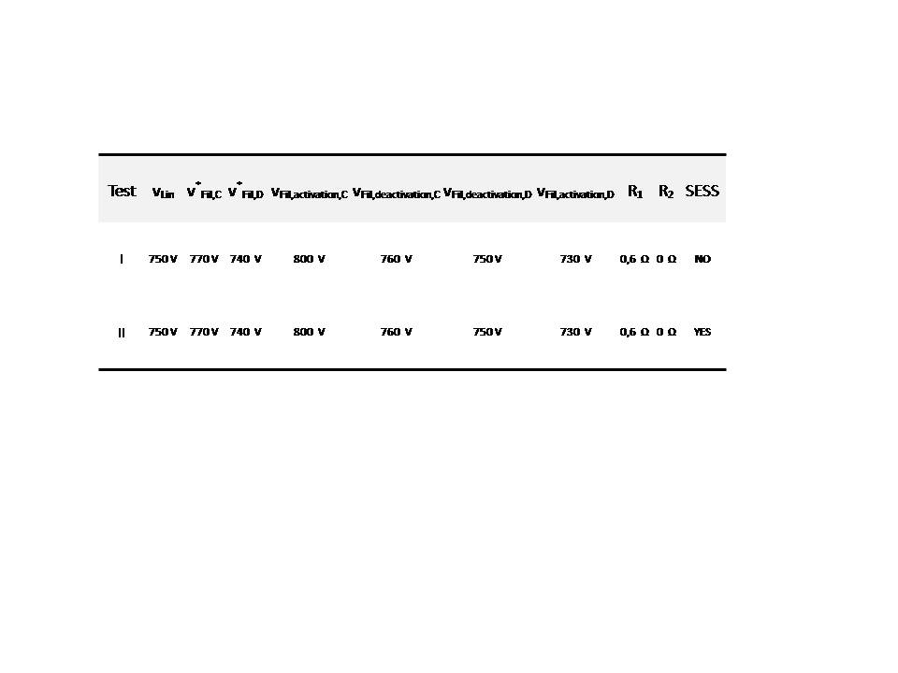
Test room Configurations
26
Notes:
In table are arranged the settings adopted for two configuration in the test room, most significant in terms of energy saving, voltage profile optimization and power peak shaving referred to the speed and torque profiles showed in the figure on the right.

Slide 27
Experimental Test without SESS
750
Maximum Voltage drop (100 V) at t = 20 s
Maximum Current from feeding line (green line - 225 A) at t = 20 s
Braking Chopper
operations (cyan line)
Test I : Experimentally detected voltages vs time
Test I : Experimentally detected currents vs time
27
Notes:
In acceleration, the voltage drop due to the motion of vehicle reach its maximum value of at t = 20s, while in braking the time behavior of the voltages are almost equal. The voltage of SESS stack is steadily equal to 400 V because they are not operated in this situation.
The max value of the current provided by the ES is about 223 A at t = 23.4 s corresponding to the cruising phase. As expected, the current of SESS is equal to zero so the power line provide all the energy needed for the propulsion unit.
. By analyzing the operations of braking chopper, it works first as "spillway“; moreover, the control of the braking chopper allows to keep the voltage at eligible values dissipating the power in surplus.

Slide 28
Experimental Test including SESS
750
Braking Chopper
operations only as “spillway”
Reduction of current provided from the feeding line (green line – peak current reduction of 42%)
Voltage follow the reference values either in charge and discharge of SESS (Voltage drop = 42V at t=20 s)
Test II: Experimentally detected voltages vs time
Test II : Experimentally detected currents vs time
28
Notes:
Looking at Figure on the left, the SESS has been previously charged at voltage value of about . In motion phases briefly described as "traction" ( acceleration + cruising), the control works to sustain the line current (green line Fig.on the right) through the SESS current (red line Fig. on the right), keeping the voltage (blue line Fig. on the left) close to the reference value of 740 V until the storage system provide all the available energy bringing his voltage to the value at t = 30 s. Instead, during the braking phase the operations of braking chopper involve only the "spillway" functionality (cyan line Fig. on the right) as previously described while Supercapacitors store the energy differently dissipated. The control manages with the charge of SESS holding the value of dc-link voltage of dc/dc converter (blue line Fig. on the left) near the reference value of 770V.

Slide 29
Energetical Comparison
With SESS
Without SESS
Energy | Traction | Braking
Electrical Substation [Wh] | 793.2 | -101.2
Drive [Wh] | 1119.6 | -328.7
SESS [Wh] | -391.3 | 214.5
Braking Chopper [Wh] | 0 | 4.9
Energy | Traction | Braking
Electrical Substation [Wh] | 1230.5 | -104.2
Drive [Wh] | 1121.7 | -328.7
SESS [Wh] | 0 | 0
Braking Chopper [Wh] | 0 | 216.4
29
Notes:
It is clear that looking at energy provided from ES during traction phase, the SESS supports the power line using the energy previously stored to sustain the propulsion unit and the losses of the line. In braking, SESS allows the recovering of a large amount of the energy regenerated in line by limiting the operations of the braking chopper.

Slide 30
Conclusive Remarks
Energy Saving :
During the braking operations, the greater part of the energy is recovered and the braking chopper works only as “spillway”.
Peak Shaving :
The reduction of peak current provided by the feeding line is about 42 %.
Losses reduction :
During the traction phase, the reduction of the losses on the feeding line is about 60 %.
Voltage profile Optimization :
The maximum voltage drop is equal to 42 V, with a reduction of about 58 %
30

Slide 31
Publications
“ A method for “design to range” energy storage systems in catenary free operation of light railway vehicles” - 5th International Conference on Clean Electrical Power Renewable Energy Resources Impact 16-18 June 2015 – Taormina, Italy – IEEE Conference.
“ Energetical comparative analysis of I.M. and P.M. brushless drives in Light Railway Transportation Systems ” - 23th International Symposium on Power Electronics, Electrical Drives, Automation and Motion 22-24 June 2016, Anacapri, Italy – IEEE Conference.
"An Assisted Speed-Sensorless Control of Induction Motor Drives for Railways Applications" - 4th International Conference on Electrical Systems for Aircraft, Railway, Ship propulsion and Road Vehicles & International Transportation Electrification Conference, 2 - 4 November 2016, Toulouse, France – IEEE Conference.
31
Notes:
bbbb

Slide 32
Further Developments
Experimental validation of Sensorless Control Strategies proposed
Experimental on-line tests for a Light Railway System with inclusion of Stationary SESS
32

Slide 33
THANKS FOR YOUR
ATTENTION
33
Notes:
Thanks

