Slide 1
PhD Student : Domenico Perna
Tutor : Andrea Del Pizzo
XXIX Cycle - First year presentation
1

Slide 2
MY BACKGROUND :
GRADUATED IN ELECTRICAL ENGINEERING WITH THESIS “ PLANNING OF STORAGE SYSTEMS IN MICROGRIDS”
SCHOLARSHIP HOLDER XXIX CYCLE PhD ITEE – UNINA SUPPORTED by ANSALDO BREDA S.p.A.
RESEARCH GROUP : POWER CONVERTERS ELECTRICAL MACHINES AND DRIVES (DIETI – UNINA)
2

Slide 3
RESEARCH ACTIVITY
Electrical drives of railway vehicles equipped with energy storage systems for high energy performance
3

Slide 4

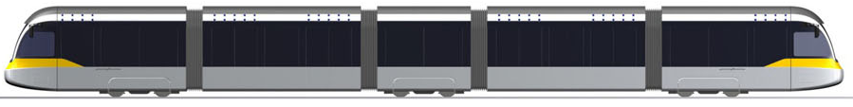
STREETCAR WITH ON BOARD SUPERCAPACITORS ENERGY STORAGE SYSTEM
CATENARY
Storing energy at station stop or while breaking and Reusing it to support acceleration phase
SUPERCAPACITORS SYSTEM
4

Slide 5
CATENARY-FREE OPERATION
CATENARY
Using energy stored in order to cross the gap without Catenary
SUPERCAPACITORS SYSTEM
5

Slide 6
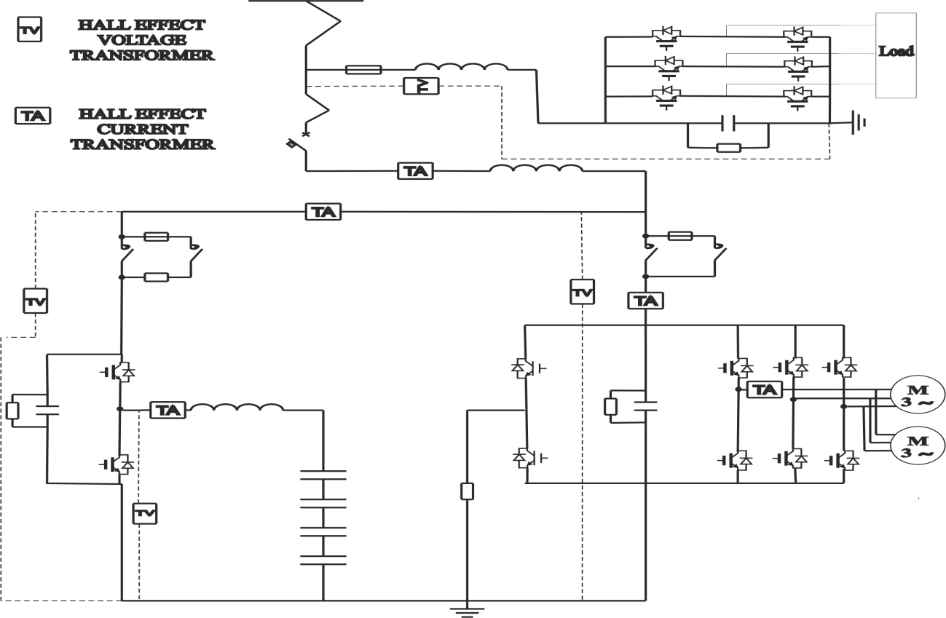
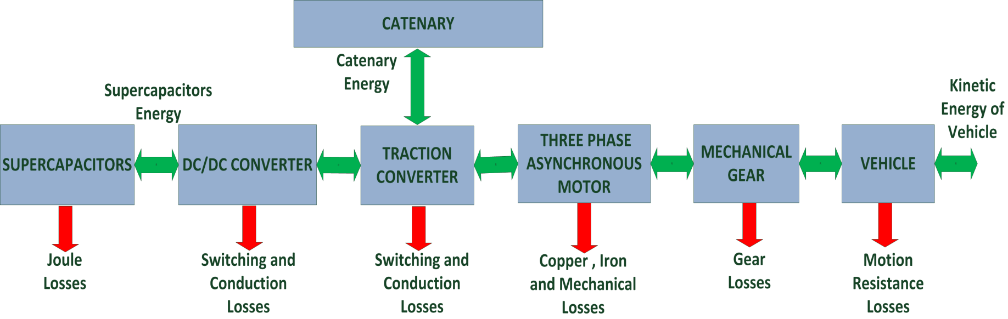
OPTIMAL SIZING OF SUPERCAPACITORS ENERGY STORAGE SYSTEM
EXPERIMENTAL TESTS
ENERGETIC MODEL OF VEHICLE
6

Slide 7
FIRST YEAR CREDITS
 | Credits year 1
 |  | 1 | 2 | 3 | 4 | 5 | 6
 | Estimated | bimonth | bimonth | bimonth | bimonth | bimonth | bimonth | Summary
Modules | 21 | 0 | 3 | 9 | 6 | 6 | 0 | 21
Seminars | 5 | 0 | 0 | 0 | 0 | 0 | 0,4 | 0,4
Research | 34 | 10 | 7 | 1 | 4 | 4 | 9,6 | 39
 | 60 | 10 | 10 | 10 | 10 | 10 | 10 | 60
Year | Lecture/Activity | Type | Credits | Certification
1 | Europrogettazione | Ad hoc module | 3 | x
1 | Misure per l'Ingegneria dei Materiali | MS Module | 9 | x
1 | Elettronica Industriale di Potenza | MS Module | 6 | x
1 | 15th Edition of European PhD School | External Course | 3ECTS | x
1 | State of the art in Power Converters for High Voltage DC Transmission Systems | Seminar | 0,4 | x
7

Slide 8
EXPECTED CREDITS
Year | Courses/Seminars/Research | Credits
2 | Non Linear Dinamic | 6
2 | Functional Analysis | 9
2 | Seminars | 5
2 | Research | 40
8

Slide 9
THANKS FOR YOUR
ATTENTION
9

