Slide 1


Pasquale Franzese
Tutor: Diego Iannuzzi
XXXIV Cycle
I year-end presentation
ULTRA FAST or
WIRELESS POWER TRANSFER
ELECTRIC CHARGING

Slide 2


Pasquale Franzese (mat. DR993624)
Master Science title: Master’s degree in Automation Engineering (cum laude) on 29/10/2018, Università di Napoli Federico II
Master Thesis title: Experimental validation of wireless power transfer for E- bike charging station
Doctoral Cycle: XXXIV ITEE PhD
Tutor: Prof. Diego Ianuzzi
Fellowship type: financed by CRIAT (Centro di Ricerca Interuniversitario su Azionamenti per Trazione Aerea, Terrestre e Marittima) of Università di Napoli Federico II
My fellowship is associated with a project “ELECTRIC ULTRA FAST CHARGING STATION (E-UFCS)” presented for “POR FESR CAMPANIA 2014/2020- O.S. 1.1” that is a collaboration between CRIAT and Samso s.p.a

Slide 3



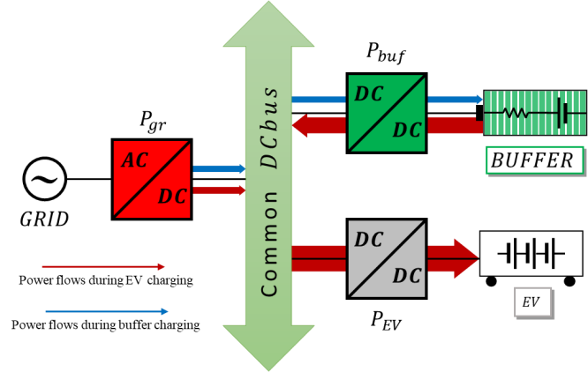
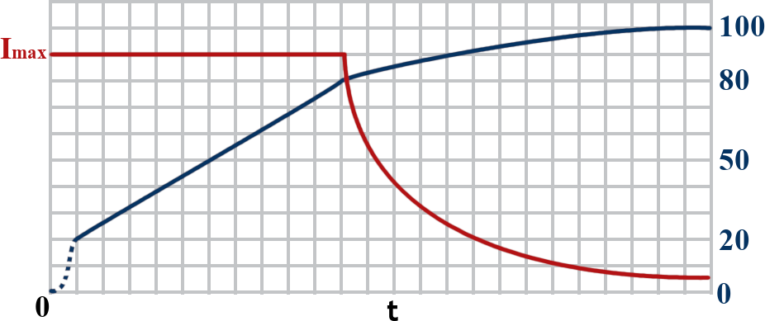
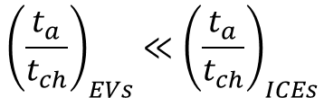



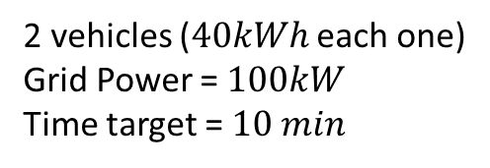
ULTRA FAST CHARGING
$$t_{a}=time of autonomy$$
$$t_{ch}=charge time$$
$${\left(\frac{t_{a}}{t_{ch}}\right)}_{EVs}≪{\left(\frac{t_{a}}{t_{ch}}\right)}_{ICEs}$$
Grid Power
+
BESS
2 vehicles ($40kWh$ each one)
Grid Power = $100kW$
Time target = $10 min$
Grid
Installed
Power
Demanded Power
$$SoC$$

Slide 4






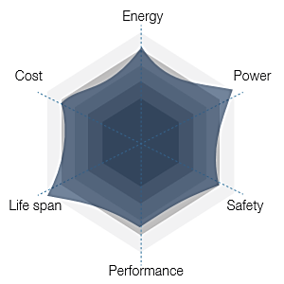

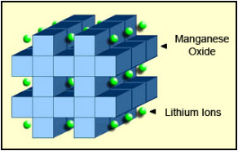
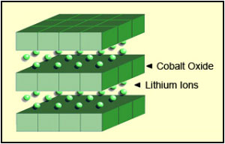







ULTRA FAST CHARGING
3~
Lead–acid
NiCd
Nickel–metal hydride
Lithium-ion
Li-ion polymer
Zinc–air
Molten-salt
$$Wh/kg$$
$Capacity$ $(Ah)$
Ultra High Power NMC $\left(LiNiMnCoO_{2}\right)$
$$Wh/{cm}^{3}$$
$$Charge/Discharge$$
$$C−rate$$
$$Life cycle$$
$$Low Internal Resistance (higher efficiency)$$
*Sized with a power balancing
(Load Levelling)

Slide 5
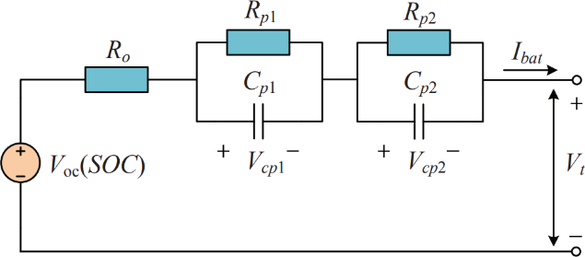
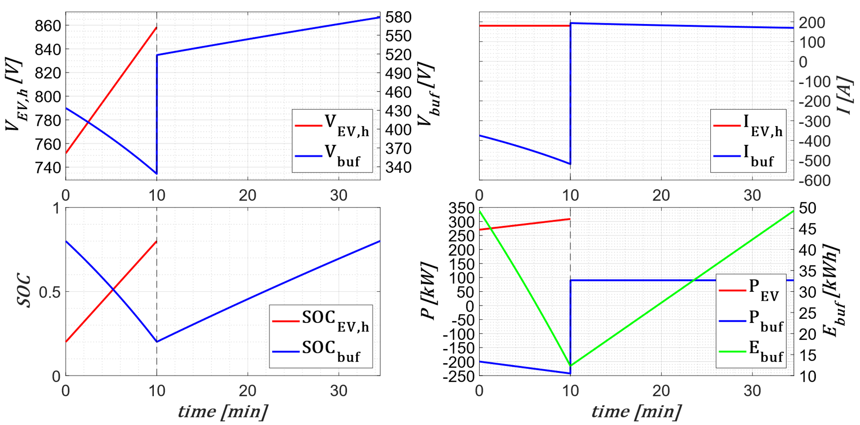


ULTRA FAST CHARGING
Diego Iannuzzi, Pasquale Franzese. “Preliminary Design of Ultrafast Charging Station for Electrical Vehicles” in ELECTRIMACS2019 Salerno, IMASC-IEEE
Diego Iannuzzi, Pasquale Franzese. “Ultrafast Charging Station for Electrical Vehicles: Dynamic Modelling, Design and Control Strategy”, Mathematics and Computers in Simulation 2020

Slide 6
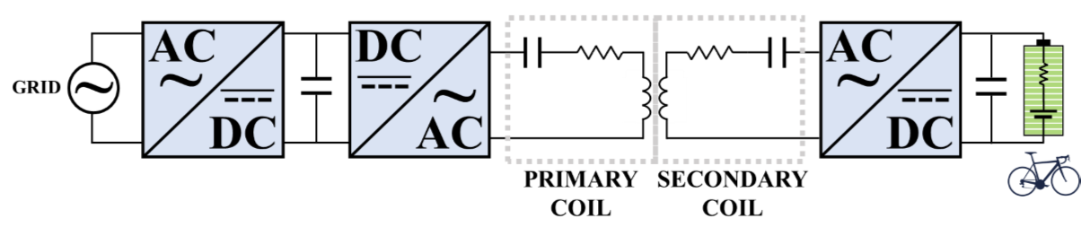
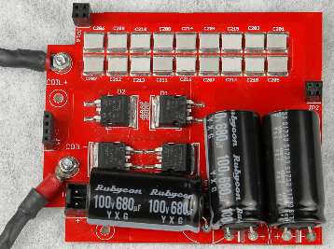
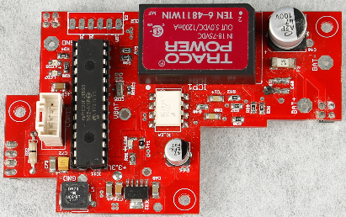


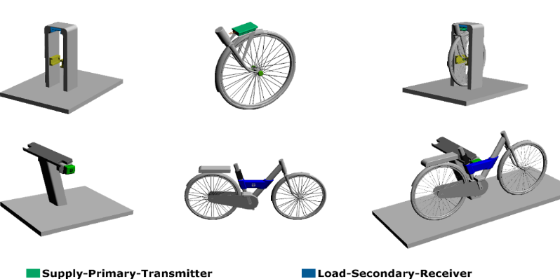





WIRELESS POWER TRANSFER CHARGING
GAIN SCHEDULING
HARMONIC
DECOMPOSITION
SENSORLESS CONTROL
$$i_{p}\left(t_{k}\right)$$
-1
F
ALGEBRAIC
RESOLUTION
F
$$i_{s}\left(t_{k}\right)$$
$$v_{p}\left(t_{k}\right)$$
$$v_{s}\left(t_{k}\right)$$
Pasquale Franzese, Diego Iannuzzi. “Wireless Battery Charger based on Sensorless Control for E-bike Station” in EPE'19 ECCE Europe, IEEE

Slide 7





PROPOSAL FOR THE NEXT YEAR
ULTRA FAST CHARGING
Estimation in case of use and develope strategies to increase the life cycle
Design a Battery Management System with a electro-thermic mathematical model
Implement control of converters on a physical control box and than on a control board
Build a demonstrator of ultrafast charging station
WIRELESS POWER TRANSFER CHARGING
Implement control of converters on the control board
Put into operation the wireless charging station and test control algorithms

Slide 8
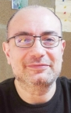
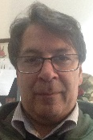
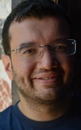
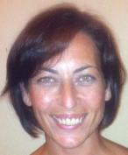
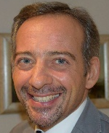
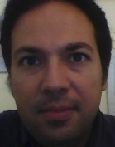
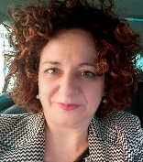
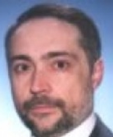
I YEAR CREDITS
Elettromagnetismo e Relatività
Prof. Amedeo Capozzoli
(amedeo.capozzoli@unina.it)
Big Data
Prof. Antonio Picariello, ing. Giancarlo Sperlì
(antonio.picariello@unina.it, giancarlo.speri@unina.it)
Misure e collaudo su
machine ed impianti elettrici
Prof. Annalisa Liccardo
(annalisa.liccardo@unina.it)
Misure per la compatibilità elettromagnetica
Prof. Nicola Pasquino
(nicola.pasquino@unina.it)
Sensori e trasduttori di misura
Prof. Rosario Schiano Lo Moriello
(rosario.schianolomoriello@unina.it)
Ingegneria del software
Prof. Anna Rita Fasolino
(annarita.fasolino@unina.it)
Economia ed organizzazione aziendale
Prof. Corrado Lo Storto
(corrado.lostorto@unina.it)

Slide 9
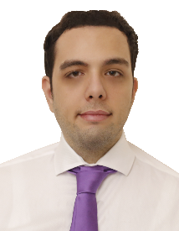
Thank you for your attention!
Contact:
pasquale.franzese@unina.it
room T.07 – building 3/a – Via Claudio, 21

