Slide 1
Nicola Moccaldi Tutor: Pasquale Arpaia XXXIV Cycle - I year presentation
Cyberphysics and Mixed Reality for Health Telemonitoring in the Industry 4.0 Perspective

Slide 2
Content
My background
Problem
Research activity
Products
Next years

Slide 3
Background
Graduation and porfessional activities:
M.S. degree (cum laude) in communication science from the Faculty of Arts and Philosophy, University of Salerno, Fisciano, Italy, in 1999.
M.Sc. degree in electronic engineering from the University of Naples Federico II, Naples, Italy, in 2018.
Since 1999, numerous professional assignments in the social and health sector policies including planning and implementation of corporate communication, coordination of complex services, design, and the evaluation of services, on behalf of several nonprofit organizations and government agencies.
Since 2015, Researcher in electronic engineering applied to biomedical field with Innovum S.R.L., Naples
Fellowship:
PhD Student of XXXIV cycle in Information Technology and Electrical Engineering (ITEE). Theme: “Cyberphysics and Mixed Reality for Health Telemonitoring in the Industry 4.0 Perspective”
My fellowship is financed by Centro di Servizi Metrologici Avanzati (CeSMA) .

Slide 4
Cooperation
Research Group: Prof. Pasquale Arpaia (tutor), Cooperation: ARHemLab, CeSMA

Slide 5
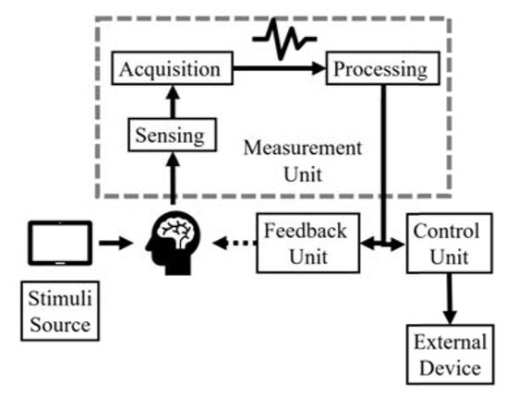
Problem 1: BCI-AR
In Industry 4.0, humans are becoming a composite factor in a highly automated system
To improve the collaboration between men and robots, there is the need of enhancing the human-machine interaction
An alternative communication channel, is offered by the combination of BCI and AR:

Slide 6
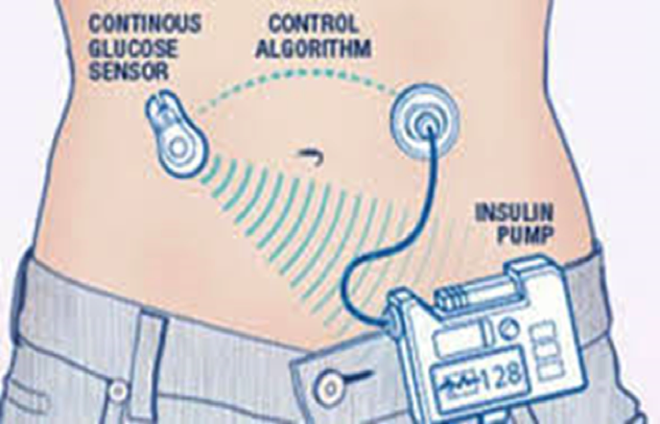
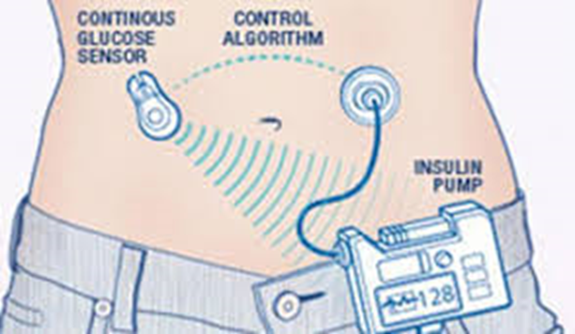
Problem 2: Insulinmeter
For diabetic patients, a full control of the blood glucose level is a problem of strong clinical, social, and economic importance.
in case of bolus administration, even the most recent automated systems cannot react to the quick variations of glucose due to food ingestion, moreover the presence of lipo-hypertrophic skin alterations is associated with poor metabolic control and considerable intra-individual glycemic instability.

Slide 7
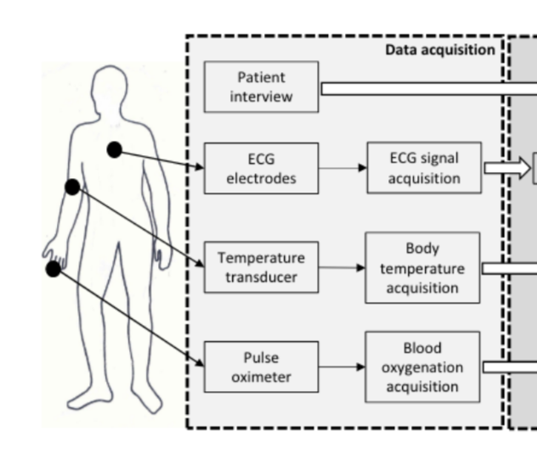
Problem 3: Cardiovascular risk Assessment
Worldwide, the number of elderly people is increasing. According to the World Health Organization, the population expecting to live into their sixties and beyond will nearly double between 2015 and 2050.
With the aim of contributing to a healthy ageing of population, heart health is a major issue. Current clinical practice indicates risk calculators as the key tools for cardiovascular risk assessment.
A recent trend in cardiovascular risk assessment foresees the employment of further parameters to enhance the resolution. A wearable system helps in recording secondary risk markers, non-detectable in the current clinical practice.

Slide 8
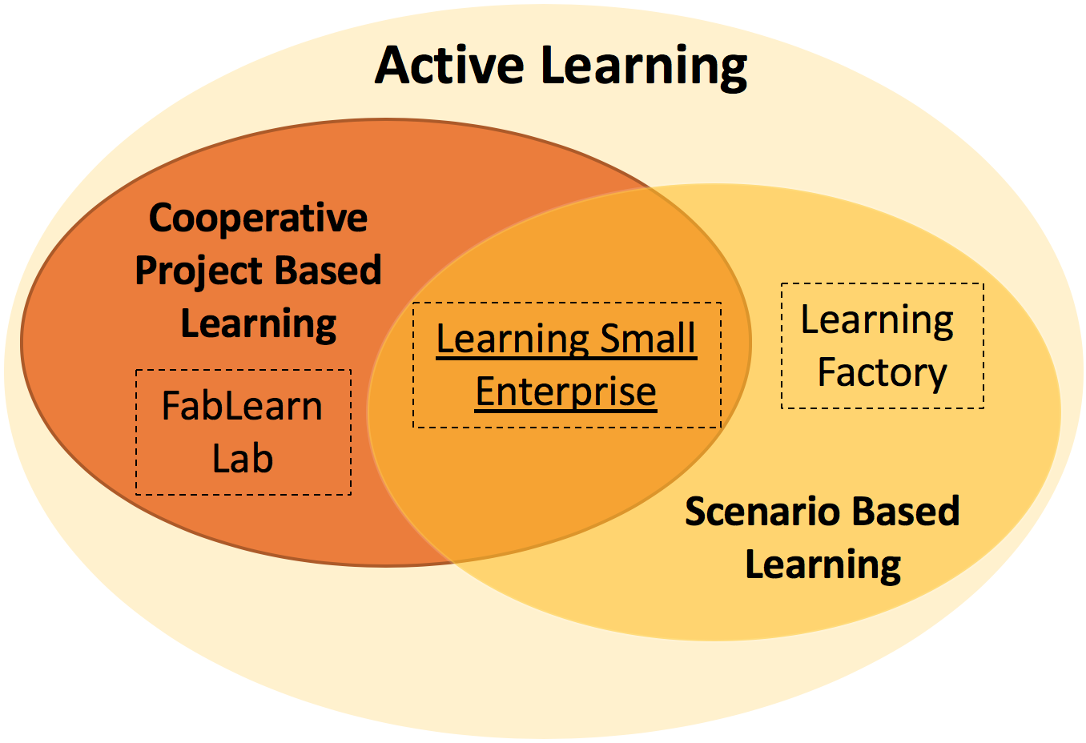
Problem 4: Innovative teaching strategies
With the advent of I4.0 companies expect their employees not only to utilize deep knowledge, but also to operationalize this knowledge in unimaginable situations.
An innovative educational space is the Academic Fablab: peers maybe even more knowledge-able than stewards or teachers, and the line between them is blurred as they learn alongside.
This requires new attitudes and competences
to teachers.

Slide 9
Research activity
The combination of AR with a Brain-Computer Interface (BCI) can provide the solution to a hands-free user input, thus providing a novel way of gathering information from the surrounding environment. The research proposes wearable monitoring systems for inspection in the framework of Industry 4.0
The research explores the feasibility of insulin absorption assessment based on impedance spectroscopy.
The goal of reaserch is developing a machine-learning algorithm for cardiovascular risk assessment based on biosignals non-invasively acquired.
The Research focalizes innovative didactic strategies as Cooperative Project-Based and Scenario-Based learning approaches adequate to meet the new training needs of the i4.0 context.

Slide 10
1st year production
Published (‘*’ = journal papers. Others = proceeding papers )
*Angrisani, Leopoldo, et al. "Single-Channel, Steady State Visually Evoked Potential-based Brain Computer Interface: a Proof of Principle for Biomedical Daily Use." Journal of Physics: Conference Series. Vol. 1065. No. 13. IOP Publishing, 2018. Published online: 13 November 2018
*Angrisani, L., Arpaia, P., Capaldo, G., Moccaldi, N., Salatino, P., & Ventre, G. (2018, August). Evolution of the academic FabLab at University of Naples Federico II. In Journal of Physics: Conference Series (Vol. 1065, No. 2, p. 022013). IOP Publishing. Published online: 13 November 2018
Angrisani, L., Arpaia, P., Moccaldi, N., & Esposito, A. (2018, September). Wearable Augmented Reality and Brain Computer Interface to Improve Human-Robot Interactions in Smart Industry: A Feasibility Study for SSVEP Signals. In 2018 IEEE 4th International Forum on Research and Technology for Society and Industry (RTSI) (pp. 1-5). IEEE. Date Added to IEEE Xplore: 29 November 2018
*Arpaia, P., Cuomo, O., Moccaldi, N., Smarra, A., & Taglialatela, M. (2018, August). Non-invasive real-time in-vivo monitoring of insulin absorption from subcutaneous tissues. In Journal of Physics: Conference Series (Vol. 1065, No. 13, p. 132008). IOP Publishing. Published online: 13 November 2018

Slide 11
1st year production
*Angrisani, Leopoldo, et al. "A Single-Channel SSVEP-Based Instrument With Off-the-Shelf Components for Trainingless Brain-Computer Interfaces." IEEE Transactions on Instrumentation and Measurement (2018). Date of Publication: 11 December 2018
*Angrisani, Leopoldo, et al. "A Wearable Brain-Computer Interface Instrument for Augmented Reality-based Inspection in Industry 4.0." IEEE Transactions on Instrumentation and Measurement (2019). Date of Publication: 03 May 2019
Arpaia, P., Cuocolo, R., Donnarumma, F., D’Andrea, D., Esposito, A., Moccaldi, N., ... & Prevete, R. (2019, June). Feasibility of cardiovascular risk assessment through non-invasive measurements. In 2019 II Workshop on Metrology for Industry 4.0 and IoT (MetroInd4. 0&IoT) (pp. 263-267). IEEE. Date Added to IEEE Xplore: 12 August 2019
Angrisani, Leopoldo, et al. "Metrological performance of a single-channel Brain-Computer Interface based on Motor Imagery." 2019 IEEE International Instrumentation and Measurement Technology Conference (I2MTC). IEEE, 2019. Date Added to IEEE Xplore: 09 September 2019
*Angrisani, Leopoldo, et al. "A “learning small enterprise” networked with a FabLab: An academic course 4.0 in instrumentation and measurement." Measurement 150 (2020): 107063. Available online 23 September 2019

Slide 12
1st year production
To be submitted
P. Arpaia, R. Cuocolo, F. Donnarumma, A. Esposito, N. Moccaldi, A. Natalizio, R. Prevete “A machine learning-based soft transducer for real-time noninvasive cardiovascular risk measurement”, to be submitted to Measurement.
Submitted
P. Arpaia, N. Moccaldi, R. Prevete, I. Sannino, A. Tedesco, “A wearable EEG instrument for real-time frontal asymmetry monitoring in worker stress analysis”, submitted to IEEE Transactions on Instrumentation and Measurement.
P. Arpaia, U. Cesaro, M. Frosolone, N. Moccaldi, M. Taglialatela, “A micro-bioimpedance meter for monitoring insulin bioavailability in personalized diabetes therapy”, submitted to Nature Scientific Report.
Under revision
P. Arpaia, L. Duraccio, N. Moccaldi, S. Rossi, “Wearable Brain-Computer Interface instrumentation for Augmented Reality telemonitoring of robot-based rehabilitation”, under revision by IEEE Transactions on Instrumentation and Measurement.

Slide 13
Next year
Research activity:
Clinical experiments for validation of prototypes.
Conferences and PhD Schools:
2020 IEEE International Symposium on Medical Measurements & Applications (MeMeA) june 2020
Italo Gorini PhD School, Reggia Calabria, Italy, September 2020
Credit Summury:

Slide 14
Thank you for your kind attention

