Slide 1

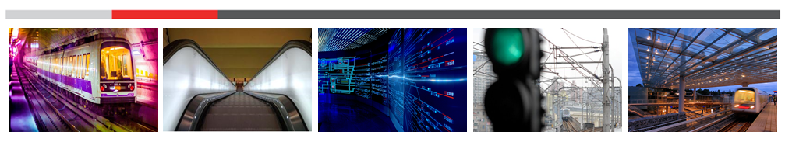

Pasquale Natale
Tutor: Diego Iannuzzi
XXX Cycle - III year presentation
Energy Management Strategies of Wayside Supercapacitor-based Storage Systems for DC Urban Railway Networks

Slide 2

My background
  Graduated cum laude in Electrical Engineering at University of Naples “Federico II” with a thesis on “optimal sizing and control of supercapacitors storage systems for tramway network”
  Research group: Power converters, electrical machines and drives (DIETI – UNINA)
  Fellowship supported by Ansaldo STS S.p.A.

Slide 3
Credits summary
    III year credits
 |  | Credits year 3
 |  |  | 1 | 2 | 3 | 4 | 5 | 6
 |  | Estimated | Bimonth | bimonth | bimonth | bimonth | bimonth | bimonth | Summary
Modules |  | 0 | 0 | 0 | 0 | 0 | 0 | 0 | 0
Seminars |  | 1,1 | 1,2 | 0 | 0 | 0,3 | 0 | 0 | 1,5
Research |  | 58,9 | 15 | 3,5 | 5 | 15 | 10 | 10 | 58,5
 |  | 60 | 16,2 | 3,5 | 5 | 15,3 | 10 | 10 | 60
Year | Lecture/Activity | Type | Credits | Certification | Notes
3 | FCE preparation course | External course | 0 | x | I got the certification
3 | Software design diversity from conceptual models to practical implementations | Seminar | 0,4 | x
3 | L’innovazione nel mercato IT | Seminar | 0,8 | x
3 | Power system stability and syncronization: application to the lost power grid system | Seminar | 0,3 | x

Slide 4
Credits summary

Slide 5
Contents
Introduction
Energy efficiency measures in rail systems
ESSs in urban rail networks
ESS control strategies
Numerical applications and experimental results
Conclusions and possible improvements

Slide 6

Introduction

Slide 7
My problem
  Control of “wayside” energy storage systems (WESS) for an improved energy management in urban DC electrified rail networks.
  Evaluation of energy performances

Slide 8
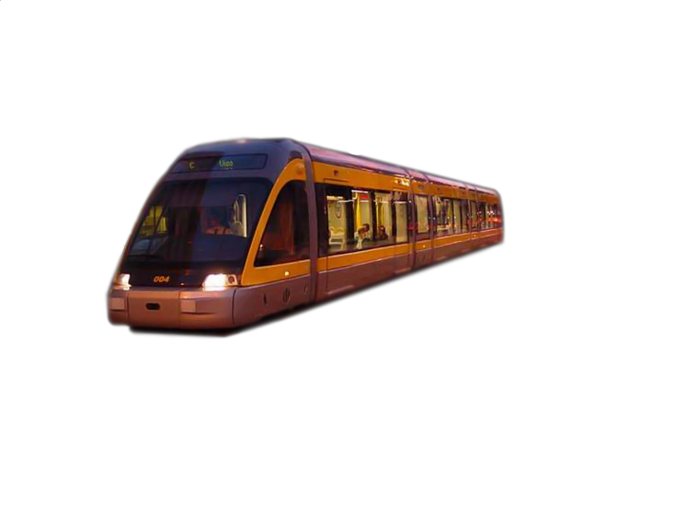
Wayside ESS
Final Goal
Energy flows management
Wayside ESS

Slide 9
Eu policies for CO₂ reduction
GLOBAL WARMING
Policies for a soustainable growth: Europe 2020
60% reduction of GHG emissions by 2050 in transport
2011 Transport White Paper
(EU commision)
CO2 emissions reduction in railway sector: 30% over 1990-2020 and 50% by 2030
“Moving towards sustainable mobility” (UIC, CER)

Slide 10
Energy saving requirements in urban railway systems
CO₂ reduction policies
Energy system analysis during the whole lifecycle
New requirements in tenders in which rail companies are involved and an increasingly receptive market for solutions related to energy saving
Research and Development activities on energy saving measures (Horizon 2020)

Slide 11
Urban railway systems (UNI-8379)
Regular Rapid Transit or Metro-Railway (RRT): mass passenger rapid transport system, with high capacity and frequency in urban areas, consisting of vehicles propelled or driven by power cars, with guided way, circulation regulated by signals and completely independent by other traffic.
Light Rail Transit (LRT): mass passenger rapid transport system that, while maintaining the same features of a RRT, has a reduced hourly capacity, due to reduced seat capacity of trains, both for dimension of the single car and for the train composition. It utilizes less massive (“light”) equipment and infrastructure with to respect those used for metro systems and is classified as semi-segregated systems.
Tramway: passenger transport system in urban areas and/or metropolitan areas, consisting of vehicles propelled or driven by power cars, with guided way, generally on public roads and then subjected to the Road Code and therefore with driving by sight

Slide 12
Energy efficiency measures

Slide 13
System energy flows analysis
Energy consumption in urban rail systems
Traction: energy required to operate the rolling stock (propulsion and auxiliaries)
Non –traction: depots, stations, etc

Slide 14
Traction Energy flows

Slide 15
Energy-efficiency strategies

Slide 16
Energy-efficiency strategies/2

Slide 17
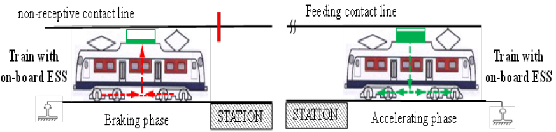
Braking energy recovery: on-board ESS
Drawbacks
Space restrictions
Weigth restrictions
Critical sizing
Advantages
Catenary free operation
No line transmission losses
Simple control implementation

Slide 18
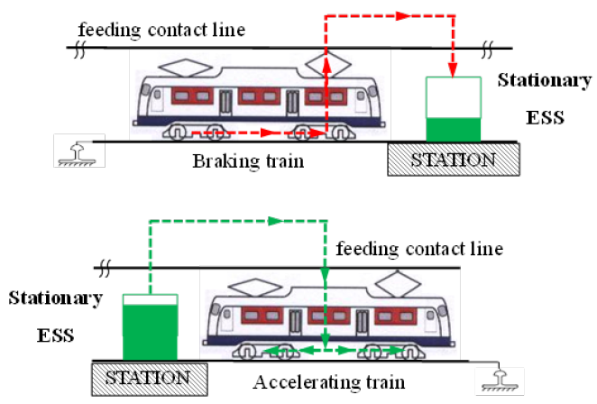
Braking energy recovery: wayside ESS
Advantages
The energy can be exchanged by all the vehicles in operation on the track (energy flows optimization);
Few weight and space restrictions
Operations no affected by installation and maintenance
Increase of TPS distance and/or service frequency
Drawbacks
Fine-tuned analysis for optimal sizing and allocation

Slide 19
ESSs in urban railway systems

Slide 20
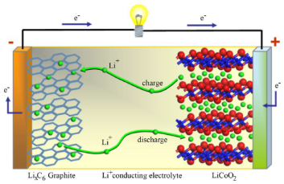

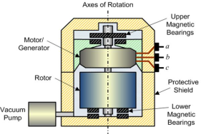
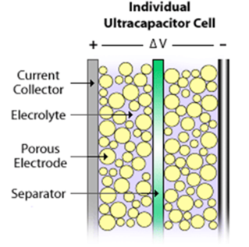
Available technological solutions
Batteries
High energy density
Low power density
Flywheels
High energy and power densities
Low safety and efficiency
Super Capacitors
High power density
Low energy density

Slide 21
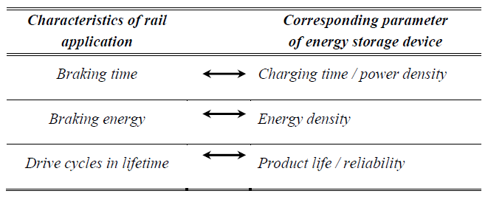
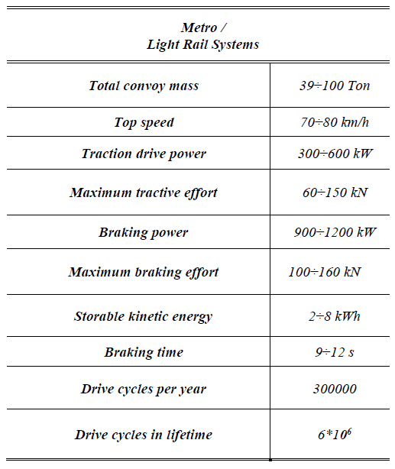
Load characteristics and ESS requirements
ESS requirements
Short time rates (1÷60 s)
High power rates (0,1÷1 MW)
High lifecycle (100000÷300000 per year)
Reduced weight and volume
Intermediate energy rates

Slide 22
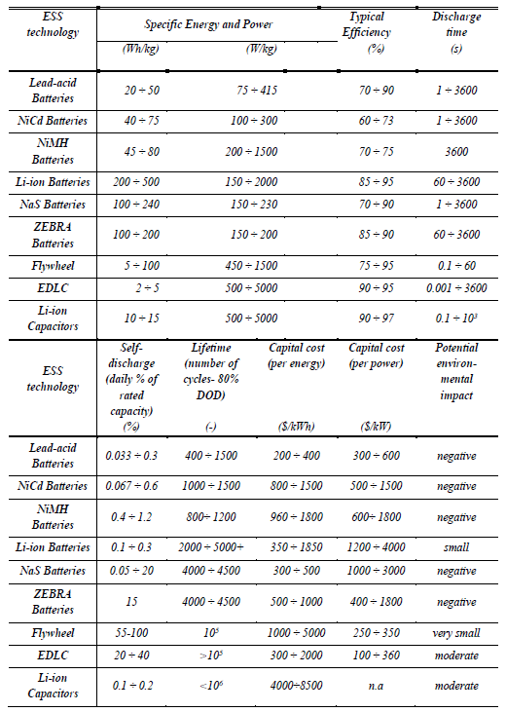
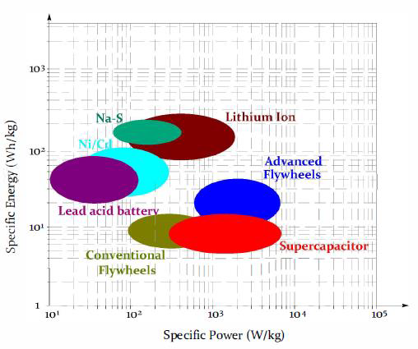

Comparison of available solutions
Ragone plot

Slide 23
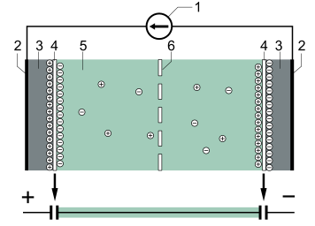
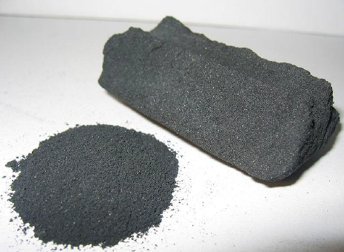
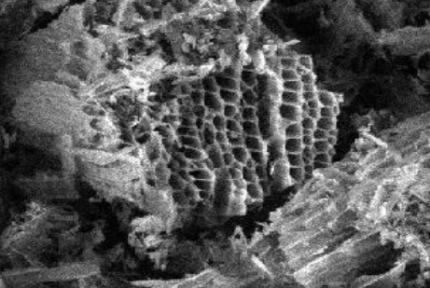
The Super Capacitor
SC elementary cell
Electrodes (activated carbon)
Legend
Charger
Current collectors
Polarized electrodes
Electric double layer
Electrolyte
Separator
Charging/discharging process

Slide 24
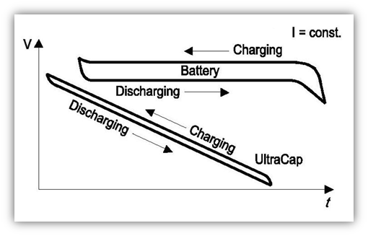
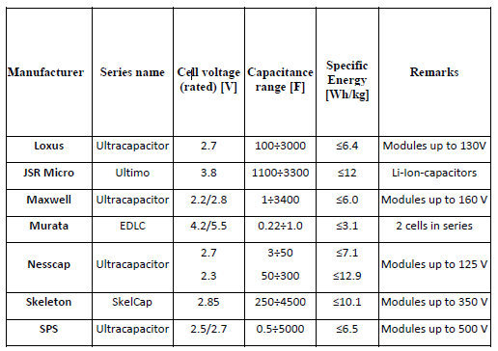



The Super Capacitor/2
Voltage evolution
Commercial solutions
Simplified equivalent circuit and mathematical model

Slide 25

The Super Capacitor/3
Useful features for urban rail applications
Sufficient energy density
High power density (useful for urban railway transportation)
High lifecycle
Fast charge and discharge dynamics
High reliability

Slide 26
ESS control strategies

Slide 27
Proposed control strategies
Approaches
Heuristic method
Analitycal method
Multi-threshold line voltage control
Optimal line voltage reference

Slide 28
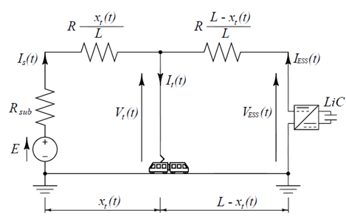

First case study: single track section
Equivalent circuit
Mathematical model

Slide 29
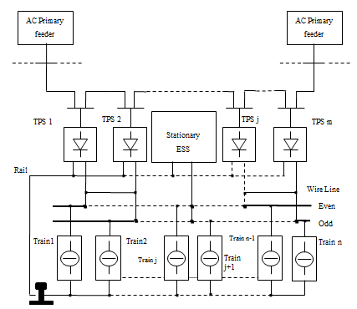



Second case study: complex metro rail network
Schematic view
Mathematical model
with:

Slide 30
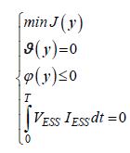



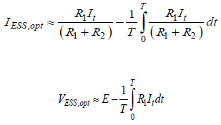

Optimal control strategy :first case study
Optimization problem: minimization of line losses
Objective function: line losses
Calculated analytical solution
Simplified analytical solution

Slide 31
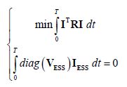

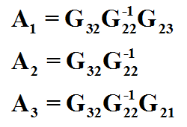
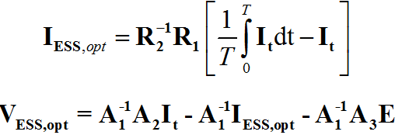
Optimal control strategy :second case study
Optimization problem: minimization of line losses
Objective function: line losses
Analytical solution

Slide 32
Optimal control strategy :control algorithm

Slide 33
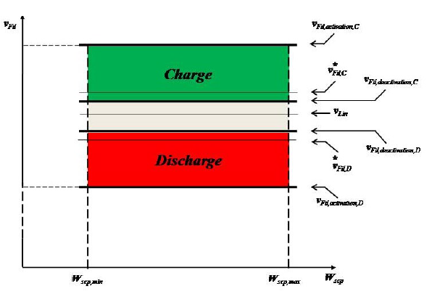
Heuristic control strategy
Legend
Actual supply line voltage at the installation point of the ESS, VFil
Charging mode activation threshold VFil,activation;C;
Charging mode deactivation threshold VFil,deactivation;C;
Charging mode reference value V*Fil,C;
Discharging mode activation threshold VFil,activation;D;
Discharging mode deactivation threshold VFil,deactivation;D;
Discharging mode reference value V*Fil,D.

Slide 34
Optimal control strategy :control algorithm

Slide 35
Numerical applications and experimental results

Slide 36
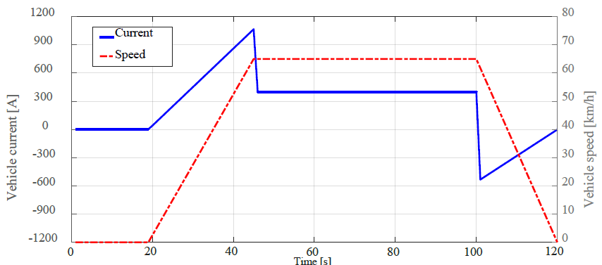
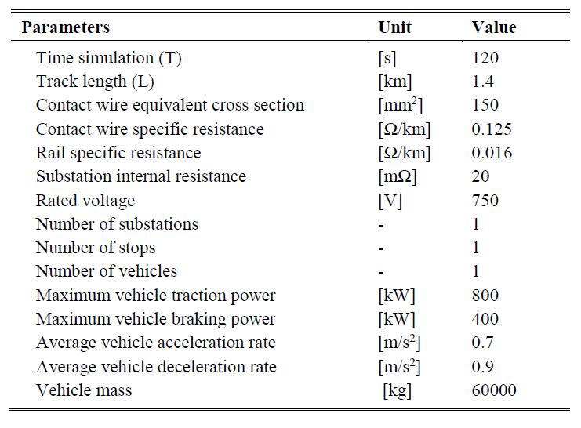
Optimal control strategy :first case study-numerical application
Simulated traction cycle and line voltage references

Slide 37
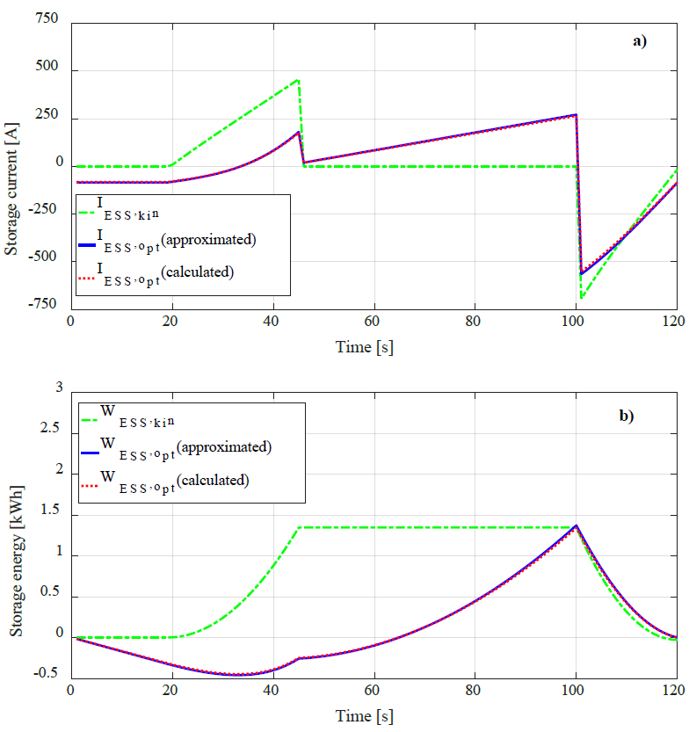
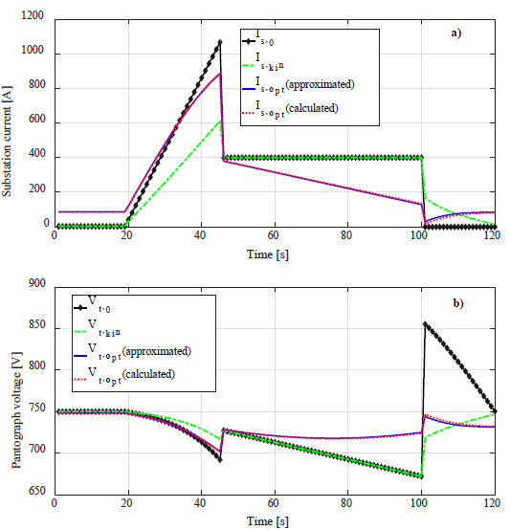
Optimal control strategy :first case study-numerical application
ESS current and energy profiles
TPS and vehicle profiles

Slide 38
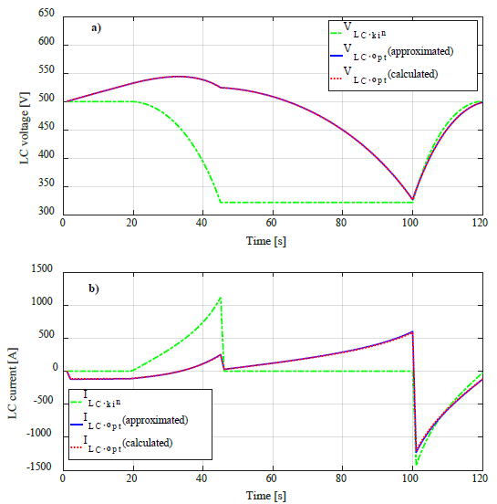
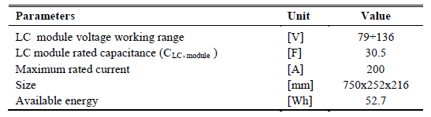
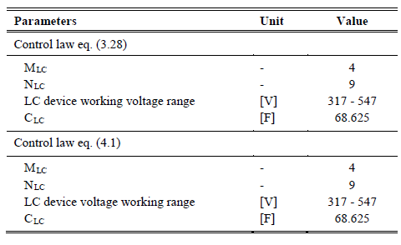
Optimal control strategy :first case study-numerical application
LC device profiles
LC device sizing

Slide 39
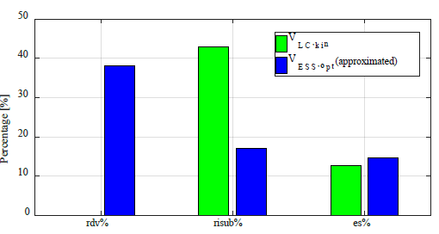



Optimal control strategy :first case study-numerical application
Performances comparison
Legend

Slide 40
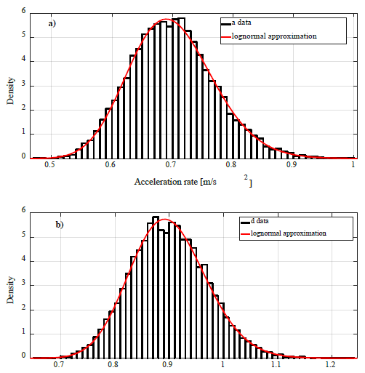
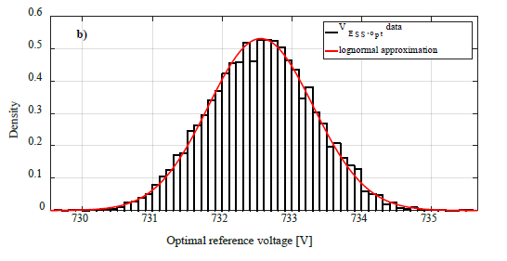
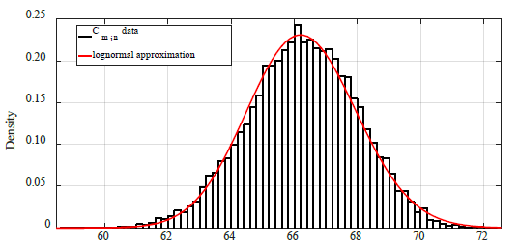
Optimal control strategy :first case study-robustness analysis
Perturbations
Results

Slide 41
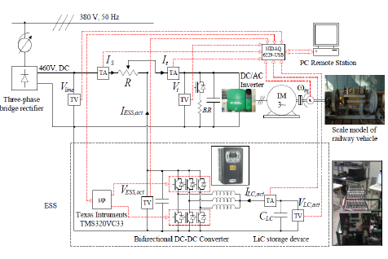
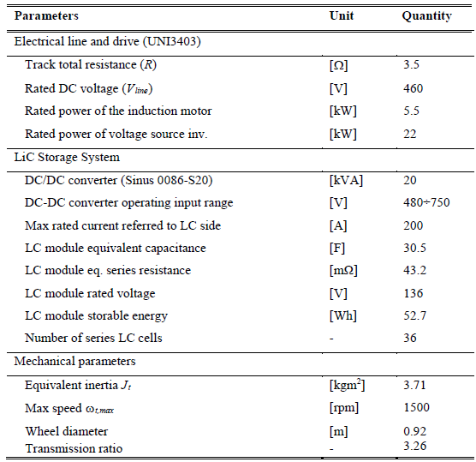
Optimal control strategy :first case study-experimental results
Downscaled simulator

Slide 42
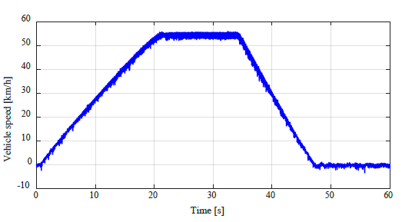
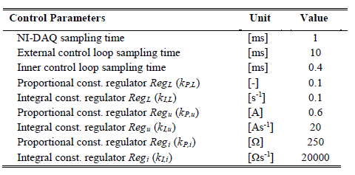
Optimal control strategy :first case study-experimental results
Simulation inputs

Slide 43
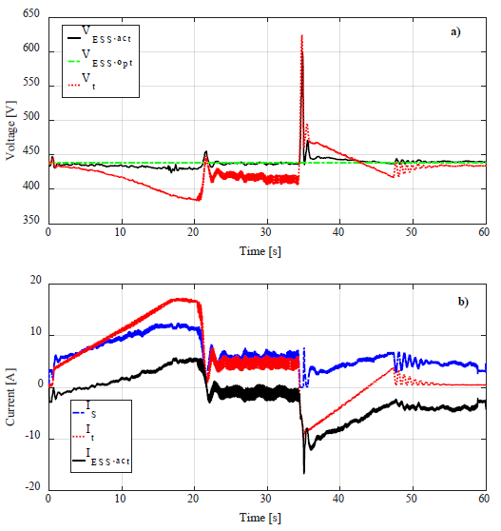
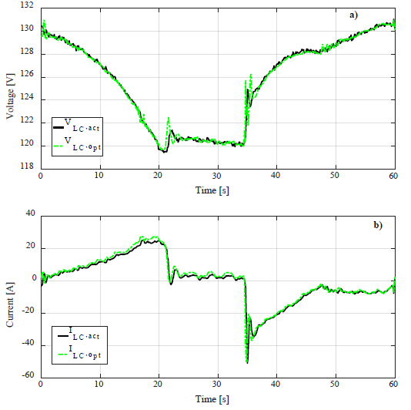
Optimal control strategy :first case study-experimental results
Line side
LC side

Slide 44
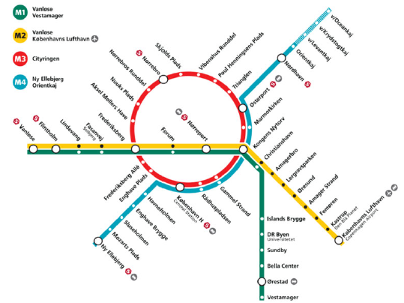
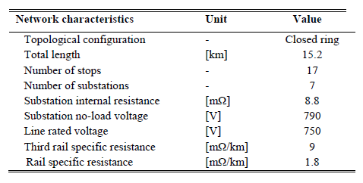
Optimal control strategy :second case study-numerical application
Metro line

Slide 45
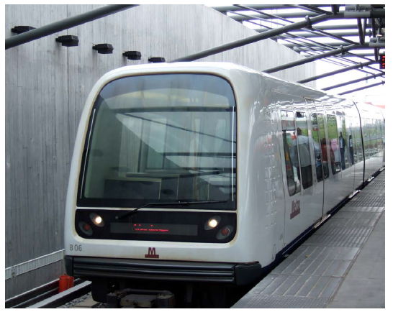
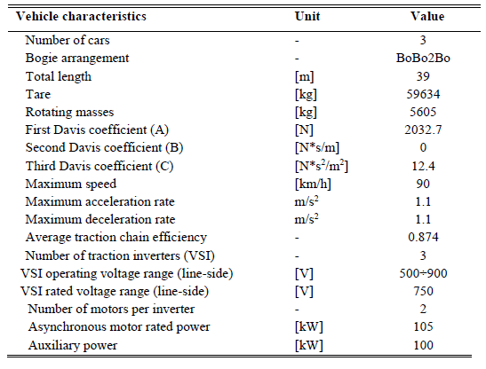
Optimal control strategy :second case study-numerical application
Metro rail vehicle

Slide 46
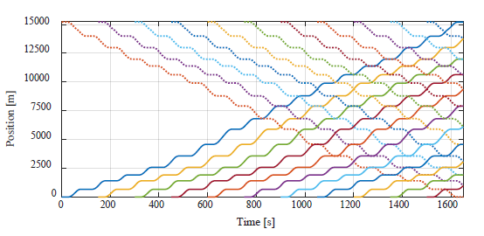
Optimal control strategy :second case study-numerical application
Simulated timetable

Slide 47
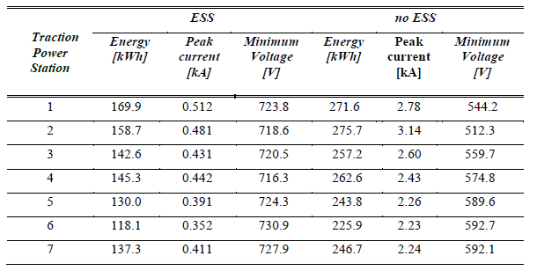
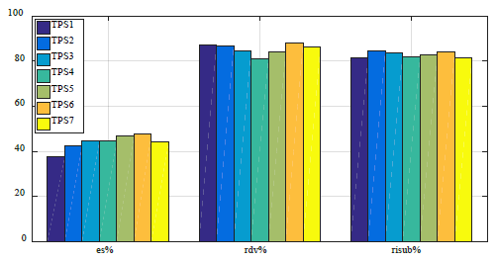
Optimal control strategy :second case study-numerical application
Simulated timetable

Slide 48
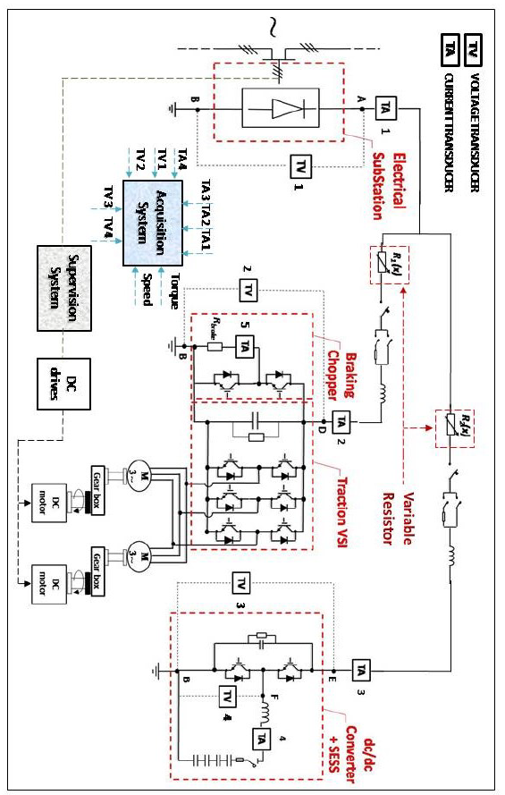
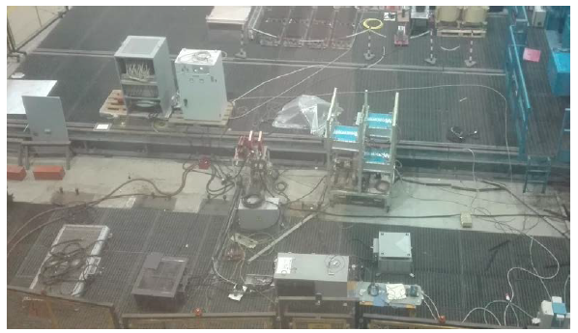

Heuristic control strategy :first case study-experimental results
Test bench overview

Slide 49


Heuristic control strategy :first case study-experimental results
Test bench main features simulated traction cycle and control parameters

Slide 50




Heuristic control strategy :first case study-experimental results
Without ESS
With ESS

Slide 51
Heuristic control strategy :first case study-experimental results
Results summary
Reduction of the maximum voltage drop affecting vLoad of about 50%;
Reduction of the energy delivered by the substation of about 35% (1230.5 Wh vs. 793.2 Wh)
Reduction of the energy burned on the braking chopper of about 98% (216.4 Wh vs. 4.9 Wh); the braking rheostat only acts as a “spillway”.

Slide 52
Conclusions and possible improvements

Slide 53
Conclusions
Possible improvements
The first control strategy proposed, along with a particular modelling approach (leading to represent the rail network like a distribution network with fixed load busses), allows to obtain an analytical form for the offline evaluation of the control law of the WESS. This simple and robust formulation is particularly useful for sensitivity analyses and probabilistic investigations to support the planning of the system as a whole (e.g. identify the most convenient positions to install the ESSs, also in function of economic reasons).
The second control strategy presented does not allow neither a system analysis nor an optimal solution to the ESS management and sizing problem; conversely, it is very simple to implement, flexible and, currently, it represents an example the most used approach adopted by lots of manufacturers.
Concerning the first control strategy: inclusion within the objective function of the ESS investment cost in function of the used technological solution.
Concerning the second control strategy: reduction of the external parameters set to simplify the control algorithm implementation.

Slide 54
Products
Conference papers
Iannuzzi D., Natale P., Nizza A., Pagano M., “An ‘on scale’ simulator for urban DC railway traction application”, AEIT International Annual Conference, Naples , October 14-16, 2015
Caramia P., Mottola F., Natale P., Pagano M., “Energy Saving Approach for Optimizing Speed Profiles in Metro Application”, International Conference on Electrical Systems for Aircraft, Railway and Ship Propulsion (ESARS)”, Toulouse (France) 02-04 November 2016
P. Caramia, G. Lauro, P. Natale, M. Pagano, “Automatic train operation systems: a survey on algorithms and performance index” AEIT International Annual Conference, Cagliari 20-22 September 2017
Journal Paper
F. Ciccarelli, D. Iannuzzi, D. Lauria and P. Natale, “Optimal Control of Stationary Lithium-Ion Capacitor-Based Storage Device for Light Electrical Transportation Network," in IEEE Transactions on Transportation Electrification, vol. 3, no. 3, pp. 618-631, Sept. 2017
Papers in preparation
F. Ciccarelli, D. Iannuzzi, P. Natale, “Comparison of wayside ESS control strategies for urban rail application”.

Slide 55
Thank you for your attention
Energy Management Strategies of Wayside Supercapacitor-based Storage Systems for DC Urban Railway Networks

Slide 56
Products
Conference papers
P. Caramia, G. Lauro, P. Natale, M. Pagano, “Automatic train operation systems: a survey on algorithms and performance index” AEIT International Annual Conference, Cagliari 20-22 September 2017
Journal Paper
F. Ciccarelli, D. Iannuzzi, D. Lauria and P. Natale, “Optimal Control of Stationary Lithium-Ion Capacitor-Based Storage Device for Light Electrical Transportation Network," in IEEE Transactions on Transportation Electrification, vol. 3, no. 3, pp. 618-631, Sept. 2017
Papers in preparation
F. Ciccarelli, D. Iannuzzi, P. Natale, “Comparison of wayside ESS control strategies for urban rail application”.

Slide 57


Optimal control strategy :second case study-numerical application
TPS voltage profiles

Slide 58


Optimal control strategy :second case study-numerical application
TPS current profiles

Slide 59


Optimal control strategy :second case study-numerical application
ESSs current profiles

Slide 60


Optimal control strategy :second case study-numerical application
ESSs energy profiles

