Slide 1


Pasquale Natale
Tutor: Diego Iannuzzi
XXX Cycle - I year presentation
Supercap-based Energy Storage Systems for improving energy performances in light railway systems

Slide 2

My background
  Graduated cum laude in Electrical Engineering at University of Naples “Federico II” with thesis on “optimal sizing and control of supercapacitors storage systems for tramway network”
  Research group: Power converters, electrical machines and drives (DIETI – UNINA)
  Fellowship supported by Ansaldo STS S.p.A.

Slide 3
The problem
  Optimal sizing and allocation of “wayside” energy storage systems for the improvement of energy performances in urban DC electrified transit networks.
  Evaluation of energy performances in complex urban railway networks integrated with wayside energy storage systems

Slide 4
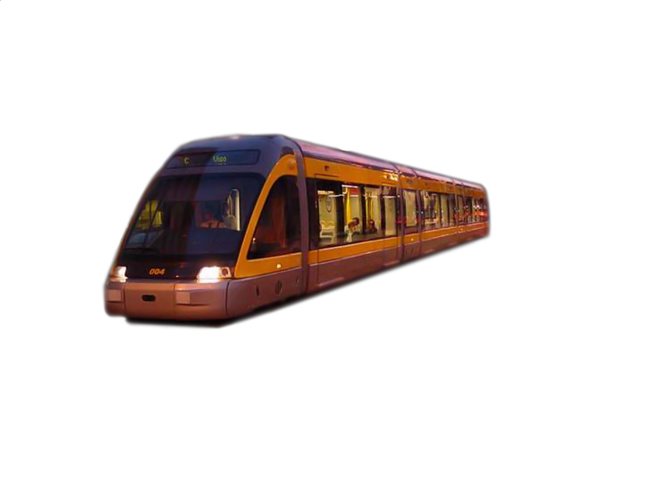
Wyside ESS
Final Goal
Energy flows optimization
Wayside ESS

Slide 5
Research activity
Progetto SFERE – “Sistemi Ferroviari: Eco-sostenibilità e Risparmio Energetico” (PON01_00595)
OR5 – Test su dimostratori sperimentali
AR 5.3 - Realizzazione e test del sistema di accumulo a supercapacitori integrato a bordo e nell'infrastruttura

Slide 6
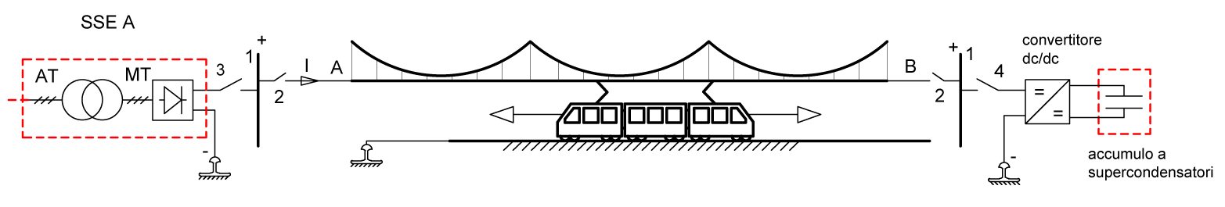
Research activity
Case-study: single track DC railway netrwork equipped with supercap-basedESS at the end of line

Slide 7
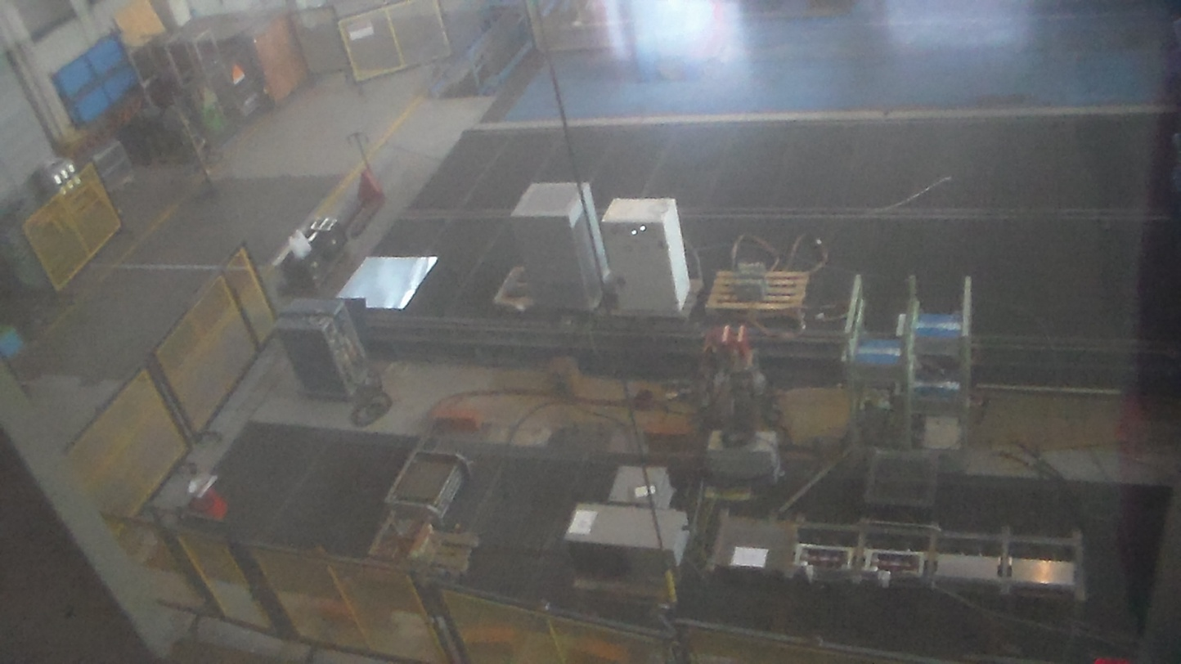
Research activity
Real scale simulator : overwiev of the test bench

Slide 8
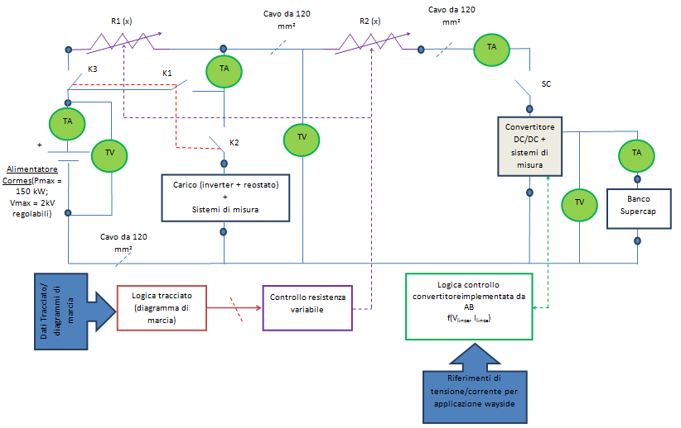
Research activity
Real scale simulator : synoptic table

Slide 9
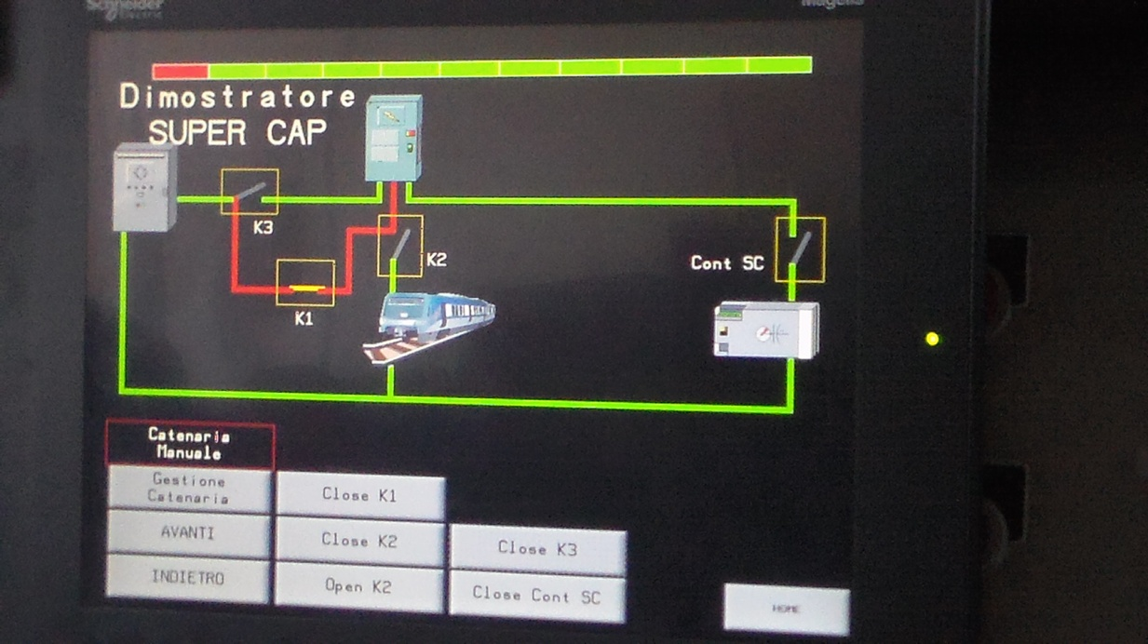
Research activity
Real scale simulator : user graphic interface

Slide 10
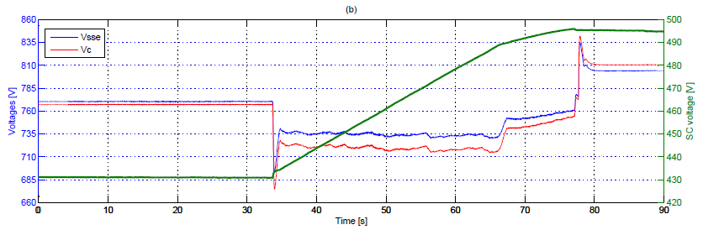
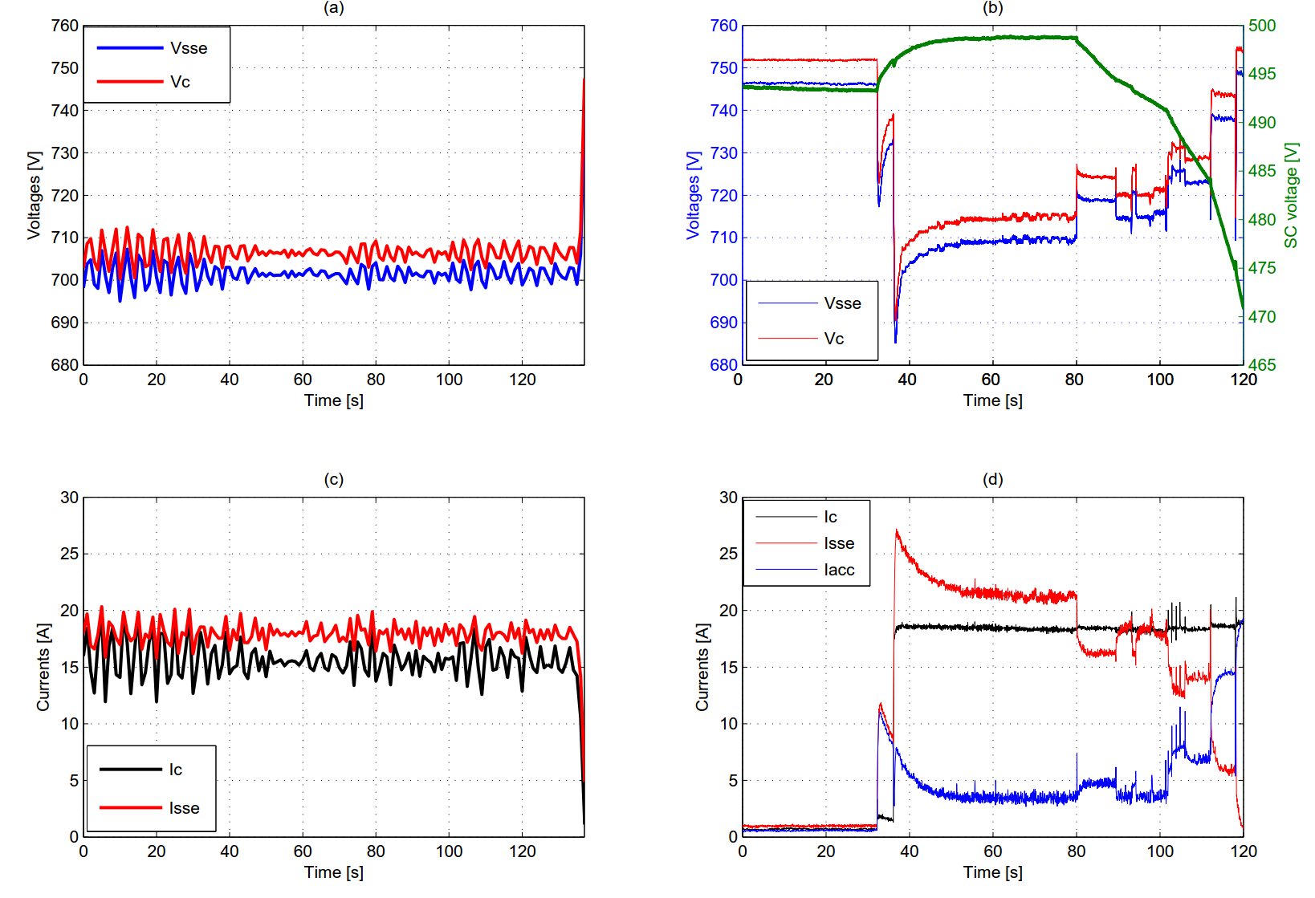
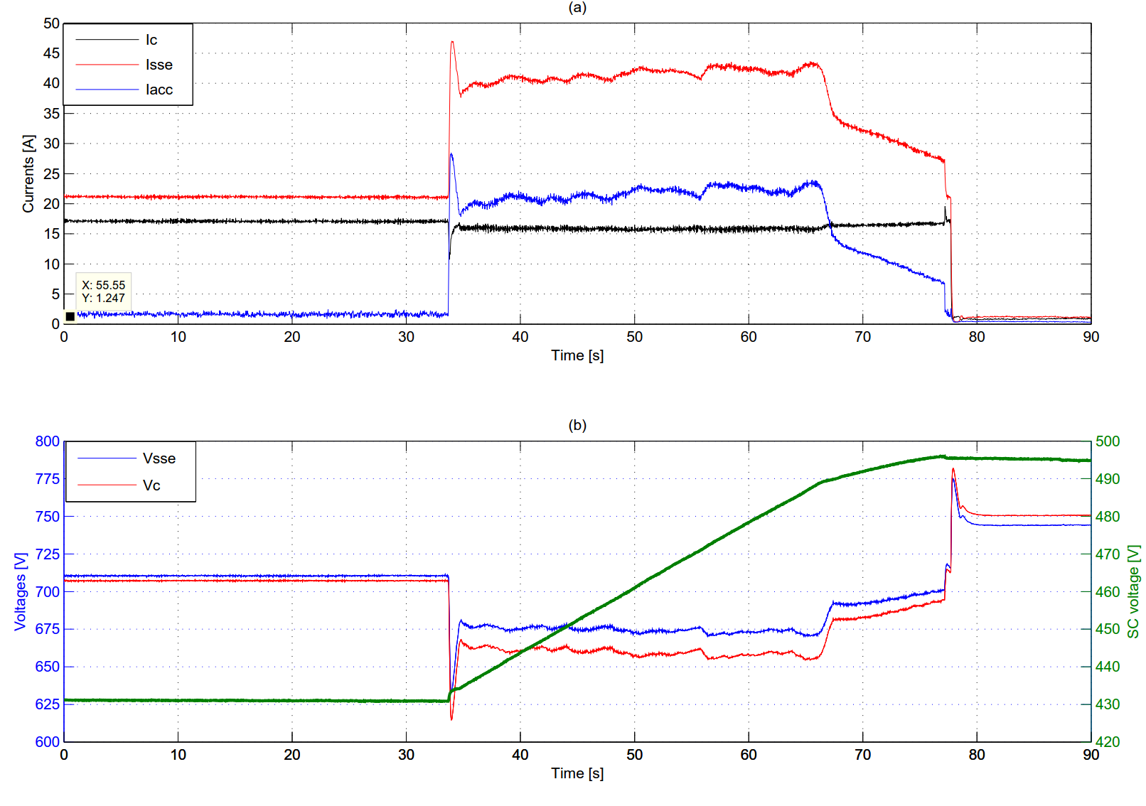
Research activity
Real scale simulator : numerical results
Wayside ESS
Voltage drop and line losses reduction
Energy saving
Peak shaving of load demand

Slide 11
Products
Conference papers
Iannuzzi D., Natale P., Nizza A., Pagano M., “An ‘on scale’ simulator for urban DC railway traction application”, AEIT International Annual Conference, Naples , October 14-16, 2015
Papers in preparation
Iannuzzi D., Lauria D., Natale P.,“A real-time control strategy for supercapacitor-based energy storage systems in light electrical transportation networks”

Slide 12
Next years
    I year credits
Next research activities:
Modeling of complex DC electrified urban railway networks equipped with wayside ESS for the evaluation of system performances
    Expected II year credits

