Slide 1
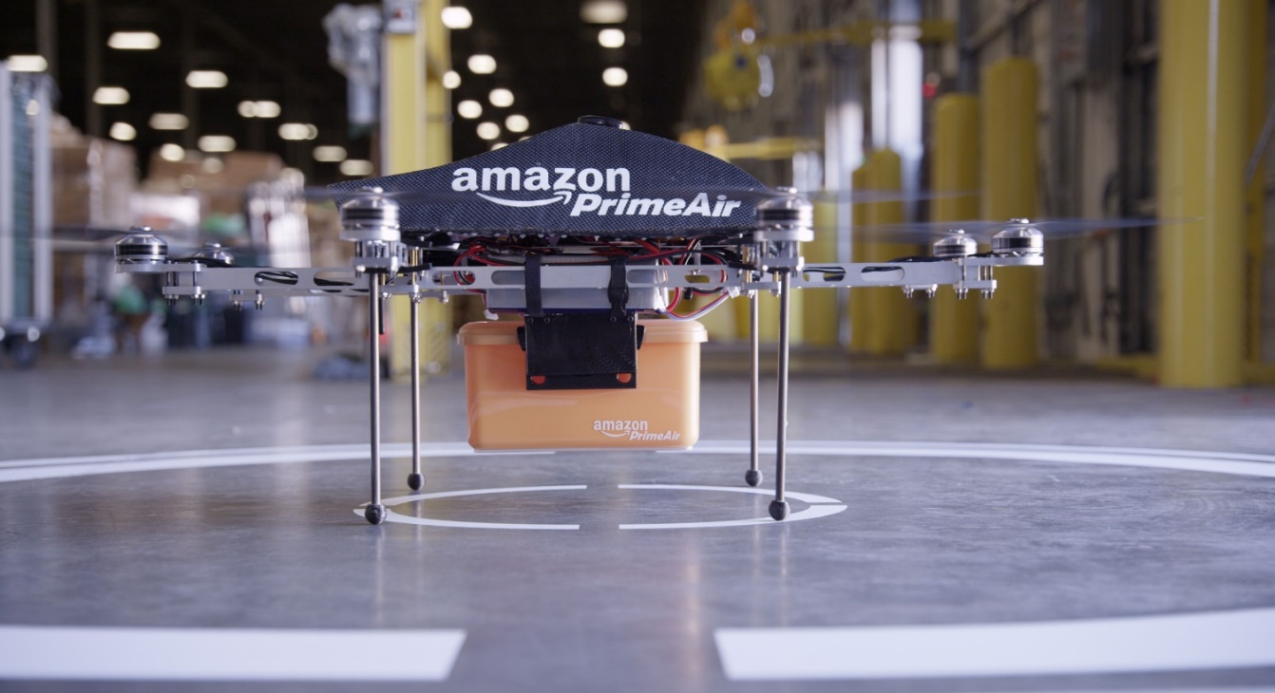
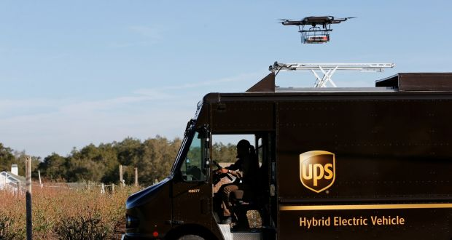
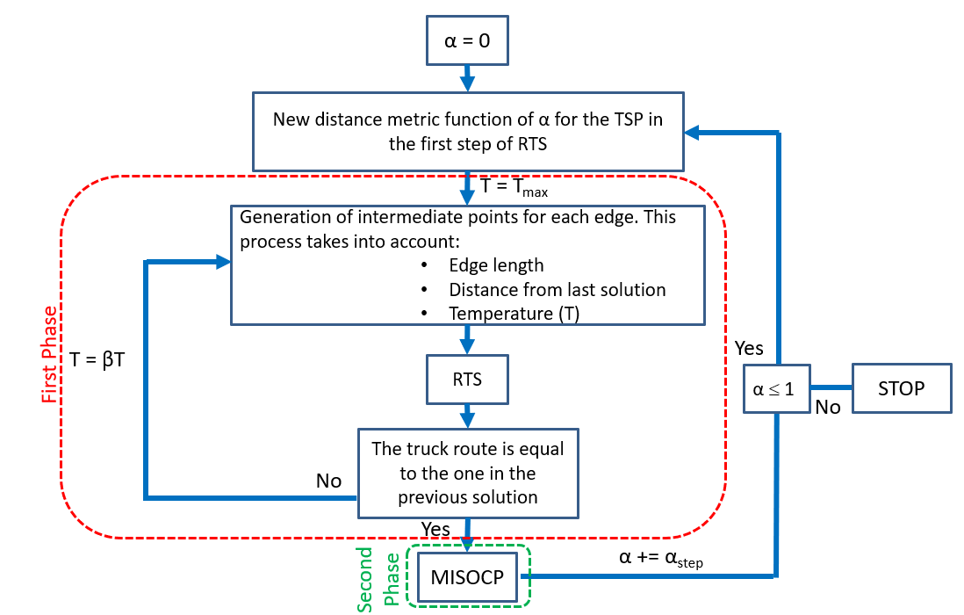
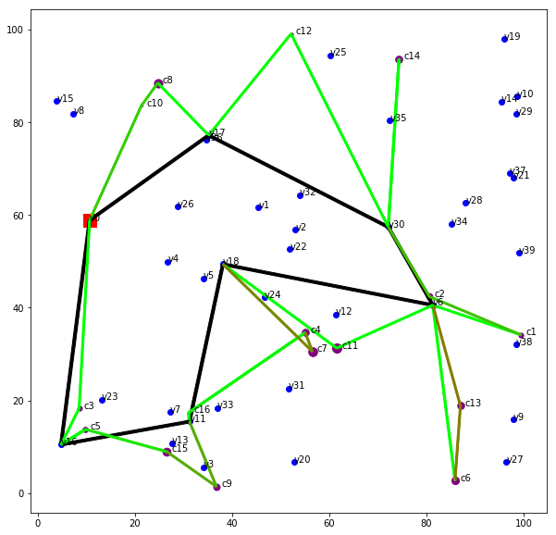
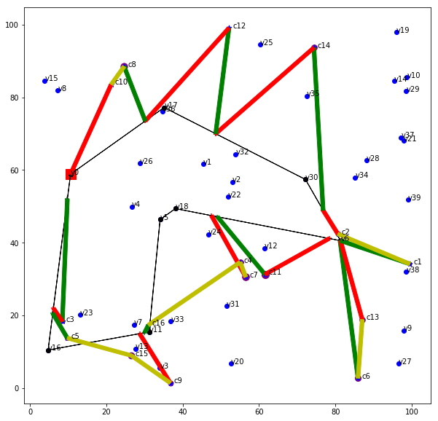
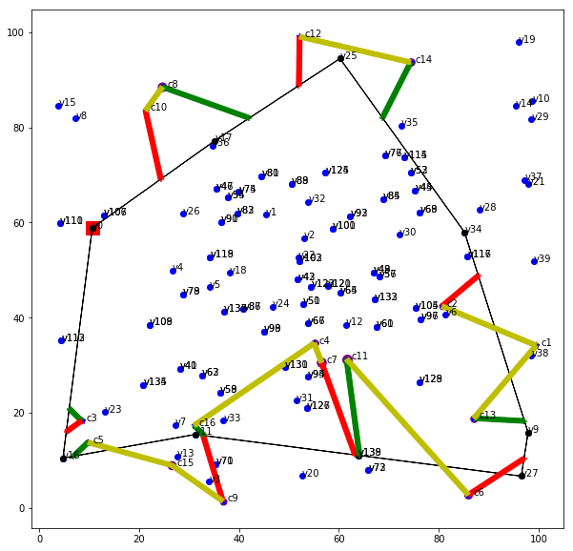
Adriano Masone Tutor: Antonio Sforza – co-Tutor: Luigi Paura XXXII Cycle - II year presentation
Advanced models and algorithms for
Routing Problems of Unmanned Aerial Vehicles
Use of UAVs in delivery operations
The use of unmanned aerial vehicles (“UAVs” or “drones”) for both commercial and governmental purposes has recently drawn increased interest from private industry and academia alike. The applications of UAV technology arise in many fields: agriculture, surveying land or infrastructure, security, cinematography, network communications, health care, emergency operations, and package delivery, to cite only a few. Array of potential domains of application is very broad, in the following we describe our model through the lens of online order fulfillment for consumer goods.
Amazon CEO Jeff Bezos publicly announced in an April 18, 2018 letter to shareholders that the Amazon Prime service, which offers free two-day shipping of millions of Amazon products, had surpassed 100 million subscribers and that 2017 saw the largest subscriber growth in the history of Amazon Prime. Thus, an interview with Bezos discussing the possibility of delivering Amazon packages up to five pounds (2.3 kg) via drone within 30 minutes of order placement has continued to stir great interest in the operations research community.
Amazon is not alone in their pursuit of drones for delivery. FedEx, UPS, Posti, Google, Russian Post, and DPD all have reportedly been testing drones. If Amazon’s Prime Air project, Google’s Project Wing project, and similar ventures come to fruition at scale, then many traditional assumptions and models related to the last-mile of delivery must be reassessed.
Due to range limitations related to the finite battery capacity or communication range of the drone and the desire to limit the number of warehouses due to scale economies, some papers have considered hybrid truck-and-drone models of delivery, which mitigate the impacts of the limited range of the drone.
The hybrid truck-and-drone delivery problem
The optimization problem considered is usually formalized as follows: a set of customers must be served exactly once by either a driver-operated delivery truck or an UAV operating in coordination with the truck. The truck and UAV must depart from, and return to, a single depot (distribution center) exactly once. The two vehicles may depart (or return) either in tandem or independently; while traveling in tandem the UAV is transported by the truck, thus conserving battery power. Different objective functions are considered but the most used is the minimization of the completion time. The optimization problem so defined is very hard to solve, therefore the majority of the papers in the literature have used the following simplifying assumptions:
all packages are homogeneous
the drone is capable of carrying a single package at a time
the battery life of a drone is a fixed amount of time,
not dependent on the weight of the package(s) it is carrying
the set of allowable locations for launching/retrieving a drone from the truck coincides with the set of customer locations.
a full network is built where the vertices are the customer locations linked by euclidean distance edges
the only possible drone launch/retrieval locations are the vertices of the defined network.
Literature on optimization approaches to drone applications
A literature review has been performed to obtain a comprehensive insight on the topic and to provide a summarizing scheme of the main papers which present methodological contribution and/or real problems where drones perform operations in cooperation with other vehicles. The considered papers tackle problems where drones and vehicles work in parallel with the same priority. Some papers not closely related to the main topic have been included for their interesting contribution to the general theme. The papers have been classified according to seven criteria: modelling, optimization model, algorithm, computational results/instance, drone task, vehicle task, coordination vehicle/drone. For each criteria some categories have been identified to better classify the paper.
A new approach to the Multi-Visit Drone Routing Problem
A new truck-and-drone delivery scheme that does not rely upon the classic assumptions, called Multi-Visit Drone Routing Problem (MVDRP), has been tackled (Poikonen et al. 2018). The MVDRP scheme allows the drone to visit multiple customers consecutively without returning to the truck in between. Rather than using a fixed time limit for drone flight, it assumes the drone has a fixed energy capacity. Moreover, the scheme assumes that the amount of energy depletion depends on the sum of the weights of the packages the drone is carrying and on the direction of travel. The new approach takes explicitly into account the road network used by the truck. So, it defines the set of allowable drone launch/retrieval locations independently from the set of customer locations. Poikonen et al. 2018 proposes a flexible solution heuristic, called RTS (Route-Transform-Shortest Path) to determine a solution to the MVDRP. This algorithm is based on the assumption that the only possible launch/retrieval locations are the road network vertices. To overcome this limitation, a new solution method has been developed.
A Continuous Solution Method for the MVDRP
A new method has been proposed based on a general framework devoted to determine potential interesting launch/retrieval location points along the road network edges used by the truck. In particular, it consists of two phases. In the first one, the road network edges are discretized, and more launch/retrieval locations are added to the network and a MVDRP solution is obtained using the RTS algorithm. This procedure is repeated until the truck route is the same in two successive solutions.
In the second phase, knowing the truck route and the set of customers served by the drone it is possible to reduce the completion time by carefully synchronizing truck and drone routes. Indeed, we exploit the flexibility of the drone route, which can move forward or backward between launch/retrieval locations in such a way that the truck’s waiting times are minimized. This result is obtained solving a Mixed Integer Second Order Cone Programming (MISOCP) model to determine a solution where the total completion time is minimized allowing the drone to be launched/retrieved at any point from the truck route of the solution obtained in the first phase.
The first results show that our method is able to obtain solutions with a saving of 12%, on average, compared to the solutions obtained using the RTS algorithm.
Literature summarizing scheme
Flow-chart of the proposed solution method
RTS solution – O.f. = 340.64
RTS + MISOCP solution – O.f. = 322.61
Proposed method solution – O.f. = 307.05
Next year future activity developments
Next year research will follow two main directions.
The first one foresees the improvements of the proposed solution method, structured as follows:
- Improvements of the solution method code aimed to significantly reduce computational time;
- Extension of the method to the case where the truck could carry more than one drone;
- Evolution of the proposed heuristic in a metaheuristic framework.
The second direction consists in exploring the research opportunities arising in Last Mile Logistics based on the amount of information coming from automated systems and smart technology. In particular, the future research can focus its attention on the impact on the total cost of the route balance of a fleet of vehicles in the classic Capacitated Vehicle Routing Problem.
Finally, the research on drone applications in logistics and other application fields will be developed considering mixed-integer programming model and exact solution methods. The MILP formulations proposed in literature will be analyzed together with the proposed Branch-and-cut algorithms and the related valid inequalities. The approaches will be tested and compared on benchmark instances, evaluating the possibility to improve them in terms of model formulation and solution algorithm.
Notes:
Instructions to fill the poster
Box RGB 22 34 48
Context of your research activity (motivations, needs, trends, activity of your group (if the case)… - describe for self explanatory)
Box RGB 255 220 0
Your research activity up to the second year (idea, methodology, developments, results, expected validation,… - insert whatever you like, text, images, photos. This box is reserved to your very specific activity, not to your group)
Box RGB 151 23 32
Your contacts
Cooperations with Universities, companies, participations in progrojects and programmes (logos can be included)
Box RGB 79 129 189
Next year
Future developments of your activity
Box width is 80 cm
Box height can be changed according to your needs
The text is written in Calibri font

