Slide 1


Adriano Masone
XXXII Cycle – 1st year presentation
Tutors: Prof. Luigi Paura and Prof. Antonio Sforza
Data Throughput Optimization at mmWave and THz Frequencies
for Vehicle to Infrastructure Communications
-----------------------------
A p-Median Based Method for the
Large-Scale Optimal Diversity Management Problem
Notes:
Goodmorning I’m Adriano Masone i ll present a brief sketch of my first year research activity with particular reference to two topics

Slide 2




Background
Graduation MS:
Graduated in Management Engineering the 22nd July 2016 at the University “Federico II” Naples. Final mark: 110/110 cum laude
DIETI group:
OPS Lab: Prof. Antonio Sforza, Eng. Claudio Sterle, Prof. Maurizio Boccia
FLY: Prof. Luigi Paura, Eng. Angela Sara Cacciapuoti, Eng. Marcello Caleffi
Cooperations:
Prof. Igor Vasilyev and Anton Ushakov (Matrosov Institute for System Dynamics and Control Theory, Siberian Branch of the Russian Academy of Sciences)
Fellowship:
CNIT – Consorzio Nazionale Interuniversitario per le Telecomunicazioni
Notes:
few information about my background
I graduated in Management Engineering
My research activities are done within two DIETI groups OPS Lab and FLY
Moreover I cooperated with I. Vasy and A. Ush From the Russian accademy of sciences
My fellowship is granted by CNIT

Slide 3
Data Throughput Optimization for Vehicle to Infrastructure Communications
Context:
The ultra-high bandwidth available at millimeter (mmWave) and Terahertz (THz) frequencies can effectively realize short-range wireless access links in small cells enabling potential uses cases such as driver-less cars, data backhauling and ultra-high-definition infotainment services. In this context, vehicles can be used as digital mules as alternative to fiber-based and legacy wireless-based backhauling.
Problem:
Multiple vehicles may pass through the same region concurrently. This requires the SDN controller to assign them to the Software Defined Base Station (SDBS) at different time instants (time-slots) since there is only one mmWave/Thz transreceiver at the roadside location. The data throughput dependends on the assignment configuration of vehicles/time-slots.
The Data Throughput Optimization problem consists in finding the assignment configuration of vehicles/time-slots that maximizes the data throughput.
Notes:
The first topic of interest of my research activity is related to data throughput optimization for vehicle to infrastructure communications. This problem arises from the possibility to use vehicle as digital mules to transmit the data in MMWave and Thz frequencies to a SDBS. In particular, since one vehicle at a time can transmit data to a SDBS, when we have multiple vehicles we need to assign them at different time slots. Each assignment configuration of vehicles to time slots results in a different data thorughput. The Data Throughput Optimization problem consists in finding the sequence that maximizes the data throughput.

Slide 4
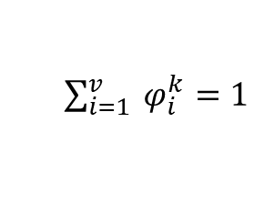

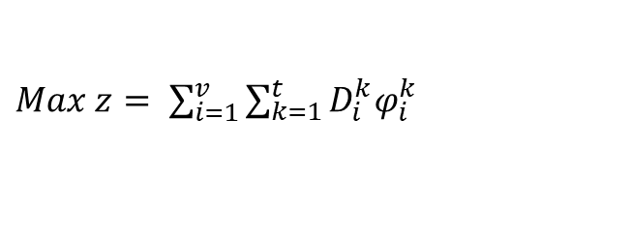

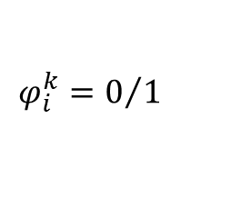

Generalized Assignment Problem
Considering the vehicles as agents and the time-slots as tasks it is possible to formulate the problem as a generalized assignment problem
Data:
  V = {1,..,v} set of vehicles
  T = {1,..,t} set of time-slots
  D^{k}_{i} trasmittable data by the vehicle i to the SDBS
  in the time-slot k
Variables:
$$φ_{i}^{k}$$
Binary variable which is 1 if the vehicle i is assigned to the SDBS in the time-slot k, 0 otherwise
Maximizing the data throughput
$Max z= \sum_{i=1}^{v}{\sum_{k=1}^{t}{D_{i}^{k}φ_{i}^{k}}}$
(1)
s.t.
$\sum_{i=1}^{v}{ φ_{i}^{k}}=1$
$$∀ k ∈T$$
Only one vehicle can be assigned to the SDBS in each time-slot
(2)
$$φ_{i}^{k}=0/1$$
$$∀ i ∈V,∀ k∈T$$
Binary constraints
(3)
Notes:
Considering the vehicles as agents and time slots as tasks it is possible to formulate the problem as a gap.
V will be the set of vehicles T the set of time-slots and Dik the transmittable data

Slide 5

Modeling
t
Synchronization
time
Transmission
time
Transmission time
Time-slot k-1
Time-slot k
Time-slot k+1
Notes:
Obviously the real problem has some pecularities. Indeed In this slide you can see three time slot k-1 k k+1. Within a time-slot there is a synchonization time and a transmission time. Assigning the same vehicle to two consecutive time-slots allows to transmit the data also in the synchronization time with a throughput gain

Slide 6

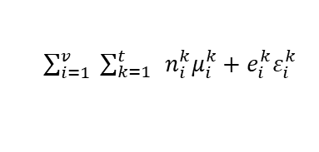
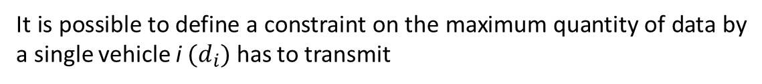
Constraint for the total transmitted data by a single vehicle
It is possible to define a constraint on the maximum quantity of data by a single vehicle i ${(d}_{i})$ has to transmit
$\sum_{i=1}^{v}{ \sum_{k=1}^{t}{ }}n_{i}^{k}μ_{i}^{k}+e_{i}^{k}ε_{i}^{k}$
d
t
Notes:
Another peculiarities of this problem is the constraint of the total data transmitted by a single vehicle

Slide 7
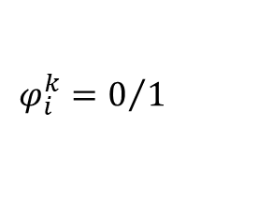





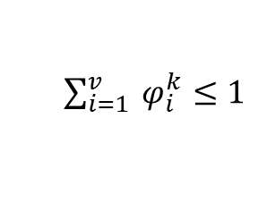




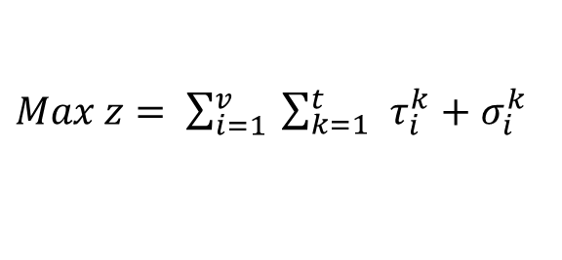







Final model
Maximizing the data throughput
$Max z= \sum_{i=1}^{v}{ \sum_{k=1}^{t}{ }}τ_{i}^{k}+σ_{i}^{k }$
(1)
s.t.
$\sum_{i=1}^{v}{ \sum_{k=1}^{t}{ }}τ_{i}^{k}+σ_{i}^{k}≤ d_{i}$
$$∀ i ∈V$$
Constraints on the total transmitted data by a single vehicle
(2)
$\sum_{i=1}^{v}{ φ_{i}^{k}}≤1$
$$∀ k ∈T$$
Only one vehicle can be assigned to the SDBS in each time-slot
(3)
$$σ_{i}^{k}≤{e_{i}^{k}φ}_{i}^{k}$$
$$∀ i ∈V,∀ k∈T$$
A vehicle can trasmit data to the SDBS in the sincronization time of the time-slot only if it is assigned to it and it is already synchronized with the SDBS
(4)
$$σ_{i}^{k}≤{e_{i}^{k}φ}_{i}^{k−1}$$
$$∀ i ∈V,∀ k∈T$$
$φ_{i}^{0}$ = 0
$$∀ i ∈V$$
$$τ_{i}^{k}≤ {n_{i}^{k}φ}_{i}^{k}$$
$$∀ i ∈V,∀ k∈T$$
A vehicle can trasmit data to the SDBS in the transmission time of the time-slot only if it is assigned to it.
(5)
$$φ_{i}^{k}=0/1$$
$$∀ i ∈V,∀ k∈T$$
Binary constraints
(6)
$${0≤τ}_{i}^{k}≤n_{i}^{k}$$
$$∀ i ∈V,∀ k∈T$$
Continuous constraints
(7)
$${0≤σ}_{i}^{k}≤e_{i}^{k}$$
$$∀ i ∈V,∀ k∈T$$
Notes:
The basic generalized assignment can be integrate with all this peculiarities have been taken in account leading to this final model that returns the optimal solution of instances made up of hundreds vehicles and hundreds of time-slots in few seconds solving it by a commercial optimization solver

Slide 8
The Optimal Diversity Management Problem
Context:
A company produces a good and or a service which can be provided with several options. Hence, a customer can choose different option combinations (configurations) depending on his needs and/or preferences.
Problem:
The company can produce only a limited number of configurations to cover all the possible ones. In this way, if no available configuration contains exactly the required options, can be satisfied by a compatible configuration, i.e. by a configuration containing all the required options plus some others undemanded by the customer. This implies that a client could receive some unrequired options, so generating an over-cost for the company.
The Optimal Diversity Management Problem (ODMP) consists in choosing a subset of configurations which cover all the customer demands, minimizing the total over-cost.
Notes:
The second topic of interest for my activity regards a problem that arises for a company when a product or a service can be customized with several options. Each subset of option combination represents a configurations that a companty needs to produce. Obviously the company cannot make available at the assembly line all the possible configurations so it replaces the not available configurations with ones that have the same options plus some others not needed, so generating an over-cost for the company. The ODMP consists in choosing a subset of configurations which cover all the customer demands minimizing the total over-cost

Slide 9
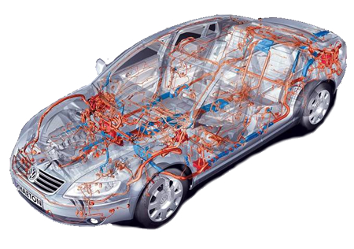
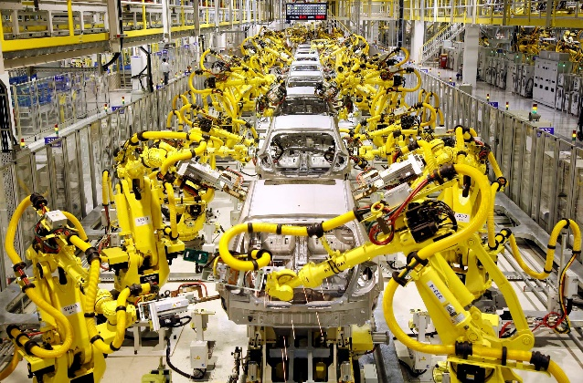
ODMP: An example in car industry
A car can be equipped with a large number of options, each of them requiring the installation of the related electrical wiring. The total number of options could be up to forty (in future even more), and hence the possible electrical wiring configurations could be many thousands, but obviously only a limited number of them can be made available at the assembly line.
Notes:
It is possible to find an example of the ODMP in car industry where the options are the car options and the configurations are the electrical wiring configurations

Slide 10
ODMP: A network representation
Let O be the set of all the options O = {o₁,..,o_{m}} and S be the set of all the possible n configurations S_{i} ⊆ O, S = {S₁,..,S_{i},..,S_{n}}. We can build a weighted directed network G(V,A) where:
each node i ϵ V is associated with a configuration S_{i} ϵ S;
an arc (i,j) connects a node i to a node j iff the configuration S_{i} can replace the configuration S_{j} , i.e. A = {(i,j) : S_{j} ⊂ S_{i}}.
the weight of the arc corresponds to the over-cost w_{ij}.
S_{i} = {o₁, o₄, o₇, o₁₂ , o₂₁}
S_{j} = {o₁, o₄, o₇, o₂₁}
S_{k} = {o₇ , o₂₁}
i
w_{ij}
w_{ik}
j
k
w_{jk}
Notes:
A netwok representation can be adopted to allow a formultaion in terms of P-meian
For this problem we exploit a network representation where each node is associated with a configuration an arc connects a node i and a node j iff the config. Si can replace Sj and the weight of the arc corresponds to the overcost

Slide 11
ODMP: Formulation as p-median problem
The network representing an ODMP is a large-scale, acyclic network.
On the base of this representation, the ODMP can be formulated as a p-median problem (PMP). Indeed, if only p configurations can be made available, the problem is to find p median nodes such that the sum of the weights of arcs connecting the medians to all the remaining nodes, corresponding to the total production over-cost, is minimized.
The PMP is NP-Hard (Kariv and Hakimi, 1979).
Modern commercial MIP codes are able to solve to optimality instances (with particular structure) of thousands of nodes.
Notes:
The network representation allows us to formulate the ODMP as a P-median Problem that is a well known Net Fac Loc Problem proved to be NP-Hard in the 1979

Slide 12
A decomposition based method
Decomposition algorithm for large scale p-median
(Taillard, 2003; Avella et al., 2005)
If connected
Network
Clustering
Step 1: Network Decomposition
Already
decomposed
If not connected
Combination of Lagrangian heuristic and Simulated Annealing
Step 2: Solution of p-median subproblems for each cluster
Step 3: Combination of the solutions of the p-median subproblems
Solution of a Multiple Choice Knapsack Model
Notes:
We develop a decomposition based method to tackle large scale instances. The method is based on the decomposition of the initial problem in several smaller subproblems. The subproblems are solved by a lagrangian heuristic. Then their solutions are combined solving a multiple choice knapsack model to obtain the solution of the whole p-median problem.

Slide 13
Papers, Presentations and Seminars
Papers:
A Partitioning Based Heuristic for a Variant of the Simple Pattern Minimality Problem, M. Boccia, A. Masone, A. Sforza, C. Sterle. Optimization and Decision Science: Methodologies and Applications, Springer Proceedings in Mathematics and Statistics, Springer.
A Graph Clustering Based Decomposition Approach for Large Scale p-Median Problems, A. Masone, A. Sforza, C. Sterle, I. Vasilyev. International Journal of Artificial Intelligence (in press).
A p-Median Based Exact Method for the Large-Scale Optimal Diversity Management Problem, A. Masone, C. Sterle, A. Ushakov, I. Vasilyev. Networks (under review).
Presentations:
A partitioning-based heuristic for large scale p-median problems, A. Masone, A. Sforza, C. Sterle, I. Vasilyev. Optimization and Decision Science 2017, 7th September, Sorrento, Italy.
Seminars:
Beyond 5G: Data Throughput Optimization at mmWave and THz Frequencies for Vehicle to Infrastructure Communications, A. S. Cacciapuoti, A. Masone, 14th December 2017, University “Federico II” of Naples.

Slide 14
1st year credits
Lecture/Activity | Type | Credits
Optimization Methods and Applications - Heuristics for Combinatorial Network Optimization | Ad hoc module | 2
Gestione Strategica dell'Innovazione | Ad hoc module | 4
Ottimizzazione | MS Module | 9
International School on Mathematics "Graph Theory, Algorithms and Applications | Doctoral School | 6.6
Fuzzy Logic, Genetic Algorithms and their Application to Next Generation Network | Seminar | 0.4
How to organize and write scientific rebuttal | Seminar | 0.4
An exact knapsack separation procedure for structured Binary Integer Programming Problems | Seminar | 1
A shared memory parallel heuristic algorithm for the large.scale p-median problem | Seminar | 1
From Control to Interaction in Multi-Robot Systems | Seminar | 0.3
Challenges and Opportunities for IT Innovation in the Space Business | Seminar | 0.3
(Effective) Machine Learning in the Time of Big Data | Seminar | 0.2
Optimal Content Distribution and Multi-resource Allocation in Software Defined Virtual CDNs | Seminar | 0.3
Beyond 5G: Data Throughput Optimization at mmWave and THz Frequencies for Vehicle to Infrastructure Communications | Seminar | 0.5
Graph Queries: Generation, Evaluation, Learning | Seminar | 0.4
Large Scale Integrative Bionformatics and Systems Biology in Cancer Genomics | Seminar | 0.3
 | Credits year 1
 |  | 1 | 2 | 3 | 4 | 5 | 6
 | Estimated | bimonth | bimonth | bimonth | bimonth | bimonth | bimonth | Summary
Modules | 20 | 4 | 8.6 |  |  |  | 9 | 21.6
Seminars | 5 | 0.8 |  |  | 2 | 0.8 | 1.5 | 5.1
Research | 35 | 5 | 5 | 8 | 8 | 5.3 | 2 | 33.3
 | 60 |  |  |  |  |  |  | 60

Slide 15
Table for training
 | Credits year 1 |  |  |  |  |  |  |  | Credits year 2 |  |  |  |  |  |  |  | Credits year 3
 |  | 1 | 2 | 3 | 4 | 5 | 6 |  |  | 1 | 2 | 3 | 4 | 5 | 6 |  |  | 1 | 2 | 3 | 4 | 5 | 6
 | Estimated | bimonth | bimonth | bimonth | bimonth | bimonth | bimonth | Summary | Estimated | bimonth | bimonth | bimonth | bimonth | bimonth | bimonth | Summary | Estimated | bimonth | bimonth | bimonth | bimonth | bimonth | bimonth | Summary | Total | Check
Modules | 20 | 4 | 8.6 |  |  |  | 9 | 22 | 8 | 3 | 5 |  |  |  |  | 8 | 5 | 5 |  |  |  |  |  | 5 | 35 | 30-70
Seminars | 5 | 0.8 |  |  | 2 | 0.8 | 1.5 | 5.1 | 6 | 1 |  | 2 | 1 |  | 2 | 6 | 4 | 2 | 1 | 1 |  |  |  | 4 | 15 | 10-30
Research | 35 | 5 | 5 | 8 | 8 | 5.3 | 2 | 33 | 46 | 6 | 5 | 8 | 9 | 10 | 8 | 46 | 51 | 6 | 9 | 9 | 9 | 9 | 9 | 51 | 130 | 80-140
 | 60 |  |  |  |  |  |  | 60 | 60 | 10 | 10 | 10 | 10 | 10 | 10 | 60 | 60 | 13 | 10 | 10 | 9 | 9 | 9 | 60 | 180 | 180

Slide 16

Data throughput on a network with 2 vehicles

Slide 17
Modeling
k-1
k
k+1
Synchronization
time
Transmission
time
Synchr.
time
Transmission
time

Slide 18
Modeling
MmWave
Thz
MmWave
x
Notes:
Obviously the real problem has some pecularities. Indeed In this slide you can see three time slot k-1 k k+1. Within a time-slot there is a synchonization time and a transmission time. Assigning the same vehicle to two consecutive time-slots allows to transmit the data also in the synchronization time with a throughput gain

Slide 19
Results
Solution:
Optimal
Randomic
Greedy from
Cacciapuoti et al. 2017
Data Throughput
Normalized Synchronization Time T₀/T
Commercial MIP solvers are able to find in few tens of seconds the optimal solution of instances with hundreds of time-slot and several hundreds of vehicles.

Slide 20
Results: Quality of the solutions
 |  |  |  | m=√p |  |  |  |  |  |  |  | m=p/2
 |  |  |  | H2 |  | I1 |  | I2 |  | MC |  | MC
Instance | n | p | ISS14 | DIR | RB | DIR | RB | DIR | RB | A | S | A | S
ds1n01 | 25000 | 25 | 31229.3 | 16.884 | 22.784 | 19.941 | 22.07 | 17.005 | 22.634 | 0.003 | 0.033 | 0.007 | 0.057
ds1n02 | 36000 | 36 | 45115.6 | 23.161 | 15.162 | 17.724 | 20.375 | 18.415 | 20.166 | 0.003 | 0.019 | 0.003 | 0.057
ds1n03 | 49000 | 49 | 61384.1 | 17.343 | 23.683 | 19.157 | 26.729 | 19.497 | 19.157 | 5.004 | 0.025 | 0.007 | 0.057
ds1n04 | 64000 | 64 | 80053.7 | 20.084 | 22.048 | 21.818 | 26.962 | 21.549 | 23.324 | 3.728 | 0.014 | 0.006 | 0.073
ds1n05 | 30000 | 25 | 37563.6 | 17.187 | 23.146 | 20.271 | 23.54 | 21.163 | 23.053 | 0.003 | 0.028 | 0.006 | 0.077
ds1n06 | 43200 | 36 | 54191.4 | 16.439 | 20.682 | 22.753 | 22.014 | 26.044 | 20.052 | 0.003 | 7.334 | 0.038 | 0.082
ds1n07 | 58800 | 49 | 73626.8 | 21.82 | 21.421 | 19.432 | 19.438 | - | 20.272 | 0.003 | 5.079 | 0.01 | 0.073
ds1n08 | 76800 | 64 | 96039 | 27.393 | 32.071 | 19.74 | 22.474 | 21.896 | 41.323 | 0.003 | 0.03 | 4.073 | 0.103
ds1n09 | 35000 | 25 | 43902.1 | 16.542 | 23.087 | 24.763 | 23.666 | 18.449 | 22.577 | 0.002 | 9.543 | 0.005 | 0.079
ds1n10 | 50400 | 36 | 63169.2 | 20.245 | 21.418 | 20.191 | 20.97 | 20.688 | 20.753 | 0.003 | 0.049 | 0.007 | 0.084
ds1n11 | 68600 | 49 | 85833.5 | 19.557 | 22.216 | 19.562 | 21.378 | 20.39 | 22.027 | 0.003 | 0.024 | 5.18 | 0.087
ds1n12 | 89600 | 64 | 112059.2 | 22.832 | 24.448 | - | - | - | - | 3.953 | - | 0.009 | 0.093
ds3n01 | 25000 | 25 | 17696.2 | 18.361 | 34.379 | 20.64 | 35.662 | 24.767 | 34.547 | 0.002 | 0.014 | 0.015 | 0.028
ds3n02 | 36000 | 36 | 27423 | 26.904 | 28.343 | 26.3 | 25.487 | 26.445 | 25.702 | - | - | 0.026 | 0.041
ds3n03 | 49000 | 49 | 44149 | 24.922 | 19.844 | 19.42 | 23.831 | 19.024 | 20.2 | - | - | 0.011 | 1.411
ds3n04 | 64000 | 64 | 58840.3 | 17.473 | 14.543 | 14.4 | 14.827 | 14.343 | 14.209 | - | - | 0.74 | 0.746
ds3n05 | 30000 | 25 | 21829.9 | 26.598 | 28.585 | 20.87 | 33.251 | 20.878 | 31.207 | - | - | 0.017 | 0.023
ds3n06 | 43200 | 36 | 32339.4 | 26.005 | 27.207 | 27.53 | 31.299 | 31.299 | 25.409 | - | - | 3.088 | 3.095
ds3n07 | 58800 | 49 | 50857.9 | 23.505 | 26.568 | 29.98 | 27.518 | 29.163 | 27.229 | - | - | 0.012 | 0.016
ds3n08 | 76800 | 64 | 66573.6 | 13.786 | 9.928 | 14.62 | 9.398 | 12.46 | 10.039 | - | - | 0.607 | 0.035
ds3n09 | 35000 | 25 | 24811 | 18.485 | 18.249 | 18.59 | 18.176 | 19.125 | 15.228 | - | - | 0.129 | 0.108
ds3n10 | 50400 | 36 | 38102.6 | 18.191 | 23.477 | 22.62 | 24.873 | 23.107 | 23.986 | - | - | 0.027 | 0.017
ds3n11 | 68600 | 49 | 61857.1 | 20.632 | 17.849 | 18.69 | 17.842 | 18.344 | 17.509 | - | - | 0.762 | 0.768
ds3n12 | 89600 | 64 | 78777.5 | - | 22.313 | 22.85 | 21.38 | - | 20.614 | - | - | 0.027 | 0.012

Slide 21
Results: Computation times
 |  |  |  | m=√p |  |  |  |  |  |  |  | m=p/2
 |  |  |  | H2 |  | I1 |  | I2 |  | MC |  | MC
Instance | n | p | ISS14 | DIR | RB | DIR | RB | DIR | RB | A | S | A | S
ds1n01 | 25000 | 25 | 93 | 328.86 | 314.88 | 273.2 | 271.16 | 283.56 | 285 | 299.5 | 365.24 | 45.37 | 196.87
ds1n02 | 36000 | 36 | 215 | 386.93 | 639.88 | 653.8 | 778.23 | 675.06 | 470.36 | 491.3 | 523.33 | 171.96 | 194.75
ds1n03 | 49000 | 49 | 421 | 694.19 | 541.39 | 470.7 | 487.74 | 537.38 | 486.56 | 583.48 | 609.89 | 222.74 | 174.07
ds1n04 | 64000 | 64 | 939 | 733.87 | 684.83 | 625 | 670.07 | 665.69 | 819.23 | 746.37 | 862.58 | 266.3 | 224.62
ds1n05 | 30000 | 25 | 133 | 511.73 | 437.86 | 354.9 | 418.63 | 421.64 | 667.91 | 668.34 | 1027.96 | 227.95 | 200.02
ds1n06 | 43200 | 36 | 244 | 676.7 | 690.84 | 606.8 | 796.63 | 486.95 | 895.53 | 710.84 | 774.96 | 316.84 | 265.68
ds1n07 | 58800 | 49 | 566 | 1014.26 | 1009.74 | 1133 | 968.34 | 947.31 | 867.95 | 1154.37 | 905.04 | 643.53 | 404.89
ds1n08 | 76800 | 64 | 1020 | 980.27 | 1254.46 | 1270 | 1102.95 | - | 1186.33 | 1206.82 | 1275.47 | 452.16 | 409.61
ds1n09 | 35000 | 25 | 197 | 779.86 | 686.71 | 656.1 | 603.15 | 708.85 | 679.47 | 838.52 | 872.95 | 255.19 | 290.93
ds1n10 | 50400 | 36 | 460 | 971.29 | 1251.51 | 1133 | 854.63 | 1029.59 | 828.84 | 979.25 | 1098.44 | 318.28 | 360.42
ds1n11 | 68600 | 49 | 666 | 1309.88 | 1095.71 | 1268 | 1330.25 | 1199.6 | 1091.24 | 1478.69 | 1359.3 | 292.66 | 417.76
ds1n12 | 89600 | 64 | 1487 | 3462.64 | 1569.36 | - | - | - | - | 2011.43 | - | 504.64 | 765.01
ds3n01 | 25000 | 25 | 138 | 420.98 | 305.09 | 399.2 | 345.86 | 368.73 | 340.33 | 282.06 | 242.84 | 99.04 | 112.07
ds3n02 | 36000 | 36 | 216 | 403.76 | 583.66 | 489.4 | 422.62 | 417.92 | 409.12 | - | - | 185.2 | 244.91
ds3n03 | 49000 | 49 | 398 | 581.08 | 783.25 | 826.5 | 907.75 | 694.12 | 744.13 | - | - | 290.25 | 443.07
ds3n04 | 64000 | 64 | 968 | 632.72 | 629.64 | 692 | 622.93 | 686.49 | 693.88 | - | - | 466.2 | 413.19
ds3n05 | 30000 | 25 | 170 | 501.78 | 530.52 | 544.7 | 594.12 | 520.38 | 477.18 | - | - | 169.31 | 134.33
ds3n06 | 43200 | 36 | 342 | 565.99 | 557.27 | 636.1 | 574.48 | 568.98 | 583.7 | - | - | 250.5 | 288.81
ds3n07 | 58800 | 49 | 946 | 1052.8 | 868.14 | 1350 | 934.33 | 1309.28 | 2242.7 | - | - | 314.57 | 461.44
ds3n08 | 76800 | 64 | 1836 | 1243.59 | 1160.98 | 1412 | 1189.98 | 1210.77 | 955.17 | - | - | 535.27 | 586.66
ds3n09 | 35000 | 25 | 290 | 609.5 | 852.29 | 605.1 | 781.84 | 773.84 | 955.91 | - | - | 185.24 | 179.67
ds3n10 | 50400 | 36 | 659 | 837.29 | 1032.86 | 1020 | 1050.4 | 1034.22 | 1170.52 | - | - | 289.56 | 297.25
ds3n11 | 68600 | 49 | 876 | 1996.41 | 2092.21 | 2716 | 2558.87 | 1331.35 | 1143.11 | - | - | 578.56 | 405.46
ds3n12 | 89600 | 64 | 1688 | - | 2560.45 | 2058 | 1609.55 | - | 3058.83 | - | - | 842.62 | 784.11

