Slide 1
Raffaele Martino Tutor: prof. Alessandro Cilardo XXXII Cycle - I year presentation
Advanced Hardware Implementations of SHA-2 for Emerging Innovative Applications

Slide 2
Background
Master’s Degree in Computer Engineering in 2016, magna cum laude
Ph.D. student within the SECLAB group
No fellowship
Collaboration from March to June 2017 with CINI within an H2020 project
For details and products of this collaboration see the TRAR

Slide 3
Problem Formulation
Hash algorithms are a fundamental building block of a number of secure applications
Traditional: secure transport layer (HMAC), digital signatures
Innovative: blockchain (Bitcoin mining)
Innovative applications put higher and higher demands on the hashing component
Performance
Power Efficency
Hardware Implementations
FPGA
SoCs with PL

Slide 4
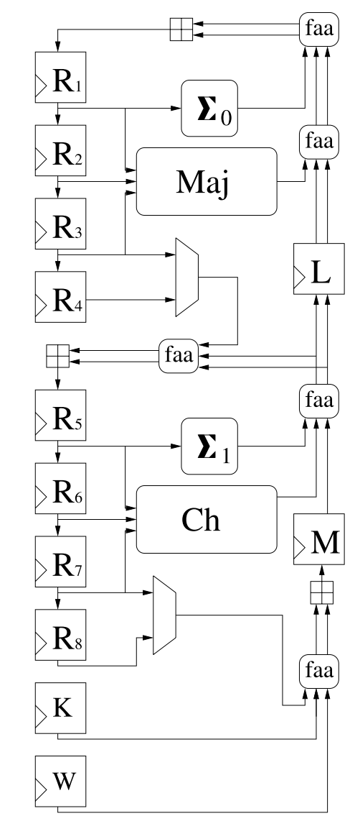
Algorithm Improvements
Implementation level
Exploit the most advanced circuit design techniques
Technological level
Fit the best the characteristic of the specific FPGA

Slide 5
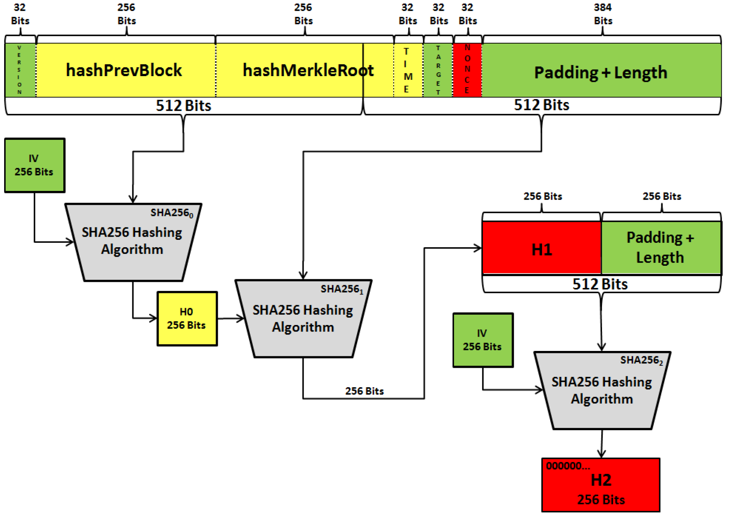
Bitcoin-specific Improvements
Current Bitcoin FPGA (and ASIC) miners employ standard designs for SHA
Improvements of the SHA-256 design
Stand-alone miner on a SoCs with PL
The processor can be used also for some algorithm optimizations
In Bitcoin mining, a large part of the input is fixed or “slowly” variable
Hard-code some values
Optimizations for slowly-variable values
Use of collision attacks

Slide 6
I Year Results
Fulfilled study obligations
1 conference paper published
Language Certification obtained
Certificate in Advanced English, passed with Grade A, CEFR level C2, 1st December 2017

Slide 7
Next years
Focus on research activity
Journal publication(s) expected to be at the very least in preparation by the end of II Year
Period abroad expected to occur during III Year

