Slide 1




Source Identification in
Image Forensics
Francesco Marra
Tutor: Carlo Sansone – co-Tutor: Luisa Verdoliva
XXX Cycle - III year presentation

Slide 2
Background
MS degree with honour in Computer Engineering
Univesity of Naples - Federico II.
Research Fellow at University of Cagliari
in collaboration with SIVA and GRIP group of University of Naples. (Oct 2013 - Oct 2014)
Published conference paper during the fellowship:
  F. Marra, F. Roli, D. Cozzolino, C. Sansone, L. Verdoliva, "Attacking the triangle test In sensor-based camera identification" IEEE International Conference in Image Processing (ICIP), pp.5307-5311, Oct. 2014

Slide 3
Credits summary
 | Credits year 1 |  |  |  |  |  |  | Credits year 2 |  |  |  |  |  |  | Credits year 3
 | 1 | 2 | 3 | 4 | 5 | 6 |  | 1 | 2 | 3 | 4 | 5 | 6 |  | 1 | 2 | 3 | 4 | 5 | 6
 | bimonth | bimonth | bimonth | bimonth | bimonth | bimonth | Summary | bimonth | bimonth | bimonth | bimonth | bimonth | bimonth | Summary | bimonth | bimonth | bimonth | bimonth | bimonth | bimonth | Summary | Total
Modules |  | 3 |  |  | 7 | 6 | 16 |  | 6 |  | 3 | 3 |  | 12 |  |  |  |  |  | 4 | 4 | 32
Seminars |  |  | 0,8 | 4,4 |  |  | 5,2 | 1 | 0,2 | 0,2 | 4,2 |  |  | 5,6 | 1,4 | 3 |  |  |  | 0 | 4,4 | 15,2
Research | 5 | 5 | 5 | 5 | 6 | 9 | 35 | 9 | 4 | 9 | 4 | 7 | 12 | 45 | 9 | 6 | 10 | 10 | 10 | 8 | 53 | 133
 | 5 | 8 | 5,8 | 9,4 | 13 | 15 | 56,2 | 10 | 10,2 | 9,2 | 11,2 | 10 | 12 | 62,6 | 10,4 | 9 | 10 | 10 | 10 | 12 | 61,4 | 180,2
Period spent abroad
Research at “WaveLab” – University of Salzburg, Austria
Tutor: Prof. Andreas Uhl
20 March - 20 July 2017

Slide 4
Credits summary
 | Credits year 1 |  |  |  |  |  |  | Credits year 2 |  |  |  |  |  |  | Credits year 3
 | 1 | 2 | 3 | 4 | 5 | 6 |  | 1 | 2 | 3 | 4 | 5 | 6 |  | 1 | 2 | 3 | 4 | 5 | 6
 | bimonth | bimonth | bimonth | bimonth | bimonth | bimonth | Summary | bimonth | bimonth | bimonth | bimonth | bimonth | bimonth | Summary | bimonth | bimonth | bimonth | bimonth | bimonth | bimonth | Summary | Total
Modules |  | 3 |  |  | 7 | 6 | 16 |  | 6 |  | 3 | 3 |  | 12 |  |  |  |  |  | 4 | 4 | 32
Seminars |  |  | 0,8 | 4,4 |  |  | 5,2 | 1 | 0,2 | 0,2 | 4,2 |  |  | 5,6 | 1,4 | 3 |  |  |  | 0 | 4,4 | 15,2
Research | 5 | 5 | 5 | 5 | 6 | 9 | 35 | 9 | 4 | 9 | 4 | 7 | 12 | 45 | 9 | 6 | 10 | 10 | 10 | 8 | 53 | 133
 | 5 | 8 | 5,8 | 9,4 | 13 | 15 | 56,2 | 10 | 10,2 | 9,2 | 11,2 | 10 | 12 | 62,6 | 10,4 | 9 | 10 | 10 | 10 | 12 | 61,4 | 180,2
Seminars
Modelli matematici e calcolo scientifico nell'ingegneria e nell'innovazione tecnologica – 15/4/2015 (0.4 CFU)
Partial possibilistic regression path modeling – Rosaria Romano – 20 April 2015 (0.4 CFU)
Social Signal Processing: understanding social interactions through nonverbal behavior analysis – 5/5/2015 (0.4 CFU)
Perception-based surround sound recording and reproduction - DIETI- Unina – 22/2/2016 (0.2 CFU)
Model Based and Pattern Based GUI Testing – Prof. Ana Paiva - University of Oporto– 23-25/11/2015 (0.8 CFU)
Armi autonome, problemi etici e decisioni politiche – Prof. G. Tamburrini – 1/12/2015 (0.2 CFU)
Big Data and Analytics with Azure – Microsoft Big Data & Cloud Team – 26/04/2015 (0.2 CFU)
An overview on image forensics with emphasis on physics-based scene verification - Dr. Christian Riess – 18/5/2016 (0.2 CFU)
MINIX3: a reliable and secure operating system – Prof. Andrew S. Tanenbaum – 30/11/2016 (0.4 CFU)
Workshop on Deep Learning for Visual Computing - Prof. Simone Bianco - 21/11/16 (1 CFU)

Slide 5
Credits summary
 | Credits year 1 |  |  |  |  |  |  | Credits year 2 |  |  |  |  |  |  | Credits year 3
 | 1 | 2 | 3 | 4 | 5 | 6 |  | 1 | 2 | 3 | 4 | 5 | 6 |  | 1 | 2 | 3 | 4 | 5 | 6
 | bimonth | bimonth | bimonth | bimonth | bimonth | bimonth | Summary | bimonth | bimonth | bimonth | bimonth | bimonth | bimonth | Summary | bimonth | bimonth | bimonth | bimonth | bimonth | bimonth | Summary | Total
Modules |  | 3 |  |  | 7 | 6 | 16 |  | 6 |  | 3 | 3 |  | 12 |  |  |  |  |  | 4 | 4 | 32
Seminars |  |  | 0,8 | 4,4 |  |  | 5,2 | 1 | 0,2 | 0,2 | 4,2 |  |  | 5,6 | 1,4 | 3 |  |  |  | 0 | 4,4 | 15,2
Research | 5 | 5 | 5 | 5 | 6 | 9 | 35 | 9 | 4 | 9 | 4 | 7 | 12 | 45 | 9 | 6 | 10 | 10 | 10 | 8 | 53 | 133
 | 5 | 8 | 5,8 | 9,4 | 13 | 15 | 56,2 | 10 | 10,2 | 9,2 | 11,2 | 10 | 12 | 62,6 | 10,4 | 9 | 10 | 10 | 10 | 12 | 61,4 | 180,2
Courses
Ad hoc Course, “Project Management”, Jan-2015 (3 CFU)
Modulo mutuato, “Elaborazione Numerica dei Segnali”, Mar-2015 (6 CFU)
Ad hoc Course, “Fondamenti di Analisi Funzionale”, Mar-2015 (7 CFU)
Ad hoc Course, “Scientific Writing”, May/Jun-2016 (3 CFU)
Ad hoc Course, “The Entrepreneurial Analysis of Engineering Research Projects”, Feb-2016 (3 CFU)
Ad hoc Course, “Game Theory and analysis of competitive dynamics for industrial systems”, Jan-2016 (3 CFU)

Slide 6
Credits summary
 | Credits year 1 |  |  |  |  |  |  | Credits year 2 |  |  |  |  |  |  | Credits year 3
 | 1 | 2 | 3 | 4 | 5 | 6 |  | 1 | 2 | 3 | 4 | 5 | 6 |  | 1 | 2 | 3 | 4 | 5 | 6
 | bimonth | bimonth | bimonth | bimonth | bimonth | bimonth | Summary | bimonth | bimonth | bimonth | bimonth | bimonth | bimonth | Summary | bimonth | bimonth | bimonth | bimonth | bimonth | bimonth | Summary | Total
Modules |  | 3 |  |  | 7 | 6 | 16 |  | 6 |  | 3 | 3 |  | 12 |  |  |  |  |  | 4 | 4 | 32
Seminars |  |  | 0,8 | 4,4 |  |  | 5,2 | 1 | 0,2 | 0,2 | 4,2 |  |  | 5,6 | 1,4 | 3 |  |  |  | 0 | 4,4 | 15,2
Research | 5 | 5 | 5 | 5 | 6 | 9 | 35 | 9 | 4 | 9 | 4 | 7 | 12 | 45 | 9 | 6 | 10 | 10 | 10 | 8 | 53 | 133
 | 5 | 8 | 5,8 | 9,4 | 13 | 15 | 56,2 | 10 | 10,2 | 9,2 | 11,2 | 10 | 12 | 62,6 | 10,4 | 9 | 10 | 10 | 10 | 12 | 61,4 | 180,2
External courses and Summer School
PhD Course: “Statistical Signal Processing for Multimedia Forensics and Security” - Prof. Fernando Perez Gonzales at Politecnico di Milano, Dipartimento di Elettronica, Informazione e Bioingegneria - 25 al 29 May 2015
PhD Summer School: VISMAC International Summer Schoool, - GIRPR - 13 to 17 June 2016. (4 CFU)
PhD Summer School: ICVSS International Summer Schoool on Computer Vision – “Computer Vision: What Happens Next?” - 17 to 23 July 2016. (3 CFU)
PhD Summer School: IEEE SPS Winter School on Security and Privacy Issues in Biometrics – 8-12 Jan 2017 – Abu Dhabi (3 CFU)
PhD Summer School: IEEE-EURASIP Summer School on Signal Processing – Signal Processing meets Deep Learning –4-8 Sept 2017 Capri (4 CFU)

Slide 7
Outline
Introduction to Source Identification
Motivation and scenarios
Source identification through “device fingerprint”
Research activities
List of publications
Notes:
In this short talk (or seminar) I will give an introduction to digital image forensics with a particular look on source identification problems. Then motivation and some scenarios will be presented.

Slide 8
Outline
Introduction to Source Identification
Motivation and scenarios
Source identification through “device fingerprint”
Research activities
List of publications
Notes:
In this short talk (or seminar) I will give an introduction to digital image forensics with a particular look on source identification problems. Then motivation and some scenarios will be presented.

Slide 9
Digital Image Forensics
Digital Images are everywhere around us, due to the increment of digital devices and technology
Which camera brand took the picture? Which specific model?
Is a picture taken from a specific camera?
Is it forged or manipulated?
Does it come from digital camera, digital scanner, camcorder? Generated by computer graphic?
Does it have any hidden info?
Digital Forensics
Computer Forensics
Network Forensics
Multimedia Forensics
Image
Video
Audio
Model Identification
Forgery detection
Camera Identification
Forgery Localization
Source Identification
Integrity detection
Counter Forensics
Device class Identification
In a court digital images and videos are not easily acceptable because is difficult to establish their integrity
Notes:
Today I will talk about Source Identification problem.
Depending on the problem, source identification can be divided in «device class id,model id,camera id>>

Slide 10
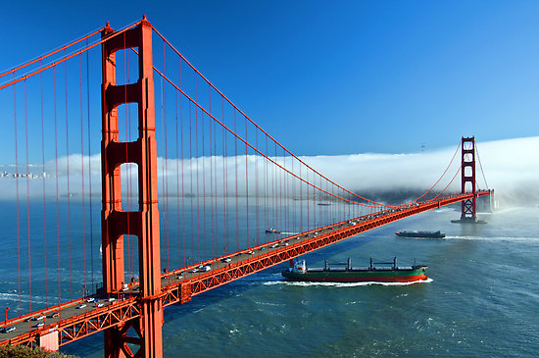
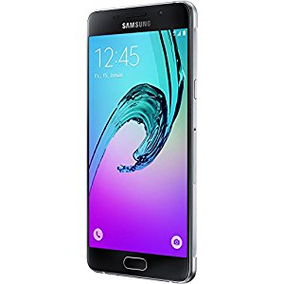
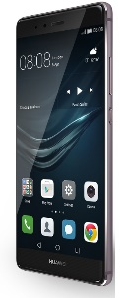
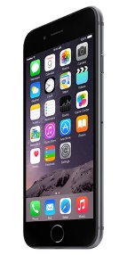
Source Identification problem (1)
Which is the specific source that has taken this photo?
Samsung A5
Huawei P9 lite
iPhone 6
Notes:
In camera attribution problem given a photo and a set of device we want to know (next)

Slide 11
Source Identification problem (2)
Which is the specific source that has taken this photo?
Samsung A5
Huawei P9 lite
iPhone 6
Notes:
which specific camera has taken the photo.

Slide 12
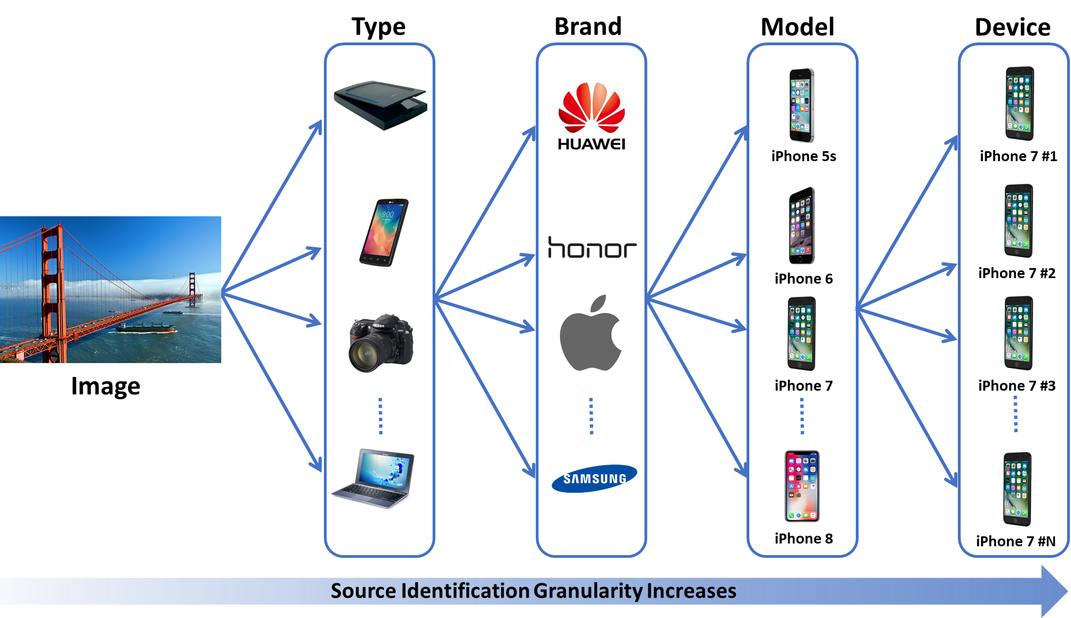
Source Identification Granularity

Slide 13
Outline
Introduction to Digital Image Forensics
Motivation and scenarios
Source identification through “device fingerprint”
Research activities
List of publications
Notes:
In this short talk (or seminar) I will give an introduction to digital image forensics with a particular look on source identification problems. Then motivation and some scenarios will be presented.

Slide 14
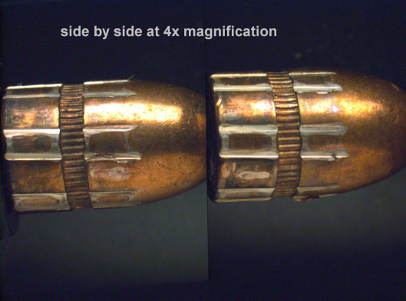
Source Identification : application scenarios
Camera ballistic : tracing the acquisition device finding the owner of the «guilty» device
  Child pornography image (or video)
  Bullying
  Finding or recognize a stolen device
  Linking social network account
  Validating an evidence image
Notes:
The source identification is a sort of camera balistics.
As we can link a bullet to the gun, we would link an image to the guilty device.
There are many applications scenarios where source identification is useful: child pornography, bullying, of if we want to recognize a stolen device, linking fraudolent social network account….

Slide 15
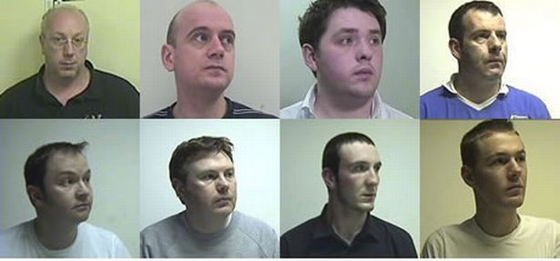
Application scenarios: a real case
Operation Algebra child rape convictions in Scotland
…Professor Hany Farid of Dartmouth College, New Hampshire and Dr Miroslav Goljan, of Binghamton University, New York extracted computer data from the images. This established that the Hogmanay image had been taken on a Sony Cybershot….
…Dr Farid was asked to analyze four digital camera images: the Hogmanay Image and three others known to have been taken by Strachan on a Sony Cybershot camera.
Dr Farid was able to show to the court that it was "highly likely" the four pictures came from the same camera, indicating the equipment was owned by Strachan.
http://p10.hostingprod.com/@spyblog.org.uk/blog/2009/05/09/operation-algebra-child-rape-convictions-in-scotland-open-wifi-tracking-digi.html
Notes:
But sometimes it works. In operation algebra, thanks to camera and model identification, the culpit of a child rape was catched.

Slide 16
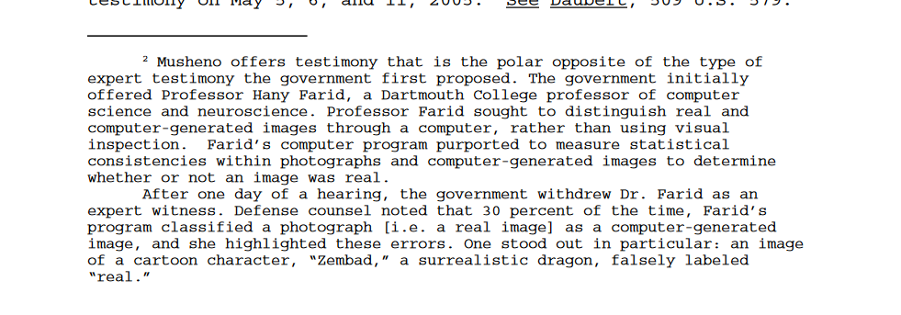
Application scenarios: a real case (fail)
Is the child pornography image real or computer-generated?
U. S. v. Rudy Frabizio, U.S. District Court, Boston, MA, 2008
http://euro.ecom.cmu.edu/program/law/08-732/Evidence/USvFrabizio.pdf
Notes:
Digital image forensics was used in court several times…not always has success. Here Professor Farid technique failed to distinguish computer generated images from real images.

Slide 17


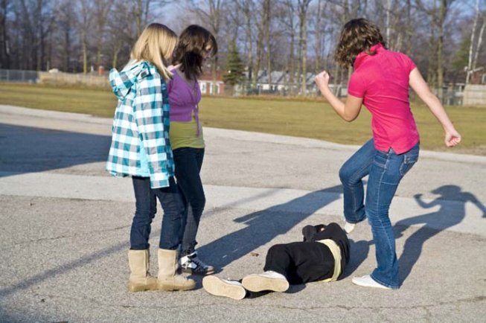



Application scenarios: investigation (1)
Picture-to-Identity on Social Network
Who takes this photo?
Notes:
Source identification can be useful, for example, if we want to link an image, to a social network account or…

Slide 18
Application scenarios: investigation (2)
Identity-to-Identity on Social Network
User 1
User 2
suspicious user
User 3
User 4
Notes:
If we want to link two identity. For example two social network account.

Slide 19
Outline
Introduction to Source Identification
Motivation and scenarios
Source identification through “device fingerprint”
Research activities
List of publications
Notes:
In this short talk (or seminar) I will give an introduction to digital image forensics with a particular look on source identification problems. Then motivation and some scenarios will be presented.

Slide 20
Device Fingerprint
The device fingerprint concept, stems from the forensic value of human fingerprints
In the ideal case, the device fingerprint have two properties:
  Diversity requires that no two device class/model/camera have the same fingerprint
  Stability requires that fingerprints remain the same over time
Swaminathan, A., Min Wu, & Liu, K.J.R. (2008). Digital Image Forensics via Intrinsic Fingerprints. IEEE Transactions on Information Forensics and Security, vol.3, no.1, pp.101-117
Notes:
The name «device fingerprint» as the name suggest, comes from the human fingerprint.
As the human controupart, in the ideal case it have two proprieties:
diversity: so two different device/model/class has different fingerprint
And Stability. So the fringerprint will no change over time

Slide 21
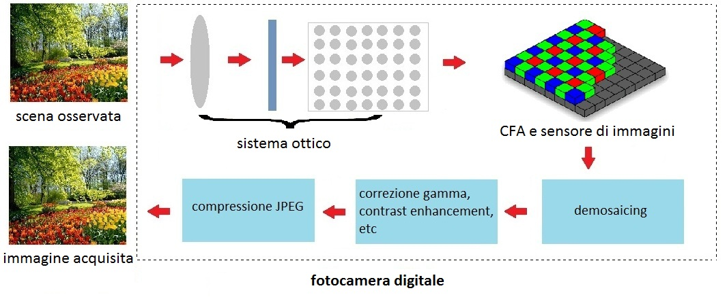
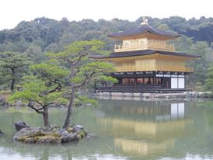
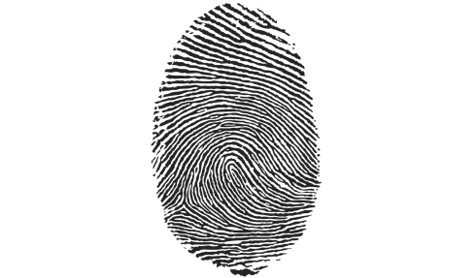
Device fingerprint in a digital image
Observed scene
Optical system
Sensor noise and CFA
JPEG
compression
Enhancement operations
demosaicing
Acquired image
Camera response function
Notes:
In the acquisition process of a digital images, the in-camera fingerprint is like «addedd» to the image. This fingerprint is made up by a unique device noise, called the sensor noise, and by micropattern due to the acquisition chain (lens aberration, demosaicing algorithm, white balancing, compression, and so on)

Slide 22

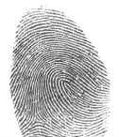
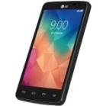
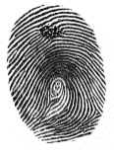
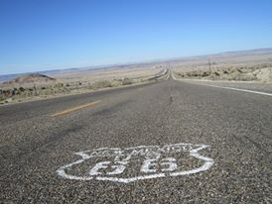
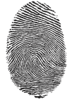
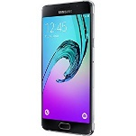

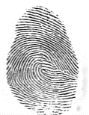
Source Identification with prior information
Prior: M cameras with known fingerprint
Goal: Associate the target image with one of the cameras
Camera 1
Target image
Camera 2
Fingerprints
dataset
Camera 3
Camera 4
Notes:
Usually in source camera identification, as prior information we have the PRNU of each camera.
We can construct a fingerprint dataset.
In order to make the identification it is possible to compare the noise residual of the target image with each fingerprint in the dataset.

Slide 23


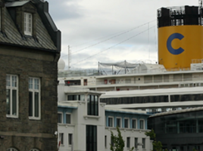




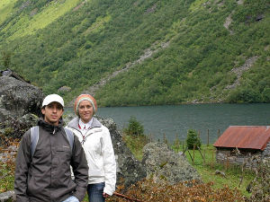
Blind image source identification
What happens if no prior information are available?
    How many cameras?
    How to calculate the device fingerprint?
Camera 1
Camera 2
Camera 3
Camera 4
Notes:
With this method everything works well and with good performances.
But often (in real case) we haven’t any prior information about camers and we have no information about images origin
This is what is called «blind image source identification»
For exaple here we haven’t information about how many cameras taken the photos in my dataset, so we cannot estimate the PRNUs

Slide 24




Blind image source identification
In each image noise residual there is a trace of the device fingerprint
We can perform a clustering algorithm
Notes:
Remembering that in each image noise residual there is a trace of the PRNU,
One thing we can do is to use the correlation between noise residuals as distance
and then performing a clustering algorithm.

Slide 25
Outline
Introduction to Source Identification
Motivation and scenarios
Source identification through “device fingerprint”
Research activities
List of publications
Notes:
In this short talk (or seminar) I will give an introduction to digital image forensics with a particular look on source identification problems. Then motivation and some scenarios will be presented.

Slide 26
Research activities
Identification with prior information
Zero knowlege source identification
Identification on Social Network
Counter-forensics

Slide 27



Research activities (2)
Identification with prior information
  A deep learning approach for model identification
    Application on Iris sensor
  Residual-based local features for model identification
Zero knowlege source identification
Identification on Social Network
Counter-forensics
Camera 1
CNN
Classifier
Camera 2
Target image
Camera 3
.
.
Camera N

Slide 28
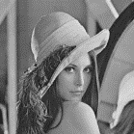
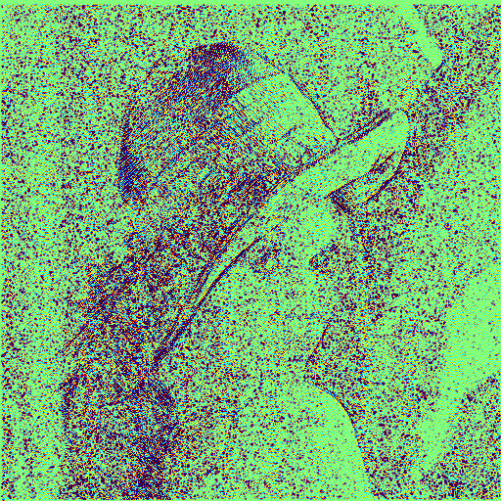
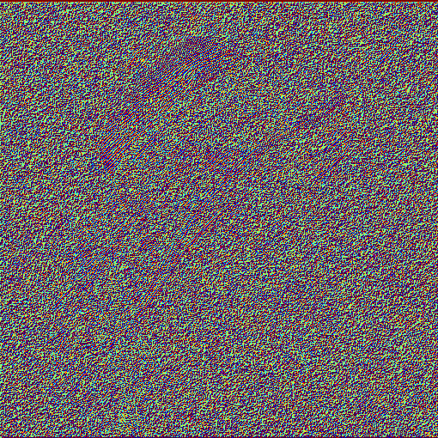
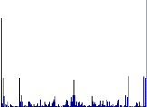
Research activities (3)
Identification with prior information
  A deep learning approach for model identification
    Application on Iris sensor
  Residual-based local features for model identification
Zero knowlege source identification
Identification on Social Network
Counter-forensics
filter
Feature extraction
Canon Ixus 70
Nikon Coolpix S710
Nikon D200
...
...
Samsung NV15
classifier
histogram

Slide 29
Research activities (4)
Identification with prior information
Zero knowlege source identification
  PRNU-based Image Clustering
  PRNU-based Forgery Localization
Identification on Social Network
Counter-forensics
PRNU-based Image Clustering
Image Dataset
Final clustering

Slide 30
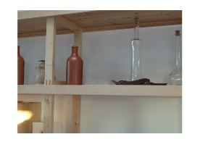
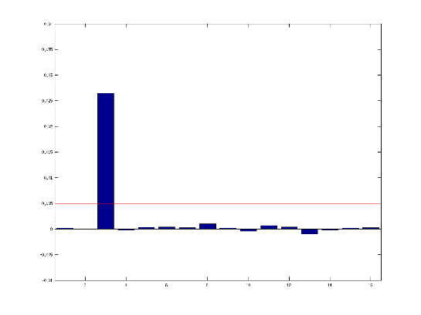
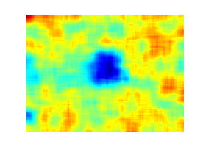
Research activities (5)
Identification with prior information
Zero knowlege source identification
  PRNU-based Image Clustering
  PRNU-based Forgery Localization
Identification on Social Network
Counter-forensics
Image Dataset
Probe Image
Cluster Assignment
PRNU-based forgery localization

Slide 31

Research activities (6)
Identification with prior information
Zero knowlege source identification
Identification on Social Network
Counter-forensics

Slide 32
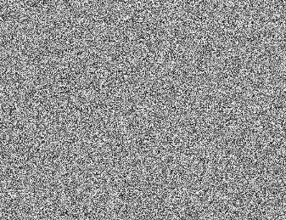


Research activities (7)
Identification with prior information
Zero knowlege source identification
Identification on Social Network
Counter-forensics
Adversal noise
Eve’s image
Alice’s image

Slide 33
Outline
Introduction to Source Identification
Motivation and scenarios
Source identification through “device fingerprint”
Research activities
    PRNU-based Image Clustering
List of publications
Notes:
In this short talk (or seminar) I will give an introduction to digital image forensics with a particular look on source identification problems. Then motivation and some scenarios will be presented.

Slide 34
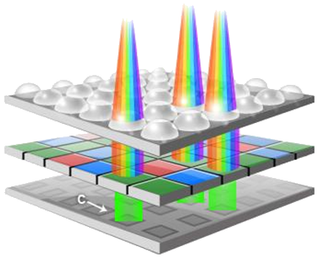

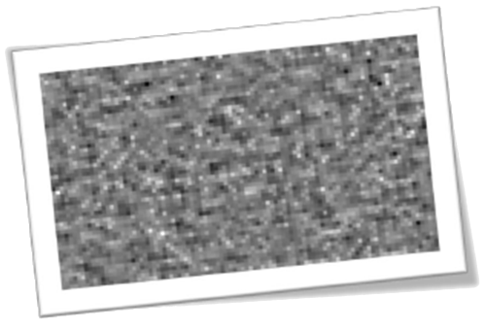
PRNU as a camera fingerprint
The Photo Response Non-Uniformity (PRNU) is a non spatial uniform behavior of imaging sensor.
It is caused by imperfections in the sensor manufacturing process.
It can be modeled as multiplicative factor:
It is
  specific of each camera
  constant in time
  embedded in every picture
  Robust to various processing procedures
Observed image
Additive noise
PRNU
Real scene
Notes:
Camera identification, rely on the so-called Photo Response Non-Uniformity (PRNU). It is a noise added by the sensor defects due to manifacturing process. It can be used for camera identification because it has all the proprietis we need : it is specific for each camera, constant in time, present in every picture and robust.

Slide 35
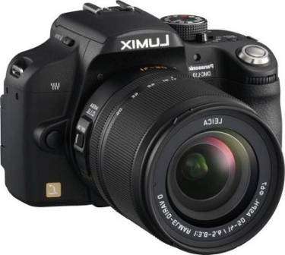
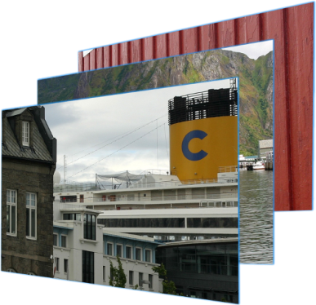


Camera Identification through PRNU
First step. Estimating the specific PRNU of the camera
Second step. Detecting the camera PRNU in the picture
Camera PRNU
Image to test
Camera PRNU
?
=
Notes:
The PRNU-based camera identification, as the other source identification, is made up by two step: estimation and detection

Slide 36
Blind PRNU-based camera identification
What happen if no prior information are avaible?
    How many cameras?
    How to calculate the PRNU?
In each image noise residual there is a trace of the PRNU
Calculating the NCC or PCE (as distance) between each image PRNU, we can perform a clustering algorithm
Single Image PRNU
Notes:
La problematica da affrontare per dover applicare la tecnica basata sul PRNU è stata
la mancata conoscenza per ogni fotografia della fotocamera utilizzata.
quindi ipotizzando che era limitato il numero di fotocamere utilizzate
abbiamo raggruppato le immagini di addestramento secondo la fotocamera utilizzata.

Slide 37
Blind camera id: State of the art
Bottom-up approach
    Bloy (2008) Pairwise Nearest Neighbors (PNN)
    Li (2010) unsupervised MRF approach
    Caldelli (2010) PNN + stopping by silouette coefficient
    Fahmy (2015) unsupervised PNN + unlabeled refinement
Top-down approach
    Amerini (2014) Ncut + stopping by aggregation coefficient
Notes:
In the literature, there are basically two kind of approaches: Bottom-up and Top-Down.
The bottom-up approach starts with all images as singleton and try to form larger cluster merging one single image at time to another cluster,
While the Top-down approach starts with all images in one cluster and at each iteration try to split one cluster in two.

Slide 38


Strengths/weaknesses of SoA
Bottom-up methods looks at single image-image links:
  Choosing the local best solution cause errors
Top-down approach looks at all the links at once
  Global optimization avoids problems caused by outlier weighs
Rely on one global parameter (hard to tune)
Parameters chosen by the model of the data itself
Notes:
What we learn from the past is that
- The greedy iteration of bottom-up approach is not the best solution. This because it looks only at image to image relationships.
- The top-down approach looks at all the links. This global optimization usually avoid problems caused by the outlier weights
- However this approach relsies on only one parameter, that gives best result on a training set is not the best solution
- Finally it is better to choose the parameter directly by the model of the data itself

Slide 39
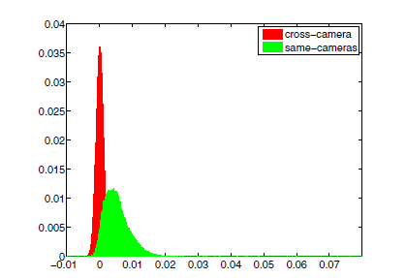
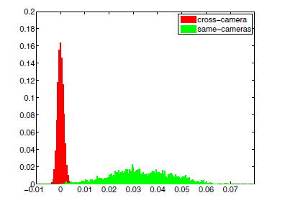
Motivations
Image to image correlations are unreliable
PRNU estimation improves with number of images
Simple parameters are easier to tune (for an unsupervised approach)
Estimation with N=1 images
Estimation with N=50 images
Notes:
There are three things that drive us in the choice of our algorithm:
The first is that the image-to-image correlations of noise residual are unreliable
In the figure on the left, in red there is the distribution of cross camera correlation and in green the intra-camera coming from one image
They are very close.
But we know that fingerprint estimation improves with the number of the images. On the right we have the same distribution but with correlation between images and a PRNU estimated using 50 images. This time the two distribution are well separated. And this is what we want
Third, we want to use simple parameter, such as threshold on the correlation that is simplier to estimate looking at these distributions

Slide 40
Blind PRNU-based Image Clustering for Source Identification
2-step algorithm: High-purity clustering + Cluster Refinement
Affinity
matrix
High-purity
Clustering
Cluster Refinement
Image Dataset
Final clustering
Affinity: noise-residual correlations
Ensemble clustering using Correlation clustering
Blind cluster merging
F. Marra, G. Poggi, C. Sansone and L. Verdoliva, Blind PRNU-based Image Clustering for Source Identification, IEEE Trans. on Information Forensics and Security (TIFS)
Notes:
In this new algorithm we keep the paradigm of the two step clustering, but in the first now we use an ensemble clustering method and in second a bayesian cluster refinement. Both will not need any parameters

Slide 41
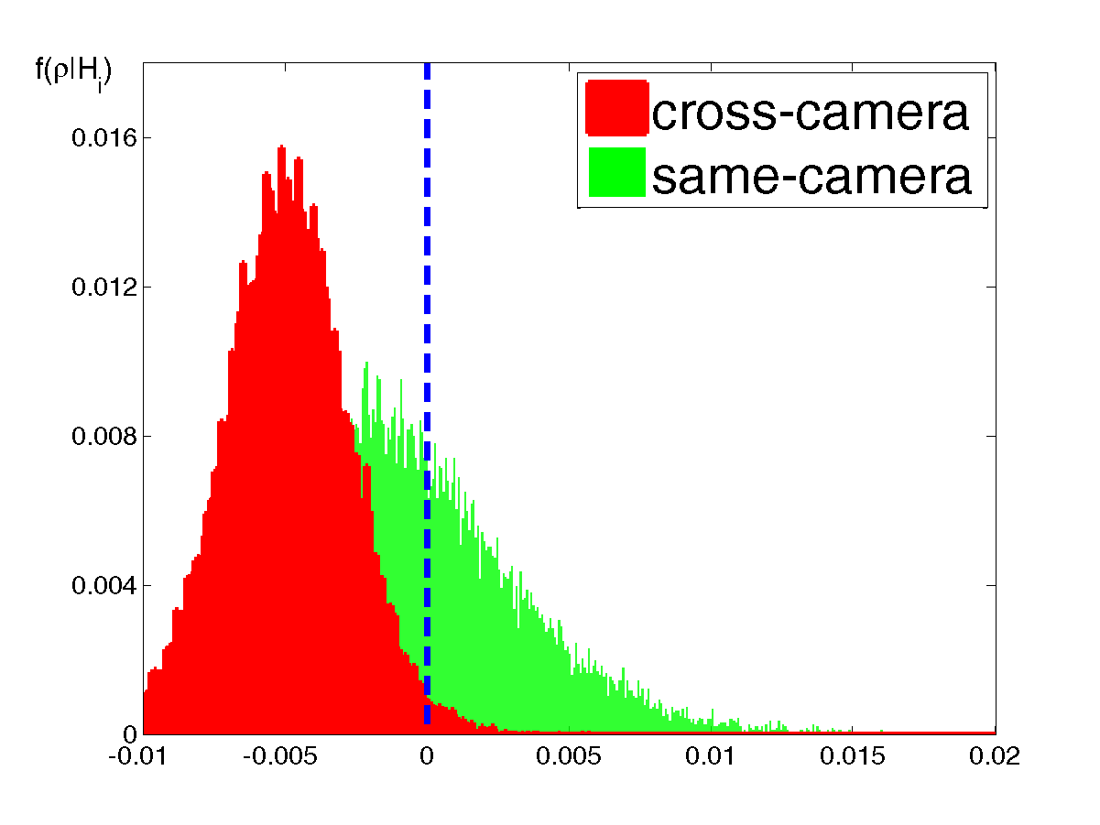
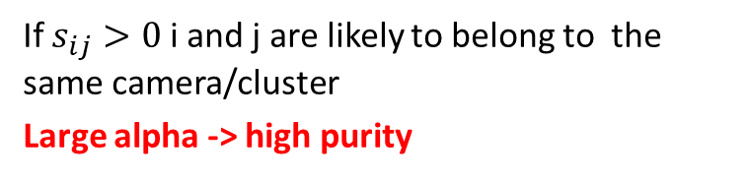
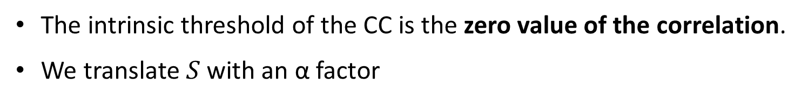
High-purity Clustering (1)
Solve the problem with the Correlation Clustering [Bansal04]
Tendency to belong to the same cluster
Tendency to belong to different clusters
The intrinsic threshold of the CC is the zero value of the correlation.
We translate$S$ with an α factor
If $s_{ij}>0$ i and j are likely to belong to the same camera/cluster
Large alpha -> high purity
[Bansal04] N. Bansal, A. Blum, S. Chawla, "Correlation Clustering". Machine Learning, (2004)
Notes:
The ensemble clustering methos combine multiple base partition of a given dataset forming a single clustering of better quality.
The base partition could come from different clustering algo, or the same algorithm with different parameter and so on…

Slide 42
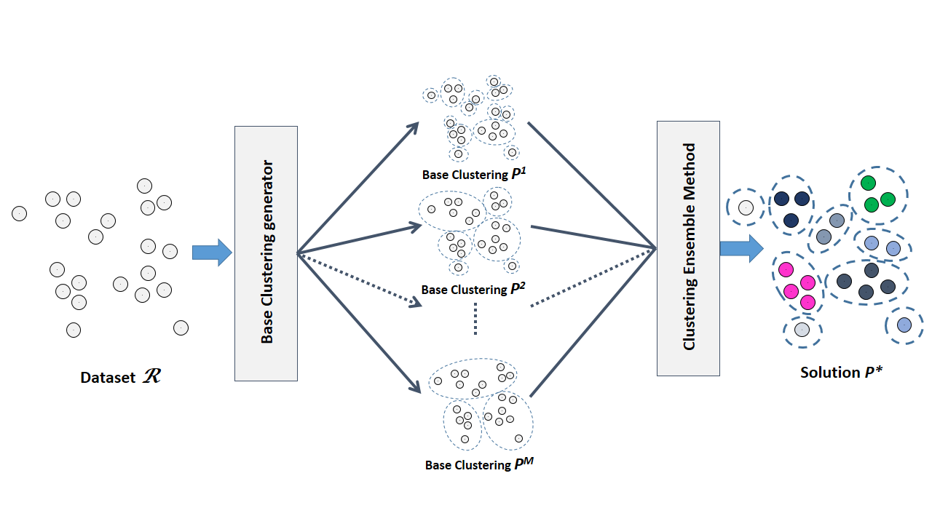
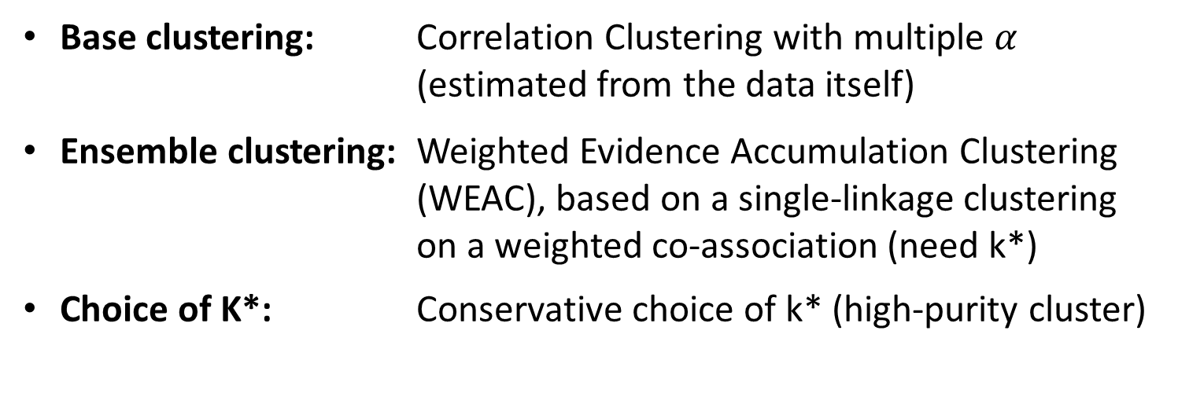
High-purity Clustering (2)
Base clustering: Correlation Clustering with multiple $α$
    (estimated from the data itself)
Ensemble clustering: Weighted Evidence Accumulation Clustering (WEAC), based on a single-linkage clustering on a weighted co-association (need k*)
Choice of K*: Conservative choice of k* (high-purity cluster)
Notes:
The ensemble clustering methos combine multiple base partition of a given dataset forming a single clustering of better quality.
The base partition could come from different clustering algo, or the same algorithm with different parameter and so on…

Slide 43
Clustering Refinement
The refinement step merges small clusters with larger ones, based on the correlation between their PRNUs
Notes:
After the first step, we have again a refinement step. But here we rely on in-camera and cross-camera distribution calculation and ML method for eliminating the need of the parameter.

Slide 44
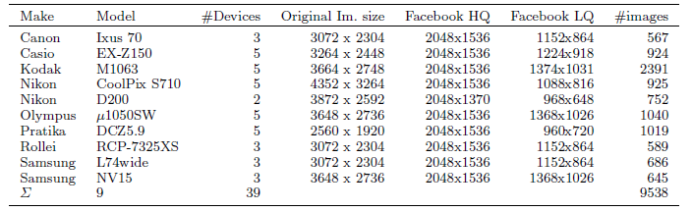
Clustering Results (dataset)
Images from Dresden dataset
We even uploaded them on Facebook and than downloaded using Facebook API
Notes:
Finally we show some results on Dresden dataset, both on original images that images uploaded and then downloaded from Facebook

Slide 45
Clustering Results
Results on original images
Results on images downloaded from Facebook (High-quality)
Notes:
The performance in term of ARI are higher of the SoA method, both on the original images,

Slide 46
Open issues on
Source identification
Blind methods on real-word scenario (scaled, translated, rotated images)
Merge of different source information (e.g. camera model, device)
Extension to video

Slide 47
Publications
Conference papers
D. Cozzolino, F. Marra, G. Poggi, C. Sansone, and L. Verdoliva
“PRNU-Based Forgery Localization in a Blind Scenario”
International Conference on Image Analysis and Processing (ICIAP), pages 569579, Sept 2017
(Best Paper Award - Special Mention)
F. Marra, G. Poggi, C. Sansone, and L. Verdoliva
“Correlation clustering for PRNU-based blind image source identification”
In IEEE International Workshop on Information Forensics and Security, pages 16, Dec. 2016
F. Marra, G. Poggi, C. Sansone, and L. Verdoliva
“Evaluation of residual-based local features for camera model identification”
New Trends in Image Analysis and Processing ICIAP 2015 Workshops, pages 1118, Sept. 2015
F. Marra, F. Roli, D. Cozzolino, C. Sansone, and L. Verdoliva
“Attacking the triangle test in sensor-based camera identification”
IEEE International Conference on Image Processing, pages 5307-5311, Oct. 2014
Journal papers
F. Marra, G. Poggi, C. Sansone, and L. Verdoliva
“A deep learning approach for iris sensor model identification”
Pattern Recognition Letters, 2017 (in press) doi:10.1016/j.patrec.2017.04.010
F. Marra, G. Poggi, C. Sansone, and L. Verdoliva
“Blind prnu-based image clustering for source identification”
IEEE Transactions on Information Forensics and Security, 12(9):21972211, Sept. 2017
F. Marra, G. Poggi, C. Sansone, and L. Verdoliva
“A study of cooccurrence based local features for camera model identification”
Multimedia Tools and Applcations, pages 117, Feb. 2017

Slide 48
…AND THE BEST IS YET TO COME!
Thank you for your attention

Slide 49
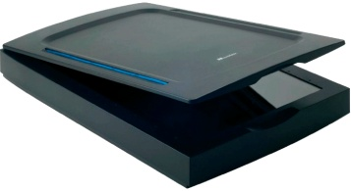


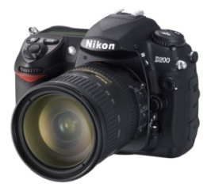
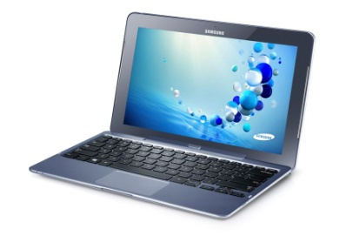
Device class Identification
Introduction to Digital Image Forensics
Is the image coming from a digital camera, a smartphone, a digital scanner, a camcorder or generated by computer graphic?
?
Notes:
In device class identification, we want to know if an image comes from (for example) a digital scanner, a camcorder, a digital camera or is computer generated

Slide 50
Device class Identification
Introduction to Digital Image Forensics
Is the image coming from a digital camera, a smartphone, a digital scanner, a camcorder or generated by computer graphic?
?
Notes:
In this case, the image is computer generated

Slide 51

Introduction to Digital Image Forensics
Model identification
Which iPhone took the photos below?
http://snapsnapsnap.photos/how-does-the-iphone-6-camera-compare-to-previous-iphone-cameras/
Notes:
In model identification, we want to assess which specific camera model took a given photo

Slide 52
Introduction to Digital Image Forensics
Model identification
Which iPhone took the photos below?
iphone 1
iphone 3G
iphone 3Gs
iphone 4
iphone 4s
iphone 5
iphone 5s
iphone 6
http://snapsnapsnap.photos/how-does-the-iphone-6-camera-compare-to-previous-iphone-cameras/

Slide 53
Introduction to Digital Image Forensics
Image Source Identification
Which is the specific camera that has taken this photo?
Samsung A5
Huawei P9 lite
iPhone 6
Notes:
In camera attribution problem given a photo and a set of device we want to know (next)

Slide 54
Introduction to Digital Image Forensics
Image Source Identification
Which is the specific camera that has taken this photo?
Samsung A5
Huawei P9 lite
iPhone 6
Notes:
which specific camera has taken the photo.

Slide 55
Outline
Introduction to Digital Image Forensics
Motivation and scenarios
What is the “device fingerprint”?
Camera Identification
Model Identification

Slide 56
Source Identification : application scenarios
Motivation and scenarios
Camera ballistic : tracing the acquisition device finding the owner of the «guilty» device
  Child pornography image (or video)
  Bullying
  Finding or recognize a stolen device
  Linking social network account
  Validating an evidence image
Notes:
The source identification is a sort of camera balistics.
As we can link a bullet to the gun, we would link an image to the guilty device.
There are many applications scenarios where source identification is useful: child pornography, bullying, of if we want to recognize a stolen device, linking fraudolent social network account….

Slide 57
Application scenarios: a real case (fail)
Motivation and scenarios
Is the child pornography image real or computer-generated?
U. S. v. Rudy Frabizio, U.S. District Court, Boston, MA, 2008
http://euro.ecom.cmu.edu/program/law/08-732/Evidence/USvFrabizio.pdf
Notes:
Digital image forensics was used in court several times…not always has success. Here Professor Farid technique failed to distinguish computer generated images from real images.

Slide 58
Application scenarios: a real case
Motivation and scenarios
Operation Algebra child rape convictions in Scotland
…Professor Hany Farid of Dartmouth College, New Hampshire and Dr Miroslav Goljan, of Binghamton University, New York extracted computer data from the images. This established that the Hogmanay image had been taken on a Sony Cybershot….
…Dr Farid was asked to analyze four digital camera images: the Hogmanay Image and three others known to have been taken by Strachan on a Sony Cybershot camera.
Dr Farid was able to show to the court that it was "highly likely" the four pictures came from the same camera, indicating the equipment was owned by Strachan.
http://p10.hostingprod.com/@spyblog.org.uk/blog/2009/05/09/operation-algebra-child-rape-convictions-in-scotland-open-wifi-tracking-digi.html
Notes:
But sometimes it works. In operation algebra, thanks to camera and model identification, the culpit of a child rape was catched.

Slide 59
Application scenarios: investigation
Motivation and scenarios
Picture-to-Identity on Social Network
Who takes this photo?
Notes:
Source identification can be useful, for example, if we want to link an image, to a social network account or…

Slide 60
Application scenarios: investigation
Motivation and scenarios
Identity-to-Identity on Social Network
User 1
User 2
suspicious user
User 3
User 4
Notes:
If we want to link two identity. For example two social network account.

Slide 61
Outline
Introduction to Digital Image Forensics
Motivation and scenarios
What is the “device fingerprint”?
Camera Identification
Model Identification
Temporal Forensics
Notes:
All the source identification methods (both class, model than source identification) rely on a sort of device fingerprint of different nature that is in every images. But first, I want to show you a scene from a famous movie that talk about the device fingerprint…

Slide 62
What we mean by Device Fingerprint?
What is the “device fingerprint”?
The device fingerprint concept, stems from the forensic value of human fingerprints
In the ideal case, the device fingerprint have two proprieties:
  Diversity requires that no two device class/model/camera have the same fingerprint
  Stability requires that fingerprints remain the same over time
Swaminathan, A., Min Wu, & Liu, K.J.R. (2008). Digital Image Forensics via Intrinsic Fingerprints. IEEE Transactions on Information Forensics and Security, vol.3, no.1, pp.101-117
Notes:
The name «device fingerprint» as the name suggest, comes from the human fingerprint.
As the human controupart, in the ideal case it have two proprieties:
diversity: so two different device/model/class has different fingerprint
And Stability. So the fringerprint will no change over time

Slide 63
Kind of device fingerprint
What is the “device fingerprint”?
Device fingerprint can be classified in three categories:
in-camera fingerprints: due to the digital acquisition process (specific optical system, color sensor and camera software);
out-camera fingerprints: processing applied to digital media modifies their properties (e.g. statistical, geometrical, etc.)
scene fingerprints: specific properties depending on the content, like lighting properties, which characterize the reproduced scene.
It is obvious that in the source identification problem, only the first category of traces, the in-camera fingerprints, will be taken into account
Caldelli R., Amerini I., Picchioni F., De Rosa A., Uccheddu F. (2010) Multimedia Forensic Techniques for Acquisition Device Identification and Digital Image Authentication
Notes:
In an image, there are more than one «fingerprint» to look:
The in-camera fingerprint, comes from the acquisition process
The out-camera fingerprint that are the traces let on images by processing like rescaling, rotating…
And scene fingerprint, like content or light proprieties
For source identification, we look only at the in-camera fingerprint

Slide 64
Acquiring a digital image
What is the “device fingerprint”?
Observed scene
Optical system
Sensor noise and CFA
JPEG
compression
Enhancement operations
demosaicing
Acquired image
Camera response function
Notes:
In the acquisition process of a digital images, the in-camera fingerprint is like «addedd» to the image. This fingerprint is made up by a unique device noise, called the sensor noise, and by micropattern due to the acquisition chain (lens aberration, demosaicing algorithm, white balancing, compression, and so on)

Slide 65


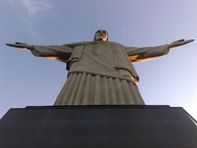
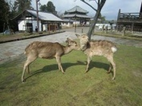

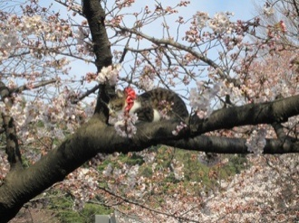
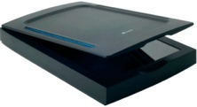
Source identification process
What is the “device fingerprint”?
In source identification, digital fingerprints are usually extracted and then compared with a dataset of possible fingerprints, specific for each kind/model/brand of acquisition devices, in order to link the digital data to the corresponding source
Notes:
Whatever is the source of the in-camera fingerprint, the typical source identification process, consist in the same steps

Slide 66
Source identification process
What is the “device fingerprint”?
In source identification, digital fingerprints are usually extracted and then compared with a dataset of possible fingerprints specific for each kind/model/brand of acquisition devices, in order to link the digital data to the corresponding source
Extract fingerprints
Fingerprints
dataset
Notes:
First we extract fingerprints from training set to form a fingerprint datasets or to train a classifier

Slide 67
Source identification process
What is the “device fingerprint”?
In source identification, digital fingerprints are usually extracted and then compared with a dataset of possible fingerprints specific for each kind/model/brand of acquisition devices, in order to link the digital data to the corresponding source
Compare fingerprints
Fingerprints
dataset
Notes:
After we compare those fingerprints with that of some probe images

Slide 68
Source identification process
What is the “device fingerprint”?
In source identification, digital fingerprints are usually extracted and then compared with a dataset of possible fingerprints specific for each kind/model/brand of acquisition devices, in order to link the digital data to the corresponding source
Link digital data to the source
Notes:
Due to the presence or not of a particular fingerprint we can link a digial image to his source.

Slide 69
Outline
Introduction to Digital Image Forensics
Motivation and scenarios
What is the “device fingerprint”?
Camera Identification
Model Identification
Notes:
Now I want to talk about the camera identification problem in general, and talk about two of my last work in blind source identification.

Slide 70
PRNU as a camera fingerprint
Camera Identification
The Photo Response Non-Uniformity (PRNU) is a non spatial uniform behavior of imaging sensor.
It is caused by imperfections in the sensor manufacturing process.
It can be modeled as multiplicative factor:
It is
  specific of each camera
  constant in time
  embedded in every picture
  Robust to various processing procedures
Observed image
Additive noise
PRNU
Real scene
Notes:
Camera identification, rely on the so-called Photo Response Non-Uniformity (PRNU). It is a noise added by the sensor defects due to manifacturing process. It can be used for camera identification because it has all the proprietis we need : it is specific for each camera, constant in time, present in every picture and robust.

Slide 71
Camera Identification through PRNU
Camera Identification
First step. Estimating the specific PRNU of the camera
Second step. Detecting the camera PRNU in the picture
Camera PRNU
Image to test
Camera PRNU
?
=
Notes:
The PRNU-based camera identification, as the other source identification, is made up by two step: estimation and detection

Slide 72


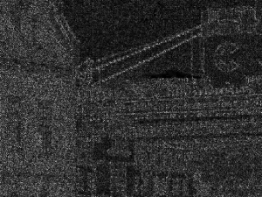
Step 1: PRNU estimation
Camera Identification
Observed image
Additive noise
PRNU
Real scene
The scene content is the strongest component of an image.
An estimate of the PRNU is obtained using a denoising filter:
Observed image ( )
Estimated Scene ( )
Residual ( )
Notes:
For extracting the PRNU we first remove the scene content performing a denoising filtering, obtaining the «noise residual of the image». This noise residual contain a trace of the PRNU
Extracting the PRNU from a single image however it contain only a weak trace of the image PRNU.

Slide 73
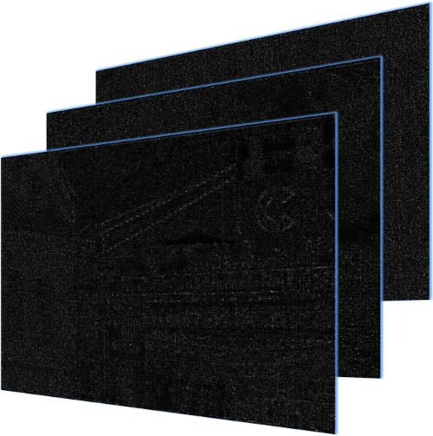

Step 1: PRNU estimation
Camera Identification
The PRNU can be estimated from many images taken by the camera.
Pictures from the camera
Estimated PRNU
Noise residuals
Notes:
To better estimate the PRNU of the camera we simply perform a weighted average of a large number noise residual of images taken by the same camera

Slide 74



Step 2 : PRNU Detection
Camera Identification
Analyzed image ( Y )
Residual ( W )
PRNU ( )
[Lukas2006] J. Lukas, J. Fridrich, and M. Goljan, “Digital Camera identification from sensor pattern noise” IEEE Transaction Inf. Foren.Sec. Vol. 1, 205–214 (2006).
Notes:
Detecting the presence of the PRNU from a probe image isn’t an hard task. We can do it, for example, by correlating the noise residual of the probe image with a given PRNU. If the correlation is high enough we can say that the image belong from that camera.

Slide 75

Camera Identification
Step 2 : PRNU Detection
The correlation allows to link the device which takes a photo with the photo itself
Taken by other cameras
Taken by target camera
False Positive
False Negative
correlation
Notes:
The figure shows the correlation histogram in case images not belonging a given camera (red bars) and images that are from the same device (green bars). Of course the two distribution overlap. The better is the estimation of the PRNU the lesser is the overlap area.

Slide 76
Identification with prior information
Camera Identification
Prior: M cameras with known fingerprint
Goal: Associate the target image with one of the cameras
Camera 1
Target image
Camera 2
Fingerprints
dataset
Camera 3
Camera 4
Notes:
Usually in source camera identification, as prior information we have the PRNU of each camera.
We can construct a fingerprint dataset.
In order to make the identification it is possible to compare the noise residual of the target image with each fingerprint in the dataset.

Slide 77
Blind image source identification
Camera Identification
What happens if no prior information are available?
    How many cameras?
    How to calculate the PRNU?
Camera 1
Camera 2
Camera 3
Camera 4
Notes:
With this method everything works well and with good performances.
But often (in real case) we haven’t any prior information about camers and we have no information about images origin
This is what is called «blind image source identification»
For exaple here we haven’t information about how many cameras taken the photos in my dataset, so we cannot estimate the PRNUs

Slide 78
Blind image source identification
Camera Identification
In each image noise residual there is a trace of the PRNU
Calculating the NCC or PCE (as distance) between each image PRNU, we can perform a clustering algorithm
Notes:
Remembering that in each image noise residual there is a trace of the PRNU,
One thing we can do is to use the correlation between noise residuals as distance
and then performing a clustering algorithm.

Slide 79
Camera Identification
Blind camera id: State of the art
Bottom-up approach
    Bloy (2008) Pairwise Nearest Neighbors (PNN)
    Li (2010) unsupervised MRF approach
    Caldelli (2010) PNN + stopping by silouette coefficient
    Fahmy (2015) unsupervised PNN + unlabeled refinement
Top-down approach
    Amerini (2014) Ncut + stopping by aggregation coefficient
[Bloy2008] Bloy GJ “Blind camera fingerprinting and image clustering.” IEEE Transactions PAMI, 2008
[Amerini2014] I. Amerini et al. “Blind image clustering based on the Normalized Cuts criterion for camera identification” Sig. Proc.: Im. Comm. (2014)
[Fahmy2015] O. M. Fahmy, “An efficient clustering technique for cameras identification using sensor pattern noise” , 2015, IWSSIP
Notes:
In the literature, there are basically two kind of approaches: Bottom-up and Top-Down.
The bottom-up approach starts with all images as singleton and try to form larger cluster merging one single image at time to another cluster,
While the Top-down approach starts with all images in one cluster and at each iteration try to split one cluster in two.

Slide 80
Outline
Introduction to Digital Image Forensics
Motivation and scenarios
What is the “device fingerprint”?
Camera Identification
  Correlation Clustering for PRNU-based Blind Image Source identification
Model Identification
Notes:
Now I want to talk about the camera identification problem in general, and talk about two of my last work in blind source identification.

Slide 81
Camera Identification
Strengths/weaknesses of SoA
Bottom-up methods looks at single image-image links:
  Choosing the local best solution cause errors
Top-down approach looks at all the links at once
  Global optimization avoids problems caused by outlier weighs
Rely on one global parameter (hard to tune)
Parameters chosen by the model of the data itself
Notes:
What we learn from the past is that
- The greedy iteration of bottom-up approach is not the best solution. This because it looks only at image to image relationships.
- The top-down approach looks at all the links. This global optimization usually avoid problems caused by the outlier weights
- However this approach relsies on only one parameter, that gives best result on a training set is not the best solution
- Finally it is better to choose the parameter directly by the model of the data itself

Slide 82
Camera Identification
Motivations
Image to image correlations are unreliable
PRNU estimation improves with number of images
Simple parameters are easier to tune (for an unsupervised approach)
Estimation with N=1 images
Estimation with N=50 images
Notes:
There are three things that drive us in the choice of our algorithm:
The first is that the image-to-image correlations of noise residual are unreliable
In the figure on the left, in red there is the distribution of cross camera correlation and in green the intra-camera coming from one image
They are very close.
But we know that fingerprint estimation improves with the number of the images. On the right we have the same distribution but with correlation between images and a PRNU estimated using 50 images. This time the two distribution are well separated. And this is what we want
Third, we want to use simple parameter, such as threshold on the correlation that is simplier to estimate looking at these distributions

Slide 83
Camera Identification
Correlation Clustering for PRNU-based Blind Image Source identification
2-step clustering
  High-purity preliminary clustering
  Reliable cluster refinement
The 1°step performs conservative clustering: only a few high-purity clusters are sought
The 2° step exploits reliable PRNU estimates to further merge all clusters
F. Marra, G. Poggi, C. Sansone and L. Verdoliva, "Correlation clustering for PRNU-based blind image source identification," 2016 IEEE International Workshop on Information Forensics and Security (WIFS), Abu Dhabi, 2016
[Bloy2008] Bloy GJ “Blind camera fingerprinting and image clustering.” IEEE Transactions PAMI, 2008
[Amerini2014] I. Amerini et al. “Blind image clustering based on the Normalized Cuts criterion for camera identification” Sig. Proc.: Im. Comm. (2014)
[Fahmy2015] O. M. Fahmy, “An efficient clustering technique for cameras identification using sensor pattern noise” , 2015, IWSSIP
Notes:
In 2016 at WIFS, we proposed an approach that is based on 2 step algorithm:
The first is a conservative step. In this we want to have some bigger cluster with high-purity, for estimating the cluster PRNUs.
Since the first step gives us an overpartitioned clustering we perform a second step that is a «cluster refinement»
Where we try to merge small cluster in the larger ones.

Slide 84
Camera Identification
Correlation Clustering for PRNU-based Blind Image Source identification
2-step algorithm: Correlation Clustering + Refinement
Affinity
matrix
High-purity
Clustering
Cluster Refinement
Image Dataset
α
Final clustering
β
Affinity: noise-residual correlations
Correlation clustering (graph-based)
Majority vote cluster merging
F. Marra, G. Poggi, C. Sansone and L. Verdoliva, "Correlation clustering for PRNU-based blind image source identification," 2016 IEEE International Workshop on Information Forensics and Security (WIFS), Abu Dhabi, 2016
Before talking about the translate α factor, let’s have a look inside the Correlation Clustering problem.
Notes:
More in detail our proposed method will first calculate the affinity matrix by correlationg noise-residual
after we perform the high purity clustering using the Correlation Clustering
And as second step we use a majority vote based cluster refinement.

Slide 85
Camera Identification
Correlation Clustering (1)
Recast the problem as a graph G=(V,E,S) partitioning
  V (vertices): images in the dataset
  E (edges): image-image relationship (fully connected)
  S (weights): correlations among noise residuals
Tendency to belong to the same cluster
Tendency to belong to different clusters
[Bansal2004] N. Bansal, A. Blum, S. Chawla, "Correlation Clustering". Machine Learning, (2004)
Notes:
The Correlation clustering is a graph based clustering.
In correlation clustering the weight on each edge express the correlation between nodes.
In general a positive correlation indicates a tendency to stay into the same cluster while
a negative correlation indicates a tendency to belong to different cluster.
This is a sort of attraction and repulsion behavior

Slide 86
Camera Identification
Correlation Clustering (2)
Recast the problem as a graph G=(V,E,S) partitioning
  V (vertices): images in the dataset
  E (edges): image-image relationship (fully connected)
  S (weights): correlations among noise residuals
Tendency to belong to the same cluster
Tendency to belong to different clusters
[Bansal2004] N. Bansal, A. Blum, S. Chawla, "Correlation Clustering". Machine Learning, (2004)
Notes:
So it is obvious that we have to keep together nodes with positive correlation and separate the others. This is the basic concept of correlation clustering.
Unfortunately what is shown here is only a just a trivial case, and the solution is very easy.

Slide 87

Camera Identification
Correlation Clustering (3)
How to cluster?
Notes:
In this case, the solution is not so obvious.
Each of the three solutions will break the meaning of the weight
How can we choose a solution?

Slide 88




Camera Identification
Correlation Clustering formulation
The problem can be cast as a constrained energy minimization
Edge $e$ cut
  generic
  solution
Variables $:$
  $$x∈{\left\{0,1\right\}}^{\left|E\right|}$$
Edge $e$ Retained
Energy function:
constraints
Objective:
We used the Large scale optimization in [Bagon2011]
[Bagon2011] S. Bagon, M. Galun, “Large scale correlation clustering optimization”, https://arxiv.org/abs/1112.2903
Notes:
Choosing an energy function to minimize (or maximize), we can recast the problem as a constraind energy minimization one.
So that, we want to find among the space of the “possible solutions” the one that minimize the energy function.
Since Correlation Clustering is an NP-hard problem, we used a large scale optimization proposed by Bagon 2011

Slide 89



Camera Identification
CC of noise residuals
High-purity Clustering
Affinity
matrix
Translate:
S_{α} = S - α
Correlation
Clustering
Refinement
step
Image Dataset
β
Final clustering
α
The intrinsic threshold of the CC is the zero value of the correlation.
We translate$S$ with an α factor: $S_{α}=S−α$
If $s_{ij}>0$ i and j are likely to belong to the same camera/cluster
Large alpha -> high purity
Notes:
Let’s come back to the first step of our proposed method. How the CC could be useful in our problem?
It seems that CC hasn’t any parameter to be set, but there is an intrinsic parameter that is the «zero of the correlation» that separate attaction links to the repulsive ones.
So, we want in our affinity matrix that for values greather than zero the images are likely coming from the same device.
What we do is to translate all weights by the factor alpha. In this way the distribution of cross-camera is almost all under the zero

Slide 90
Clustering Refinement Step
Choosing a large α parameter, CC provides a conservative clustering with a large number of clusters with high purity
Avoiding mixed clusters guarantees reliable PRNU estimates
The refinement step merges small clusters with larger ones, based on the correlation between their PRNUs
Notes:
Keeping in mind we will perform a refinement step, we don’t choose the alpha that gives the best performance on the training set but we set a higher alpha, so the result is an over-partitioned clustering, with high reliable cluster.
This gives us the opportunity to estimate reliable PRNU.
The refinement step tries to merge small clusters in bigger ones, based on majority voting algorithm.

Slide 91
Camera Identification
Clustering Refinement: example
After Correlation Clustering, with a conservative choise of α, there are many small but reliable clusters
Notes:
Let’s have a look on the refinement step. Here there are high purity clusters after the Correlation Clustering step

Slide 92


Clustering Refinement: example
Camera Identification
Step 1 (partition clusters in small and large):
(warning: T|C| is NOT a parameter, but a running threshold)
$$ℒ=\left\{C_{p}:\left|C_{p}\right|>T_{\left|C\right|}\right\}$$
$$𝒮=\left\{C_{p}:\left|C_{p}\right|≤T_{\left|C\right|}\right\}$$
T_{|C|} = 1
Notes:
At each itearation we separete «large> and <small> cluster. At first step we consider only singleton as small cluster, at the second iteration we will consider singleton and pairs…and so on.

Slide 93
Clustering Refinement: example
Camera Identification
Step 2 (estimate PRNU of large Cluster):
(Since clusters are “large” and “pure” estimates are reliable )
T_{|C|} = 1
Notes:
We estimate the PRNU of large cluster.

Slide 94


Camera Identification
Clustering Refinement: example
Step 3 (merge small clusters):
(Merge a small cluster if most of its residuals correlate “enough” with the large-cluster PRNU)
$$M_{pq}= \frac{1}{\left|C_{p}\right|}\sum_{i=1}^{\left|C_{p}\right|}{I_{\left[corr\left(R_{pi},K_{q}\right)>β\right]}}$$
$$q^{∗}=arg\max_{q}{M_{pq}}$$
β
x
Notes:
Then, based on a threshold parameter beta
if the majority of the images of the small cluster are enough correlated with the PRNU of one of the larger cluster, we merge them.
Here for example we merge three singleton with three different cluster.

Slide 95
Clustering Refinement: example
Camera Identification
Step 4 (terminate):
(If merging occurred, increase T_{|C|} and goto Step 1, Else stop.)
Notes:
We will repeat step 1 to 3 until changing are made

Slide 96
Camera Identification
Clustering Refinement: example
Step 1 & 2
T_{|C|} = 2
Notes:
So now we go ahead considering singleton and paris as small clusters.

Slide 97
Camera Identification
Clustering Refinement: example
Step 1 & 2
Step 3 & 4
β
x
T_{|C|} = 2
Notes:
And try to merge small cluster with one of the larger one.

Slide 98
Camera Identification
Clustering Refinement: example
Step 1 & 2
Step 3 & 4
β
T_{|C|} = 3
Notes:
If no merging occurs we stop.

Slide 99
Clustering Refinement: example
Camera Identification
DONE!
Notes:
So we have the final clustering.

Slide 100


Selection of the $α$ and $β$ parameters
Camera Identification
On the training set:
  $p(ρ|H_{0})∽𝒩(μ_{0},σ_{0})$: cross-camera correlations
  $p(ρ|H_{1})∽𝒩(μ_{1},σ_{1})$: intra-camera correlations
Conservative $α$:
  $$α= μ_{0}+3∙σ_{0} ⇒ P\left(ρ>α | H_{0}\right)≅{10}^{−3}$$
Majority voting threshold $β:$
  $β=E\left(ρ | H_{1}\right) ⇒ P\left(ρ>β | H_{1}\right)=0.5$
Notes:
The selection of the parameters are made on the training set.
First we calculate the image to image correlations of noise residuals.
And than we model the cross camera and intra camera correlations as a Gaussian distribution with given mean and standard deviation with EM algorithm.

Slide 101
Outline
Introduction to Digital Image Forensics
Motivation and scenarios
What is the “device fingerprint”?
Camera Identification
  Blind PRNU-based Image Clustering for Source Identification
Model Identification
Temporal Forensics
Notes:
Now I want to talk about the camera identification problem in general, and talk about two of my last work in blind source identification.

Slide 102

Removing the $α$ and $β$ parameters
The estimation of the parameters is the crucial point of the algorithm
A training set is needed
Not suitable for a real-world application
Notes:
Just yesterday evening I had the news that the a paper we submitted to the Transaction of Information For. And Sec. will be published, so I decided to arrange some slides for telling about this new work on blind image clustering without going deep in detail.
The main contribution we made, is to remove the needs of parameters estimation on a training set, that is the crucial point of WIFS paper.

Slide 103
Camera Identification
Blind PRNU-based Image Clustering for Source Identification
2-step algorithm: Ensemble Clustering (with CC)
+ Cluster Refinement
Affinity
matrix
High-purity
Clustering
Cluster Refinement
Image Dataset
α
Final clustering
β
Affinity: noise-residual correlations
WEAC Ensemble clustering using Correlation clustering
Blind cluster merging
F. Marra, G. Poggi, C. Sansone and L. Verdoliva, "Blind PRNU-based Image Clustering for Source Identification«, IEEE Trans. on Information Forensics and Security (TIFS)
Notes:
In this new algorithm we keep the paradigm of the two step clustering, but in the first now we use an ensemble clustering method and in second a bayesian cluster refinement. Both will not need any parameters

Slide 104
Ensemble clustering
The goal of an Ensemble clustering method is to combine multiple base partitions of given data into a single partition of better quality
The partitions could come from:
  Different clustering algorithms
  Running he same algorithm with different parameters or initializations
  Using different samples of the data
  Feature extraction/selection
Notes:
The ensemble clustering methos combine multiple base partition of a given dataset forming a single clustering of better quality.
The base partition could come from different clustering algo, or the same algorithm with different parameter and so on…

Slide 105
WEAC Ensemble clustering using CC
Base clustering: Correlation Clustering with multiple $α$
    (estimated from the data itself)
Ensemble clustering: Weighted Evidence Accumulation Clustering (WEAC), based on a single-linkage clustering on a weighted co-association (need k*)
Choice of K*: Conservative choice of k* (high-purity cluster)
Notes:
In our first step, as base clustering, we performed the correlation clustering on multiple parameter alpha. Here alpha is choosen from affinity matrix distribution itself.
As ensemble clustering we used the Weighted evidence accumulation clustering. Since the number of true clusters is needed, and we haven’t this information, we proposed an algorithm for estimate a conservative number of clusters k*.

Slide 106
Clustering Refinement
Some state-of-the-art methods
Step 1 (small and large cluster division):
Starting from T_{|C|} = 1. Call small cluster the ones that have less than T_{|C|} images, and large the others:
Step 2 (estimate PRNU and statistics):
Estimate all the PRNU of larger cluster, and with a leave-one-out method we estimate the two pdf (in-camera and cross-camera):
Step 3 (max log-likelihoods merging step):
Given H₀ or H₁, we can compute the log-likelihoods of the two hypotheses with respect to K_{p} for a whole cluster C_{q} by summing their individual log-likelihoods.
Step 4 (terminate condition):
Increase T_{|C|} and go to step 3 if some change has been done. Otherwise terminate.
F. Marra, G. Poggi, C. Sansone and L. Verdoliva, "Blind PRNU-based Image Clustering for Source Identification«, IEEE TIFS
Notes:
After the first step, we have again a refinement step. But here we rely on in-camera and cross-camera distribution calculation and ML method for eliminating the need of the parameter.

Slide 107
Clustering Results (dataset)
Images from Dresden dataset
We even uploaded them on Facebook and than downloaded using Facebook API
Notes:
Finally we show some results on Dresden dataset, both on original images that images uploaded and then downloaded from Facebook

Slide 108
Clustering Results (original images)
Results on original images
In term of ARI (Adjusted Rand Index)
F. Marra, G. Poggi, C. Sansone and L. Verdoliva, "Blind PRNU-based Image Clustering for Source Identification«, IEEE TIFS
Notes:
The performance in term of ARI are higher of the SoA method, both on the original images,

Slide 109
Clustering Results (Facebook images)
Results on images downloaded from Facebook (High-quality)
In term of ARI (Adjusted Rand Index)
F. Marra, G. Poggi, C. Sansone and L. Verdoliva, "Blind PRNU-based Image Clustering for Source Identification«, IEEE TIFS
Notes:
Then on facebook images. Is worth to say that all the other method, despite the one proposed by Fahmy, needs a training set for estimating the parameters.

Slide 110













A practical use in forgery localization
Image Dataset
Probe Image
Correlation with PRNU
of each cluster
Notes:
A blind PRNU-based image clustering could be used in a forgery localization framework. In the framework the image dataset is first clustered using a PRNU-based clustering method. Then the cluster PRNU are estimated and used for image-to-cluster assignment and …

Slide 111


A practical use in forgery localization
Image Dataset
Ground Truth
Probe Image
Correlation with PRNU
of each cluster
PRNU-based forgery localization
Notes:
…than used for a PRNU-based forgery localization task. Last week we submit a paper that analyze the weekness of this kind of framework on controlled dataset.

Slide 112
Future Work on
Source identification
Blind methods on real-word scenario (scaled, translated, rotated images)
Uses other information (e.g. camera model)
Video

Slide 113
Outline
Introduction to Digital Image Forensics
Motivation and scenarios
What is the “device fingerprint”?
Camera Identification
Model Identification
Temporal Forensics
Notes:
As the camera identification, even the model identification problem rely on in-camera fingerprint. For this task we don’t use the PRNU, but the micropattern that are introduced by the camera such as CFA, lens distorsion, compression…

Slide 114
Device fingerprint for Model Id
Model Identification
Knowledge-based Identification:
Exploits known details of specific in-camera processing like demosaicing, JPEG Quantization tables, Enhancement processes [1] [2]
Blind-feature identification:
Irrespective of the origin (CFA, JPEG, other) all models leave their own distinctive marks in the acquired images [3] [4]
[1] O. Celiktutan, B.S., Avcibas, I.: Blind identification of source cell-phone model. IEEE Transactions on Information Forensics and Security 3(3) (2008)
[2] Gloe, T.: Feature-based forensic camera model identification. In: LNCS Transactions on Data Hiding and Multimedia Security VIII. Volume 7228. (2012)
[3] Xu, G., Shi, Y.: Camera model identification using local binary patterns. In: IEEE International Conference on Multimedia and Expo. (2012) 392-397
[4] F. Marra, G.Poggi, C. Sansone, L. Verdoliva: A study of co-occurrence based features for camera model identication In International Journal on Multimedia Tools and Applications
Notes:
In literature there are basicly two kind of approches:
The knowledge-based that try to exploit a single known detail of in camera processing such as quantization table, demosaicing,
And the blind-feature identification, that try to extract such micropattern without looking at their origin.

Slide 115


Knowledge-based Identification
Model Identification
Image Quality Measure (IQM)
set of feature used in steganalysis [1]
High-Order Wavelet Statistics (HOWS)
moments of the wavelet coefficients over N subbands and three orientations as well as of the norms of the optimal linear predictor residuals [2]
Binary Similarity Measures (BSM)
Ojala features over the spatioquantal and spatiochromatic
patterns between bit planes [3]
[1] Ismail Avcıbas, Nasir Memon, and Bülent Sankur - Steganalysis Using Image Quality Metrics - IEEE Transaction on image processing, 2003
[2] S. Lyu and H. Farid, “Steganalysis using higher-order image statistics,” IEEE Trans. Inf. Forensics Security, 2006
[3] I. Avcibas, M. Kharrazi, N. Memon, and B. Sankur, “Image steganalysis with binary similarity measures,” J. Appl. Signal process., 2005
Notes:
In the first one category, some feature has been proposed such as Image quality measurement, statistics on wavelet or BSM

Slide 116
Blind-feature identification
Model Identification
Local Binary Pattern (LBP)
59-D LBP are extracted, from spatial domain of red and green color channels, their prediction-error 2D arrays, and the 1st-level diagonal wavelet sub-band of each image. [1]
Residual-based local descriptors (SPAM)
SPAM features (Subtractive Pixel Adjacency Matrix) [2] are extracted from each image for exploing different cameras micro-patterns due to their specific in-camera processing suite (CFA, JPEG, …). In [3] only one filter is used while in [4] all demosaicing filters are used.
Canon Ixus 70
Nikon Coolpix S710
Nikon D200
...
...
Samsung NV15
filter
Feature extraction
histogram
classifier
[1] Xu, G., Shi, Y.: Camera model identification using local binary patterns. In: IEEE International Conference on Multimedia and Expo. (2012) 392-397
[2] J. Fridrich, J. Kodovsky: Rich models for steganalysis of digital images. IEEE TIFS, 2012
[3] F. Marra, G.Poggi, C. Sansone, L. Verdoliva: A study of co-occurrence based features for camera model identication In International Journal on MTAP
[4] C. Chen and M. C. Stamm, "Camera model identification framework using an ensemble of demosaicing features," 2015 IEEE WIFS, Rome, 2015
Notes:
While non tailored feature extraction is used in blind-feature method, such as LBP (proposed by Xu in 2012) or the using the SPAM feature used before in steganalisys as I done in one of my previous work.

Slide 117
Model Identification
Model identification using CNN (1)
Tuama propose a deep learning approach for camera model identification, with:
  Preprocessing: to provide to the CNN a high-pass filtered image(256x256 patch) in order to delete the image content
  Convolutional layer: CNN with 3-Conv+ReLU layers + 1 Max Pooling
  Classification: Full-connected layers for classification
A. Tuama, F. Comby and M. Chaumont, "Camera model identification with the use of deep convolutional neural networks," 2016 IEEE International
Workshop on Information Forensics and Security (WIFS), Abu Dhabi, 2016
Notes:
Since the model identification is a classical feature extraction + classification problem, it is suitable for being resolved by a deep learning approach.
In 2016 Tuama proposed an architecture composed by three convolutional layer with activation, without pooling. Followed by one max pool operation before some full connected layers.
Before providing the image to the net, a preprocessing stage with a fixed high-pass filter is performed.

Slide 118
Model Identification
Model identification using CNN (2)
Bondi propose to:
  train a CNN for extracting a feature vector of 128 elements on a patch of 64x64 of the images
  Train a SVM on a single patch (that gives the 93% of accuracy)
  Majority voting on multiple patches of a single image for obtaining better results
L. Bondi; L. Baroffio; D. Guera; P. Bestagini; E. J. Delp; S. Tubaro, "First Steps Towards Camera Model Identification with Convolutional Neural Networks" in IEEE Signal Processing Letters
Notes:
Bondi quite in the same period, propose to train 4 layer CNN for extracting a 128 dimension feature, for each patch of the image. Than train a linear-SVM on such feature, and performing the model identification using a majority voting on multiple patches.
The results show promising results.

Slide 119
Outline
Introduction to Digital Image Forensics
Motivation and scenarios
What is the “device fingerprint”?
Camera Identification
Model Identification
  Model identification on biometrics:
  A Deep Learning Approach for Iris Sensor Model Identification
Notes:
As the camera identification, even the model identification problem rely on in-camera fingerprint. For this task we don’t use the PRNU, but the micropattern that are introduced by the camera such as CFA, lens distorsion, compression…

Slide 120
Model Identification
Sensor Model Identification on biometrics:
Iris interoperability framework
Arora propose a iris interoperability framework based on:
  Sensor model Identification module (based on entropy of RDWT sub-bands)
  Selective enhancement algorithm
S. Arora, M. Vatsa, R. Singh, A. Jain, On iris camera interoperability, in InternationalWorkshop on Biometrics and Forensics, 2012
Notes:
In my recent work accepted on PRL, we propose a deep learning approach for iris scanner sensor model identification.
We was inspired by a framework proposed by Arora in 2012, where a different enhancement algorithm is performed on each iris image coming from different sensor model.

Slide 121
Model Identification
A Deep Learning Approach for Iris Sensor Model Identification (1)
Inspired by the framework in Arora2012, in [1] we proposed a deep-learning approach for Iris Sensor Model Identification
Since the low number of images/patches available we decided to use a small network
[1] F. Marra, G.Poggi, C. Sansone, L. Verdoliva “A Deep Learning Approach for Iris Sensor Model Identification” in Pattern Recognition Letter, 2017
Notes:
What we did is to use a CNN for the model identification task.
First we tried to replicate the Tuama net, but it totally failed, so we decided to find a ad-hoc architecture. Since the number of available images on different iris sensor models are few, we decided to use a small network, with relatively few parameters.

Slide 122
Model Identification
A Deep Learning Approach for Iris Sensor Model Identification (2)
The dataset is composed by 9 Iris scanner models
We use 900 images per model and 9 paches from each image (60% training – 40% testing)
[1] F. Marra, G.Poggi, C. Sansone, L. Verdoliva “A Deep Learning Approach for Iris Sensor Model Identification” in Pattern Recognition Letter, 2017
Notes:
We collected a dataset from 9 iris scanner models, and used 900 images per model extracting 9 paches from each image.

Slide 123
Model Identification
A Deep Learning Approach for Iris Sensor Model Identification (3)
The performance gives promising result even on single patches (no majority vote like in Bondi2016)
Trained the CNN from a net pre-trained on images coming from the Dresden database (finetuning)
[1] F. Marra, G.Poggi, C. Sansone, L. Verdoliva “A Deep Learning Approach for Iris Sensor Model Identification” in Pattern Recognition Letter, 2017
Notes:
The performance on different patch size show promising results even using only a single patch.
We trained the CNN both from scratch than on a pre-trained network using the Dresden dataset.

Slide 124
Model Identification
A Deep Learning Approach for Iris Sensor Model Identification (4)
The errors occur when we try to identify the LG4000 and LG4100 model
[1] F. Marra, G.Poggi, C. Sansone, L. Verdoliva “A Deep Learning Approach for Iris Sensor Model Identification” in Pattern Recognition Letter, 2017
Notes:
Looking at confusion matrix, we can see how the performances basically are due to the presence of two LGs sensor model that are very similar.

Slide 125
Model Identification
A Deep Learning Approach for Iris Sensor Model Identification (5)
Performance of iris interoperability framework using VASIR recognition system and ad-hoc image enhancement algorithm proposed in Arora on IIITD CLI dataset
[1] F. Marra, G.Poggi, C. Sansone, L. Verdoliva “A Deep Learning Approach for Iris Sensor Model Identification” in Pattern Recognition Letter, 2017
Notes:
The performance on iris interoperability framework first proposed by Arora, using the VASIR recognition system, and the enhancement algorithm proposed by Arora, show an improvement on the previous model identification algorithm.

