Slide 1

University of Napoli Federico II, Napoli, Italy – February 9, 2022
PhD Presentation (Year 3)
Spaceborne Radar for Space Situational Awareness
Marco Maffei (PhD Candidate)
Antonio De Maio (Advisor), Augusto Aubry (Co-Advisor), Alfonso Farina (Honorary Advisor)

Slide 2
Roadmap
Introduction to Space Situational Awareness (SSA)
Notes on Channel-Target Phenomenology and Motion Models
Spaceborne Radar (SBR) Mission
SBR System Architecture
SBR Surveillance Mode
SBR Contacts Collection Strategy
SBR Functional Architecture
Towards Bayesian Multi Target Tracking (MTT)
Conclusions

Slide 3
Introduction to SSA (1/2)
The space environment around planet Earth comprises fluxes of natural and man-made junk which may keep orbiting (in case of debris) or passing by (in case of micrometeoroids) at several km/s.
A Collision threat exists between debris clouds and strategic infrastructure.
Pictorial view of planet Earth surrounded by debris. Horstmann et al., 2018.

Slide 4
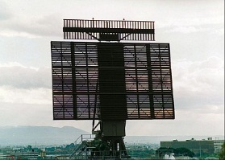
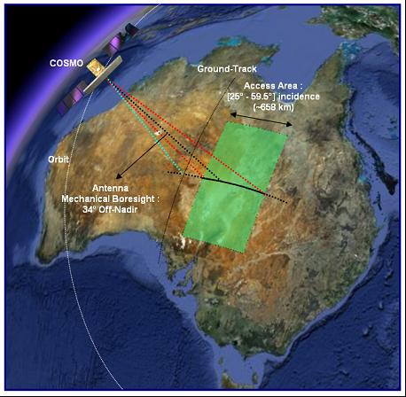
Introduction to SSA (2/2)
Ground Based Radars (GBRs) supporting SSA are either reflector based or Active Electronic Steering Array (AESA) based.
TIRA GBR (L Band).
Mehrholz et al., 2002.
Space Fence GBR (S Band).
Haimerl et al., 2016.
GESTRA GBR (L Band).
Wilden et al., 2016.
RAT-31 DL/M GBR (L Band).
Vigilante et al., 2015.
Current SBRs are not supporting SSA (i.e., GBRs are the only microwave active instruments for SSA) albeit SBRs measurements may benefit from a dedicated Field of View (FoV) along with novel signal processing schemes.
SBR predominantly used for SAR imaging.
Debris scattering scenario from SBR FoV.

Slide 5
Notes on Channel-Target Phenomenology and Motion Models
Channel-Target Phenomenology from a GBR Perspective:
UHF, L, S Bands enforcing scattering of small debris closer to the Rayleigh region.
Measurements affected by both neutral atmosphere and ionosphere.
Electromagnetic propagation in the aforementioned bands is more distorted by plasma nuisances.
Despite the availability of large transmit peak power at high geodetic altitudes power sensitivity is degraded.
Cells Under Test (CUTs) at high geodetic altitudes corresponds to more warped volumes of space.
Depending on the antenna radiation pattern and pointing as well as receiver bandwidth interference noise may arise from the Sun, the Earth, the radar itself, and also the Milky Way.
Data fusion for orbit estimation is carried out relying on multiple GBRs measurements.
Channel-Target Phenomenology from a SBR Perspective:
The Ka Band is becoming ripe thus enforcing scattering of small debris closer to the Optical region (scattering from multiple centers whose coherent reflectivity is influenced by electromagnetic roughness and relative permittivity).
Measurements affected solely by the ionosphere.
Electromagnetic propagation in the aforementioned band is less distorted by plasma nuisances.
The availability of smaller transmit peak power (kW) frames sufficient power sensitivity roughly within a 100 Km slant range.
Cells Under Test (CUTs) within such an operative slant range corresponds to less warped volumes of space.
Depending on the antenna radiation pattern and pointing as well as receiver bandwidth, interference noise may arise from the Sun, the Earth, the radar itself, and also the Milky Way.
A single SBR may provide an orbit estimation of a debris.
Characteristics of Orbital Motion:
Translational and rotational motions occur within an inertial (Euclidean) vector space due to two-body gravitational motion disturbed by nuisance accelerations and gravity torques.
Starting from an arbitrary true anomaly, the rectilinear displacement of a debris or a SBR is negligible during a short time elapse (e.g., a few seconds) and becomes significant after a longer time elapse (e.g., a few minutes).

Slide 6
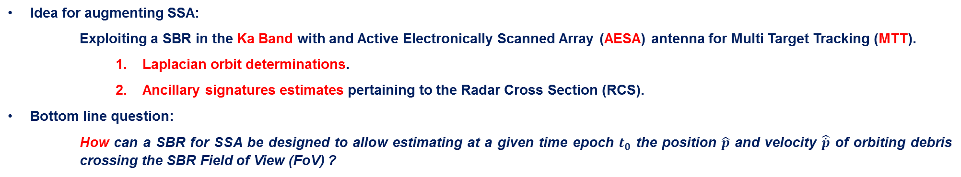
SBR Mission
Idea for augmenting SSA:
    Exploiting a SBR in the Ka Band with and Active Electronically Scanned Array (AESA) antenna for Multi Target Tracking (MTT).
      Laplacian orbit determinations.
      Ancillary signatures estimates pertaining to the Radar Cross Section (RCS).
Bottom line question:
    How can a SBR for SSA be designed to allow estimating at a given time epoch $t_{0}$ the position $\hat{p}$ and velocity $\hat{\dot{p}}$ of orbiting debris crossing the SBR Field of View (FoV) ?
Temporal motion concept of two debris crossing the SBR FoV.

Slide 7
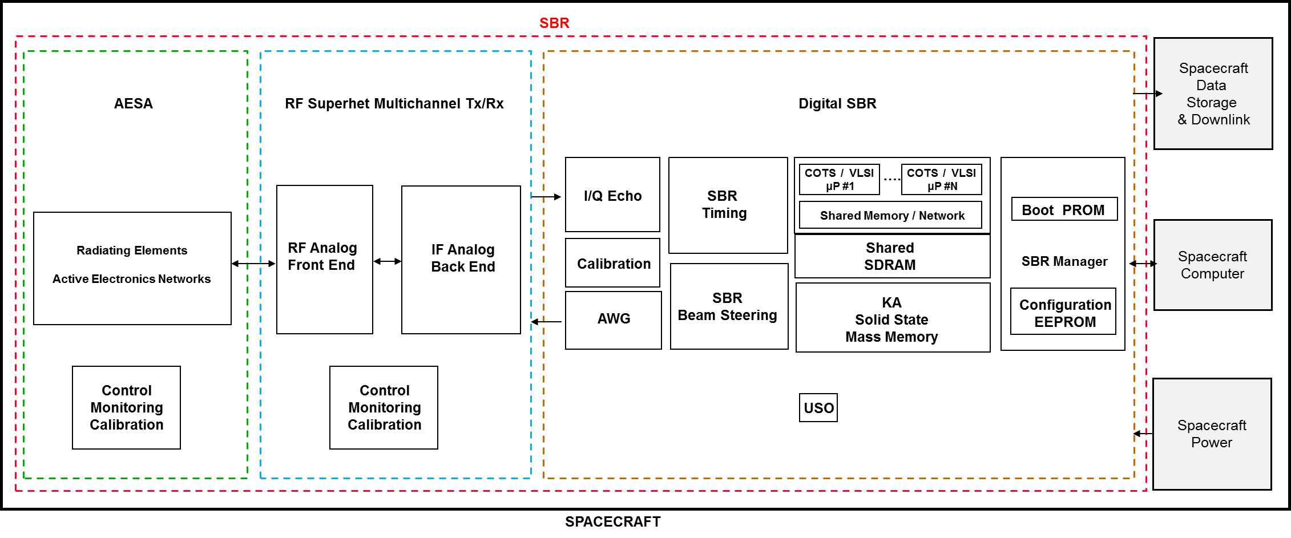
SBR System Architecture
The Technology Readiness Level (TRL) of several key enabling technologies allow envisaging a SBR architecture inspired by a monopulse-based pulse Doppler radar on an air-to-air mission striving to perform detection and parameter estimation of sprouting debris swarms using a bespoke surveillance mode.
A scalable FoV depends on the AESA transmit peak power and steering capabilities.
SBR architecture built upon a digital core.

Slide 8
SBR Surveillance Mode
  Surveillance Mode: Monitoring a Volume of Interest (VoI) via a search method in order to infer whether or not a debris cloud might be present and (possibly) ancillary scattering signatures thereof.
  Search Method: the SBR raster scans the VoI with an AESA beam and searches for targets via a Low Pulse Repetition Frequency (Low PRF) Range & Range-Rate Search (RRRS).
    During a dwell on the order of a few milliseconds a SBR illuminates an elongated volume of space (identified by an azimuth and elevation angular direction pair) and transmits a train of pulsed waveforms at a Low PRF.
    The elongated volume of space is parsed into cells whereby the SBR performs a binary hypothesis test to ponder whether or not a debris might be present.
    In case of a detection within a Cell Under Test (CUT) the SBR is able to estimate the echo range and range-rate.
SBR raster scanning the VoI via an AESA beam hopping every dwell.

Slide 9
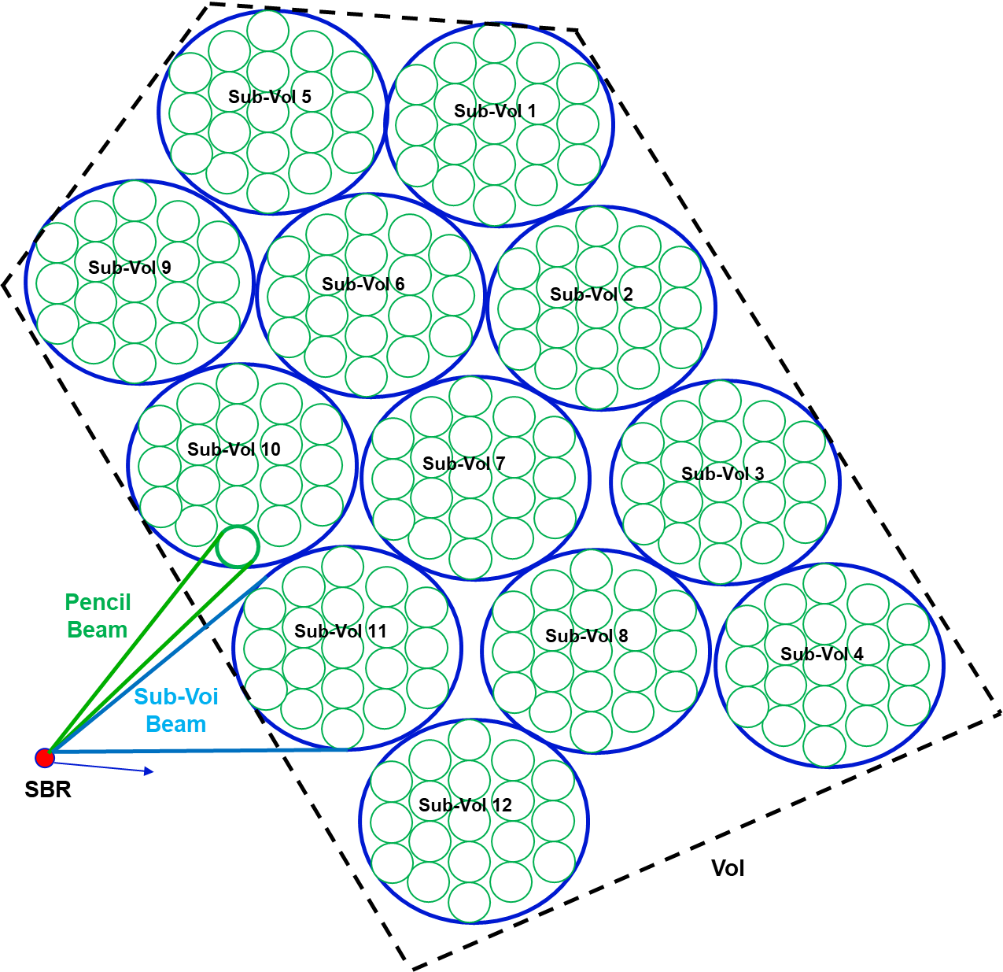
SBR Contacts Collection Strategy
  Contacts Collection Strategy: after the SBR has detected an (hyper-velocity target) in a CUT should the AESA beam be devoted to…
  …try to collect further detections of the same target, i.e., track the target (and abandon the search for other targets within the rest of the VoI)?
  …or keep searching for other targets within the rest of the VoI (thus abandoning the immediate collection of further detections of the first target which is moving away)?
The answer to these questions can be influenced by the extent of the VoI, the available multichannel diversity of the SBR and the SBR AESA beamwidth. Let us indicate (for example) 2 possible strategies:
Considering a small VoI, a Single Input Multiple Output (SIMO)
multichannel diversity, and a small AESA beamwidth once the
SBR collects a target detection it stops scanning the rest of the
VoI for other targets and devotes all radar resources to finely
track the target: Pause While Scan (PWS) Contacts Collection
Strategy.
Considering a large VoI, a Multiple Input Multiple Output (MIMO)
multichannel diversity, and a large AESA beamwidth the SBR
keeps scanning the VoI in a round robin fashion.
At every hopping dwell the SBR Signal Processor is able to form
many simultaneous small pencil beams within the large AESA
beamwidth whereby every target-detection is not immediately
but quite frequently re-collected and therefore target tracking
becomes feasible: Track While Simultaneous Search (TWSS)
Contacts Collection Strategy.

Slide 10
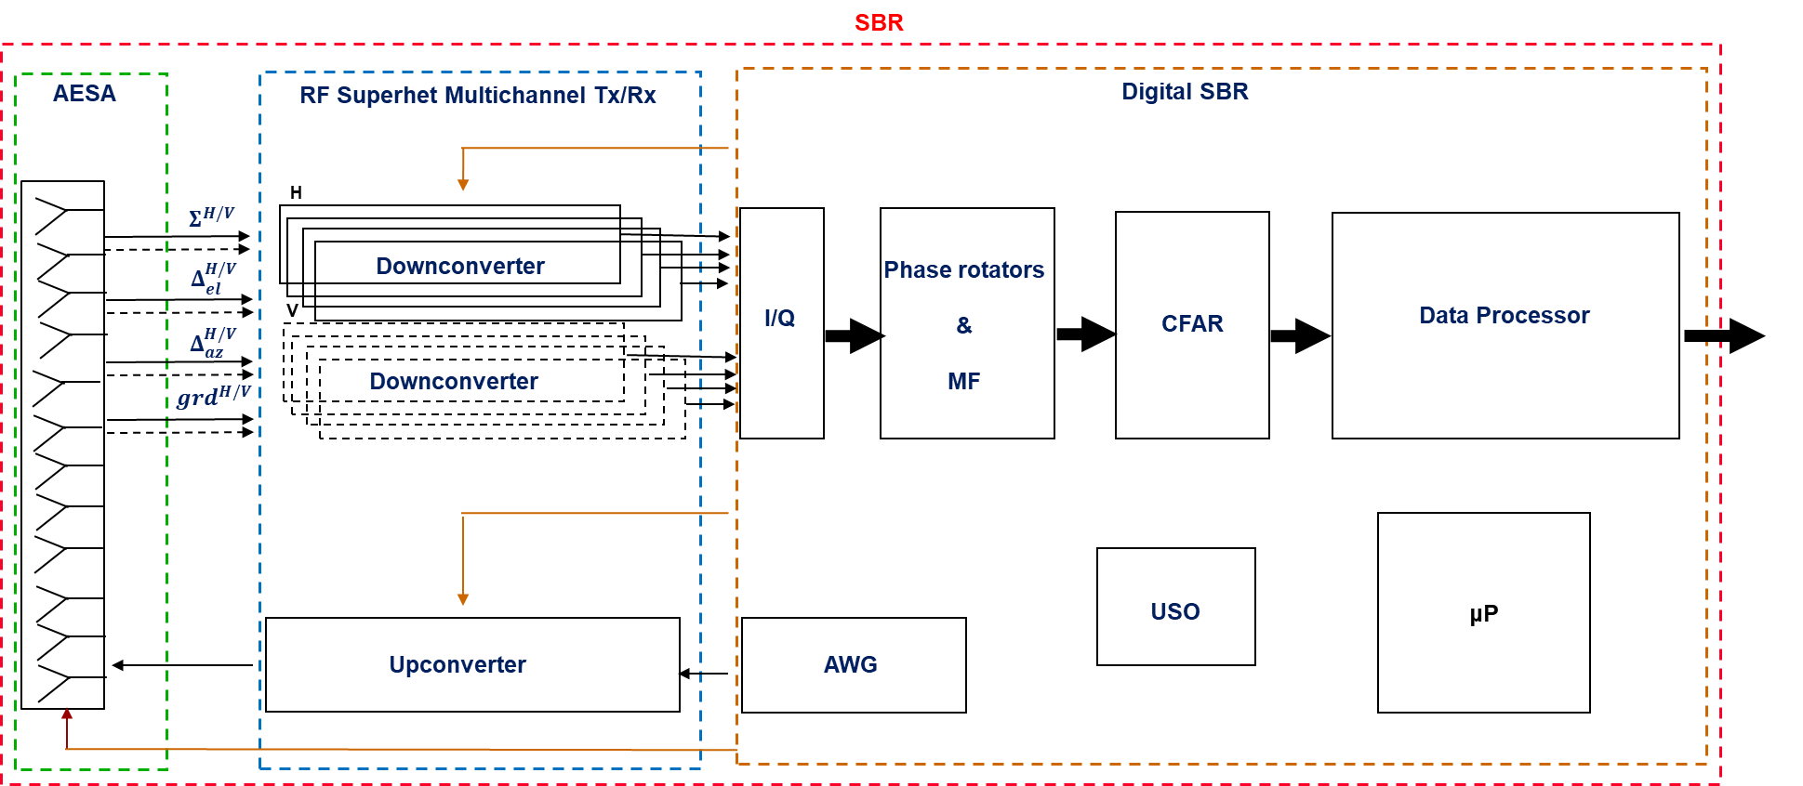
SBR Functional Architecture (1/3)
  SIMO-SBR architecture aimed at acquiring a complex data hyper-cube comprising 1 channel on transmit and 4 channels on receive for each polarization (i.e., 8 RF channels on receive).
    The transmit waveform is generated in the digital domain and upconverted to the desired Ka Band within a superheterodyne RF configuration and radiated in space via analog beamforming within the AESA subsytem.
    The receive channel at a given polarization comprises the monopulse sum, elevation-difference, azimuth-difference channels, and a guard channel for blanking.
    After suitable downconversion to an Intermediate Frequency (IF) and complex envelope extraction within an echo digitizer, the acquired samples can be processed through a bank of phase rotators in cascade with Matched Filters (MF), before feeding a Constant False Alarm Rate like (CFAR like) block (including editing) and finally fed to the data-processor for tracking purposes.
SIMO-based pulsed SBR main block schemes.

Slide 11
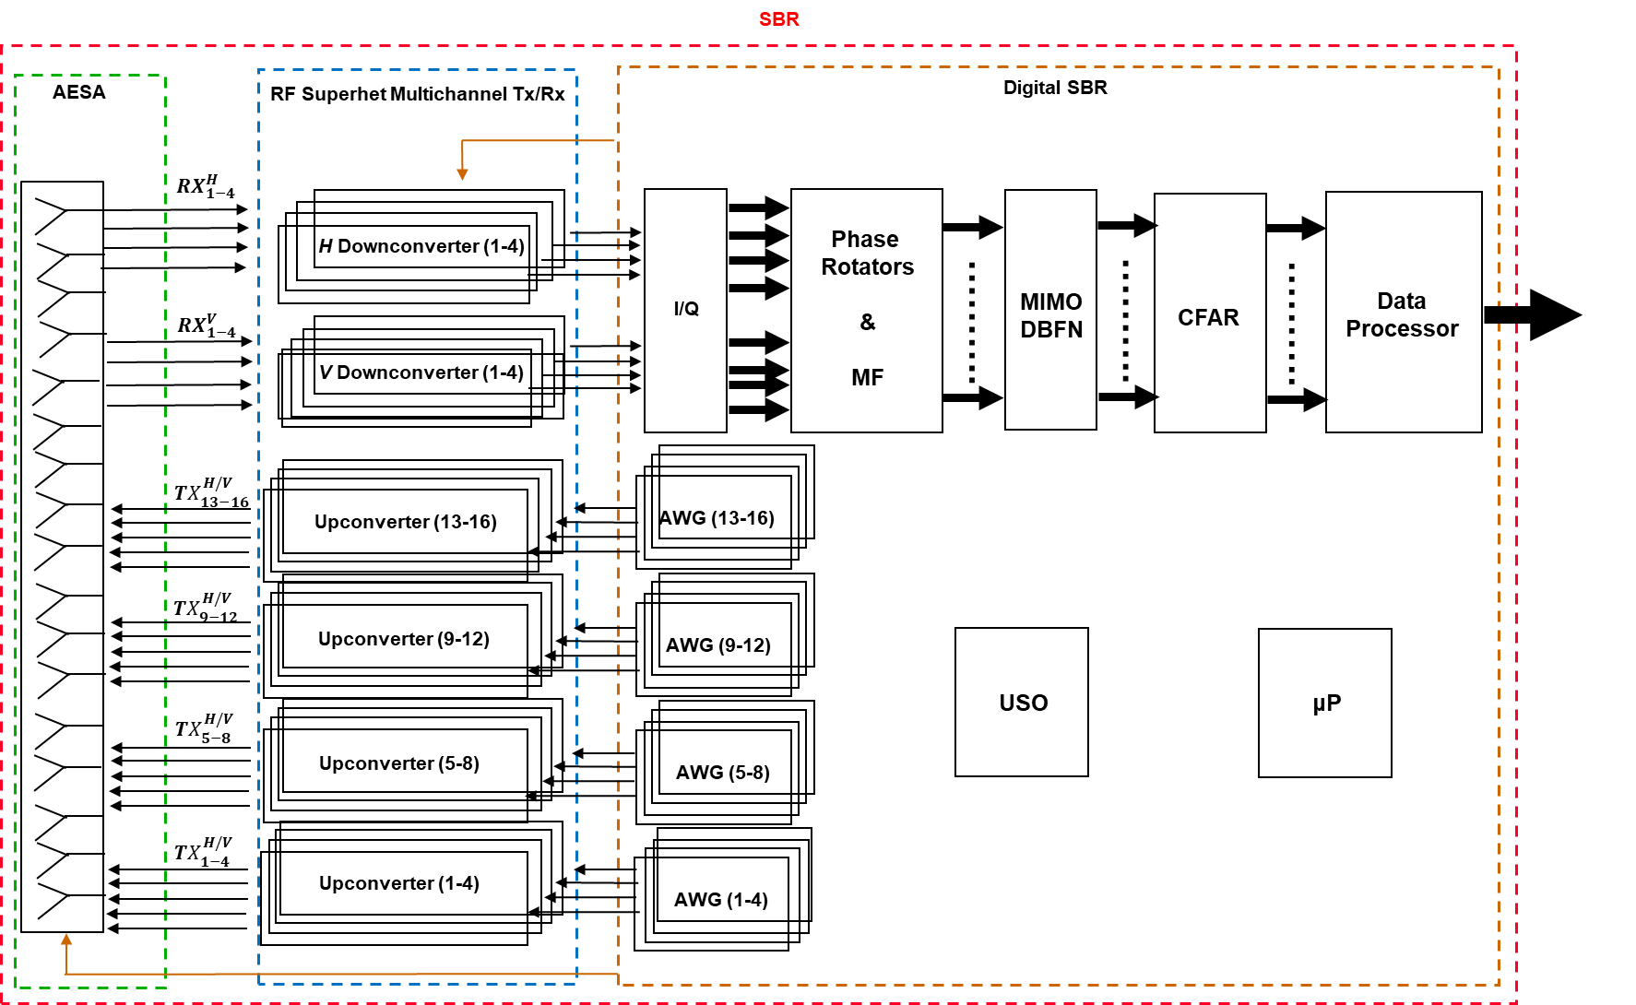
SBR Functional Architecture (2/3)
  MIMO-SBR architecture aimed at acquiring a complex data hyper-cube comprising 16 channel on transmit and 4 channels on receive for each polarization (i.e., 8 RF channels on receive).
    The 16 transmit waveforms are generated in the digital domain and upconverted to the desired Ka Band within a superheterodyne RF configuration and radiated in space via analog beamforming within the AESA subsystem (partitioned into transmit-subarrays).
    The 4 receive channels at a given polarization are extracted via analog beamforming within the AESA subsystem (partitioned into receive-subarrays).
    After suitable downconversion to an Intermediate Frequency (IF) and complex envelope extraction within an echo digitizer, the acquired samples can be processed through a bank of phase rotators in cascade with Matched Filters (MF), a MIMO Digital Beam Forming Network (DBFN) for forming pencil beams, a Constant False Alarm Rate like (CFAR like) block (including editing) and finally a data-processor for tracking purposes.
MIMO-based pulsed SBR main block schemes.

Slide 12
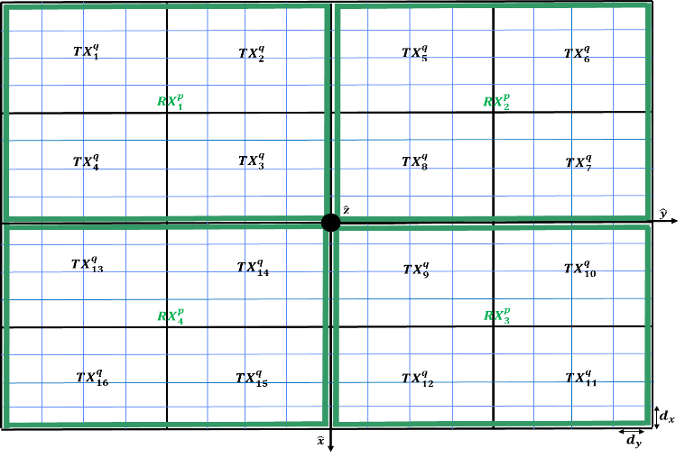
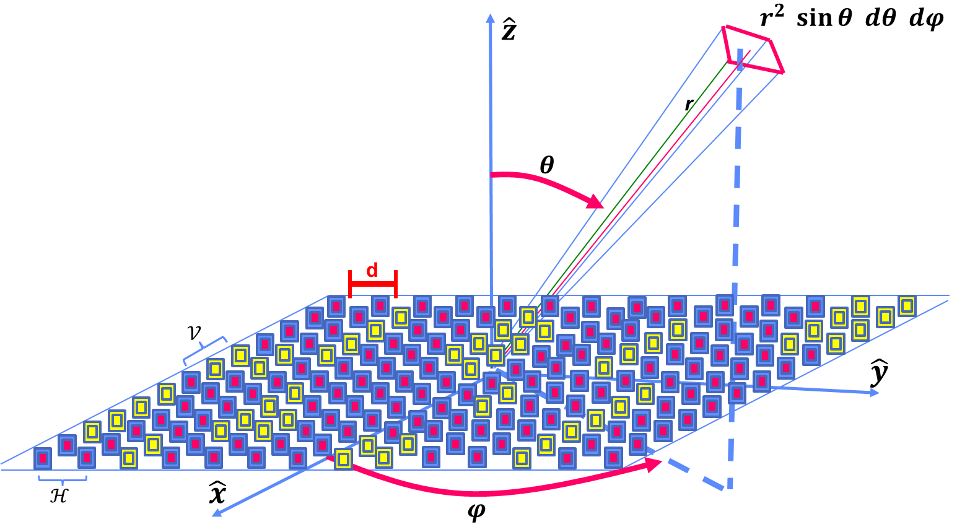
SBR Functional Architecture (3/3)
The SBR entails $N_{T}$ transmit channels at a given polarization $q$, i.e., ${TX}_{s}^{q}$ (for $s=1,…,N_{T}$, and $q$ either $H$ or $V$) and $N_{R}$ receive channels per receive-polarization, i.e., ${RX}_{g}^{p}$ (for $g=1,…,N_{R}$, with $N_{R}=4$, and $p$ either $H$ or $V$) relying on a subarray-based AESA configuration based on Domino-Tiles.
$N_{T}$ $=$ 1 for a SIMO SBR and $N_{T}$ $=$ 16 for a MIMO SBR.
SIMO/MIMO subarray-based AESA configuration.
Domino-Tile-based Subarray Concept.

Slide 13
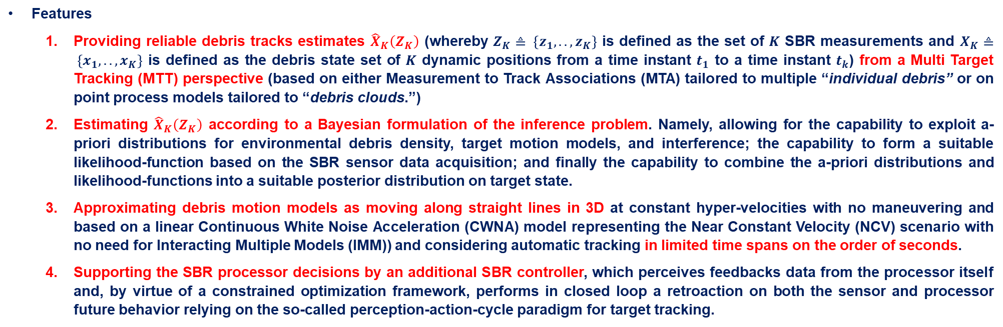
Towards Bayesian MTT
Features
  Providing reliable debris tracks estimates ${\hat{X}}_{K}\left(Z_{K}\right)$ (whereby $Z_{K}≜ \left\{z_{1},..,z_{K}\right\}$ is defined as the set of $K$ SBR measurements and $X_{K}≜ \left\{x_{1},..,x_{K}\right\}$ is defined as the debris state set of $K$ dynamic positions from a time instant $t_{1}$ to a time instant $t_{k}$) from a Multi Target Tracking (MTT) perspective (based on either Measurement to Track Associations (MTA) tailored to multiple “individual debris” or on point process models tailored to “debris clouds.”)
  Estimating ${\hat{X}}_{K}\left(Z_{K}\right)$ according to a Bayesian formulation of the inference problem. Namely, allowing for the capability to exploit a-priori distributions for environmental debris density, target motion models, and interference; the capability to form a suitable likelihood-function based on the SBR sensor data acquisition; and finally the capability to combine the a-priori distributions and likelihood-functions into a suitable posterior distribution on target state.
  Approximating debris motion models as moving along straight lines in 3D at constant hyper-velocities with no maneuvering and based on a linear Continuous White Noise Acceleration (CWNA) model representing the Near Constant Velocity (NCV) scenario with no need for Interacting Multiple Models (IMM)) and considering automatic tracking in limited time spans on the order of seconds.
  Supporting the SBR processor decisions by an additional SBR controller, which perceives feedbacks data from the processor itself and, by virtue of a constrained optimization framework, performs in closed loop a retroaction on both the sensor and processor future behavior relying on the so-called perception-action-cycle paradigm for target tracking.
Perception-Action-Cycle paradigm for target tracking.

Slide 14
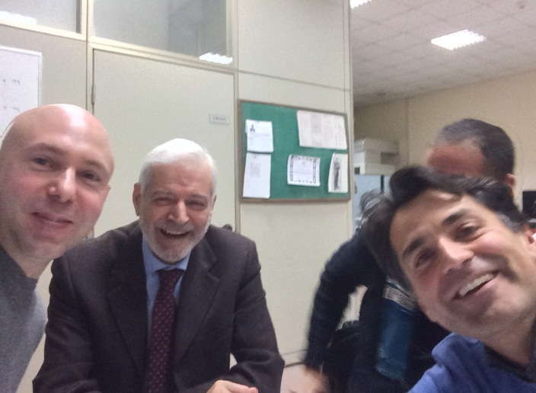
Conclusions (1/2)
In my PhD work at the University of Napoli Federico II, a research avenue has been conceived for Novel SBRs to support SSA considering small-size debris detection, tracking, and classification, under the guidance of Prof. A. De Maio (advisor), Prof. A. Aubry (coadvisor), and Prof. A. Farina (honorary advisor).
From left to right:
Marco, Alfonso, Augusto, Antonio.

Slide 15
Conclusions (2/2)
REFERENCES
M. Maffei, A. Aubry, A. De Maio, A. Farina, “On the Exploitability of the Ka Band for Spaceborne Radar Debris Detection and Tracking Measurements,” 2019 IEEE International Workshop on Metrology for Aerospace, Torino, Italy, June 2019.
M. Maffei, A. Aubry, A. De Maio, A. Farina, “Spaceborne Radar Functional Architecture for Debris Bayesian Inference,” 2020 IEEE International Workshop on Metrology for Aerospace, Pisa, Italy, June 2020.
De Maio, M. Maffei, A. Aubry, A. Farina, “Fading Occurrence Probabilities for Spaceborne Radar in Weak Plasma Scintillation,” 2021 IEEE International Workshop on Metrology for Aerospace, Napoli, Italy, June 2021.
M. Maffei, A. Aubry, A. De Maio and A. Farina, "An Ontology for Spaceborne Radar Debris Detection and Tracking: Channel-Target Phenomenology and Motion Models," in IEEE Aerospace and Electronic Systems Magazine, vol. 36, no. 6, pp. 18-42, 1 June 2021.
M. Maffei, A. Aubry, A. De Maio, A. Farina, “Spaceborne Radar Sensor Architecture for Debris Detection and Tracking,” IEEE Transactions on Geoscience and Remote Sensing, 2021.
A. De Maio, M. Maffei, A. Aubry, A. Farina, “Effects of Plasma Media with Weak Scintillation on the Detection Performance of Spaceborne Radars,” IEEE Transactions on Geoscience and Remote Sensing, 2021.
M. Maffei, A. Aubry, A. De Maio, A. Farina, “MIMO SBR via Code Division Multiplexing for Track While Simultaneous Search,” under final review to appear, IEEE Transactions on Geoscience and Remote Sensing.
M. Maffei, A. Aubry, A. De Maio, A. Farina, “Fully Polarimetric Monopulse SBR for Space Situational Awareness,” book chapter under final review on “Polarimetric Radar Signal Processing,” ed. by A. Aubry, A. De Maio, A. Farina, IET, 2022.
https://www.radarconf20.org/3-minute-thesis

