Slide 1
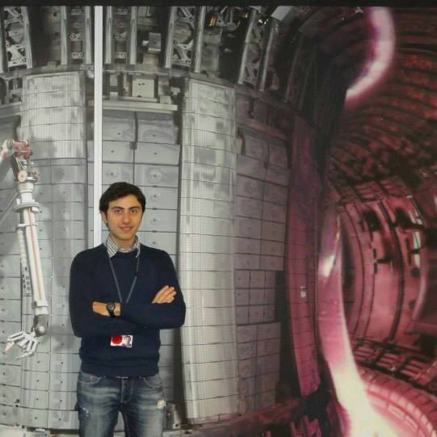
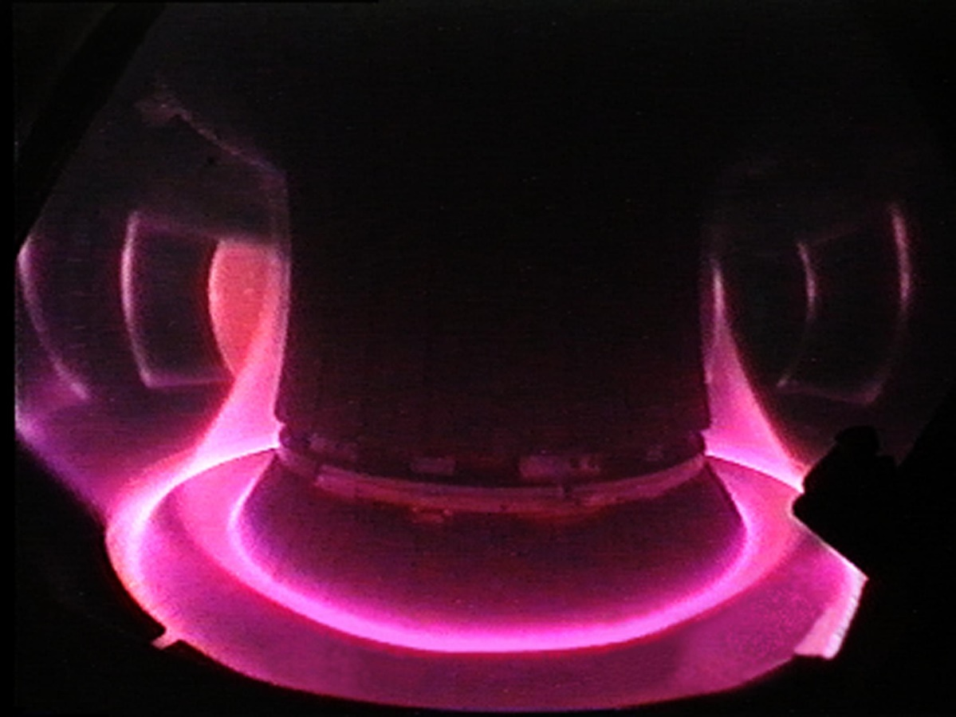
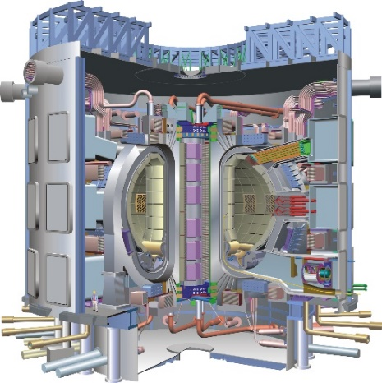
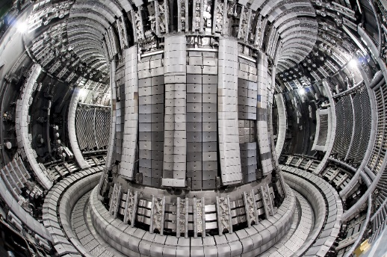
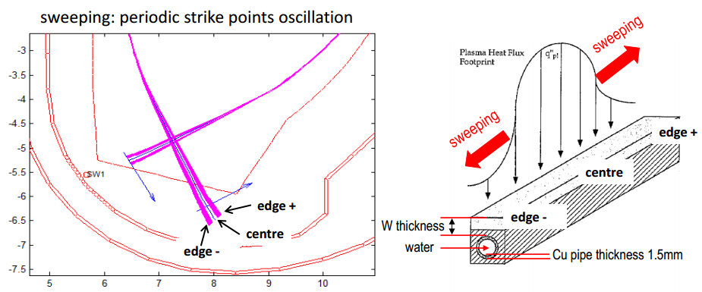
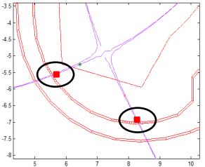
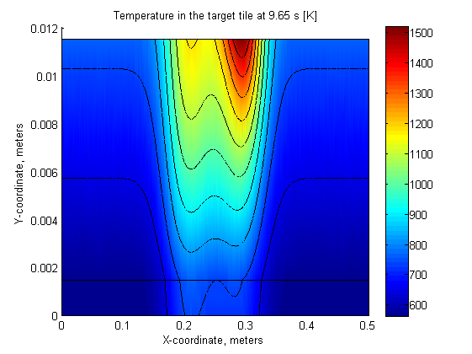
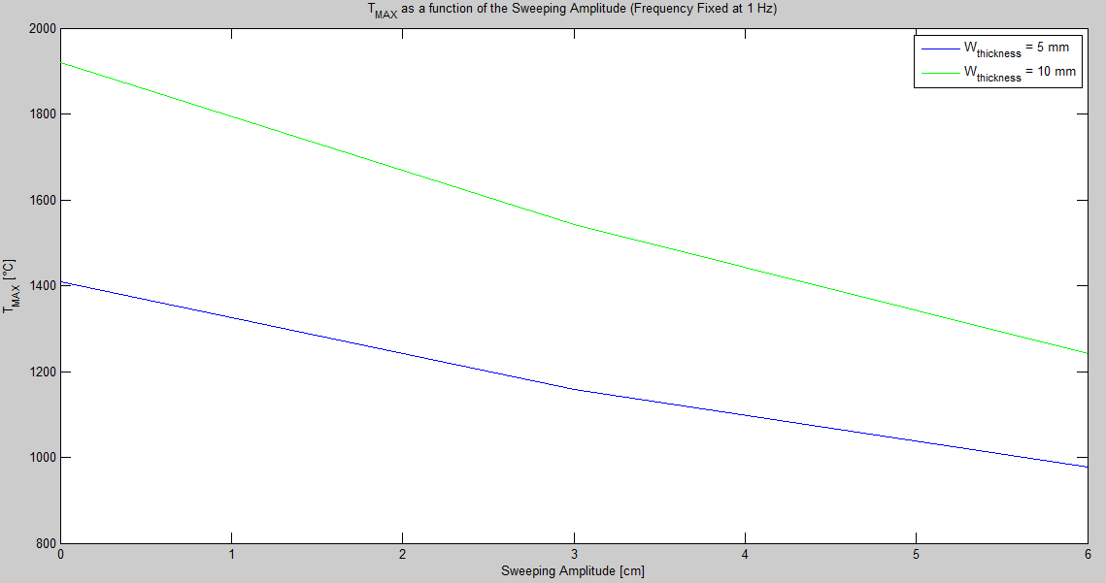
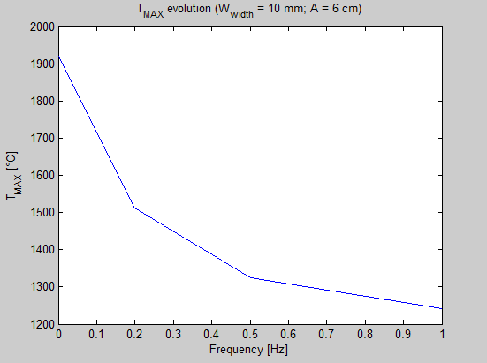
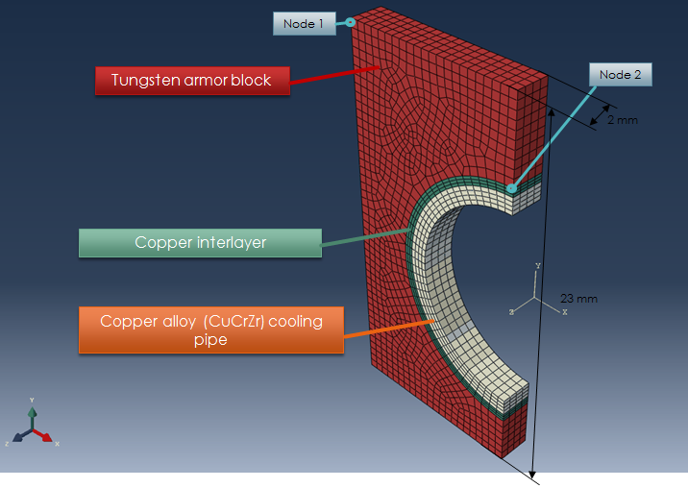






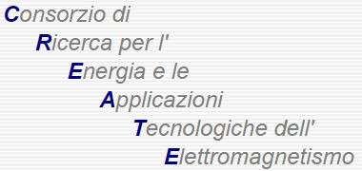

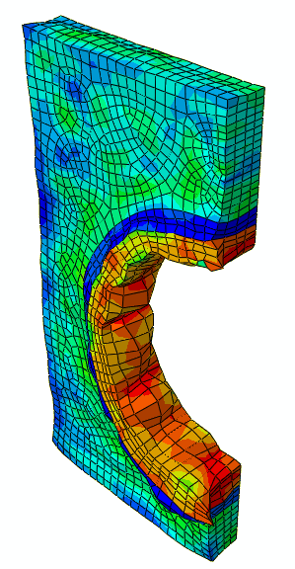
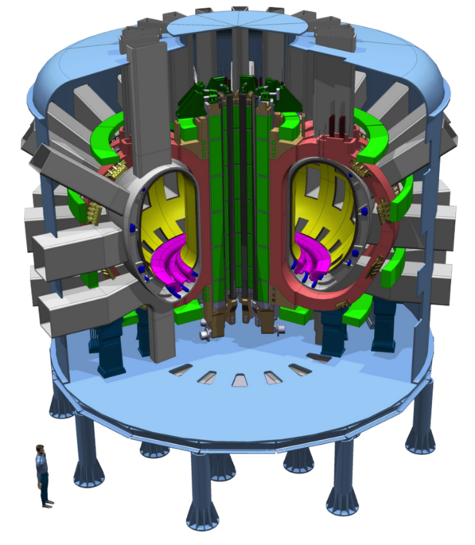
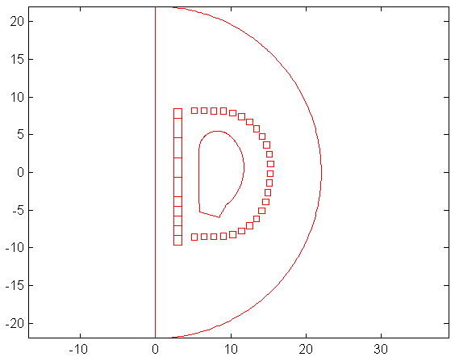
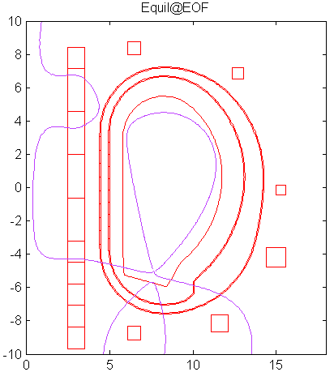

Vincenzo Paolo Loschiavo
Tutor: Raffaele Albanese
XXIX Cycle - II year presentation
“Addressing the power exhaust and particles in the next generation fusion reactors”
A roadmap to the realisation of fusion energy
Fusion electricity
The power exhaust problem
“The realisation of fusion energy has to face a number of technical challenges. For all of them candidate solutions have been developed and the goal of the programme is now to demonstrate that they will also work at the scale of a reactor. Eight different roadmap missions have been defined and assessed. They will be addressed by universities, research laboratories and industries through a goal-oriented programme […] for the Horizon 2020 period.
[…] According to the present roadmap, a demonstration fusion power plant (DEMO), producing net electricity for the grid at the level of a few hundred Megawatts is foreseen to start operation in the early 2040s. Following ITER, it will be the single step to a commercial fusion power plant.”
“Fusion Electricity – EFDA, November 2012”
“The centre of a fusion plasma is more than 100 million ˚C hot. The cooler, but still very hot edge plasma flows into a remote area of the reactor, called divertor, where it is exhausted. The divertor must be designed to withstand the high heat and particle fluxes from the plasma.
[…] Materials that resist heat fluxes up to 20 MW/m², which is of the same order as the heat load on the sun’s surface, have been produced for ITER. Alternative, backup divertor concepts are under investigation and need to be brought to sufficient maturity by 2030 through a dedicated experimental programme.”
“Fusion Electricity – EFDA, November 2012”
Interior of JET showing the ‘ITER-like’ wall of beryllium and tungsten.
ITER
Thermal fatigue analysis of the DEMO divertor target due to transient loads
A possible solution to the Power Exhaust: the Strike Point Sweeping
Among all the possible solutions for the power exhaust problem, the Strike-Point Sweeping was identified as one of the most promising techniques for spreading the heat load impinging on the material surfaces (PFCs – Plasma Facing Components).
The Strike Points Sweeping is a periodical movement of the strike points produced by dedicated coils, which are connected in antiseries.
The power needed for sweeping in the above conditions (240 kAt amplitude, 120 kAt rms) is:
- active power of 0.30 MW at 0.2 Hz, 3.3 MW at 1 Hz
- reactive power of 3.5 MVAr at 0.2 Hz, 16 MW at 1 Hz
A 2-D DEMO divertor target model (First PhD year research results)
During the first PhD year, a 2-D FE model has been developed (in MATLAB environment) in order to quantify the benefits achievable with the Strike Point Sweeping technique (varying amplitude and frequency), in terms of maximum temperature and heat flux on the material surfaces of the DEMO divertor reactor.
Strike Point Sweeping main parameters sensitivity analysis
2-D FE model simulation results - 30 MW/m² case
First conclusions: the strike point sweeping technique shows clear advantages in terms of maximum temperature and heat flux reduction.
Due to its cyclic nature, the periodical movement of the plasma strike points produce a cyclic heating and cooling of the divertor PFCs, inducing the thermal fatigue phenomenon.
A 3-D DEMO divertor target model (Second PhD year research results)
Numerical simulations have been carried out for peak heat flux densities of 15 MW/m² and 30 MW/m², sweeping amplitudes of 5 cm and 20 cm and sweeping frequency values of 0.5 Hz and 1 Hz.
In order to determine the thermal fatigue damage of the DEMO divertor target components, a 3-D FE model has been realized in ABAQUS environment.
Equivalent strain range (%) / fatigue lifetime (N) in the copper interlayer
Temperature at node 2 – 30 MW/m² case
Sweeping amplitude (cm) |  | 5 |  | 20
Sweeping frequency (Hz) |  | 0.5 | 1 | 0.5 | 1
Peak heat flux density (MW/m²) | 15 | 0.13/65344 | 0.09/356612 | 0.19/16518 | 0.10/189324
 | 30 | 0.32/1682 | 0.20/11908 | 0.45/564 | 0.22/8508
Conclusions: the fatigue lifetime of the divertor copper interlayer seems to be the limiting factor investigating the strike point sweeping as the ultimate solution in the mitigation of the DEMO power exhaust. From the results it is evident that even in the best case scenario (15 MW/m², with 5cm and 1 Hz sweeping parameters), the fatigue lifetime of the copper interlayer, in stationary sweeping conditions, is less than 100 working hours.
F. Maviglia, […], R. Albanese, R. Ambrosino, V. P. Loschiavo, “Limitations of transient power loads on DEMO and analysis of mitigation techniques”, Fusion Engineering and Design, DOI: 10.1016/j.fusengdes.2016.01.023
My 2015…
29 July – 8 August
6 – 11 September
11 - 20 May
5 - 16 October
Period spent in ENEA-Brasimone working with D. Bernardi
Period spent in Garching (IPP), working with F. Maviglia, R. Wenninger, M. Li and many more (EUFOfusion)
TCV (Lausanne) experimental campaign
1 – 7 November
Working all over the year with Prof. R. Ambrosino (Uni Parthenope)
1) Strike Point Sweeping: further analyses
Next year
3) Optimization of PF coils position in DEMO
Even if the strike point sweeping appears a promising technique as an emergency control action, it could be interesting to study the possibility that even after a certain damage degree, the interlayer keeps working properly in reducing the thermal stresses and conducting the heat. Therefore, further investigations are necessary to evaluate the fatigue lifetime of the cooling pipe.
Starting from a redundant PF coils configuration, it is possible to produce a given plasma equilibrium reducing the number of coils to a set optimizing the currents and respecting the force constraints.
The procedure has been already developed but not yet published.
ABAQUS simulation result - STRESSES
2) Investigate alternative power exhaust solutions for DEMO
Assessment of alternative divertor geometries and liquid metals PFCs:
The DTT project (Divertor Tokamak Test)
“The general objective of WPDTT2 is to design an experiment addressed to the solution of the power exhaust issues in view of DEMO. This derives from the need to develop integrated, controllable exhaust solutions for DEMO including plasma, PFCs, control diagnostics and actuators, using experiments, theory and modelling”.
“DTT design proposal”
Project Leader Prof. R. Albanese
“Optimized snow flake configurations for DEMO #01”, Final Report, R. Ambrosino, R. Albanese, V. P. Loschiavo
Notes:
Instructions to fill the poster
Box RGB 22 34 48
Context of your research activity (motivations, needs, trends, activity of your group (if the case)… - describe for self explanatpry)
Box RGB 255 220 0
Your research activity up to the second year (idea, methodology, developments, results, expected validation,… - insert whatever you like, text, images, photos. This box is reserved to your very specific activity, not to your group)
Box RGB 151 23 32
Your contacts
Cooperations with Universities, companies, participations in progrojects and programmes (logos can be included)
Box RGB 79 129 189
Next year
Future developments of your activity
Box width is 80 cm
Box height can be changed according to your needs
The text is written in Calibri font

