Slide 1


Sunny Katyara
Tutor: Bruno Siciliano, Darwin Caldwell
Co-Tutor: Fanny Ficuciello, Fei Chen
XXXIV Cycle - I year presentation
Learning Control for Fine Manipulation Taks

Slide 2

Background
M.Sc in Electrical Engineering - Wroclaw University of Science & Technology, Poland – July 2018
Master thesis title: Protection Coordination of distribution system with Distributed Resources at Wroclaw University of Science & Technology, Poland
Currently PhD student in Information Technology and Electrical Engineering XXXIII Cycle, at Università degli Studi di Napoli Federico II with a joint fellowship with IIT, supervised by Prof. Bruno Siciliano and Dr. Fanny Ficuciello at UNINA and Prof. Darwin Caldwell and Dr. Fei Chen at IIT
Funded by IIT

Slide 3
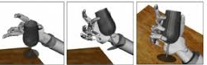
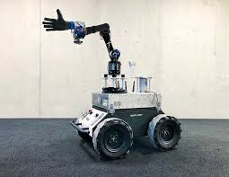
Research Problem
Statement
Traditional motion planning algorithms fail to learn control policies for fine manipulation task
To solve the issue, IL together with RL are used to learn control policies as cost optimization function
Objectives
To use movement primitives for learning human centric demonstrations (IL)
To learn control policies for compliant manipulation tasks with RL algorithms
To demonstrate the learnt skills on mobile manipulator for different manipulation tasks
To develop VMP and HaNMP-SoT

Slide 4
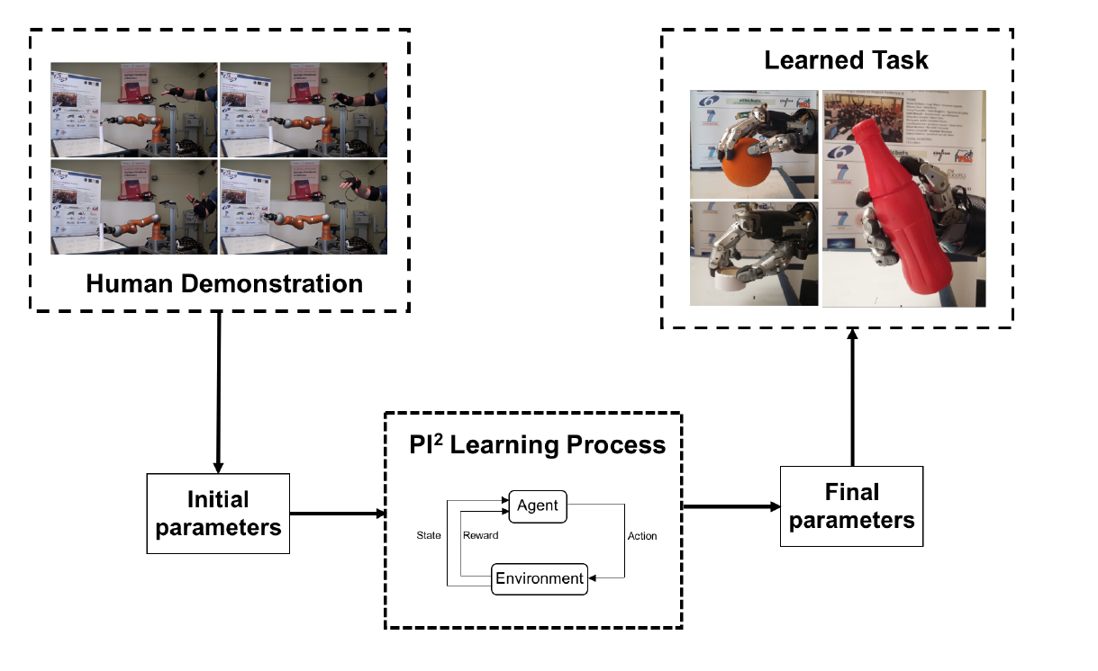
Research Activity
Initial policy parameters
Exploration–Exploitation trade-off
Synegy-based policy search method
Reward function

Slide 5
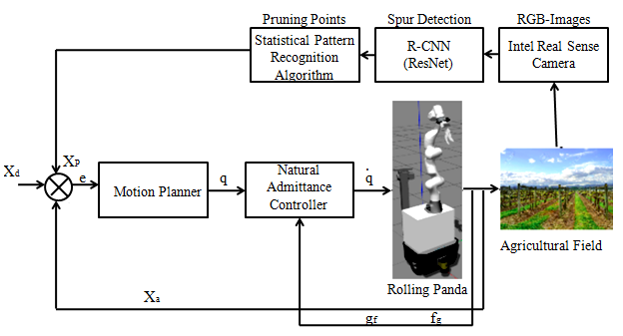
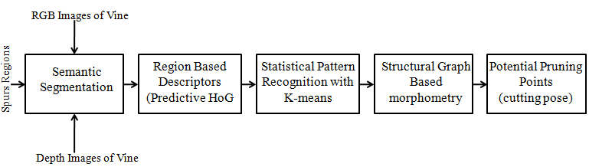
Research Activity
Pruning is chosen as one manipulation case to get started with Sim2Real skill transfer
Fig.2. Pipeline for Spur and pruning points detection
Fig.1. Methodology for Robot Pruning System

Slide 6
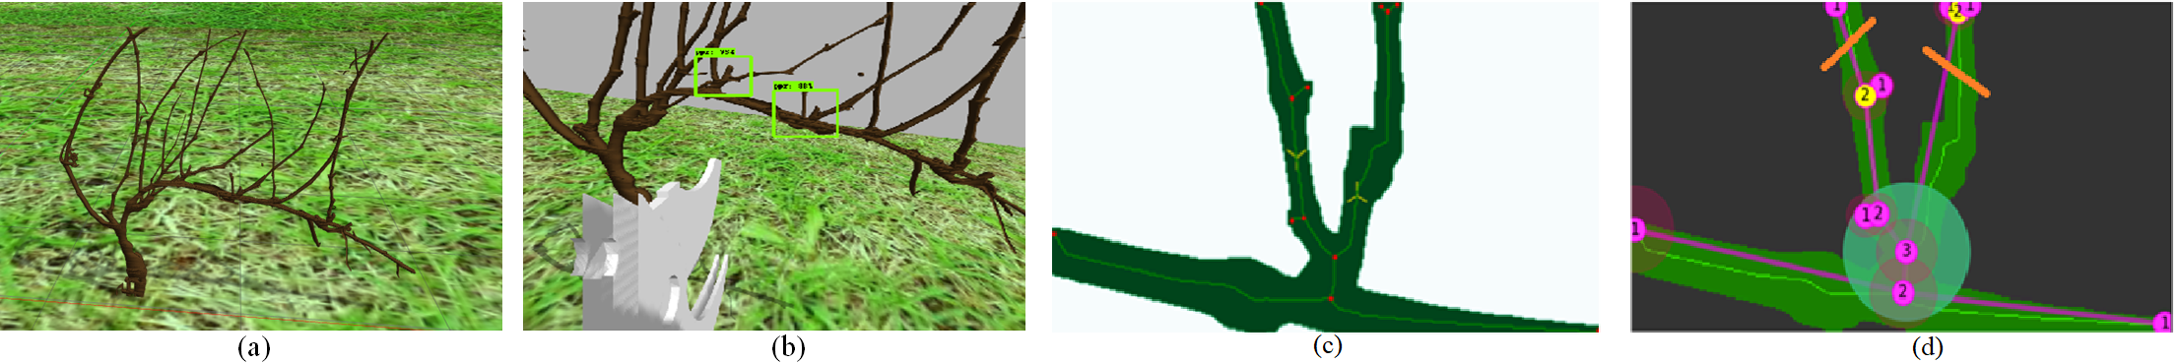
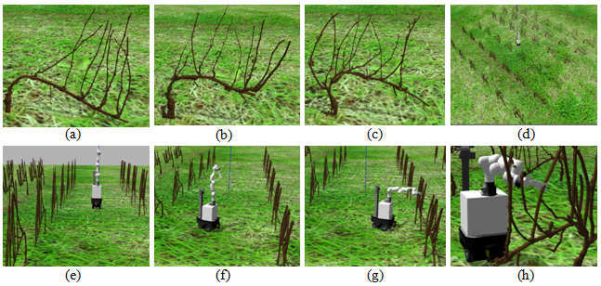
Research Activity
Fig.3. Spur and pruning points detection
Fig.4. Simulated environment for dynamic pruning

Slide 7
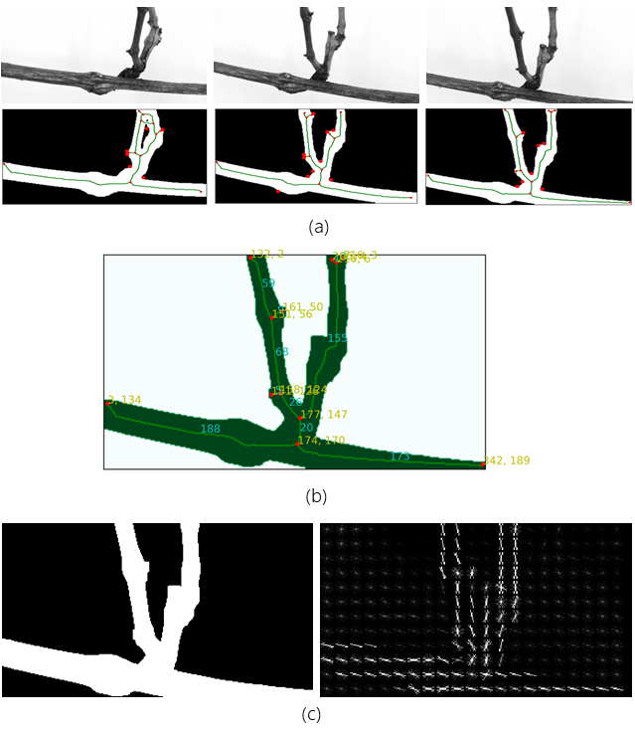
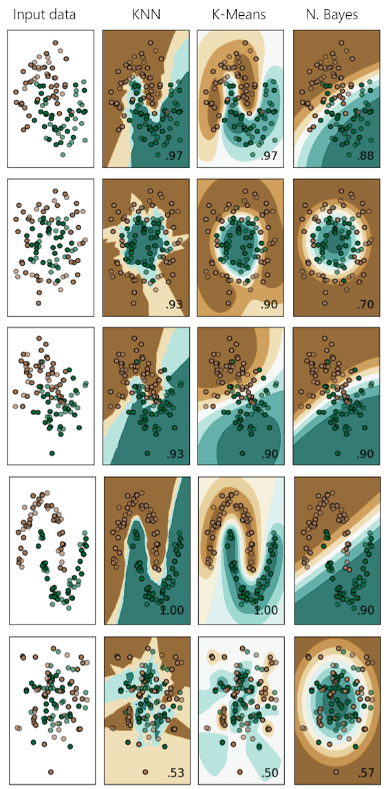
Research Activity
Fig.4. Acquisition, mapping and prediction of potential spur region
Fig.5. Classified regions percentage among the proposed statistical methods

Slide 8

Preliminary Results (Imitation Learning)

Slide 9
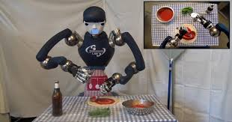
Future Application Field
Fig.6. Autonomous manipulation for anthropomorphic robotic systems
Fig.7. Human-like bimanual manipulation

Slide 10
Products
Under Review:
S. Katyara, L. Lugli, F. Ficuciello, D. Caldwell, F. Chen “Towards reproducible pruning system on dynamic natural plants for field agricultural robots” International Conference on Robotics and Automation (ICRA) 2020
L. Lugli, S. Katyara, D. Caldwell, F. Chen “Towards statistical pattern recognition graph morphometry applied in agricultural robotic vineyard pruning” International Conference on Robotics and Automation (ICRA) 2020.
In Preparation:
S. Katyara, F. Ficuciello, D. Caldwell, F. Chen, B. Siciliano “Vision based kernalized treatment of synergies for in-hand manipulation tasks” Robotics and Automation Letters (IEEE RAL) 2020
S. Katyara, F. Ficuciello, D. Caldwell, F. Chen, B. Siciliano “Run-time adaption of trajectories with DMPs using perceptual learning “Robotics, Science and Systems (RSS) 2020.

Slide 11
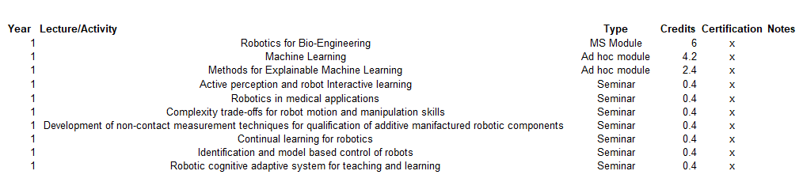
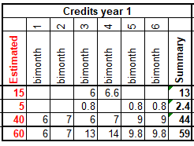
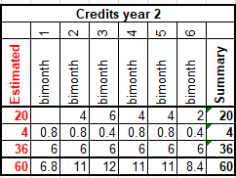
Next Year
First Year credits
Second Year credits (Expected)
Will attend 4th Summer School on Cognitive Robotics – MIT USA 2020
Will submit one journal and one conference papers
Will assist my co-supervisor on short course of Robotics

Slide 12
THANKS!

