Slide 1
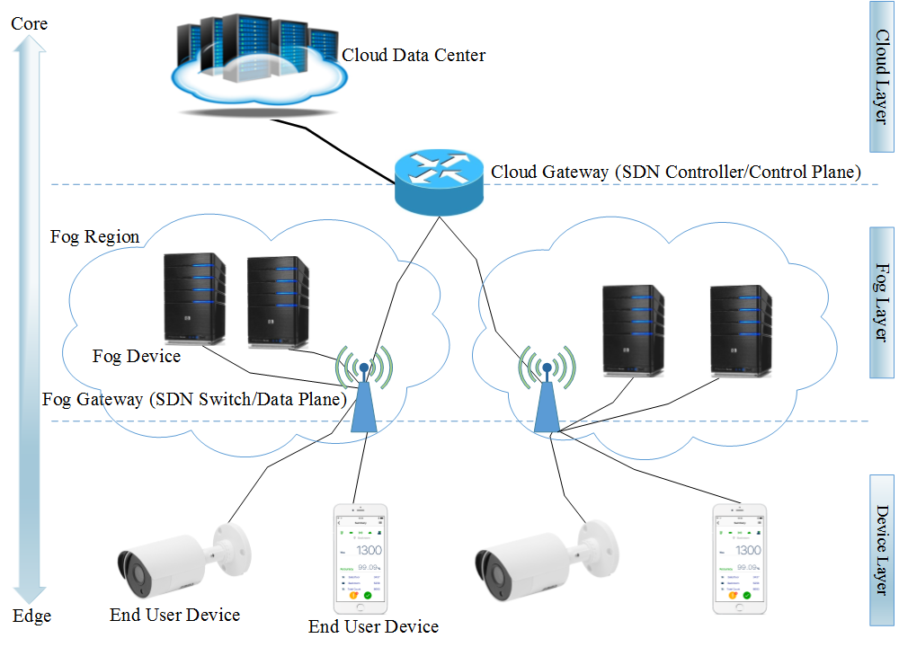
Saeed Javanmardi Tutor: Antonio Pescapè XXXIV Cycle - II year presentation
Security Driven Task Scheduling Approach for SDN-based IoT–Fog Networks
1-) Fog computing is a paradigm to overcome the cloud computing limitations which provides low latency to the users’ applications for the Internet of Things (IoT).
2-) Software-defined networking (SDN) is a practical networking infrastructure that provides a great capability in managing network flows.
TCP SYN flood attack is one of the most common denial of service attacks, in which a malicious node produces many half-open TCP connections on the targeted computational nodes so as to break them down.
we apply SDN envision IoT–Fog networks to address TCP SYN flood attacks. we put forward a fuzzy-based multi-objective PSO approach to aggregate optimal computing resources and providing a proper level of security protection into one synthetic objective to find a single proper answer.
This scheduler considers the dynamic behavior of distributed systems and uses two trust degrees obtained from Threshold Random Walk with Credit-Based connection rate-limiting (TRW-CB) and Rate Limiting algorithms— i.e. one of the most prominent source-based attack mitigation strategies available to deal with TCP SYN flood DDoS attacks. It addresses security issues inside the scheduler. It strikes a balance between efficiency and security objectives.
FPSTS architecture:
Multi-objective PSO method is a proper way to achieve a tradeoff between security and efficiency. We found Mamdani fuzzy inference system, a sufficient method to strike a balance between distinctive parameters in the two MOPSO fitness functions.
Contacts
Email: Saeed.javanmardi@unina.it
Telephone: +39 3331073870
Traffic research group
http://traffic.comics.unina.it/
For the future, we will have exhaustive study of a security framework to meet the requirements of 5G mobile edge computing. Moreover, we want to put forward a comprehensive security-driven task scheduling approach in these scenarios using different optimization techniques to tackle the other types of attacks in IoT-fog networks.
References
[1]- Javanmardi, Saeed, et al. “FPSTS: A Security Driven Task Scheduling Approach for SDN-based IoT–Fog Networks”, It is ready to be submitted to a journal.
[2]- Javanmardi, Saeed, et al. "FPFTS: A joint fuzzy particle swarm optimization mobility‐aware approach to fog task scheduling algorithm for Internet of Things devices." Software: Practice and Experience (2020).
Notes:
Instructions to fill the poster
Box RGB 22 34 48
Context of your research activity (motivations, needs, trends, activity of your group (if the case)… - describe for self explanatpry)
Box RGB 255 220 0
Your research activity up to the second year (idea, methodology, developments, results, expected validation,… - insert whatever you like, text, images, photos. This box is reserved to your very specific activity, not to your group)
Box RGB 151 23 32
Your contacts
Cooperations with Universities, companies, participations in projects and programmes (logos can be included)
Box RGB 79 129 189
Next year
Future developments of your activity
Box width is 80 cm
Box height can be changed according to your needs
The text is written in Calibri font

