Slide 1


Ivan Iudice
Tutor: Giacinto Gelli
XXIX Cycle - III year presentation
Equalization of CPM signals over doubly-selective aeronautical channels

Slide 2

Background
Education
  BS degree in Telecommunications Engineering
  Università di Napoli Federico II, September 2008
  MS degree in Telecommunications Engineering
  Università di Napoli Federico II, September 2010
Work
  Research Engineer
  Scientific Disciplines and Technology Development
  Electronics and Communications, since November 2011
  Italian Aerospace Research Centre (CIRA)

Slide 3


Collaborations
Collaborations
  Prof. Giacinto Gelli (tutor)
    DIETI
  Prof. Francesco Verde
    DIETI
  Prof. Donatella Darsena
    Dipartimento di Ingegneria
    Università Parthenope di Napoli
Notes:
I’m currently collaborating with my tutor Giacinto Gelli, and with professors Verde and Darsena

Slide 4
Credits
 |  | Credits year 3
 |  |  | 1 | 2 | 3 | 4 | 5 | 6
 | Previous | Estimated | Bimonth | Bimonth | Bimonth | Bimonth | Bimonth | Bimonth | Summary | Total | Check
Modules | 20 | 0 |  | 7 |  |  |  |  | 7 | 33 | 30-70
Seminars | 5 | 0 |  |  |  |  |  |  | 0 | 10 | 10-30
Research | 35 | 60 | 10 | 3 | 10 | 10 | 10 | 10 | 53 | 137 | 80-140
 | 60 | 60 | 10 | 10 | 10 | 10 | 10 | 10 | 60 | 180 | 180

Slide 5
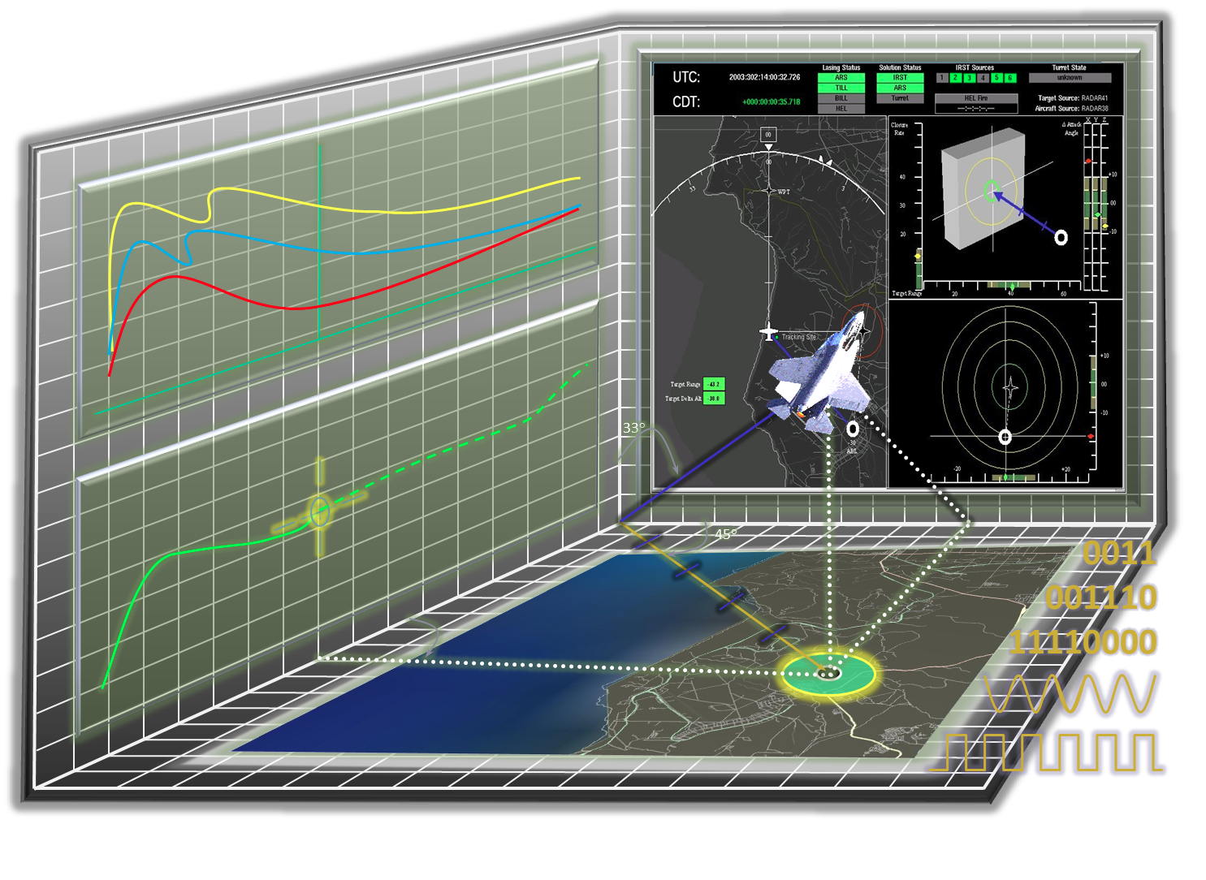
Problem
Continuous Phase Modulated (CPM) signals are widely employed for Command and Non-Payload Communications (CNPC) in unmanned aircraft applications:
  constant envelope properties
  spectral efficiency
  noise robustness

Slide 6
Optimal receiver drawbacks
CPM is a modulation with memory:
  Maximum-Likelihood (ML) detection exhibits high computational complexity
    complexity reduction by exploiting the trellis structure of CPM => Viterbi algorithm
In the aeronautical context, due to the high-speed of the aircrafts, the channel might exhibit frequency and time selectivity:
  ML detection of CPM signals becomes prohibitive:
    huge number of states of the Viterbi algorithm
    need to perform fast channel estimation and tracking

Slide 7
Suboptimal approaches
Mostly targeted at Linear Time-Invariant (LTI) channels
Conventional approaches based on a two-stage structure:
  the first stage performs Frequency-Domain channel Equalization (FDE) to mitigate the effects of Inter-Symbol Interference (ISI)
  the second stage, represented by the Viterbi algorithm, works in an almost ISI-free setting
    the noise at the input of the Viterbi algorithm is colored

Slide 8
Disadvantages of FDE
Frequency-domain equalization (FDE) is computationally demanding when the channel is rapidly time-varying:
  the channel cannot be diagonalized by a channel-independent transformation of the received data
CPM signals may exhibit specific improper or noncircular features that can be used to increase performances:
  those features are not exploited by LTI approaches

Slide 9
The proposed approach
CPM signal reception over a doubly-selective channel by time-domain Linear Time-Varying (LTV) equalizers, based on Laurent decomposition
Improper or noncircular features of the CPM signals => Widely-Linear Time-Varying (WLTV) equalizers
Cost functions => Zero-Forcing (ZF) or Minimum Mean-Square Error (MMSE)
Basis Expansion Model (BEM) for the doubly-selective channel => Frequency-Shift (FRESH) implementations of the proposed equalizers

Slide 10

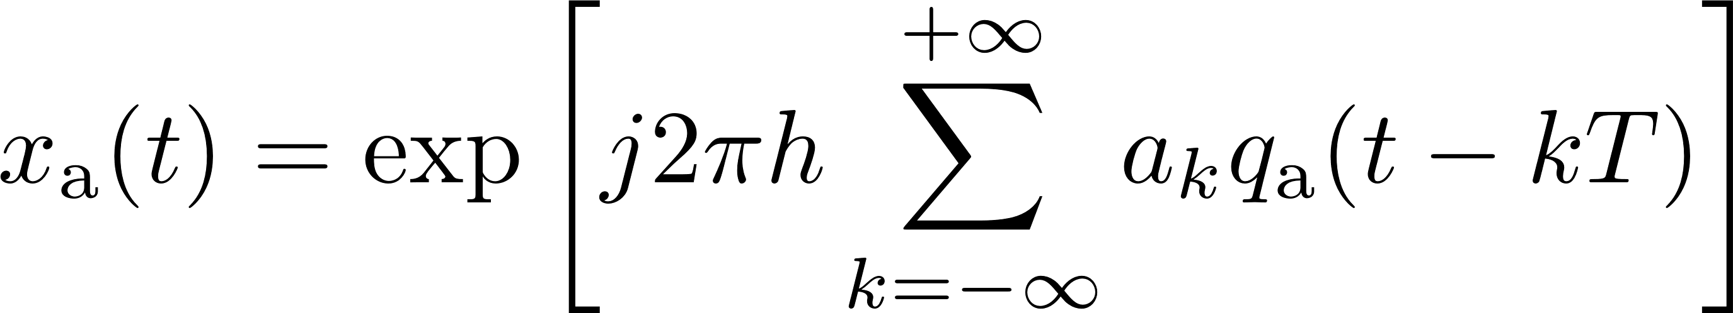
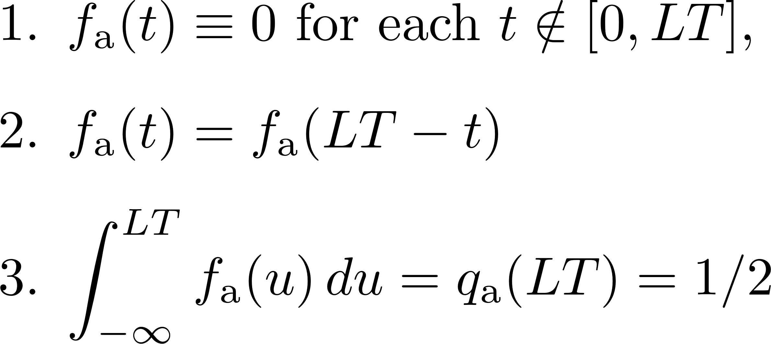
The CPM waveform
Binary partial-response and single-h CPM modulation with baud-rate

Slide 11
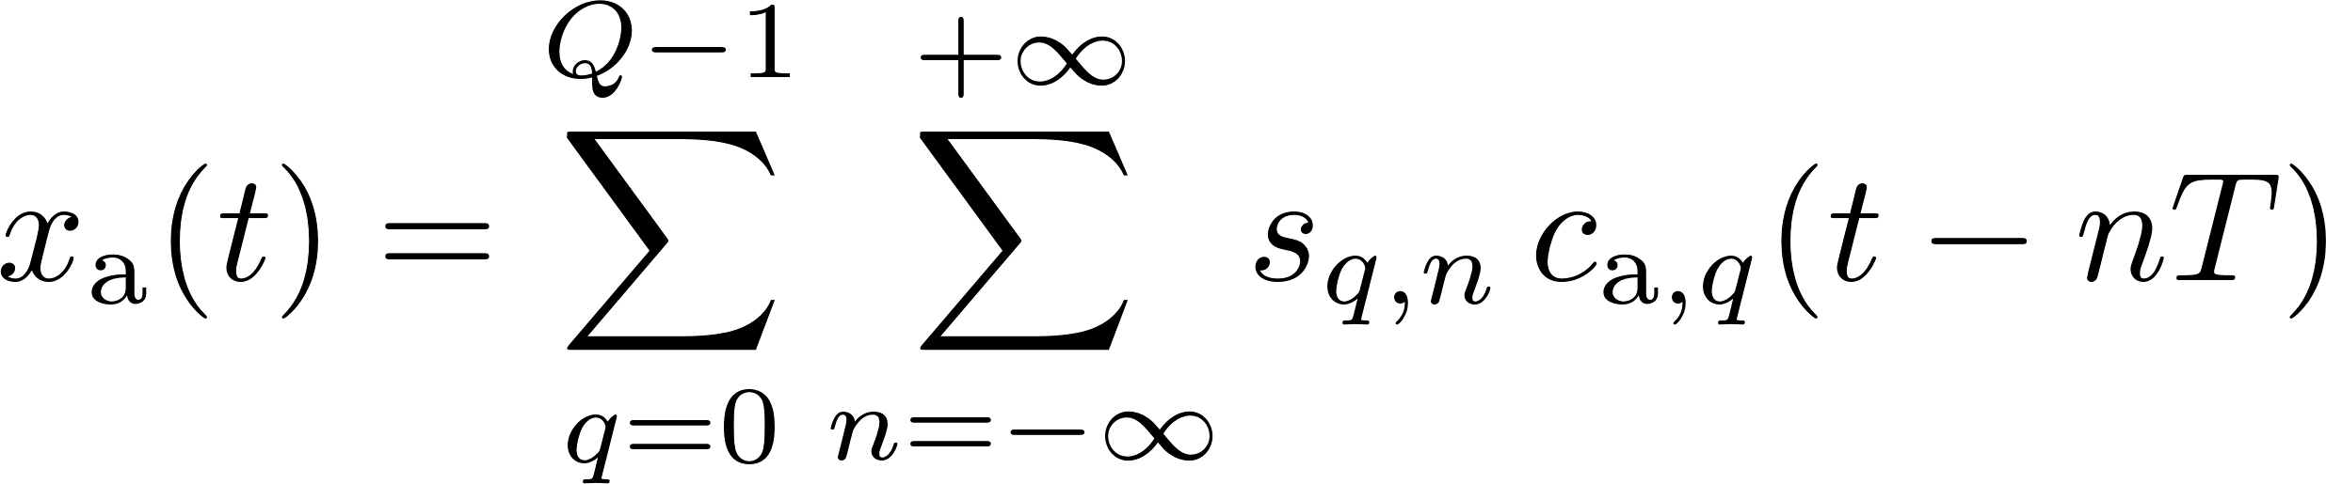
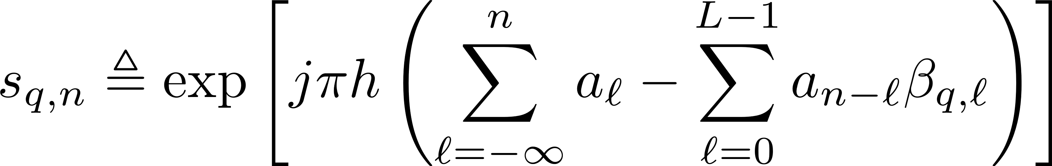
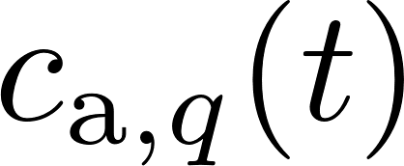
Laurent decomposition
Partial-response CPM signal, non-integer h, binary symbols:
  pseudo-symbols of Laurent decomposition:
  symbol-indipendent real pulses

Slide 12
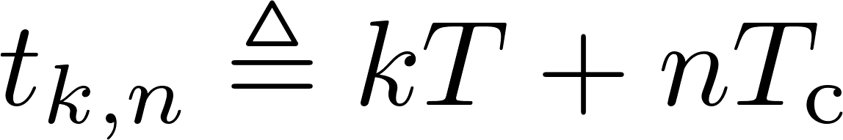
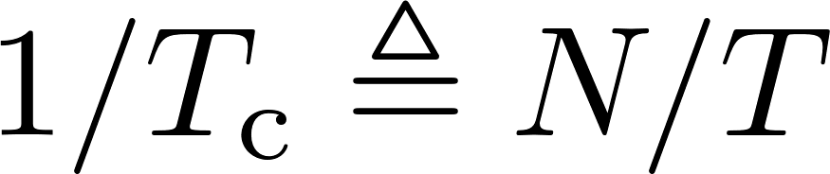
Oversampling
Perfect synchronization
The received RF signal is down-converted and sampled at times
Sampling rate with N > 1 denoting the oversampling factor

Slide 13
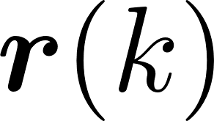
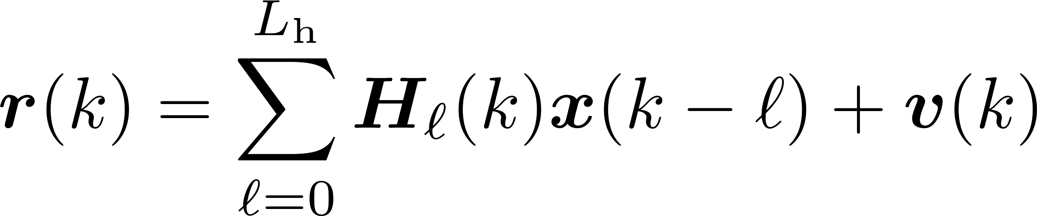

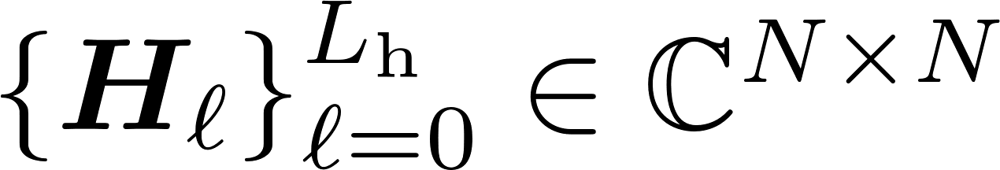
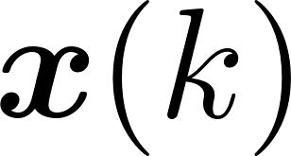
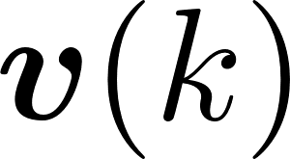
Received signal
By gathering N consecutive samples into the vector , one obtains:
  => channel order
  the time-varying matrices collect the coefficients of the doubly-selective channel
  => samples of the transmitted signal
  => additive white Gaussian noise

Slide 14
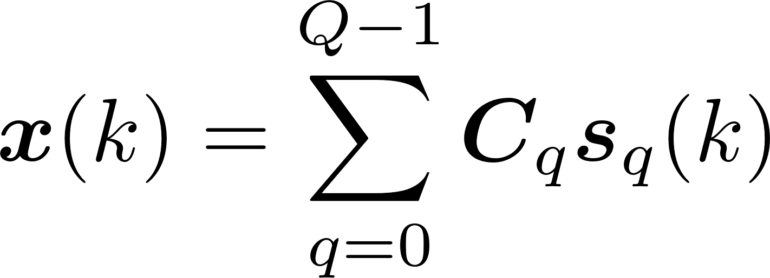

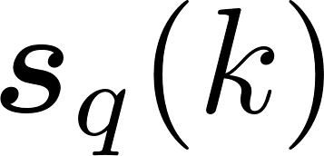
Transmitted signal
The vector can be expressed as
  each matrix collects the samples of the pulse
  each vector collects the pseudo-symbols

Slide 15
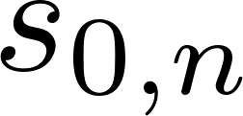
Receiver structure
Detection of the CPM signal by means of a two-stage time-varying receiving structure:
  first stage => time-varying channel equalization => recover of the pseudo-symbol
  second stage => simple recursive inversion of the nonlinear mapping between symbols and pseudo-symbols

Slide 16

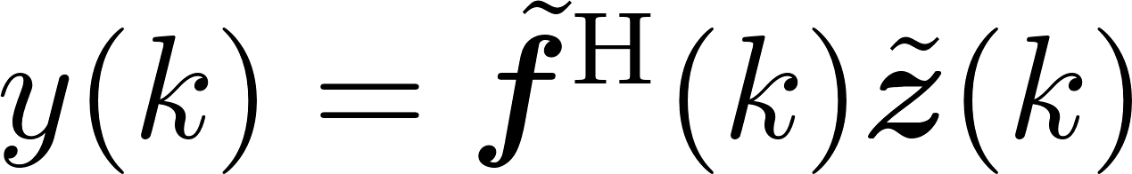
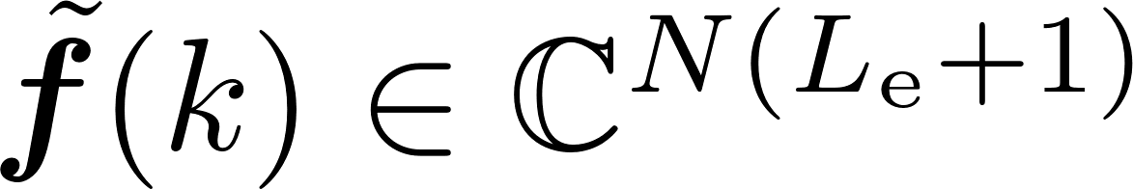
LTV input-output relationship
Causal LTV equalizer of order => input-output relationship given by
  weight vector of the equalizer
  input data vector

Slide 17
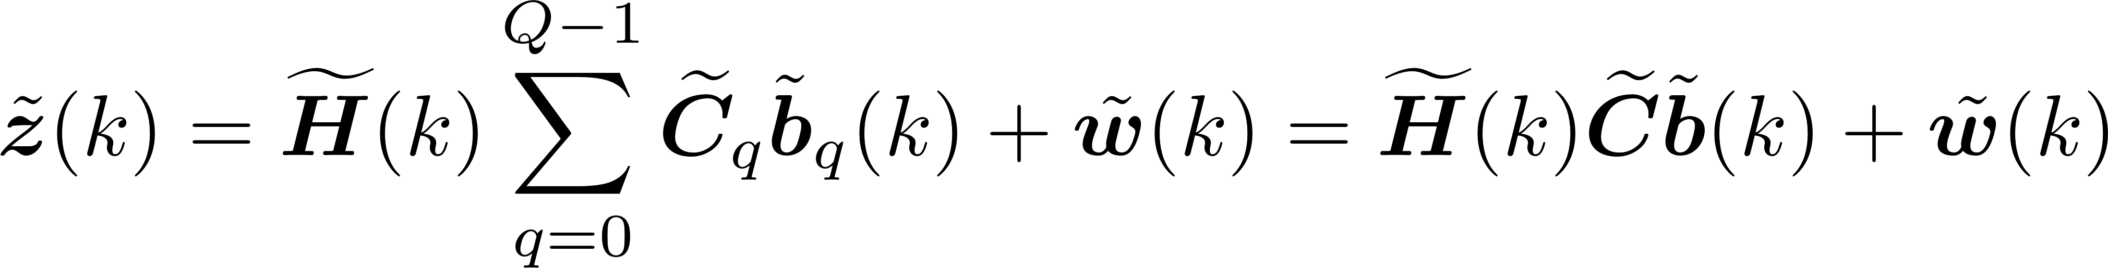
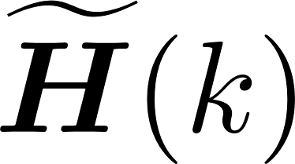

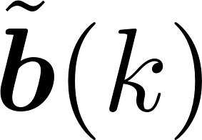
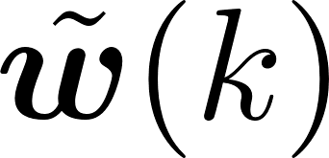
LTV input data vector
From straightforward manipulations of the input data vector, it results that
  => channel coefficients
  => samples of the Laurent’s pulses
  => pseudo-symbols of the Laurent representation
  => white Gaussian noise vector

Slide 18
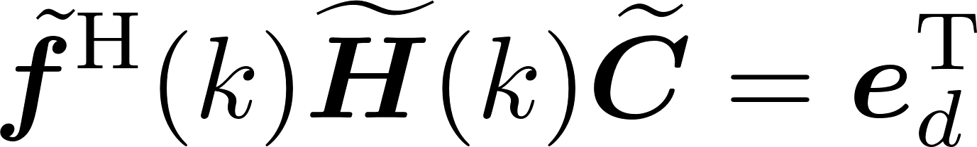
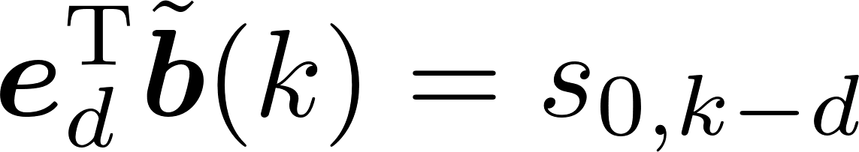


LTV-ZF design
LTV-ZF equalizer obtained imposing
  such that
full-column rank => minimal norm ZF solution:

Slide 19
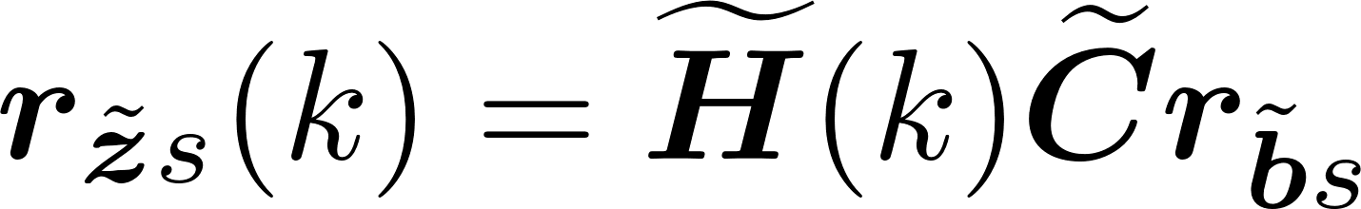
LTV-MMSE design
LTV-MMSE equalizer obtained by minimizing the output mean-square error cost function
LTV-MMSE solution:

Slide 20
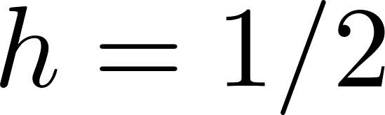
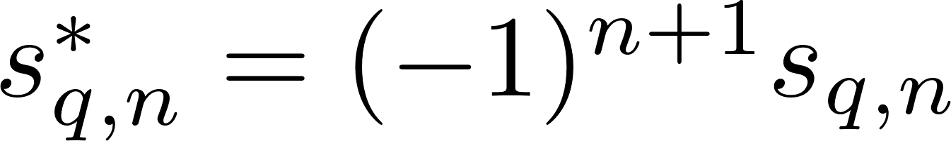
Noncircular features of CPM signals
It can be proven that CPM signals exploit improper or noncircular features for :
Employing widely-linear signal processing allows one to improve performances
Notes:
that employing widely-linear signal processing, which jointly elaborate the received signal and its complex conjugate version, allows one to improve performances.

Slide 21
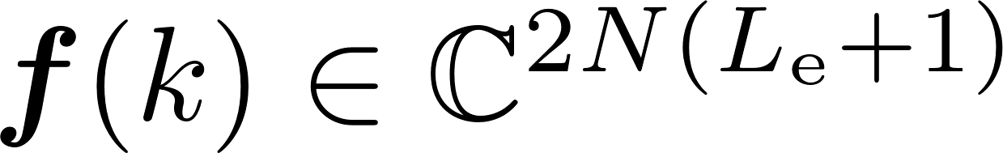
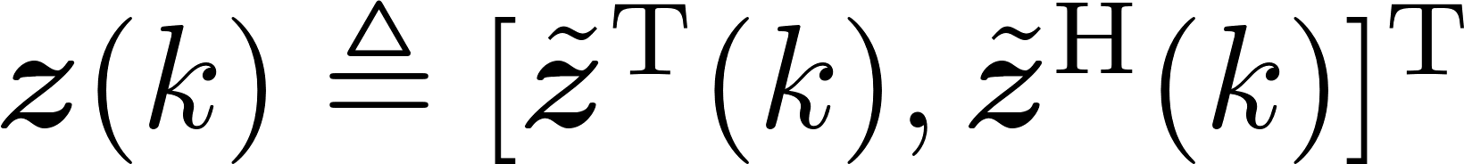
WLTV input-output relationship
Causal WLTV equalizer of order => input-output relationship given by
  => overall equalization vector
  => overall input data vector

Slide 22
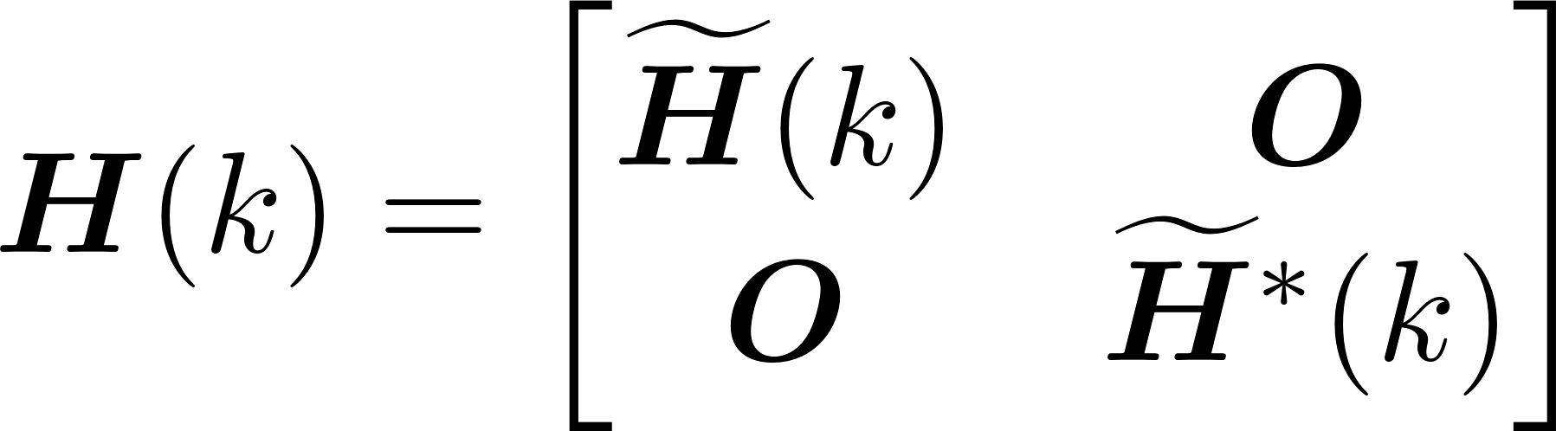

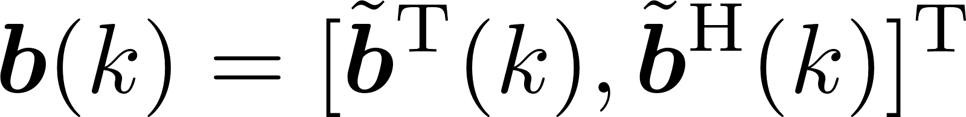

WLTV input data vector
By stacking the signal and its conjugate:

Slide 23
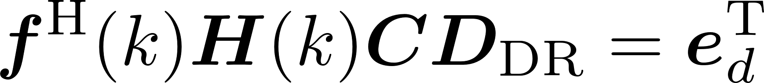
WLTV-ZF design
Using derotated versions of the WLTV input data vector => WLTV-ZF criterion:
Minimal norm solution:

Slide 24
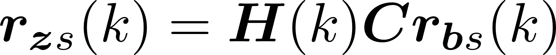
WLTV-MMSE design
WLTV-MMSE obtained by minimizing the output mean-square error cost function:
WLTV-MMSE solution:

Slide 25

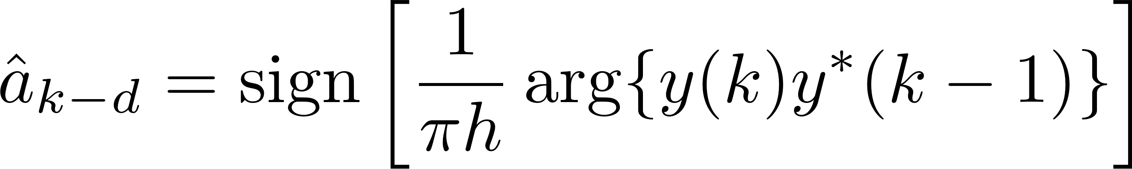
CPM demodulator
The second stage processes the pseudo-symbol estimates at the output of the first stage to recover the binary sequence
For high signal-to-noise ratio (SNR):
Recursive estimate:

Slide 26


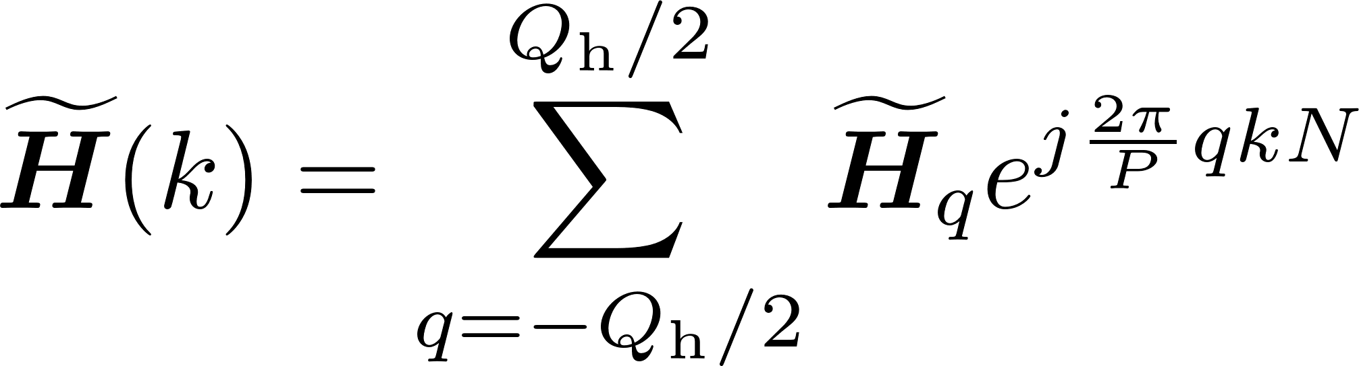
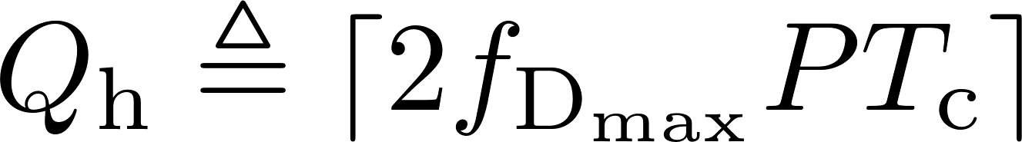


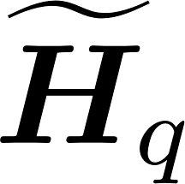
BEM channel representation
The channel matrix is represented over an observation window of symbols via the BEM:
  with
  => maximum Doppler spread
  collects the estimated coefficients
    blind estimation
    training-based estimation

Slide 27
FRESH implementation
The proposed equalizers are periodic => they can be expressed by means of their DFS representation.
The output of the FRESH equalizers can be written as a parallel bank of LTI equalizers, each driven by a different frequency-shifted version of the received vector

Slide 28
BEM model validation
BEM has been validated for representing aeronautical doubly-selective channels
We considered 4 common scenarios:
  en-route
  takeoff/landing
  taxiing
  parking

Slide 29
En-route scenario
Notes:
Qui magari prova a posizionare le figure in maniera più ordinate ed omogenea tra le varie slides

Slide 30
Takeoff/landing scenario

Slide 31
Taxiing scenario

Slide 32
Parking scenario

Slide 33
Receiver parameters
200 kb/s data link employing a binary full-response CPM modulation format with
  CPM-1REC (CPFSK) with h=0.7
  GMSK with h=0.5
Channel scenarios
  takeoff/landing (TL), maximum delay spread values 7 µs
  en-route (ER), maximum delay spread values 33 µs
Oversampling factor => N=8
Channel lengths L_{h}=2 (TL) and L_{h}=8 (ER)
Equalizer length L_{e}=L_{h}+1 and delay d=0
Doppler spreads 1.2 kHz (TL) and 3.5 kHz (ER)
BEM model
  K=1000
  P=2KN=16000
  Qh+1=25 (TL) and 71 (ER)

Slide 34
CPM-1REC in TL scenario
LTV-MMSE and LTV-ZF exhibit the same performances
LTI equalizers fail due to ill-conditioning of time averaged channel
LTV equalizers outperform the w/o EQ receiver
CPM signal is circular, then WLTV-MMSE converges to LTV-MMSE

Slide 35
CPM-1REC in ER scenario
LTV equalizers significantly outperform w/o EQ and LTI receivers
LTV-MMSE receiver exhibits better performance than its ZF counterpart
LTV-ZF equalizer fails together with LTI strategies
CPM signal is circular, WLTV-MMSE exhibits the same performances of the LTV-MMSE strategy

Slide 36
GMSK in TL scenario
WLTV strategies exhibit the same performances
LTV strategies exhibit almost the same performances
LTI equalizers fail due to the ill-conditioning of the time averaged channel
The proposed equalizers largely outperform the w/o EQ receiver
Exploiting noncircular features of the CPM signal, WLTV approaches gain almost 4dB over w/o EQ receiver

Slide 37
GMSK in ER scenario
The proposed equalizers significantly outperform w/o EQ and LTI ones
The LTV-MMSE equalizer gives better performance than LTV-ZF
The WLTV-ZF equalizer provides better performance than WLTV-ZF

Slide 38
Conclusions
LTV and WLTV equalization strategies for CPM modulated signals operating over doubly-selective channels have been considered
We proposed a two-stage receiver, where the first stage performs equalization to mitigate the channel selectivity, whereas in the second stage a simple recursive detector recovers the transmitted symbols
We derive FRESH implementations of the proposed equalizers
Numerical results show the effectiveness of the BEM approach to represent typical aeronautical communication channels
Simulation experiments carried out into two typical aeronautical scenarios confirm the effectiveness of the proposed receiving approach

Slide 39
Future developments
We are studying the feasibility of further reductions of the computational complexity of the proposed equalizers
We are studying techniques to estimate the channel coefficients blindly or by means of training sequences

Slide 40
Publications
D. Darsena, G. Gelli, I. Iudice, and F. Verde, “Widely-linear transceiver design for amplify-and-forward MIMO relaying,” in 2016 IEEE Sensor Array and Multichannel Signal Processing Workshop (SAM), Jul. 2016, pp. 1–5.
D. Darsena, G. Gelli, I. Iudice, and F. Verde, “LTV equalization of CPM signals over doubly-selective aeronautical channels,” in 2016 IEEE Metrology for Aerospace (MetroAeroSpace), Jun. 2016, pp. 75–80.

Slide 41
Some references
R. C. C. Telemetry Group, “Telemetry standards. IRIG standard 106-15 Part 1,” Tech. Rep., Jul. 2015. [Online]. Available: http://www.irig106.org/.
E. Haas, “Aeronautical channel modeling,” IEEE Transactions on Vehicular Technology, vol. 51, no. 2, pp. 254–264, Mar. 2002.
J. B. Anderson, T. Aulin, and C. E. Sundberg, Digital Phase Modulation. Springer, 1986.
F. Pancaldi and G. M. Vitetta, “Equalization algorithms in the frequency domain for continuous phase modulations,” IEEE Transactions on Communications, vol. 54, no. 4, pp. 648–658, Apr. 2006.
W. Van Thillo et al., “Low-complexity linear frequency domain equalization for continuous phase modulation," IEEE Transactions on Wireless Communications, vol. 8, no. 3, pp. 14351445, 2009.
F. Verde, “Frequency-shift zero-forcing time-varying equalization for doubly-selective SIMO channels," EURASIP Journal on Advances in Signal Processing, vol. 2006, no. 1, pp. 114, 2006.
F. Verde, “Low-complexity time-varying frequency-shift equalization for doubly-selective channels," in Proceedings of the Tenth International Symposium on Wireless Communication Systems (ISWCS 2013), 2013, pp. 15.

Slide 42
Questions?

