Slide 1
Giovanni Gravina Tutor: Carlo Forestiere XXXIV Cycle - I year presentation
Development of new Spectral Method

Slide 2
Background
I received my M.Sc. in Electronic Engineering (cum laude) from University of Naples Federico II
I work within the Nanophotonics Group
Without fellowship- I am an Air Force Officer and I work as Head of Technical Studied Section at Aircraft maintenance Unit (Lecce)
$${10}^{th}$$

Slide 3
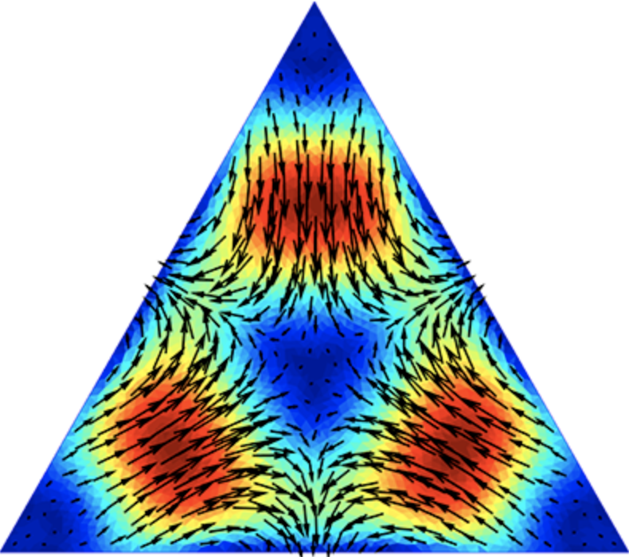
My research activity
My research activity is focused on the development of spectral techniques for the analysis of the electromagnetic behavior of nanostructures.
During my first year, the electromagnetic modes and the resonances of homogeneous, finite size, two-dimensional bodies have been examined in the frequency domain by a rigorous full wave approach based on an integro-differential formulation of the electromagnetic scattering problem.
C. Forestiere, G. Gravina, G. Miano, M. Pascale, R. Tricarico Electromagnetic modes and resonances of two-dimensional bodies, Physical Review B.

Slide 4
Future activities
A new spectral basis for the numerical solution of full-wave electromagnetic scattering problems

