Slide 1
Ugo Giordano Tutor: Prof. Stefano Russo XXIX Cycle - I year presentation
Cloud systems overload management

Slide 2
My Background
I received my Master's Science Degree in Computer Engineering from University of Naples Federico II in 2012.
I work within the Mobilab Research Group led by Prof. Stefano Russo
1-year Fellowship financed by PON Project “Display” of the public-private laboratory COSMIC
I have previously collaborated with Selex ES (a Finmeccanica Company) and, now I’m collaborating in a project with Huawei Technologies (a Chinese TELCO equipment Company)

Slide 3
Software Defect Analysis
Code and software defects analysis is crucial to improve the product quality and software development process.
In this context, in collaboration with SELEX ES, I conducted an activity aimed to propose an approach to prioritize the most critical components and programming rules to correct for a cost-effective code sanitization.
A possible future work plans to extend the proposed approach in the cloud computing environment, where Selex ES would like to move her software system in the near future.

Slide 4
Cloud advantages
Cloud computing is certainly a powerful, transformational change in the information technology industry. The benefits are real, and quite substantial:
On-demand self-service.
Broad network access
Elastic scalability
Resource pooling
Rapid elasticity
Measured service

Slide 5
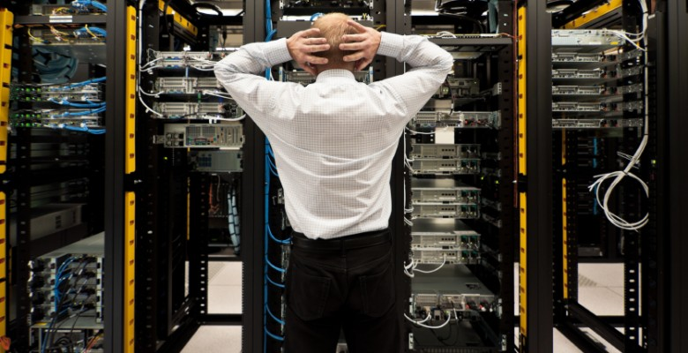
What is the problem?
As suggested by many works in the literature, most of the cloud provider over-subscribe [8, 9, 11] their data center resources in order to improve the resource performance and utilization.
Oversubscription is the act to offer more resource than there is actually capacity for under the assumption that most customers will not consume their entire portion.
However, oversubscription brings the risk of resource overload.

Slide 6
NFV overload as a Case Study
At the end of the first year I started to investigate what are the main techniques used to avoid overloading in cloud computing environment.
In recent times, cloud computing is also used to achieve virtualization of network functionality (NFV).
NFV is an initiative to virtualize network functions previously carried out by dedicated hardware.
In the context of collaboration with Huawei, I recently started an analysis aimed at identifying possible solutions to the problem consider to overload occurs as a case study NFV.

Slide 7
Publications and References
[1] Carrozza, G., Cinque, M., Giordano, U., Pietrantuono, P. & Russo, S. (2015). Prioritizing correction of static analysis infringements for cost-effective code sanitization. In Proceedings of the 2th International Workshop on Software Engineering Research and Industrial Practices (SER&IPs 2015). 37th “International Conference on Software Engineering” (ICSE 2015), Florence, May 16th to 24th.
[2] J. Zheng, L. Williams, N. Nagappan, W. Snipes, J. Hudepohl, and M. Vouk (2006). “On the value of static analysis for fault detection in software,” Software Engineering, IEEE Transactions on, vol. 32, no. 4, pp. 240– 253.
[3] N. Nagappan and T. Ball (2005). “Static analysis tools as early indicators of pre-release defect density,” in Software Engineering, 2005. ICSE 2005. Proceedings. 27th International Conference on, pp. 580–586.
[4] R. Plosch, H. Gruber, A. Hentschel, G. Pomberger, and S. Schiffer (2008). “On the relation between external software quality and static code analysis,” in Software Engineering Workshop, 2008. SEW ’08. 32nd Annual IEEE , pp. 169–174.
[5] R. Pietrantuono, S. Russo, and K. Trivedi (2010). “Software reliability and testing time allocation: An architecture-based approach,” Software Engineering, IEEE Transactions on, vol. 36, no. 3, pp. 323–337.
[6] G. Carrozza, R. Pietrantuono,and S. Russo (2014). “Defect analysis in mission – critical software systems: a detailed investigation,” J. Softw. Evol. and Proc. , vol. 27, no. 1, pp. 22–49.
[6] Huihua Lu; Kocaguneli, E.; Cukic, B. (2014). "Defect Prediction between Software Versions with Active Learning and Dimensionality Reduction," Software Reliability Engineering (ISSRE), 2014 IEEE 25th International Symposium o , vol., no., pp.312–322 .
[7] T. Menzies, Z. Milton, B. Turhan, B. Cukic, Y. Jiang, and A. Bener (2010). “Defect prediction from static code features: current results, limitations, new approaches,” Automated Software Engineering , vol. 17, no. 4, pp. 375–407.
[8] N. Bobroff, A. Kochut, and K. Beaty (2007). Dynamic placement of virtual machines for managing sla violations. In Integrated Network Management, 2007. IM ’07. 10th IFIP/IEEE International Symposium on , pages 119–128.
[9] Meng, X., Isci, C., Kephart, J., Zhang, L., Bouillet, E. and Pendarakis, D. (2010). Efficient resource provisioning in compute clouds via vm multiplexing. In Proceedings of the 7th International Conference on Autonomic Computing , ICAC ’10, pages 11–20.
[10] Wang, L., Hosn, R.A., Tang, C. (2012). Remediating overload in over-subscribed computing environments. In Cloud Computing (CLOUD), 2012 IEEE 5th International Conference on , pages 860–867.
[11] L. Tomas and J. Tordsson (2014). An autonomic approach to risk-aware data center overbooking. In Cloud Computing, IEEE Transactions on , pp. 292–305.

Slide 8
Next Years
 | Credits year 1 |  |  |  |  |  |  |  |  | Credits year 2
 |  | 1 | 2 | 3 | 4 | 5 | 6 |  | 1 Y |  | 1 | 2 | 3 | 4 | 5 | 6 |  | 2 Y
 | Estimated | bimonth | bimonth | bimonth | bimonth | bimonth | bimonth | Summary | Check | Estimated | bimonth | bimonth | bimonth | bimonth | bimonth | bimonth | Summary | Check
Modules | 24 | 0 | 0 | 6 | 0 | 3 | 20 | 24 | 20-40 | 12 | 2 | 6 | - | - | - | - | 8 | 10-20
Seminars | 6 | 0 | 0 | 3 | 0 | 2.7 | 2 | 7.7 | 5-10 | 5 | - | - | - | - | - | - | - | 5-10
Research | 35 | 8 | 8 | 2 | 9 | 8 | 2 | 37 | 10-35 | 45 | - | - | - | - | - | - | - | 30-45
 | 65 | 8 | 8 | 11 | 9 | 13.7 | 19 | 68.7 | 35 | 62 | - | - | - | - | - | - | - | 35
During the second year, I will focus on the concept of virtualization function (NFV) and network infrastructure (SDN) in cloud architectures, with the objective to propose a possible solutions to the serious problem of overload, that the current interconnection networks are experiencing.

Slide 9
Thank you for your attention!

