Slide 1
Francesco Giordano Tutor: Prof. Pasquale Arpaia – co-Tutor: Dr. Benoit Salvant (CERN) XXXIII Cycle - I year presentation
Beam induced heating in CERN LHC

Slide 2
CONTENT
Background
Problem
Research activity n°1
Research activity n°2
Minor activities
Main products
Next year

Slide 3
Background
MS Degree in Electronics Engineering at Federico II
Measurement group at DIETI (IMPALAB) and CERN
”Impact of filling scheme on beam induce RF heating in CERN LHC and HL-LHC”
Enrolled at PhD student programme at CERN

Slide 4
Problem: Beam induced RF heating
The beam of particles circulating in an accelerator generates EM field. Those EM field could be trapped in unwanted cavity and resonate. The resonant EM field interacts with the beam itself causing power loss dissipation. This is the beam induced RF heating.
The aim is to monitor and minimize the beam induce RF heating in the Large Hadron Collider (LHC) at CERN.
The beam induced heating is strongly related to the beam impedance that is a model representing how a component with a certain geometry and a certain material interacts with the beam.

Slide 5
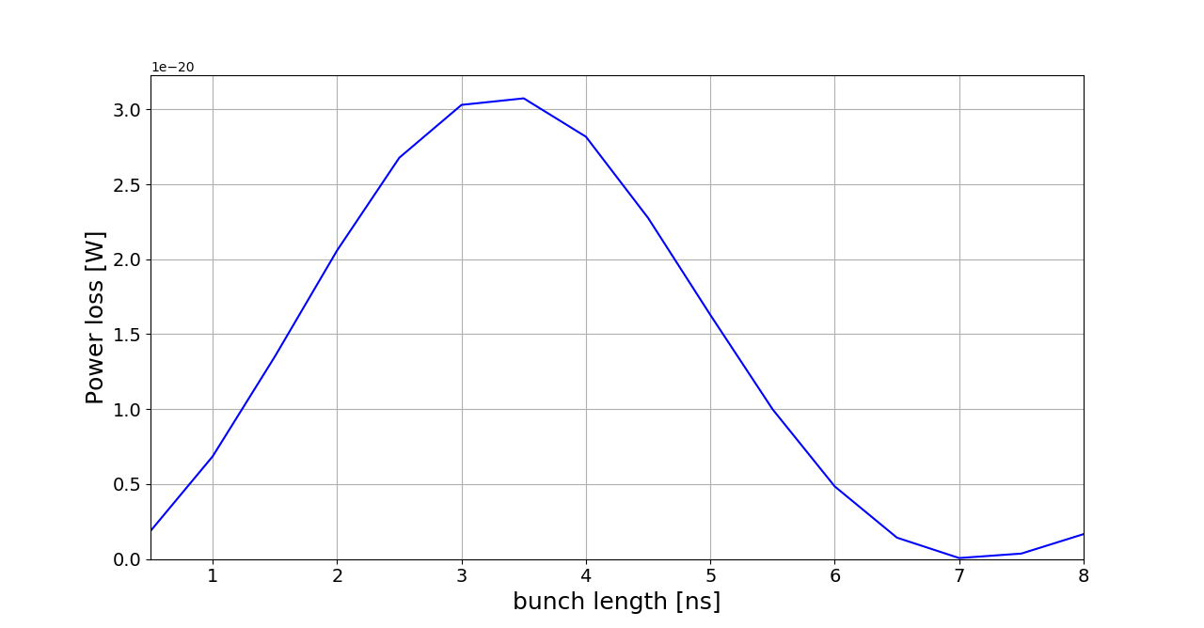
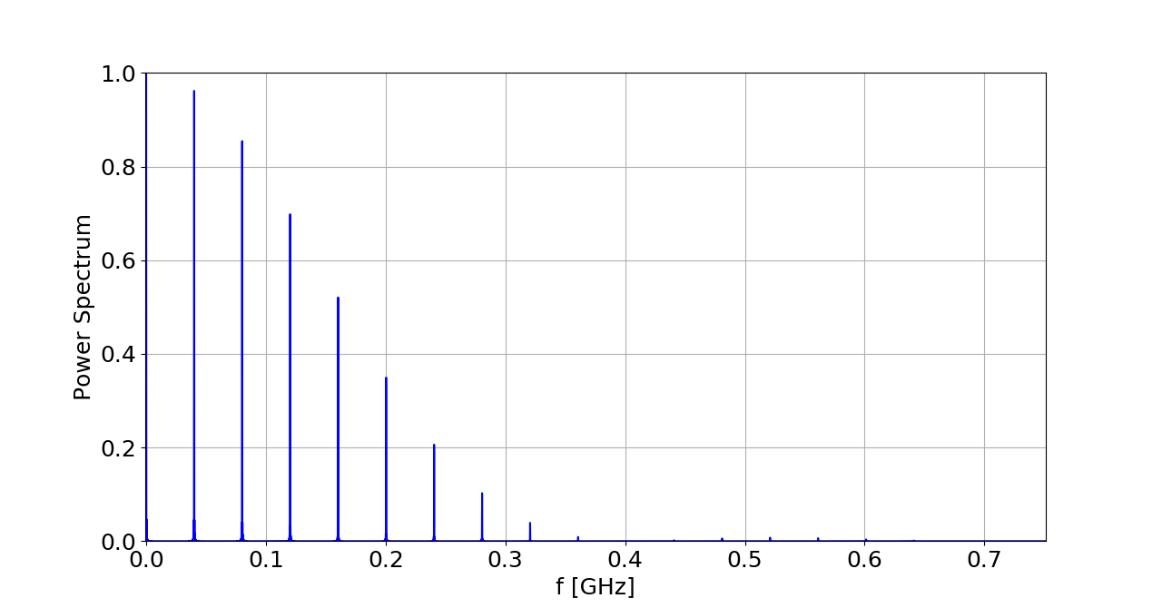
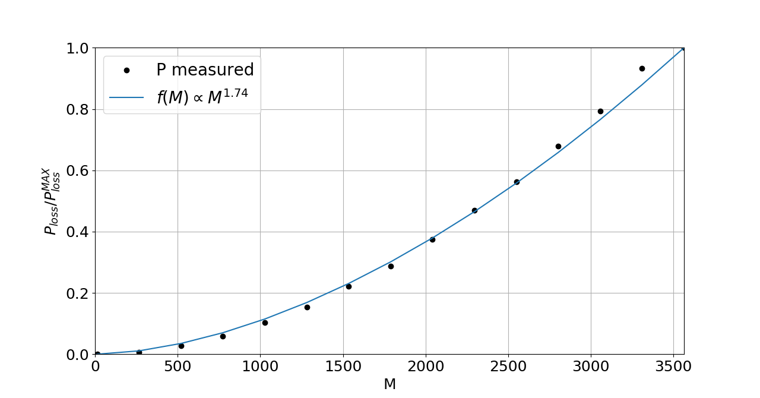
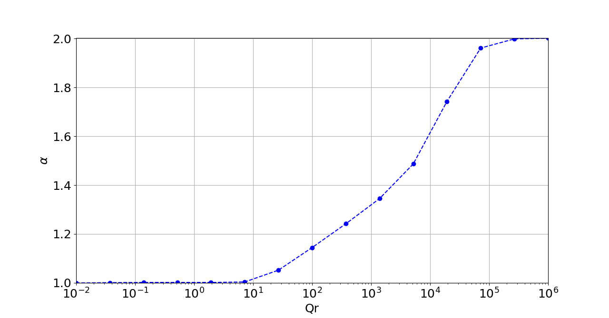
Research Activity n°1(completed)
Measurement of the impedance that can be modelled as resonator impedance without having direct access to the component.
The resonator impedance can be modelled as:
$$Z(f)=\frac{R_{s}}{1+jQ_{r}(\frac{f}{f_{r}}−\frac{f_{r}}{f})}$$
$R_{s}$: shunt impedance
$Q_{r}$: quality factor, bandwidth parameter.
$f_{r}$: resonance frequency, parameter that set the position in frequency of the impedance.

Slide 6
Research Activity n°2 (on going)
Definition of a well defined procedure to compute the power loss given by two beam inside the same component with CST Microwave Studio.
Starting from the paper of C. Zannini: Power loss calculation in separated and common beam chambers of the LHC .
The goal is to relate the EM field plot produced by CST with the analytic formula of the paper and then to define a procedure that allow to use CST for the two beam power loss computation even if CST does not implement this feature yet.
Length [cm] | Ploss CST [mW] | Ploss numerically computed [mW] | Error [%]
50 | 0.6244 | 0.6231 | 0.20
100 | 1.2829 | 1.3016 | 1.43
150 | 1.9417 | 1.9801 | 1.94
190 | 2.4682 | 2.5244 | 2.22
200 | 2.6011 | 2.6609 | 2.24
One beam result

Slide 7
Minor Activities (on going)
RF measurement of the impedance of the LHC collimator to be installed during the long shutdown of the machine (2018-2020)
Monitoring of the temperature of the LHC main components during the run.
Power loss computation for other project of the section.

Slide 8
Main products
Journal papers (not published yet):
Dependence of LHC beam spectrum and beam induced RF heating with filling scheme. P.Arpaia, L. De Vito, F. Giordano and B. Salvant. Submitted at NIM scientific journal (ELSEVIER)
Conference papers:
ANALYSIS ON THE MECHANICAL EFFECTS INDUCED BY BEAM IMPEDANCE HEATING ON THE HL-LHC TARGET DUMP INJECTION SEGMENTED (TDIS) ABSORBER . L. Teofili, F. Giordano et al. Proceedings of IPAC 2018.
A MULTI-PHYSICS APPROACH TO SIMULATE THE RF-HEATING 3D POWER MAP INDUCED BY THE PROTON BEAM IN A BEAM INTERCEPTING DEVICE. L. Teofili, F.Giordano et al. Proceedings of IPAC 2018.
Posters:
Dependence of LHC beam spectrum and beam induced RF heating with filling scheme. F.Giordano et al. PhD school Italo Gorini, CERN 2018.

Slide 9
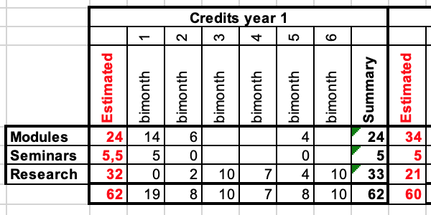
Next year

Slide 10
Next year main goals
Continue the two beam power loss study
Patter recognition algorithm to identify heating issue from the vacuum monitoring system (not all the component have temperature probes installed)

Slide 11
Thanks for the attention

Slide 12
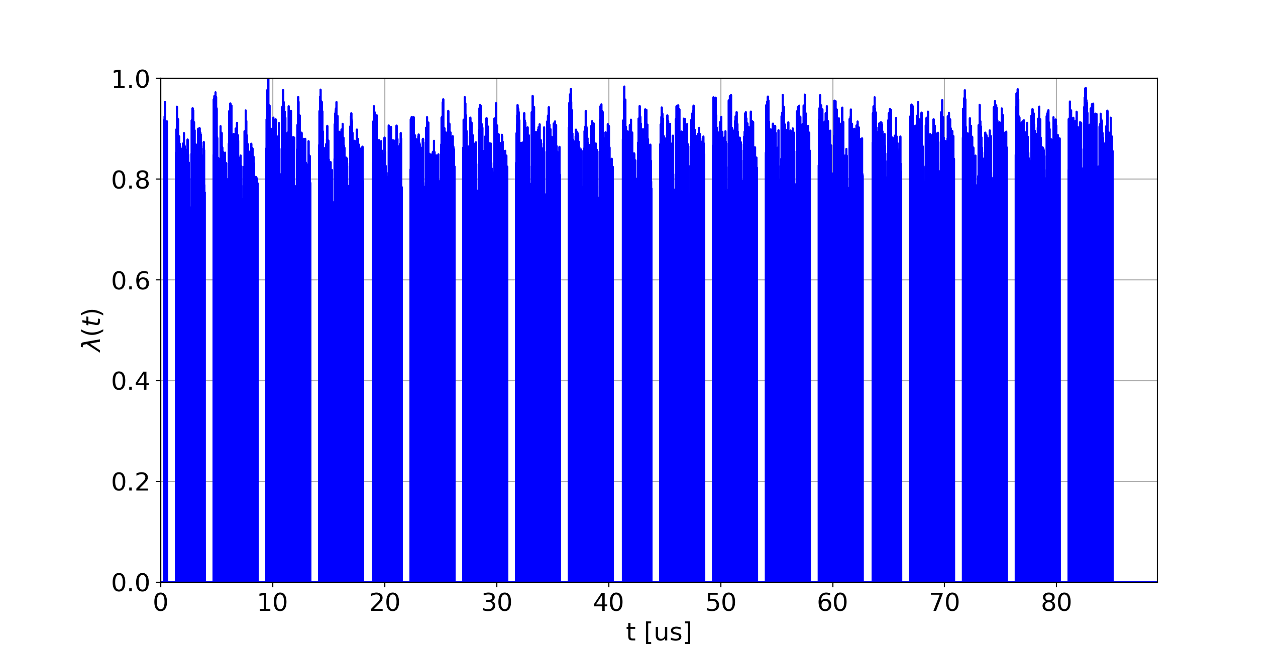
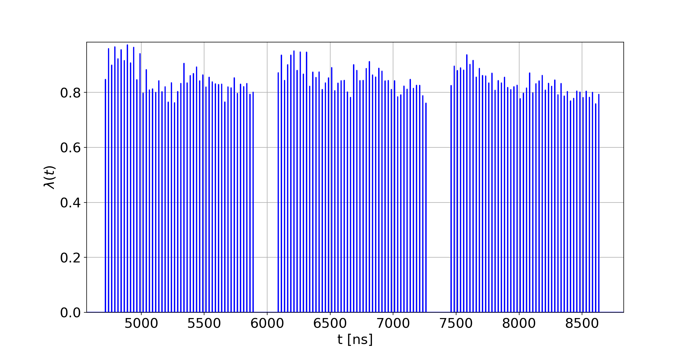
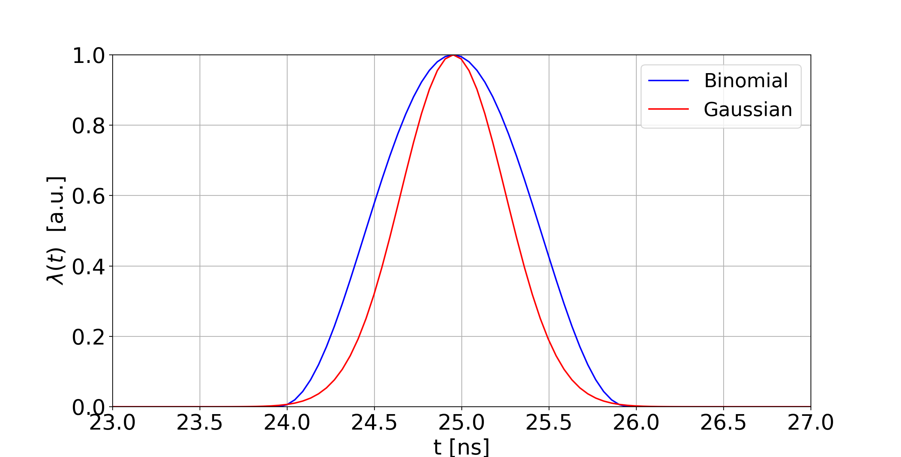
What is a filling scheme?
The filling scheme is the scheme used to inject the protons inside the machine.
Each bunch is longitudinally modelled as a Gaussian or a Binomial function

Slide 15
