Slide 1
Mauro Garofalo Tutor: Giorgio Ventre Co-Tutor: Alessio Botta XXIX Cycle - III year presentation
Big Data Analytics for Anomaly Detection in High-Speed Networks
Notes:
Nota 1

Slide 2
Short Bio
Graduation: MSc in Computer Engineering at University of Napoli Federico II
DIETI Group: COMICS
Fellowship: MIUR research grant
Collaboration: DAME

Slide 3
Credits Summary
Summer Schools
Summer School on Computer Security & Privacy - Building Trust in the Information Age, Pula (CA)

Slide 4
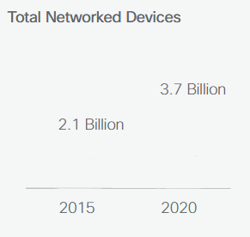
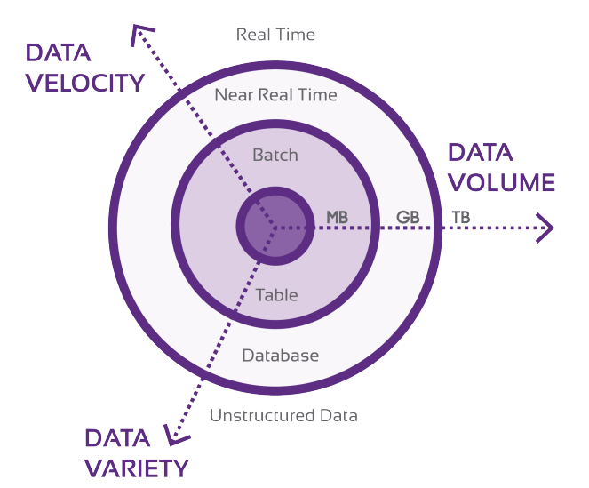
Scenario – Internet Data growth
Volume
Velocity
Variety
Computer networks are crucial to daily life
communication, banking, office
Data grown in 3 directions:
Volume, Velocity, and Variety
Understanding what is happening in the networks becomes an increasingly complex task
Notes:
Nowadays, more and more services become heavily dependent on a network access.
For example We use chat applications and social media to communicate to each other, watch movies on Video Streaming Providers, and we use e-banking services to manage our money.
Moreover, in the next few years, there will be an increase in Internet traffic data concerning not only the volume but also the velocity and data variety.
The 3Vs that defining the Big Data
In this scenario, measuring traffic characteristics in an effective way is crucial for different network activities:
Network planning Traffic management and Anomaly detection

Slide 5
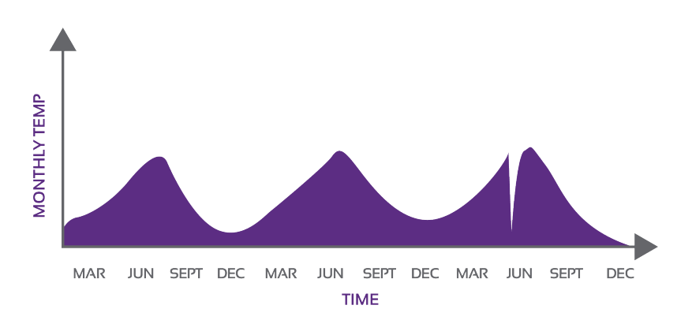
Anomaly Detection
An Anomaly Detection System (ADS) analyzes the characteristics of the input data with the aim of discovering deviations from a normal pattern of behavior.
Anomaly is a pattern in the data that does not conform to the expected behavior.
Also referred to as outliers, exceptions, aberrations, etc.
Abnormal events will occur far frequently compared to normal ones.
Anomaly Example
Points Anomalies
Contextual Anomaly
Notes:
Anomaly detection is a critical problem common to many research domain.
Anomaly can be defined as a pattern in the data that does not conform to the expected behavior.
An Anomaly Detection System (ADS) analyzes the input data with the aim of detect these deviations from the normal pattern of behavior.

Slide 6
Network Anomalies
Network anomalies could be generated both by malicious and non-malicious activities
Malicious activities (attacks)
Net scans
Port Scans
DoS/DDoS
Non-malicious activities
network misconfiguration
traffic discrimination (violation of Net Neutrality)
Notes:
In the computer network, Anomalies are unusual and significant changes in network traffic
that could be generated by
Malicious activities such as
An attack is defined as an intentional act by which an entity attempts to violate the security policy of a system
Or non-malicious activities
Like network misconfigurations or traffic discrimination in violation Network Neutrality

Slide 7
Malicious Activities Detection
Internet
Due the rapid evolution of attack techniques, it is crucial to use detection methods that are effective against both new attacks and variations of known attacks.
Capture Traffic
(Packet/Flow)
Anomaly-based IDS (ADS) have the ability to detect this kind of attacks
Anomaly Detection
Anomaly | Traffic feature distribution
Port scan | Traffic distributed in destination port space and concentrated on single destination host.
Network scan | Traffic distributed in destination address space and concentrated on limited number of destination ports
DoS/DDoS | Traffic distributed in source address space and concentrated on limited number of destination addresses.
Preprocessing
Matching
Mechanism
ALERT
Notes:
In case of Malicious Activities, Due to the evolution of the attacks, it is important to use methods able to detect any nature of malicious activities, both known and unknown. This could be done through an anomaly intrusion detection system.
Typical Anomaly Detection System works as a tree stage process.
First Stage traffic data are captured
Second, data captured are preprocessed in order to transform raw data in a format suitable for the subsequent phase.
Finally, a Matching Mechanism compare the incoming traffic with the normality model.

Slide 8
Challenges
Defining the “normality” region/model is challenging
Boundaries between normal and anomalous behavior are not precise
Normal behavior keeps evolving, so the current notion of normality might not be adequate in future.
High False Positive Rate.
Lack of publicly available labeled datasets (i.e. ground truth) for training/validation
Notes:
Defining the “normality” region/model is challenging,
Normal behavior keeps evolving, so the current notion of normality might not be adequate in future.
Lack of publicly available ground truth for training/validation

Slide 9
Malicious AD - Related Work
Flow Monitoring
Li, B., et al. (2013). A survey of network flow applications, Journal of Network and Computer Applications, 36(2), 567–581.
Hofstede, R, et al. (2014). Flow Monitoring Explained: From Packet Capture to Data Analysis With NetFlow and IPFIX. IEEE Communications Surveys & Tutorials, 16(4), 2037–2064.
Glatz, E., et al. (2012). Classifying internet one-way traffic. ACM SIGMETRICS Performance Evaluation Review, 40(1), 417.
Flow-based Anomaly Detection
Lakhina, A., et al. (2004). Characterization of network-wide anomalies in traffic flows. In Proceedings of the 4th ACM SIGCOMM conference on Internet measurement - IMC ’04 (Vol. 6, p. 201).
Muraleedharan, N. (2008). Analysis of TCP flow data for traffic anomaly and scan detection. In 2008 16th IEEE International Conference on Networks (pp. 1–4).
Androulidakis, G., et al. (2009). Network anomaly detection and classification via opportunistic sampling. IEEE Network, 23(1), 6–12.
Brauckhoff, D., et al. (2012). Anomaly Extraction in Backbone Networks Using Association Rules. IEEE/ACM Transactions on Networking, 20(6), 1788–1799.
De Assis, et al. (2013). A novel anomaly detection system based on seven-dimensional flow analysis. In GLOBECOM - IEEE Global Telecommunications Conference (pp. 735–740).
Big Data architecture for network monitoring
Marchal, S., et al. (2014). A Big Data Architecture for Large Scale Security Monitoring In 2014 IEEE International Congress on Big Data (pp. 56–63). IEEE.
Cao, L., et al. (2014). Interactive outlier exploration in big data streams. Proceedings of the VLDB Endowment, 7(13), 1621–1624.
Solaimani, M., et al. (2014). Statistical technique for online anomaly detection using Spark over heterogeneous data from multi-source VMware performance data. In 2014 IEEE International Conference on Big Data (Big Data) (pp. 1086–1094).
Notes:
In order to define and implement our proposed architecture for malicious anomaly detection, we focused our research on three main topics
Flow Monitoring
Flow-based Anomaly Detection
And Big Data architecture for network monitoring

Slide 10
Malicious AD - Contribution
We introduce a general methodology to acquire and store flows in high-speed networks.
We propose and implement an architecture for flow-based ADS looking for IPs responsible of malicious activities .
We exploit a BDA framework to reduce the response time of the ADS.
We validate our ADS with real backbone traffic.
Notes:
We introduce a general methodology to acquire and store traffic data at flows level
We propose and implement a flow-based ADS that allows to acquire and analyze network traffic looking for IPs responsible of malicious activities.
We validate our anomaly detection system with real backbone traffic.

Slide 11
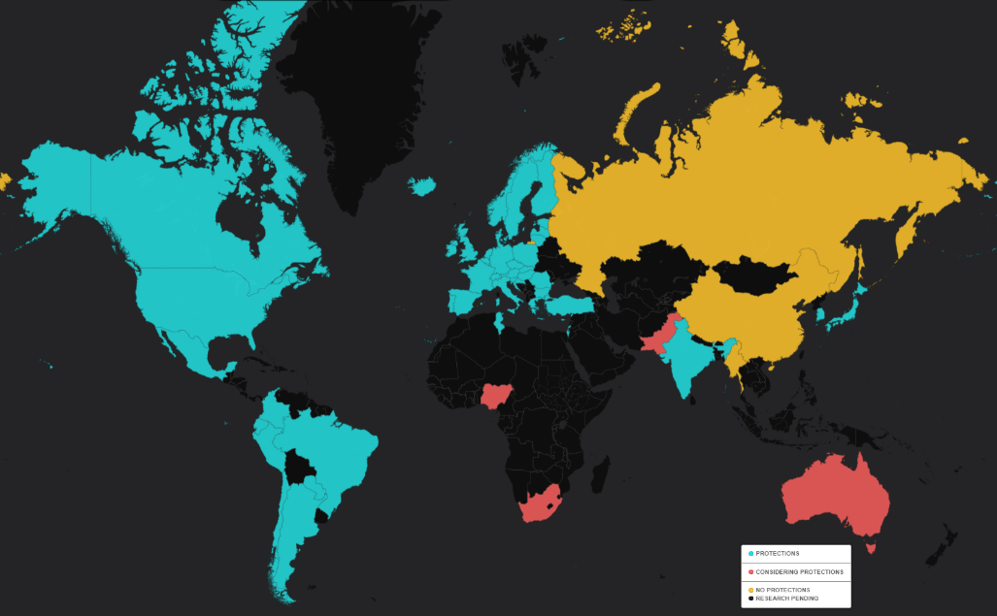
Non Malicious Anomaly Detection
Network Neutrality
The ability of all Internet users to access the content or applications of their choice.
Assurance that all traffic on the Internet is treated equally, whatever its source, content or destination.
Absence of unreasonable discrimination on the part of network operators in transmitting Internet traffic.
Network Neutrality involves
different aspects of interest
Economic, Regulatory and Privacy
a wide range of stakeholders
Policy makers, Service providers, and Researchers
Notes:
Regarding on Non-Malicious activities we face the problem of detecting network neutrality violations
There are different definitions of network neutrality.
Net Neutrality could be defined as the assurance that all traffic on the Internet is treated equally, whatever its source, content or destination.
Debate on net neutrality involves different aspects and a wide range of stakeholders
We do not want to take a position pro or against neutrality
We rather aim at analyzing current situation with respect to a particular service: Internet video streaming

Slide 12
Net Neutrality - Related Work
Main topics
Video popularity, user behavior, delivery policies, and some performance of YouTube and Daily Motion
Cha, Meeyoung, et al. (2007) I tube, you tube, everybody tubes: analyzing the world's largest user generated content video system. In ACM Internet Measurement Conference (IMC) (Vol. New York, pp. 1–14).
Plissonneau, L. et al. (2012). Analyzing the impact of YouTube delivery policies on user experience. In Teletraffic Congress (ITC 24), 2012 24th International (pp. 1–8).
Plissonneau, L., & Biersack, E. (2012). A longitudinal view of HTTP video streaming performance. In Proceedings of the 3rd Multimedia Systems Conference on - MMSys ’12 (p. 203).
Infrastructures
Padmanabhan, V. N., & Subramanian, L. (2001). An investigation of geographic mapping techniques for internet hosts. ACM SIGCOMM Computer Communication Review, 31(4), 173–185.
Calder, M., et al. (2013). Mapping the expansion of Google’s serving infrastructure. In Proceedings of the 2013 conference on Internet measurement conference - IMC ’13 (pp. 313–326).
Notes:
With this purpose we analyze the performance of three different Video service providers from a user viewpoint and provide a snapshot of the current situation
So there are two topics that are more related to our work
The first regarding Video Popularity and performance measurements of Video service providers. and
focusing on unveil the infrastructure of service providers

Slide 13
Net Neutrality - Contribution
We introduce a general methodology to acquire and analyze performance statistics
We measure, analyze, and compare the performance of YouTube, Vimeo, and Dailymotion, from several locations around the world and from a user viewpoint
We also provide insights on geographical location of the infrastructure
Notes:
We introduce a methodology to acquire and analyze performance statistics of video service provider
we measure, analyze, and compare the performance of YouTube, Vimeo, and Dailymotion, from a user viewpoint from several locations around the world
We also provide insights on geographical location of the providers infrastructure

Slide 14
Malicious Anomaly Detection

Slide 15
BDA for Flow-Based Anomaly Detection
SOFTFLOWD
Exporter:
Reads Flow cache, prepares and sends export flows
Flow cache:
Creates/Removes/Updates flow records
Flow Key
Flow start time
Flow last update time
Flow Characteristics
BACKBONE LINK
Meter
…
…
…
…
….
Netflow v5/v8/v9
or IPFIX
Speed Layer
Message Broker
Collector:
Receives export packets, interfaces to applications
NFCAPD
NFDUMP
Streaming
Batch Layer
Storage
HDFS
Notes:
This is an overview of our proposed architecture
This architecture is inspired by the classic flow monitoring architecture
Where Flow exporters, and ﬂow collector are implemented through open source software, respectively Softﬂowd as Flow Exporter and NfCapd as Flow Collector.
So, Using the Flow Exporter, Real traffic traces are transformed into ﬂow records and exported to the flow collector
Then using Nfdump the collected flow traces are transformed into a suitable file format for the Big Data Analytics framework
Finally, the Big Data Analytics framework, Apache Spark, could analyzes streaming or collected data, running our anomaly detection algorithm

Slide 16
Methodology and Tools
Flow Monitoring Architecture
Flow Monitoring Tools
Real backbone traffic traces are transformed into ﬂow records.
Flow exporters, and ﬂow collector are simulated through two software, respectively Softﬂowd and Nfdump.
Flows are stored in HDFS
Flows collected are analyzed using our detection algorithm running on Apache Spark
Source
Real Traces
Observation Points
Nfcapd
Acquisition
Flow Exporter
Softflowd
Flow Collector
Nfdump
Storage
Storage and
Management
HDFS
Analysis and
Monitoring
Apache Spark
Analysis
Notes:
To evaluate the effectiveness of our proposed architecture and to validate our anomaly detection algorithm we developed a testbed.
In this testbed, ﬂow exporters, and ﬂow collector are simulated through two software, respectively Softﬂowd and Nfdump.
Real traffic traces are transformed into ﬂow records, then stored using Hadoop Distributed File System (HDFS) (i.e. acts as Flow Collector).
Thus, data collected is analyzed through our detection algorithm running on Apache Spark

Slide 17
The Detection Algorithm
The algorithm grouped the flow records in time bin (i.e. 30 seconds).
Given a time bin, for each source IPs the ratio
$\frac{\#GeneratedFlows}{\#ReceivedFlows}$ is calculated.
If the ratio exceed the threshold the IP is considered as a generator of anomalous flows.
“A flow is a set of packets passing an Observation Point in the network during a certain time interval. All packets belonging to a particular flow have a set of common properties” . IETF RFC7011
Notes:
This is our simple detection algorithm
The algorithm get in input a flow trace
The ratio between the number of generated flows and the received flows is calculated.
Then if the ratio exceed the threshold the IP is considered as generator of Anomalous flows

Slide 18
What about the data?
MAWI archive
Traffic captured from a transpacific backbone link
Publicly accessible
15 minutes of daily captured traffic
MAWILab
Archive of labeled anomalies in the traces of the MAWI archive.
Publicly accessible
Unsupervised methodology using a combination of four anomaly detectors to provide the labeled dataset.
Hough transform, the Gamma distribution, the Kullback-Leibler divergence, and the Principal Component Analysis.
It can be considered as Gold Standard
Notes:
to validate our detection algorithm we used the real traffic traces from MAWI archive
And MAWILab dataset that containing for each MAWI trace the respective labeled anomalies dataset

Slide 19
Evaluation of Anomaly Detector
Confusion Matrix
$$Precision=PPV=\frac{TP}{TP+FP}$$
 |  | Predicted condition
 | Total population | Condition positive | Condition negative
Actual condition | condition positive | True Positive | False Negative
 | condition negative | False Positive | True Negative
$$Accuracy=\frac{TP+TN}{P+N}$$
Accuracy is not appropriate for evaluating methods for rare event detection
Network traffic dataset with 99.9% of normal data and 0.1% of intrusions a trivial classifier (where everything is labeled as normal) can achieve 99.9% accuracy!
Notes:
MAWILab archive is used as a gold standard to validate our method.
Specifically, we defined as false positive (FP), or false alarm, a source IP reported as anomalous by our detection algorithm but not by MAWILab
we defined as True Positive source IPs that both algorithms reported as anomalous.
In order to evaluate the efficiency of our anomaly detection method we use the precision
Because Accuracy is not appropriate for evaluating methods for rare event detection

Slide 20
Algorithm Evaluation
Results are related to MAWI and MAWILab traces of October 2014
Red line shows the precision using MAWILab as ground truth
We applied a rule-based refinement to False Positive IPs
Port scan rule: $\frac{\#GeneratedFlows}{\#DestinationPorts}$ Net scan rule: $\frac{\#GeneratedFlows}{\#DestinationIP}$
Blu line shows the precision after a refinement process.
Date |  | TP | FP | PPV |  | TP | FP | PPV |  | Percentage Change
21/10/2014 |  | 71 | 246 | 0,224 |  | 300 | 17 | 0,946 |  | 322,54%
25/10/2014 |  | 41 | 206 | 0,166 |  | 246 | 1 | 0,996 |  | 500,00%
26/10/2014 |  | 47 | 203 | 0,188 |  | 250 | 0 | 1 |  | 431,91%
27/10/2014 |  | 59 | 237 | 0,199 |  | 275 | 21 | 0,929 |  | 366,10%
MAWILab
MAWILab
+ Rules
Notes:
To validate our algorithm we used the traces of October 2014.
One of the more complete months in MAWILab archive with 28 out of 31 days
Red line shows the precision using MAWILab as ground truth
Due to probabilistic nature of MAWILab classification methods, we are not sure that all attacks in the traffic trace are actually in MAWILab the dataset.
So for all False Positive IP we perform a rule-based refinement process.
The line in blue in the Figure shows how our algorithm achieving an average precision of 90%

Slide 21
Non Malicious Anomaly Detection

Slide 22
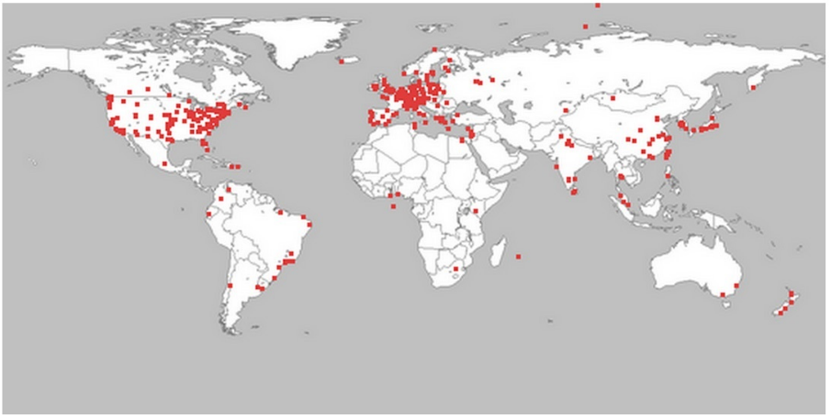
Methodology and tools
We used an extensive infrastructure of 200 PlanetLab nodes from 36 countries
We performed 24h daily measurements over 6 months
We grouped videos in 4 category depending on their popularity
~500 views, 10K < views < 120K, 120K < views < 1M, and views > 1M
For each provider we download two videos for each category
Notes:
For the detection of non malicious anomaly activity such as violation of net neutrality
we analyze the performance of three different Video service providers from a user viewpoint
For this purpose, we implement an extensive measurements infrastructure using two thousand PlanetLab nodes from 36 countries all around the world
And the measurement experiment lasted over six months.

Slide 23
Methodology and tools
PlanetLab Node
Throughput measurement
Exporting:
Create zip files for each provider and upload them to the server
Video Download
RTT & Path
ping
youtube-dl
lsof
traceroute
x200 Nodes
Centralized Server
Video Hosting Providers
Database
Collector:
Receives the providers performance measurements from all PlanetLab nodes
Statistics & Plots
Notes:
This is an overview of our proposed architecture
We used youtube-dl to download the videos from each providers and estimate the throughput.
We used lsof to get the IP address of the server that actually contains the video.
Then we used ping and traceroute to estimate the RTT and the path from the PlanetLab node to the video server
Each planetlab node repeated these steps for each video category and for each Video service provider
Finally, we collected the measurements from all nodes to preform statistics and generate the plots

Slide 24
Video Service Providers Infrastructure
Dailymotion
Entire infrastructure in France (i.e. Paris)
(but) Abnormal activities by some nodes outside France.
Vimeo
Used the very spread and very high performance Akamai’s CDN.
Clients directed to the same server, besides day time or network overload
YouTube
Cache-servers in almost all the tested countries
Delivery strategy assessing both the “distance” and the load
Notes:
Dailymotion
Entire infrastructure in France (i.e. Paris)
Abnormal activities by some nodes (Korea and Singapore maximum throughput is about 12000 KiB/s)
Vimeo
Akamai very spread (only two-hops away from clients in some cases) and very high performance.
Clients are always re-directed to the same server, besides day time or network overload
YouTube
Cache-servers in almost all the countries tested
Delivery strategy assessing both the “distance” and the load

Slide 25
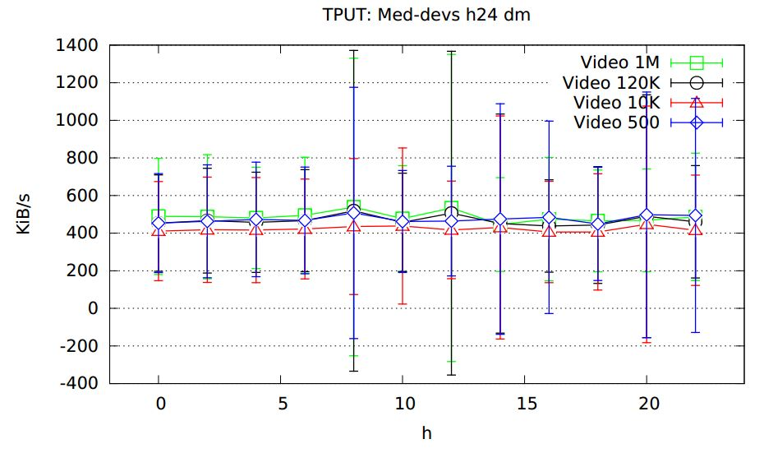
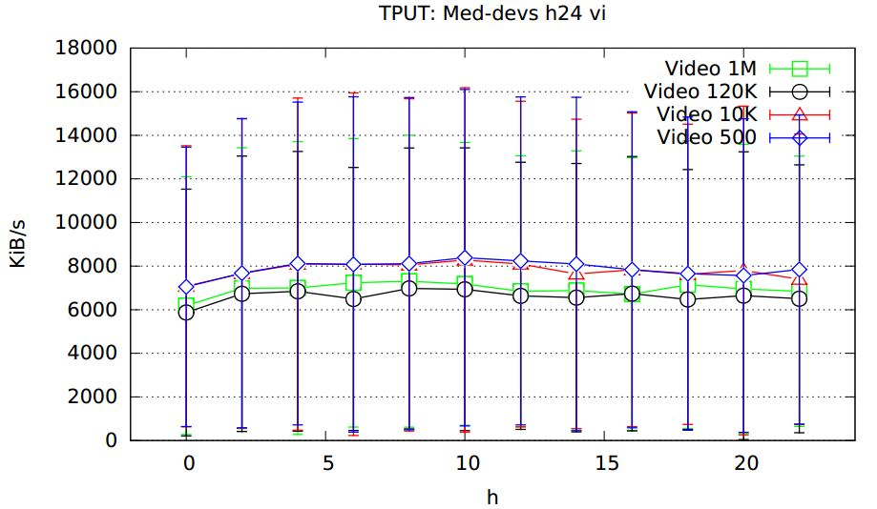
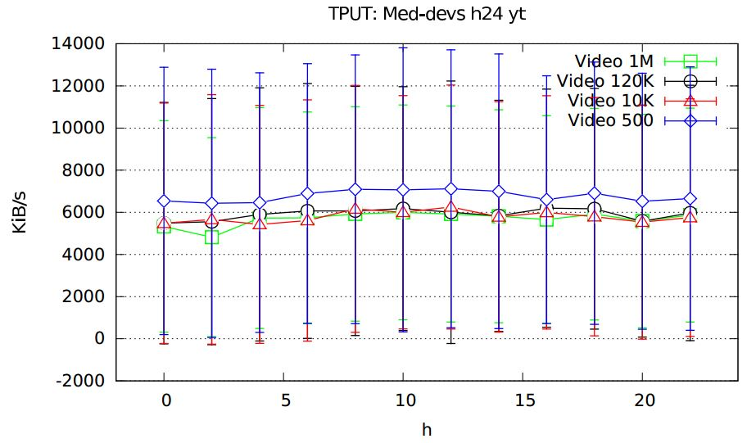
Daily patterns?
Throughput values of Vimeo and YouTube are one order of magnitude higher then Dailymotion
Video less views have slightly high throughput
No throughput variation in peak times
Interquartile ranges (intervals defined by 1st and 3rd quartile) are very large
Dailymotion
Vimeo
YouTube
Notes:
In the figures the throughput values of Vimeo and YouTube are one order of magnitude higher then Dailymotion
The results do not show any traffic patterns variation depending by time of day

Slide 26
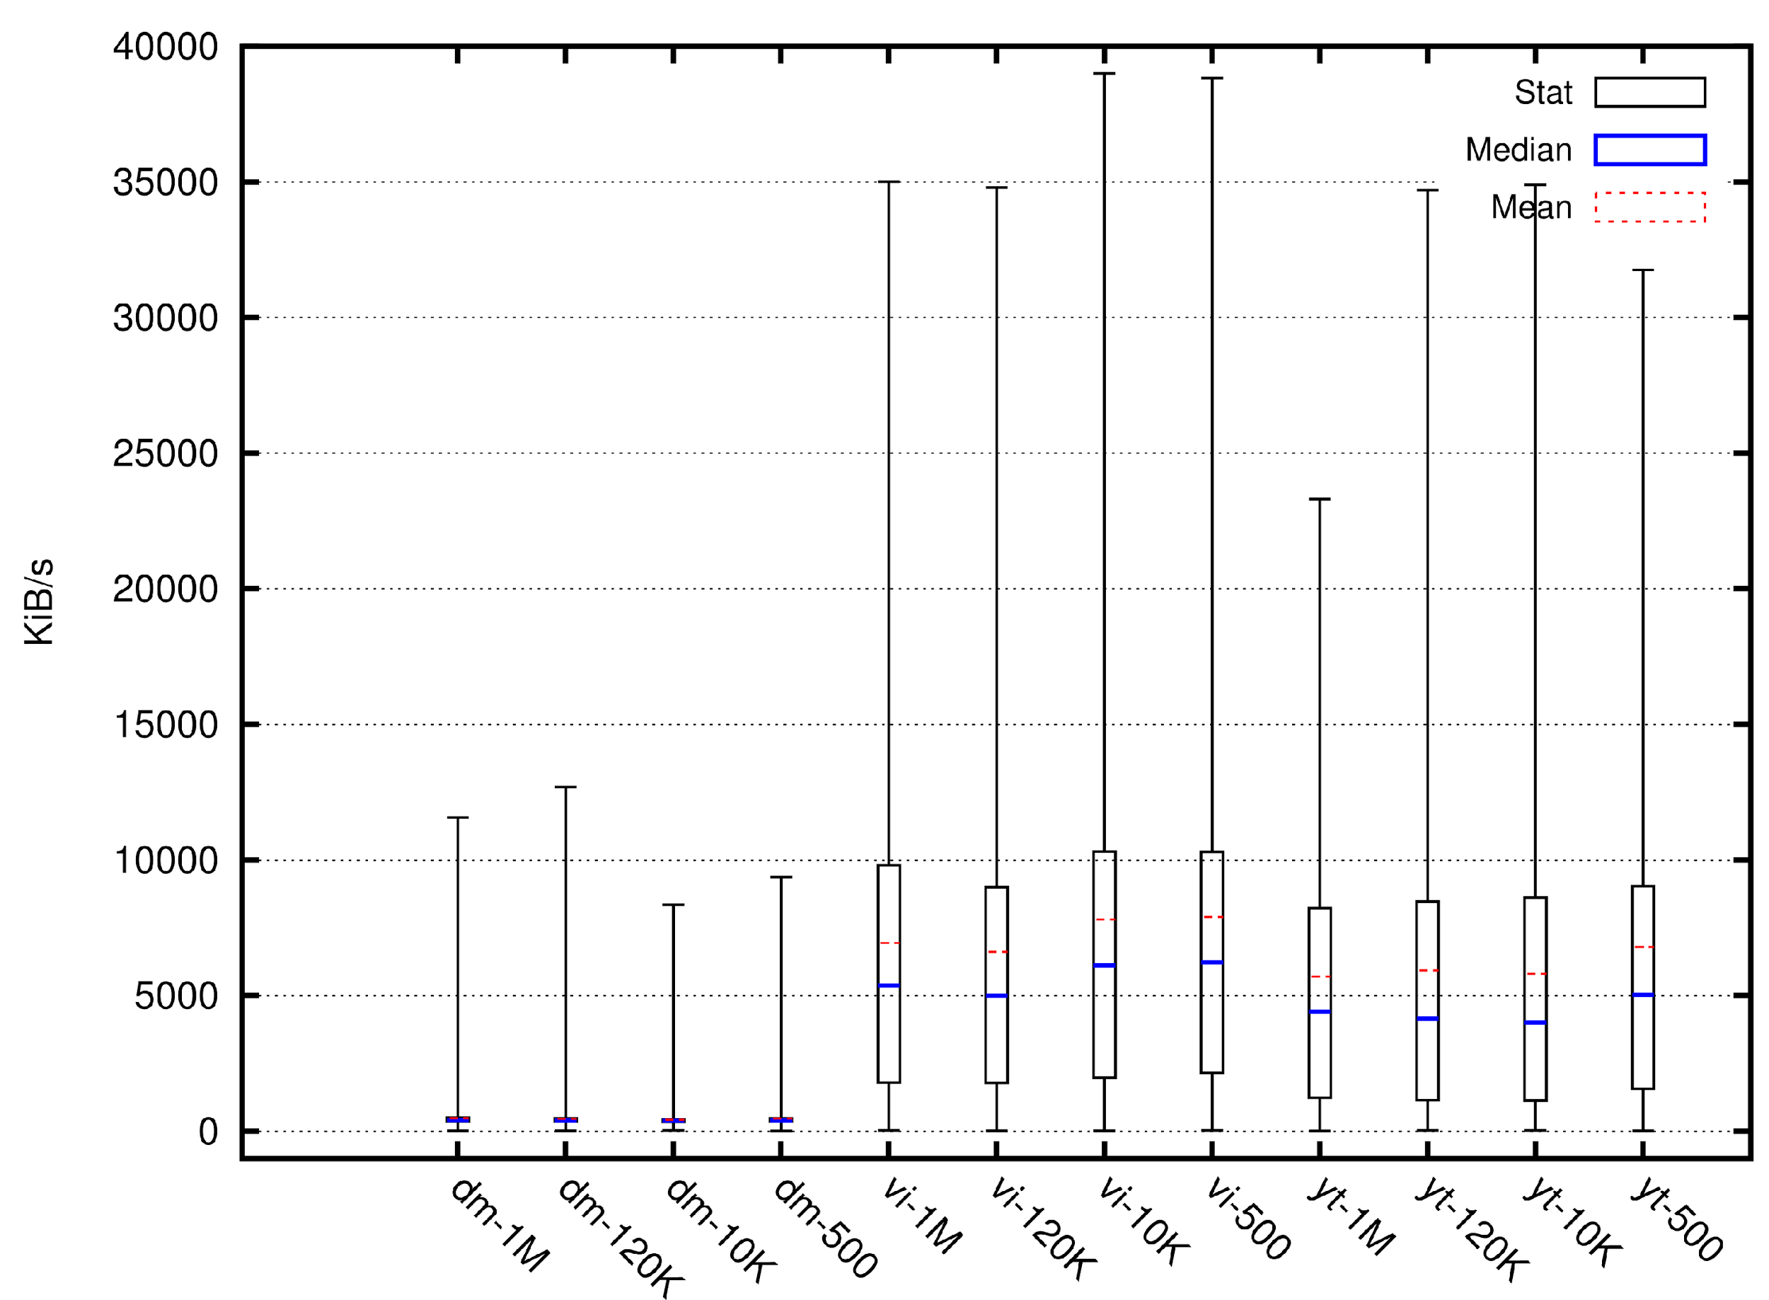
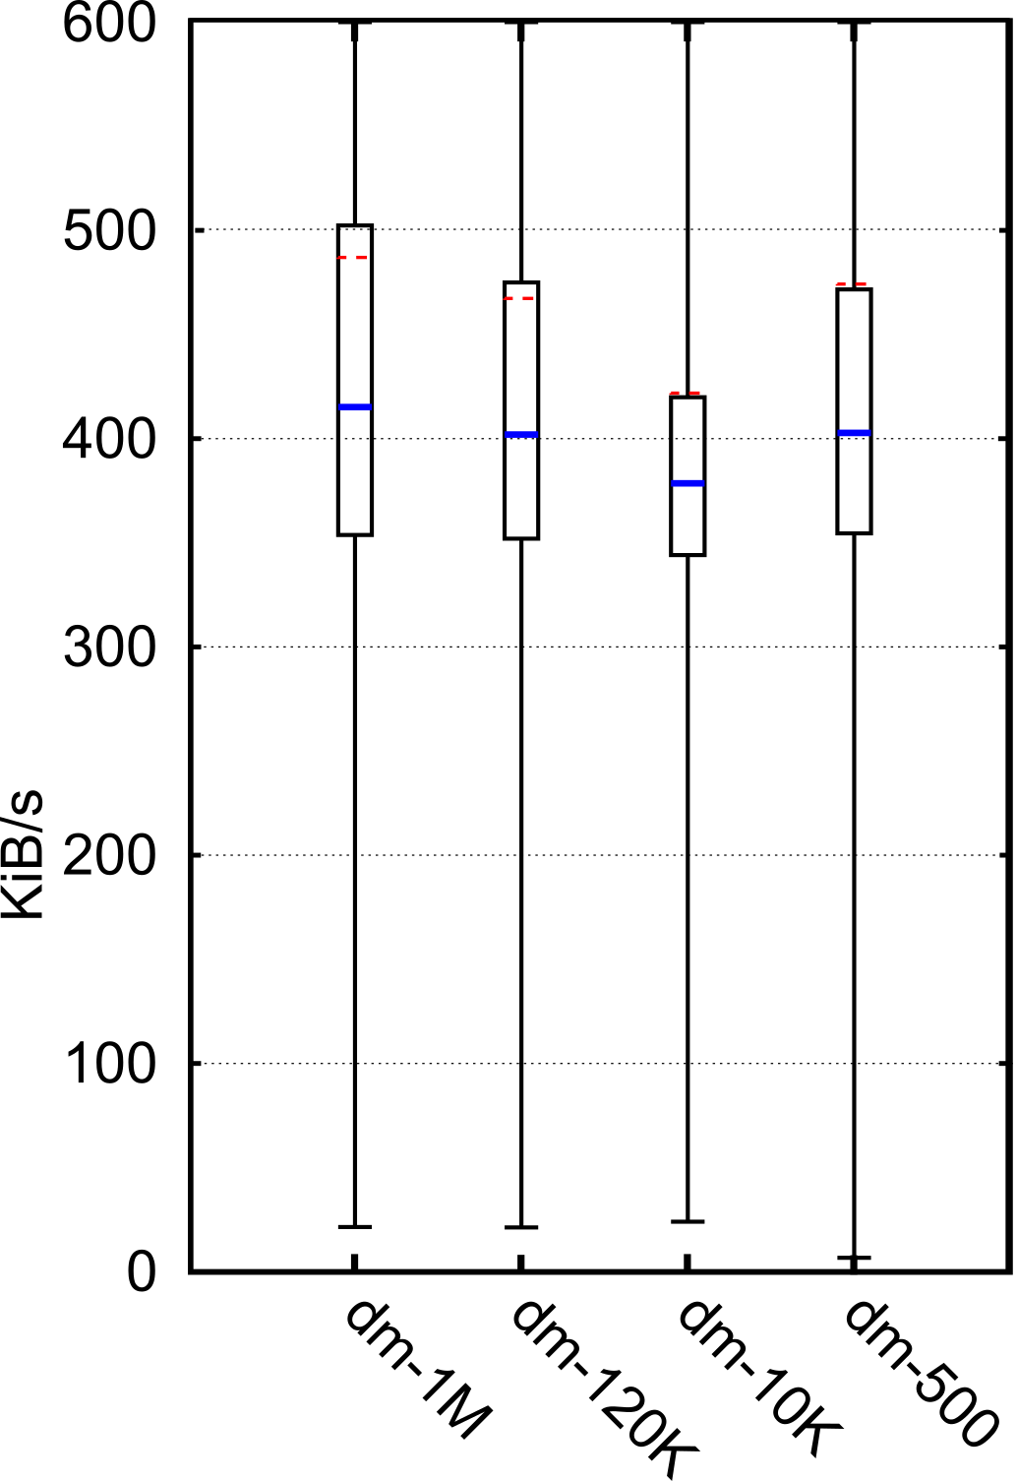
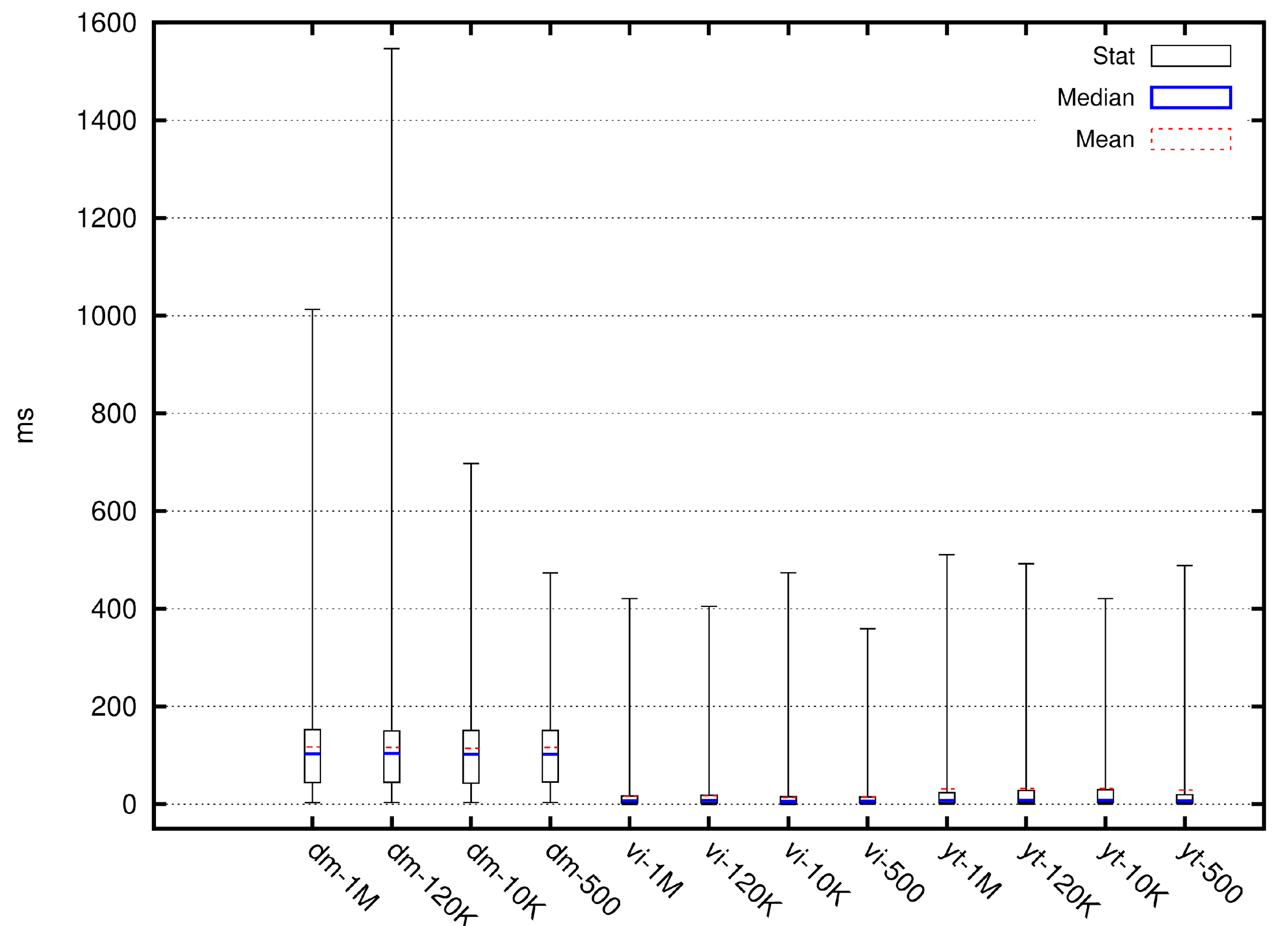
Throughput and RTT by country
Average Throughput
Dailymotion has the worst performance, and most of its clients show throughput values smaller than 500 KiB/s.
YouTube and Vimeo have similar patterns
for all video categories Vimeo has better performance
Average RTT
Dailymotion's RTT values are larger in comparison to its competitors.
Distributed infrastructures, as Akamai CDN for Vimeo, and Google cache-servers for YouTube, show better performance in terms of RTT.
Notes:
This is the performance comparison between the three providers aggregated by video category
Compared to its competitors, Dailymotion has the worst performance, both in terms of Throughput and RTT. This could be related to the centralized nature of its infrastructure.
YouTube and Vimeo have similar patterns, although Vimeo achieves better performance than YouTube
Both providers have often servers located in the same AS of their clients, which allows them to achieve very high performance.
In conclusion, The highlighted performance differences may be regarded as lack of neutrality, but they are not due to different treatments of traffic, but rather to different infrastructures

Slide 27
Conclusions
Malicious Anomaly Detection
We proposed and implemented a flow-based ADS that allows to acquire and analyze network traffic looking for IPs responsible of malicious activities.
We used a BDA framework to reduce the response time of the ADS.
We performed a comparison of our system with MAWILab archive, with validation purposes.
Non Malicious Anomaly Detection
We proposed a methodology that, regardless the type of provider, allows to acquire and analyze performance data and qualitative considerations about the infrastructure of the providers.
We performed a performance comparison of three video hosting services, namely Dailymotion, Vimeo and YouTube, estimating the throughput, RTT, number of hops, and geography location of their infrastructures.
Notes:
Summarizing
To detect malicious activity we proposed and implemented a flow-based ADS that uses a Big Data Analytics framework to reduce the response time in high-speed network.
We validate our system with real backbone traffic and our detection algorithm achieving an average precision of 90%
Regarding Non Malicious Anomaly detection
We proposed a methodology that, regardless the type of provider, allows to acquire and analyze performance data and qualitative considerations about the infrastructure of the providers.
We performed a performance comparison of three video hosting services, namely Dailymotion, Vimeo and YouTube, estimating the throughput, RTT, and geography location of their infrastructures and the Highlighting performance differences but no traffic discrimination.

Slide 28
Publications
Botta, A., Avallone, A., Garofalo, M., and Ventre, G ., “A User-Oriented Performance Comparison of Video Hosting Services” submitted to Computer Communication, 2017.
Botta, A., Avallone, A., Garofalo, M., and Ventre, G ., “Internet streaming and network neutrality: Comparing the performance of video hosting services,” ICISSP2016.
Garofalo M., Botta, A., and Ventre, G., “Astrophysics in the Big Data era: Challenges, Methods, and Tools”, AstroInformatics, 2016.
Brescia, M., Cavuoti, S., Garofalo, M., et al, “DAMEWARE: A Web Cyberinfrastructure for Astrophysical Data Mining”, PASP, Vol. 126, P. 783-797, ISSN: 0004-6280, 2014.
Garofalo, M., et al., “Acceleration of Machine Learning Models based on GPGPU technology for fast data mining in multidisciplinary physical environments”, GPU2014.

Slide 29
Thanks!

