Slide 1
Mirko Gagliardi Tutor: Alessandro Cilardo XXXI Cycle - I year presentation
Exploring Advanced Computer Architecture and Technique to Improve Performance and Power Efficiency in Many Core Era

Slide 2
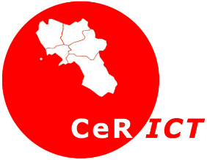
Background
Master of Science:
In “Ingegneria Informatica” at University of Naples “Federico II”
DIETI Group:
Seclab
Type of Fellowship:
Doctoral Fellowship funded by CeRICT
Collaboration:
With CeRICT in the context of the european project MANGO

Slide 3
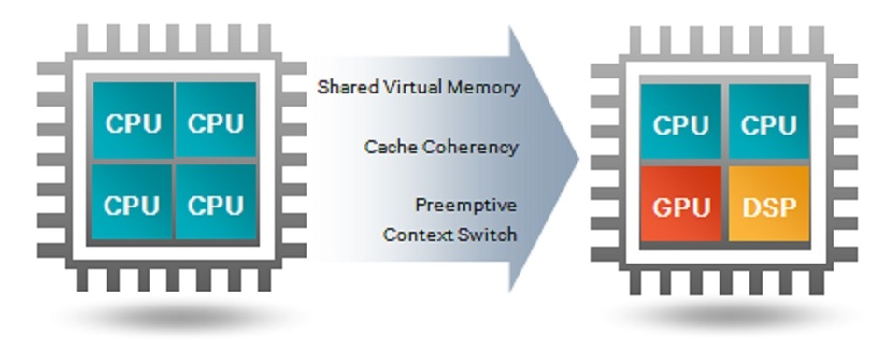
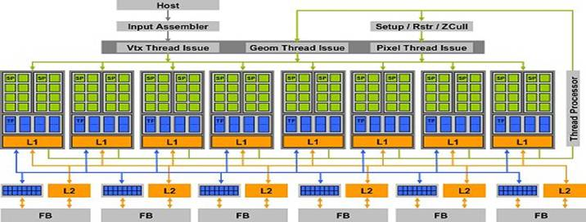
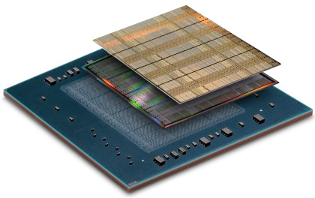
HPC modern trend: GPU-like processors
Problems:
Power wall, memory wall, ILP wall
Disruption of the rising of clock frequency
Solutions:
Heterogeneous platforms, systems made of different computational units, with specialized accelerators that complement general purpose CPUs, such as DSPs, GPUs, co-processors, enabling significant benefits in terms of both power and performance
GPU-like paradigm:
Match recent trends
also including FPGA and SoC manufacturers
Enable higher power-efficiency
Provide an effective answer to programmability issues
support for high-level languages and models, like OpenCL
State-of-Art Academic GPU-like core projects
FlexiGrip, MIAOW GPGPU, Hwacha, Maven

Slide 4
Nu+ project: configurable GPU-like core
Goal: An open parameterizable architecture for hardware solution exploration
Our Accelerator main focus
Application-driven accelerator
Parameterization
Light Control logic
More resources for operators
Power efficient
64 bit supports register and operators
In resource sharing
Custom operation
Power efficient
FP and Special Function Unit
Scratchpad memory support
Dynamic remapping: reducing bank conflicts
Power efficient
Relation in MANGO project
NoC-based manycore architecture Heterogeneous system
Nu+ will be a compute unit architectures for advanced hardware solution exploration:
RISC, GPU-like core, special-purpose accelerators
Microarchitecture-level customization techniques
Low Power and QoS-aware mechanisms
MANGO: exploring Manycore Architectures for Next-GeneratiOn HPC systems
GN
HN
GN
GN
HN
HN
HN
HN
GN
GN
GN
GN
GN
HN
GN
HN
HN
HN
GN
GN
GN
HN
GN
GN
Nu+
4

Slide 5
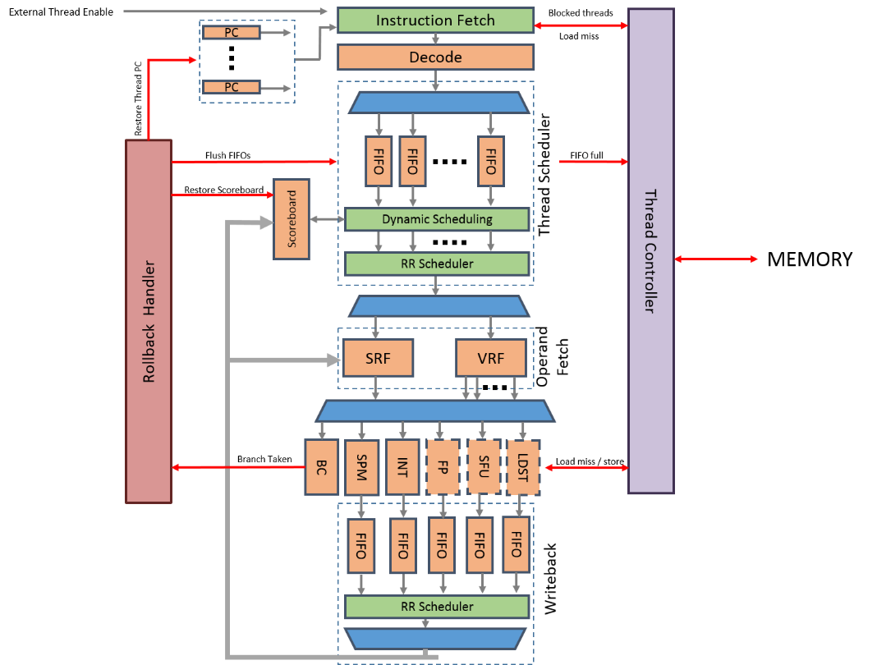
Nu+ Core Overview Main Features
RISC Core
In-order pipeline semplified control, thread switching to mask latencies
Parametrization thread number, hardware lane number, ...
Custom ISA
Multithread support
Each thread with its own PC
N hardware lane shared among all threads
Resourse sharing
High Parallelism
Scalar and Vectorial
Each thread has its own registers
64 bit support (Integer and Floating Point)
N 32 bit registers or N/2 64 bit registers
Variable latency operator support
SPM has a variable latency
Advance Writeback: automatic structural hazard detection

Slide 6
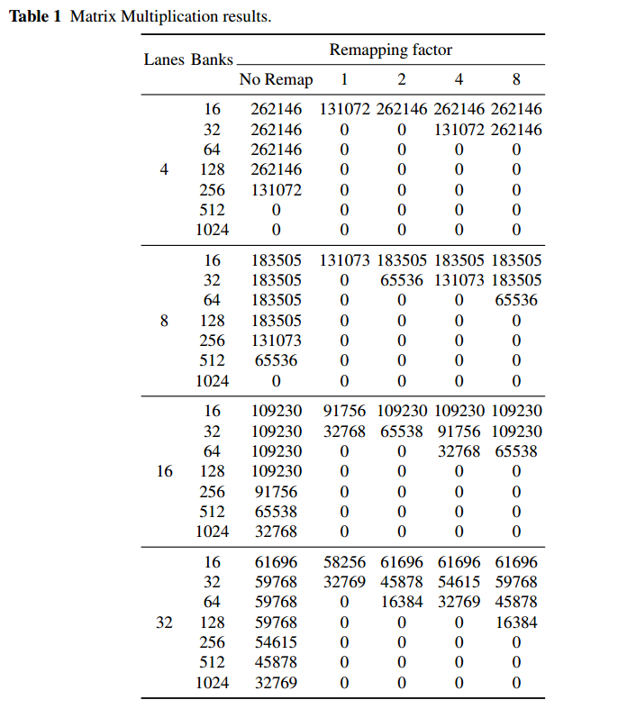
Results: application-driven customization
Hardware application-driven parameterization
Each application has an ideal hardware configuration
E.g. same kernels do not need cache coherence
In this case a coherent cache is not needed A non coherent scratchpad memory has less hardware overhead
[1] explores hardware ad hoc customization beneficts. We describe how a configurable non coherent memory affects performance and how different parallel kernels require different configurations
Main findings:
A configurabile non coherent scratchpad memory presented
Parameterization highly affects performance
Hardware optimization (Bank Remapping)
A typically software optimization has been realized in hardware
Faster than software version
Minimum overhead and high impact
Next Steps:
Exploring non-coherent power aware memory solutions
Custom operators application-driven
Low Power and QoS-aware mechanisms
[1] Cilardo Alessandro, Gagliardi Mirko, Donnarumma Ciro, "A Configurable Shared Scratchpad Memory for GPU-like Processors." International Conference on P2P, Parallel, Grid, Cloud and Internet Computing. Springer International Publishing, 2016.
6

Slide 7
Products – Conferences Papers
Cilardo Alessandro, Gagliardi Mirko. "Customizable Heterogeneous Acceleration for Tomorrow's High-Performance Computing." High Performance Computing and Communications (HPCC), 2015 IEEE 7th International Symposium on Cyberspace Safety and Security (CSS), 2015 IEEE 12th International Conference on Embedded Software and Systems (ICESS), 2015 IEEE 17th International Conference on. IEEE, 2015.
Cilardo Alessandro, Gagliardi Mirko, Donnarumma Ciro, "A Configurable Shared Scratchpad Memory for GPU-like Processors." International Conference on P2P, Parallel, Grid, Cloud and Internet Computing. Springer International Publishing, 2016.

Slide 8
Credits

