Slide 1
Giuseppe Andrea Fontanelli Tutor: Bruno Siciliano XXXI Cycle - I year presentation
Mechatronic design and methods to improve the suturing phase during a robotic surgical procedure

Slide 2
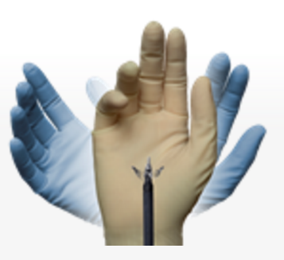
Background & Info
M.Sc degree: Automation and Control Engineering from University of Naples Federico II
Working team: ICAROS (Interdepartmental Centre for Advances in Robotic Surgery)
Supervisor: Prof. Bruno Siciliano
Fellowship program: “Borsa di Ateneo”

Slide 3
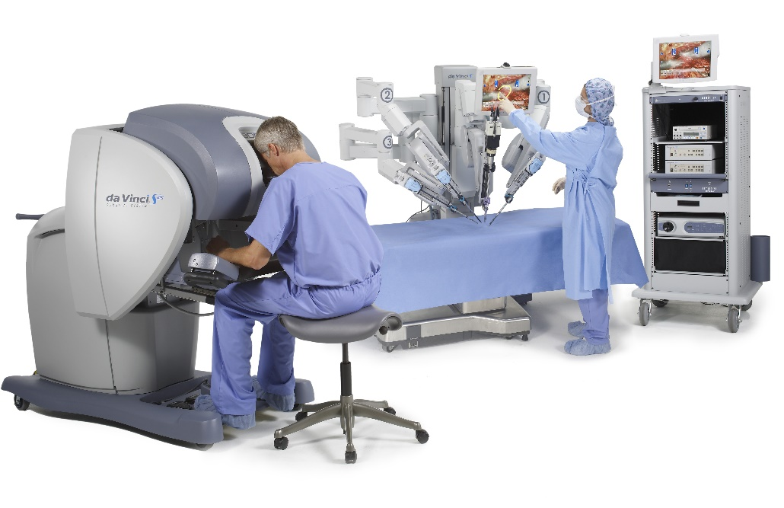
Research field
Minimally Invasive Robotic Surgery (MIRS) holds a fundamental role in modern surgical procedures.
Better sense of visual immersion and comfort for the surgeon, better precision, less post-operative pain and recovery time then the classical open or laparoscopic surgery, are just some of the benefits of using robots in minimally invasive procedures.

Slide 4
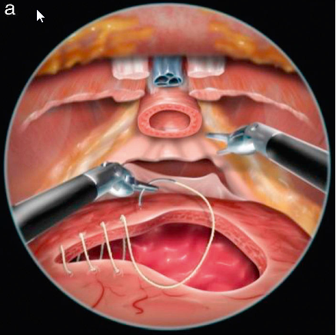
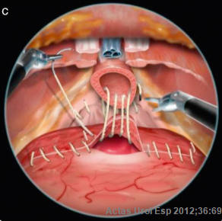
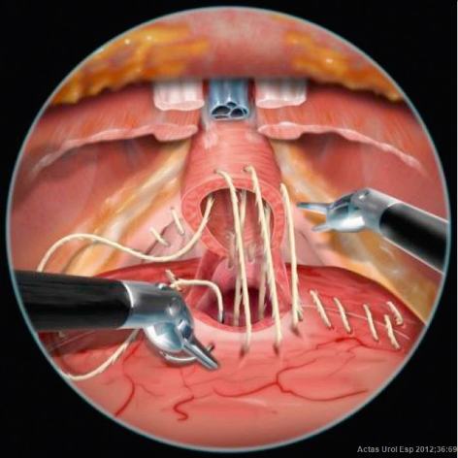
Research topic 1/2
The most difficult procedure in laparoscopic robotic surgery is the reconstructive phase that consists of suturing the tissues after the organ removal.
For example, in a radical prostatectomy procedure, the reconstructive phase consists of linking again, with a suture, the urethra to the bladder after the prostate removal.

Slide 5
Research topic 2/2
The goal of my research is the development of a robotic assisted suturing procedure using a real-time trajectory planner that will be able to minimize the tissues stress and the implementation of a virtual fixtures on the haptic interface in order to constrain the surgeon motions along the optimal path.
The work of my first Year:
Development of a Matlab toolbox for the kinematic and dynamic modelling and identification of any multi-chain robot. Dynamical modelling and identification of the Patient side (PSM) and the Master side (MTM) arms of the Da Vinci Research Kit robot (DVRK)
Implementation of a real-time tracking algorithm for soft objects and simulation of the contact between rigid and soft bodies.
Mechatronic design of new sensors and tools for the da Vinci robot
Initial study of the problem of an optimal trajectory planner for suturing.

Slide 6
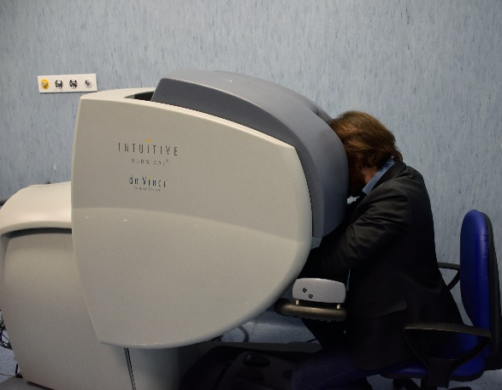
Da Vinci Research Kit
In the ICAROS center we have fully working second generation Da Vinci robot (DVRK) http://research.intusurg.com/dvrkwiki/index.php?title=Main_Page
An open controller provided by Jhons Hopkins University was installed in order to have full control of the five arms, three PSM arms with six DOF each and two MTM arms with seven DOF each
During this year I developed a Matlab toolbox for the kinematic and dynamic modelling and identification of any multi-chain robot
The dynamical model identification is obtained using an LMI-based approach [1] to include the physical consistency constraints in the optimization procedure
[1]
Cristovao D. Sousa, Rui Cortesao, “Physical Feasibility of Robot Base Inertial Parameter Identication: a Linear Matrix Inequality Approach”, in The International Journal of Robotics Research · May 2014

Slide 7
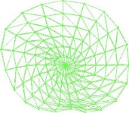
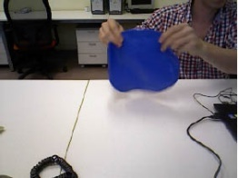
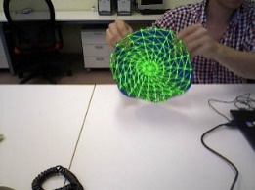
Real-time soft-bodies tracker
Real-time tracking algorithm for a 3D textureless object which undergoes elastic deformations, using the point cloud data provided by an RGB-D sensor.
Visual segmentation of the object
Segmentation of the depth map Sampling Backprojection
Rigid registration using ICP
Deformable registration using closest point correspondences and FEM model

Slide 8
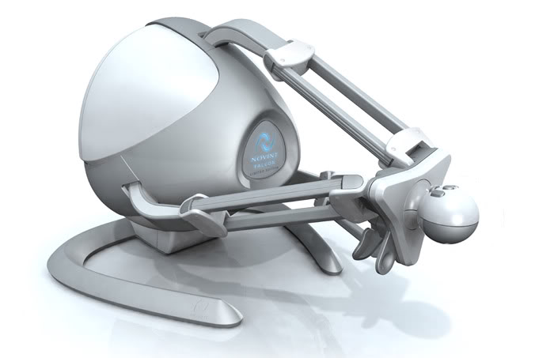
Collision detection algorithm
Implementation of a collision detection algorithm between rigid and thin object and soft bodies in an open source engine (bullet) in order to simulate the interaction between the needle and the organs.
The original algorithm presented by Fukuhara in 2014 [2] has been extended in order to calculate the collision between soft objects and generic rigid and thin bodies.
A haptic interface has been used to allow the surgeon to feel the forces applied on the simulated environments and a nonlinear model for the force interaction was considered.
[2]
Akira Fukuhara et al. “Proposition and evaluation of a collision detection method for real time surgery simulation of opening a brain fissure”. In: ROBOMECH Journal 1.1 (2014)

Slide 9
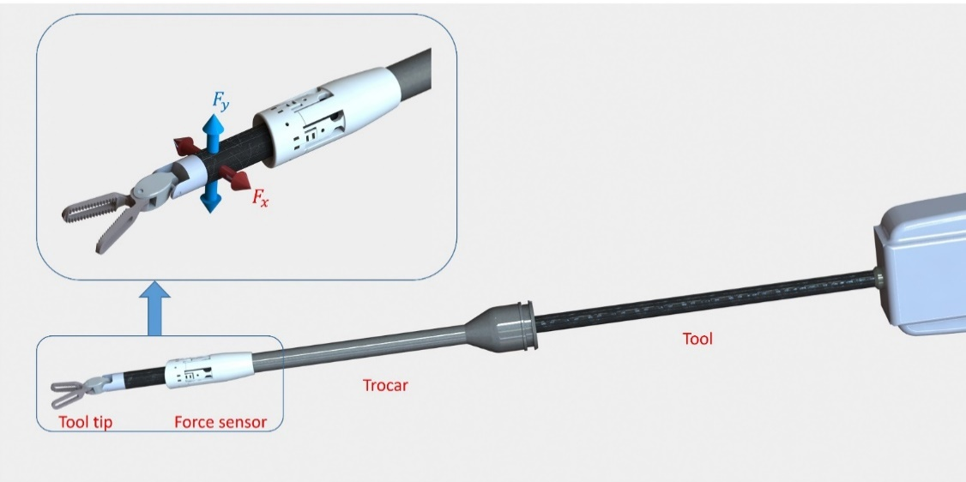
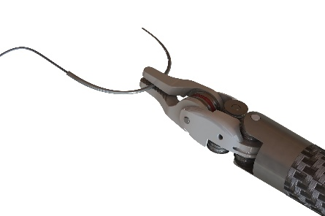
Mechatronic design
Mechatronic design of a new force sensor which can be mounted on a trocar (the entrance in the patient’s body used for the robotic tools) in order to measure the force applied on the tool tip of the robot, along the axis $x$ and $y.$
Design of a new laparoscopic tool to improve the dextirity of the surgeon during a suturing procedure

Slide 10
My products
Journal paper published: Antoine Petit, Vincenzo Lippiello, ANDREA FONTANELLI, Bruno Siciliano, “Tracking elastic deformable objects with an RGB-D sensor for a pizza chef robot” in Robotics and automation systems, September 2016.
Conference paper: F. Fazioli, F. Ficuciello, G. A. FONTANELLI, B. Siciliano, L. Villani, “Implementation of a Soft-Rigid Collision Algorithm in an Open-Source Engine for Surgery Realistic Simulation”. The article was presented as a poster section at the CRAS Workshop 2016 (Pisa 12-14 September) and as a full presentation at the HFR Workshop 2016 (Genova 29-30 September). Moreover, an extended version of that work was submitted, and accepted at the ROBIO conference 2016.
Patent: An Italian patent for a new laparoscopic tool that allows in hand manipulation of a needle during a suturing procedure was written and will be submitted in the next months.

Slide 11
Next Year
My aim for the next Year is to:
Implement a suturing simulator in the open source physical engine SOFA.
Test the new force sensor and identify them and the complete dynamical model of the Da Vinci research kit (DVRK) Robot in order to obtain an accurate measure of the interaction between the robot tools and the organs.
Implement an optimal trajectory planner using the minimization of the tissues stress as a objective function
The first year activities and the outlook for the second year can be summarized as:
 | Credits year 1 |  |  |  |  |  |  |  | Credits year 2
 |  | 1 | 2 | 3 | 4 | 5 | 6
 | Estimated | bimonth | bimonth | bimonth | bimonth | bimonth | bimonth | Summary | Estimated
Modules | 20 |  | 6 |  |  | 8 | 7 | 21 | 10
Seminars | 5 | 1,6 | 0 |  | 1 | 0 | 3,3 | 5,9 | 5
Research | 35 | 8,4 | 4 | 10 | 9 | 2 | 2 | 35,4 | 45
 | 60 | 10 | 10 | 10 | 10 | 10 | 12,3 | 62,3 | 60

Slide 12
Thank you

