Slide 1
Davide Fiore Tutor: Mario di Bernardo XXIX Cycle - III year presentation
Contraction analysis of Switched systems with applications to control and observer design

Slide 2
My Background
I received the M.Sc. degree in Ingegneria dell’Automazione from University of Napoli “Federico II”
I am currently working with the SINCRO group
My fellowship is “Fondo Sostegno ai Giovani“ - FSGDIS

Slide 3
Collaborations
During my PhD I collaborated with
Prof. John Hogan, Deparment of Engineering Mathematics
Prof. Rodolphe Sepulchre and Dr. Fulvio Forni, Department of Engineering
Dr. Giovanni Russo, Optimization and Control Group, IBM Research Ireland

Slide 4
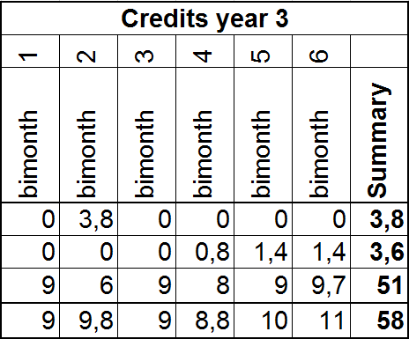
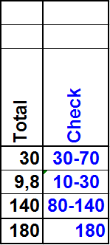
Third year
Summary of the last year activity:
During the 3rd year I spent 4 months as visiting student at the University of Cambridge, UK

Slide 5
Outline
Motivation
Brief introduction to contraction
Contraction analysis of switched systems
Further extensions

Slide 6
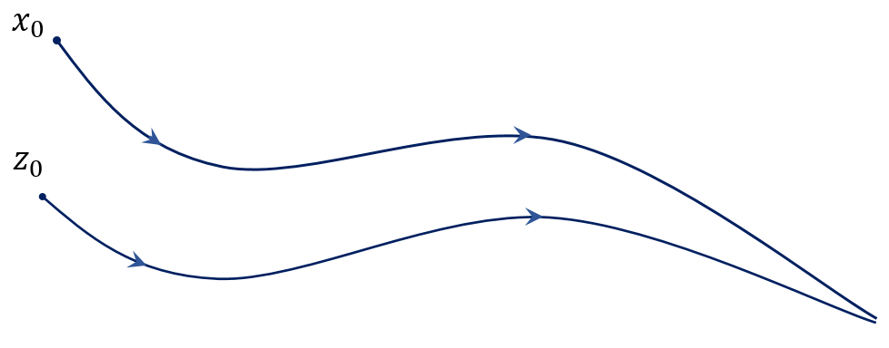
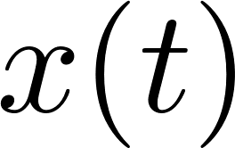
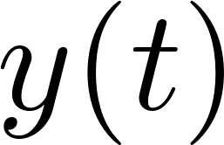
Incremental stability
In many control problems it is fundamental to study the convergence between two trajectories.
For example:

Slide 7
Incremental stability

Slide 8
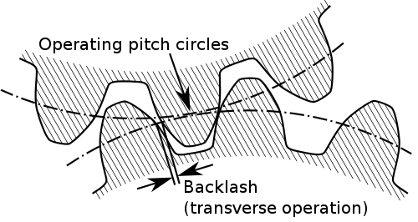
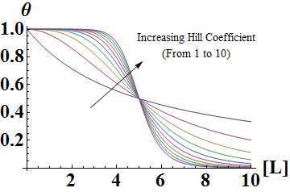
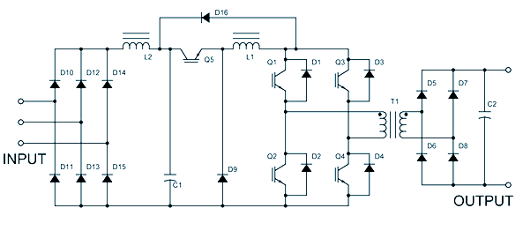
Switched systems – 1/2
Moreover, in many applications the physical systems of interest can be described by differential equations with discontinuous right-hand side.
Examples are:
Mechanical systems with impacts, friction, …
Power converter with switching elements
Gene regulatory networks
Relay control
Variable structure systems

Slide 9
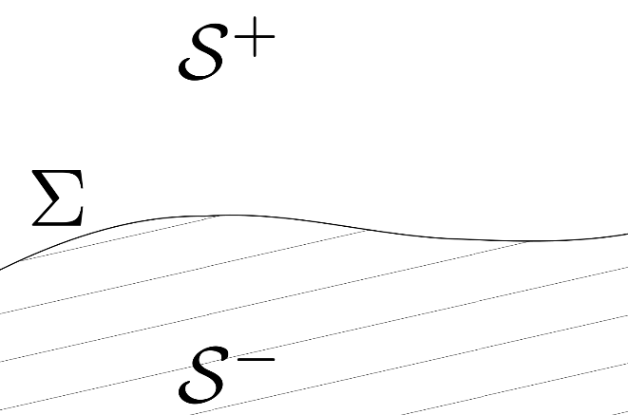
Switched systems – 2/2
All those examples can be described by dynamical systems where
The switching manifold is defined as

Slide 10
My work
When I started my PhD, incremental stability of nonlinear switched systems was still not studied in the literature.
The aim of my work was to fill this gap.
To derive sufficient conditions for incremental stability we developed an extension of contraction analysis to switched systems.

Slide 11
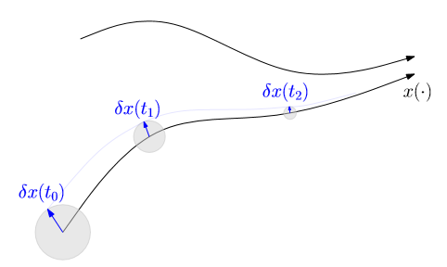
Contraction analysis
Contraction analysis exploits stability of the linearized dynamics to infer incremental stability of the nonlinear system.
Definition: A nonlinear system is contracting if initial conditions or temporary state perturbations are forgotten exponentially fast.
If a system is contracting in a forward invariant set , then its solutions converge to a unique equilibrium point.
If then the solutions globally converge to it.

Slide 12
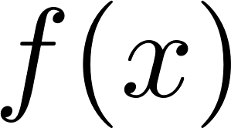
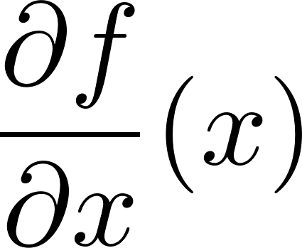
Basic idea
Consider a nonlinear system where is a continuously differentiable function.
The system is contracting if its Jacobian matrix satisfies a certain condition.
Specifically, given some norm, the nonlinear system is contracting in a set if

Slide 13
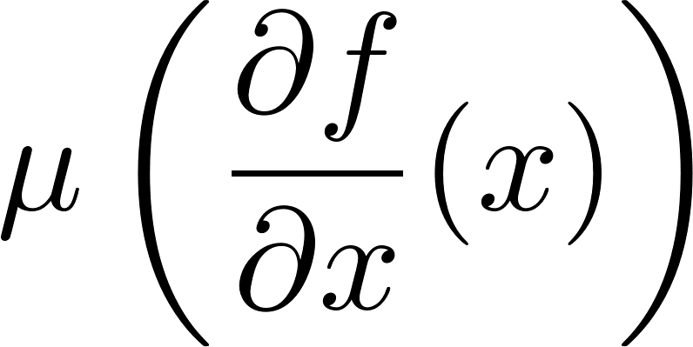
Problem statement
Contraction analysis cannot be directly applied to switched systems because they are not continuously differentiable.
Indeed, we cannot continuously evaluate the matrix measure of the Jacobian matrix because it is not defined on the switching manifold
How can contraction analysis be extended to switched systems?

Slide 14
Methodology
To overcome the previous limitations
We constructed a new continuously differentiable system (a regularization) that approximates the dynamics of the original system
We conducted usual contraction analysis on it
We obtained in the limit the desired results for the original system
We found out that a switched system is contracting if
It verifies the usual condition on the points where it is diffentiable
An additional condition is verified on the switching manifold

Slide 15
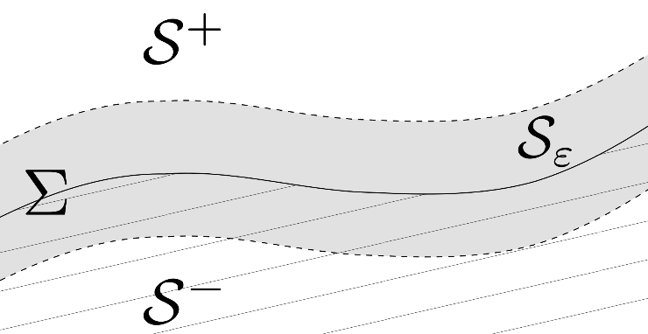
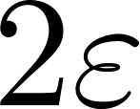
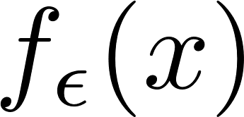
Regularization
Rather than looking to the discontinuous system we can consider its regularization
Under the hypothesis of right-uniqueness of solutions, we have that
Therefore, we can analyze contraction of and then in the limit recover results for

Slide 16
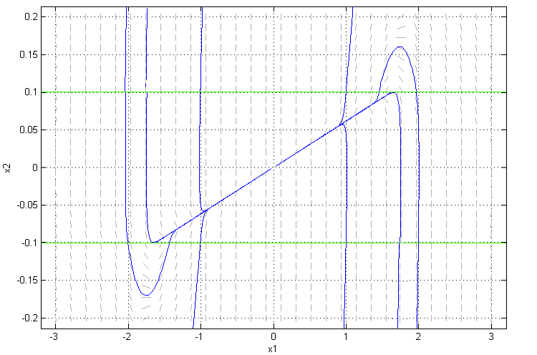
Regularization – An example
… and how its regularization looks like
An example of switched system…

Slide 17
Contracting switched systems
Analyzing the regularized system and taking the limit we get the following result:
Theorem: A bimodal switched system is contracting if there exists a norm with associated matrix measure such that

Slide 18
Geometrical interpretation
The third condition guarantees contraction during both crossing and sliding.

Slide 19
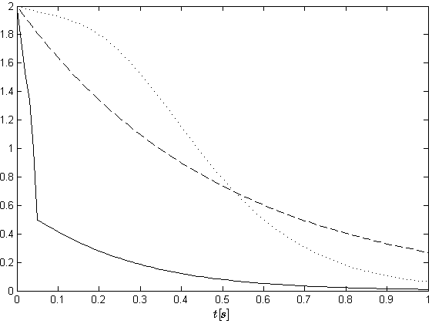
Applications – 1/2
The previous theoretical results have been used in switching control design

Slide 20
Applications – 2/2
And in state observer design
Evolution of the states of system and observer
Evolution of the estimation error

Slide 21
Remarks
However, our conditions require that the switched system is contracting during both flow and switching.
Moreover, when using matrix measures we are considering contraction with respect to a constant metric.
In some application these assumptions can be too strong.
Therefore, to relax our conditions we have to move on from matrix measures and use a more general and flexible tool.

Slide 22
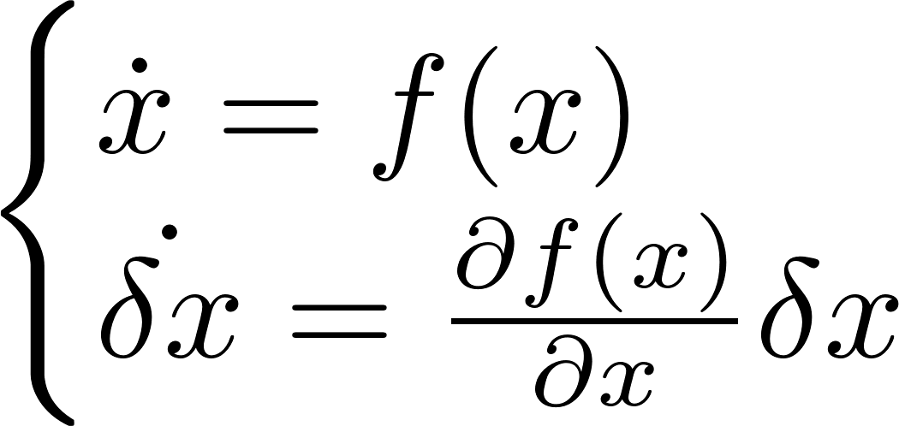
Finsler-Lyapunov approach
All the approaches presented in the literature to contraction analysis have been unified in a differential Lyapunov theory.
The idea is to look to contraction as a Lyapunov stability analysis applied to the differential dynamics
Theorem: A system is contracting if there exist a positive definite function , and a constant such that

Slide 23
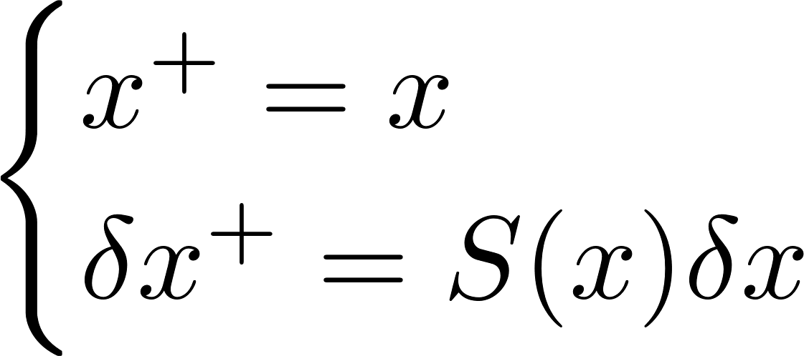
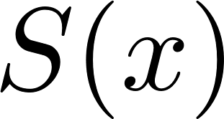
Differential dynamics
Using again regularization, we found out that the differential dynamics of a Filippov system has a hybrid nature
Continuous-time dynamics during flow
Discrete-time dynamics during switching where is known in the literature as saltation matrix (Aizerman, ‘58)

Slide 24
Hybrid contraction analysis
Therefore, we can combine Finsler-Lyapunov functions with hybrid Lyapunov stability theory
Theorem: A Filippov system is contracting if there exist a positive definite function , and two constants and such that

Slide 25
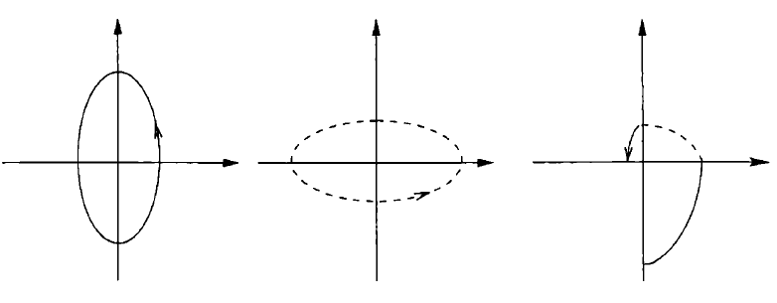
Relaxations
As in classical hybrid Lyapunov analysis, the last two conditions can be relaxed
As long as is non-increasing along every solutions, the system is still contracting even if one of the two conditions is not satisfied.
For example, we can now analyze systems that contracts only during switches between marginal stable dynamics (whose flow is not contracting)

Slide 26
Publications
Journal paper:
Fiore, Hogan, di Bernardo, “Contraction analysis of switched systems via regularization”, Automatica (73), 2016
Conference papers:
di Bernardo, Fiore, “Switching control for incremental stabilization of nonlinear systems via contraction theory”, in Proceedings of the 2016 European Control Conference
Fiore, Coraggio, di Bernardo, “Observer design for piecewise smooth and switched systems via contraction theory”, submitted to IFAC World Congress 2017
Fiore, Russo, di Bernardo, “Exploiting nodes symmetries to control synchronization and consensus patterns in multiagent systems”, in preparation for IEEE CDC’17
Fiore, Forni, Sepulchre, di Bernardo, “Differential analysis of piecewise smooth systems”, in preparation for IEEE CDC’17

Slide 27
Additional slides

Slide 28
Available literature
Some results on contraction analysis for non-differentiable systems are available in the literature:
PWA systems (Pavlov, Pogromsky, van der Wouw, Nijmeijer, 2005)
Resetting hybrid systems (Rifai and Slotine, 2006)
Carathéodory systems (di Bernardo, Liuzza, Russo, 2011; Lu and di Bernardo, 2016)
Sliding mode solutions (di Bernardo and Liuzza, 2014; di Bernardo and Fiore, 2015)
Transverse stability of hybrid limit cycles (Tang and Manchester, 2015)
Filippov systems (Fiore, Hogan, di Bernardo, 2016) Our approach is based on regularization.

Slide 29
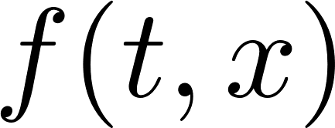
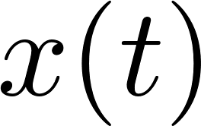
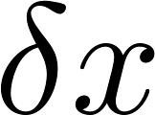
Contraction analysis – 1/3
Consider a nonlinear system where is a continuously differentiable function.
The differential dynamics along a certain solution is where is the infinitesimal displacement between and any neighboring solution.

Slide 30
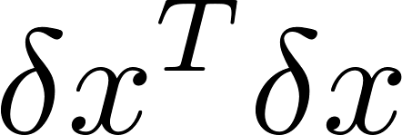
Contraction analysis – 2/3
The evolution in time of the squared Euclidean distance between neighboring solutions is
Denoting by the largest eigenvalue of the symmetric part of the Jacobian matrix we have
If then, by integration we have

Slide 31
Contraction analysis – 3/3
This in turn implies that, by path integration, the length of any finite curve between any two solutions of the system converges exponentially to zero
The previous analysis in Euclidean norm can be generalized to (quadratic) Riemannian metrics
To conduct contraction analysis in non-Euclidean metrics (as 1-norm, ∞-norm) we have to use another approach.
The mathematical tool to conduct this analysis is the matrix measure

Slide 32
Matrix measure – 1/3
The mathematical tool to conduct this analysis is the matrix measure
Definition: Given a real matrix and a norm with its induced matrix norm , the associated matrix measure is the function defined as
It also know as logarithmic norm, and it was introduced by Dahliquist and Lozinskii in 1958.

Slide 33
Matrix measure – 2/3
Euclidean norm
1-norm
sup-norm

Slide 34
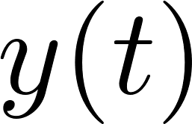
Matrix measure – 3/3
The norm of the difference between two solution and to the continuously differentiable nonlinear system satisfies
Integrating
Therefore, if the matrix measure of the Jacobian matrix is negative definite in the set of interest, that is then the system is incrementally stable therein.

Slide 35
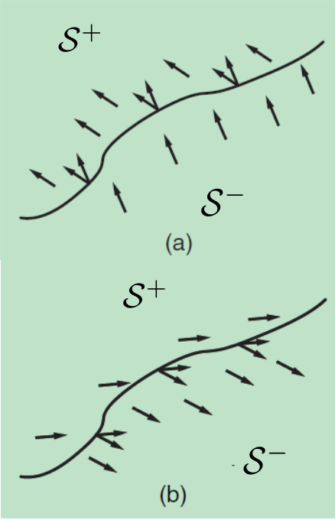
Carathéodory solutions
When the normal component of the vector fields either side of are in the same direction, the gradient of a trajectory is discontinuous.
Hence the classical requirement that a solution to must follow the direction of the vector field at all times is not satisfied (on a set of measure zero).
Carathéodory solutions are absolutely continuous curves that satisfy
crossing

Slide 36
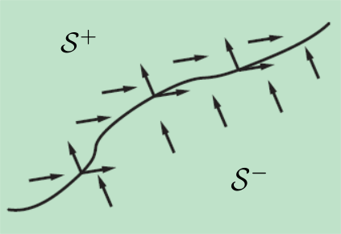
Filippov solutions
But when the normal component of the vector fields on either side of are in the opposite direction a vector field on needs to be defined.
Instead of focusing on the value of the vector field at individual points, we consider how the vector field looks like around each point.
Mathematically, it is defined the Filippov set-valued map
sliding

Slide 37
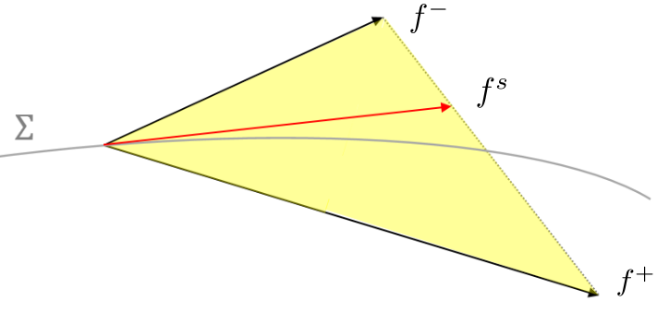
Sliding vector field
Formally, the differential equation is replaced with a differential inclusion
A Filippov solution is therefore an absolutely continuous function that satisfies the DI for almost all t.
A particular choice (applicable to systems with dry friction) is to define on the sliding vector field s.t.
[1] Cortés – “Discontinuous dynamical systems”, IEEE Control system magazine (2008) [2] Filippov – “Differential equations with discontinuous righthand side” (1988)

Slide 38
Solutions of Filippov systems
At the points of discontinuity the solutions behave differently from those of smooth systems.
Crossing
Sliding

Slide 39
Example – 1/4

Slide 40
Example – 2/4

Slide 41
Example – 3/4

Slide 42
Example – 4/4

Slide 43
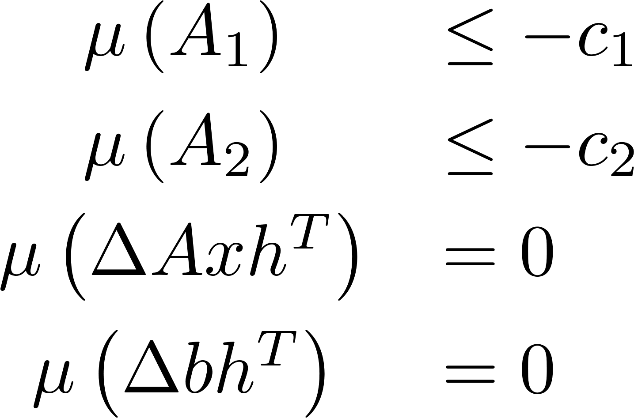
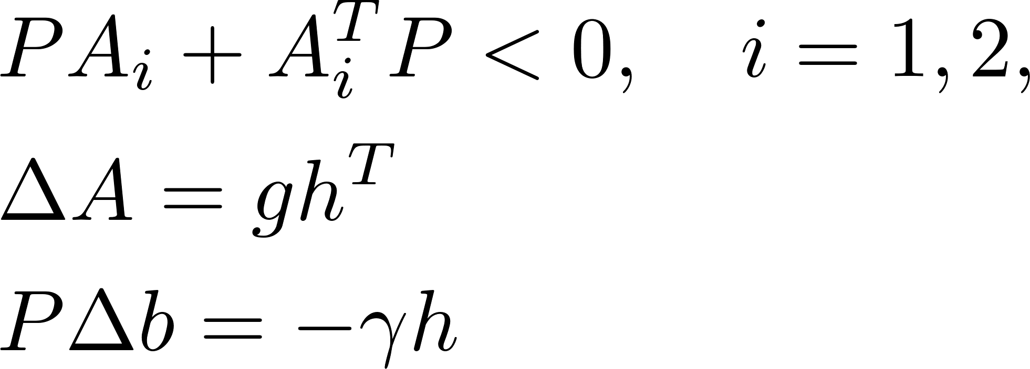
Application to PWA systems
PWA systems
Our conditions become
Using Euclidian norm
“entrainment”

Slide 44
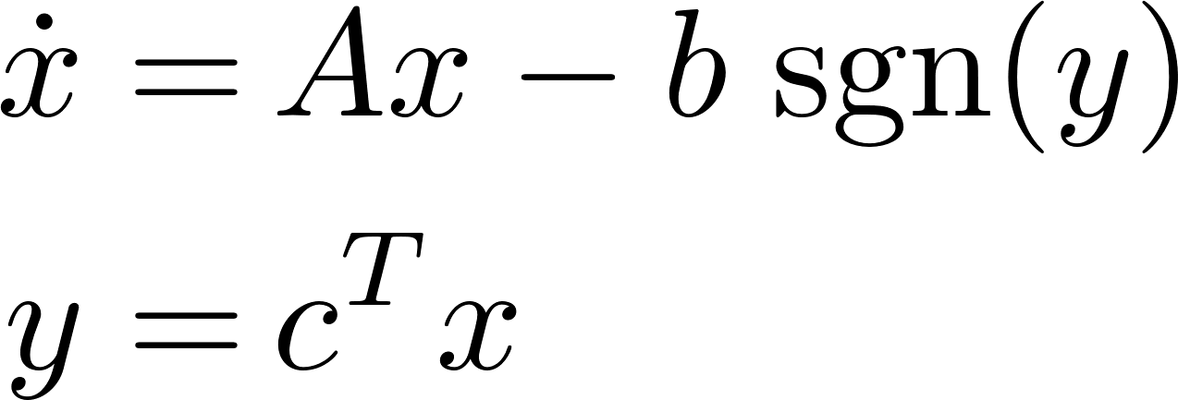
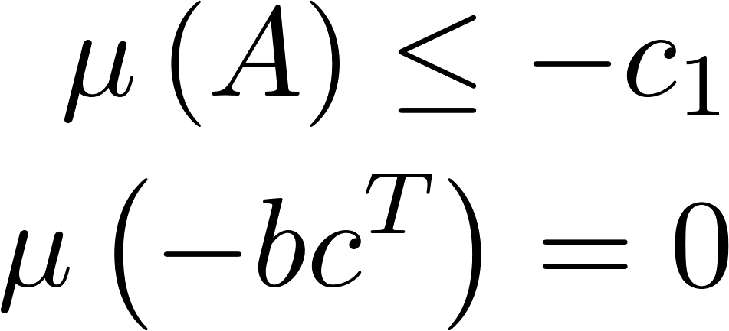
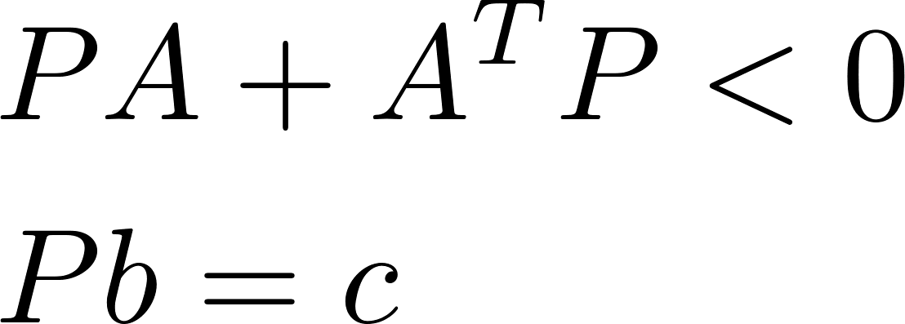
Application to Relay fb systems
Relay feedback systems
Our conditions become
Using Euclidean norm they become the same of the famous Kalman-Yakubovich Lemma
Hence there is a clear connection with passivity when the switching function coincides with the output

