Slide 1
Davide Fiore Tutor: Mario di Bernardo XXIX Cycle - I year presentation
Incremental stability of Filippov systems

Slide 2
My Background
I received the M.Sc. degree in Ingegneria dell’Automazione from University of Napoli “Federico II” with the thesis “Convergence analysis of Filippov systems via contraction theory”
I work with the SINCRO group
My fellowship is “Fondo Sostegno ai Giovani“ - FSGDIS

Slide 3
Outline
What is incremental stability?
Why is contraction theory useful?
What is a Filippov system?
Our results

Slide 4
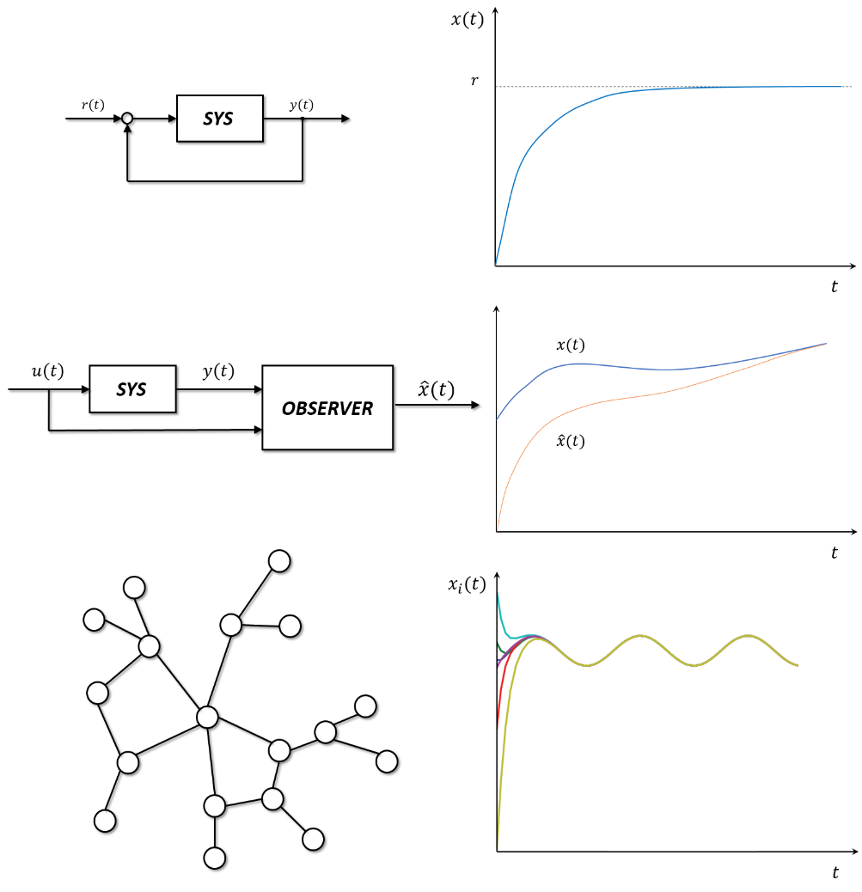
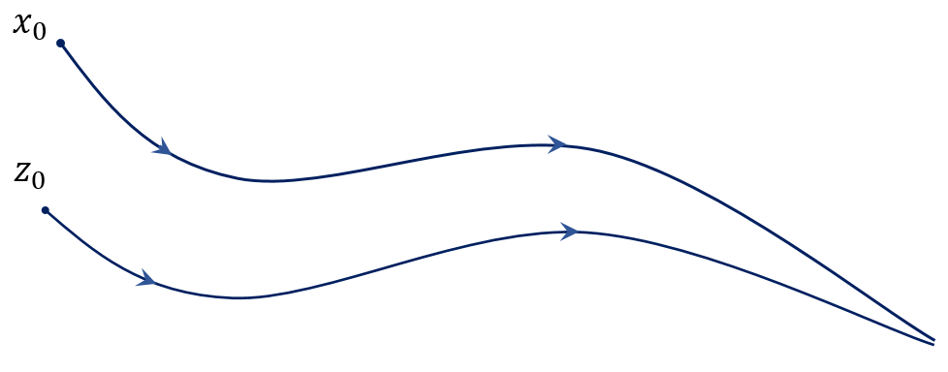
Incremental Stability
In many cases it is useful to study a system stability without having the exact knowledge of some attractors or nominal solutions.
It is sufficient to know that two generic trajectories of the system converge towards each other.
This property is the so-called incremental stability

Slide 5
Contraction Theory
Contraction theory provides a sufficient condition for incremental stability.
If a system is contracting then it is exponentially incrementally stable.

Slide 6
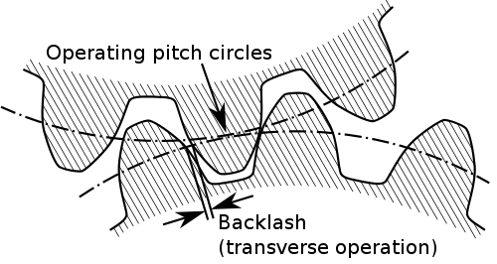
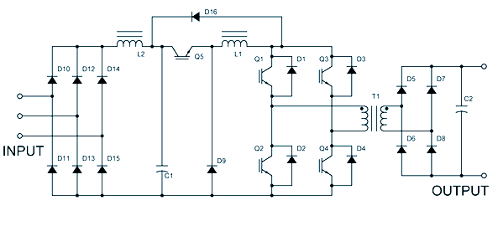
Contraction Theory
Contraction theory provides a sufficient condition for incremental stability.
If a system is contracting then it is exponentially incrementally stable.
Problem: Most of the available results assumes continuous differentiability of the system vector field, but in many applications systems are described by differential equations with discontinuities.

Slide 7
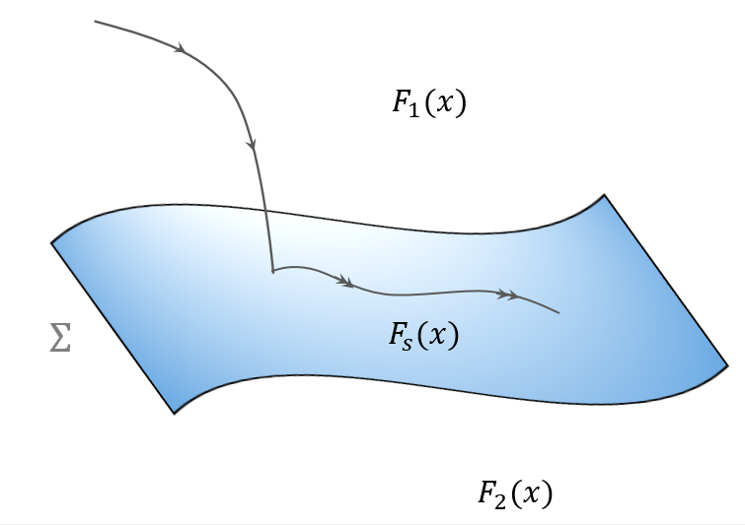
Filippov systems
Our research is aimed to extend contraction theory to some classes of switching systems, particularly those modelled by ODEs with discontinuous right-hand sides (or Filippov systems).
A bimodal Filippov system is given by
where
and are two smooth vector fields
is the ‘sliding vector field’ and it is given by

Slide 8
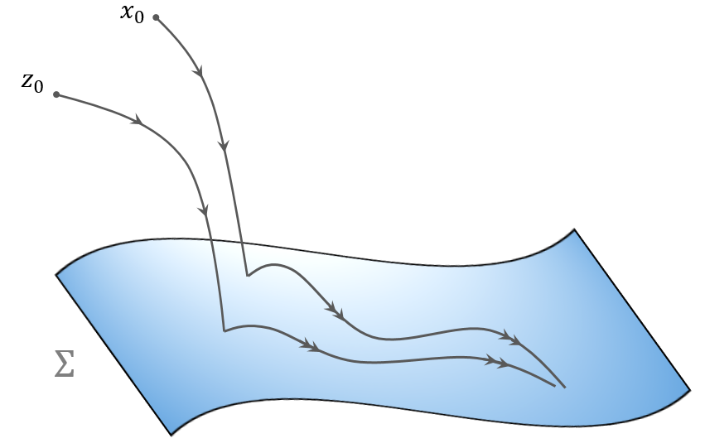
Problem statement
Under what conditions on the system the sliding vector field is incrementally stable?
Our idea is to treat as a constrained vector field with and study its contraction properties

Slide 9
Methodology
Find the projector onto the hyperplane tangent to
Find a change of coordinates , with , embedding the constraint
Obtain the reduced order (n-1 dimensional) system describing the Filippov system on the manifold as with
Then the incremental stability of the Filippov system on can be studied evaluating the matrix measure of the Jacobian given as

Slide 10
My Products
Conference paper:
M. di Bernardo, D. Fiore, “Incremental stability of Filippov systems in Rn”, 2014 IEEE 53rd Annual Conference on Decision and Control (CDC), p. 4679-4684, Los Angeles, California, 2014
In preparation:
M. di Bernardo, S.J. Hogan, D. Fiore, “Contracting Filippov systems: a regularization approach”
M. di Bernardo, M. Jeffrey, D. Fiore, “On contracting sliding vector fields”

Slide 11
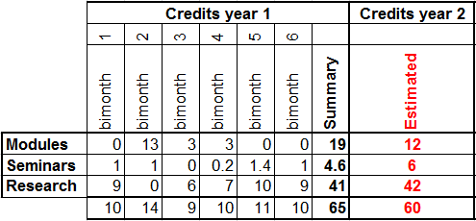
Next year
Continue the work on contraction of PWS systems using other analytical tools, such as
Singular perturbation theory to regularize the discontinuities
Utkin’s control approach to the sliding mode control
Summary of the first year activity and outlook on the second year:

