Slide 1
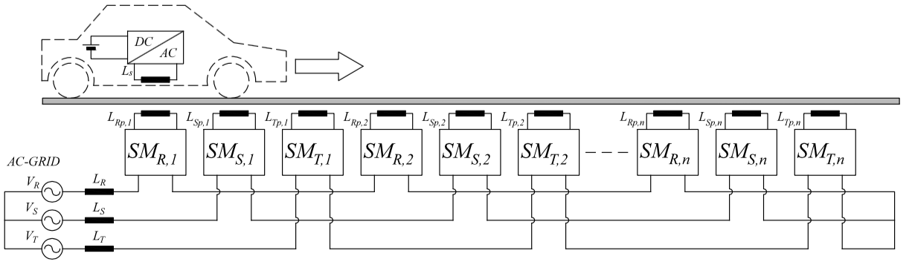
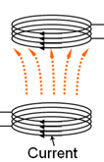
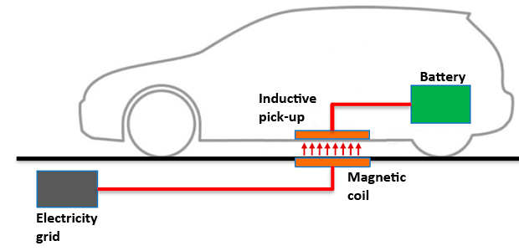
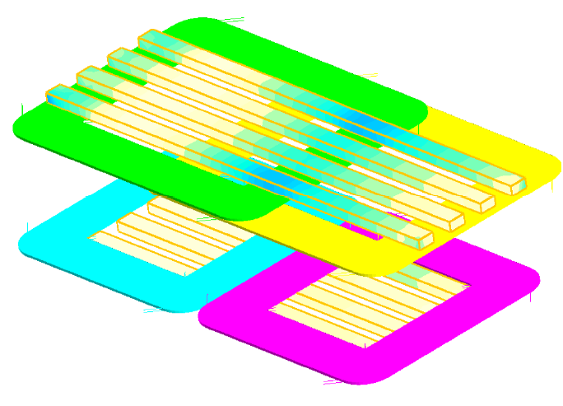
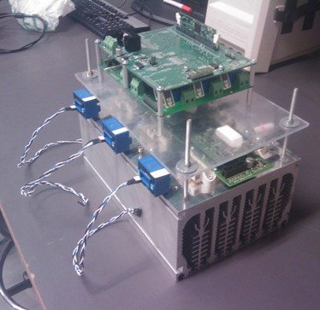
Luigi Ferraro
Tutor: Diego Iannuzzi – co-Tutor: Stephane Caux
XXIX Cycle - II year presentation
Inductive Charging System For Electric Road Vehicle
RESEARCH ACTIVITY
The main goal is to realize a laboratory prototype suitable for both stationary and dynamic charging. This latter issues can be addressed by using different pads topologies. In particular, the single-phase double D primary pad, buried under path and coupled with a bipolar (BP) secondary pad, installed on vehicle chassis, seems to be a promising solution in order to meet our requirements.
The Induction Power Transfer IPT makes possible the power transfer without cables. This solution could be useful to supply an Electric Vehicle (EV). Moreover, the EV charging can occur while the vehicle proceeds on a dedicated path.
An IPT system is essentially constituted of two electric systems magnetically coupled and powered by a high frequency converter. In order to realize a laboratory prototype suitable for both stationary and dynamic charging, a combination Double D - Bipolar coils has been chosen.
BP-Pad
DD-Pad
z
y
x
x-misalgnment
y-misalgnment
RESEARCH ACTIVITY UP TO THE SECOND YEAR
PAD Design:
A FEM (Finite Element Method) simulation tool has been used to model and test the pad design. By means of a 3D finite element analysis, it has been possible to determine the numerical value of the main system parameters for different combinations of air gap and misalignment.
Mathematical Model:
Numerical Model:
In order to verify the effectiveness of the developed analytical model, a set of simulations has been performed by using PSIM tool.
CONTACTS
- Group of Power Converters Electrical Machines and Drives – DIETI - UNINA
- PhD Jointly ENSEEIHT – “École nationale supérieure d'électrotechnique, d'électronique, d'informatique, d'hydraulique et des télécommunications” Toulouse – France – GEET – “Genie electrique electronique de Toulouse”
- PROGETTO M.I.C.C.A - “Microgrid Ibride in Corrente Continua e Corrente Alternata” - PON03PE_00178_1 Titolo Borsa di Studio: “Sistemi di ricarica rapida ed ultrarapida per batterie di veicoli elettrici stradali”
- Bando Vinci 2015 - Contributi di mobilità per tesi di Dottorato in cotutela
RESEARCH ACTIVITY FOR NEXT YEAR
Control Model:
The mathematical model must be linearized by means of small-signal linearization to obtain a linear dynamic model, starting from a steady-state operating point. Thus, it will be possible to develop a suitable control algorithm.
Laboratory prototype:
A laboratory prototype will be realized with the aim of evaluating the system performance. In particular, the main issues regarding the power supply connection, the inductive charging method, the size and weight of the static converter will be properly addressed.
Notes:
Instructions to fill the poster
Box RGB 22 34 48
Context of your research activity (motivations, needs, trends, activity of your group (if the case)… - describe for self explanatpry)
Box RGB 255 220 0
Your research activity up to the second year (idea, methodology, developments, results, expected validation,… - insert whatever you like, text, images, photos. This box is reserved to your very specific activity, not to your group)
Box RGB 151 23 32
Your contacts
Cooperations with Universities, companies, participations in progrojects and programmes (logos can be included)
Box RGB 79 129 189
Next year
Future developments of your activity
Box width is 80 cm
Box height can be changed according to your needs
The text is written in Calibri font

