Slide 1


Darjn Esposito
Tutor: Prof. Antonio Strollo
XXIX Cycle - I year presentation
Speculative Parallel-Prefix Adders

Slide 2
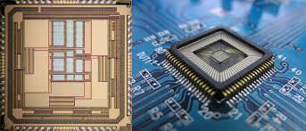

My Background
I received the M. S. degree in Electronic Engineering from University of Napoli “Federico II”.
I work within the VLSI DIETI group.
My fellowship is financed by DIETI for research in VLSI systems.
Prof. Antonio Strollo
Prof. Davide De Caro
Prof. Nicola Petra
Prof. Ettore Napoli

Slide 3
Speculative Parallel-Prefix Adders
Motivations
Adders are wide used in microprocessors for address calculations as well as for floating point division and multiplication.
In high-performance applications (es. CPU, GPU) Parallel-Prefix adders are used.
Their delay goes as O(log₂(n)), which is the theoretical limit [1].
How can we overcome this delay bound?
The answer to this question represents one of the major challenges in arithmetic circuit design.
n is the adder bit number
[1] I. Koren, Computer Arithmetic Algorithms. A K Peters, 2002.

Slide 4

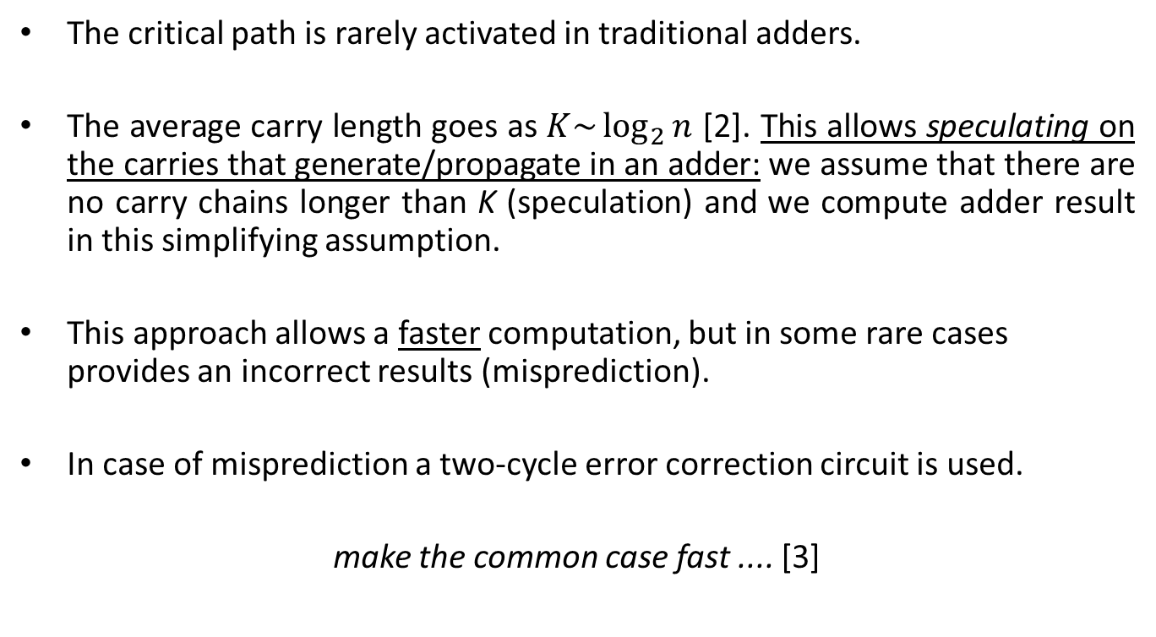
Main Idea
The critical path is rarely activated in traditional adders.
The average carry length goes as $K\sim \log_{2}{n}$ [2]. This allows speculating on the carries that generate/propagate in an adder: we assume that there are no carry chains longer than K (speculation) and we compute adder result in this simplifying assumption.
This approach allows a faster computation, but in some rare cases provides an incorrect results (misprediction).
In case of misprediction a two-cycle error correction circuit is used.
make the common case fast .... [3]
[2] Verma, A.K.; Brisk, P.; Ienne, P., "Variable Latency Speculative Addition: A New Paradigm for Arithmetic Circuit Design," Design, Automation and Test in Europe, 2008. DATE '08 , pp.1250-1255, March 2008.
[3] J. L. Hennessy and D. A. Patterson, Computer Architecture: A Quantitative Approach. San Francisco, CA: Morgan Kaufmann, 1996.

Slide 5
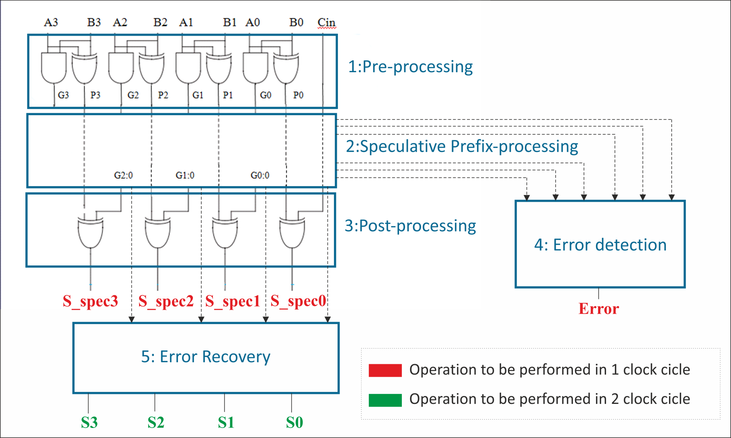
A General Overview
Critical path
T_{clk}= max(T_{S_spec} , T_{error})

Slide 6
Analysis of the literature
Speculative adders proposed in Literature use carry-select or some form of carry-lookahead [4]-[7].
Main issue of these topologies: error detection delay is comparable to (or even dominates) speculative sum delay. ☹
Lack in literature of speculative adders based on parallel-prefix architecures (well established as the most effective – fastest – standard adders topologies).
My research focused on
  (i) develop novel speculative adders based on modified, speculative, parallel-prefix topologies.
  (ii) develop more effective error detection circuits.
[4] Nowick, S.M., "Design of a low-latency asynchronous adder using speculative completion," Computers and Digital Techniques, IEE Proceedings - , vol.143, no.5, pp.301,307, Sep 1996.
[5] Verma, A.K.; Brisk, P.; Ienne, P., "Variable Latency Speculative Addition: A New Paradigm for Arithmetic Circuit Design," Design, Automation and Test in Europe, 2008. DATE '08 , pp.1250-1255, March 2008.
[6] Cilardo, A., "A new speculative addition architecture suitable for two's complement operations," Design, Automation & Test in Europe Conference & Exhibition, 2009. DATE '09, pp.664-669, April 2009.
[7] Kai Du; Varman, P.; Mohanram, K., "High performance reliable variable latency carry select addition," Design, Automation & Test in Europe Conference & Exhibition (DATE), 2012, pp.1257-1262, March 2012.

Slide 7
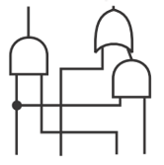

Han-Carlson Speculative Adder
An example: Han-Carlson parallel-prefix topology.
Carry length (K)=16
K=16
Deleted
Carry length (K)=8
Faster computation!
K=8

Slide 8
Error detection
In the literature, speculative adders error detection circuitry is based on simplifying assumptions -> “false positive” errors, increasing average delay. ☹.
I have developed a rigorous derivation of error condition in speculative parallel-prefix adders, resulting in a novel error detection network, without “false positive” errors. ☺
e.g. 2+2=4 ☺, but error detection circuitry flags the result as wrong ☹

Slide 9
Some Results (1)
Matlab script have been developed which generate Verilog HDL descriptions of proposed adders.
Monte Carlo simulations have been run to verify the circuits and to obtain error probability values.

Slide 10
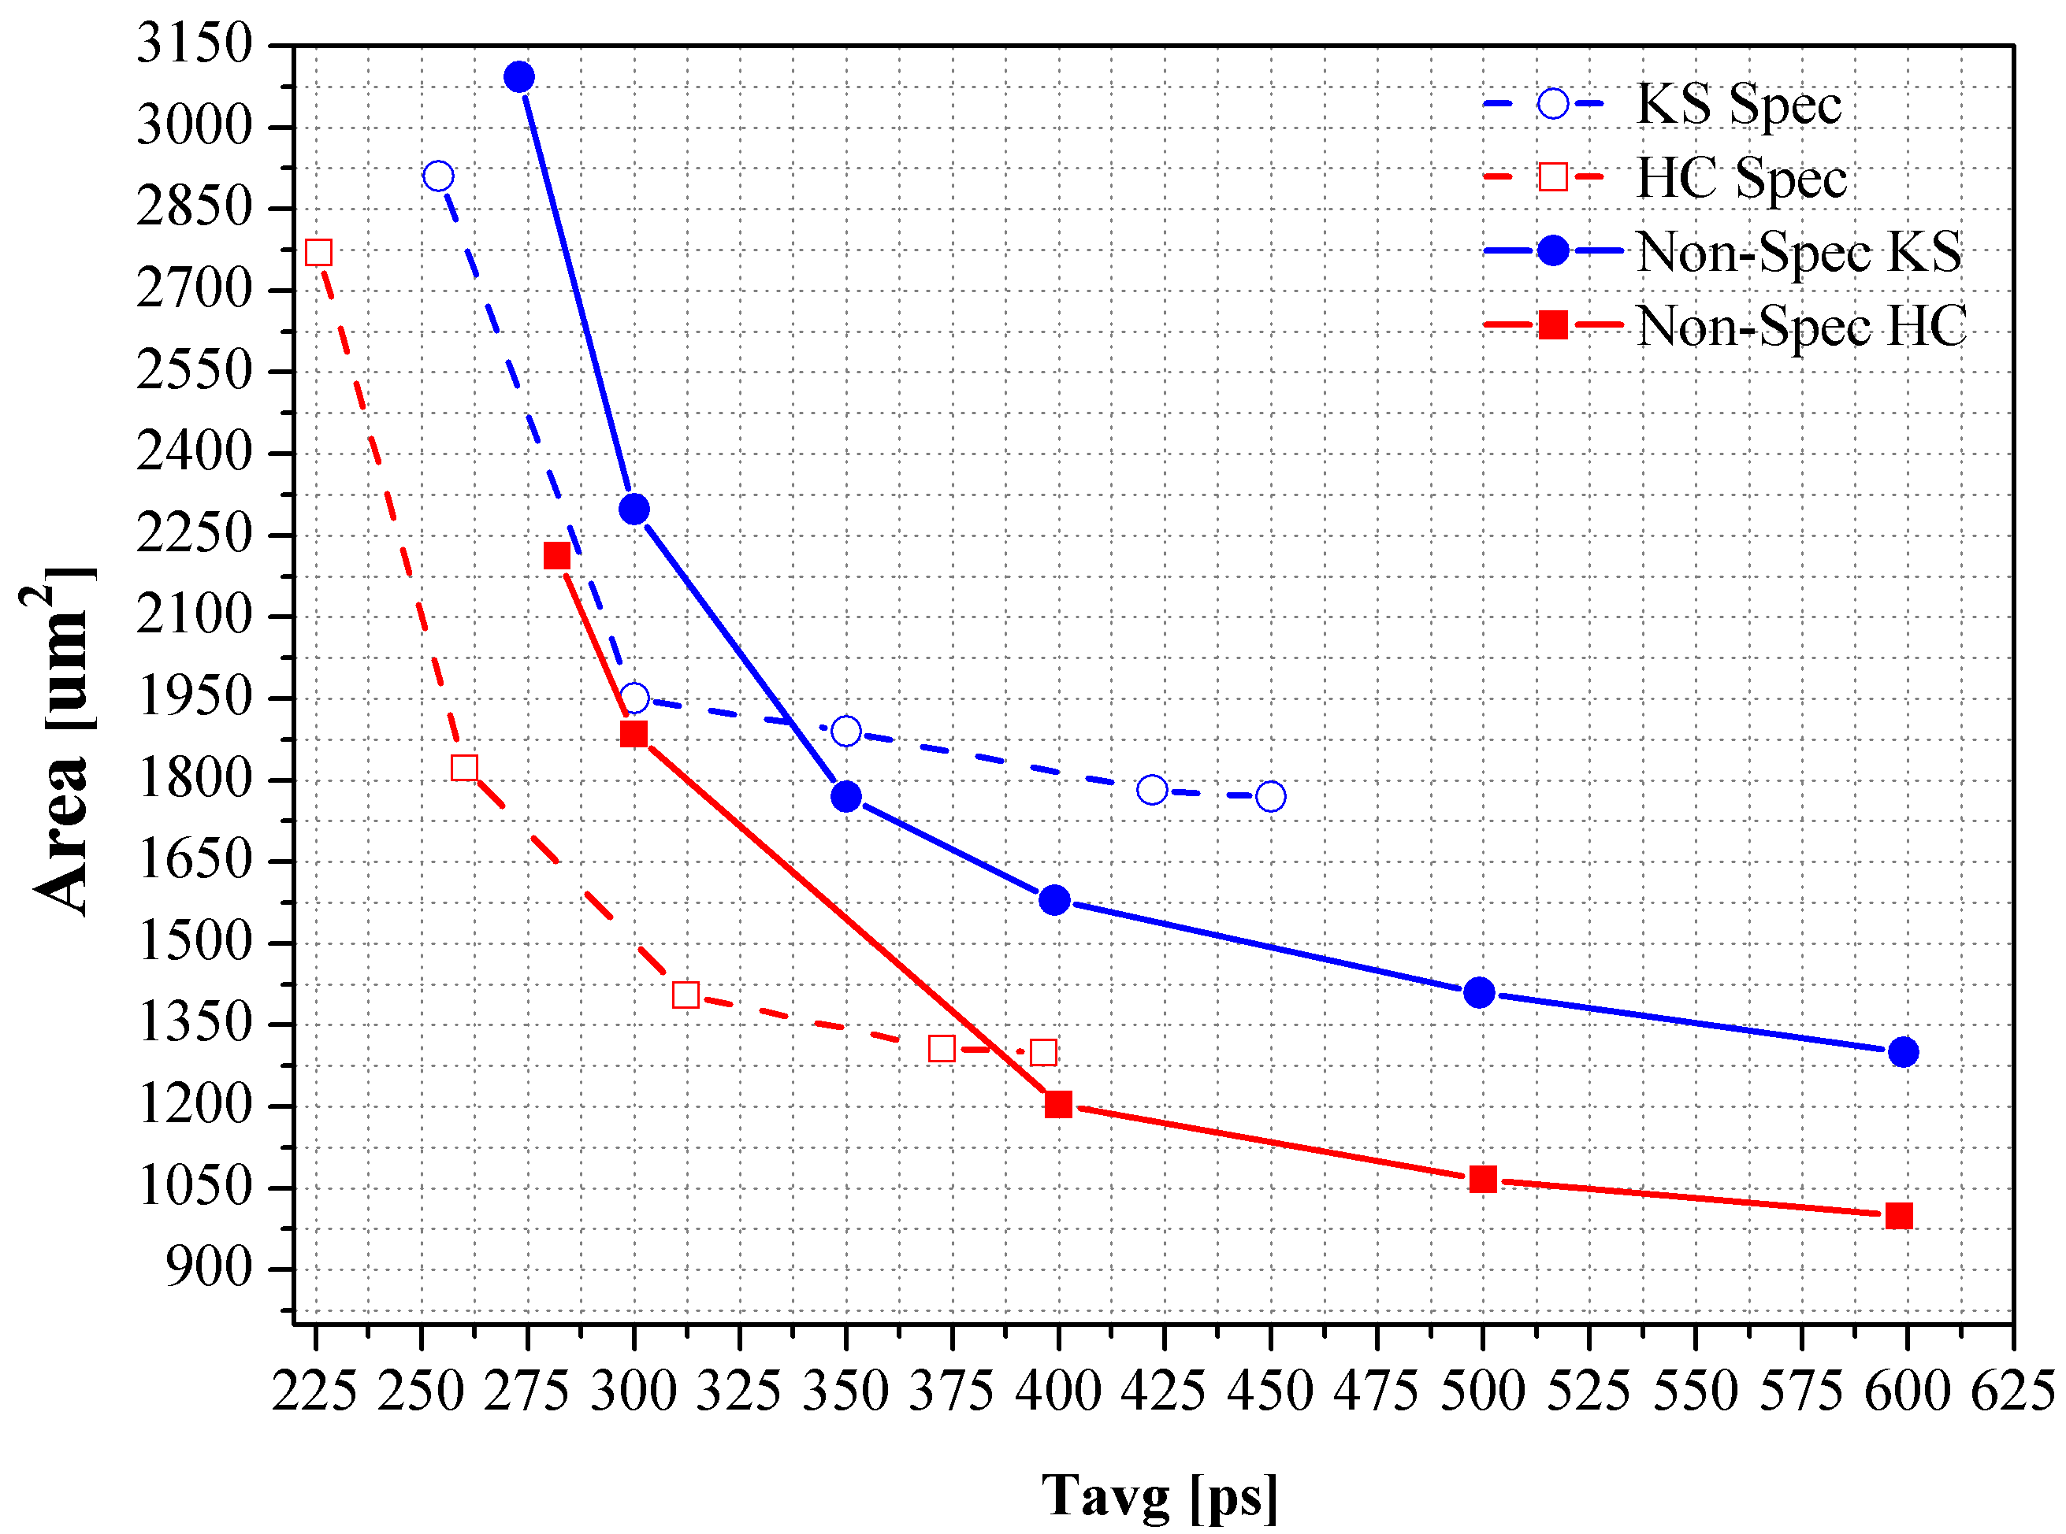
Some Results (2)
Synthesys result in UMC 65nm library, varying timing constraint (64 bit adder):
Proposed Han-Carlson speculative adder yields best performances (18% minimum delay reduction, compared to non-speculative counterparts).

Slide 11
Products
Journal papers:
  D. Esposito, D. De Caro, E. Napoli, N. Petra, A. G. M. Strollo, “Variable Latency Speculative Han-Carlson Adder”, Circuits and Systems I: Regular Papers, IEEE Transactions on, accepted for pubblication, in press.
Conference papers:
  D. Esposito, D. De Caro, A. G. M. Strollo, “Speculative Parallel-Prefix Adders", Proceedings of 46th GE Conference, ISBN: 978-88-905519-2-5.
  D. Esposito, D. De Caro, M. De Martino, A. G. M. Strollo, “Error Detection in Variable Latency Parallel-Prefix Speculative Adders”, 13th IEEE International NEW Circuits And Systems (NEWCAS) conference, submitted.
  D. Esposito, D. De Caro, M. De Martino, A. G. M. Strollo, “Variable Latency Speculative Han–Carlson Adders Topologies”, 11th Conference on PhD Research in Microelectronics and Electronics (IEEE PRIME 2015), submitted.
  M. De Martino, D. Esposito, D. De Caro, N. Petra, A. G. M. Strollo, “Easy Clock Synchronization in Multi-domain Spread Spectrum Clocking Systems”, 13th IEEE International NEW Circuits And Systems (NEWCAS) conference, submitted.

Slide 12
Next year…
Extend the speculative approach to other parallel-prefix topologies (e.g. Brent-Kung, Carry-Increment, etc..).
Develop an effective implementation of speculative adders for applications where long propagation chains due to sign extension occur.
Summary of credits:

Slide 13
Thank you for your attention!

