Slide 1



Darjn Esposito
Tutor: Prof. Antonio Strollo
XXIX Cycle - III year presentation
VLSI Circuits for Approximate Computing

Slide 2
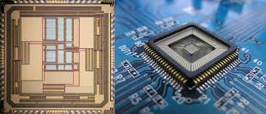

My Background
I received the M. S. degree in Electronic Engineering from University of Napoli “Federico II”.
I work within the VLSI DIETI group.
My fellowship is financed by DIETI for research in VLSI systems.
Prof. Antonio Strollo
Prof. Davide De Caro
Prof. Nicola Petra
Prof. Ettore Napoli

Slide 3

Credits Summary
Credits Table
I have spent 6-months (January 2016 to July 2016) as visiting PhD student at National University of Singapore, Green IC group.

Slide 4
Outline
VLSI circuits for Approximate computing
  Motivations
  My Activity
  Technical details:
    Variable-latency speculative adders
    Approximate adders for signed operands
    Multiply-and-Accumulate (MAC) Unit employing speculative adders
    Precision-Scalable Latch-Memory
    Precision-Scalable MAC Units
    Publications and Questions
Notes:
http://cpudb.stanford.edu

Slide 5
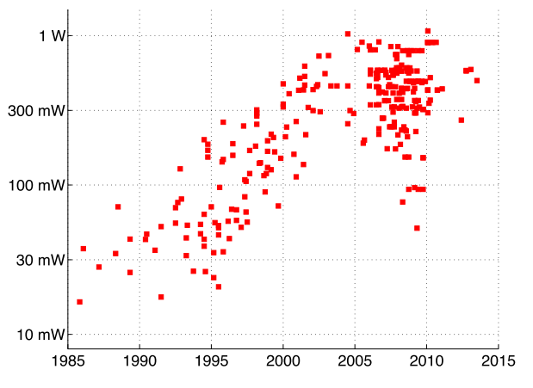

Motivations
Power density scaling
Dennard scaling (“constant field scaling”)[1]
Reality:
Power density doubled from generation to generation!
Notes:
http://cpudb.stanford.edu

Slide 6
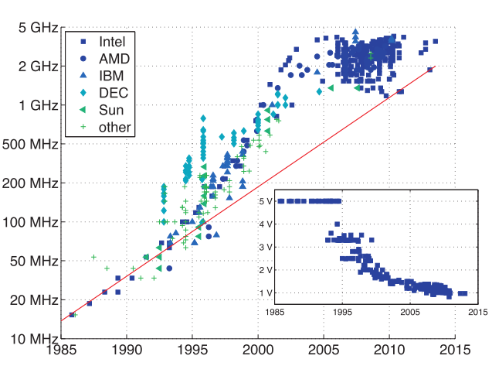
Motivations
End of Dennard scaling (2005)
Frequencies scaled faster than dictated by constant-field scaling.
Voltage scaled slower!
«Power wall» for air-cooling (about 100W)
Saturation
Voltage vs year
No further scaling of Threshold voltage, due to leakage currents.
End of Dennard scaling!
Notes:
mark

Slide 7
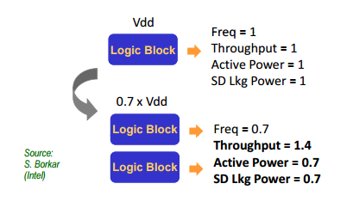
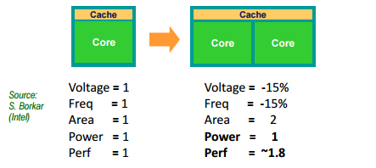
Motivations
Multi-core architectures
Passage to multi-core architecture.
Higher throughput with lower power!
Sequential applications running slower than before, using a single, slower, core!=>Voltage and frequency of core are increased (DVFS), while the others are in idle to balance the power budget. “Dark silicon”
Notes:
http://cpudb.stanford.edu

Slide 8
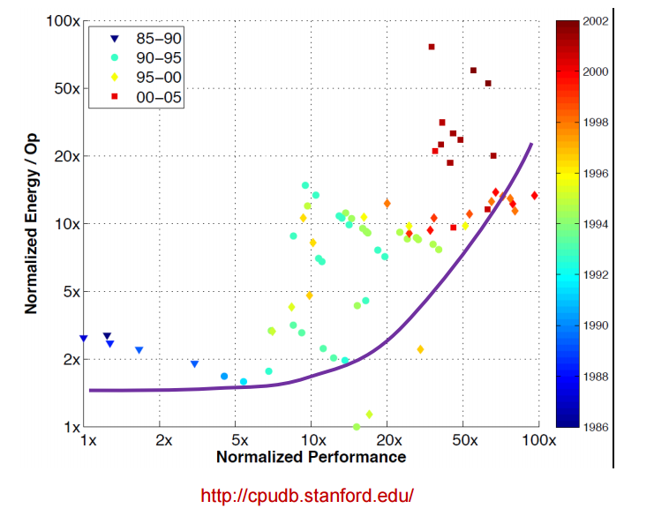
Motivations
Limits of multi-core
Multi-core is not the solution to keep the performance scaling trend:
(i) Energy per operation continues to increase.
(ii) Device scaling is providing always smaller energy gains.
=>These reasons limit the cores number.
Notes:
http://cpudb.stanford.edu

Slide 9
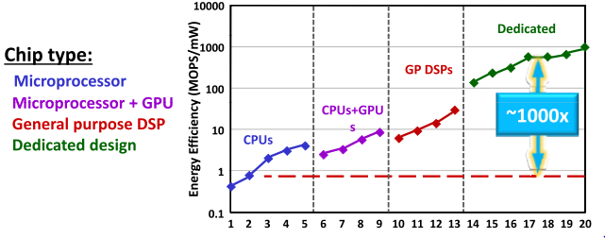

Motivations
A possible solution:specialized hardware
Dedicated hardware allows a 100-1000X increase in energy efficiency [2]
Approximate computing represents a valid “dedicated” solution.
time
Notes:
http://cpudb.stanford.edu

Slide 10
Motivations
Error tolerant applications
Approximate computing relaxes the requisite of error-free computation to improve circuit performance.
Error resilient applications characteristics [3],[5]:
  Redundancy in dataset they process
  Provide range of output that are equivalent
  Small errors cannot be perceived by users
  Manage signals intrinsically imprecise
  Typical error-resilient applications:
    Multimedia processing (image,audio,video)
    Recognition, Mining, Synthesis (e.g. Machine learning)
    Design space is enlarged: quality, energy, delay, area
Notes:
http://cpudb.stanford.edu

Slide 11
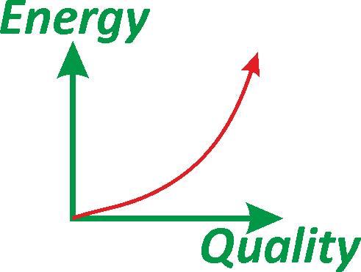
Motivations
My research activity
I Investigated approximate topologies of the fundamental digital blocks:
  Approximate Adders
  Approximate Multipliers
  Approximate Memories
  The proposed topologies have been employed in computer vision applications, to prove their feasibility.
  The energy-quality tradeoff has been investigated.
Notes:
http://cpudb.stanford.edu

Slide 12
Outline
VLSI circuits for Approximate computing
  Motivations
  My Activity
  Technical details:
    Variable-latency speculative Parallel-Prefix adders
    Approximate adders for error tolerant applications
    Multiply-and-Accumulate (MAC) Unit employing speculative adders
    Precision-Scalable Latch-Memory
    Precision-Scalable MAC Units
    Publications and Questions
Notes:
http://cpudb.stanford.edu

Slide 13
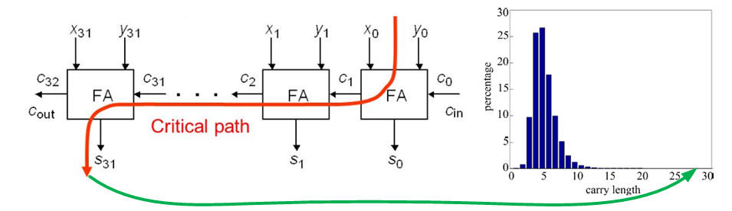


Speculative Adders-idea
Adders are ubiquitous in digital systems.
Improving their performance is really challenging.
Theoretical speed bound O($\log_{2}{N}$), where N is the bit size
How to overcome the bound?
Better than worst case approach
Notes:
http://cpudb.stanford.edu

Slide 14
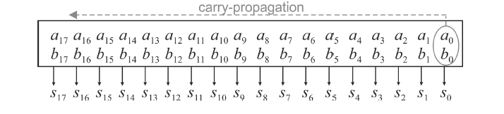
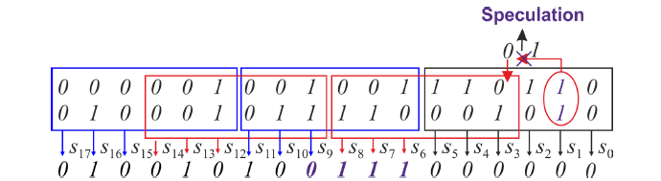
Speculation
Adders critical path is rarely activated.
It is possible to «speculate» about carry propagation (i.e. carry propagates for no more than 5 bits in 32 bits adders).
Critical path is significantly reduced
Notes:
http://cpudb.stanford.edu

Slide 15
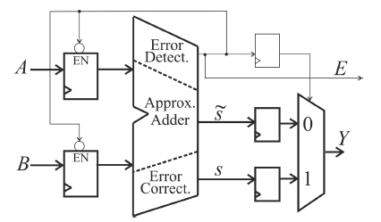
Investigated Approximate Adders
Two types of speculative adders have been investigated:
  In case of non-error tolerant applications the adder is augmented with error detection and correction networks (Variable Latency Speculative Adder), providing always an error free result: [6]
  For error tolerant applications the erroneous output is provided to the remaining systems.
Notes:
http://cpudb.stanford.edu

Slide 16
Variable-Latency Speculative Adders
Hypothesis are done on the maximum carry-length. (speculation)
When the hypothesis fails, an error occurs.
In case of error a two-cycle error correction is employed:
Rationale: make the common case fast…
Notes:
http://cpudb.stanford.edu

Slide 17
Variable-Latency Speculative Adders
Lack in literature of speculative adders based on parallel-prefix architectures (well established as the most effective – fastest – standard adders topologies).
My research focused on
  (i) develop novel speculative adders based on modified, speculative, parallel-prefix topologies.
  (ii) develop more effective error detection circuits.
Notes:
http://cpudb.stanford.edu

Slide 18
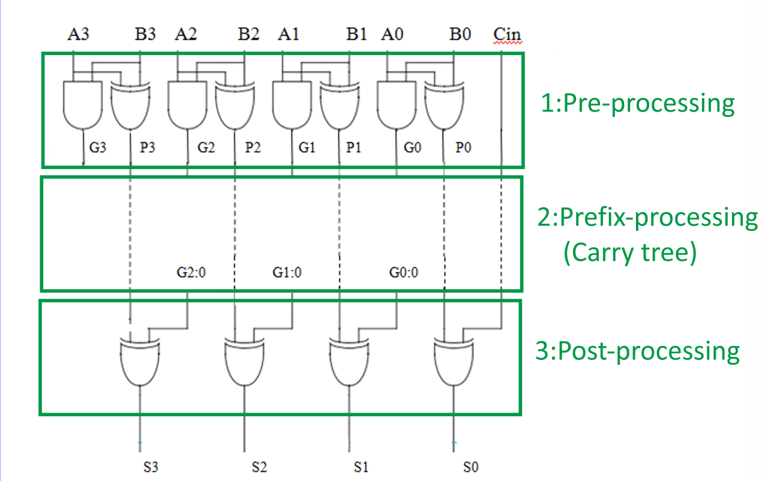
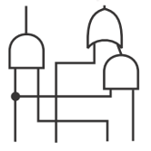

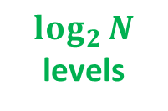

Parallel-Prefix Adders Briefly revised
General structure of parallel-prefix adders
$$\log_{2}{N}$$
levels
N$≜$Adder Size
Notes:
http://cpudb.stanford.edu

Slide 19
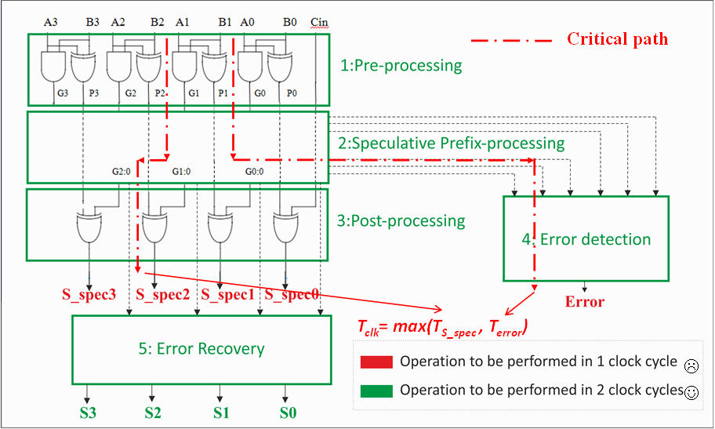
Variable-Latency Speculative Adders
Variable latency speculative adder basic structure:
Notes:
http://cpudb.stanford.edu

Slide 20
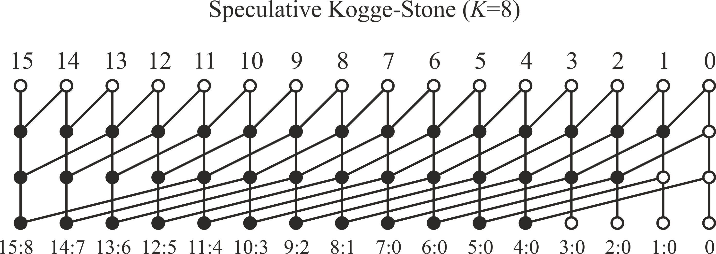
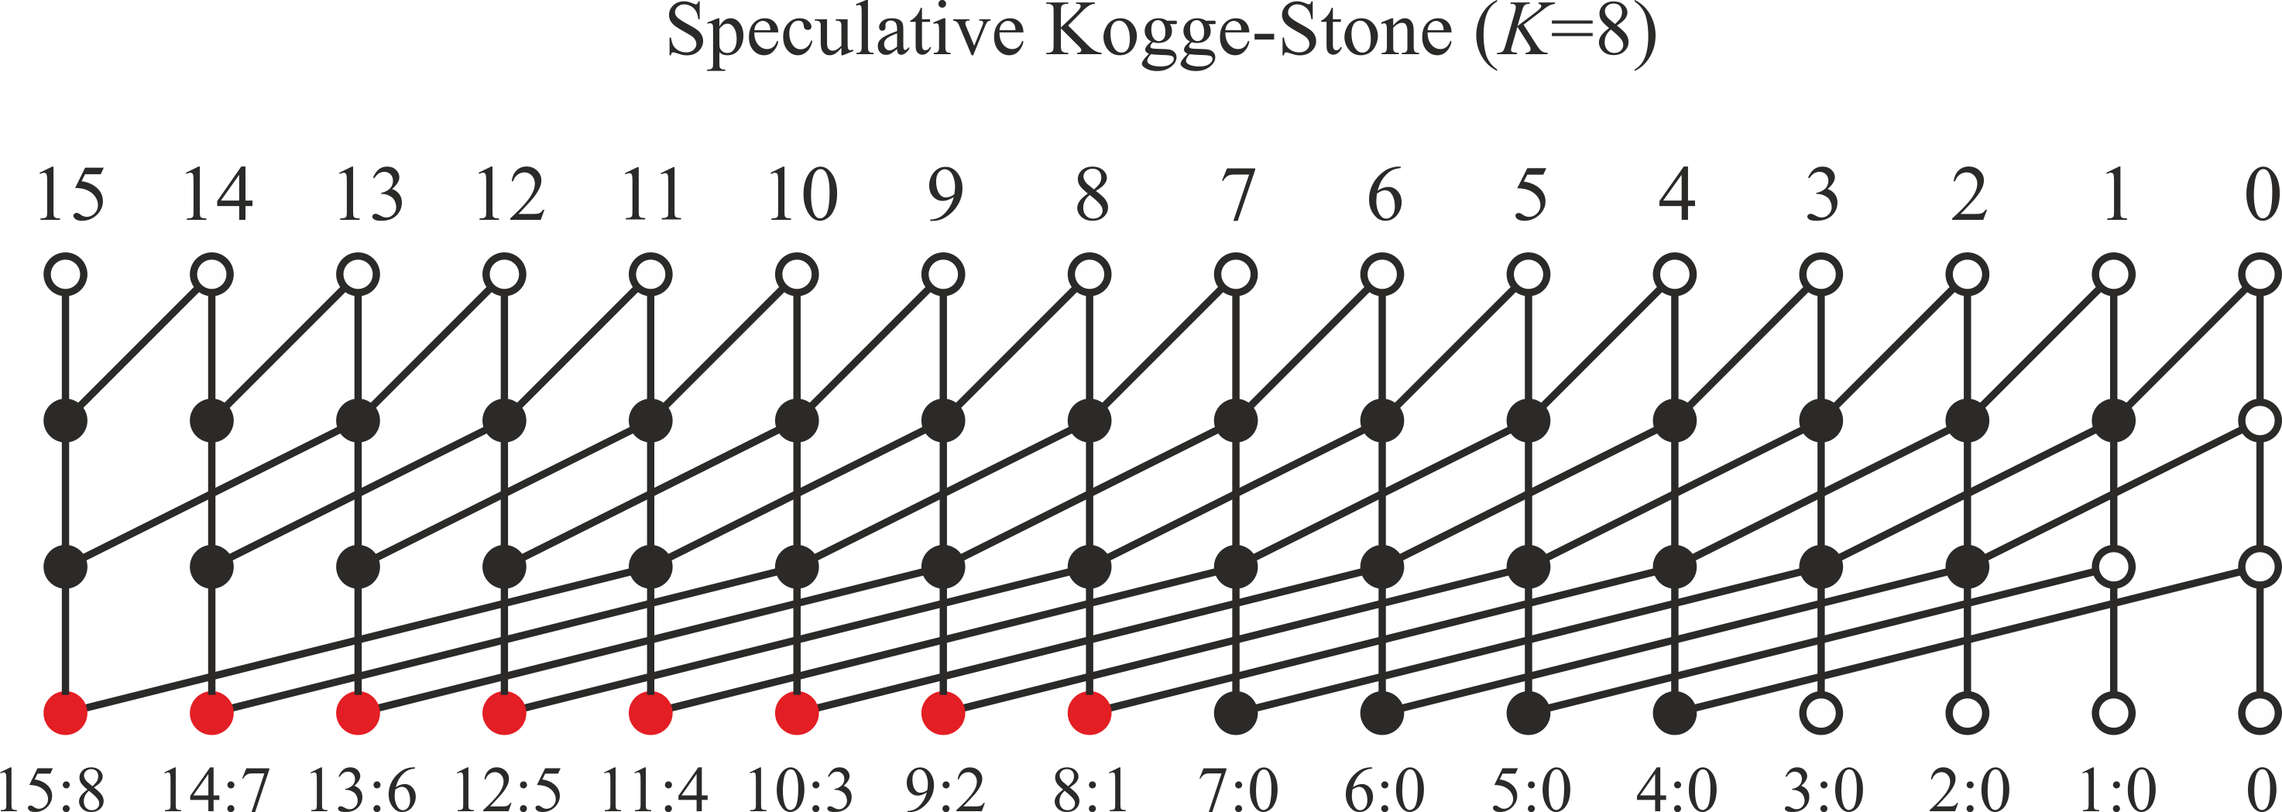
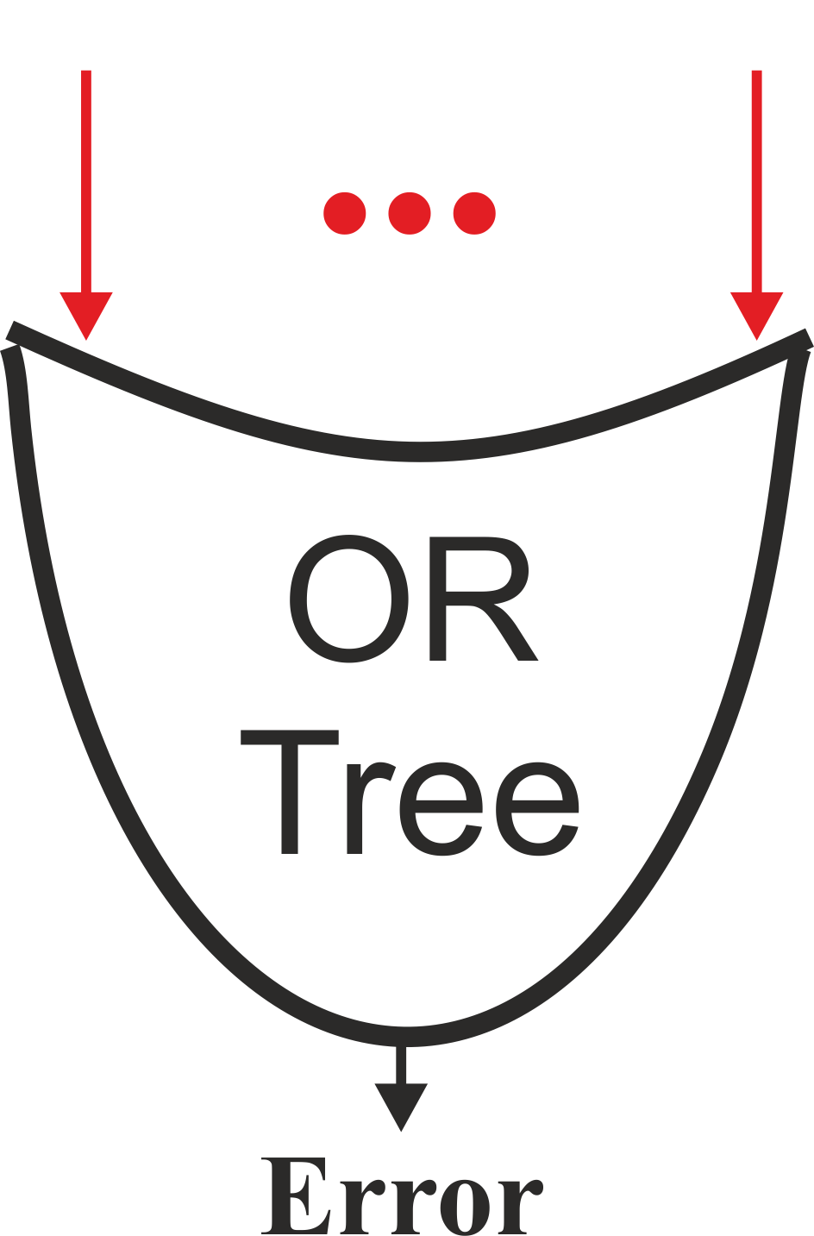

Variable-Latency Speculative Adders
Previously proposed VLSA [6]:
Speculation!
Deleted
e.g. 56 terms to be or-ed in a 64 bit speculative adder with K=8.
Fast speculative sum (Delay$\sim \log_{2}{K}$). ☺
Slow Error detection stage (N-K nodes to be checked). ☹
Notes:
http://cpudb.stanford.edu

Slide 21
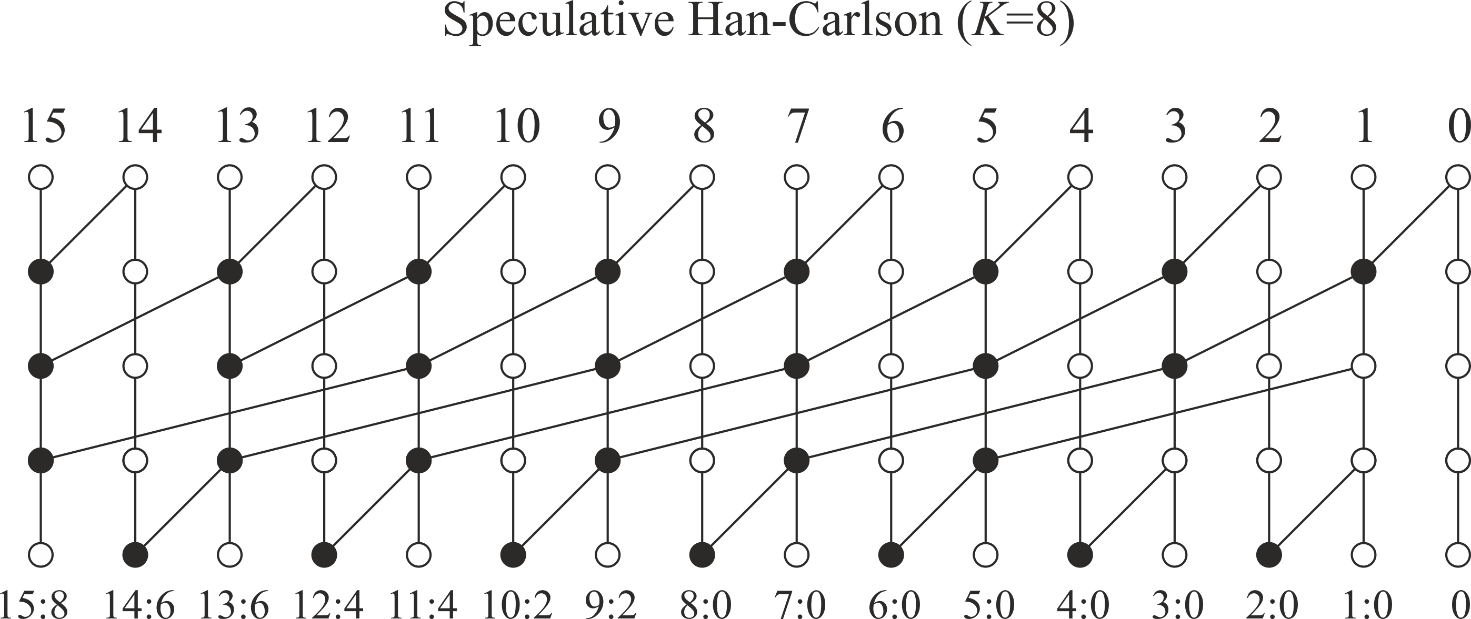
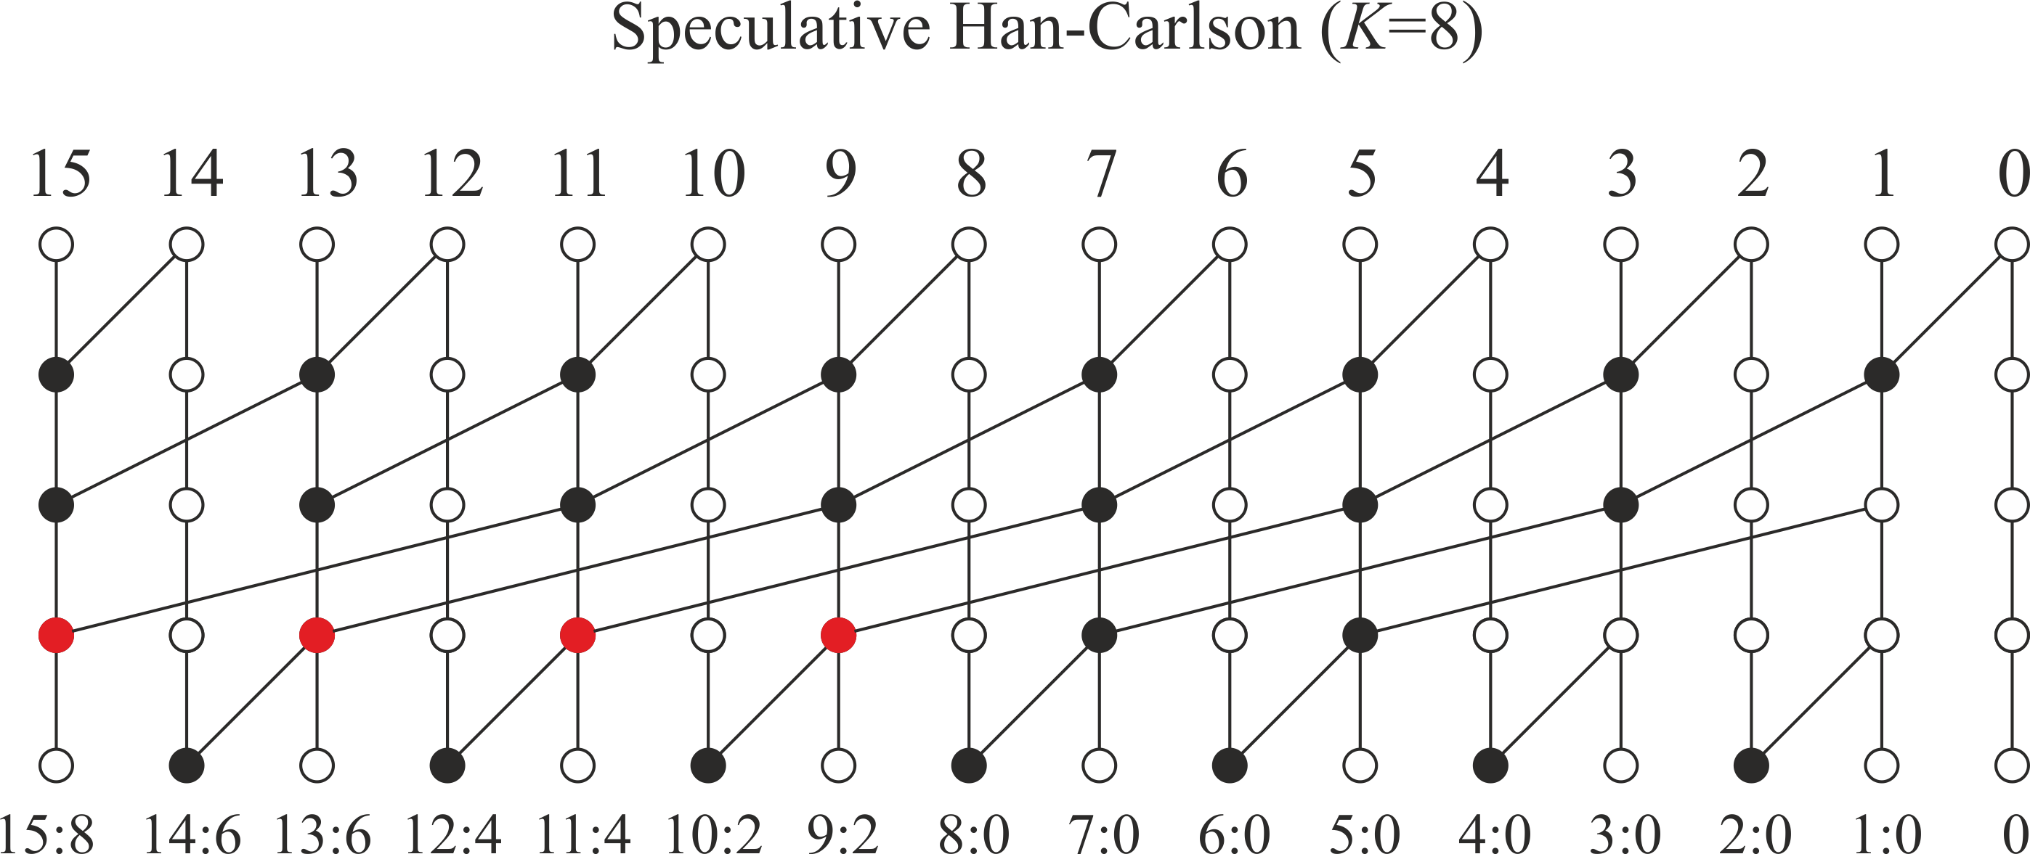
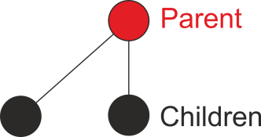
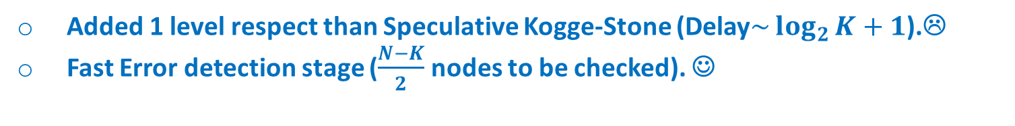
Variable-Latency Speculative Adders
Proposed speculative Han-Carlson topology:
Deleted
2 children per parent
Added 1 level respect than Speculative Kogge-Stone (Delay$\sim \log_{2}{K}+1$).☹
Fast Error detection stage ($\frac{N−K}{2}$ nodes to be checked). ☺
Notes:
http://cpudb.stanford.edu

Slide 22
Variable-Latency Speculative Adders
Many others speculative topologies have been proposed:
  Speculative Hybrid Han-Carlson
  Speculative Brent-Kung
  Speculative Carry-Increment
  Speculative Ladner-Fisher
  Speculative Sklansky
Notes:
http://cpudb.stanford.edu

Slide 23
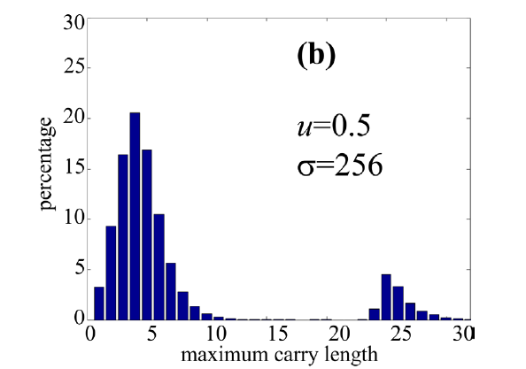
Variable-Latency Speculative Adders
Unfortunately, as observed in literature, when speculative adders deal with 2’complement numbers, the expected carry propagation length significantly increases [7]:
With 2’s complement number error probability approaches to 25%
Notes:
http://cpudb.stanford.edu

Slide 24
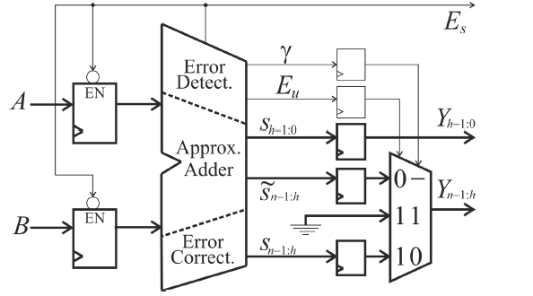
Variable-Latency Speculative Adders
A reformulation of the speculative assumption has been proposed when operating with 2’s complement numbers.
This results in a novel error detection network and in a novel VLSA architecture:
Notes:
http://cpudb.stanford.edu

Slide 25
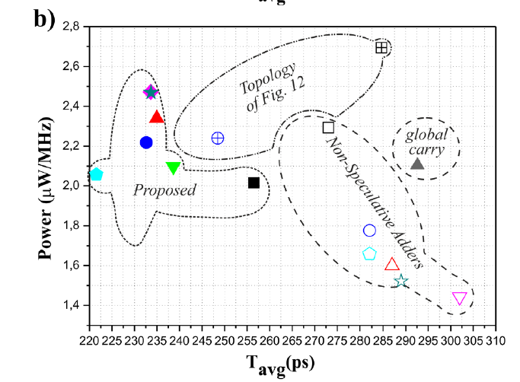
Variable-Latency Speculative Adders
Proposed speculative adders are faster than non-speculative adders. (note that the speed can be traded with a power, performing voltage-scaling)
Previously
Proposed
[J] D. Esposito, D. De Caro, E. Napoli, N. Petra, A. G. M. Strollo, “Variable Latency Speculative Han-Carlson Adder”, IEEE Trans. on Circuits and Systems I: Regular Papers, vol.62, no.5, pp.1353-1361, 2015.
[J] D. Esposito, D. De Caro and A. G. M. Strollo, "Variable Latency Speculative Parallel Prefix Adders for Unsigned and Signed Operands," in IEEE Transactions on Circuits and Systems I: Regular Papers, vol. 63, no. 8, pp. 1200-1209, Aug. 2016.
[C] D. Esposito, D. De Caro, A. G. M. Strollo, “Speculative Parallel-Prefix Adders", Proceedings of 46th GE Conference, ISBN: 978-88-905519-2-5.
[C] D. Esposito, D. De Caro, M. De Martino, A. G. M. Strollo, “Variable Latency Speculative Han–Carlson Adders Topologies”, 11th Conference on PhD Research in Microelectronics and Electronics (IEEE PRIME 2015), pp.45-48, 2015.
Notes:
http://cpudb.stanford.edu

Slide 26
Outline
VLSI circuits for Approximate computing
  Motivations
  My Activity
  Technical details:
    Variable-latency speculative Parallel-Prefix adders
    Approximate adders for signed operands
    Multiply-and-Accumulate (MAC) Unit employing speculative adders
    Precision-Scalable Latch-Memory
    Precision-Scalable MAC Units
    Publications and Questions
Notes:
http://cpudb.stanford.edu

Slide 27
Approximate adder for signed operands
As discussed before, error probability of speculative adders significantly increases when operating with signed number.
An error correction has been proposed, based on the following observations:
-operands A and B have opposite sign
-A+B >0
-|A| and |B| are sufficiently small
If these conditions are catched we assume that an error happens, therefore the output is corrected using a simple network.
Notes:
http://cpudb.stanford.edu

Slide 28
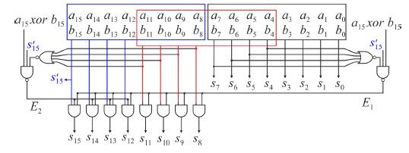
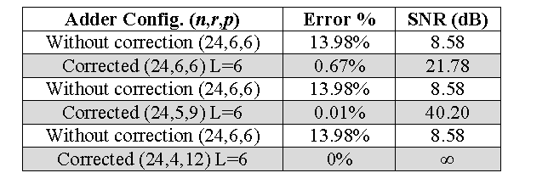
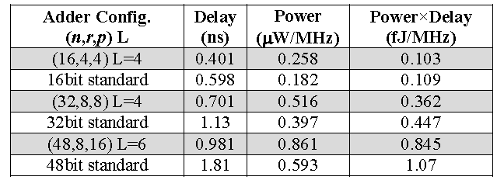
Approximate adder for signed operands
Resulting circuit:
Results:
[C] D. Esposito, G. Castellano, D. De Caro, E. Napoli, N. Petra and A. G. M. Strollo, "Approximate adder with output correction for error tolerant applications and Gaussian distributed inputs," 2016 IEEE International Symposium on Circuits and Systems (ISCAS), Montreal, QC, 2016, pp. 1970-1973.
Notes:
http://cpudb.stanford.edu

Slide 29
Outline
VLSI circuits for Approximate computing
  Motivations
  My Activity
  Technical details:
    Variable-latency speculative Parallel-Prefix adders
    Approximate adders for signed operands
    Multiply-and-Accumulate (MAC) Unit employing speculative adders
    Precision-Scalable MAC Units
    Precision-Scalable Latch-Memory
    Publications and Questions
Notes:
http://cpudb.stanford.edu

Slide 30
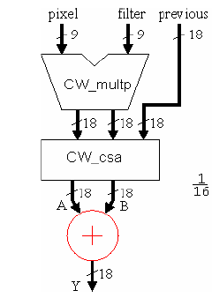
Multiply-and-Accumulate (MAC) Unit employing speculative adders
The use of speculative adders as last stage of Multiply-and-accumulate adders have been investigated.
Speculative adder
Notes:
http://cpudb.stanford.edu

Slide 31
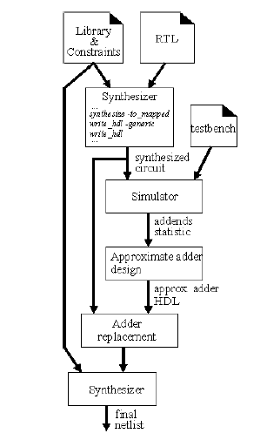
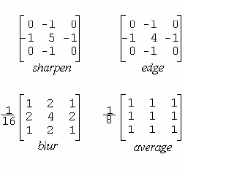
Multiply-and-Accumulate (MAC) Unit employing speculative adders
Speculative adders performance are strongly related to operands statistic.
A design flow is proposed to optimize the speculative adder in carry-save MAC.
Employed kernels:
Notes:
http://cpudb.stanford.edu

Slide 32
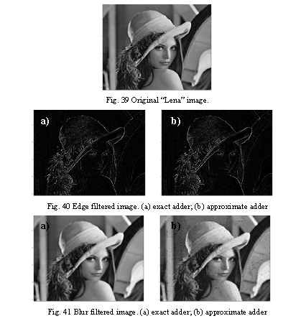
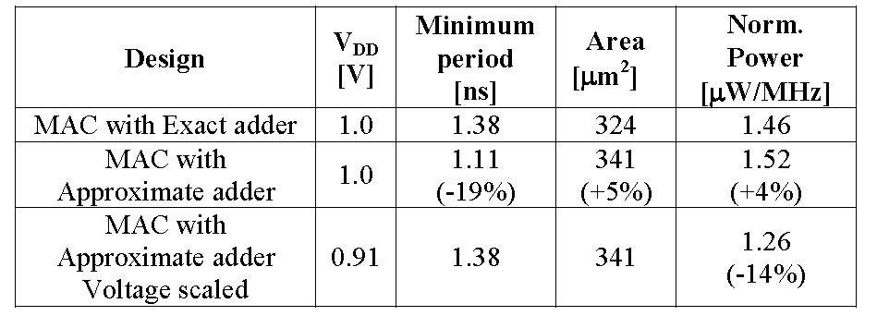
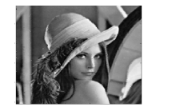

Multiply-and-Accumulate (MAC) Unit employing speculative adders
Quality results: Implementation results:
Pixel skipping
[C] D. Esposito, D. De Caro, E. Napoli, N. Petra, A. G. M. Strollo, “On the Use of Approximate Adders in Carry-Save Multiplier-Accumulators”, accepted at 2017 IEEE International Symposium on Circuits and Systems (ISCAS), Baltimore, MD, USA.
Notes:
http://cpudb.stanford.edu

Slide 33
Outline
VLSI circuits for Approximate computing
  Motivations
  My Activity
  Technical details:
    Variable-latency speculative Parallel-Prefix adders
    Approximate adders for signed operands
    Multiply-and-Accumulate (MAC) Unit employing speculative adders
    Precision-Scalable Latch-Memory
    Precision-Scalable MAC Units
    Publications and Questions
Notes:
http://cpudb.stanford.edu

Slide 34
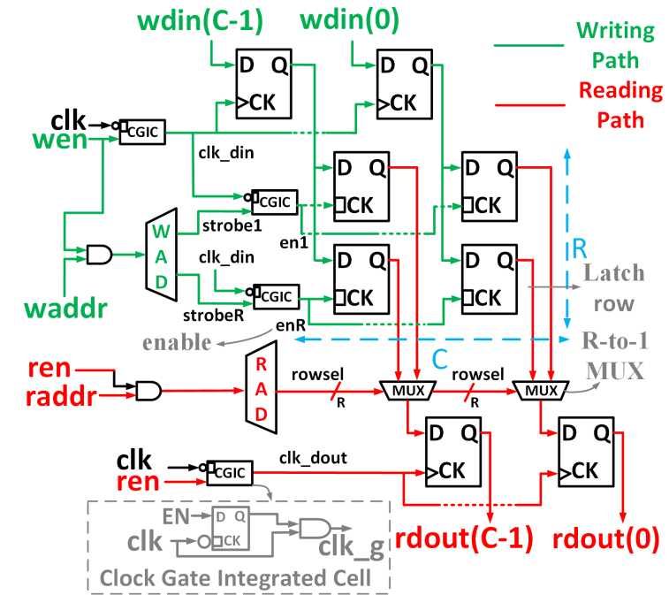
Precision-Scalable Latch-Memory
Memories occupy a significant portion of system energy.
Standard Cell Memories (SCM) constitutes a valid alternative to SRAM macrocelles for embedded memories (up to 4-6 Kbits).[8]
High design flexibility (described in HDL language)
Notes:
http://cpudb.stanford.edu

Slide 35
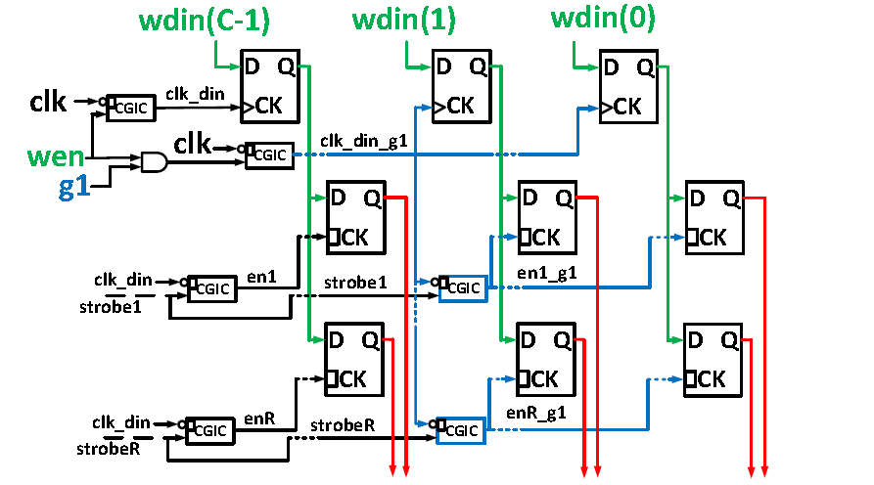
Precision-Scalable Latch-Memory
A precision-scalable SCM has been proposed for the first time.
Energy-quality scalability for SCM is shown.
It requires modifications to both writing and reading parts.
Proposed approximate writing architecture:
Notes:
http://cpudb.stanford.edu

Slide 36
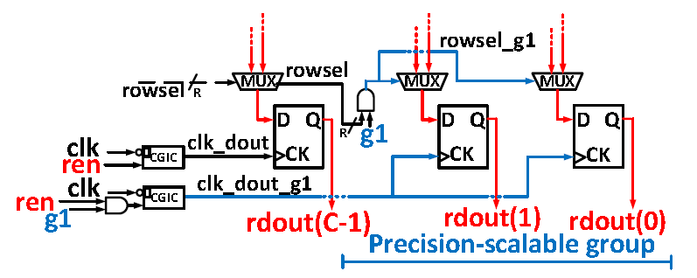
Precision-Scalable Latch-Memory
Proposed approximate reading part:
Notes:
http://cpudb.stanford.edu

Slide 37
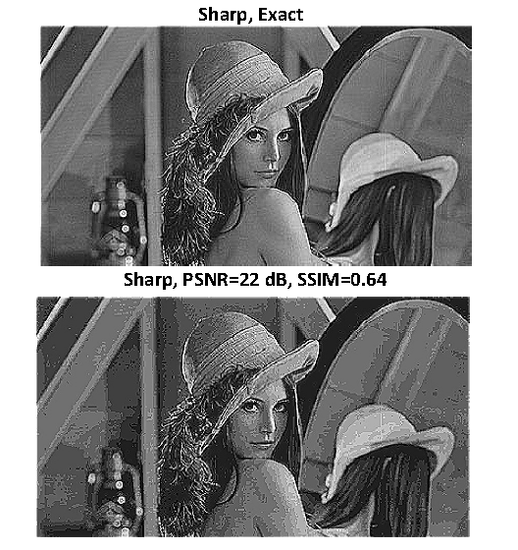
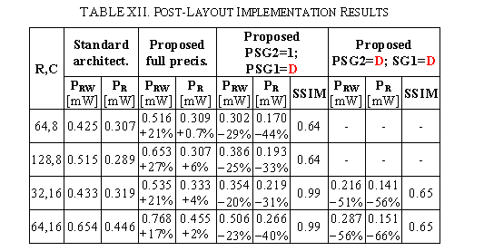
Precision-Scalable Latch-Memory
Up to 66% of dissipated power improvement
[C] D. Esposito, A. G. M. Strollo, M. Alioto, “Power-Precision Scalable Latch Memories”, accepted at 2017 IEEE International Symposium on Circuits and Systems (ISCAS), Baltimore, MD, USA.
Notes:
http://cpudb.stanford.edu

Slide 38
Outline
VLSI circuits for Approximate computing
  Motivations
  My Activity
  Technical details:
    Variable-latency speculative Parallel-Prefix adders
    Approximate adders for signed operands
    Multiply-and-Accumulate (MAC) Unit employing speculative adders
    Precision-Scalable Latch-Memory
    Precision-Scalable MAC Units
    Publications and Questions
Notes:
http://cpudb.stanford.edu

Slide 39
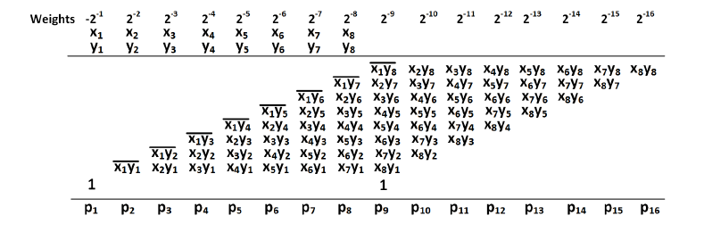
Precision-scalable MAC Units
Multipliers constitute one of the most energy-hungry fundamental digital block .
They are used to implement in hardware the 2D-convolution operation, which is a basic and compute intensive operation in many image processing and machine learning tasks.
Partial products
Notes:
http://cpudb.stanford.edu

Slide 40
Precision-scalable MAC Units
My activity focused on precision-scalable (@ run-time) MAC units.
An additional input allows disabling the switching of the columns of the PPM (saving dynamic power) [9]:
X
X
X
X
e.g. 4 disabled columns
Notes:
http://cpudb.stanford.edu

Slide 41
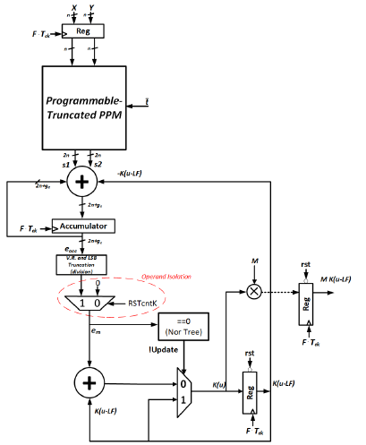
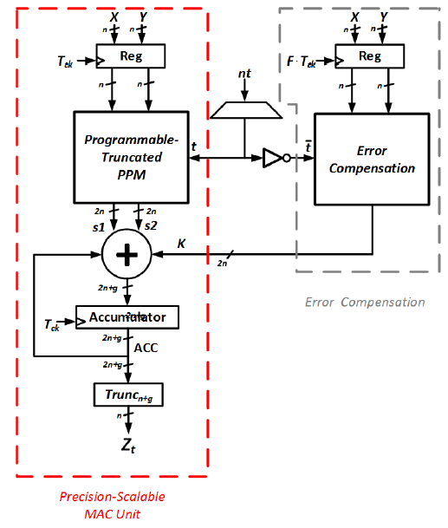

Precision-scalable MAC Units
A real-time, data-aware error compensation circuit, at negligible energy overhead has been proposed.
Notes:
http://cpudb.stanford.edu

Slide 42
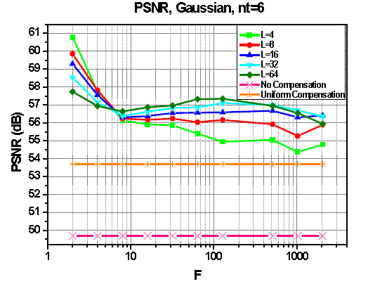
Precision-scalable MAC Units
Quality results:
proposed
Notes:
http://cpudb.stanford.edu

Slide 43
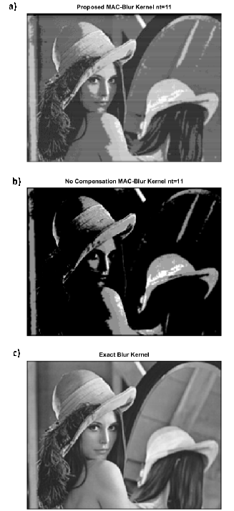
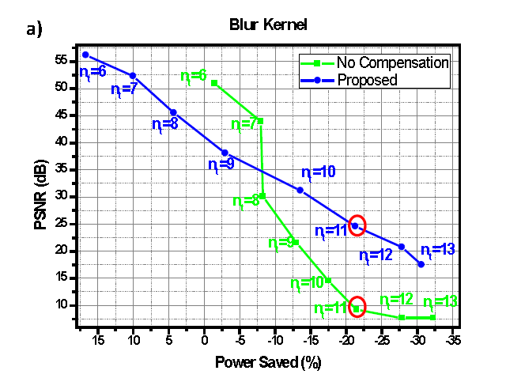
Precision-scalable MAC Units
Notes:
http://cpudb.stanford.edu

Slide 44
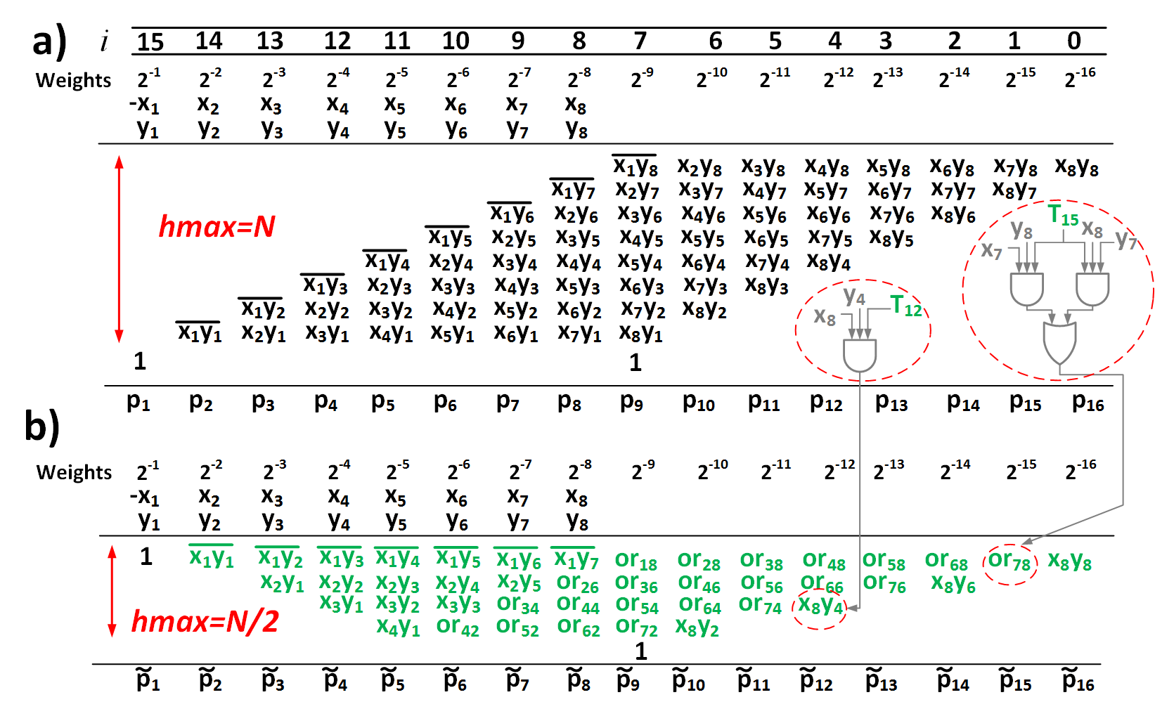
Precision-scalable MAC Units
Moreover an approximate Precision-Scalable MAC Units has also been proposed.
A recoding of the PPM is employed to separate low probability and high probability terms.
The low probability terms are neglected.
The high probability terms are approximately summed using an OR gate in place of an half-adder.
Notes:
http://cpudb.stanford.edu

Slide 45
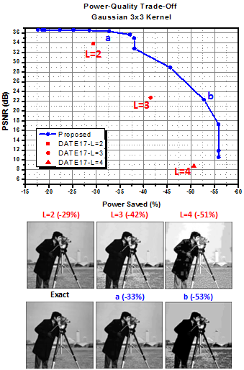
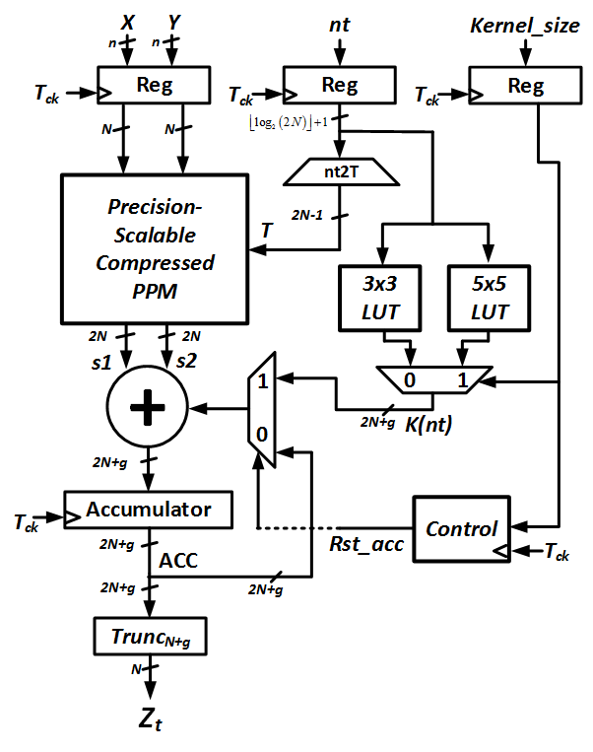
Precision-scalable MAC Units
Resulting circuit: Energy-quality tradeoff:
Notes:
http://cpudb.stanford.edu

Slide 46


Precision-scalable MAC Units
Test-chip in CMOS 28nm, actually in design phase:
Precision-scalable
Latch-Memory
Precision-scalable
MAC Unit
Notes:
http://cpudb.stanford.edu

Slide 47
Products
Journal papers:
D. Esposito, D. De Caro, E. Napoli, N. Petra, A. G. M. Strollo, “Variable Latency Speculative Han-Carlson Adder”, IEEE Trans. on Circuits and Systems I: Regular Papers, vol.62, no.5, pp.1353-1361, 2015.
D. Esposito, D. De Caro and A. G. M. Strollo, "Variable Latency Speculative Parallel Prefix Adders for Unsigned and Signed Operands," in IEEE Transactions on Circuits and Systems I: Regular Papers, vol. 63, no. 8, pp. 1200-1209, Aug. 2016.
E. Napoli, G. Castellano, D. De Caro, D. Esposito, N. Petra and A. G. M. Strollo, "A SISO Register Circuit Tailored for Input Data with Low Transition Probability," in IEEE Transactions on Computers, vol. 66, no. 1, pp. 45-51, Jan. 1 2017.
E. Napoli; G. Castellano; D. De Caro; D. Esposito; N. Petra; A. G. M. Strollo, "Single Bit Filtering Circuit Implemented in a System for the Generation of Colored Noise," in IEEE Transactions on Circuits and Systems I: Regular Papers , vol.PP, no.99, pp.1-11.
D. De Caro; E. Napoli; D. Esposito; G. Castellano; N. Petra; A. G. M. Strollo, "Minimizing Coefficients Wordlength for Piecewise-Polynomial Hardware Function Evaluation With Exact or Faithful Rounding," in IEEE Transactions on Circuits and Systems I: Regular Papers , vol.PP, no.99, pp.1-14.
G. Castellano, D. De Caro, D. Esposito, P. Bifulco, E. Napoli, N. Petra, M. Romano, M. Cesarelli, A.G.M. Strollo, " A Hardware Oriented Real Time Filter for Poisson Video Denoising with Application to X-ray Fluoroscopy", submitted to IEEE Trans. on IEEE Transactions on Circuits and Systems for Video Technology
Notes:
http://cpudb.stanford.edu

Slide 48
Products
International Conference papers:
D. Esposito, D. De Caro, A. G. M. Strollo, “Speculative Parallel-Prefix Adders", Proceedings of 46th GE Conference, ISBN: 978-88-905519-2-5.
D. Esposito, D. De Caro, M. De Martino, A. G. M. Strollo, “Variable Latency Speculative Han–Carlson Adders Topologies”, 11th Conference on PhD Research in Microelectronics and Electronics (IEEE PRIME 2015), pp.45-48, 2015.
D. Esposito, G. Castellano, D. De Caro, E. Napoli, N. Petra and A. G. M. Strollo, "Approximate adder with output correction for error tolerant applications and Gaussian distributed inputs," 2016 IEEE International Symposium on Circuits and Systems (ISCAS), Montreal, QC, 2016, pp. 1970-1973.
E. Napoli, G. Castellano, D. Esposito and A. G. M. Strollo, "Digital circuit for the generation of colored noise exploiting single bit pseudo random sequence," 2016 IEEE 7th Latin American Symposium on Circuits & Systems (LASCAS), Florianopolis, 2016, pp. 23-26.
D. Esposito, A. G. M. Strollo, M. Alioto, “Power-Precision Scalable Latch Memories”, accepted at 2017 IEEE International Symposium on Circuits and Systems (ISCAS), Baltimore, MD, USA.
D. Esposito, D. De Caro, E. Napoli, N. Petra, A. G. M. Strollo, “On the Use of Approximate Adders in Carry-Save Multiplier-Accumulators”, accepted at 2017 IEEE International Symposium on Circuits and Systems (ISCAS), Baltimore, MD, USA.
D. Esposito, A. G. M. Strollo, M. Alioto, “Low-Power Approximate MAC Unit”, submitted at 13th Conference on PhD Research in Microelectronics and Electronics (IEEE PRIME 2017).
Notes:
http://cpudb.stanford.edu

Slide 49
Thank you for your attention!
Questions?
Notes:
http://cpudb.stanford.edu

Slide 50
References
R. H. Dennard, F. H. Gaensslen, V. L. Rideout, E. Bassous and A. R. LeBlanc, "Design of ion-implanted MOSFET's with very small physical dimensions," in IEEE Journal of Solid-State Circuits, vol. 9, no. 5, pp. 256-268, Oct 1974.
M. Horowitz, "1.1 Computing's energy problem (and what we can do about it)," 2014 IEEE International Solid-State Circuits Conference (ISSCC), San Francisco, CA, 2014, pp. 10-14.
K. Roy, A. Raghunathan, “Approximate Computing: An Energy-Efficient Computing Technique for Error Resilient Applications”, IEEE Computer Society Annual Symposium on VLSI (ISVLSI), Montpellier, 2015, pp. 473-475.
J. Han, M. Orshansky, "Approximate computing: an emerging paradigm for energy-efficient design", proc. 18th IEEE Europ. Test Symp., pp. 1-6, May 2013.
Q. Xu, N. S. Kim, T. Mytkowicz, "Approximate Computing: A Survey," in IEEE Design & Test, vol. 33, no. 1, pp. 8-22, Feb. 2016.
A. K. Verma,P. Brisk, P. Ienne, "Variable Latency Speculative Addition: A New Paradigm for Arithmetic Circuit Design," Design, Automation and Test in Europe, 2008. DATE '08 , pp.1250-1255, March 2008.
A. Cilardo, "A new speculative addition architecture suitable for two's complement operations," Design, Automation & Test in Europe Conference & Exhibition, 2009. DATE '09, pp.664-669, April 2009.
P. Meinerzhagen, S. M. Y. Sherazi, A. Burg and J. N. Rodrigues, "Benchmarking of Standard-Cell Based Memories in the Sub- Vt Domain in 65-nm CMOS Technology," in IEEE Journal on Emerging and Selected Topics in Circuits and Systems, vol. 1, no. 2, pp. 173-182, June 2011.
M. de la Guia Solaz, W. Han and R. Conway, "A Flexible Low Power DSP With a Programmable Truncated Multiplier," in IEEE Transactions on Circuits and Systems I: Regular Papers, vol. 59, no. 11, pp. 2555-2568, Nov. 2012.
Notes:
http://cpudb.stanford.edu

Slide 51

Extra Slides
Example of signed speculative sum:
Negative sum: no carry propagation=>no errors
Positive sum: carry propagation=>speculation fails
Notes:
http://cpudb.stanford.edu

Slide 52


Extra Slides
Novel speculative assumption:
Notes:
http://cpudb.stanford.edu

Slide 53

Extra Slides
Novel speculative assumption:
Notes:
http://cpudb.stanford.edu

Slide 54



Extra Slides
Signed operands model:
Notes:
http://cpudb.stanford.edu

Slide 55




Extra Slides
Error probabilities for generic speculative adders with signed operands:
Notes:
http://cpudb.stanford.edu

Slide 56

Extra Slides
Error probability values:
Notes:
http://cpudb.stanford.edu

Slide 57

Extra Slides
Synthesis results:
Notes:
http://cpudb.stanford.edu

Slide 58

Extra Slides
Error probability (approx adder):
Notes:
http://cpudb.stanford.edu

Slide 59

Extra Slides
Statistic of carry-save operands:

Slide 60

Extra Slides
Control:

Slide 61

Extra Slides
Average kernel:

Slide 62

Extra Slides
Average kernel:

Slide 63

Extra Slides
Average kernel:

Slide 64

Extra Slides
Area & Leakage:

Slide 65



Extra Slides
VGG kernel:

Slide 66

Extra Slides
Approx MAC, Area & Leakage:

Slide 67

Extra Slides
Approx SCM, Area & Leakage:

