Slide 1
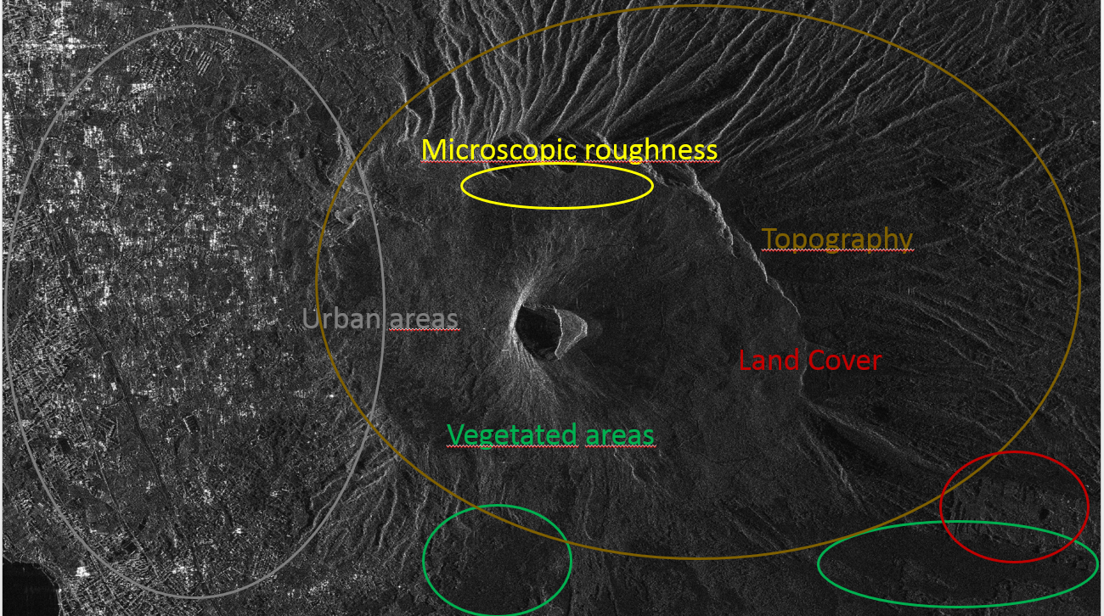
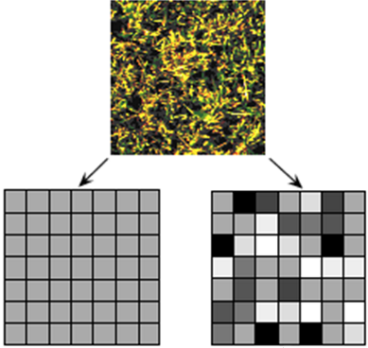
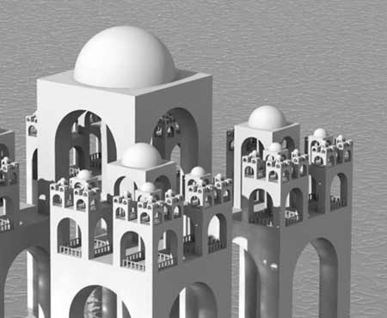
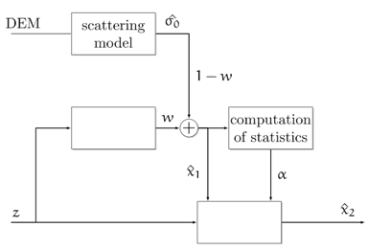
Alessio Di Simone Tutor: Daniele Riccio XXIX Cycle - II year presentation
Information retrieval from a single SAR image
Motivations:
Synthetic Aperture Radar (SAR) images represent an essential tool for natural resources monitoring and environmental hazards management and control.
SAR data contain huge information concerning the physical and chemical properties of the illuminated surface.
The actual peculiarities of radiation-matter interaction at the microwaves and the typical speckle noise greatly affect SAR data interpretation by human users and analysis by computer programs.
The main aim of the research activity is the improvement of both SAR data readability and understandability from human users and information retrieval from computer programs. This is accomplished via two research topics:
Derivation of a proper despeckling approach based on scattering concepts.
Implementation of a terrain correction algorithm based on the estimation of the local incidence angle.
Theoretical Framework:
The main aim of the theoretical background is to properly model both the backscattering coefficient of the surface $σ^{0}$ and the SAR pixel intensity $I$.
Scattering-based Despeckling
Parameters (Incidence Angle) Estimation
The provided scattering model is applied within a novel despeckling approach based on scattering mechanisms. The scattering-based version of some well-known despeckling algorithms, namely PPB and SARBM3D, were theoretically developed and experimentally assessed.
Fractal Surface Model
Linking the SAR Image Model with the Scattering Model:
SB-PPB⁽¹⁾
$$\text{Pr}\left\{z\left(x, y\right)−z\left(x^{′}, y^{′}\right)<\overline{ζ}\right\}= \frac{1}{\sqrt{2π}T^{(1−H)}τ^{H}}\int_{−∞}^{\overline{ζ}}{\text{exp}\left(−\frac{ζ^{2}}{2T^{2(1−H)}τ^{2H}}\right)dζ}$$
$$I =nGΔxΔrπ{(2k)}^{2−2H}S_{0}{\left|β_{mn}\right|}^{2}\frac{\cos^{4}θ}{{\left(\sin{θ}\right)}^{3+2H}}$$
$$I_{s}^{SB−PPB}=\sum_{t∈Ω}{w_{s,t}I_{t}}$$
H: Hurst Coefficient
T: Topothesy
Speckle removal by spatial multilook:
Following a Weighted Maximum Likelihood Estimation (WMLE) approach, weights are defined as
(Fractal) Scattering Model
$$I_{filt} =GΔxΔrπ{(2k)}^{2−2H}S_{0}{\left|β_{mn}\right|}^{2}\frac{\cos^{4}θ}{{\left(\sin{θ}\right)}^{3+2H}}$$
$$w_{s,t}^{}≜{p\left(σ_{Δs}^{}=σ_{Δt}^{} | A,{\hat{σ}}_{}^{SPM}\right)}^{\frac{1}{h}}$$
$$σ_{mn}^{0}=2π8k^{4}\cos^{4}θ{\left|β_{mn}\right|}^{2}\frac{S_{0}}{{\left(2k\sin{θ}\right)}^{2+2H}}$$
$$w_{s,t}=\exp\left[−\sum_{k}{\left(\frac{1}{\tilde{h}}\ln\left(\frac{A_{s,k}}{A_{t,k}}+\frac{A_{t,k}}{A_{s,k}}\right)+\frac{L}{T_{fil}}\frac{{\left|{\hat{σ}}_{s,k}^{}−{\hat{σ}}_{t,k}^{}\right|}^{2}}{{\hat{σ}}_{s,k}^{}{\hat{σ}}_{t,k}^{}}\right)}\right]$$
L: equivalent number of looks (ENL)
$\tilde{h},T_{fil}$: filter parameters
$A$: square root intensity
$\hat{σ}$: estimated backscattering coefficient
$$β_{hh}=\frac{\cos{ϑ−\sqrt{ε_{r}−\sin^{2}{ϑ}}}}{\cos{ϑ+\sqrt{ε_{r}−\sin^{2}{ϑ}}}};{ β}_{vv}=\left(ε_{r}−1\right)\frac{\sin^{2}{ϑ}−ε_{r}\left(1+\sin^{2}{ϑ}\right)}{{\left[ε_{r}\cos{ϑ+\sqrt{ε_{r}−\sin^{2}{ϑ}}}\right]}^{2}}$$
Model calibration:
A flat-nonflat scene classification is performed to iteratively refine the weights in flat regions.
$σ_{mn}^{0}$: Backscattering coefficient
$k$: Propagation constant
$θ:$ Local Incidence Angle
$S_{0}$: Spectral Amplitude
$$G=\frac{\sum_{i,j}^{M,N}{I_{filt, i,j}}}{ΔxΔrπ{(2k)}^{2−2H}S_{0}{\left|β_{mn}\left(θ_{0}\right)\right|}^{2}\frac{\cos^{4}θ_{0}}{{\left(\sin{θ_{0}}\right)}^{3+2H}}}$$
SB-SARBM3D
SAR Image Model
Incidence angle estimation by Least Squares Fitting:
A priori scattering information is exploited to provide a better pilot image ${\hat{x}}_{1}$
$$I =nGΔxΔr\frac{σ_{mn}^{0}}{\sin{θ}}$$
$$\hat{θ}=\min_{θ}{\sum_{i,j}^{M,N}{{\left(I_{oss,i,j}−I_{filt,i,j}\left(θ\right)\right)}^{2}}}$$
1$°$ pass of
SARBM3D
$$w_{s}=1−\min\left(\frac{r_{I,s}}{r_{θ,s}},\frac{r_{θ,s}}{r_{I,s}}\right)$$
$G$: Calibration constant
$γ$: 2D reflectivity pattern
$Δx$: Azimuth SAR resolution
$Δr$: Slant range resolution
2$°$ pass of
SARBM3D
$r_{I}:$ ratio detection of the SAR image intensity
$r_{θ}:$ ratio detection of the local incidence angle map
⁽¹⁾ Di Martino G., Di Simone A., Iodice A., Riccio D. (in print) - Scattering-Based Non-Local Means SAR Despeckling. IEEE Transactions on Geoscience and Remote Sensing.
Cooperation:
University of Naples L’Orientale: ArcheoMod Project, Italian Archaeological Mission in the Eastern Desert of Egypt
NASA-ESA-ASI: Cassini-Huygens Mission to Saturn and its moon Cassini.
Future Developments:
Improvement of other state-of-the art despeckling techniques entering scattering properties.
Combination of surface parameters estimation and scattering-based despeckling.
Radiometric terrain correction.
Other surface parameters retrieval procedures
DEM refinement.
Notes:
Instructions to fill the poster
Box RGB 22 34 48
Context of your research activity (motivations, needs, trends, activity of your group (if the case)… - describe for self explanatpry)
Box RGB 255 220 0
Your research activity up to the second year (idea, methodology, developments, results, expected validation,… - insert whatever you like, text, images, photos. This box is reserved to your very specific activity, not to your group)
Box RGB 151 23 32
Your contacts
Cooperations with Universities, companies, participations in progrojects and programmes (logos can be included)
Box RGB 79 129 189
Next year
Future developments of your activity
Box width is 80 cm
Box height can be changed according to your needs
The text is written in Calibri font

