Slide 1
Anna Di Meglio Tutor: Prof. Franco Garofalo co-Tutor: Prof. Pietro De Lellis XXXII Cycle – III/2 year presentation
Modeling and control of complex dynamical evolving networks

Slide 2
Outline
About my PhD
My background
Credits summary
List of Publications
Complex networks
Rethinking complex dynamical networks
Temporal networks
Control of Stochastic Temporal Networks
Co-evolving networks
Co-evolving networks to explain financial markets dynamics
Opinion dynamics in co-evolving networks
Synchronization of co-evolving networks
Optimal gain adaptation for pinning controllability
Partial containment control over signed graphs
Evolutionary Game Theory: a model predictive control-like update rule
Background
Core activities
Side activities

Slide 3
General Information
MSc in Management Engineering, Università degli Studi di Napoli Federico II.
PhD (1/2 III year) in Information Technology and Electrical Engineering, Automation and Control area.
M.I.U.R. grant.
Research period Abroad (January 2018- March 2019), University of New Mexico under the supervision of Prof. Francesco Sorrentino (Chaos Lab)
PUBLICATIONS
Conference Papers | 3
Journal Papers | 5
Extended Abstract | 4
CREDITS
 | YEAR 1 | YEAR 2 | YEAR 3 | TOT.
Modules | 21 | 13 | 3 | 47
Seminary | 5 | 5 | 5 | 15
Research | 34 | 45 | 52 | 131

Slide 4
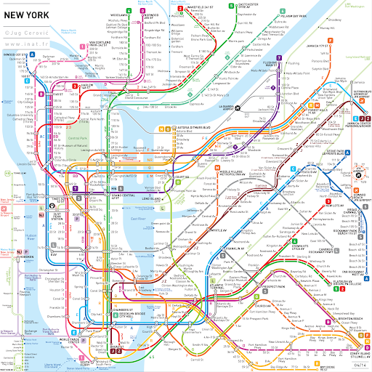
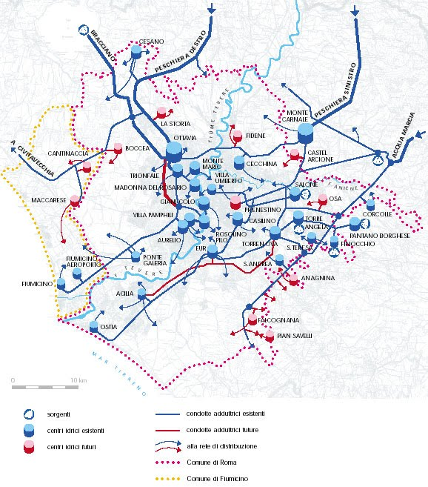
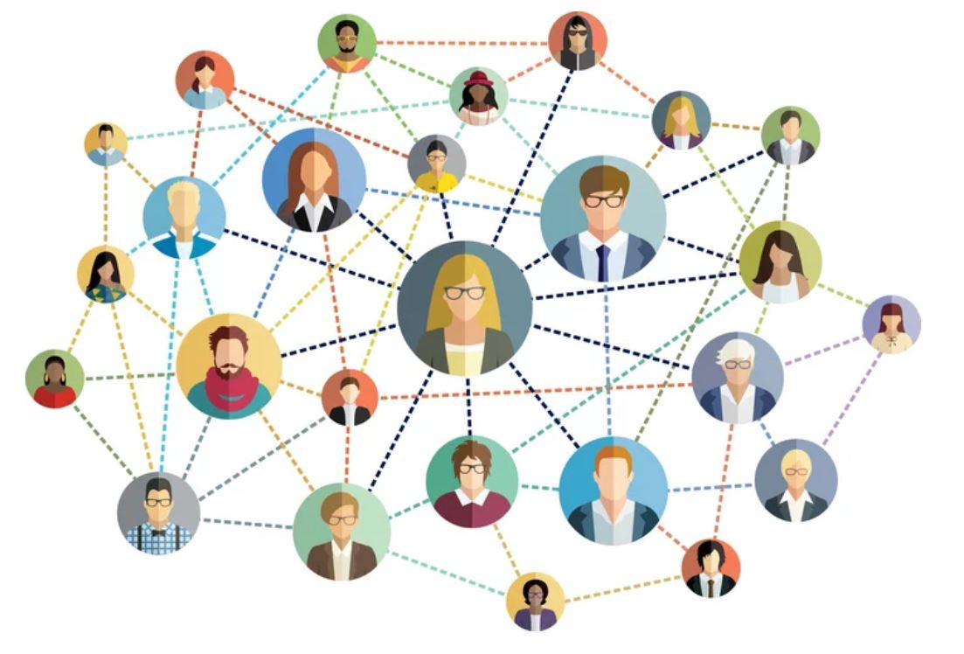
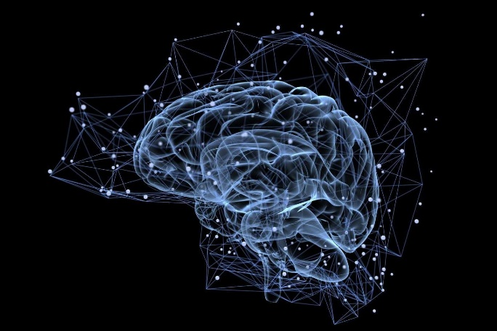
Complex networks
What they have in common?

Slide 5
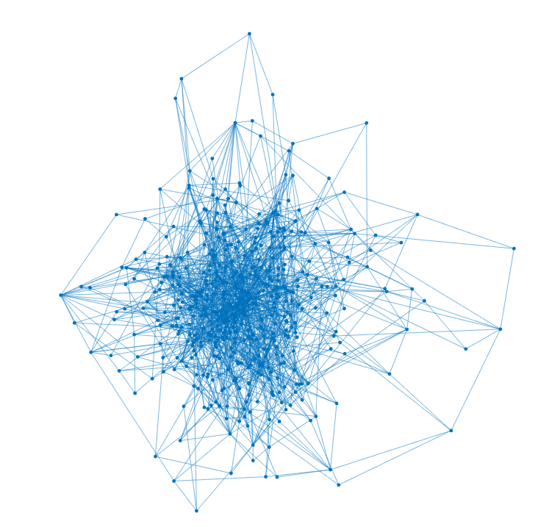
Complex networks
Def. COMPLEX NETWORK: A complex network is constituted by a set of nodes (the entities), which are in interaction through a graph $𝒢=\left\{V,E\right\}$.
$V$ denotes the nodes’ set while $E$ is the set of edges.
Barábasi & Albert network with N=500 and $\left\langle k\right\rangle =3$.

Slide 6
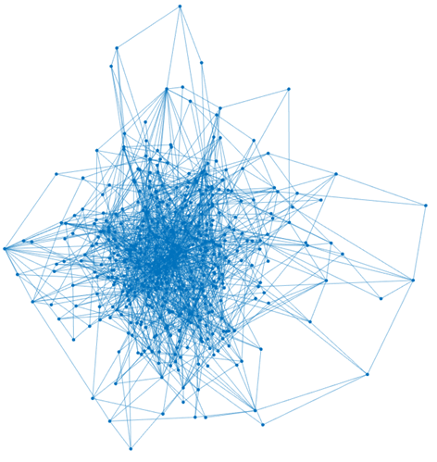
Complex dynamical networks
Def. COMPLEX DYNAMICAL NETWORK: A complex dynamical network is a complex network in which to each node is associated a state variable whose evolution descries the dynamics of each node, i.e., $x_{i}\left(t\right)∈ℝ^{n} ∀i∈V$.
Node state variable $x_{i}\left(t\right)$
Classical dynamical system theory
Interconnection topology
Graph theory
$$\dot{x_{i}}=f\left(x_{i}\right)+c \sum_{j}{a_{ij}h\left(x_{j} \right) }$$

Slide 7
Rethinking complex dynamical networks by control theory
$$\dot{x_{i}}=f\left(x_{i}\right)+c \sum_{j}{a_{ij}h\left(x_{j} \right) }+u_{i}$$
TRADITIONAL ASSUMPTION: the topology is supposed to be static, i.e., the edges set is fixed, and no dynamics are associated to the edges’ set.
Individual dynamics
Control
term
Coupling term
Classical dynamical system theory
Control theory
Graph theory
OUR ASSUMPTION: the topology is supposed to change, i.e., the edge set can change together with the nodes’ dynamics.
$$\dot{x_{i}}=f\left(x_{i}\right)+c \sum_{j}{a_{ij}(t)h\left(x_{j}\right) }+u_{i}$$

Slide 8
Temporal Networks
Def. TEMPORAL NETWORK: network whose edges are active only at certain time instants or during fixed time interval, snapshot [1].
…
$$i$$
$$1$$
$$2$$
$$t_{m}$$
$$\dot{x_{i}}=f\left(x_{i}\right)+c \sum_{j}{a_{ij}(t)h\left(x_{j} − x_{i}\right) }+u_{i}$$
$$𝒢=\left\{V,E\left(t\right)\right\}$$
$$A\left(t\right)=\left\{a_{ij}\left(t\right)\right\}=\left\{\begin{matrix}1 & if \left(i,j\right)∈E(t) \\ 0 & otherwise\end{matrix}\right.$$
[1] P. Holme and S. Jari. "Temporal networks." Physics reports 519.3 (2012): 97-125.

Slide 9
Control of temporal networks
$\dot{x}=A_{k}x+Bu$ $t∈\left[t_{k}, t_{k+1}\right), k=1,…,m$
They found out that a linear dynamical network is:
Easier to control, in terms of its controllability, i.e., the ability to move the network from any state space position to zero in finite time;
Cheaper to control, in terms of the minimal control energy to control it.

Slide 10
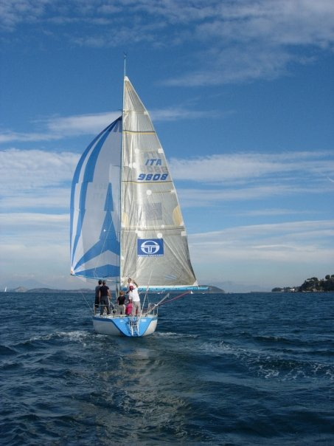
Stochastic temporal networks
BARÁBASI ET AL. ASSUMPTION: the sequence of adjacency matrices constituting the temporal network is known at the beginning of the control time horizon.
«We sail within a vast sphere, ever drifting in uncertainty, driven from end to end» B.Pascal
We relax this unrealistic assumption The sequence of adjacency matrices constituting the temporal network is not known at the beginning of the control time horizon. In each snapshot, we have a deterministic knowledge of the current $A_{k}$ while only a probabilistic description of the future snapshots.
DeLellis P., Di Meglio A., Garofalo F., Lo Iudice F. «The inherent uncertainty of temporal networks: a true challenge for control» submitted for publication in Scientific Reports, 2020.

Slide 11
Control of stochastic temporal networks
Can the benefit of temporality prevail over uncertainty?
$$\min_{u}{E\left[J\left(u\right)\right]}$$
$$s.t.$$
$$\dot{x}\left(t\right)=A_{σ\left(k\right)}x\left(t\right)+Bu\left(t\right) t∈\left[t_{k},t_{k+1}\right), k=1,…,m$$
$x\left(t_{0}\right)=x_{0}, x\left(t_{m}\right)=x_{m}$
As:
$E\left[J\left(u\right)\right]=E\left[\sum_{k=0}^{m−1}{J_{k}\left(u_{k}\right)}\right]$ with $J_{k}\left(u_{k}\right)=\int_{t_{k}}^{t_{k+1}}{u_{k}{\left(t\right)}^{T}u_{k}\left(t\right)dt}$;
$u_{k}^{∗}\left(t\right)=B^{T}e^{A_{σ\left(k\right)}^{T}\left(t_{k+1}−t\right)}W_{k}^{−1}\left(x_{k+1}−e^{A_{σ\left(k\right)}\left(t_{k+1}−t\right)}x_{k}\right)$;
The constraints are function of a stochastic variable.
STOCHASTIC PROGRAMMING
$\min_{x_{i}}{E\left[\sum_{k=0 }^{m−1}{J_{k}\left(x_{k},x_{k+1}\right)}\right]} ∀i=1,…, m−1$
DeLellis P., Di Meglio A., Garofalo F., Lo Iudice F. «The inherent uncertainty of temporal networks: a true challenge for control» submitted for publication in Scientific Reports, 2020.

Slide 12
Control of stochastic temporal Networks
$\min_{x_{i}}{E\left[\sum_{k=0 }^{m−1}{J_{k}\left(x_{k},x_{k+1}\right)}\right]} ∀i=1,…, m−1 (1)$
We analytically solved the minimum control energy problem (1) through stochastic programming, thus finding
an expression for the optimal way-points as a function of the target final state and the previous one;
the optimal expected minimum control energy, expressed as a quadratic form with kernel that can be recursively computed, and that can be considered.
DeLellis P., Di Meglio A., Garofalo F., Lo Iudice F. «The inherent uncertainty of temporal networks: a true challenge for control» submitted for publication in Scientific Reports, 2020.

Slide 13
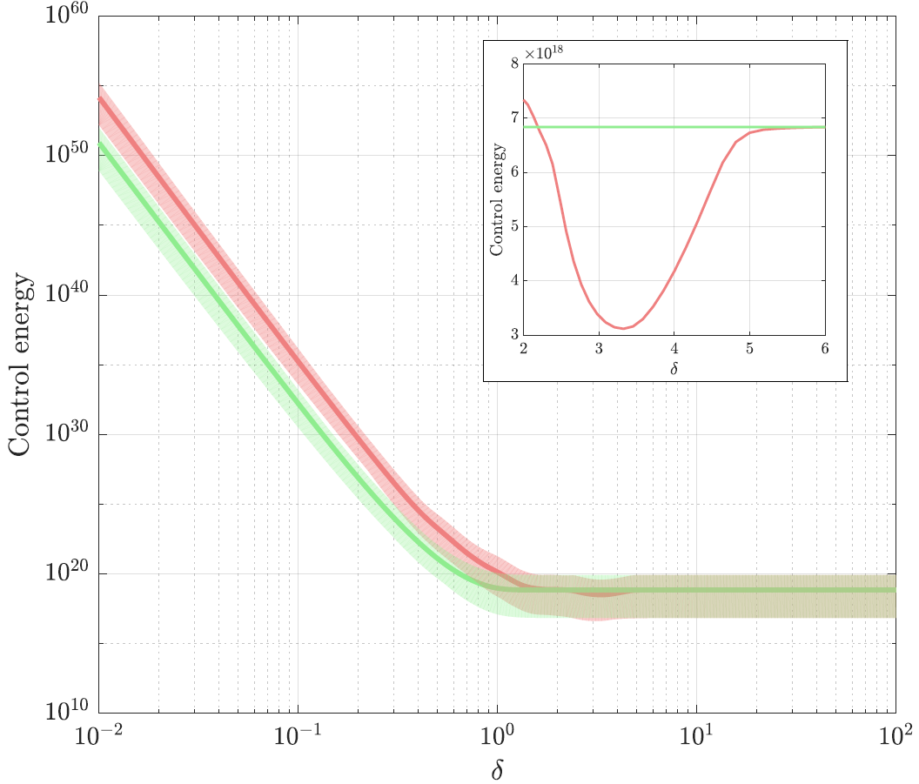
Control of stochastic temporal Networks
In the fast regime (i.e. for small $δ$) uncertainty prevails over temporality with the expected energy required to control the network being larger than the energy benchmark.
As the temporality vanishes (i.e. for large $δ$) the difference becomes negligible.
In the intermediate regime (see the zoom), the advantage is still present.
N= 100 nodes and m= 3 snapshot. The shaded areas are enclosed by the minimum and the maximum energies over ${10}^{5}$ final states in the unit hypersphere.
$δ≔\left(t_{m}−t_{0}\right)/m \sim$ temporality, expected control energy; benchmark
DeLellis P., Di Meglio A., Garofalo F., Lo Iudice F. «The inherent uncertainty of temporal networks: a true challenge for control» submitted for publication in Scientific Reports, 2020.

Slide 14
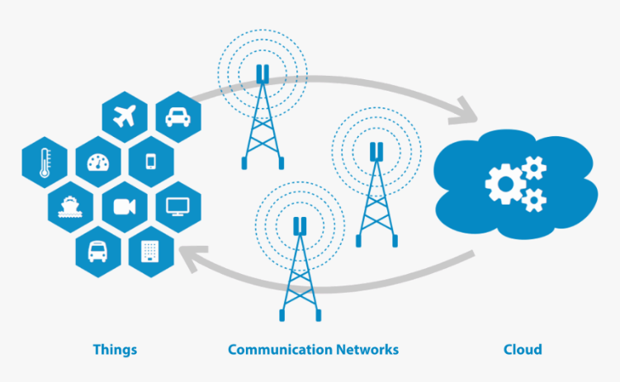
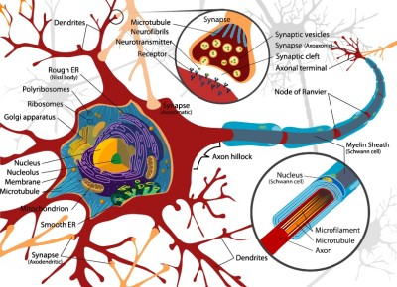
Co-evolving Networks
Is the temporal networks framework suitable when modelling time-varying interactions in real life?

Slide 15
Co-evolving networks
Def. CO-EVOLVING NETWORK:
A network in which both the nodes and the edges dynamically evolves and are mutually interconnected.
Node state variable $x_{i}\left(t\right)$
Interconnection topology
Edge state variable $a_{ij}\left(t\right)$
$$\left\{\begin{aligned}\dot{x_{i}}=f\left(x_{i}, 𝒢,a_{ij},u_{i}\right) ∀i∈V \\ {\dot{a}}_{ij}=g\left(x_{i}, x_{j}, a_{ij},𝒢\right) ∀\left(ij\right)∈E\end{aligned}\right.$$

Slide 16
Co-evolving networks explains behavioral financial markets
How does a financial crisis come up?
TRADITIONAL ASSUMPTION: the financial markets are driven by the rational decisions of the homo oeconomicous.
BEHAVIORAL THEORY:
the mental and emotional patterns of financial agents affect their trading strategies.
ECONOPHISICS:
the macroscopic emerging feature of financial markets is a consequence of the behavior of its microscopic constituents, the financial agents
Which is the impact of the relations among financial agents on the market evolution?

Slide 17
Co-evolving networks explains behavioral financial markets
To each agent is associated:
Financial wealth $x\left(t\right)$;
The risk attitude $α\left(t\right)$;
The reputation $r\left(t\right)$.
To each edge is associated a state variable $σ\left(t\right)$ determining the evolution of the interactions among the agents.
We introduce an irrationality coefficient affecting the reputation of the agents that in turn constitutes the control input for the edge dynamics.
Taxation and trading mechanism; $A\left(0\right)$
Behavioral variables
$$A\left(t\right)$$
Node dynamics
$$x\left(t\right), r\left(t\right),α(t)$$
(FINANCIAL AGENTS)
Edge dynamics
$$σ\left(t\right)$$
(INTERACTIONS)
DeLellis P., Di Meglio A., Garofalo F., Lo Iudice F. «The evolving cobweb of relations among partially rational investor» PlosOne, 2017, 12 (2): e0171891.

Slide 18
Co-evolving networks explains behavioral biases in financial markets
Changing the behavioral variables, and then the input of the edges’ dynamics, we modelled different behaviors biases which are considered as possible drivers of bubbles and crashes.
HERDING: the phenomenon where investors follow what they perceive other investors are doing, rather than their own analysis.
OVERCONFIDENCE: bias in which an agent's subjective confidence in his or her judgements is not justified by the objective accuracy of those judgements.
DeLellis P., Di Meglio A., Garofalo F., Lo Iudice F. «The evolving cobweb of relations among partially rational investor» PlosOne, 2017, 12 (2): e0171891.
DeLellis P., Di Meglio A., Lo Iudice F. «Overconfidence agents and evolving financial networks» Nonlinear Dynamics, 2018, 92 (1), 33-40.

Slide 19
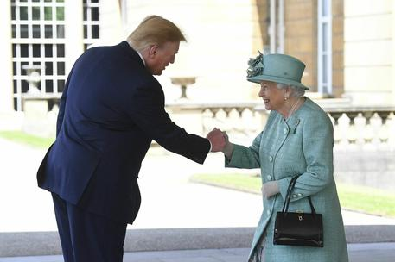
Opinion dynamics in co-evolving networks
OPINION DYNAMICS studies how the opinions arise and spread among people affected by behavioral bias. It quantifies the intensity of opinions through a state variable and investigates whether collective dynamics (typically consensus) emerge.
In group of individuals, the aim is not always complete consensus. For instance, an agent subset, the leaders, aims at steering the opinion of the group within a certain range.
DeLellis P., Di Meglio A., Garofalo F., Lo Iudice F. «Steering opinion dynamics via containment control» Computational Social Networks, 2017, 4 (12).

Slide 20
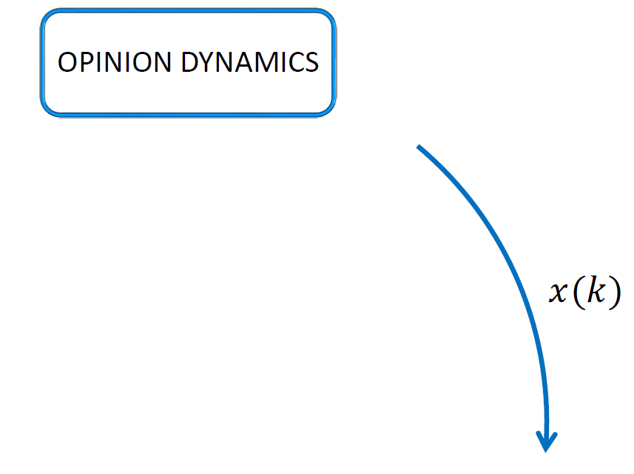
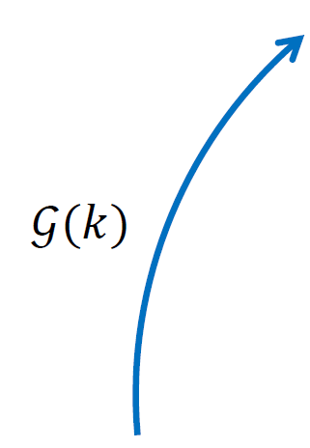
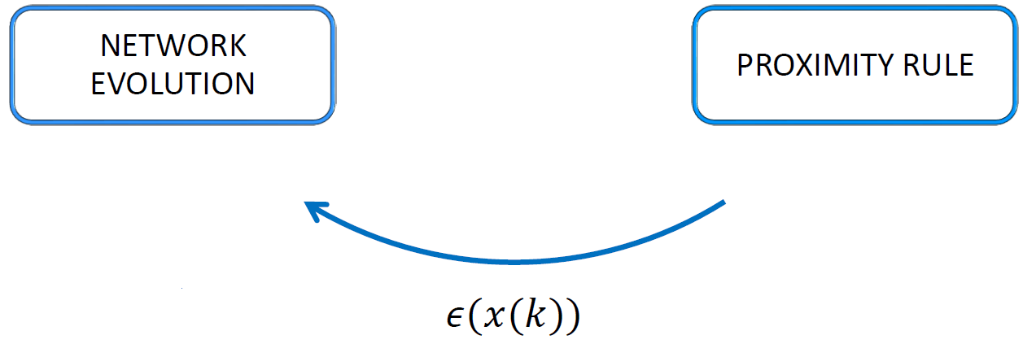
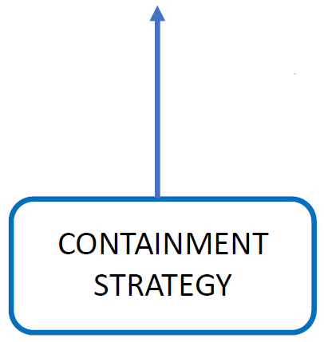
Opinion dynamics in co-evolving networks
A state variable describes the evolution of the intensity of the opinion of each node of the network;
A measure of the dissimilarities between the opinions of two connected agents drives the evolution of the interaction topology (proximity rule);
According to the current interaction topology, the leaders of the networks (agents whose opinions are not influenced by those of the others, the followers), apply a specific containment strategy, i.e., decide who to influence (containment strategy).
DeLellis P., Di Meglio A., Garofalo F., Lo Iudice F. «Steering opinion dynamics via containment control» Computational Social Networks, 2017, 4 (12).

Slide 21
Opinion dynamics in co-evolving networks
We compared a time-varying control strategy with a static one and the performance of the control action in the time-varying case is better.
A non-informed leader (leader that is not aware of the interaction topology) is able to contain the opinions of a large fraction of the population within the range of the leaders’ opinions.
Only an omniscient leader can achieve better performances.
DeLellis P., Di Meglio A., Garofalo F., Lo Iudice F. «Steering opinion dynamics via containment control» Computational Social Networks, 2017, 4 (12).

Slide 22
Synchronization of co-evolving networks
Does a co-evolving network synchronize?
COMPLEX NETWORKS: a network is said to be synchronized if the nodes’ states asymptotically follow a same trajectory, i.e., $x_{1}=x_{2}= …=x_{N}=s$.
CO-EVOLVING NETWORKS: a network is said to be synchronized if the nodes’ states asymptotically follow a same trajectory, i.e., $x_{1}=x_{2}= …=x_{N}=s$ while the edges’ variables asymptoti-cally reaches an equilibrium.

Slide 23
Synchronization of co-evolving networks
We consider a co-evolving network, described by
$$\left\{\begin{matrix}{\dot{x}}_{i}\left(t\right)=f\left(x_{i}\left(t\right)\right)+\sum_{j}{{ σ}_{ij}\left(t\right)h\left(x_{j}\left(t\right)\right)} & ∀ i∈V \\ \begin{aligned} \\ {\dot{σ}}_{ij}\left(t\right)=−b\left(σ_{ij}\left(t\right)−ε\right)+k{\left\|x_{i}\left(t\right)−x_{j}\left(t\right)\right\|}^{2} \end{aligned} & ∀ \left(i,j\right)∈E\end{matrix}\right.$$
Does this network synchronize?
We found conditions on the control parameters $ε$ and $k$ such that the synchronous solution $Σ: x_{1}=x_{2}= …=x_{N}=s$ is stable.
IDEA: employing the Master Stability approach we select $ε≥\tilde{ε}$, where $\tilde{ε}$ guarantees that $Σ$ is stable to local perturbations.
YES!
DeLellis P., Di Meglio A., Garofalo G. «Optimal synchronizability of co-evolving networks» In preparation.

Slide 24
Synchronization of co-evolving networks
Can the achieving of synchronization be optimized?
$${\dot{x}}_{i}\left(t\right)=f\left(x_{i}\left(t\right)\right)+\sum_{j}{{ σ}_{ij}\left(t\right)h\left(x_{j}\left(t\right)\right)}+{\tilde{u}}_{i}$$
$$u_{i}$$
CONTROL ENERGY
$$\min_{u}{\int_{t_{0}}^{T}{u^{T}\left(t\right)u\left(t\right)dt}}$$
$$s.t.$$
$$ε_{ij}≥\tilde{ε}$$
STABILITY CONSTRAINT
DeLellis P., Di Meglio A., Garofalo G. «Optimal synchronizability of co-evolving networks» In preparation.

Slide 25
Outline
About my PhD
My background
Credits summary
List of Publications
Complex networks
Rethinking complex dynamical networks
Temporal networks
Control of Stochastic Temporal Networks
Co-evolving networks
Co-evolving networks explain financial markets
Opinion dynamics in co-evolving networks
Synchronization of co-evolving networks
Optimal gain adaptation for pinning controllability
Partial containment control over signed graphs
Evolutionary Game Theory: a model predictive control-like update rule
Background
Core activities
Side activities

Slide 26
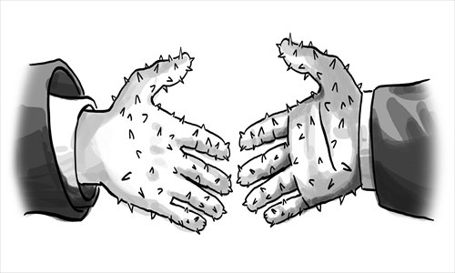
Side activities
Di Meglio A., DeLellis P., di Bernardo M. «Decentralized Gain Adaptation for Optimal Pinning Controllability of Complex Networks» 2019, IEEE Control System Letters 4(1), 253-258.
$${\dot{x}}_{i}=f\left(x_{i},t\right)−σ\sum_{j=1}^{N}{a_{ij}x_{j}\left(t\right)}+u_{i}, u_{i}\left(t\right)=−p_{i}e_{i}\left(t\right)=−p_{i}\left(x_{i}\left(t\right)−s\left(t\right)\right)$$
DeLellis P., DiMeglio A., Garofalo F., Lo Iudice F. «Partial Containment Control over signed graphs» 2019, 18 th European Control Conference (ECC), 596-601.
Di Meglio A., Della Rossa F., Dercole F. «Direct reciprocity and model-predictive rationality: A setup for network reciprocity over social ties» 2019, 18 th European Control Conference (ECC), 1531-1536

Slide 27
Optimal gain adaptation for pinning controllability
CONTROL GOAL: induce synchronization in a dynamical network through a control input (i.e., the pinner) injected in a subset of the nodes (i.e., the pinned nodes).
$${\dot{x}}_{i}=f\left(x_{i},t\right)−σ\sum_{j=1}^{N}{a_{ij}x_{j}\left(t\right)}+u_{i}$$
where the control input is
$$u_{i}\left(t\right)=−p_{i}e_{i}\left(t\right)=−p_{i}\left(x_{i}\left(t\right)−s\left(t\right)\right)$$
with $p_{i}=1$ if $i∈𝒫$ and 0 otherwise.
The error dynamics can be written as
$${\dot{e}}_{i}\left(t\right)=f\left(x_{i},t\right)−f\left(s,t\right)−\sum_{j=1}^{N}{m_{ij}e_{i}\left(t\right)}$$
where $m_{ij}$ is the $ij$-th of an extended Laplacian matrix $M≔\overline{L}+P$
with $\overline{L}=σL$ and $P$ the diagonal matrix containing $p_{i}$.

Slide 28
Optimal gain adaptation for pinning controllability
$λ_{1}\left(M\left(p\right)\right)$ has a crucial rule in pinning controllability:
Enlarge the set of the pinning controllable node dynamics;
Improve the convergence rate towards $s\left(t\right)$.
DISTRIBUTED STRATEGY FOR OPTIMAL SELECTION OF CONTROL GAINS
$$p^{∗}=\arg{\min_{p}{−λ_{1}\left(M\left(p\right)\right)}}$$
$$s.t.$$
$$1_{m}^{T}p≤\overline{p}$$
$$p≥0$$
GLOBAL INFORMATION
Di Meglio A., DeLellis P., di Bernardo M. «Decentralized Gain Adaptation for Optimal Pinning Controllability of Complex Networks» 2019, IEEE Control System Letters 4(1), 253-258.

Slide 29
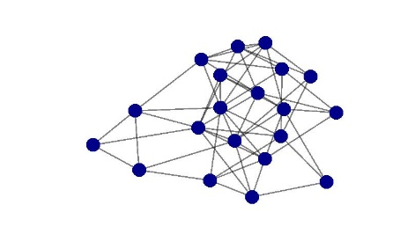
Optimal gain adaptation for pinning controllability
$$M, 𝒫$$
We designed a multi-layer algorithm inspired by [4] that starting with $M$and $𝒫$
The first layer estimates in a decentralized fashion the sensitivity of $λ_{1}\left(M\right)$ respect to $p$;
The second layer implements a decentralized version of the steepest descent method using the output of the first layer.
Then, the optimal $p^{∗}$ are fed to the pinner to achieve the control goal.
ESTIMATION LAYER
Time-scale
$$p$$
$$\frac{∂λ_{1}\left(M\right)}{∂p}$$
GAINS ADAPTATION ALGORITHM
$$p^{∗}$$
$$s\left(t\right)$$
$$x\left(t\right)$$
CONTROLLED NETWORK
Di Meglio A., DeLellis P., di Bernardo M. «Decentralized Gain Adaptation for Optimal Pinning Controllability of Complex Networks» 2019, IEEE Control System Letters 4(1), 253-258.

Slide 30
Partial containment control over signed graphs
Typical control protocols: the nodes must follow a common trajectory (e.g. consensus, synchronization, pinning control).
Typical assumptions:
The controller has full knowledge of the network structure;
The nodes are cooperative.
Our control protocol: $m$ leaders push $q<n$ nodes in the convex hull spanned by their states: partial containment control.
Our assumptions:
The leaders do not have full knowledge of the network;
The nodes have cooperative and antagonistic interactions.
DeLellis P., DiMeglio A., Garofalo F., Lo Iudice F. «Partial Containment Control over signed graphs» 2019, 18 th European Control Conference (ECC), 596-601.

Slide 31
Partial containment control over signed graphs
Consider the network dynamics
$$x_{i}\left(k+1\right)=\left\{\begin{aligned}x_{i}\left(k\right)+\sum_{j=1}^{n}{a_{ij}\left(x_{j}\left(k\right)−\operatorname{sgn}\left(a_{ij}\right)x_{i}\left(k\right)\right) ∀i∈ℱ} \\ x_{i}\left(k\right) ∀i∈𝒞 \end{aligned}\right.$$
where $a_{ij}$ is the generic element of the adjacency matrix associated to the signed graph $𝒢=\left\{𝒱,ℰ\right\}$, that is,
The network is $q$-partially signed contained if $∃ Q⊆ℱ$ with $\left|Q\right|=q$ such that each node $i∈Q$is asymptotically signed contained
$$\underset{k→+∞}{limsup} \left|x_{i}\left(k\right)\right| ≤\max_{j∈𝒞} \left|x_{j}\left(0\right)\right|$$
1
$$A=\left[\begin{matrix}0 & a_{12} & 0 \\ 0 & 0 & −a_{23} \\ a_{31} & 0 & 0\end{matrix}\right]$$
+
+
-
3
2
DeLellis P., DiMeglio A., Garofalo F., Lo Iudice F. «Partial Containment Control over signed graphs» 2019, 18 th European Control Conference (ECC), 596-601.

Slide 32
Partial containment control over signed graphs
How we can contain the bigger number of nodes in a signed network?
We translate the problem of containing the bigger number of nodes in a NETWORK OPTIMIZATION PROBLEM
$$ℒ^{∗}=arg max \left|φ(ℒ)\right|$$
$$s.t$$
$$\left|ℒ\right|=d$$
$ℒ≔$ the set of nodes directly controlled by the leaders;
DeLellis P., DiMeglio A., Garofalo F., Lo Iudice F. «Partial Containment Control over signed graphs» 2019, 18 th European Control Conference (ECC), 596-601.

Slide 33
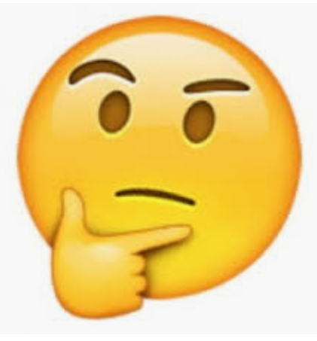
Evolutionary Game Theory
An evolutionary game setup is made by:
A game modeling a repeated interaction among pairs of agents.
Prisoner Dilemma (PD). Two-player-two-option game in which a cooperator (C) provides a benefit $b$ to the opponent at cost $c<b$, while a defector (D) provides no benefit at no cost. It is often parametrized by the game return $r=b/c$.
A set of strategies to compare.
Always C Vs always D.
An evolutionary process linking the payoffs to the strategy update in socio-economic systems.
Imitation of the best performance.
PUZZLE
Why should we cooperate when defection gives
a larger reward?

Slide 34
Evolutionary Game Theory and cooperation in social networks
It has been shown that:
Imitation lacks rationality especially in presence of heterogeneous interactions.
Individuals show reciprocity.
Adopting the best response evolutionary process, network reciprocity does not emerge anymore.
Does exist an EGT setup able to induce cooperation in a networked scenario?

Slide 35
Evolutionary Game Theory
We have shown that a strategy update rule based on a multi-step prediction of the future payoffs together with direct reciprocity supports network reciprocity.
Our EGT setup:
Game: Prisoner Dilemma
Strategies: Tit for Tat (T) or Tit for 2 Tat (T2) (direct reciprocity) Vs always defection (D).
Tit for Tat: the agent first cooperates, then subsequently replicate the opponent's previous action.
Tit for two Tat: the agent cooperates twice before replicate a defection of the opponents.
Evolutionary process: MPC-inspired strategy update rule
Di Meglio A., Della Rossa F., Dercole F. «Direct reciprocity and model-predictive rationality: A setup for network reciprocity over social ties» 2019, 18 th European Control Conference (ECC), 1531-1536
Della Rossa F., Dercole F., DiMeglio A. «Direct reciprocity and model-predictive strategy update explain network reciprocity observed in socio-economic network» 2020, accepted in Games.

Slide 36
List of publications
JOURNAL PAPERS:
DeLellis P., Di Meglio A., Garofalo F., Lo Iudice F. «The evolving cobweb of relations among partially rational investors» Plos One (2017), 12(2)
DeLellis P., Di Meglio A., Garofalo F., Lo Iudice F. «Steering opinion dynamics via containment control», Computational Social Networks (2017) 4(1), 12.
DeLellis P., Di Meglio A., Lo Iudice F. «Overconfident agents and evolving financial networks» Nonlinear Dynamics (2018), 92(1), 33-40.
Di Meglio A., DeLellis P., di Bernardo M. «Decentralized gain adaptation for optimal pinning controllability of complex networks» IEEE Control Systems Letters (2019), 4(1), 253-258.
Della Rossa F., Dercole F., Di Meglio A. «Direct reciprocity and model-predictive strategy update explain the network reciprocity observed insocio-economic networks», accepted in Games (2020).
DeLellis P., Di Meglio A., Garofalo F., Lo Iudice F. «The inherent uncertainty of temporal networks: a true challenge for control» submitted to Scientific Reports.

Slide 37
List of publications
CONFERENCE PAPERS:
DeLellis P., Di Meglio A., Garofalo F., Lo Iudice F. «Evolution of networks of financial agents driven by herding phenomena» 2017 American Control Conference (ACC), 1598-1603.
DeLellis P., Di Meglio A., Garofalo F., Lo Iudice F. «Partial containment control over signed graphs», 18-th European Control Conference (ECC) 2019, 596-601.
Di Meglio A., Della Rossa F., Dercole F. «Direct reciprocity and model-predictive rationality: A setup for network reciprocity over social ties», 18-th European Control Conference (ECC) 2019, 1531-1536.

Slide 38
Thanks for the attention anna.dimeglio@unina.it

