Slide 1
Dario Di Mauro Tutor: Francesco Cutugno XXX Cycle - III year presentation
Human-Computer Interaction in Intelligent Environments

Slide 2
My Background
Master Degree in Computer Science in 2013
I worked in the Or.C.He.S.T.R.A. project for the cultural heritage revaluation, collaborating with art historian and archaeologists
Type of fellowship P.O. Campania FSE 2007/2013
I visited the Smart Space Lab Middlesex University, London prof. Juan Carlos Augusto

Slide 3
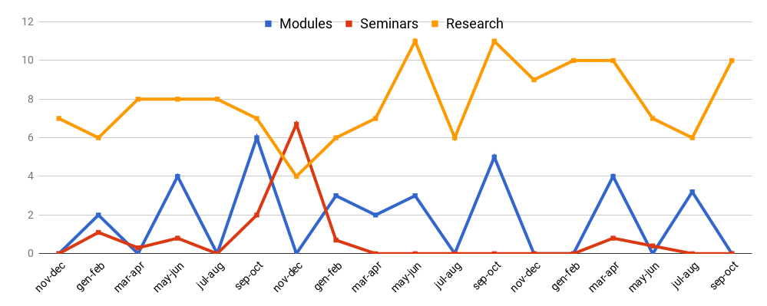
Credit Summary
 | I year |  |  |  |  |  |  | II year |  |  |  |  |  |  | III year
Bimonth | 1 | 2 | 3 | 4 | 5 | 6 | Summary | 1 | 2 | 3 | 4 | 5 | 6 | Summary | 1 | 2 | 3 | 4 | 5 | 6 | Summary | Total
Modules | 0 | 2 | 0 | 4 | 0 | 6 | 12 | 0 | 3 | 2 | 3 | 0 | 5 | 13 | 0 | 0 | 4 | 0 | 3.2 | 0 | 7.2 | 32
Seminars | 0 | 1.1 | 0.3 | 0.8 | 0 | 2 | 4.2 | 6.7 | 0.7 | 0 | 0 | 0 | 0 | 7.4 | 0 | 0 | 0.8 | 0.4 | 0 | 0 | 1.2 | 13
Research | 7 | 6 | 8 | 8 | 8 | 7 | 44 | 4 | 6 | 7 | 11 | 6 | 11 | 45 | 9 | 10 | 10 | 7 | 6 | 10 | 52 | 141
 | 7 | 9.1 | 8.3 | 13 | 8 | 15 | 60 | 11 | 9.7 | 9 | 14 | 6 | 16 | 65 | 9 | 10 | 15 | 7.4 | 9.2 | 10 | 60 | 186

Slide 4
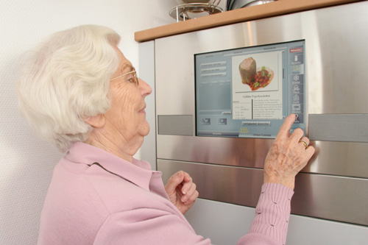
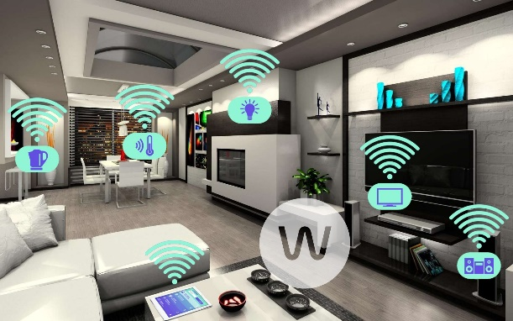
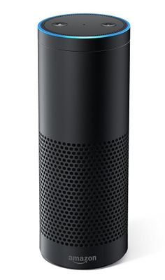
Intelligent Environments
Technology supports people in daily lives
World populated with intelligent devices
A centralised unit often processes all the dialogues

Slide 5
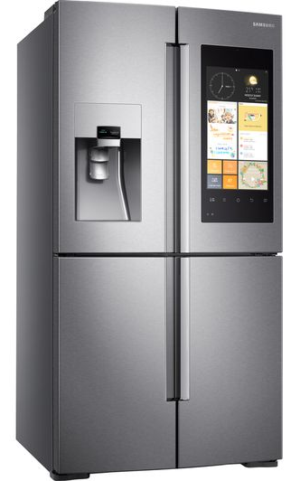
HCI in Intelligent Environments
Showing family’s stuff
Maintaining a shopping list
Recommending a recipe
Managing the heating
Samsung Family HUB
?
Nest Learning Thermostat

Slide 6
HCI in Intelligent Environments
Smart entities
Connected inconsistent objects
Human-Computer Interaction issues
Pervasive Human-centred Architecture for Smart Environmental Responsiveness
Amazon Echo Google Home
Apple Kit
etc.

Slide 7
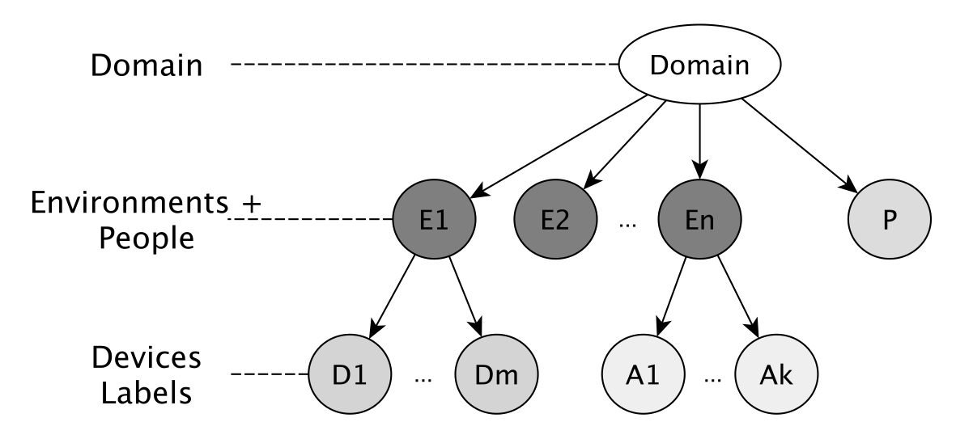
Environment Representation

Slide 8
Considered Environments
Smart homes
Smart museums
Few people
Highly connected devices
Long-term interaction
Many producers (brands, etc)
Many people
Low and steady connections
A single director (curator)
Short-term interaction
Personalised interfaces

Slide 9
Node Architecture

Slide 10
PHASER node
Represents a single “interactive” entity
Abstract representation for I/O
Just knows how to process requests on its own context
Supports Natural User Interfaces
Dialogues with OpenDial

Slide 11
Network of PHASER entities
Partial Info (Business Card) - Accepted Input
- Ontology details
different colours different environments

Slide 12
Navigation Problem
“azg*fg” ?
different colours different environments

Slide 13
Navigation Problem
Context-aware decision
Full match
Partial match
Bag of words
Grammar-based
Regular expressions
“azg fg” ?
different colours different environments

Slide 14
Network Adaptation
different colours different environments

Slide 15
Network Adaptation
different colours different environments
If recurrent interactions appear

Slide 16
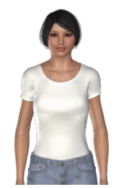
Strange interaction
But… Isn’t strange talking to the Washing Machine to prepare a tea?
Each object has an intelligence
The intelligence is hidden behind an avatar
If each object shows the same avatar, you are not talking to a WM anymore

Slide 17
Conflict Resolution
Conflicts
Many requests – single device
Single request – many devices
Many requests – many devices
Med
Discovery & Resolution
Request-level
Service-level
Provided vs influenced
Domain-level

Slide 18
Conflict Resolution
Domain
Services
Features

Slide 19
Environment design

Slide 20
Involved Actors
Expert
director of the environment
Interaction Designer
defines the behaviour of each device
Architect
controls the outfitting of the environment

Slide 21
Tool for Experts

Slide 22
Architects

Slide 23
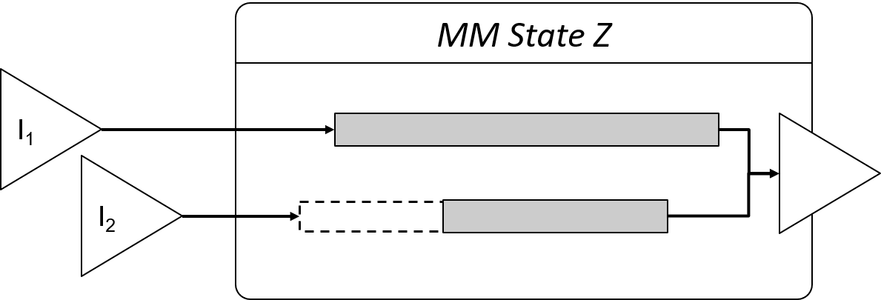
Interaction Designers
Improved statechart formalism
Translation to standard statechart
Events based on inputs data
Support for multimodal signals

Slide 24
Simulation
AI controlled characters to simulate visitors in museums
Paintings are PHASER nodes

Slide 25
Experiments and results

Slide 26
Results (home)
28 nodes
6 environments

Slide 27
Results (museum)

Slide 28
Conclusions
Ubiquitous infrastructure for HCI in Intelligent Environments
The system is scalable, reactive and fault-tolerant
PHASER works in multiple domains
Non-expert users are supported
Virtual simulated environment can be mixed with real ones

Slide 29
Production
1 journal
1 book chapter
8 international conferences
3 national conferences
In progress:
2 journal papers

Slide 30
Thank you

Slide 31
Node Definition
N=<ι, Cnf_{ι}, ClosePeers_{ι}, DiscoveredPeers_{ι}, oBC_{ι}>
Cnf: parameters, input, output, ontology details
ClosePeers: reference to remote peers with a designed connection
DiscoveredPeers: reference to remote peers with a discovered connection
oBC: Business Cards of remote peers (close and discovered)

Slide 32
Navigation Formula
Comp(s,c,n,R) = M(R,n) + Toll(s,c,n) + Friend(s,n)
Match confidence
M(R,n)∈[0,1]
Cost of environment
Toll(s,c,n)∈[0,Τ_{max}]
Friendship
Friend(s,n)∈(0,f)

