Slide 1


Luigi De Simone
Tutor: Prof. Domenico Cotroneo
XXIX Cycle - III year presentation
Dependability Benchmarking in Network Function Virtualization

Slide 2


::. Background
I received my M.Sc. in Computer Engineering (cum laude) from University of Naples Federico II
I research within the DESSERT group at DIETI
Type of fellowship: PhD student grant
DEpendable Systems and Software
Engineering Research Team
DESSERT

Slide 3
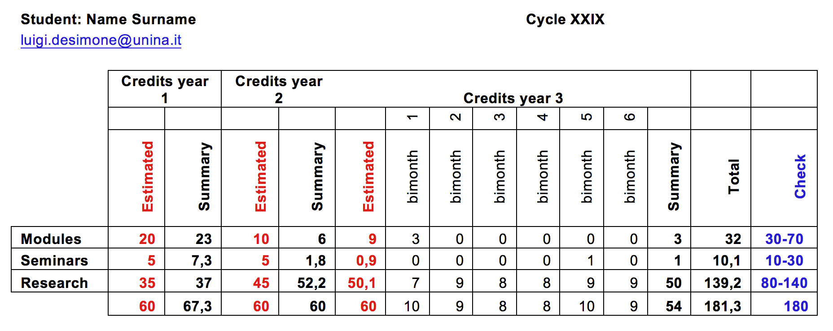
::. Credits Summary
Experience abroad: I have spent 2-months (Sep 2016 - Oct 2016) as visiting PhD student at Technische Universität Darmstadt, DEEDS group

Slide 4
::. OUTLINE
Introduction to Network Function Virtualization
Dependability Benchmarking Methodology of NFV
Fault Injection Suite and Case Study
Results and Discussion
Conclusions
Future Directions

Slide 5
Network Function Virtualization

Slide 6
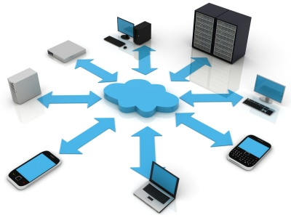
::. Traditional Network Model
Large variety of proprietary nodes and dedicated hardware appliances
Advanced Network services (Video streaming, VoIP, IPTV) to be launched faster
Specific requirements:
  High Availability (6-nines)
  High Performance
  Fast Fault Recovery
  Carrier-grade Services
Notes:
More and more etherogeneus devices connected to the network
Tablets, smartphones, PCs
Demanding services
Video streaming, IPTV, VoiceOverIP
performance, space, consumption
Needs of reducing time-to-market

Slide 7
::. Softwarization of Networks
The NFV paradigm
v
v
Traditional Network Model
Virtualized Network Model
VIRTUAL APPLIANCES
DPI
CG-NAT
GGSN/
SGSN
DPI
BRAS
BRAS
GGSN/SGSN
Firewall
PE Router
ORCHESTRATION, AUTOMATION
& REMOTE INSTALL
PE Router
Session Border Controller
STANDARD HIGH VOLUME SERVERS
Firewall
CG-NAT
Network functions implemented in software by leveraging virtualization technologies enabling
  Minimization of HW dependency
  Consolidation onto high-volume COTS HW
Notes:
Use network resource without worrying about where it is physically located, how much it is, how it is organized, etc.
Integrating multiple virtual appliances from different vendors. Network operators need to be able to “mix & match” hardware from different vendors, hypervisors from different vendors and virtual appliances from different vendors without incurring significant integration costs and avoiding lock-in.

Slide 8
::. Benefits of Network Virtualization
Traditional Network
Proprietary HW
Space and energy consuming
Network Virtualization
Reduced equipment costs and Power consumption
Less HW dependency
Network agility and flexibility
Expensive Operation
Innovation and Openness
But…
comparable Performance and Reliability?
Shifting to software
Notes:
Reduced operator CAPEX and OPEX through reduced equipment costs and reduced power consumption
Reduced time-to-market to deploy new network services
Improved return on investment from new services
Greater flexibility to scale up, scale down or evolve services
Openness to the virtual appliance market and pure software entrants
Opportunities to trial and deploy new innovative services at lower risk
Flexibility to easily, rapidly, dynamically provision and instantiate new services in various locations
Improved operational efficiency
by taking advantage of the higher uniformity of the physical network platform and its homogeneity to other support platforms.
Software-oriented innovation to rapidly prototype and test new services and generate new revenue streams
More service differentiation & customization
Reduced (OPEX) operational costs: reduced power, reduced space, improved network monitoring
IT-oriented skillset and talent
Telecom workloads have demanding requirements (99.99...% availability) and cannot afford outages

Slide 9

::. Performance and Reliability threats in NFV
Complex stack of hardware and software off-the-shelf components
  Exposure to several sources of hardware and software faults
  Lack of tools and methodologies for testing fault-tolerance
VM
MANAGEMENT
VM
VNF
Guest
OS
Guest
OS
?
NFVI
Hypervisor
Hypervisor
Virtualization
      As a result, it is hard to trust the reliability of NFV services
?
Hardware
Hardware
Hardware

Slide 10
::. Which is the best virtualization technology for NFV?
An open problem in scientific literature [1-5]
and critical in the NFV context
The best virtualization between who?
The best virtualization against what?
The best virtualization for who?
To choice the NFV elements to compare
To choice the faults more representative in NFV
To choice the more suitable metrics for the NFV stakeholders
Notes:
vari modi per fare NFV, ma si deve capire il modo migliore.....come si fa?
migliore tra chi? => cosa sto comparando? siccome nfv è variegato abbiamo stabilito metodologicanete gli elementi che hanno senso comparare. quello che abbiamo trovato è che compariamo applicati VNF e MANO, e che si inietta a livello NFVI (hypervisor, hw).
migliore rispetto a cosa? consideriamo la varietà dei guasti (hw,sw,conf)
migliore rispetto a chi? chi sono gli stackholder di chi ci dobbiamo preoccupare? (end user, architects, system administror?) => definire le metriche più adatte!
Come fare a misurare la reliability di NFV in maniera X,Y e Z,.=> in accorodo alle linee guida generale del dep. benchmarking.

Slide 11
::. Which is the best virtualization technology for NFV?
An open problem in scientific literature [1-5]
and critical in the NFV context
We need to define a methodology to identify elements, faults and measures to quantitatively assess the performance and dependability in NFV
The best virtualization between who?
The best virtualization against what?
The best virtualization for who?
To choice the NFV elements to compare
To choice the faults more representative in NFV
To choice the more suitable metrics for the NFV stakeholders
Notes:
vari modi per fare NFV, ma si deve capire il modo migliore.....come si fa?
migliore tra chi? => cosa sto comparando? siccome nfv è variegato abbiamo stabilito metodologicanete gli elementi che hanno senso comparare. quello che abbiamo trovato è che compariamo applicati VNF e MANO, e che si inietta a livello NFVI (hypervisor, hw).
migliore rispetto a cosa? consideriamo la varietà dei guasti (hw,sw,conf)
migliore rispetto a chi? chi sono gli stackholder di chi ci dobbiamo preoccupare? (end user, architects, system administror?) => definire le metriche più adatte!
Come fare a misurare la reliability di NFV in maniera X,Y e Z,.=> in accorodo alle linee guida generale del dep. benchmarking.

Slide 12
::. Contributions
Definition of a Dependability Benchmarking Methodology of NFV
A Fault Injection Tool Suite for virtualization technologies
An NFV case study on dependability benchmarking

Slide 13
Dependability Benchmarking Methodology for NFV

Slide 14
::. Dependability Benchmarking
  The goal of dependability benchmarking is to quantify the dependability properties of a computer system or component, in an automated, reproducible, portable and trustworthy way, through deliberately introduce faulty conditions in the system
  BT is the component/system under evaluation
  SUB includes the BT along with other resources (e.g., hw and sw) that are needed to run the BT
  FIT the component subjet to the injection of faults

Slide 15
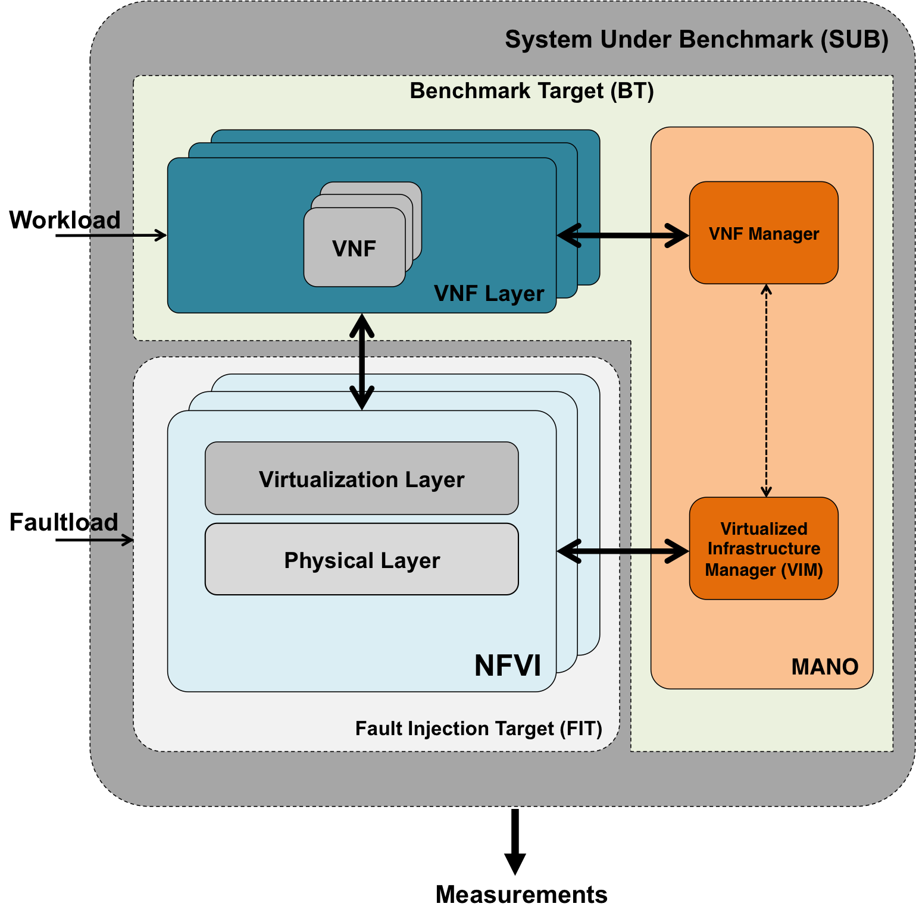
::. Benchmark elements in NFV
Benchmark Target
  VNFs, can be both open source (e.g., Clearwater IMS) and commercial (e.g., Brocade 5600 vRouter, Cisco CSR 1000v)
  MANOs, such as Openstack, Vmware HA, Docker Swarm
Fault Injection Target
  The NFVI, which includes different virtualization technologies (e.g., VMware ESXi, KVM, Xen, Docker)

Slide 16
::. The Methodology
Definition of workload, faultload, and metrics
Fault Injection Experiments
Computation of metrics and reporting
Deployment of VNFs over the NFVI
Workload and VNFs execution
Data collection
Testbed clean-up
...
...
Injection of the i-th fault

Slide 17
::. Benchmark measures
The measures represent the main feedback provided to the benchmark user
Service-level (VNF) measures, which characterize the quality of service as it is perceived by VNF users, including measures of performance and availability of the VNF services
Infrastructure-level (NFVI) measures, which characterize the NFVI in terms of its ability to detect and to handle faulty conditions caused by hardware and software components inside the infrastructure

Slide 18
::. Service-level measures: VNF Latency and Throughput
End points
t^{request}
VNF
End points
End points
VNF
VNF
t^{response}
VNF
Virtualization Layer
Off-The-Shelf hardware and software
Fault Injection
VNF Latency:
the time required to process a unit of traffic (such as a packet or a service request)
VNF Throughput:
the rate of processed traffic (packets or service requests) per second

Slide 19
::. Service-level measures: VNF Unavailability
Requests/s
Request Rate (INPUT)
Throughput (OUTPUT)
Service available
QoS Threshold
0
Time
Service unavailable

Slide 20
::. NFV Fault Management
NFVI
Failover
Virtual Node
Virtual Node
Fault Notifications
VNF
VNF
Data/control flow checks
Virtualization Infrastructure Manager
Re-
config
Watchdog
NFV Management & Orchestration
Performance monitor
Data/control flow checks
Virt. Layer
Virt. Layer
Watchdog
Heartbeats
Hardware
Hardware
Faults
Health Checks
Notes:
Fault Detection include mechanisms (e.g., heartbeats and watchdogs) that notice a faulty component (such as a VM or a physical device) as soon as a fault occurs, in order to timely start the fault management process
Fault Recovery include mechanisms a recovery action to mitigate a faulty component. Examples of recovery actions for NFVIs include VM/container migration on healthy nodes, by leveraging virtualization technologies, or VM/container restart

Slide 21
::. Metrics summary in NFV
Requests/s
Request Rate (INPUT)
Throughput (OUTPUT)
Fault Detection
Latency
Fault Recovery
Latency
Service available
QoS Threshold
0
Time
ΔT1
ΔT2
ΔT3
Unavailability measure = ΔT1 + ΔT2 + ΔT3

Slide 22
::. The Fault Model
The Fault Model consists of a set of faults and exceptional conditions (i.e., hardware, software, and operator faults) that are injected to emulate the real threats the system would experience during operation
We define a fault model for the four domains (virtual and physical) of the NFV framework: CPU and Memory, and Network and Storage subsystems
Three general fault types
  Unavailability (the resource becomes unresponsive and unusable)
  Delay (the resource is overcommitted and slowed-down)
  Corruption (the information stored or processed by the resource is invalid)
Notes:
Hardware Faults: the use of Commercial Off-The-Shelf (COTS) hardware is a potential source of faults in the NFVI, since they have not been designed for carrier-grade requirements
Software Faults: NFVI reuse COTS software components at various levels of the virtualization stack (e.g., hypervisors, guest OSes, management and orchestration software, middleware, and third-party VNF software
Operator Faults: the complexity and the large scale of virtualization infrastructures expose them to human mistakes during operations and configuration.

Slide 23
::. CPU and Memory Fault Model
 |  | Root cause | Fault/Error to be injected | Applicable to
Physical CPU | Unavailability | Physical CPU permanently broken [hw.] | Physical CPU disabled | Physical machines
 | Delay | Physical machine is overloaded [op., sw.] | CPU hog in the virtualization layer context
 | Corruption | Electromagn. interferences, virtualization layer bugs [hw., ] | CPU register corruption in the virtualization layer context
Virtual CPU | Unavailability | Insufficient capay planning [op., ] | Virtual CPU disabled | Virtual Nodes
 | Delay | Virtual machine is overloaded [op., sw., ] | CPU hog in Virtual Node context
 | Corruption | EMIs, virtualization layer bugs [sw., hw., ] | CPU register corruption in Virtual Node context
Physical memory | Unavailability | Physical memory bank permanently broken [hw., ] | Physical memory bank disabled | Physical Node
 | Delay | Virtual machine is overloaded [op., sw., ] | Memory hog in the virtualization layer context
 | Corruption | Elecromagn. interferences, virtualization layer bugs [hw., sw., ] | Memory page corruption in the virtualization layer context
Virtual memory | Unavailability | Insufficient capay planning [op., ] | Virtual Node memory is preempted by the the virtualization layer | Virtual Nodes
 | Delay | Virtual machine is overloaded [op., sw., ] | Memory hog in the virtualization layer context
 | Corruption | Elecromagn. interferences, virtualization layer bugs [hw., sw., ] | Memory page corruption in Virtual Node context

Slide 24
::. Network and Storage Fault Model
 |  | Root cause | Fault/Error to be injected | Applicable to
Physical network | Unavailability | NIC or network cable permanently broken [hw., ] | Physical NIC interface disabled | Physical machines (individual end-point), physical switches (multiple end-points)
 | Delay | Network link saturated [op., ] | Network frames delayed on physical NIC
 | Corruption | Elecromagn. interferences, virtualization layer bugs [hw., sw., ] | Network frames corrupted on physical NIC
Virtual network | Unavailability | Misconfiguration [op., ] | Virtual NIC interface disabled | Virtual Node (individual end-point), virtual switches (multiple end-points)
 | Delay | The virtualization layer is overloaded [op., sw., ] | Network frames delayed on virtual NIC
 | Corruption | Elecromagn. interferences, virtualization layer bugs [hw., sw., ] | Network frames corrupted on virtual NIC
Physical storage | Unavailability | HBA or storage cable permanently broken [hw., ] | Physical HBA interface disabled | Physical machines (individual end-point), physical disks (multiple end-points)
 | Delay | Storage link saturated [op., ] | Physical storage I/O delayed
 | Corruption | Elecromagn. interferences, virtualization layer bugs [hw., sw., ] | Physical storage I/O corrupted
Virtual storage | Unavailability | Misconfiguration [op., ] | Virtual HBA interface disabled | Virtual Node (individual end-point), virtual disks (multiple end-points)
 | Delay | The virtualization layer is overloaded [op., sw., ] | Virtual storage delayed
 | Corruption | Elecromagn. interferences, virtualization layer bugs [hw., sw., ] | Virtual storage corrupted

Slide 25
::. NFV Workload
The VNFs should be exercised using a representative workload
The proposed dependability benchmarking methodology is not tied to a specific choice of the workload
Realistic workloads can be generated using load testing and performance benchmarking tools (e.g., Netperf)

Slide 26
Fault Injection Suite and
Case Study

Slide 27
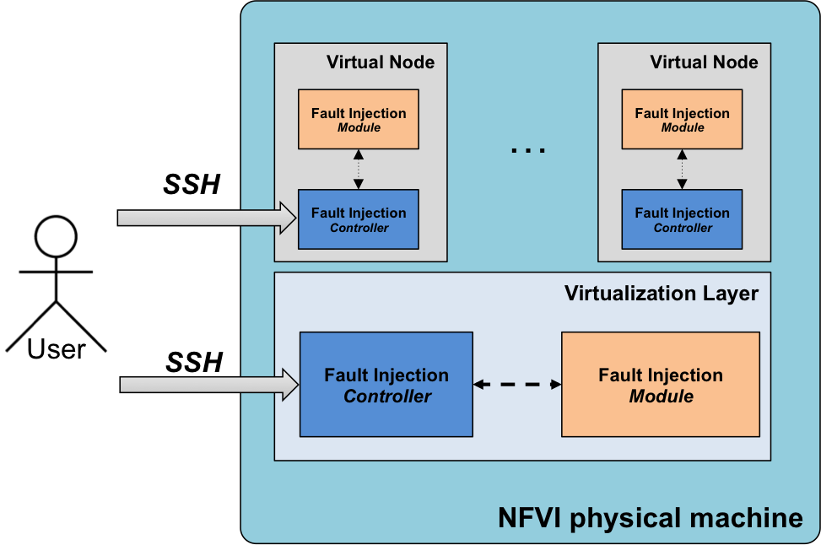
::. Fault Injection Tool Suite
Injection Config:
Inject CPU
Inject MEMORY
Inject NETWORK
Inject STORAGE
Notes:
• Fault Injection Controllers. These user space programs can be di- rectly invoked by the user, for instance through an ssh session. Each of these tools controls the injection of a specific type of faults. For instance, one of the tools controls the injection of network faults, while another tool tools controls the injection of storage faults. In turn, these tools interact with other kernel-space tools running in the virtualization layer and in the virtual nodes;
• Fault Injection Modules. These programs can be both kernel modules and user space programs, and perform the actual fault injection both for the physical layer and virtual layer 3.1, implementing all the host- level faults and guest-level faults.

Slide 28
::. Fault Injection Internals
Physical Host
Virtual Node
Virtual Node
Fault Injection
Controller
Wrapped device driver
Wrapped device driver
Virtualization Layer
Network/Storage subsystem
1a: An I/O req. is sent by the ESXi host to the network
Wrapped
device driver
2: The incoming/outgoing I/O is dropped, corrupted, or delayed by the injector, instead of delivering it to the intended recipient
Device driver
1b: An I/O response is sent by the network to the Virtualization Layer
Physical adapter

Slide 29



::. Case study
Clearwater an open-source
NFV-oriented implementation
of IP Multimedia Subsystem (IMS)
We consider two different virtualization technologies
  Hypervisor-based commercial virtualization solution platform, i.e., the VMware ESXi hypervisor
  Container-based solution, i.e., the Docker containers
We use SIPp to generate SIP call set-up requests

Slide 30
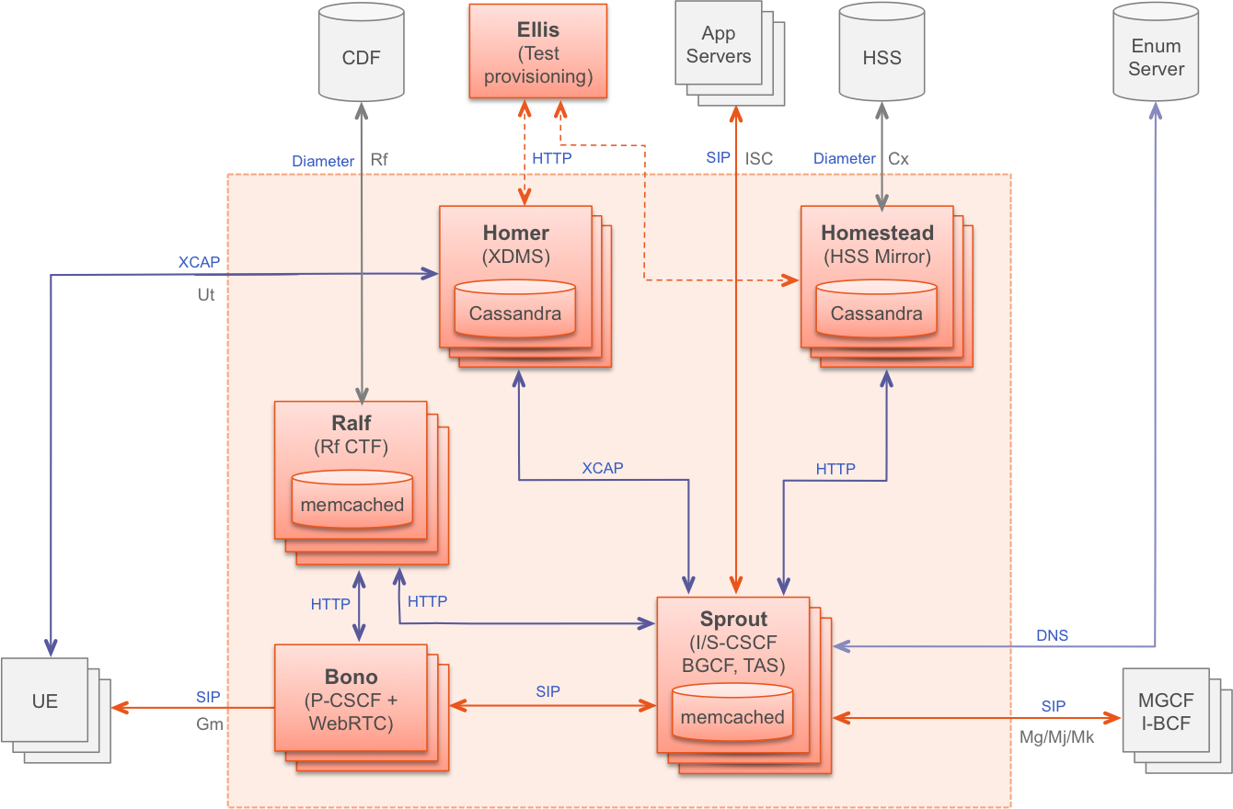
::. Clearwater IMS
Notes:
- Bono: the SIP edge proxy, which provides both SIP IMS Gm and WebRTC interfaces to clients.
• Sprout: the SIP registrar and authoritative routing proxy, and handles client authentication.
• Homestead: component for retrieving authentication credentials and user profile information.
• Homer: XML Document Management Server that stores service settings for each user.
• Ralf : component that provides billing services.

Slide 31
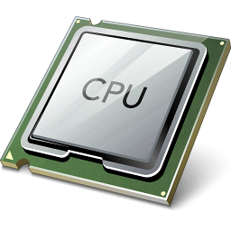
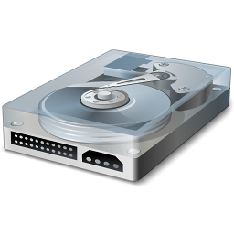

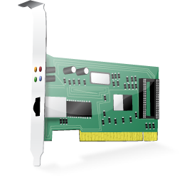
::. Hypervisor-based vs Container-based
Virtual Machine
Docker Container
Apps
Apps
Bins/Libs
Bins/Libs
Isolates guest OS from other guests and from the host
Completely abstracts HW resources to the guest
The host OS kernel is enhanced with capabilities to execute apps with own CPU, memory, filesystem, network
Operating Systems
VMware ESXi
(Hypervisor)
Operating System
CPU
Storage
Memory
Network
Physical resources
Notes:
ISOLATION mean TEMPORAL ISOLATION and MEMORY ISOLATION

Slide 32
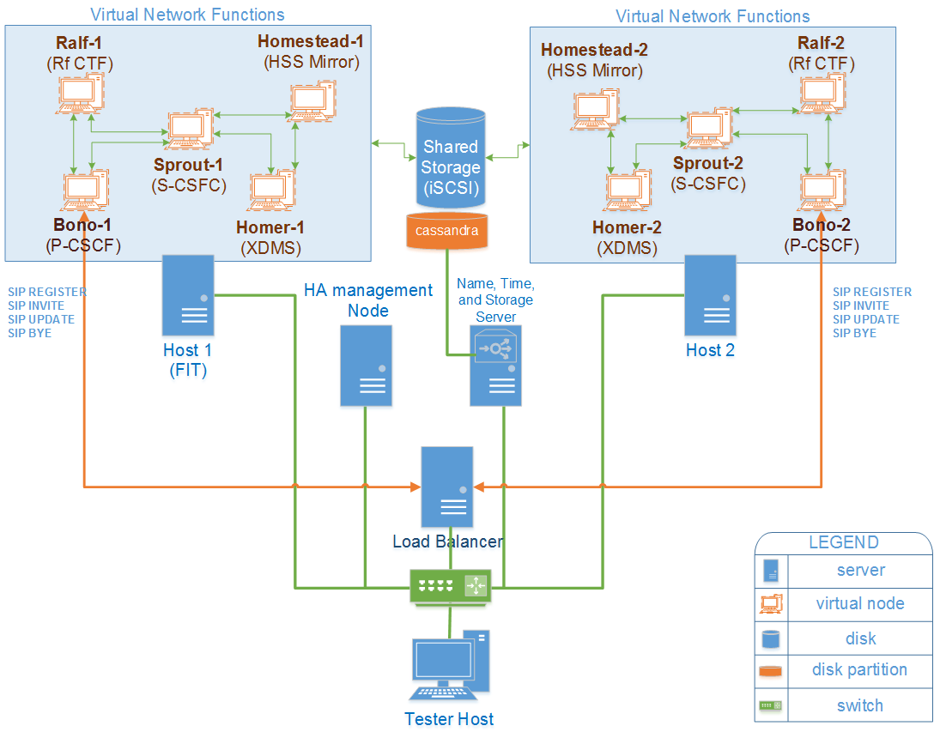
::. The Testbed

Slide 33
Results and Discussion

Slide 34
Physical Layer VMware ESXi
In ESXi the host crash and the HA mechanism migrates all the VM on the healthy host
In Docker, the host does not crash, and the HA mechanisms does not trigger any migration
ESXi is very sensible to network and storage disruption, because the infrastructure heavily rely on hearbeats between hosts and datastores
Docker shows lower memory isolation as we expect
Physical Layer Docker
Notes:
CPU_CORRUPT: In Docker l'host non crash ma rimane unavailable. Swarm in questo caso non migra, quindi unvailability è alta.
NET e STO per ESXI è molto sensibile dovuto al fatto che la gestione dei vari datastore e dei meccanismi di HA sono molto complessi in ESXi

Slide 35
Physical Layer VMware ESXi
Physical Layer Docker

Slide 36
Physical Layer VMware ESXi
Physical Layer Docker

Slide 37
Virtual Layer (HOMESTEAD)
VMware ESXi
ESXi and Docker implement network stack differently, and ESXi shows more weakness than Linux kernel
Docker is faster than ESXi to detect and migrate correctly the virtual node
Also in Virtual Layer is confirmed the worst memory isolation for Docker containers compared to VM
In the VM, the delay faults impacts also on root filesystem differently from Docker
Virtual Layer (HOMESTEAD)
Docker
Notes:
CPU UNAVAILABILITY: Docker è più veloce a migrare container che ESXi a migrare VM.
Per MEM si conferma la poca isolation in DOCKER
Per NET_DELAY: "LinNet: map_pkt_to_skb:2069: This message has repeated 93 times: vmnic0: dropping packet due to parsing failure". La funzione map_pkt_to_skb è utilizzata durante la trasmissione di un pacchetto nel sottosistema che virtualizza la rete per le VM. DIFFERENZE DI IMPLEMENTAZIONE DELLA RETE

Slide 38
Virtual Layer (HOMESTEAD)
VMware ESXi
Virtual Layer (HOMESTEAD)
Docker

Slide 39
Virtual Layer (HOMESTEAD)
VMware ESXi
Virtual Layer (HOMESTEAD)
Docker

Slide 40
Virtual Layer (SPROUT)
VMware ESXi
Also for Sprout node is confirmed that ESXi and Docker implement network stack differently, and ESXi shows more weakness than Linux kernel
In Docker, Sprout node processes are unable to restart after seg fault
In ESXi, the corruption of Sprout is detected, thus the VM is restarted
Also for Sprout node is confirmed the worst memory isolation for Docker containers compared to VM
Virtual Layer (SPROUT)
Docker
N.B: NO SHARED STORAGE IN SPROUT
Notes:
CPU CORRUPTION: sembra che sprout rispetto ad homestead sia molto più sensibile ai failure di corruption CPU. questo sembra perchè corrompendo l'eip chronos non si ripiglia più. INVECE IN ESXI VM SPROUT , vcenter si accorge della corruzione e riavvia la VM.

Slide 41
Virtual Layer (SPROUT)
VMware ESXi
Virtual Layer (SPROUT)
Docker
N.B: NO SHARED STORAGE IN SPROUT

Slide 42
Virtual Layer (SPROUT)
VMware ESXi
Virtual Layer (SPROUT)
Docker
N.B: NO SHARED STORAGE IN SPROUT

Slide 43
::. Conclusions
Which is the best virtualization technology for NFV?
  In the most answers in engineering, it depends! ☺
  The carrier-grade requirement should be ensured whatever virtualization is intended to be used
New challenges introduced by leveraging the virtualization to deploy network infrastructures with NFV
  Expected behaviors in NFV can be completely different from the legacy networks, in terms of provided performance and reliability due to fault management mechanisms, dependence on storage subsystem, and virtualization layer faults
Developing fault injection tools is hard in complex software systems, and it needs to be carefully planned in the context of NFV
  Developers can reuse the methodology to benchmark new releases or even different VNFs, and MANOs technologies
Notes:
Possiamo rispondere a quale virtualizzazione è migliore? in realtà dipende dal workload, dipende dalla tipologia di faullt....anche che le best practitces non fullgillono i requisiti
2) challenge dovute proprio al deploy di NFV sulle tecnologie di virtualizzazione, soprattutto i comporatmenti attesi non sono attesi.....poichè ci sono comportamente inattesi implemtate fault inejction è oneroso ed è un investimento da pianificare bene....una volta fatto, ci da gli insight visti sopra, e inoltre con un effort gestibile si può realizzare la metodologia...e quindi riusarlo per release future, cambiare vnf, mano, e tecnologie di virtualizzazione. nelle challenge inserire il fatto dell'aging di HA, delle corruzioni dello storage condiviso e dell'hypervisor, del tuning dei meccanismi di fault management. Un contributo utile è anche l'effort necessario per riusare lo stesso testbed (sia per Docker sia per VMware), il design dei tool....
Performance and availability are critical concerns for NFV
NFVIs are very complex, and making design choices is difficult
We proposed a dependability benchmarking methodology useful to point out dependability issues and to guide designers
Future work will extend the evaluation to alternative virtualization technologies

Slide 44
::. Future Directions
Apply the methodology within other virtualization technologies for benchmarking (e.g., kvm, Xen, LXC), and other approaches for software virtualization, such as unikernels
Consider hw and sw network acceleration technologies (e.g., Intel DPDK, 6Wind virtual accelerator) which will be largely used in NFV deployments
Software Defined Networking (SDN) is complementary to the NFV paradigm and it must be considered achieve carrier-grade services
Adoption of the proposed methodology in production for NFV deployments
Notes:
Specificando gli sviluppi futuri, bisogna considerare tutto il mondo relativo ai microservices (unikernel per esempio), ecc.....
L'utilizzo in production della metodologia.....come farlo a declinare nel contesto NFV? FAULT INJECTION IN PRODUCTION e’ GIA’ DI PER SE DIFFICILE!!!!!!!

Slide 45
::. Products
Conference Paper
De Simone, L., "Towards Fault Propagation Analysis in Cloud Computing Ecosystems," Software Reliability Engineering Workshops (ISSREW), 2014 IEEE International Symposium on , pp.156,161, 3-6 Nov. 2014, DOI: 10.1109/ISSREW.2014.47
BEST PRESENTATION AWARD
Cotroneo, D.; De Simone, L.; Iannillo, A.K.; Lanzaro, A.; Natella, R.; Jiang Fan; Wang Ping, "Network Function Virtualization: Challenges and Directions for Reliability Assurance," Software Reliability Engineering Workshops (ISSREW), 2014 IEEE International Symposium on , pp.37,42, 3-6 Nov. 2014, DOI: 10.1109/ISSREW.2014.48
Cotroneo, D.; De Simone, L.; Iannillo, A.K.; Lanzaro, A.; Natella, R., "Improving Usability of Fault Injection," Software Reliability Engineering Workshops (ISSREW), 2014 IEEE International Symposium on, pp.530,532, 3-6 Nov. 2014, DOI: 10.1109/ISSREW.2014.37

Slide 46
::. Products
Domenico Cotroneo, Luigi De Simone, Antonio Ken Iannillo, Anna Lanzaro, Roberto Natella, “Dependability Evaluation and Benchmarking of Network Function Virtualization Infrastructures”, at 1st IEEE Conference on Network Softwarization (NetSoft), pp. 1 – 9, 13-17 April 2015 London, DOI: 10.1109/NETSOFT.2015.7116123
BEST PAPER AWARD
Domenico Cotroneo, Luigi De Simone, Francesco Fucci, Roberto Natella, “MoIO: Run-time monitoring for I/O protocol violations in storage device drivers”, at Software Reliability Engineering (ISSRE), 2015 IEEE 26th International Symposium on, pp. 472 – 483, 2-5 Nov. 2015 Gaithersbury, MD, DOI: 10.1109/ISSRE.2015.7381840
Journal Paper
Domenico Cotroneo, Luigi De Simone, Roberto Natella, “NFV-Bench: A Dependability Benchmark for Network Function Virtualization Services”, IEEE Transaction on TBD, IN PREPARATION

Slide 47
::. References
[1] Ju et al. “On fault resilience of OpenStack”. SOCC ’13
[2] Gunawi et al. ”FATE and DESTINI: a framework for cloud recovery testing”. NSDI ‘11
[3] Joshi et al. “PREFAIL”. OOPSLA ’11
[4] Pham et al. “CloudVal: A framework for validation of virtualization environment in cloud infrastructure”. DSN ’11
[5] Le et al. “Fault injection in virtualized systems—challenges and applications” IEEE Trans. on DSC 2015
[6] Le et al. “Rehype: Enabling vm survival across hypervisor failures”. ACM SIGPLAN 2011
[7] Amit et al. “Virtual cpu validation”. SOSP 2015

Slide 48
Thanks!

Slide 49
Q & A

Slide 50
::. Backup Slides

Slide 51
::. NFV Architecture

Slide 52
::. Telcos’ Perspective
Telcos and Service Providers have to deliver services aiming at
  Increasing speed of Time-to-Market
  Reducing OPEX and CAPEX
  Lowering costs of proprietary hardware
  Increasing the agility of the network to respond to dynamic requirements
  Faster development cycles

Slide 53
::. Hypervisor-based virtualization
Full Virtualization in which the hypervisor (or VMM) completely isolates the guest OS and completely abstracts hardware resources to the guest
  Emulate privileged CPU instructions and I/O operations
  Multiplex resources between concurrent VMs
  Examples of hypervisors with full virtualization are VMware ESXi, KVM, and Microsoft Hyper-V
Para Virtualization in which the guest OS is aware that it is running in a VM
  Guest OSs are modified to communicate directly with the hypervisor (via a system call mechanism called hypercalls) to achieve better performance
  An example of hypervisor with paravirtualization is Xen

Slide 54
::. Container-based Virtualization
Container-based Virtualization, also known OS-level virtualization, leverages host OS kernel capabilities to execute appliances in isolated domains (or container) with own
  virtual CPU (precisely physical CPU quotas)
  virtual memory (like in traditional OS processes)
  virtual filesystem (i.e., the container perceives a filesystem structure that is different than the host’s)
  virtual network (i.e., the container sees a different set of networking interfaces)
  IPC, PIDs, and users management
Examples of container-based virtualization technologies are Docker, OpenVZ, LXC

