Slide 1


Pasquale De Falco
Tutor: Guido Carpinelli
XXX Cycle - I year presentation
Advanced Probabilistic Methods and Indices for Forecasting the Generation of Renewable Power and Energy Demand

Slide 2

Background
  Graduated in Electrical Engineering, University of Naples “Federico II” with thesis on “Probabilistic methods and indices for forecasting the generation of wind and photovoltaic plants”
  Research group: Power systems (DIETI – UNINA)
  Fellowship funded by MIUR

Slide 3
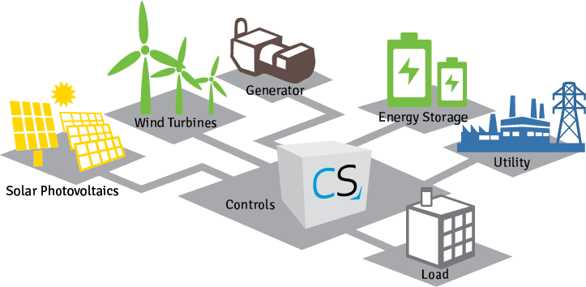
The problem
  The accurate short-term forecasting of renewable energy sources and load demand for the optimal management of Smart Grids, supporting the rational use of electrical energy from a technical, economic and environment-friendly point of view

Slide 4
Research Activity
  Advanced Probabilistic Methods and Indices for Forecasting the Generation of Renewable Power and Energy Demand
Classical deterministic methods
Classical probabilistic methods
Traditional indices
Artificial neural networks
Time series models
Numeric Weather Prediction
Quantile regression
Parametric forecasting
Markov-switching time series
Spot value indices
Sharpness and reliability meters
New probabilistic forecasting methods
New economic indices
Bayesian Inference models
Probabilistic cost-based indices
Probabilistic penality-based indices

Slide 5

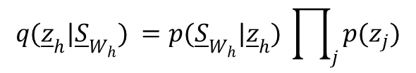
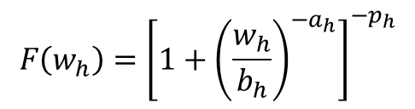
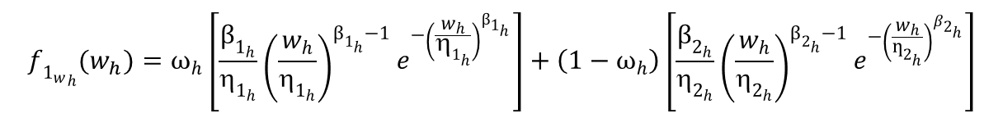
Research Activity
Bayesian Inference models
$$f_{{1_{w}}_{h}}(w_{h})=ω_{h}\left[\frac{β_{1_{h}}}{_{1_{h}}}{\left(\frac{w_{h}}{_{1_{h}}}\right)}^{β_{1_{h}}−1}e^{−{\left(\frac{w_{h}}{_{1_{h}}}\right)}^{β_{1_{h}}}}\right]+\left(1−ω_{h}\right)\left[\frac{β_{2_{h}}}{_{2_{h}}}{\left(\frac{w_{h}}{_{2_{h}}}\right)}^{β_{2_{h}}−1}e^{−{\left(\frac{w_{h}}{ƞ_{2_{h}}}\right)}^{β_{2_{h}}}}\right]$$
$${F\left(w_{h}\right)=\left[1+{\left(\frac{w_{h}}{b_{h}}\right)}^{−a_{h}}\right]}^{−p_{h}}$$
Quantiles estimation
Reliability analysis
Risk assessment
Economic evaluation for market participation
Measurement Dataset
BAYESIAN INFERENCE
$${\underline{S}}_{W_{h}}=\{w_{h−k−M+1}, ... , w_{h−k}\}$$
$$q({\underline{z}}_{h}|{\underline{S}}_{W_{h}}) =p({\underline{S}}_{W_{h}}|{\underline{z}}_{h}) \prod_{j}{p(z_{j})}$$
Monte Carlo Markov Chain

Slide 6
Research Activity
Some numerical results
Index | Forecasting Method
 | Proposed Method |  | Reference Method
 | B-MWB-1 | B-MWB-2 | PPM
NMAE (%) | 9.48 | 9.13 | 12.56
NRMSE (%) | 15.37 | 14.97 | 17.96
NCRPS (%) | 5.69 | 5.51 | 8.19

Slide 7
Products
Journal papers
A. Bracale, P. De Falco. “An Advanced Bayesian Method for Short-Term Probabilistic Forecasting of the Generation of Wind Power”, Special Issue on Forecasting Methods and Measurements of Forecasting Errors for Renewable Energy Sources, Energies, vol. 8, 2015.
Conference papers
L. Alfieri, A. Bracale, P. De Falco, M. Aprea. “On the comparison among optimal measurement placement methods for a hybrid micro grid harmonic state estimation. Part I: theoretical aspect”, 3rd International Symposium on Energy Challenges and Mechanics, Aberdeen, UK, 7-9 July, 2015.
L. Alfieri, A. Bracale, P. De Falco, M. Aprea. “On the comparison among optimal measurement placement methods for a hybrid micro grid harmonic state estimation. Part II: numerical applications”, 3rd International Symposium on Energy Challenges and Mechanics, Aberdeen, UK, 7-9 July, 2015.
Papers in preparation or waiting for approval
A. Bracale, G. Carpinelli, P. De Falco, R. Rizzo, A. Russo. “New Advanced Method and Cost-based Indices Applied to Probabilistic Forecasting of Photovoltaic Generation”.
A. Bracale, G. Carpinelli, P. De Falco. “A Bayesian-based approach for the short-term forecasting of electrical loads in power systems”.

Slide 8
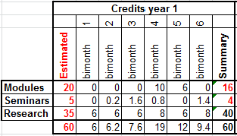
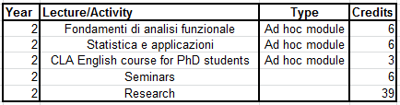
Next years
    I year credits
Next research activities:
advanced probabilistic methods for the probabilistic forecasting of photovoltaic, wind and load powers
characterization of extreme values of wind speed, from both mechanical and electrical reliability point of view
new non-linear approaches for the dynamic harmonic state estimation in smart grids
    Expected II year credits

Slide 9
Thanks for your attention!

