Slide 1


Domenico A.G. Dell’Aglio
Tutor: Prof. Antonio Iodice
XXXII Cycle - I year presentation
An efficient SAR raw signals simulator for any acquisition mode

Slide 2

My background
    Master Degree in Telecommunications Engineering at University of Naples “Federico II”
    Electromagnetic Fields and Remote Sensing Research Group
    Type of fellowship: from University of Naples “Federico II” without grant

Slide 3
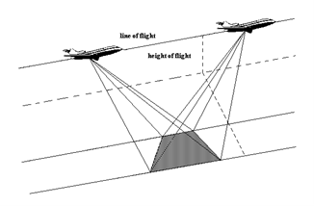
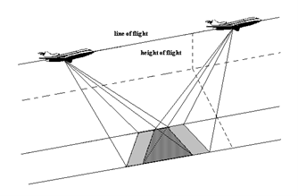
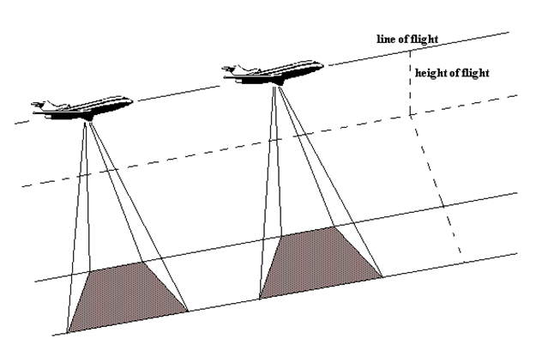
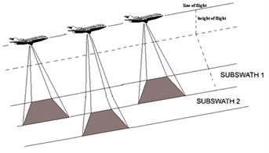
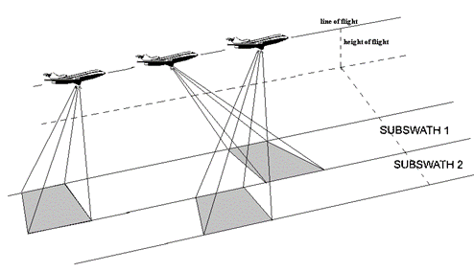
SAR Acquisition Modes
Spotlight
Sliding-Spotlight
Stripmap
ScanSAR
TOPSAR

Slide 4
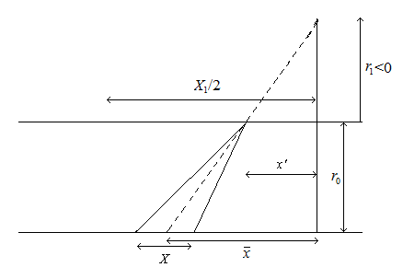
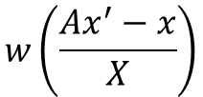



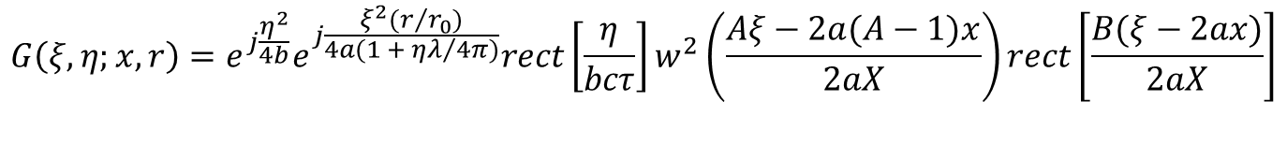

A unified formulation
$$A=\frac{r_{1}−r_{0}}{r_{1}}$$
$$ω_{a}=\frac{v}{r_{0}}(1−A)$$
$$w\left(\frac{Ax^{′}−x}{X}\right)$$
$$v_{f}=Av$$
$$\overline{x}=Ax′$$
$$g\left(x^{′},r^{′}−r;x,r\right)=e^{−j\frac{4π}{λ}ΔR}e^{−j\frac{4π}{λ}\frac{{Δf}/f}{cτ}{(r^{′}−r−ΔR)}^{2}}rect\left[\frac{r^{′}−r−ΔR}{{cτ}/2}\right]w^{2}\left(\frac{Ax^{′}−x}{X}\right)rect\left[\frac{x′}{X_{1}}\right]$$
$$G\left(ξ,η;x,r\right)=e^{j\frac{η^{2}}{4b}}e^{j\frac{ξ^{2}(r/{r_{0}})}{4a(1 + {ηλ}/{4π})}}rect\left[\frac{η}{bcτ}\right]w^{2}\left(\frac{Aξ−2a(A−1)x}{2aX}\right)rect\left[\frac{B(ξ−2ax)}{2aX}\right]$$

Slide 5
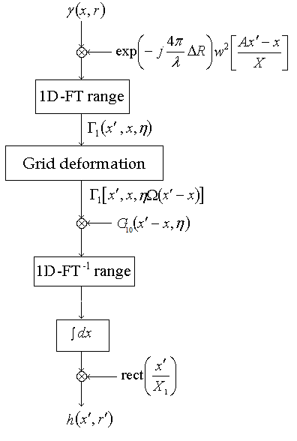
Algorithm and system parameters

Slide 6
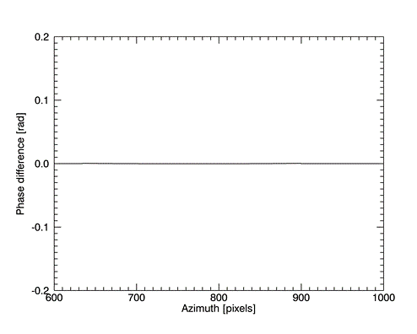
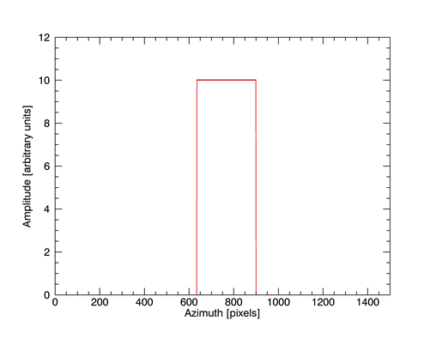
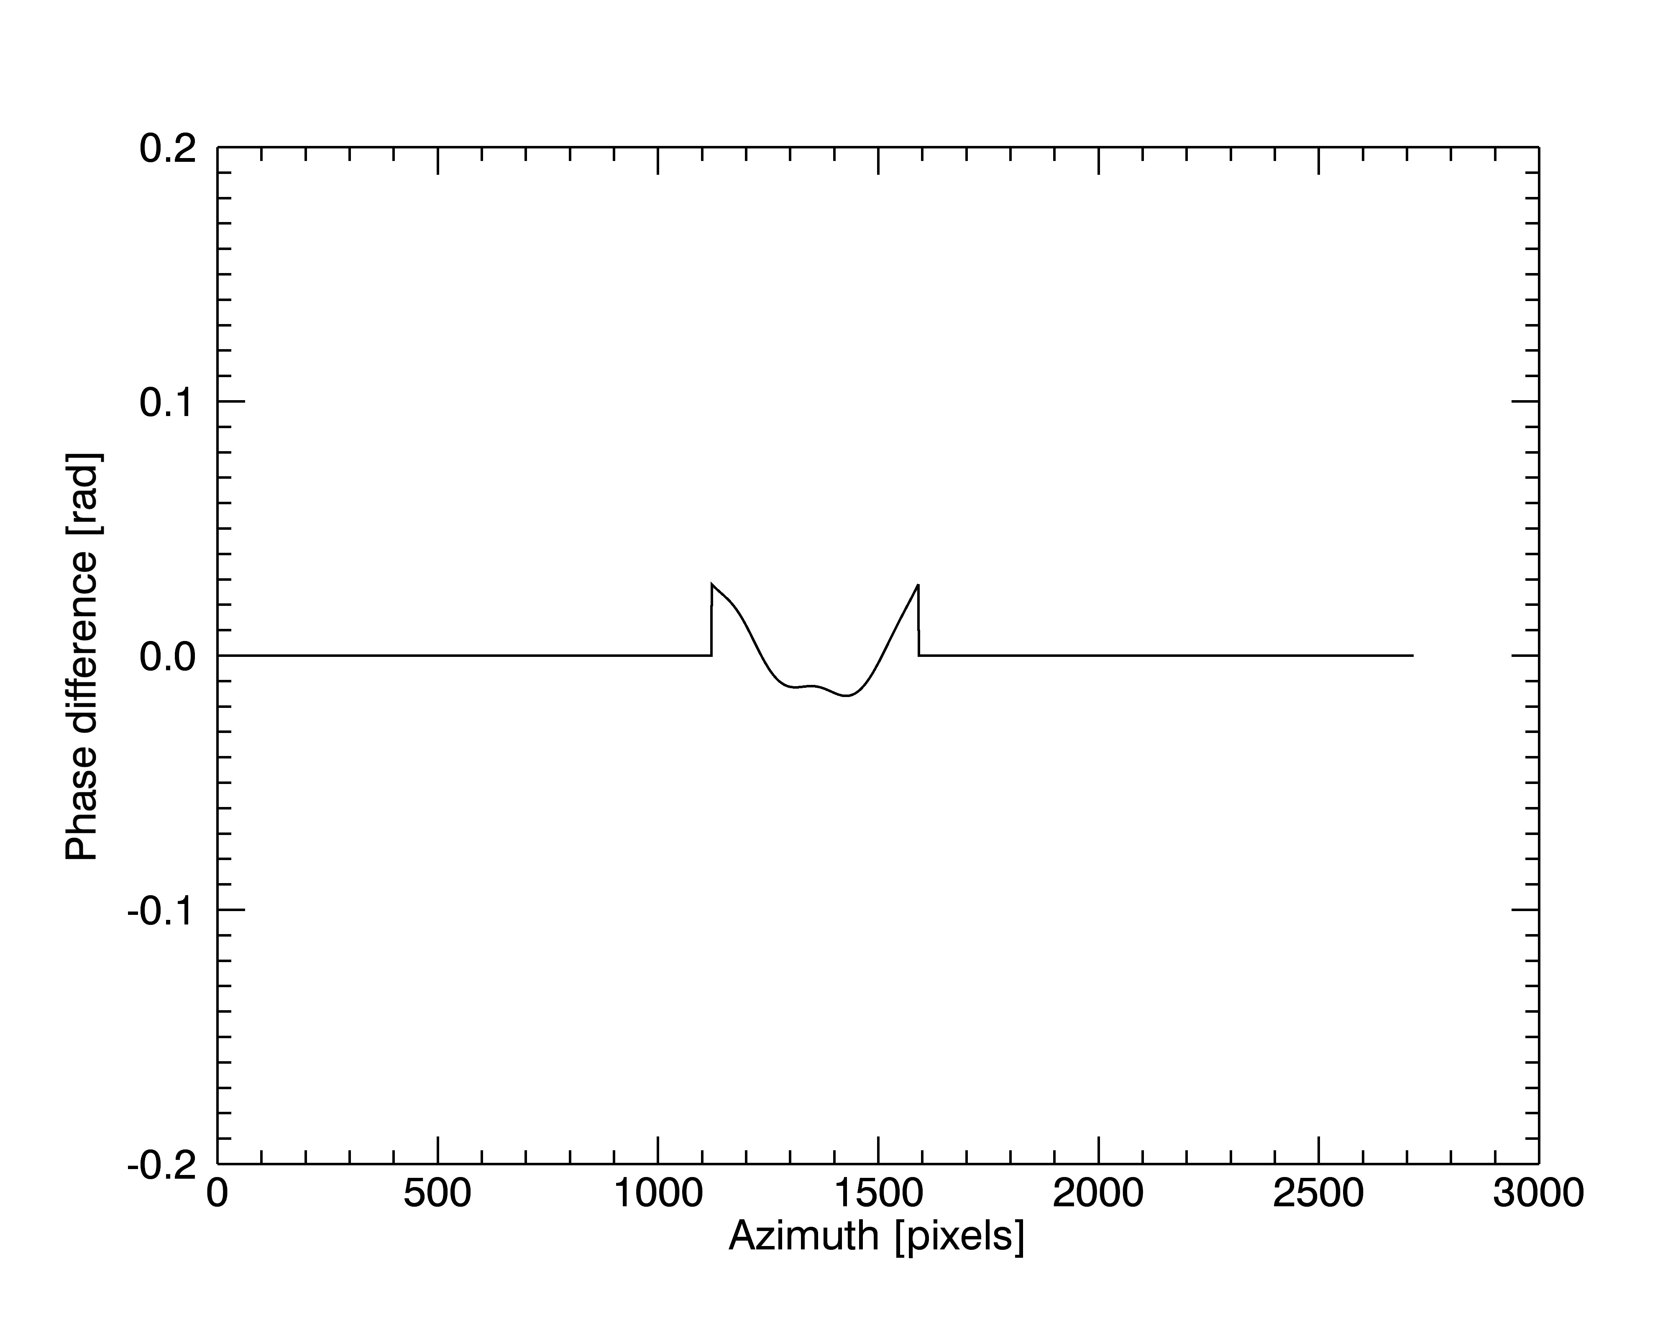
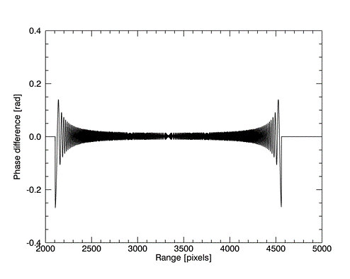
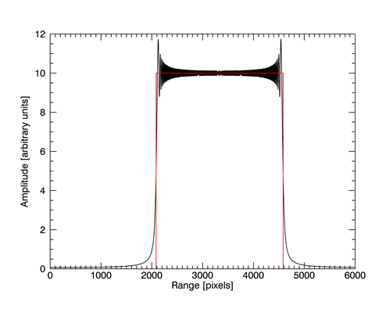
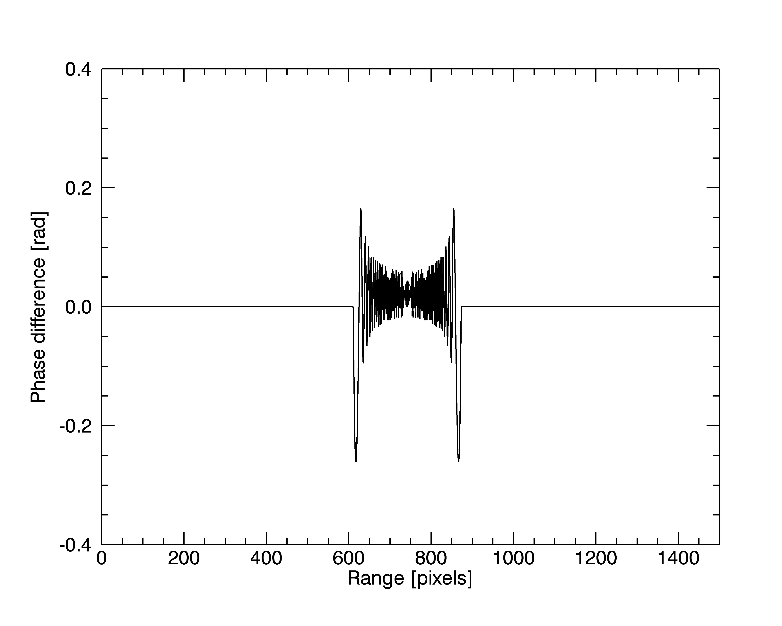
Results for TOPSAR mode 1/2

Slide 7
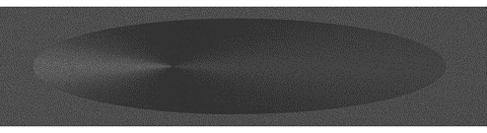
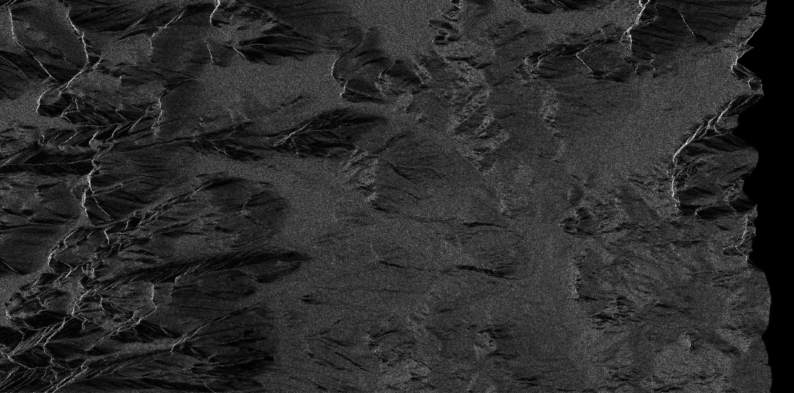
Results for TOPSAR mode 2/2
Amplitude image obtained by focusing a simulated raw signal of a canonical extended scene constituted by a cone over a flat plane.
Amplitude image obtained by focusing a simulated raw signal of the Apennines area in Campania, Italy. A multilook of 2 has been applied in the range direction to obtain an almost square pixel.

Slide 8
My products
    “A Unified Formulation of SAR Raw Signals from Extended Scenes for All Acquisition Modes” submitted on IEEE Transactions on Geoscience and Remote Sensing
    “Efficient Simulation of Extended-Scene SAR Raw Signals with Any Acquisition Mode” submitted on IGARSS 2018

Slide 9
Towards the second year

