Slide 1
Ph.D. presentation Analysis and Control of Piecewise-Smooth Systems and Networks
Sincronizzazione e Controllo di Reti e Processi
Marco Coraggio
Tutor: Mario di Bernardo Ph.D. in Information Technology and Electrical Engineering
University of Naples Federico II, 12 February 2020

Slide 2
Summary of my activities
1

Slide 3
Genearal Information
M. Sc. in Automation engineering in 2016.
PhD specialised in Control Theory scholarship from University (borsa di ateneo).
3 months at Uni. of Calif. Santa Barbara with Prof. Francesco Bullo and Dr. Saber Jafarpour.
Research products:
2 journal papers (+1 submitted),
3 conference papers,
4 keynotes at conferences.
Credits
Area | Year 1 | Year 2 | Year 3 | Total
Courses | 28.5 | 8 | 0 | 36.5
Seminars | 3.9 | 5.8 | 4.3 | 14
Research | 27.6 | 46.2 | 55.7 | 129.5

Slide 4
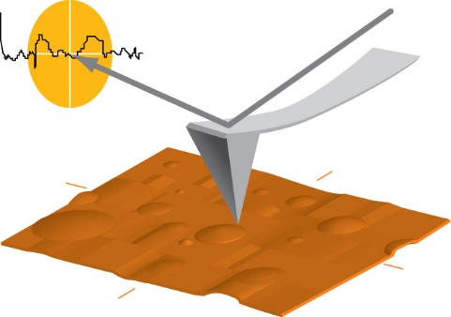
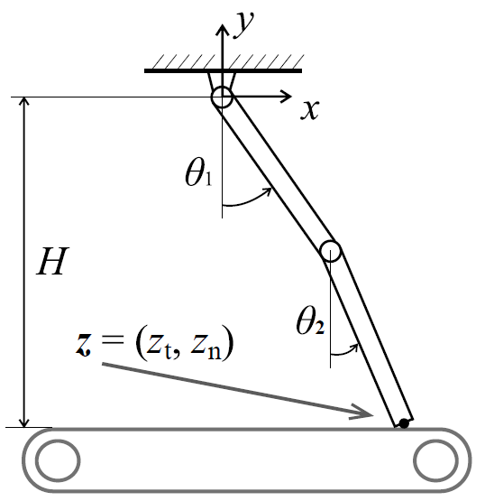
My work
Control of atomic force microscope
Control of oscillations in landing gears
in a robotic arm
Observer design of piecewise-smooth systems

Slide 5
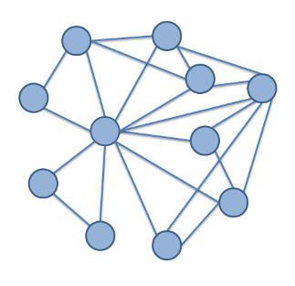
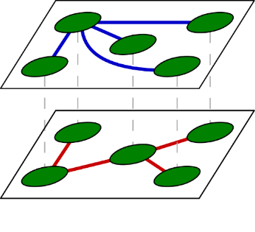
My work
Synchronization of non-identical systems
Synchronization of piecewise-smooth systems
Improving robustness in electrical microgrids

Slide 6
Publications
Journal papers:
[submitted] Coraggio, De Lellis, di Bernardo, “Achieving Convergence and Synchronization in Networks of Piecewise-Smooth Systems via Distributed Discontinuous Coupling”, submitted to Automatica, 2019.
Coraggio, De Lellis, Hogan, and di Bernardo, “Synchronization of Networks of Piecewise-Smooth Systems”, IEEE Control System Letters, 2018.
Coraggio, Homer, Payton, di Bernardo, “Improved Control Strategies for Atomic Force Microscopes in Intermittent Contact Mode,” IEEE Trans. Contr. Sys. Tech, 2018.
Conference papers:
Fiore, Coraggio, di Bernardo, “Observer design for piecewise smooth and switched systems via contraction theory,” IFAC World Congress, 2016.
Burbano, Coraggio, di Bernardo, Garofalo, Pugliese, “Adaptive and quasi-sliding control of shimmy in landing gears”, IEEE Euroepan Control Conference, 2018.
Marchese, Coraggio, Hogan, di Bernardo, “Control of Painlevé Paradox in a Robotic System”, IEEE Euroepan Control Conference, 2019.

Slide 7
Synchronization of piecewise-smooth systems
1

Slide 8
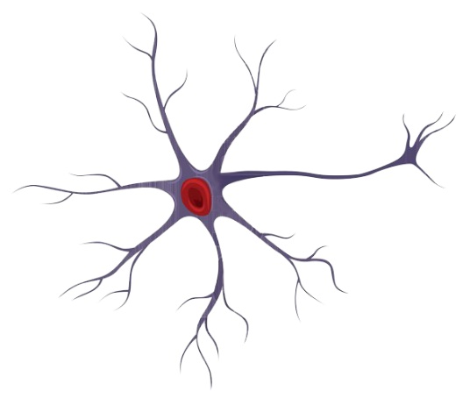
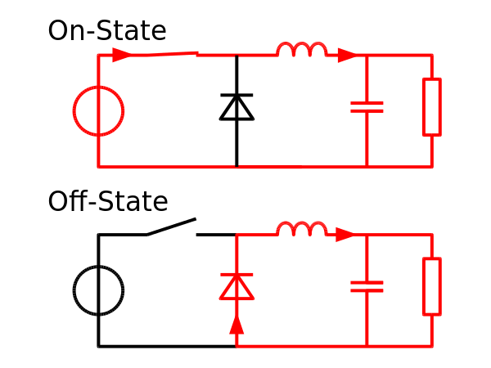
Piecewise-smooth systems
Many systems have discontinuous dynamics:
Switching control systems,
Mechanical gears,
Neuron and cardiac cells,
Power converters, etc.
Error
Control
On
Off

Slide 9
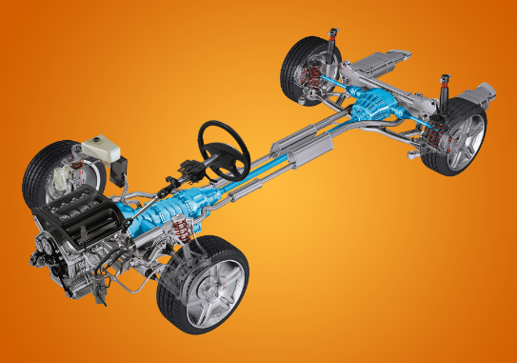
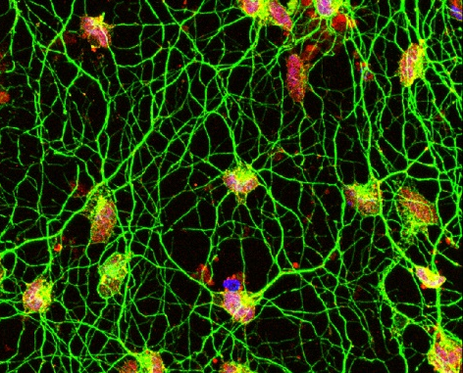
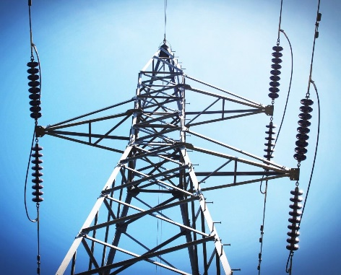
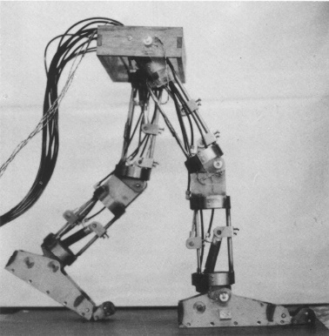
Piecewise-smooth networks
PWS systems can interact in networks:
Vehicle driveline,
Biological neuron networks,
Power grids,
Cooperative robot tasks, etc.
Collective behaviour is crucial.
Synchronization is the simplest, relevant in many applications.

Slide 10
State of the art on synchronization
Paper | Global sync. | Asymptotic sync. | Lack of centralised control
[1] | ✘ | ✔ | ✔
[2] | ✔ | ✘ | ✔
[3] | ✔ | ✔ | ✘
[1] S. Coombes, R. Thul, “Synchrony in networks of coupled non-smooth dynamical systems: Extending the master stability function”, Eur. J. Appl. Math., 2016.
[2] P. De Lellis, M. di Bernardo, D. Liuzza, “Convergence and sync. in heterogeneous networks of smooth and piecewise smooth systems,” Automatica, 2015.
[3] X. Yang, Z. Wu, J. Cao, “Finite-time synchronization of complex networks with nonidentical discontinuous nodes,” Nonlinear Dynamics, 2013.

Slide 11
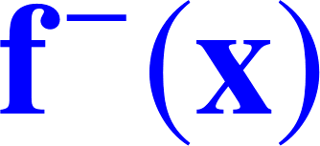
Problem formulation
Network model:
f can be discontinuous, e.g.
Our aim: Find conditions for asymptotic synchronization:
x₁
x₃
x₅
x₂
x₄
x₂
x₁
Synchronization must be:
Global
Without centralised control

Slide 12
σ-QUAD condition
First, it is useful to somehow constrain the dynamics f, otherwise it will be difficult to give any result at all.
I defined σ-QUADness:
A σ-QUAD function f can be nonlinear and have any number of finite jumps.
Lipschitz continuity:
One-sided Lipschitz:
QUAD:

Slide 13
Discontinuous coupling layer
Start with linear diffusive coupling layer.
Add a discontinuous coupling layer (even different topology).
We have a multiplex (multilayer) network:
x₁
x₃
x₅
x₂
x₄

Slide 14
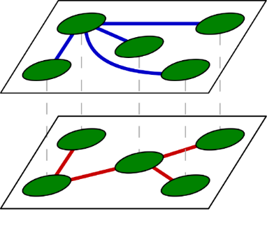
Synchronization of PWS QUAD systems
Theorem. Suppose
f is σ-QUAD(P, Q, M), with P > 0,
Γ, Γ_{d} > 0.
The network synchronizes if c > c* and c_{d} ≥ c_{d}*, where
x
Agent dynamics
Topology
Coupling protocol

Slide 15
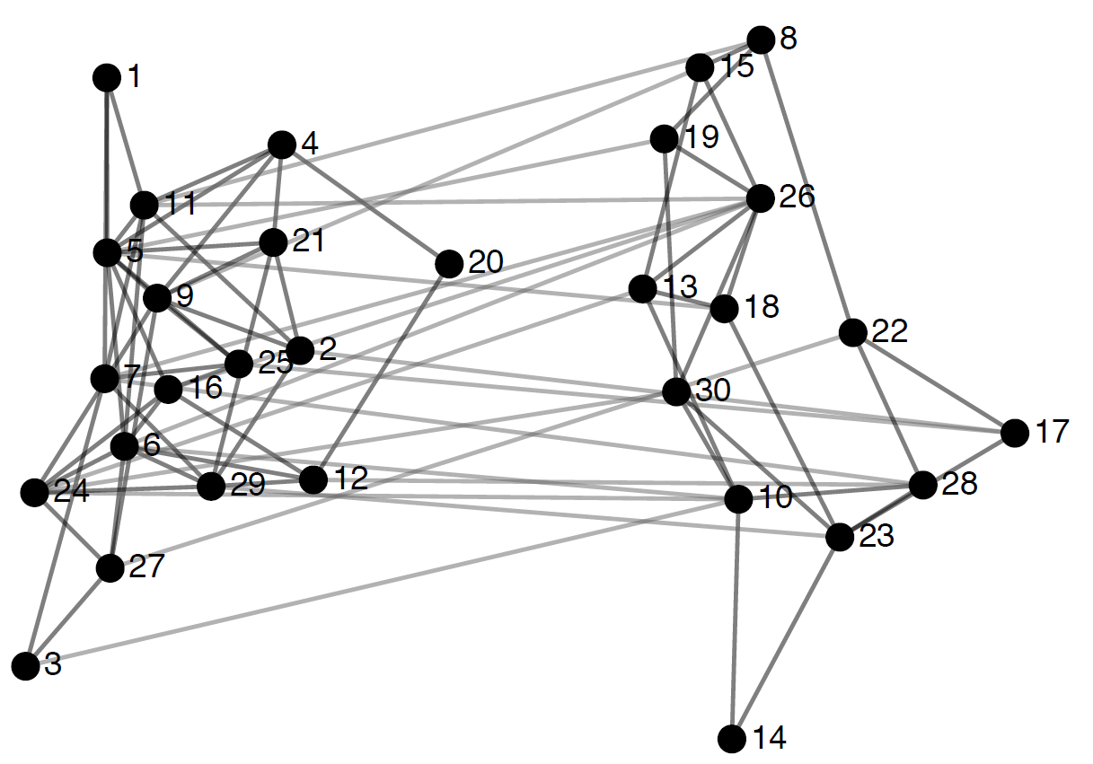
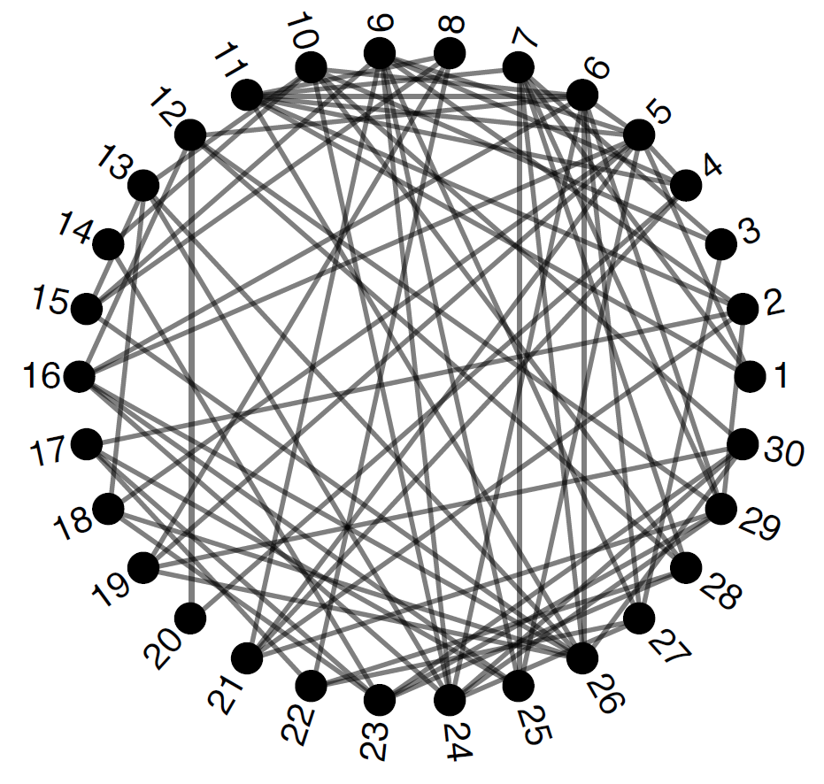
Minimum density
δ_{𝒢 d} : minimum density of 𝒢_{d}; computed from sparsest cut.
I devised an algorithm and simple formulae for selected topologies (complete, star, ring, path, k-nearest-neighbours).
sparsest cut
NP-hard! but…

Slide 16
Example 1: Theorem application
Consider N = 30 chaotic relay systems , with
These systems are σ-QUAD with

Slide 17
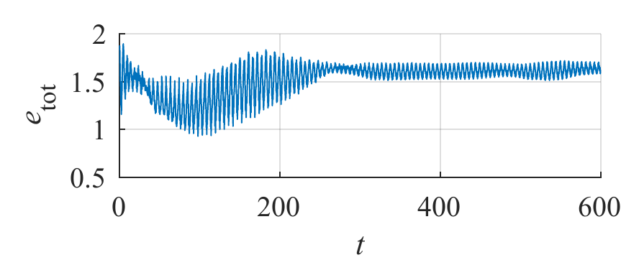
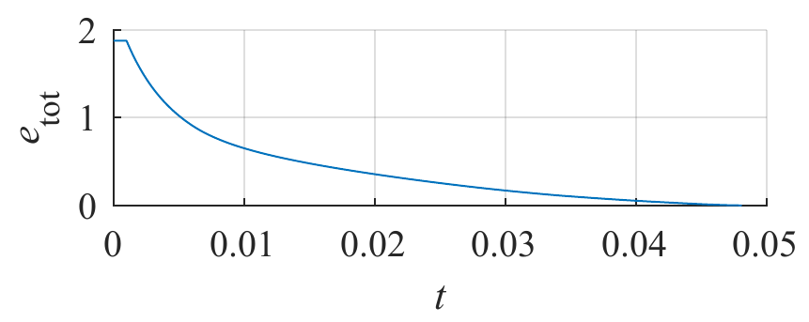
Example 1: Theorem application
Coupling protocol: Γ = Γ_{d} = I; Diffusive layer: λ₂(L) = 1; Discontinuous layer: δ_{𝒢 d} = 1.290.
c* = ||Q||₂ / λ₂(L) = 100.063, c_{d}* = ||M||∞ / δ_{𝒢 d} = 3.102.
sync. error
c = 0.1 < c*, c_{d} = 0.001 < c_{d}*
c = 101 > c*, c_{d} = 3.2 > c_{d}*

Slide 18
Power flow minimisation in microgrids
2
A glimpse

Slide 19
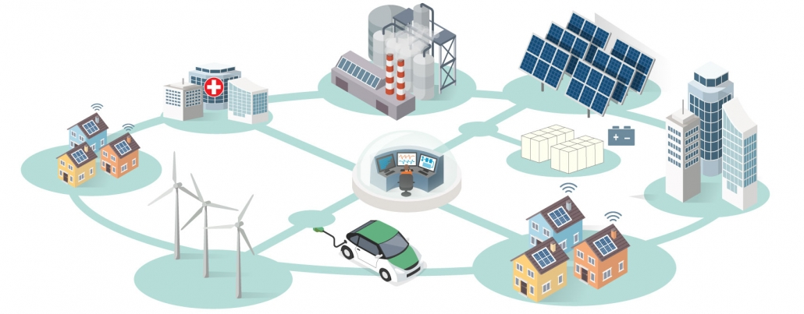
Microgrids
Microgrids are distribution networks. Powers: ~ 100 kW for both loads and generators.
Becoming more common with generators using renewable sources and smart loads.
Can operate separately with respect to transmission grid.

Slide 20
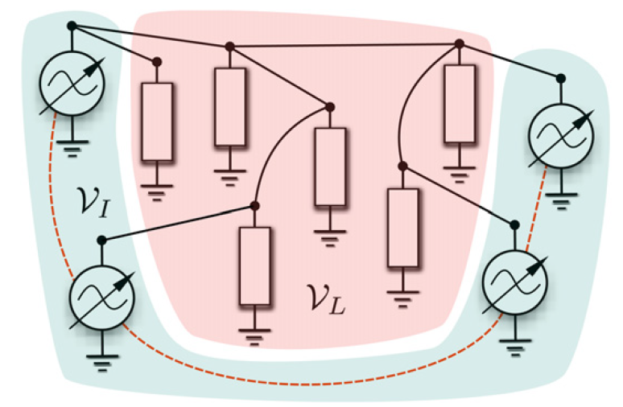
Model
This will be our control input
Typically, the network will reach a steady state with .
ξ_{ij} = A_{ij} sin( θ_{j} – θ_{i} ) is the power flow on link (i, j).
𝒱_{I} : inverter (generator) nodes 𝒱_{L} : load nodes
θ_{i} : voltage phase angle D_{i} : Droop coefficient (control) P_{i}* : nominal power of node i
E_{i} : node voltage Y_{ij} : admittance between i and j

Slide 21
Optimisation problem (goal)
Control goal: Avoid large power flows. (This would cause failure on links)
The higher D_{i}, the less power generator i provides.
We wish to solve the optimisation problem
I solved this problem using a decentralised and dynamic strategy.
ξ : vector of power flows on all links D : contains all D_{i}

Slide 22
Idea
Strategy:
Locate which links are currently under the greatest stress (we can measure power flow ξ ).
Transmit this information upstream to the generators.
Decrease the use of the generators that are congesting the network (by changing D_{i}).

Slide 23
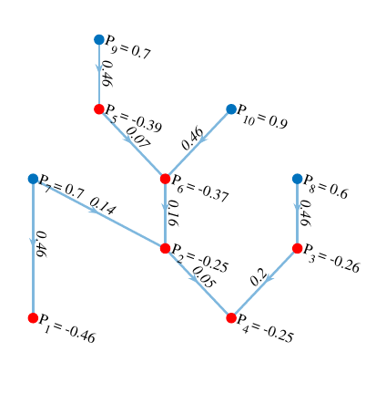
Maximum downstream flow
Ξ_{i} : maximum flow in downstream of node i.
Ξ_{i} gives global information but can be computed with local information and arbitrarily fast.
Ξ₉ = 0.46
Blue: generator
Red: load
0.46
The graph needs to be acyclic

Slide 24
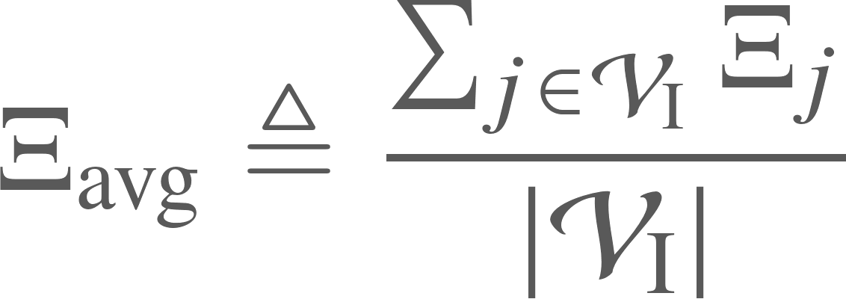
An equivalent control problem
We recast the optimisation problem as
We use information on Ξ_{i} to regulate D_{i}:
Optimal power flows coming from distributed algorithm are equal to those from centralised optimisation.
Some technical detail was omitted

Slide 25
Example – centralised optimisation
Maximum flows
Power flows with centralised optimisation

Slide 26
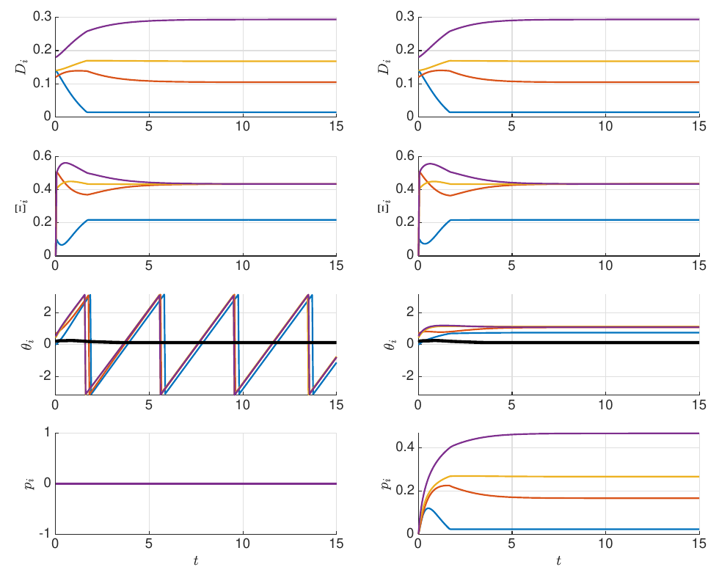
Example – Distributed algorithm
w/o freq. control
w/ freq. control

Slide 27
Thank you for your attention.
marco.coraggio@unina.it

Slide 28
Additional slides on piecewise-smooth networks
A

Slide 29
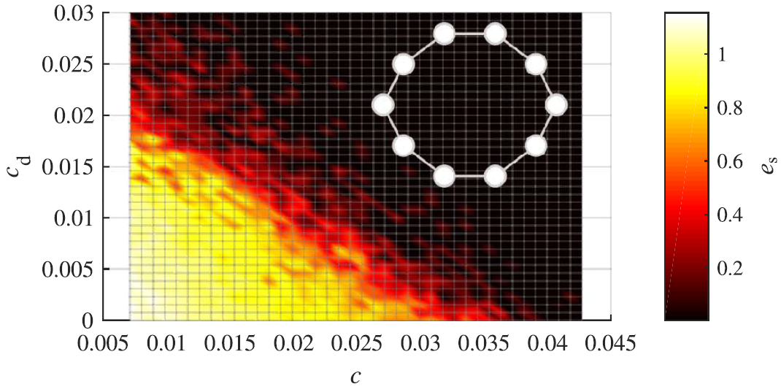
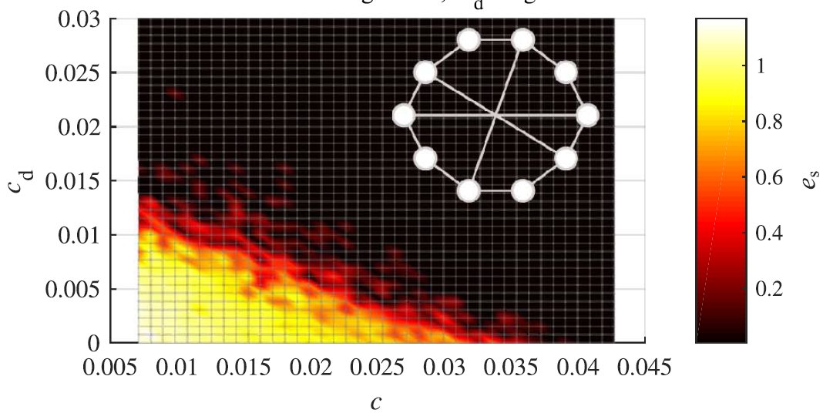
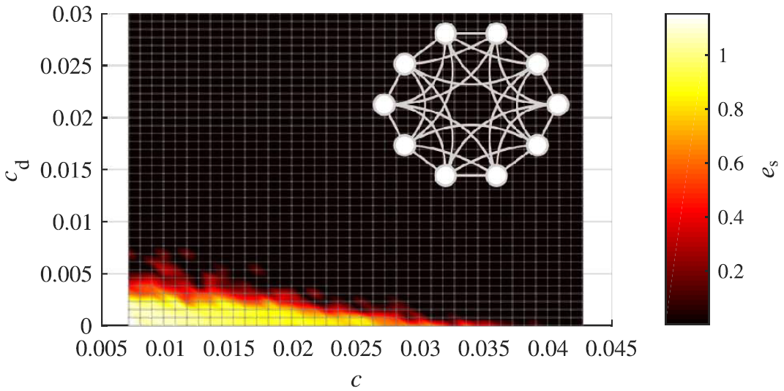
Example 2: Relation between layers
N = 10 Sprott circuits; L: 3-nearest-neighbours; L_{d}: variable.
Change topology of discontinuous layer: syncrhonizability changes.

Slide 30
Remarks
Future work: Can we find smaller coupling thresholds that depend on each other?
Extension: I recently proved that discontinuous coupling can:
Synchronize non-identical agents.
Compensate disturbances.

Slide 31
Additional slides on microgrids
B

Slide 32
A better definition
it would be impractical to compute Ξ̃_{i}. (centralised and cumbersome)
A first order arbitrarily fast system is used to compute Ξ̃_{i} (Ξ_{i} → Ξ̃_{i})
convergence rate

Slide 33
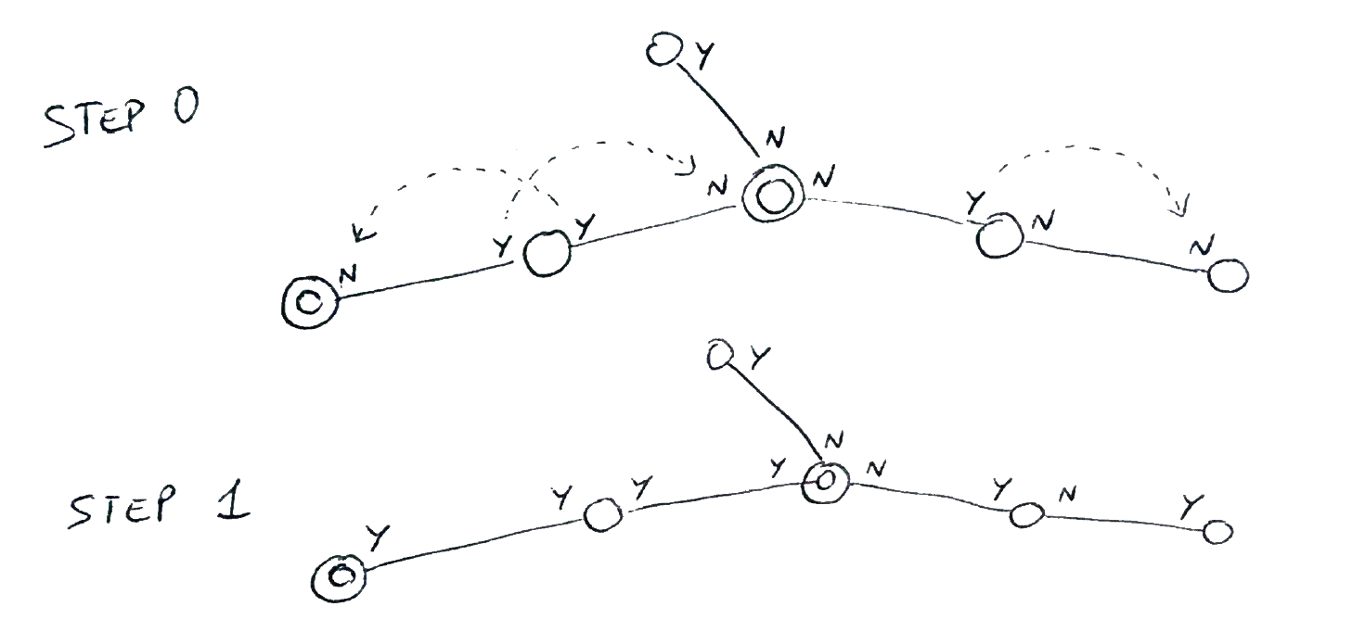
Adjusting the algorithm
Since flows are measurable, it is possible to infer locally whether each node is an inverter or a load.
We want to transmit this information in a distributed fashion.
Converges very quickly, at most N – 1 iterations.
Double circles are inverters.
Y/N means that in that direction there is/is-not an inverter

Slide 34
Adjusting the algorithm
Define β_{i,ij} ∈ {0, 1}: it says whether there is an inverter following the branch ij starting from inverter i.

Slide 35
Time scales
Our control scheme has different time scales.
Controller on D_{i}'s
Slow
Secondary controller (p_{i})
Estimation of Ξ_{i} and Ξ_{avg}
Fast

