Slide 1


Angelo Coppola
Tutor: Prof.ssa Stefania Santini co-Tutor: Luisa Andreone and Anita Fiorentino, FCA group
XXXIV Cycle - I year presentation
C-ITS services and advanced vehicle control for complex traffic scenarios

Slide 2



Background & Info
MS degree in Hydraulic and Transportation Systems Engineering, University of Naples Federico II
Fellowship type: “Borsa POR”
Collaborations:
  Fiat Chrysler Automobiles group, FCA
  Research Group of Prof. Gennaro Nicola Bifulco
  (DICEA, University of Naples Federico II)

Slide 3
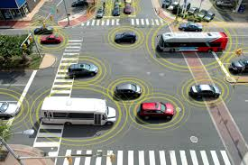
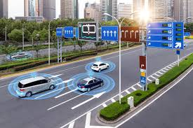
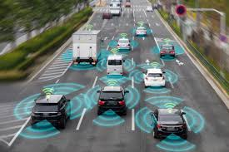
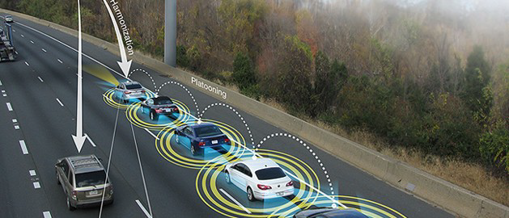
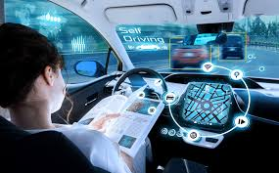
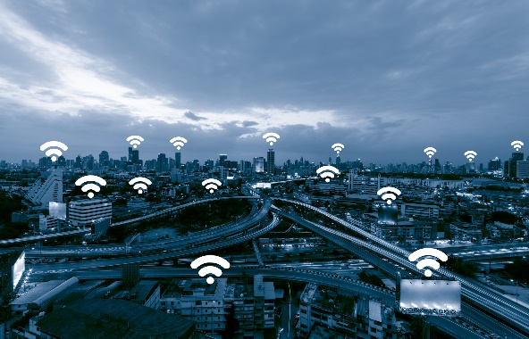
Research Topic (1/2)
Development of reliable and resilient control architectures to increase the performance of automated and connected driving.
Application to C-ITS, e.g autonomous and connected vehicles in urban and extra-urban scenario, mixed traffic flow, smart cities.

Slide 4
Research Topic (2/2)
The aims of the research are:
  develop innovative C-ITS strategies for autonomous vehicles;
  testing and validation of C-ITS strategies in order to increase autonomous driving safety in complex mixed traffic flow.
The idea is to tailor the theoretical results with respect to practical problems, e.g. the simultaneous presence of human-driven and autonomous vehicles.

Slide 5
My First Year
My first year activity focused on:
  study of existing C-ITS strategies in urban environment;
  development of a simulation platform to test C-ITS strategies;
  theoretical design of new collaborative control strategies at urban intersections;
  testing of considered C-ITS strategies in complex mixed traffic scenarios at intersections;
My contribution consists in:
  provide new collaborative control strategies;
  develop a light-weighted and open simulation platform;
  apply the theoretical framework in urban scenario, with both autonomous and human-driven vehicles.

Slide 6
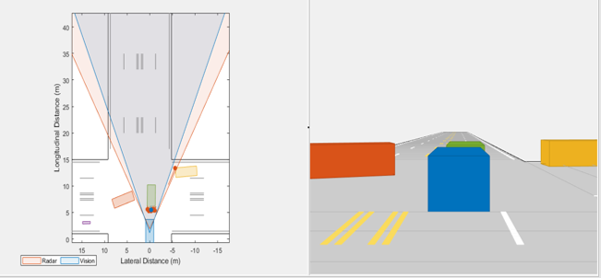
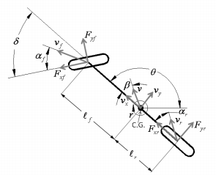
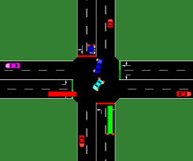
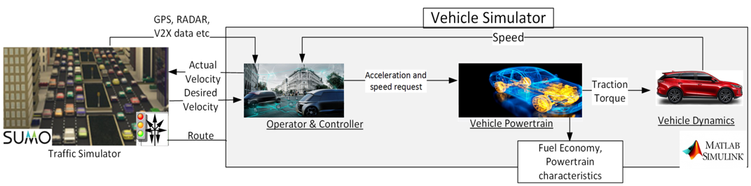
Simulation Platform
Virtual Simulation Platform integrating:
  Matlab/Simulink
    Vehicle Dynamics;
    Sensors;
    Simplified 3D road environment.
  SUMO for road traffic environment.
Main advantages:
  light-weighted
    no powerful hardware is needed to perform simulations;
  low cost
    no additional commercial software are required;
  easily adaptable to the developers needs
    customize vehicle dynamics and control logic.

Slide 7
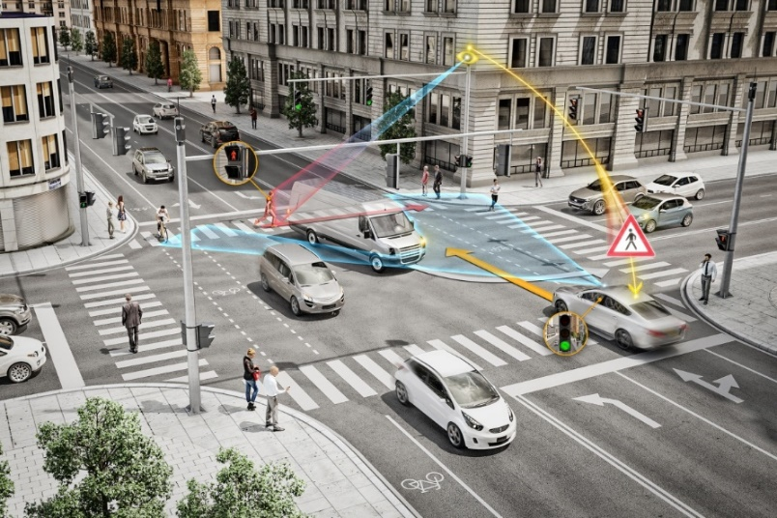
Urban Intersection
Urban intersections management is one of the most critical challenge in urban environment because of two main problems:
changes in driver behavior, tight spacing and frequent stopping-and-going maneuvers, further affect road safety, increasing the probability of road accidents;
stops along trip increases travel time, fuel consumption and pollutant emissions.

Slide 8

Unsignalized Intersection Problem
WHAT IF:
  No road signs
    no TLS
    no priority
  Mixed traffic flow
    autonomous vehicles
    human-driven vehicles
  Occlusions in line of sight

Slide 9


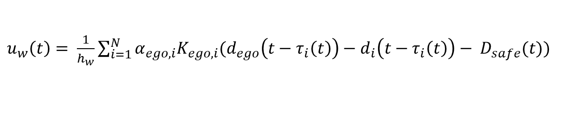
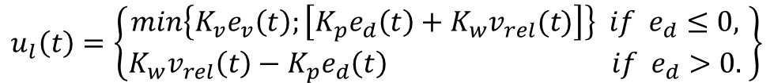
Proposed Solution
The proposed solution exploits V2V communication and on-board ranging sensors capabilities to extend the line-of sight of the vehicle.
The control signal is given by two contributions:
$$a_{des} \left(t\right)= u\left(t\right)= u_{l}\left(t\right)+ u_{w}(t)$$
$a_{des}\left(t\right)$ is the desired acceleration
$$u_{l}\left(t\right)=\left\{\begin{matrix}min\left\{K_{v}e_{v}\left(t\right);\left[K_{p}e_{d}\left(t\right)+K_{w}v_{rel}(t)\right]\right\} if{ e}_{d}≤0, \\ K_{w}v_{rel}\left(t\right)−K_{p}e_{d}\left(t\right) if{ e}_{d}>0.\end{matrix} \right\}$$
On-board ranging sensors contribution
$u_{w}\left(t\right)= \frac{1}{h_{w}}\sum_{i=1}^{N}{α_{ego,i}K_{ego,i}(d_{ego}\left(t−τ_{i}\left(t\right)\right)−}$ $d_{i}\left(t−τ_{i}\left(t\right)\right)− D_{safe}(t))$
V2V contribution

Slide 10

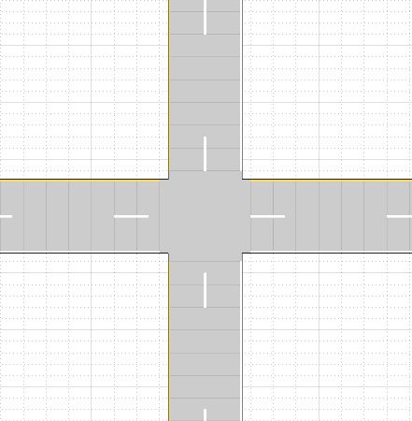

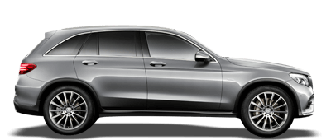

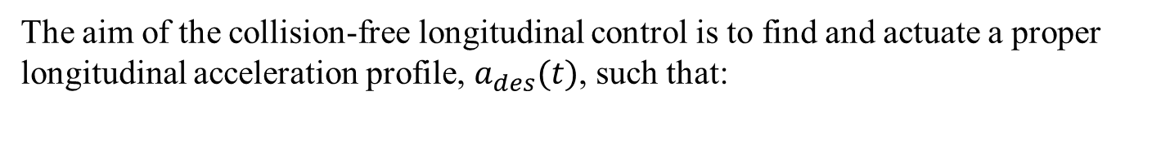









V2V Contribution
The aim of the collision-free longitudinal control is to find and actuate a proper longitudinal acceleration profile, $a_{des}(t)$, such that:
$$d_{ego}\left(t\right)= euclidean distance of the Ego Vehicle vehicle$$
$with respect to the center of intersection$
$$d_{i}\left(t\right)= euclidean distance of the i−th human−driven$$
$$vehicle, \left(∀i=1,…,N\right), with respect to the center of intersection$$
$D_{safe}=D_{min}$ + $T_{gap}$ $V_{x}(t)$
Distance at
standstill
Headway
time
Desired spacing policy
$$V_{x(t)}$$
Controller $C_{Ego}$
$$d_{i}(t)$$
$$d_{ego}(t)$$
$$u_{Ego}$$
Each communication link is characterized by a different time-varying delay.
$τ_{i}(t)$
Communication Topology
$i=1,…,N$
The topology of the graph is associated to an adjacency matrix with non negative elements.
$$α_{i}= \left\{\begin{matrix}\begin{aligned}1 in the presence of a communication \\ link from vehicle Ego to i\end{aligned} \\ 0 otherwise \end{matrix}\right\}$$

Slide 11
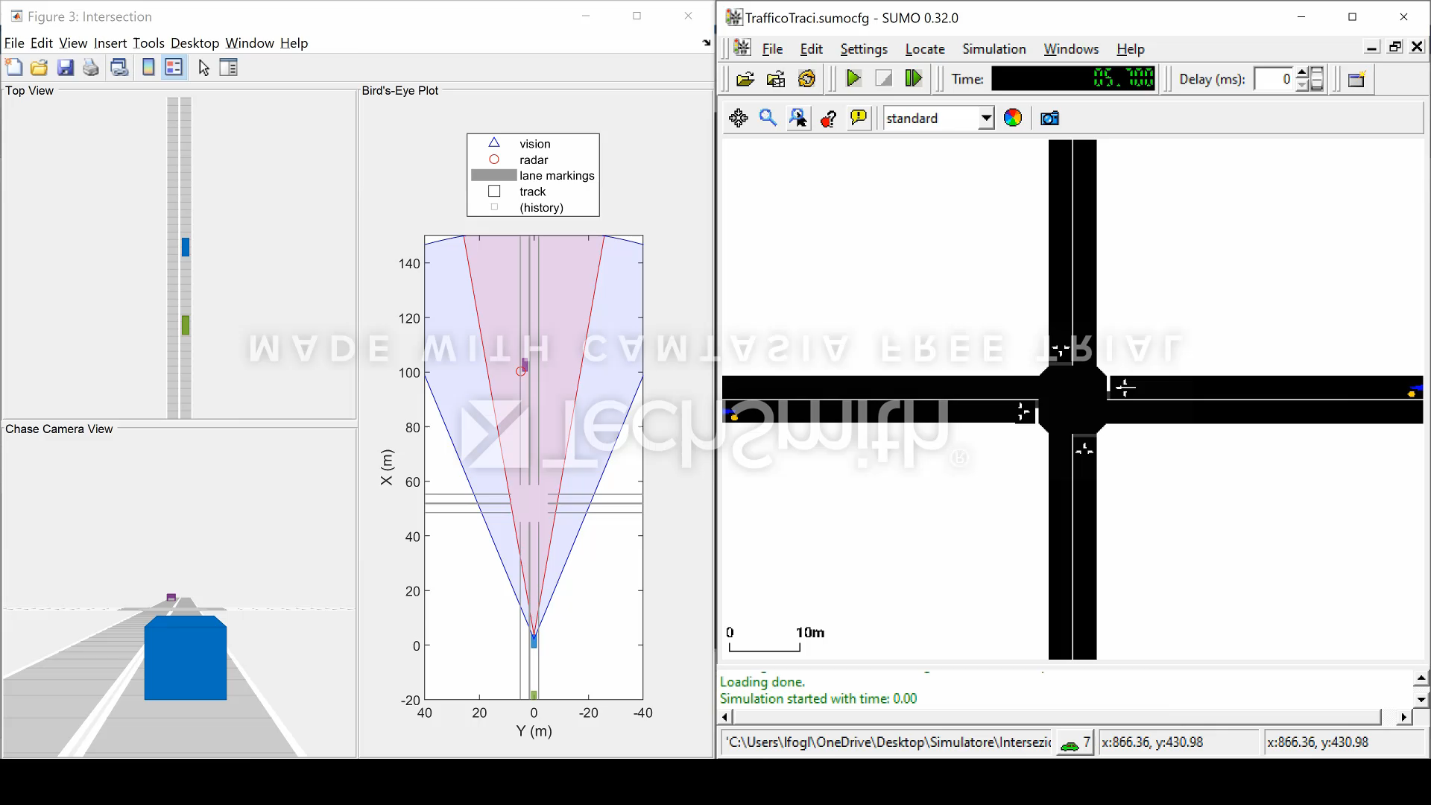
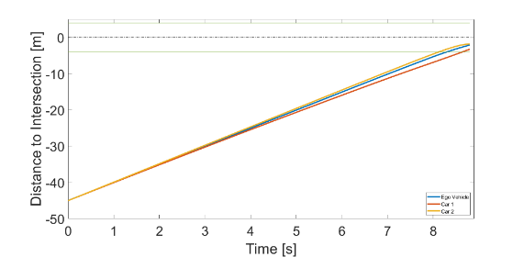
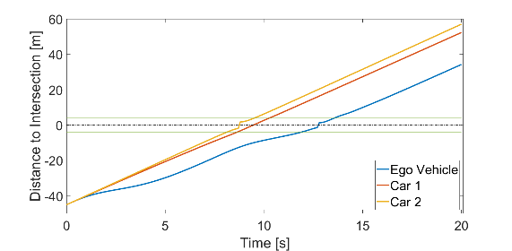
Numerical Analysis
To validate the theoretical results, a case study has been analyzed:
  an Autonomous and Connected vehicle crossing an unsignalized intersection with foe human-driven vehicles.
The Ego Vehicle adapts its motion according to information obtained from:
  ACC;
  V2V.
SUMO control human-driven vehicles:
  generation distribution;
  route distribution;
  intersection management;
  motion of vehicles.

Slide 12
My Products
Published: “Motivating the need for an integrated software architecture for Connected and Automated Vehicles technologies development and testing” Luigi Pariota, Angelo Coppola, Luca Di Costanzo,Claudio D’Aniello, Gennaro Nicola Bifulco, in MT-ITS2019 6th International Conference on Models and Technologies for Intelligent Transportation Systems, 7/06/2019
Published: “Green Light Optimal Speed Advisory: a C-ITS to improve mobility and pollution” Luigi Pariota, Luca Di Costanzo, Angelo Coppola, Claudio D’Aniello, Gennaro Nicola Bifulco, in 2019 IEEE International Conference on Environment and Electrical Engineering and 2019 IEEE Industrial and Commercial Power Systems Europe (EEEIC/I&CPS Europe), 11/06/2019
To Be Published: “Intersection Crossing in Mixed Traffic Flow Environment leveraging V2X information”, Angelo Coppola, Bianca Caiazzo, Gennaro Nicola Bifulco, Stefania Santini, in 8th IEEE International Conference on Connected Vehicles and Expo (ICCVE), November 2019

Slide 13
Next Year
My aims are to extend the cooperative approach and to continue the integration of the simulation platform, both developed during the first year of my Ph.D.
The idea is to exploit the control theory to coope with human-driven vehicles in urban mixed traffic scenarios.
The first year activities and the outlook on the second year can be summarized as:

