Slide 1
Francesco Caturano Tutor: Simon Pietro Romano XXXIV Cycle - I year presentation
SECSI: SECurity Solutions for Innovation

Slide 2
Background
Computer Science Engineering degree in 2018
«Automated discovery of CoAP-enabled IoT devices»
NomadicLab , Ericsson Finland
First Year ITEE PhD student
SECSI group (Simon Pietro Romano, Gaetano Perrone)
Research fellow at GARR
«Docker Security Playground: a microservices based framework for the implementation of attack scenarios on virtualized network infrastructures»

Slide 3
Context
Automation of attack scenarios through virtualization techniques
Cyber-ranges vs. security playgrounds
Web Application robustness testing
from Dynamic Programming…
…to Reinforcement Learning
Security Automation
&
Virtualization
Artificial Intelligence for Security Testing

Slide 4
Contribution (1 of 2)
A platform that allows for design and management of virtualized network infrastructures…
…tailored to the study of Network Security
Organized as a set of public interactive laboratories
…conceived as separate security learning assets
Laboratories used for both educational and research purposes
Training material for students of the Network Security course
Distributed testbeds for experimentations

Slide 5
Laboratories: an example

Slide 6
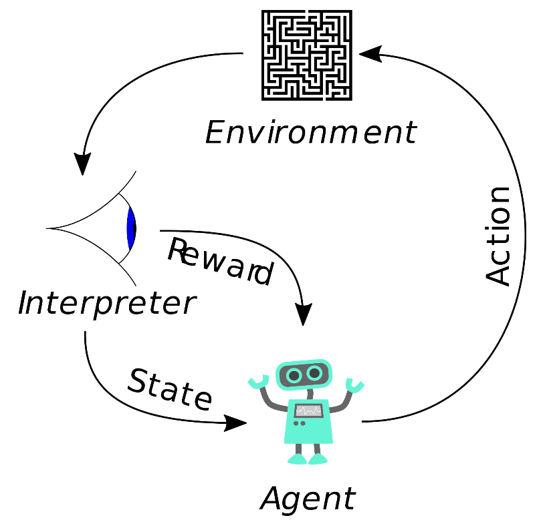
Contribution (2 of 2)
Modeling the attacker’s behavior when detecting vulnerabilities
Web Application security testing
Trial&Error methodology well described by a Markov Decision Process
Various Frameworks available to solve MDPs
Dynamic Programming
Reinforcement Learning
Case of study
Cross-Site Scripting
SQL Injection

Slide 7
Conclusions & Publications
Accepted
«Automated Discovery of CoAP-enabled IoT devices»
Presented at IEEE ICUFN 2019
Ready for submission
«The Role of microservices in security playgrounds»
Using docker containers to enable integration of different virtualization techniques
In Preparation
«Modeling XSS vulnerabilities through Reinforcement Learning techniques»
Testing Web Applications for well-known security vulnerabilities

Slide 8
Thanks for the attention!

