Slide 1
Gerardo Castellano Tutor: Prof. Davide De Caro XXX Cycle
SAW-Less Digitally-Assisted Receivers

Slide 2
My Background
I received the M.S. degree in Electronic Engineering from University of Napoli “Federico II”
I work within the VLSI DIETI group
My fellowship was financed by Marvell (Italia) - DIETI
Prof. Davide De Caro
Prof. Antonio Strollo
Prof. Ettore Napoli
Prof. Nicola Petra

Slide 3
Outline
SAW-Less Digitally-Assisted Receivers
Motivations
Research Activity
Technical details
Digital Tx Noise Reduction in SAW-Less Diversity Receivers
Digital Background Control for Hybrid Transformer-based Receivers
Publications and Questions

Slide 4
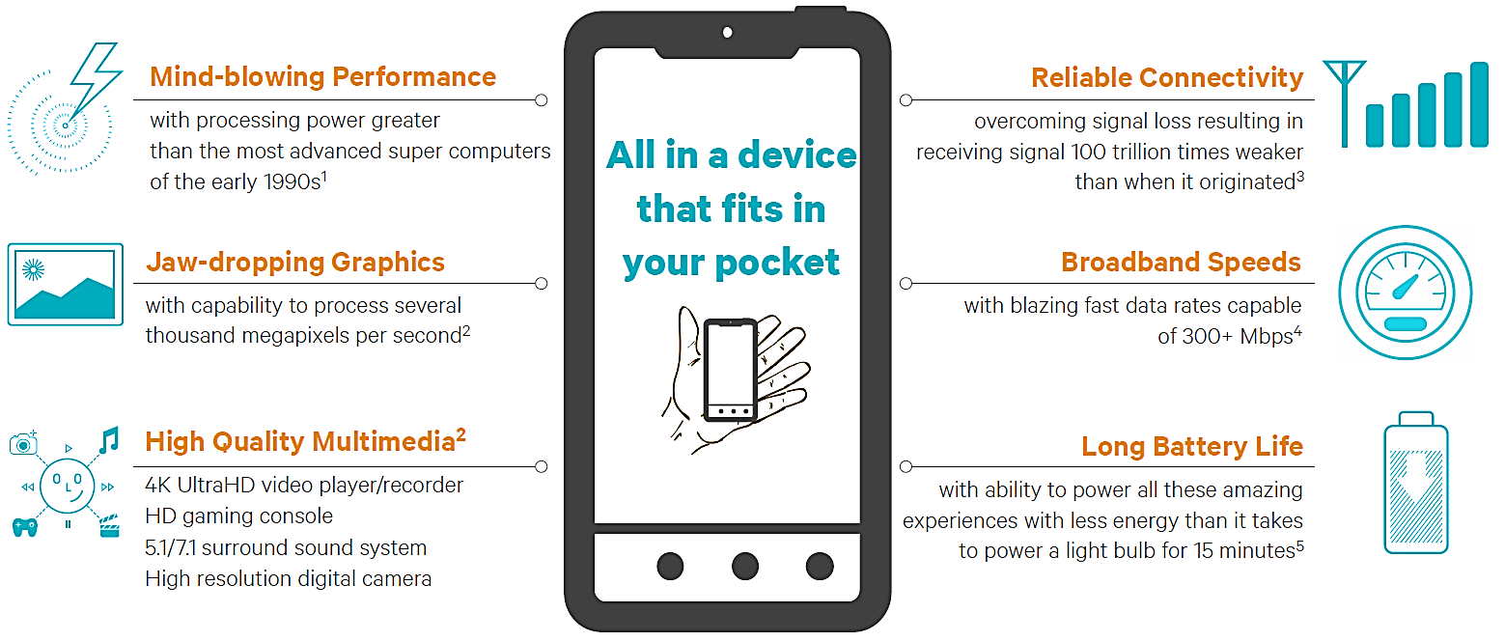
Motivations
Modern mobile devices have to manage different standards (2G, 3G, 4G, Wi-Fi, Bluetooth, etc.) to meet the needs of users

Slide 5
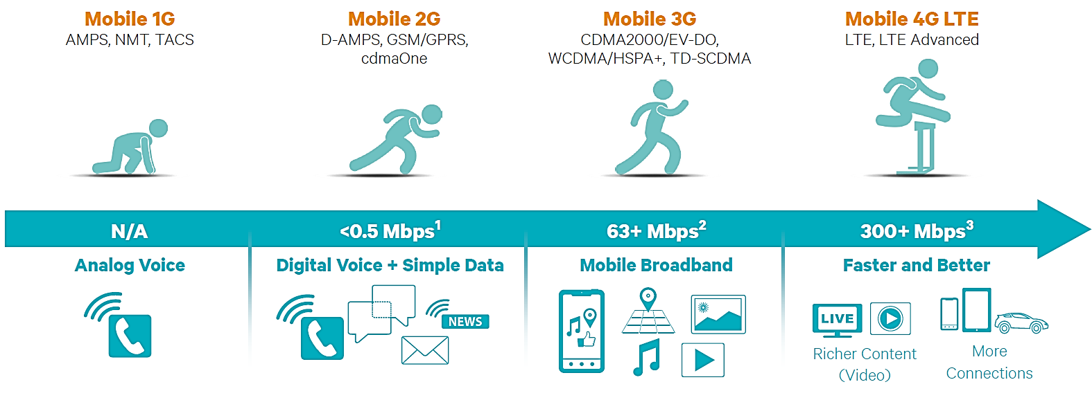
Motivations
The ever growing demand for performance and higher data rate are leading to larger bandwidth (tens of MHz) and the adoption of advanced methods, like Carrier Aggregation and MIMO structures

Slide 6
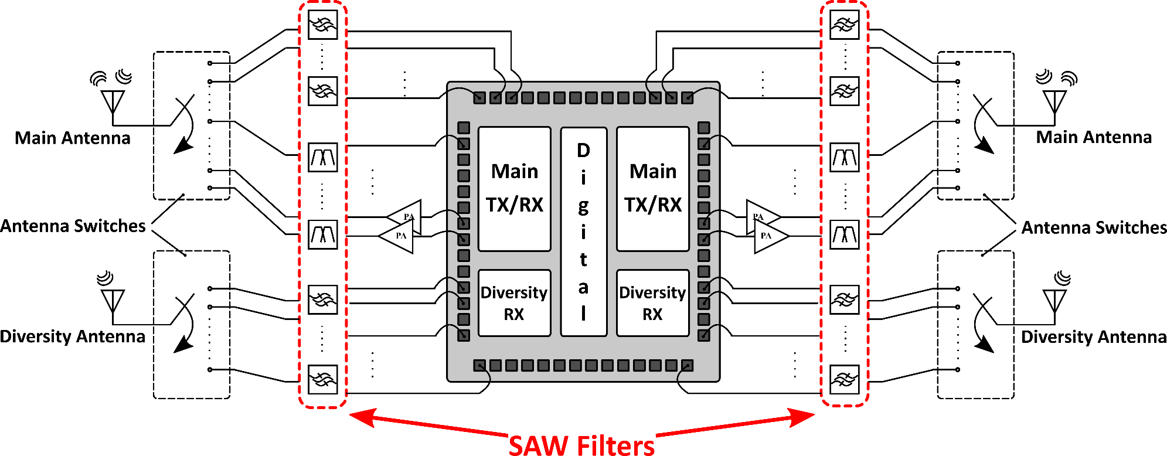
Motivations
Typical multi-standard platform with several narrow-band paths
The technology scaling keeps low the cost of the integrated components
Off-chip elements only marginally interested by the technology evolution

Slide 7
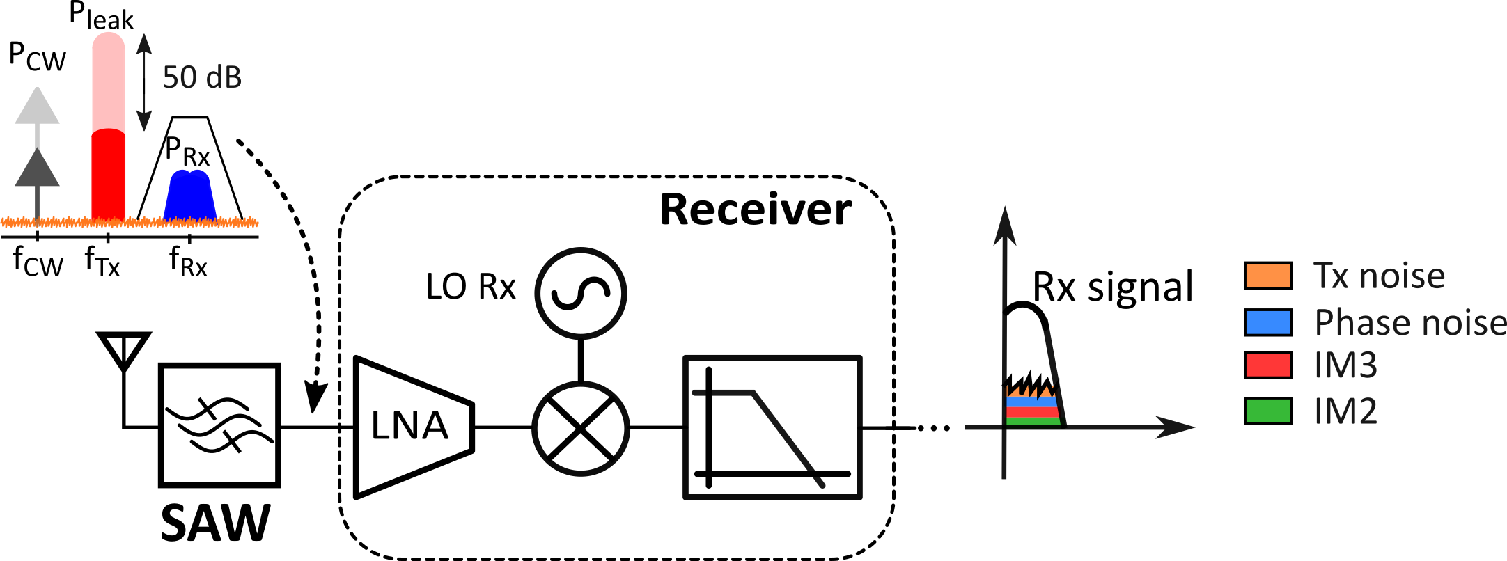
Motivations
Highly selective SAW filters are used to reduce out-of-band interferences in FDD standards
The receiver meet the required sensitivity
Issues: • High cost • Lack of tunability • Bulky structure

Slide 8
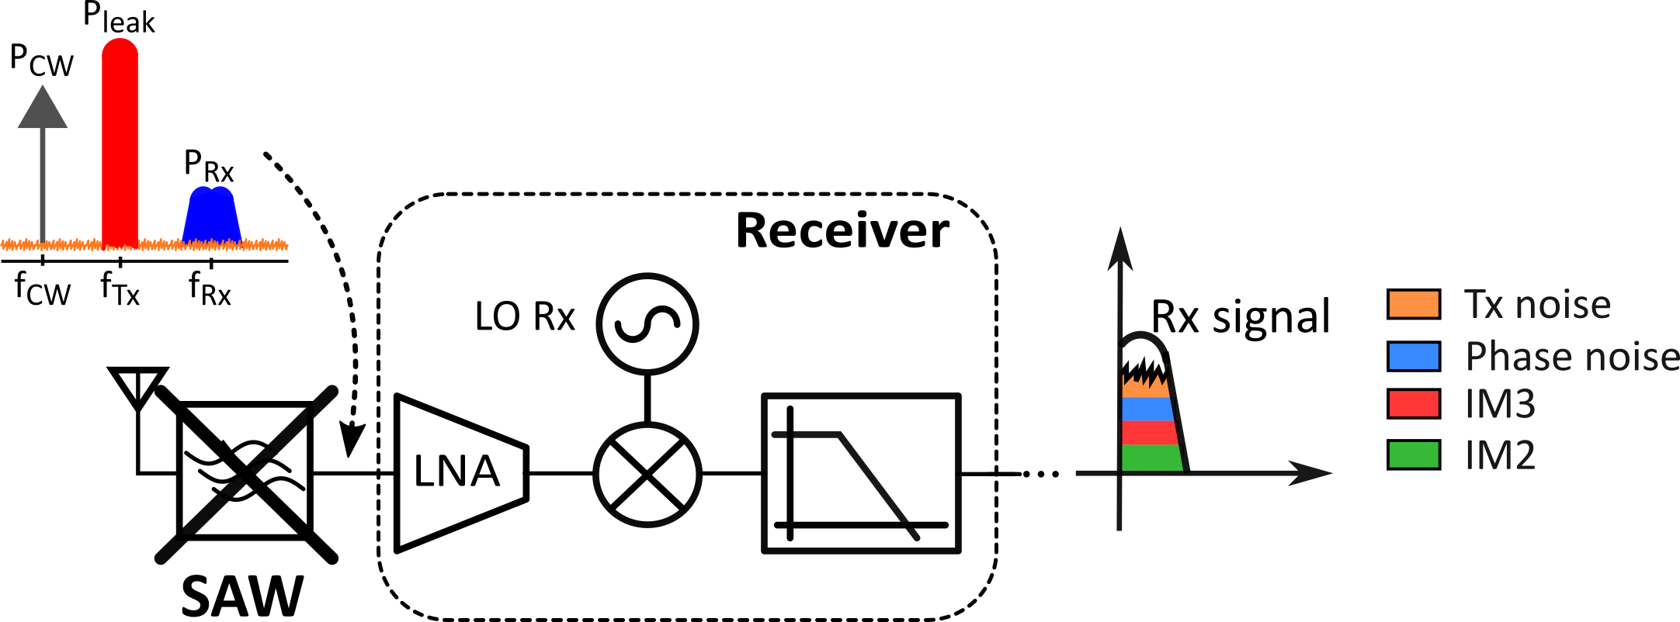
Motivations
Without external filtering, the undesired signals compromise the receiver performance [1]: sensitivity, gain compression, reciprocal and harmonic mixing, intermodulation products, transmitter noise folding

Slide 9
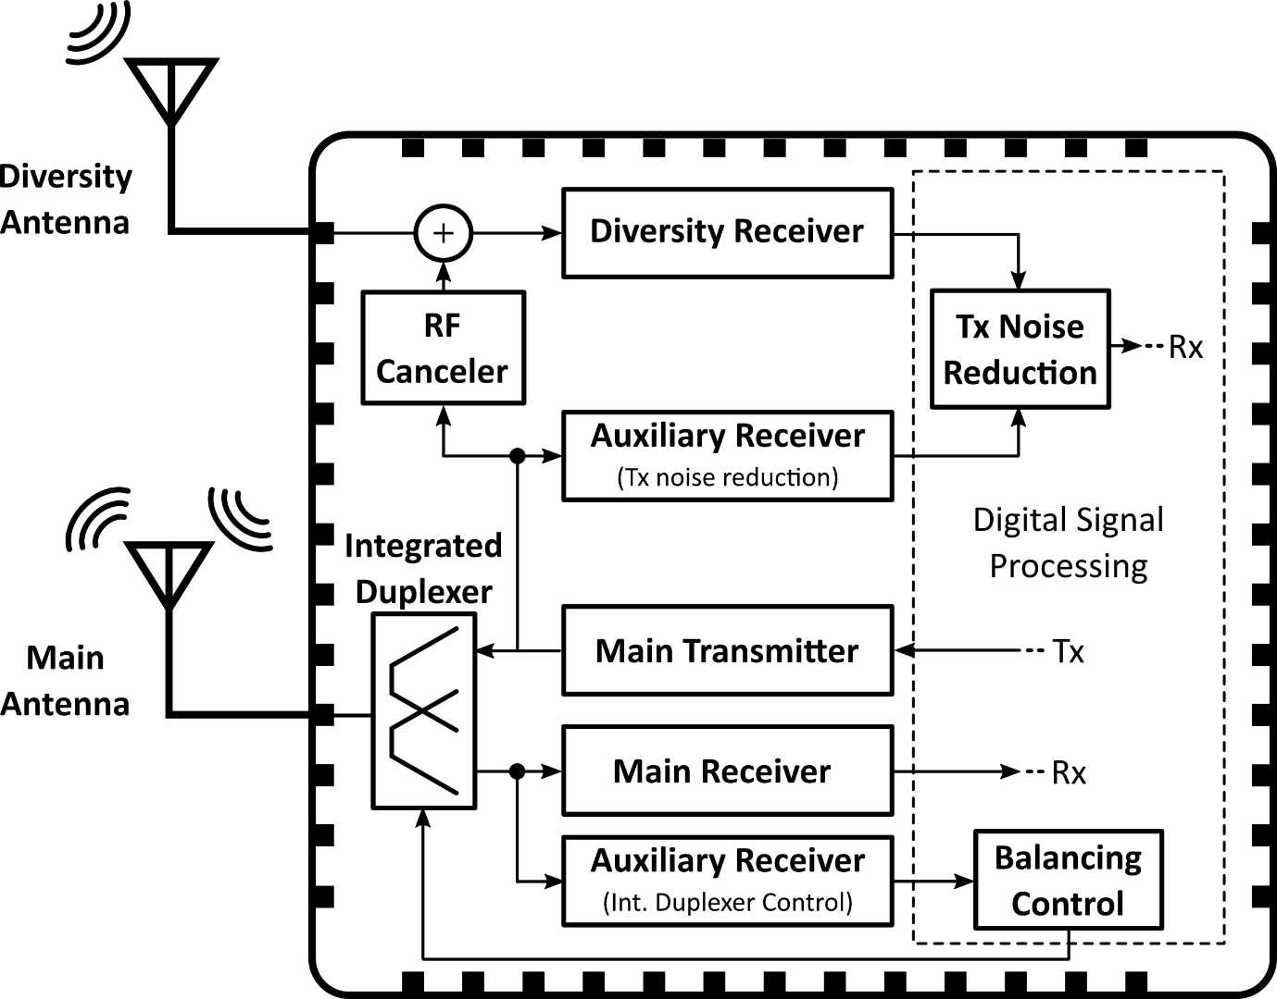
Research Activity
Saw-Less Digitally-Assisted receiver
In collaboration with the Microelectronics laboratory
University of Pavia

Slide 10
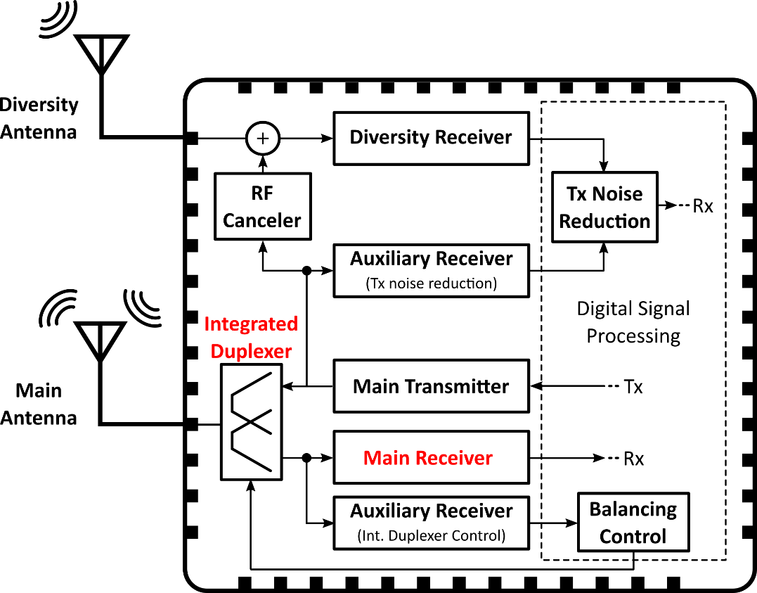
Research Activity
Main Receiver with Integrated Duplexer [2]
The Hybrid Transformer replaces multiple Saw-based duplexers with a single integrated and tunable circuit
Only the Tx signal is partially attenuated, whereas the external blockers pass unfiltered through the HT
A low-power highly-linear receiver meets the standard specifications, requiring only 45dB of Tx-Rx isolation

Slide 11
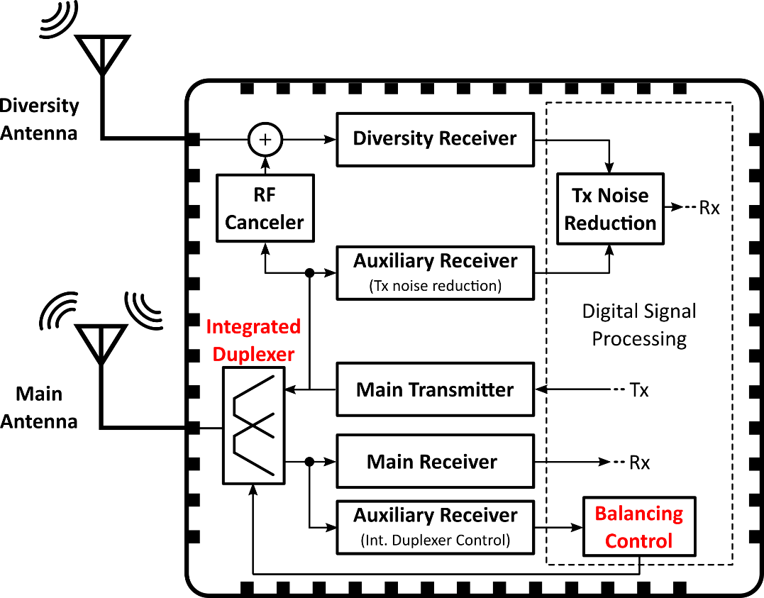
Research Activity
Hybrid Transformer Balancing Control (this thesis) [1.J][1.C]
The attenuation of the Tx signal is not fixed, but it depends on the balancing condition of the hybrid transformer
Sensitivity of the isolation to the antenna impedance
The digital control adaptively adjusts the HT balancing to follow the antenna impedance time variations, keeping high the isolation level

Slide 12
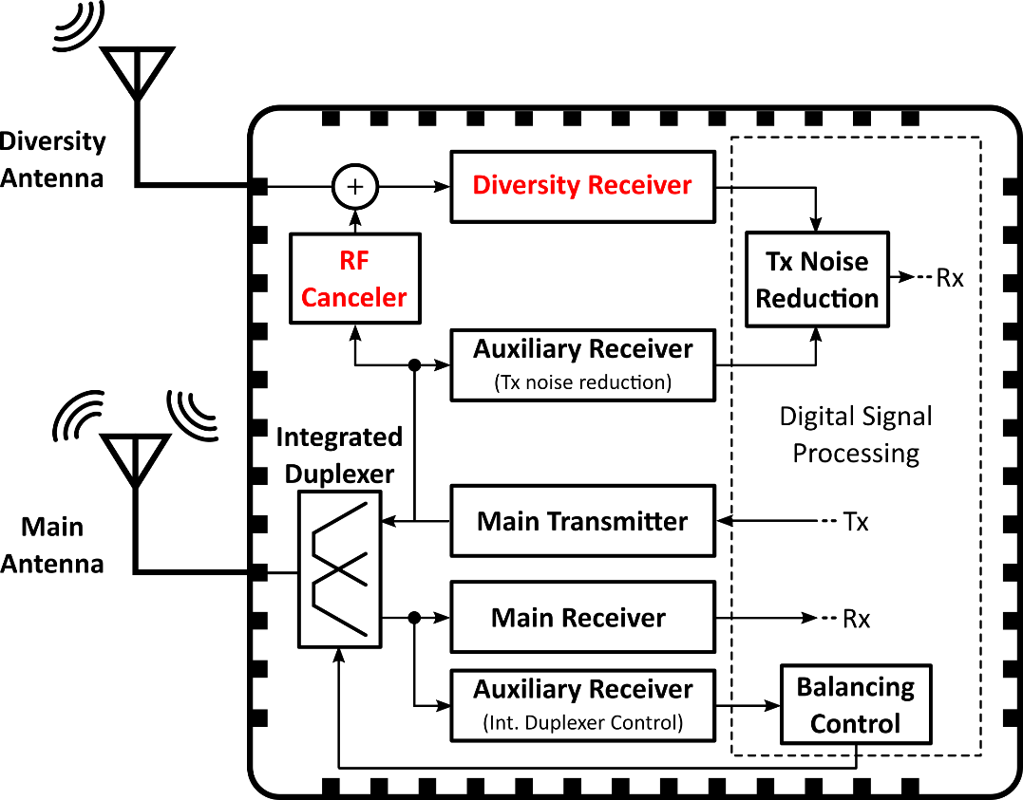
Research Activity
Diversity Receiver with Radio Frequency Canceler [3]
Due to the near field coupling, part of the Tx signal leaks at the input of the diversity receiver
To avoid desensitization, a receiver chain with high linearity is proposed
The RF canceler, acting like a vector modulator, ensures more than 25dB of Tx signal reduction and improves the diversity receiver linearity

Slide 13
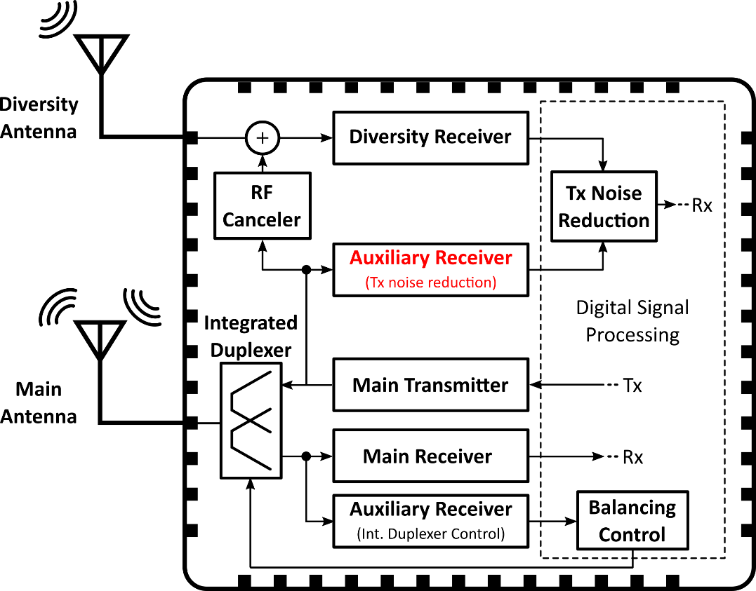
Research Activity
Auxiliary Receiver for Transmitter Noise Monitoring [2.C]
The RF canceler only reduces the out-of-band Tx signal
The Tx broadband noise that falls into the Rx band degrades the diversity receiver sensitivity
An auxiliary receiver is connected at the transmitter output to provide a baseband copy of the Tx noise that falls in the Rx band

Slide 14
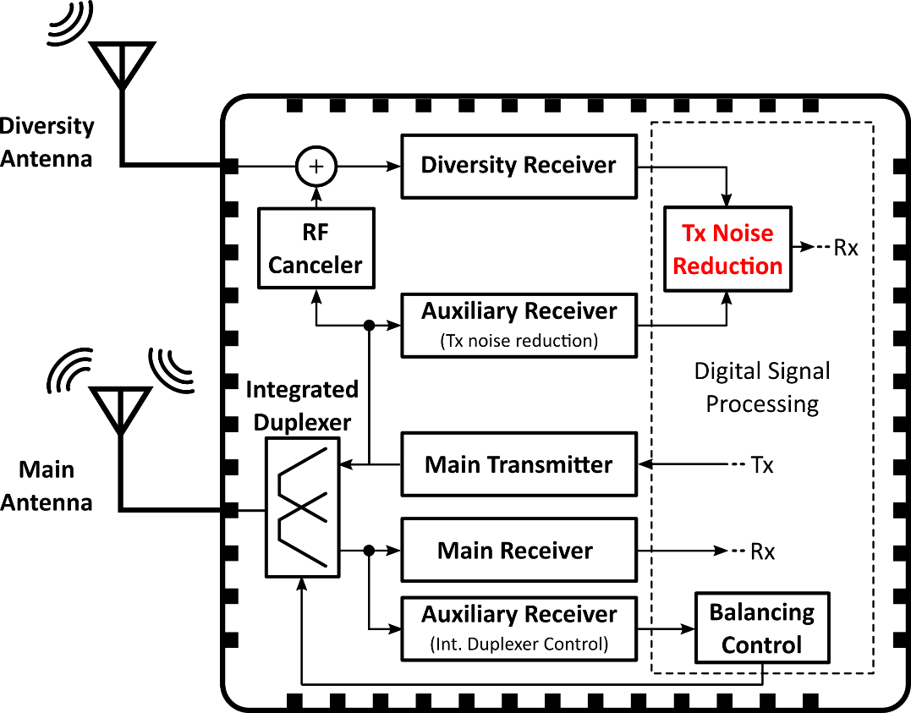
Research Activity
Transmitter Noise Reduction (this thesis)
The auxiliary receiver only monitors the Tx noise in the Rx band
In digital domain the effective Tx noise reduction is carried out
The equalizer restores the sensitivity of the diversity receiver without compromising the quality of the Rx signal

Slide 15
Outline
SAW-Less Digitally-Assisted Receivers
Motivations
My Activity
Technical details
Digital Tx Noise Reduction in SAW-Less Diversity Receivers
Digital Background Control for Hybrid Transformer-based Receivers
Publications and Questions

Slide 16
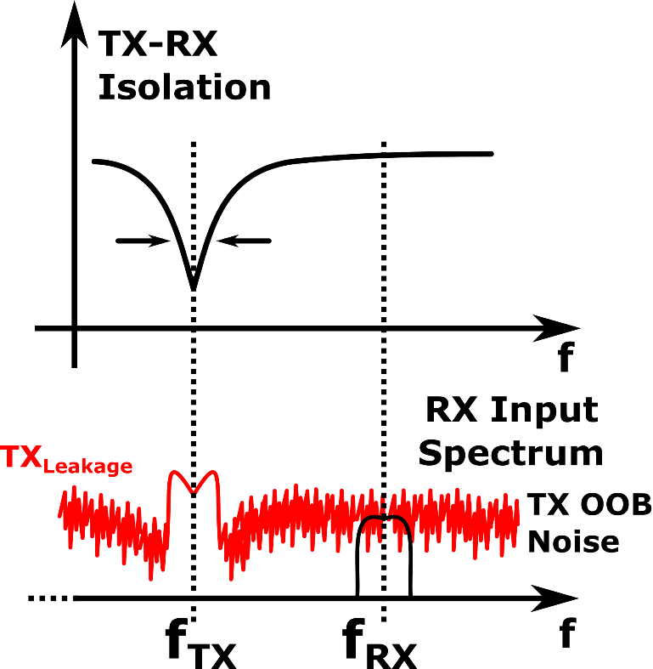
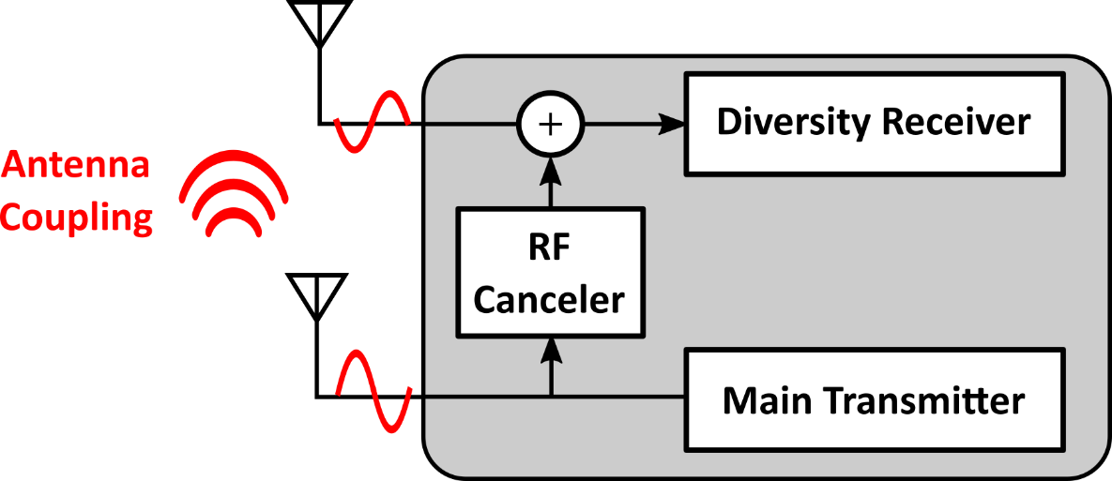
Transmitter noise
The RF canceller injects a modulated copy of the main TX signal at the RX input
Good TX-RX isolation only over a limited bandwidth
Transmitter out-of-band emissions degrade diversity RX sensitivity

Slide 17
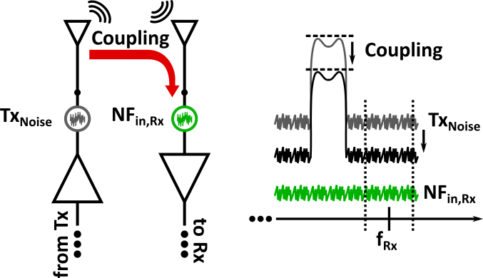
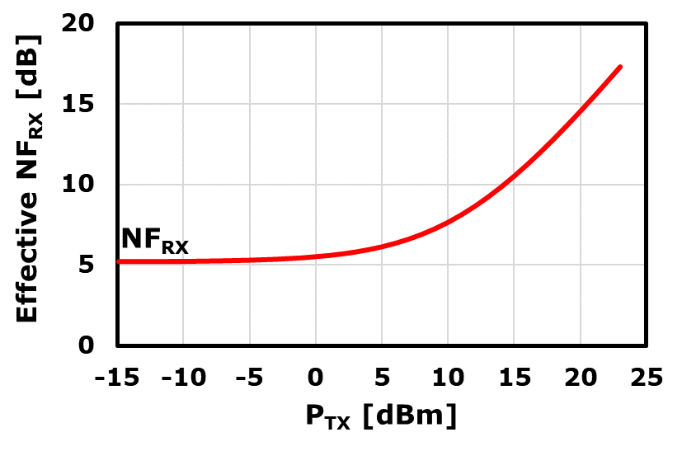
Sensitivity Degradation
Coupling=25 dB
TX_{Noise}=-155 dBc/Hz
Receiver noise figure [3] NF_{in,Rx}=5.2dB (nominal value)
With the transmitter at full power (P_{TX}=23dBm) the receiver noise figure degrades up to ≈17dB (≈12dB NF degradation)

Slide 18
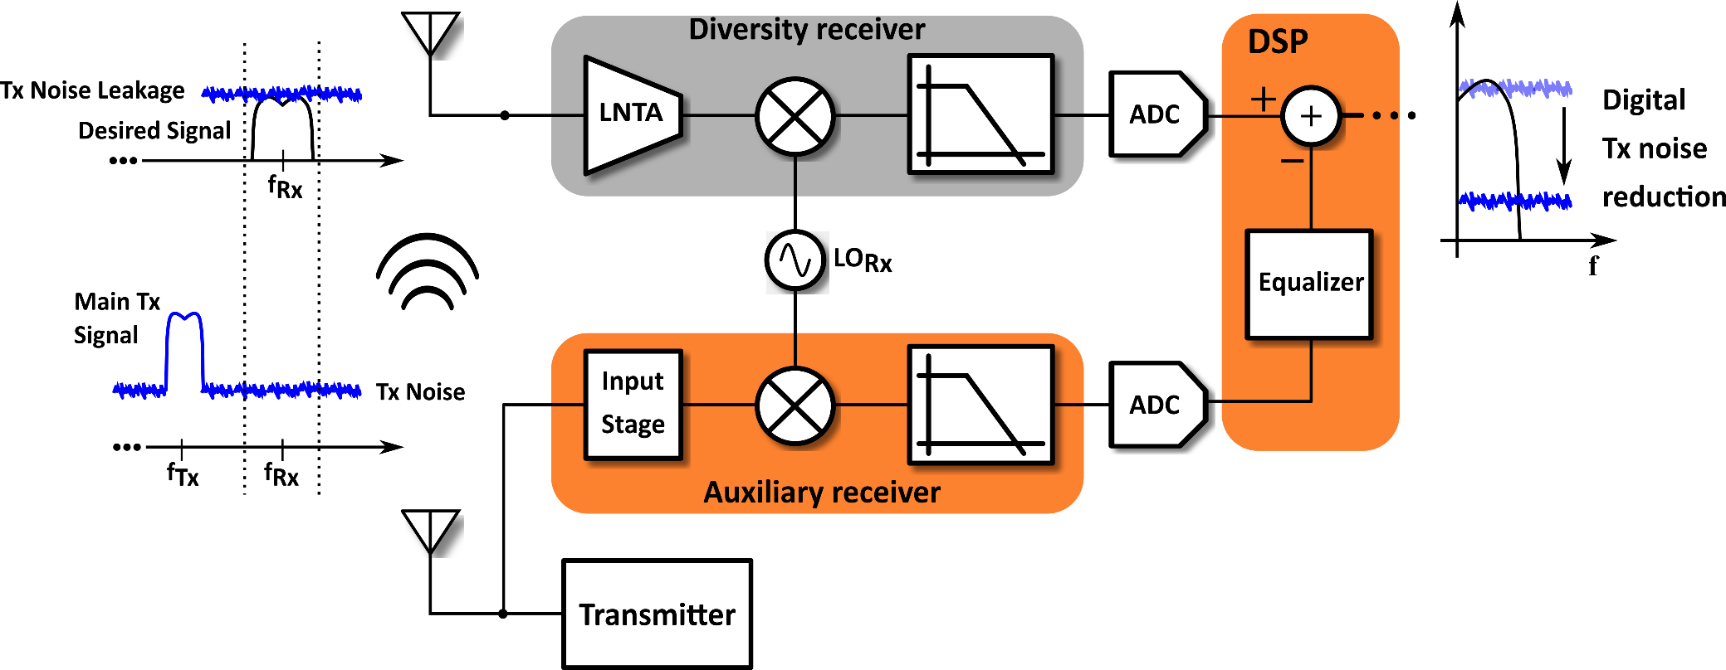
Proposed solution: Digital Noise Reduction
Main goal: relax TX broadband noise specification
Auxiliary path [2.C] provides a digital-domain copy of the TX noise in Rx band
Digital filter cancels out the TX noise, restoring the diversity receiver sensitivity

Slide 19
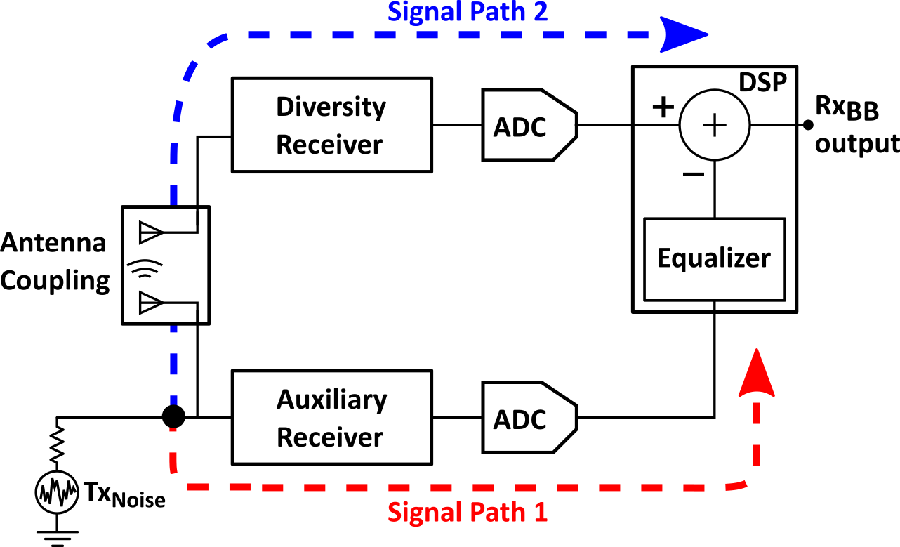
System model
The equalizer should match in baseband the differences between the two paths
Assuming ideal receivers and ADCs, the only difference is due to the antenna coupling
Tx noise which falls in the Rx band modeled as white noise
External Rx signal uncorrelated with the Tx noise

Slide 20
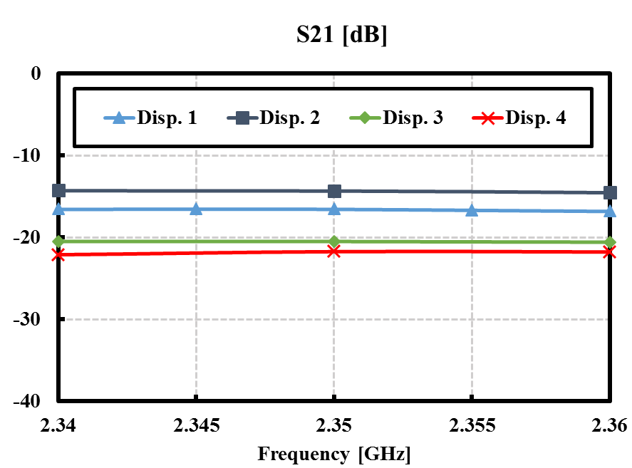
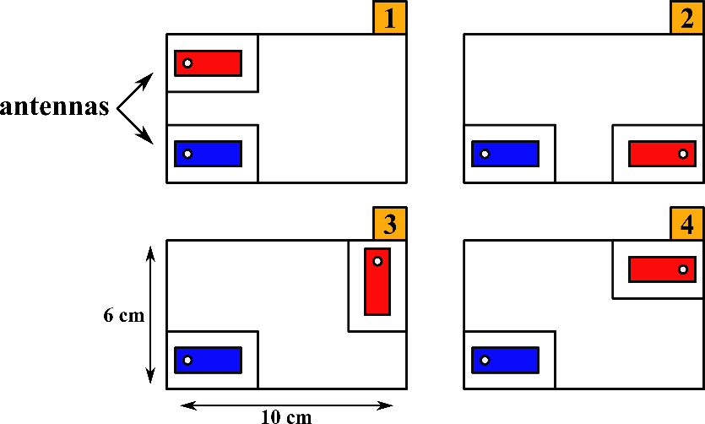
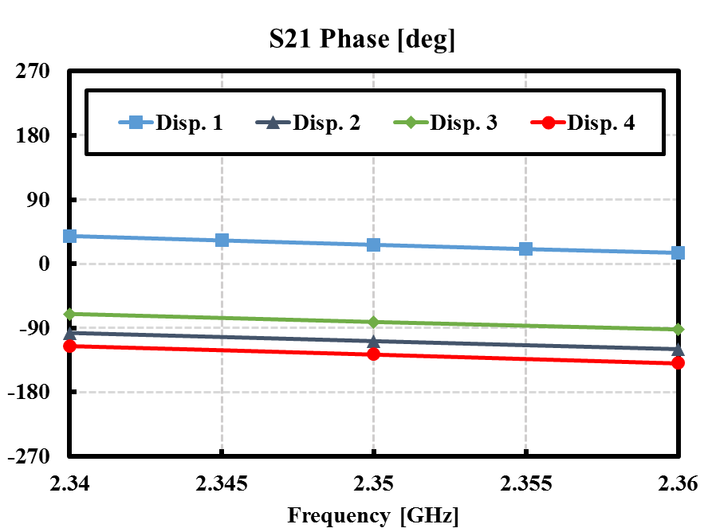
Antenna coupling
Planar Inverted-F Antenna (PIFA)
In-Band (200MHz) coupling analysis [4]
Gain: from -16dB to -22dB
Group delay: from 3ns to 4ns
These features may change due to the external environment

Slide 21
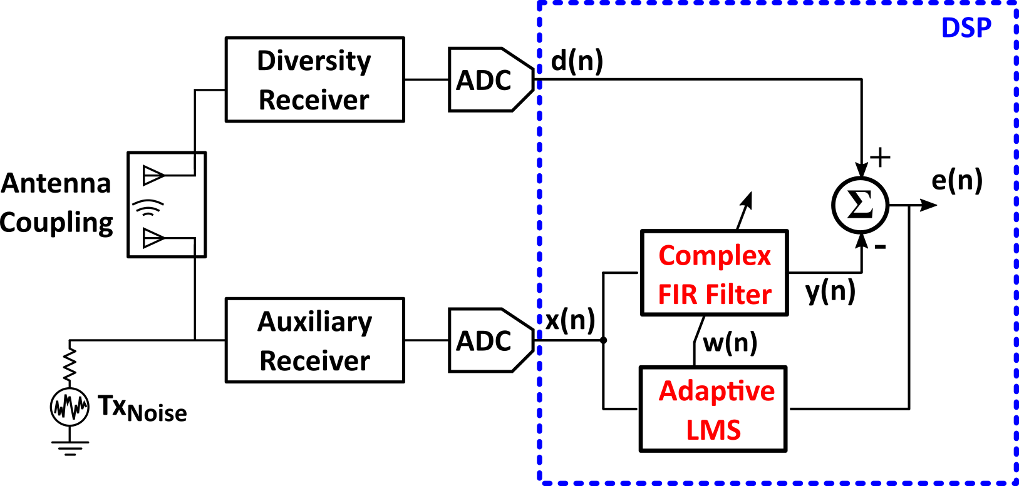
Least Mean Square Digital Equalizer
Iterative method [5] that converges to the optimal Wiener filter solution
It can dynamically change the filter response
Wiener filter theory [6]
Cross-correlation vector
Optimal coefficients
Autocorrelation matrix
Minimum mean square error
MAX digital noise reduction depends on the signals correlation

Slide 22
White Noise
In continuous time, the cross-correlation corresponds to the impulsive autocorrelation of x(t) shifted by the antenna coupling group delay
In discrete time, the cross-correlation is non-zero only if the group delay is perfectly multiple of the sampling period (unrealistic)
Poor DNR

Slide 23
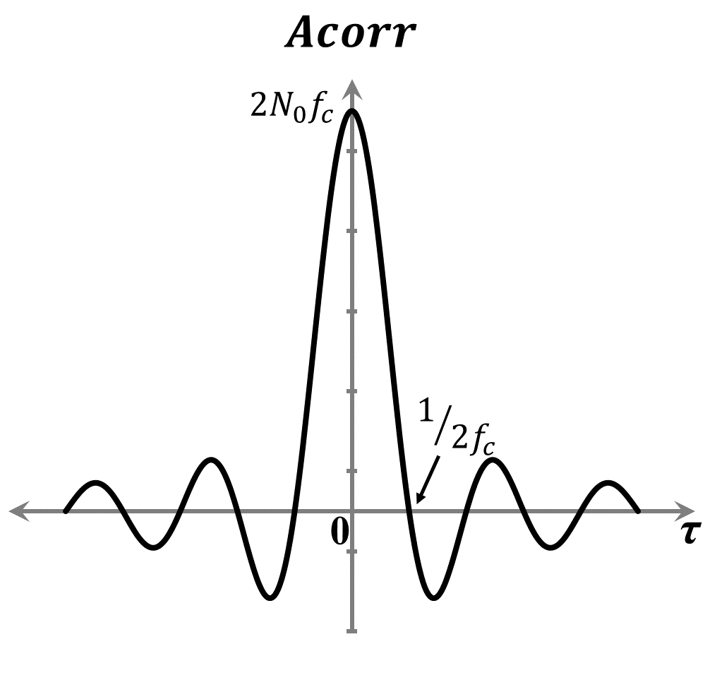
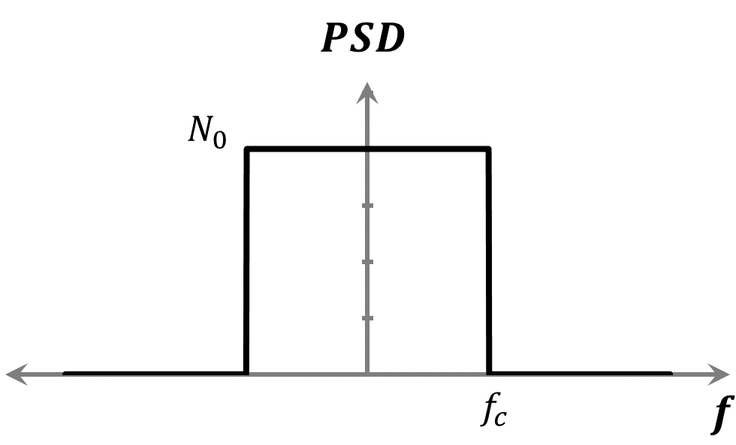
Filtered Noise
The baseband filters, usually used before the ADCs, extend the timeframe in which the autocorrelations of the signals, and hence their cross-correlation, are non-zero.
It will depend on the filters specifications (bandwidth, order, etc.)
Ideal band-limited white noise

Slide 24
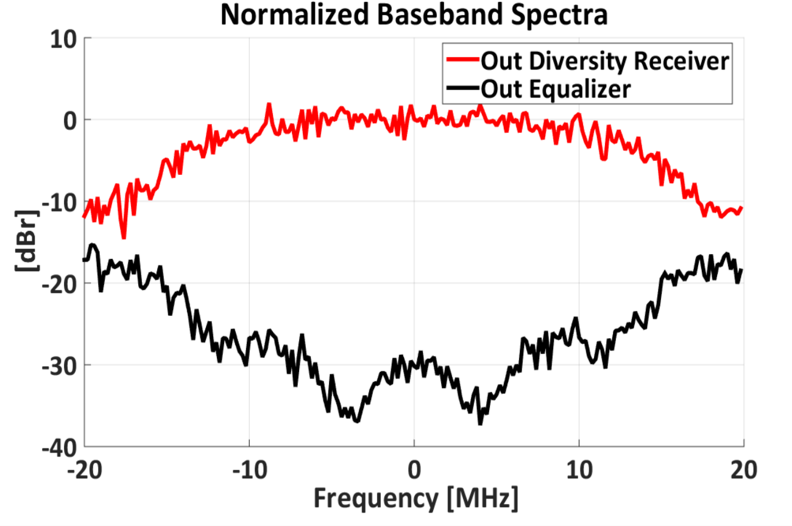
Digital Noise Reduction Performance
Baseband Specifications
Signal Bandwidth | 20MHz
Analog LPF | 4th order Butterworth f_{c} = 15MHz
ADC | f_{s} = 40MHz 8bits
Digital Equalizer | 4th order Complex LMS FIR filter
Antenna coupling
group delay = 4ns
DNR (Total)=21dB

Slide 25
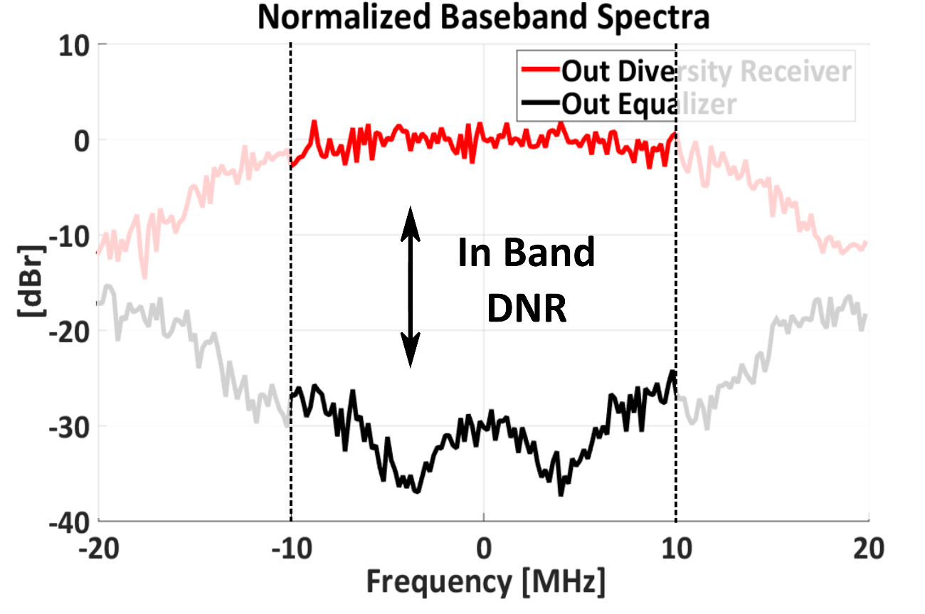
Digital Noise Reduction Performance
Baseband Specifications
Signal Bandwidth | 20MHz
Analog LPF | 4th order Butterworth f_{c} = 15MHz
ADC | f_{s} = 40MHz 8bits
Digital Equalizer | 4th order Complex LMS FIR filter
Antenna coupling
group delay = 4ns
DNR (In Band)=28dB
Signal Bandwidth

Slide 26
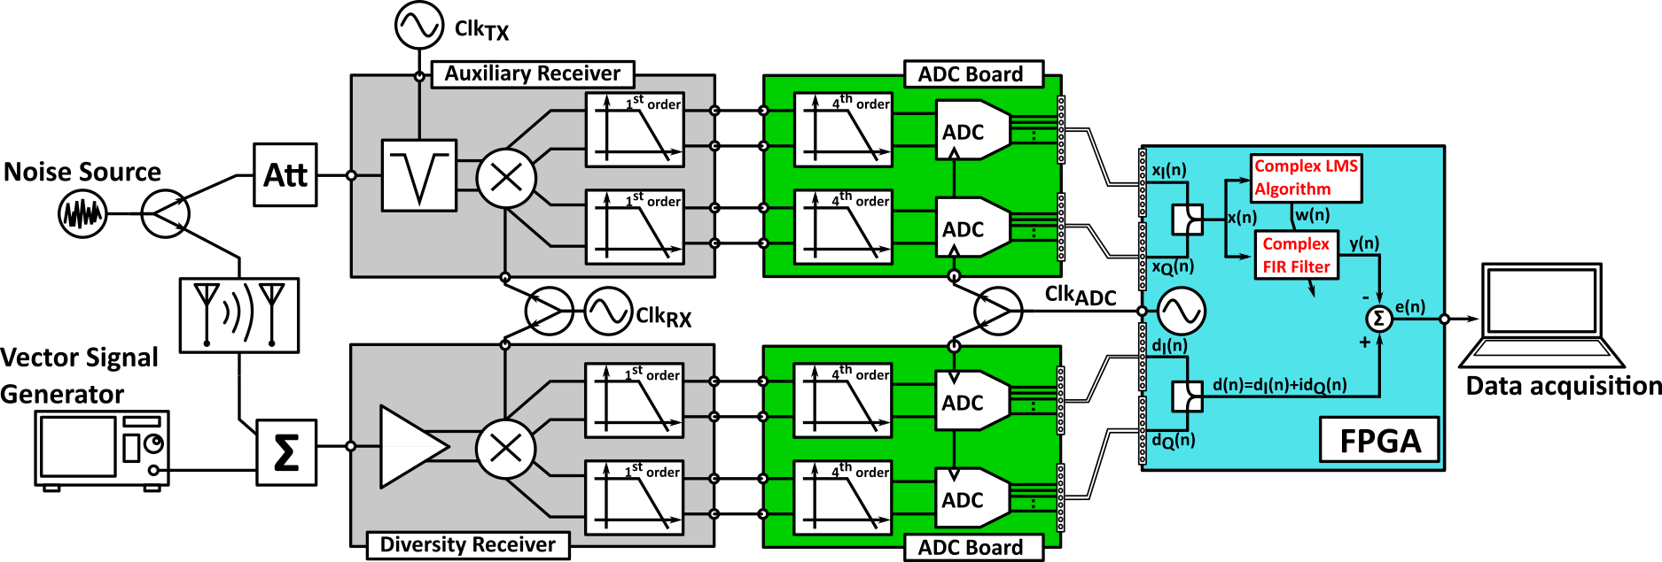
Experimental Setup
Input Signals
Generators
Receivers’ Boards
RF Chips Prototype
[2.C] [3]
ADCs’ Boards
DSP
$$Clk_{RX}=1,2 GHz Clk_{TX}=1 GHz Clk_{ADC}=40 MHz$$

Slide 27
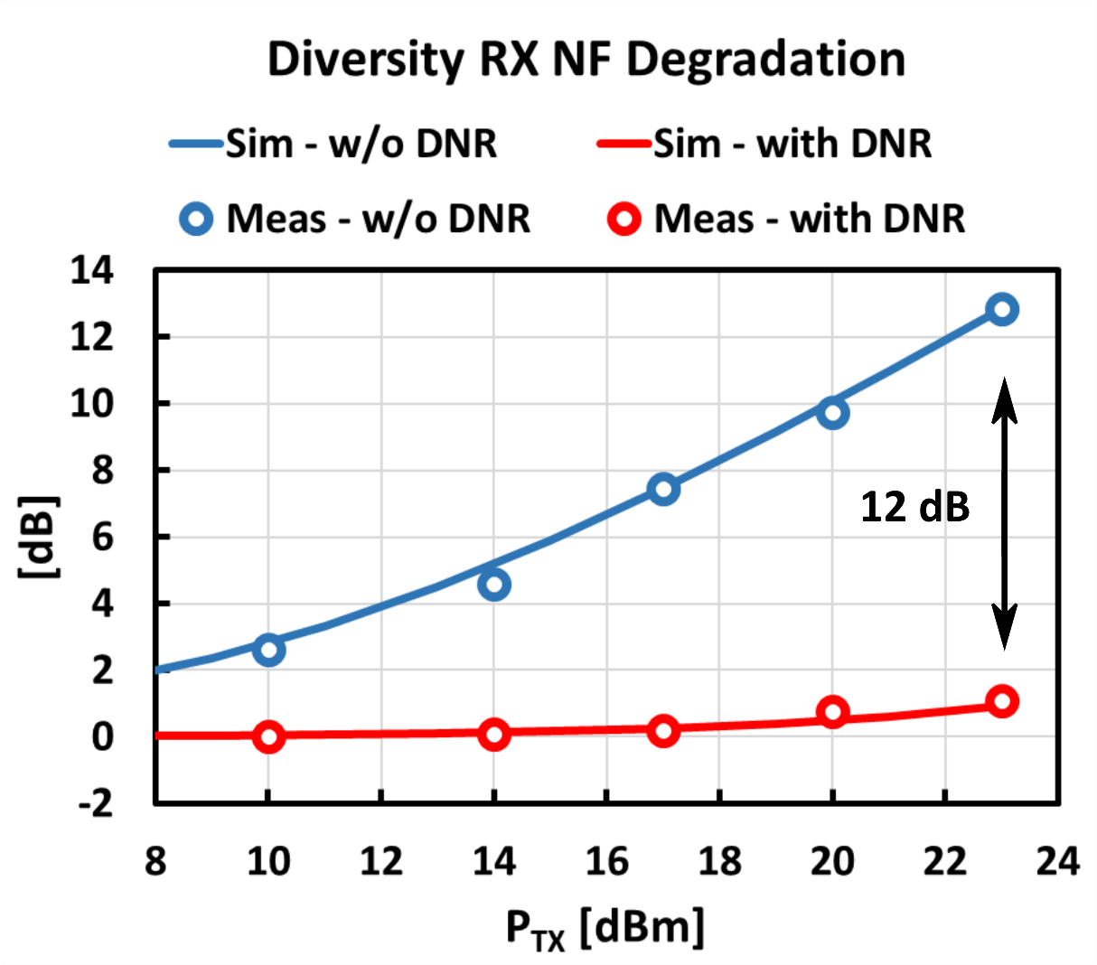
Experimental Results: DNR (1)
System specifications
TX Noise power | -155 dBc/Hz
Coupling | 25 dB
NF Diversity | 5.2 dB
NF Auxiliary | 6.2 dB
DNR | 28 dB

Slide 28
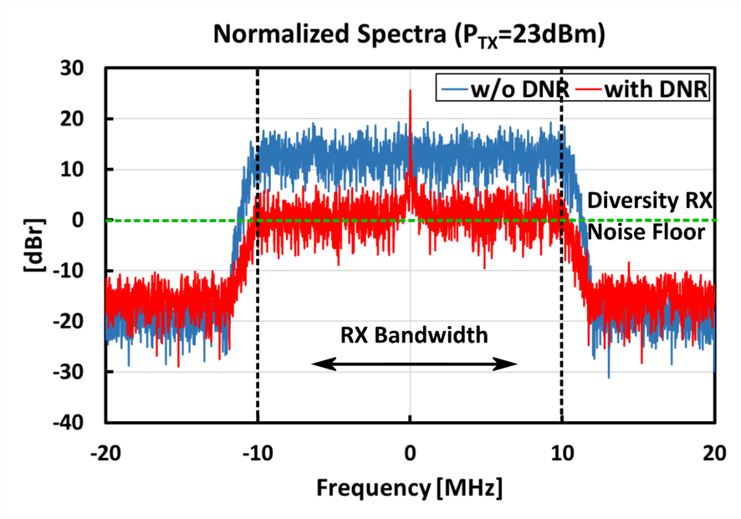
Experimental Results: DNR (2)
The DNR restores the receiver sensitivity up to P_{TX}=23dBm
Without DNR, ΔNF ≈ 13 dB;
With DNR ΔNF ≈ 1 dB
Equivalent Tx_{noise} = -171 dBc/Hz

Slide 29
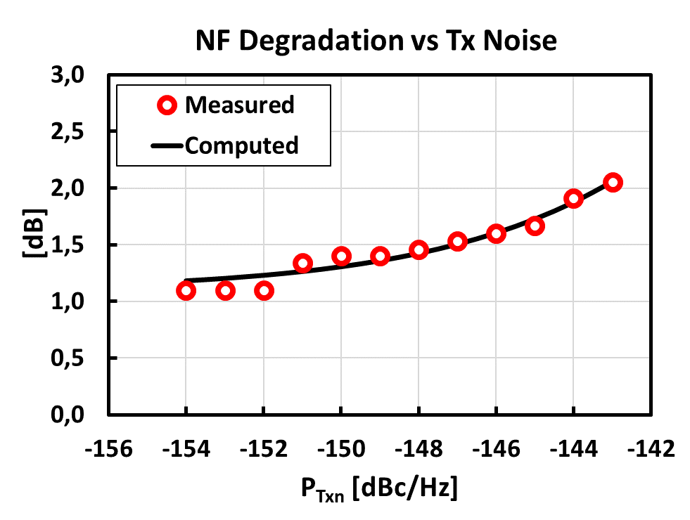
Experimental Results: DNR (3)
TX_{noise} = -143 dBc/Hz
ΔNF ≈ 2 dB
Higher TX_{noise} levels does not significantly degrade NF_{RX.}

Slide 30
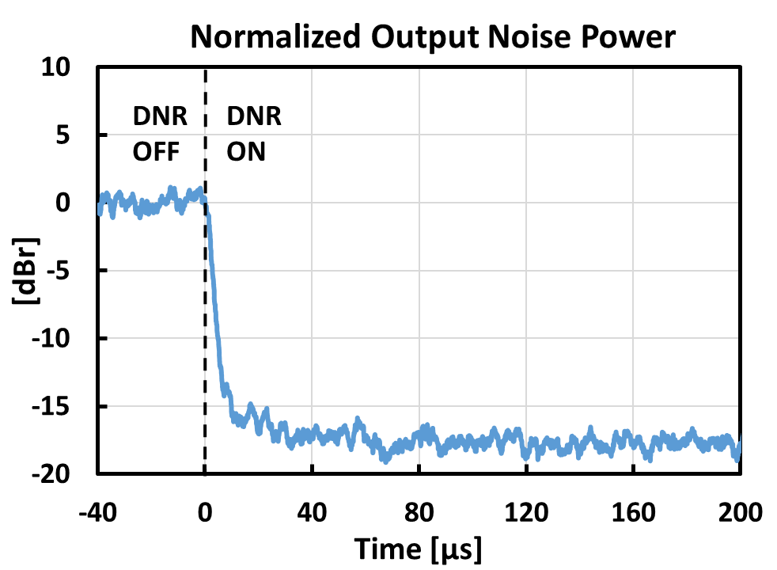
Experimental Results: Convergence Time
The equalizer reaches the optimal configuration after a few tens of microseconds
Efficient tracking of antenna coupling variations

Slide 31
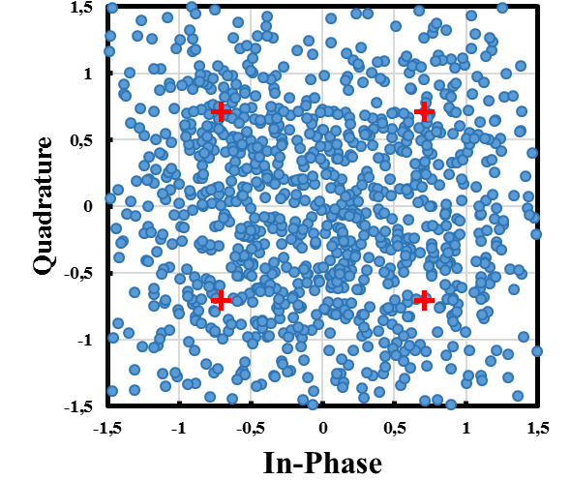
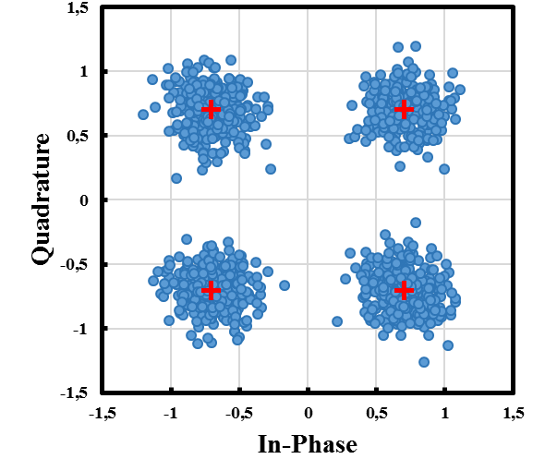
Experimental Results: RX signal
20 MHz QPSK modulated signal
DNR OFF
DNR ON
DNR OFF: MER ≈ 1 dB
DNR ON: MER ≈ 13 dB

Slide 32
Outline
SAW-Less Digitally-Assisted Receivers
Motivations
My Activity
Technical details
Digital Tx Noise Reduction in SAW-Less Diversity Receivers
Digital Background Control for Hybrid Transformer-based Receivers
Publications and Questions

Slide 33
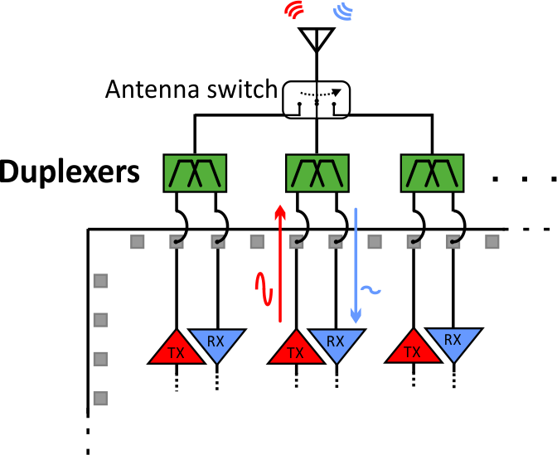
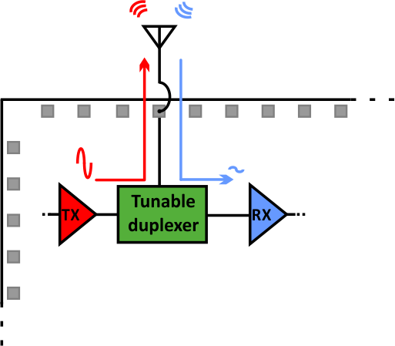
Tunable Duplexer
The idea is of replacing multiple external SAW-based duplexers (FDD standards) with a tunable on-chip circuit

Slide 34
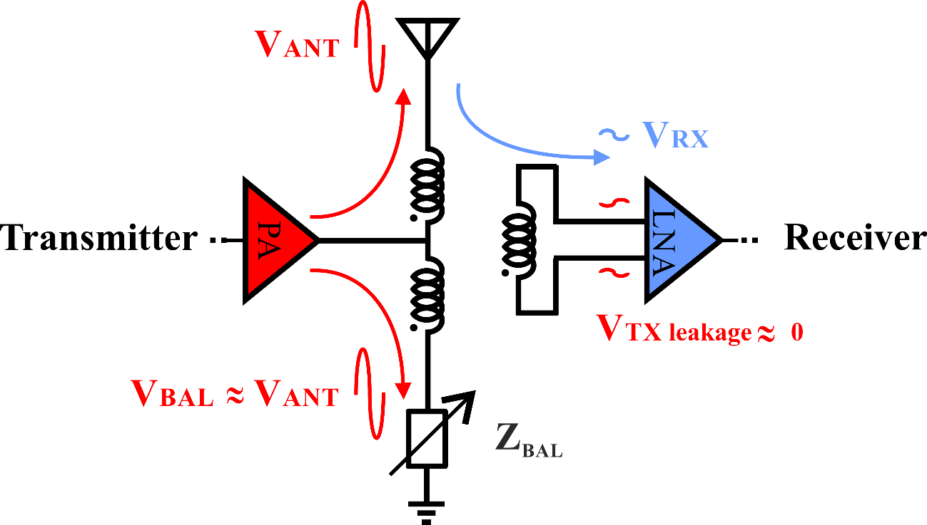
Hybrid Transformer
A hybrid transformer is a four-ports circuits with a biconjugacy between alternate sets of ports
If properly balanced, it ensures a good isolation level between transmitter and receiver

Slide 35
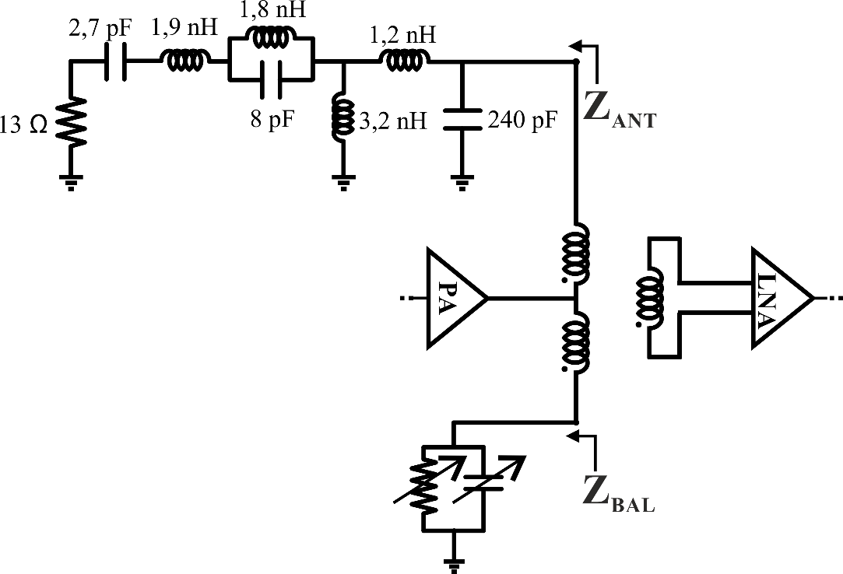
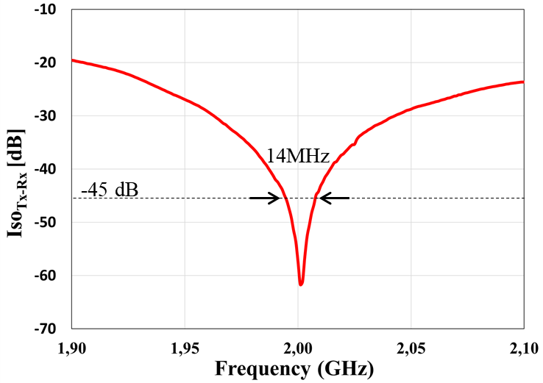
Isolation Sensitivity - Frequency Domain
Planar Inverted-F Antenna (PIFA) + parasitics (bondwire, pad) model [7]
Programmable R-C parallel network
The frequency dependence of a realistic antenna limits the isolation level over a certain bandwidth

Slide 36
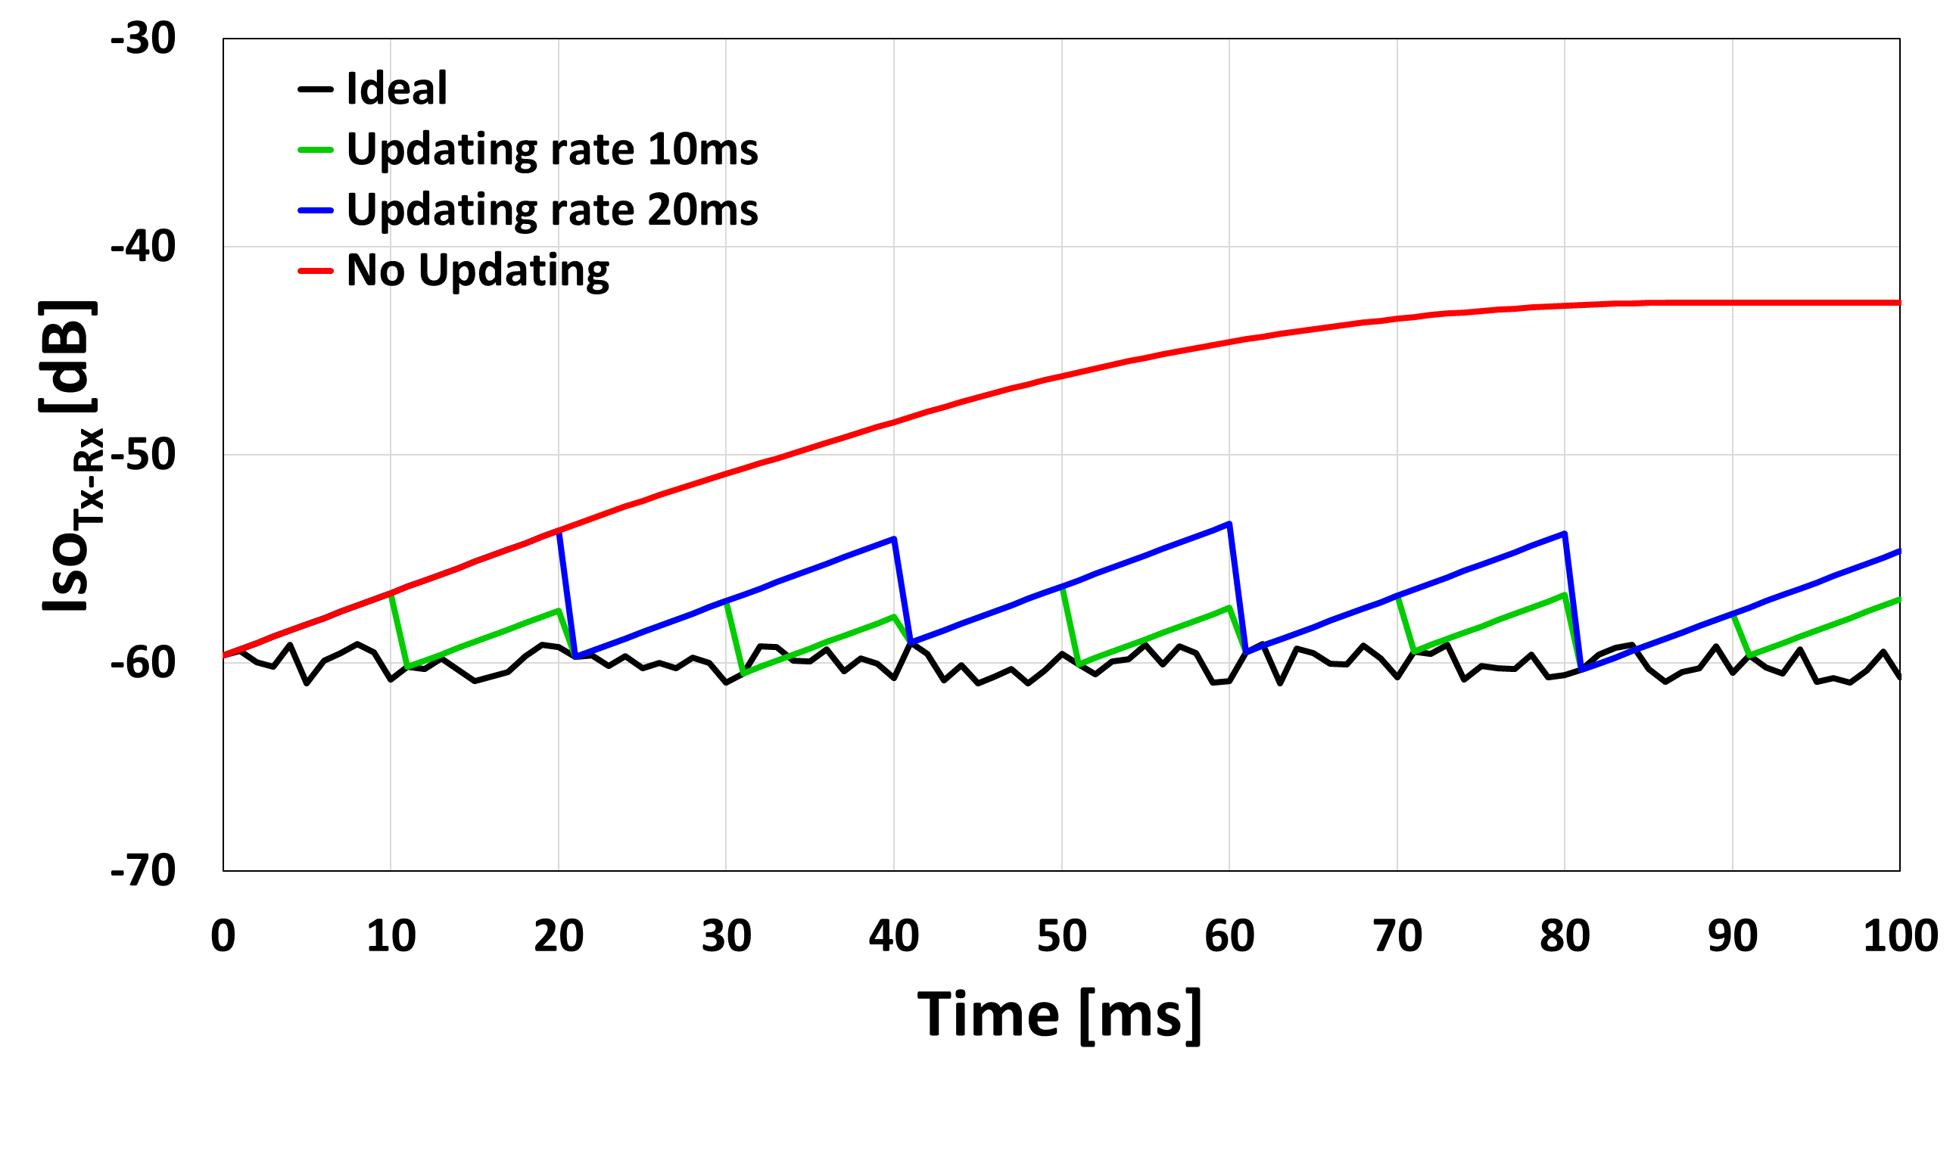
Isolation Sensitivity - Time Domain
The antenna interactions between antenna and external environment determine a time-dependent balancing [8]
A 10ms updating rate keeps the isolation worsening below 3dB (green curve)

Slide 37
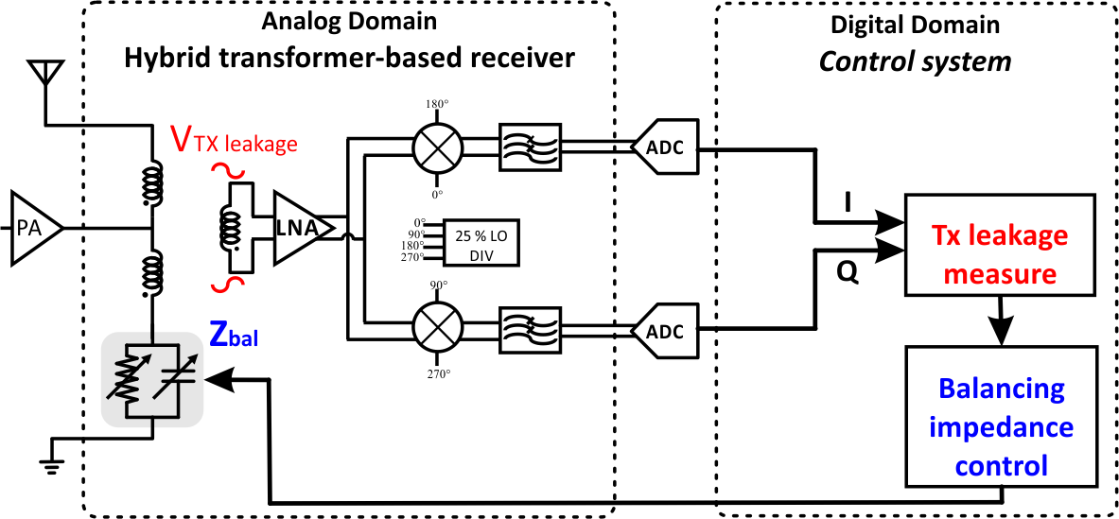
Proposed Solution: Digital Control System
RF Chip prototype [2]
FPGA (this thesis) [1.J][1.C]
The aim is to provide a hardware implementation of a low power control system tailored to an integrated duplexer receiver prototype

Slide 38
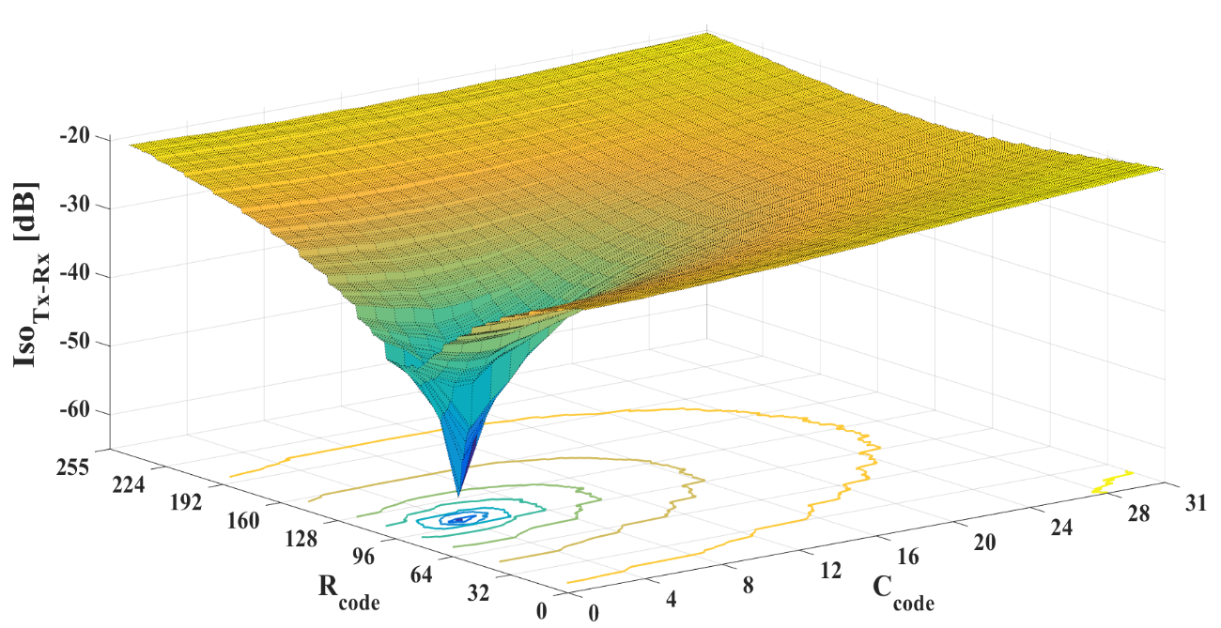
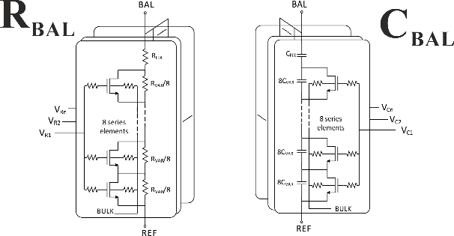
Balancing Control
Problem formulation
Minimize
The control system should find the balancing value to optimize the Tx-Rx isolation
In realistic operating conditions
is a priori unknown
changes with the time
[35,70] Ω
8 bits
[200,400] fF
5 bits

Slide 39
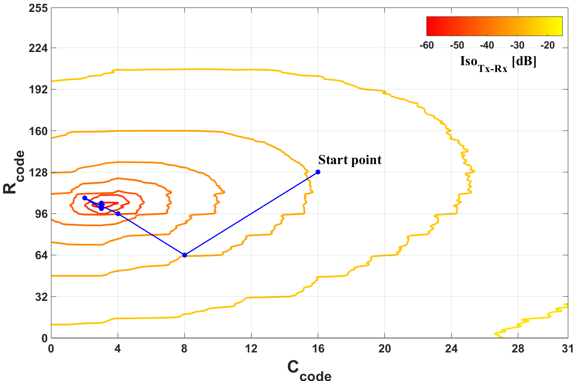
Optimization Algorithm
Customized gradient descent method
Gradient components estimated through Tx leakage measurements and exploiting finite difference approximations
Only the difference sign (sgn) is effectively used to identify the right direction
The updating step size γ is chosen like in the binary search method

Slide 40
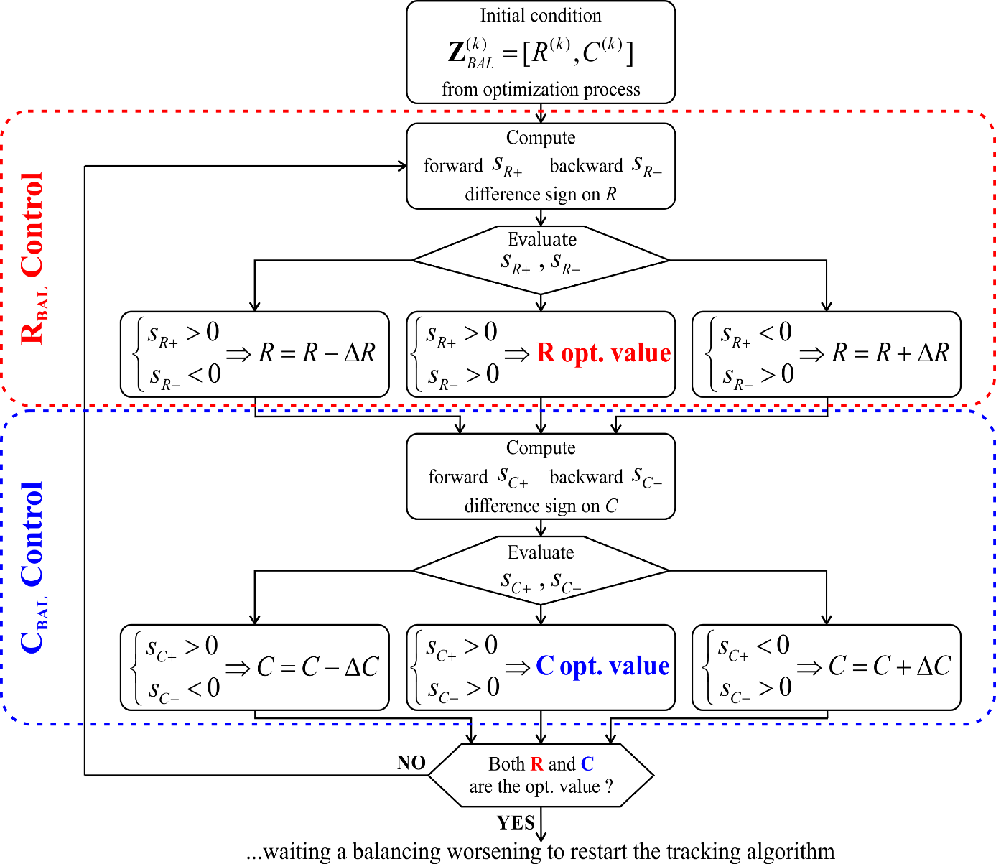
Tracking Algorithm
Aim
following the slow drift of the optimal configuration
Variations much slower with respect to the settling time of the control system
Only a few LSBs need to be adjusted

Slide 41
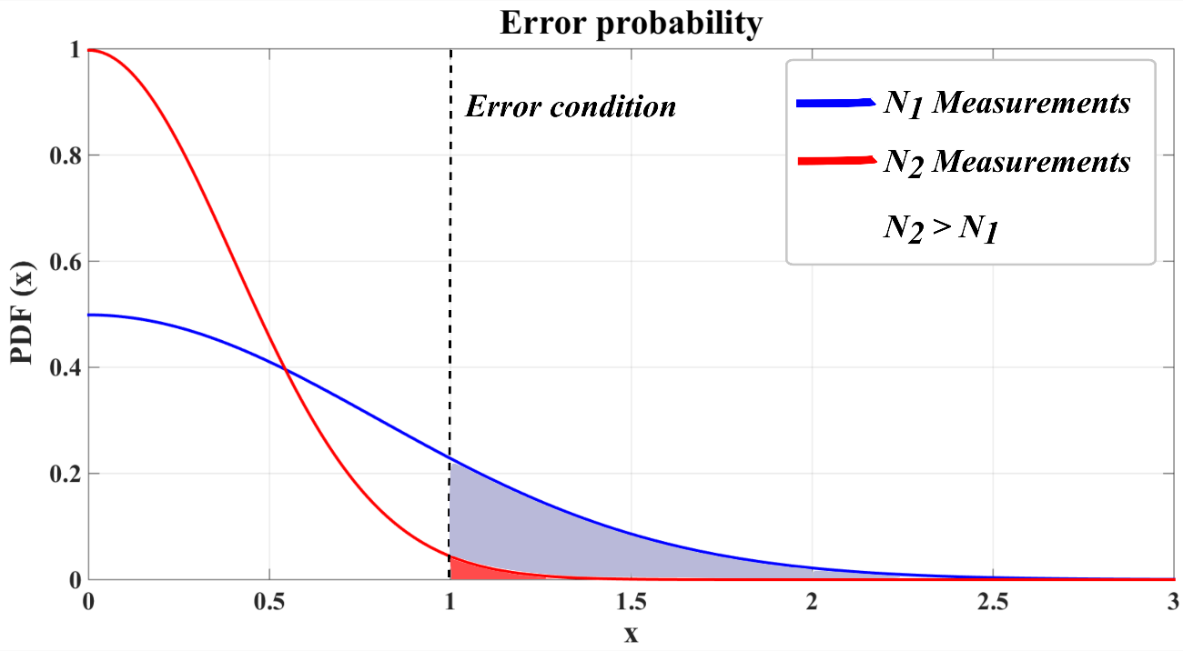
Adaptive Monte Carlo Method
The signal noise could compromise the gradient evaluation (e.g. on R_{BAL}):
Additive White Gaussian Noise
Normalized error
Error condition
According to the input SNR, the control system adaptively defines the number of measurements N to keep the error probability below a tolerated value (e.g. 1/1000)

Slide 42
Digital control circuit
Receiver bandwidth = 5MHz @RF
I,Q signal bandwidth = 2.5 MHz
Sampling frequency = 5 MHz (Nyquist)
Dynamic range = 7 bits
Synthesis report
Technology | 40nm CMOS
Cell Area [µm²] | 7288
Power [µW] | 19.13

Slide 43
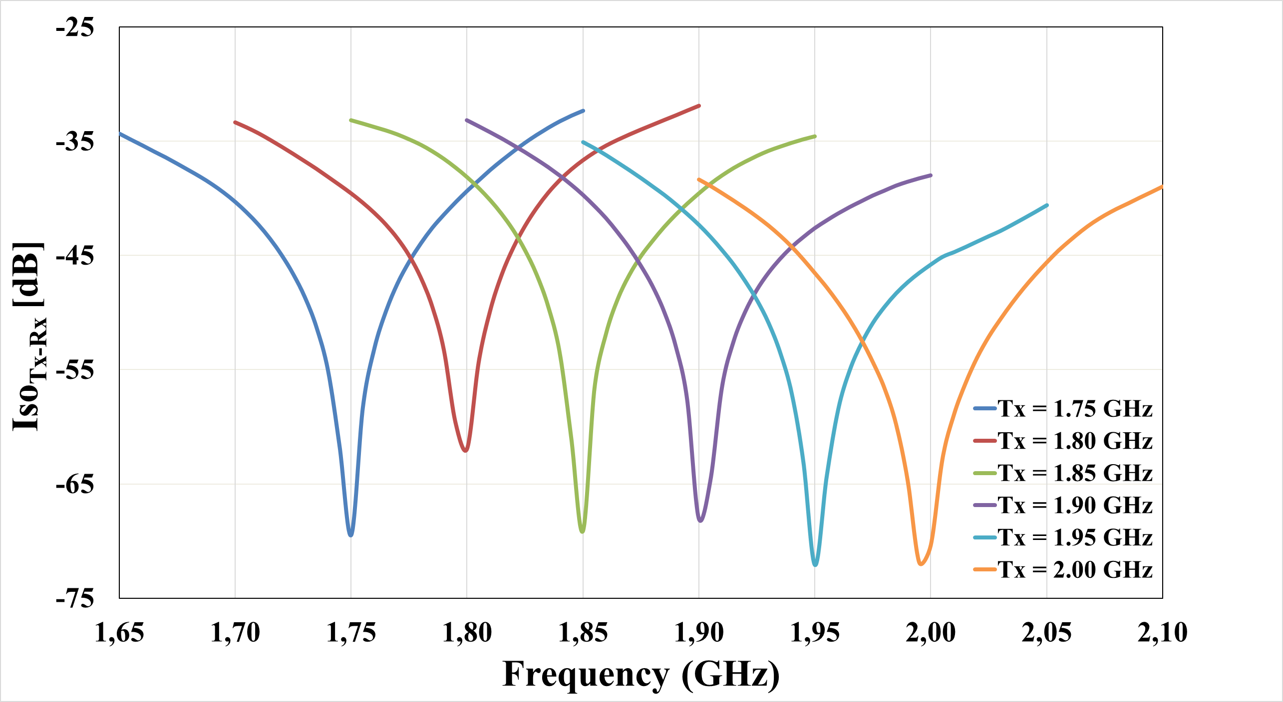
Experimental Results: Tunability
Properly changing the balancing impedance, it is possible to tune the hybrid transformer at different transmit bands

Slide 44
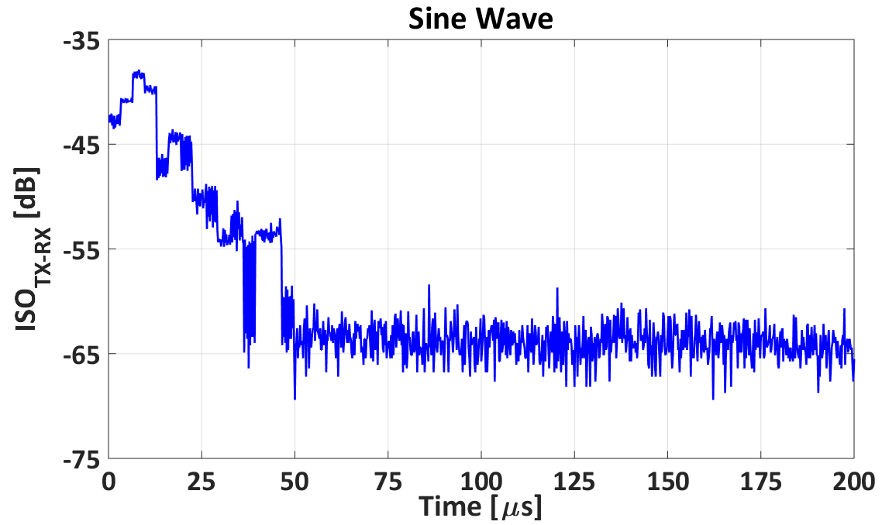
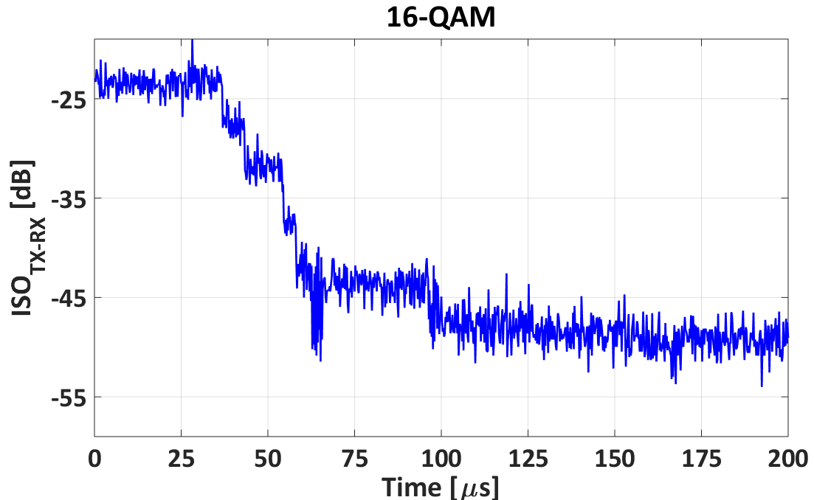
Experimental Results: Optimization
The optimization process is completed in an acceptable time even when modulated signals with high peak to average ratio are transmitted
Tx Signal | Average Convergence Time [µs]
Sine Wave | 50
QPSK | 105
8-PSK | 127
16-QAM | 153

Slide 45
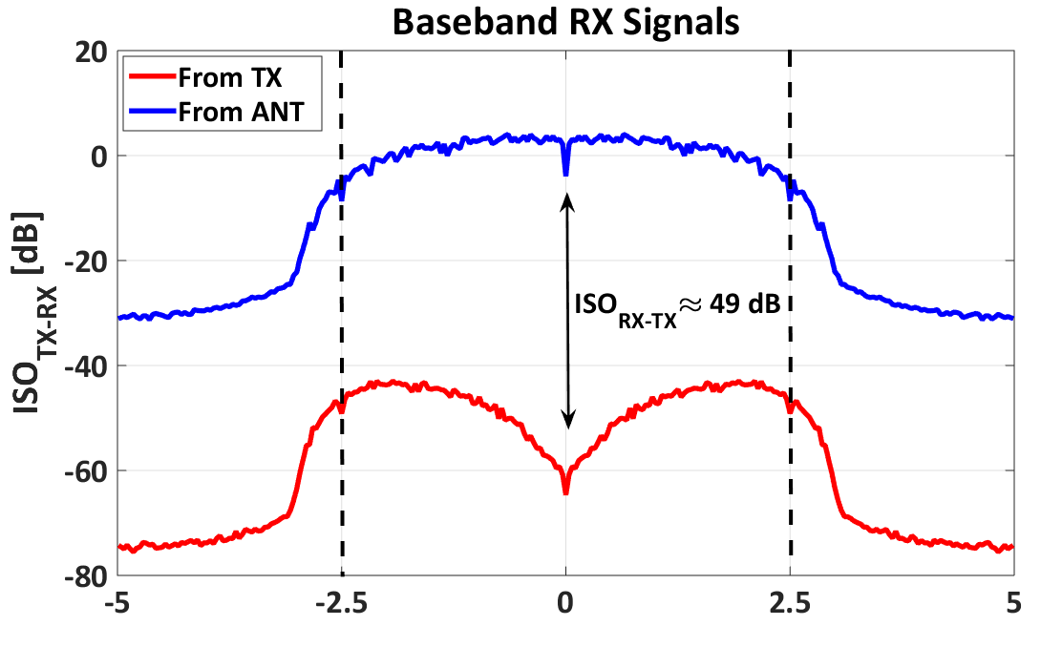
Experimental Results: Isolation Bandwidth
Signal Bandwidth
With a modulated signal, the optimal ISO_{TX-RX} is obtained when the Z_{ANT} ≈ Z_{BAL} at the TX carrier frequency (middle point of the signal bandwidth)

Slide 46
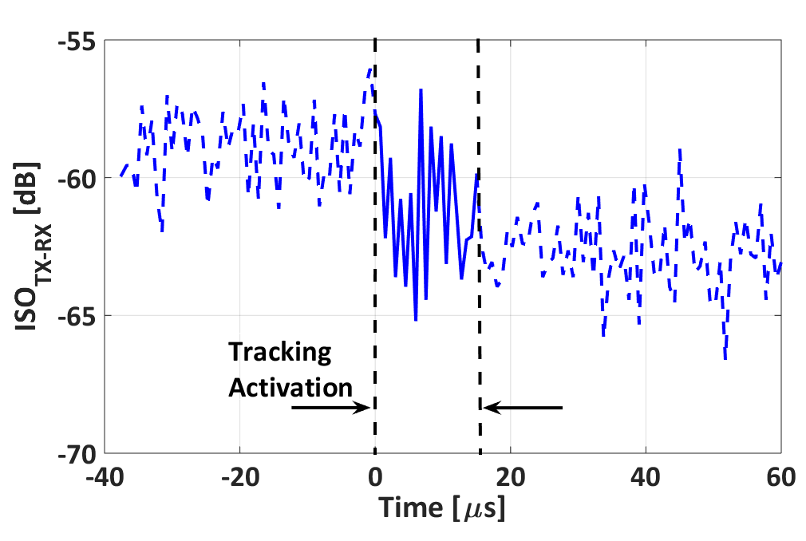
Experimental Results: Tracking
After a slight change of the balancing condition, the tracking algorithm restores the optimal value after a few iterations

Slide 47
Credit Summary

Slide 48
Publications
Journal papers:
G. Castellano, D. Montanari, D. De Caro, D. Manstretta and A. G. M. Strollo, "An Efficient Digital Background Control for Hybrid Transformer-Based Receivers," in IEEE Transactions on Circuits and Systems I: Regular Papers, vol. PP, no. 99, pp. 1-13, early access.
E. Napoli, G. Castellano, D. De Caro, D. Esposito, N. Petra and A. G. M. Strollo, "A SISO Register Circuit Tailored for Input Data with Low Transition Probability," in IEEE Transactions on Computers, vol. 66, no. 1, pp. 45-51, Jan. 1 2017.
E. Napoli, G. Castellano, D. De Caro, D. Esposito, N. Petra and A. G. M. Strollo, "Single Bit Filtering Circuit Implemented in a System for the Generation of Colored Noise," in IEEE Transactions on Circuits and Systems I: Regular Papers, vol. 64, no. 5, pp. 1040-1050, May 2017.
D. De Caro, E. Napoli, D. Esposito, G. Castellano, N. Petra and A. G. M. Strollo, "Minimizing Coefficients Wordlength for Piecewise-Polynomial Hardware Function Evaluation With Exact or Faithful Rounding," in IEEE Transactions on Circuits and Systems I: Regular Papers, vol. 64, no. 5, pp. 1187-1200, May 2017.
D. De Caro, F. Tessitore, G. Vai, G. Castellano, E. Napoli, N. Petra, C. Parrella, A. G. M. Strollo, “Single flip-flop driving circuit for glitch-free NAND-based digitally controlled delay-lines”, Springer, Circuits Syst Signal Process (2017) 36: 1341.
G. Castellano, D. De Caro, D. Esposito, P. Bifulco, E. Napoli, N. Petra, M. Romano, M. Cesarelli, A.G.M. Strollo, " A Hardware Oriented Real Time Filter for Poisson Video Denoising with Application to X-ray Fluoroscopy", submitted to IEEE Transactions on Circuits and Systems for Video Technology.

Slide 49
Publications
Conference papers:
G. Castellano, D. De Caro, A. G. M. Strollo and D. Manstretta, "A low power control system for real-time tuning of a hybrid transformer-based receiver," 2016 IEEE International Conference on Electronics, Circuits and Systems (ICECS), Monte Carlo, 2016, pp. 328-331.
D. Montanari, D. Manstretta, R. Castello, G. Castellano, "A 0.7-2 GHz Auxiliary Receiver with Enhanced Compression for SAW-less FDD,“ presented at ESSCIRC Conference 2017: 43rd European Solid-State Circuits Conference, Leuven, 2017.
D. Esposito, G. Castellano, D. De Caro, E. Napoli, N. Petra and A. G. M. Strollo, "Approximate adder with output correction for error tolerant applications and Gaussian distributed inputs," 2016 IEEE International Symposium on Circuits and Systems (ISCAS), Montreal, QC, 2016, pp. 1970-1973.
E. Napoli, G. Castellano, D. Esposito and A. G. M. Strollo, "Digital circuit for the generation of colored noise exploiting single bit pseudo random sequence," 2016 IEEE 7th Latin American Symposium on Circuits & Systems (LASCAS), Florianopolis, 2016, pp. 23-26.

Slide 50
References
B. Razavi, “RF Microelectronics,” 2nd Edition, Prentice-Hall Press, Upper Saddle River, NJ, USA, 2011.
M. Ramella, I. Fabiano, D. Manstretta, and R. Castello, “A 1.7-2.1GHz +23dBm TX Power Compatible Blocker Tolerant FDD Receiver with Integrated Duplexer in 28nm CMOS”, 2015 IEEE Asian Solid-State Circuits Conference (A-SSCC), Xiamen, 2015, pp. 1-4.
E. Kargaran, S. Tijani, G. Pini, D. Manstretta and R. Castello, "Low power wideband receiver with RF Self-Interference Cancellation for Full-Duplex and FDD wireless Diversity," 2017 IEEE Radio Frequency Integrated Circuits Symposium (RFIC), Honolulu, HI, 2017, pp. 348-351.
D. Montanari, L. Silvestri, M. Bozzi and D. Manstretta, "Antenna coupling and self-interference cancellation bandwidth in SAW-less diversity receivers," 2016 46th European Microwave Conference (EuMC), London, 2016, pp. 731-734.
B. Widrow, J. McCool and M. Ball, "The complex LMS algorithm," in Proceedings of the IEEE, vol. 63, no. 4, pp. 719-720, April 1975.
S. Haykin, “Adaptive Filter Theory,” 3rd Edition, Prentice-Hall, Inc. Upper Saddle River, NJ, USA, 1996.
S. H. Abdelhalem, et al., “Tunable CMOS Integrated Duplexer with Antenna Impedance Tracking and High Isolation in the Transmit and Receive Bands”, IEEE Trans. on MTT, pp. 2092–2104, Sep 2014
L. Laughlin, M. Beach, K. Morris, and J. L. Haine, “Electrical balance duplexing for small form factor realization of in-band full duplex”, IEEE Commun. Mag., vol. 53, no. 5, pp. 102–110, May 2015

Slide 51
Thank you for your attention!
Questions?

