Slide 1
Gerardo Castellano Tutor: Prof. Davide De Caro XXX Cycle - I year presentation
Real-time Denoising of Fluoroscopic Videos

Slide 2
My Background
I received the M.S. degree in Electronic Engineering from University of Napoli “Federico II”
I work within the VLSI DIETI group
My fellowship is financed by Marvell (Italia) - DIETI
Prof. Davide De Caro
Prof. Antonio Strollo
Prof. Ettore Napoli
Prof. Nicola Petra

Slide 3
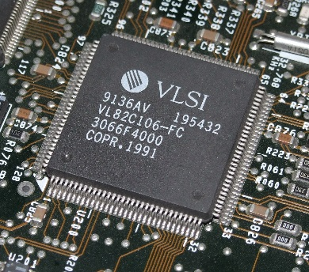
Research activity
VLSI Digital systems
Circuits for image processing
Real-time denoising of fluoroscopic videos
Cooperation
Biomedical DIETI group
Wireless mobile terminals
Digitally-enhanced transceivers
Cooperation
Microelectronics Laboratory University of Pavia
Marvell Technology Group

Slide 4
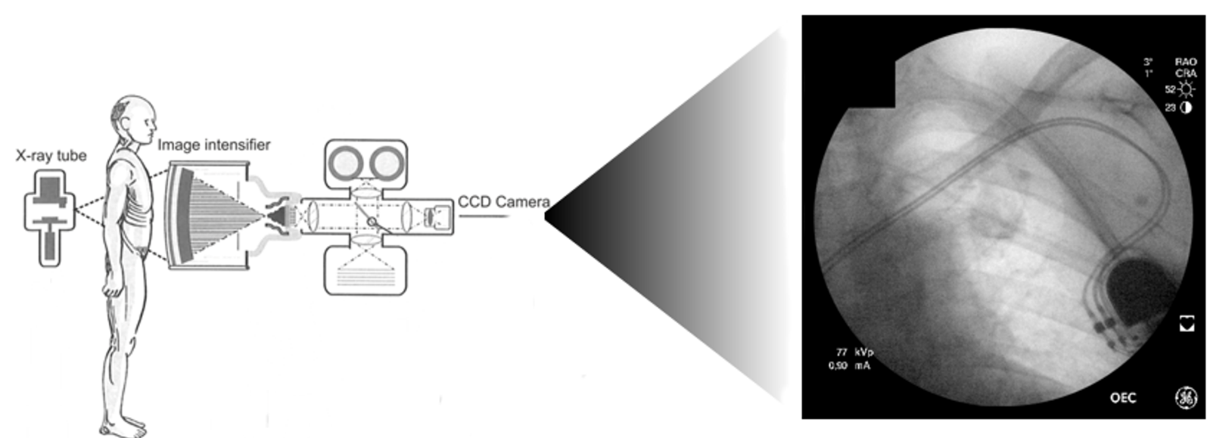
X-ray fluoroscopy
Low X-Ray dose
Quantum noise
Real-time noise reduction without detail loss

Slide 5
State-of-the-art
4-PDE [1] - BM3D [2] - VBM3D [3] - BM3Dc [4] …
Highly effective
Optimized for signal-dependent noise
Computationally complex
Spatio-Temporal Average Filter [5]
Suitable for real-time elaboration
Optimized for signal-dependent noise
Poor performance with high noise level
FIR filter architecture
[1]Yu-Li You, M. Kaveh, “Fourth-order partial differential equations for noise removal”, IEEE Transaction on Image Processing, vol. 9, no. 10, 2000.
[2]K. Dabov, A. Foi, V. Katkovnik, K. Egiazarian, “Image denoising by sparse 3-D transform-domain collaborative filtering”, IEEE Transactions on Image Processing, vol. 16, no. 8, pp. 2080–2095, 2007.
[3]K. Dabov, A. Foi, K. Egiazarian, “Video denoising by sparse 3D trasform-domain collaborative filtering”, European Signal Processing Conference (EUSIPCO), Poznań, Poland, September 3-7, 2007.
[4]A. Foi, “Clipped noisy images: Heteroskedastic modeling and practical denoising”, Signal Processing 89 (12), pp. 2609–2629, 2009.
[5]M. Genovese, P. Bifulco, D. De Caro, E. Napoli, N. Petra, M. Romano, M. Cesarelli, A.G.M. Strollo, “Hardware implementation of a spatio-temporal average filter for real-time denoising of fluoroscopic images”, Integration, the VLSI Journal, 2014.

Slide 6
Proposed denoising technique
Purpose |  | Solution
Fine representation of each pixel in the frame |  | Distinguish the temporal elaboration from the spatial one
Temporal filtering with moving average operations (best results) |  | IIR filter properly designed: increase the temporal window without a significant increase of memory
Avoid harmful effects like motion blur and smoothing |  | Conditioned filtering both in time and in space, taking into account the characteristics of the local noise

Slide 7
Results
Input video MSE_{in} PSNR_{in} (dB) SSIM_{in} [6]
20.06 0.234
The proposed method ensures:
comparable performances with some of the most efficiently denoising methods (not suitable for real-time elaboration)
significantly higher performances respect to STAF [5] (suitable for real-time elaboration)
Denoising method | MSE_{out} | PSNR_{out} (dB) | SSIM_{out} [6]
4-PDE [1] |  | 28.36 | 0.740
BM3D [2] |  | 39.87 | 0.990
VBM3D [3] |  | 45.26 | 0.995
BM3Dc [4] |  | 40.09 | 0.991
STAF [5] T=32 S=3x3 |  | 33.73 | 0.974
Proposed T=128 S=3x3 |  | 49.90 | 0.997
T = Temporal window
S = Spatial window
[6] Z. Wang, A. C. Bovik, H. R. Sheikh, E. P. Simoncelli, “Image quality assessment: from error visibility to structural similarity”, IEEE Transaction on Image Processing, vol. 13, no. 4, 2004.

Slide 8
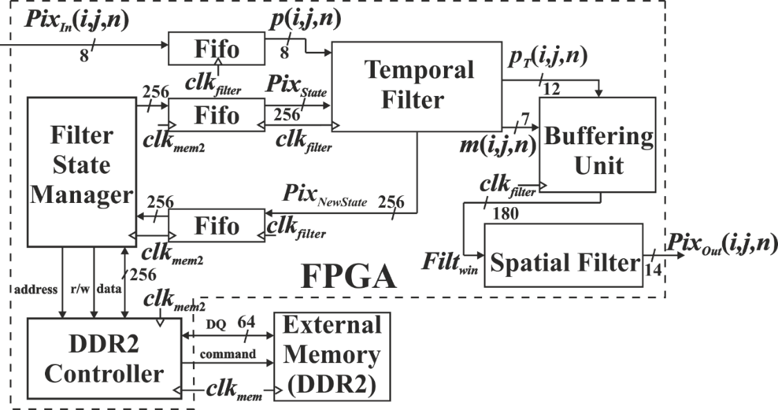
Hardware Implementation
Modern fluoroscopic devices require to process 1024×1024 greyscale images with a frame rate up to 30fps and the proposed circuit is able to filter the video in real time.
The smart design of the system allows to distinctly overcomes the STAF [5] circuit in term of required resource.
Resource usage from the circuits when implemented on a Stratix IV EP4SGX70HF35C2 Altera FPGA with 1GB RAM DDR2 (ext. memory)
Circuit | #ALM (%) | #FF (%) | #M9K (%) | MLAB (kb) (%) | #DSP 18-bit (%) | Frequency (MHz) | #fps frame size 1024x1024
STAF [5] T=32 S=3x3 | 23202/29040 (80%) | 22480/58080 (39%) | 116/462 (25%) | 103/908 (11%) | 2/384 (<1%) | 51.4 | 49
Proposed T=128 S=3x3 | 6237/29040 (22%) | 5977/58080 (11%) | 26/462 (6%) | 63/908 (7%) | 14/384 (4%) | 52.33 | 49

Slide 9
Product
Journal papers
G. Castellano, D. Esposito, P. Bifulco, D. De Caro, E. Napoli, N. Petra, M. Cesarelli, A.G.M. Strollo, “Spatio-temporal IIR Filter for Real-time Denoising of Fluoroscopic Videos”, IEEE Trans. On Biomedical Circuits and Systems, submitted.
S. Balamurugan, A. Biswal, G. Castellano, D. De Caro, R. Marimuthu, E. Napoli, N. Petra, P.S. Mallick and A.G.M. Strollo, “Design of Low Power Fixed-Width Multipliers with Column Bypassing”, IEEE Trans. on VLSI Systems, submitted.
Conference papers
E. Napoli, G. Castellano, D. Esposito, A.G.M. Strollo, “Digital Circuit for the Generation of Colored Noise Exploiting Single Bit Pseudo Random Sequence”, 2016 IEEE 7th Latin American Symposium on Circuits and Systems, submitted.
E. Napoli, G. Castellano, D. Esposito, A.G.M. Strollo, “Programmable Delay Circuit for Low Transition Probability Signals”, 2016 IEEE International Symposium on Circuits and Systems, submitted.
D. Esposito, G. Castellano, D. De Caro, E. Napoli, N. Petra, A.G.M. Strollo, “Approximate Adder With Output Correction for Error Tolerant Applications and Gaussian Distribuited Inputs”, 2016 IEEE International Symposium on Circuits and Systems, submitted.

Slide 10
Next year
System evolution to further improve its performance in video with a large number of moving objects.
Carry on the research activity on the digitally-enhanced transceivers for new generation of wireless mobile terminals.
Summary of credits:
 | Credits year 1 |  |  |  |  |  |  |  | Credits year 2 |  |  |  |  |  |  |  | Credits year 3
 |  | 1 | 2 | 3 | 4 | 5 | 6 |  |  | 1 | 2 | 3 | 4 | 5 | 6 |  |  | 1 | 2 | 3 | 4 | 5 | 6
 | Estimated | bimonth | bimonth | bimonth | bimonth | bimonth | bimonth | Summary | Estimated | bimonth | bimonth | bimonth | bimonth | bimonth | bimonth | Summary | Estimated | bimonth | bimonth | bimonth | bimonth | bimonth | bimonth | Summary | Total | Check
Modules | 20 | 0 | 3 | 0 | 7 | 1 | 5 | 16 | 14 |  |  |  |  |  |  | 0 | 0 |  |  |  |  |  |  | 0 | 16 | 30-70
Seminars | 5 | 0 | 0,6 | 2,2 | 1,4 | 0 | 0,2 | 4,4 | 5 |  |  |  |  |  |  | 0 | 0 |  |  |  |  |  |  | 0 | 4,4 | 10-30
Research | 35 | 10 | 6 | 8 | 2 | 9 | 5 | 40 | 41 |  |  |  |  |  |  | 0 | 60 |  |  |  |  |  |  | 0 | 40 | 80-140
 | 60 | 10 | 9,6 | 10 | 10 | 10 | 10 | 60 | 60 | 0 | 0 | 0 | 0 | 0 | 0 | 0 | 60 | 0 | 0 | 0 | 0 | 0 | 0 | 0 | 60 | 180

Slide 11
Thank you for your attention!

