Slide 1
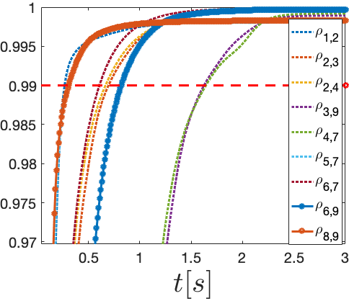
Ricardo Cardona-Rivera Tutor: Mario di Bernardo XXXIV Cycle - II year presentation
Electrical Power Networks:
A systems and control approach
Key Research Questions
Most of the daily-life activities rely on the electrical power systems
The power system is managed of layers of control systems with different timescales
Can we propose a unifying framework to connect all these layers?
How can we improve planning and control strategies of the power network?
Can we decrease the impact of failures by introducing the microgrid concept on the existing power network?
Power network as a multilayer control system:
Primary Layer: control of the power generation devices. Set-point following. High order models
Secondary Layer: frequency integral control, small power imbalances compensation. Frequency dynamics
Tertiary Layer: Active and reactive set-point generation. Constrained Optimization problem. No dynamics
Synchronization-based power network partitioning in microgrids:
The Idea:
Improvement on the network performance through self-sufficient partitions called Microgrids
Frequency dynamics are used to find pairs of nodes that synchronize faster
${\dot{θ}}_{i}=P_{i}+ \sum_{j}{B_{ij}sin(θ_{j}−θ_{i})}$
The Method:
The synchronization time of each pair of nodes connected by a transmission line is computed, based on a phase correlation measure
The chosen partition must minimize the sum of all synchronization times of all pairs of buses inside each microgrid
Phase Correlation $ρ_{ij}\left(t\right)∈[0,1]$
Method applied to the IEEE 9 bus system. The resultant partition is composed of three mode sets. Transmission lines outside partition have the lower susceptance
Time evolution of correlation measure $ρ_{ij}\left(t\right)$ for each pair of nodes of the IEEE 9 bus system. Synchronization is achieved when $ρ_{ij}\left(t\right)>0.99$
Contacts and Acknowledgements
ricardo.cardonarivera@unina.it , +39 0817683607
In collaboration with Mario di Bernardo and Francesco Lo Iudice
Scholarship for foreign students provided by UNINA
Further Developments
Can the synchronization based partitioning method also minimize other planning criteria reported in literature?
How does this partitioning can improve frequency control and tertiary layer control problems?
Notes:
Instructions to fill the poster
Box RGB 22 34 48
Context of your research activity (motivations, needs, trends, activity of your group (if the case)… - describe for self explanatpry)
Box RGB 255 220 0
Your research activity up to the second year (idea, methodology, developments, results, expected validation,… - insert whatever you like, text, images, photos. This box is reserved to your very specific activity, not to your group)
Box RGB 151 23 32
Your contacts
Cooperations with Universities, companies, participations in progrojects and programmes (logos can be included)
Box RGB 79 129 189
Next year
Future developments of your activity
Box width is 80 cm
Box height can be changed according to your needs
The text is written in Calibri font

