Slide 1

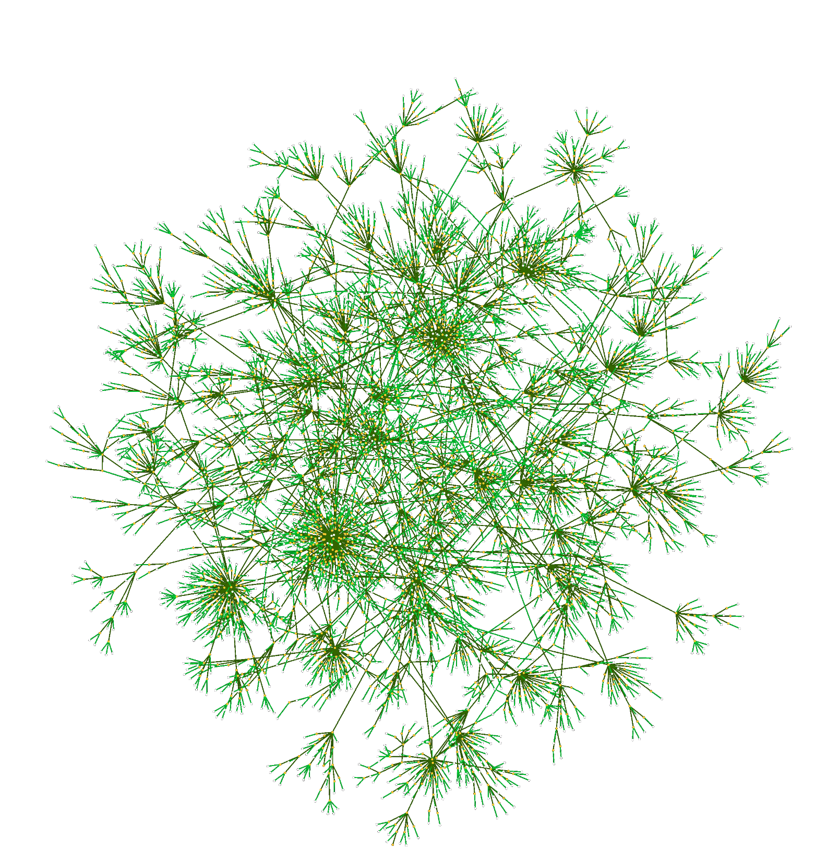

Enrico G. Caldarola
Tutor: Prof. Antonio Picariello
Co-tutor: Prof. Antonio Rinaldi
XXIX Cycle - III Year Presentation
A multi-strategy methodology for ontology integration and reuse
Integrating large and heterogeneous knowledge bases in the rise of Big Data

Slide 2

Presentation Content
  Overall perspective
    My background
      Graduation MS, DIETI group, cooperations
      Type of fellowship
    Credits summary
      Credits
      Specific objects
      Experience abroad
      Table for training (credits)
    Problem addressed
      Relevance
      Approach
  Specific activity
      idea, methodology, developments, results, validation
    Research products
      Publications, Patents
    Question time

Slide 3
My backgroud
2006: MSc in Computer Science Engineering at Politecnico di Bari
Msc Thesis and stage at IBM – Knowledge Factory -BARI
2007: Sintesi SCpA, software developer, HMIs, numerical controls

Slide 4
Collaborations
2013: Research fellow at Institute of Industrial Technologies and Automation (CNR).
2015: ARPA Puglia, Environmental Big Data researches
DIETI: Prof. A. Picariello and A. Rinaldi group.

Slide 5



Fellowship
Member of IAOA: The International Association for Ontology and its Applications;
IARIA eKnow technical committee;
Reviewer at inderscience publisher.

Slide 6
Credit summary
 | Credits year 1 |  |  |  |  |  |  |  | Credits year 2 |  |  |  |  |  |  |  | Credits year 3
 |  | 1 | 2 | 3 | 4 | 5 | 6 |  |  | 1 | 2 | 3 | 4 | 5 | 6 |  |  | 1 | 2 | 3 | 4 | 5 | 6
 | Estimated | bimonth | bimonth | bimonth | bimonth | bimonth | bimonth | Summary | Estimated | bimonth | bimonth | bimonth | bimonth | bimonth | bimonth | Summary | Estimated | bimonth | bimonth | bimonth | bimonth | bimonth | bimonth | Summary | Total | Check
Modules |  |  |  |  |  |  | 5 | 5 |  | 4 |  |  |  |  | 9 | 13 |  |  |  | 6 | 6 |  | 6 | 18 | 36 | 30-70
Seminars |  |  |  |  |  | 0.5 | 6 | 6.5 |  | 1.2 | 6.2 | 0.4 |  | 0.5 | 5 | 13 |  | 2.5 |  |  |  | 0.4 | 5.2 | 8.1 | 28 | 10-30
Research |  | 8 | 7 | 8 | 10 | 8 | 7 | 48 |  | 6 | 3 | 8 | 8 | 7 | 2 | 34 |  | 8 | 7 | 4 | 7 | 6 | 2 | 34 | 116 | 80-140
 |  |  |  |  |  |  |  | 60 |  |  |  |  |  |  |  | 60 |  |  |  |  |  |  |  | 60 | 180 | 180
Notes:
First year:
Modules:
Project Management
Three core issues for the Internet: things, security and economics” held by Prof. Henning Schulzrinne;
Seminars:
Site Reliability Engineering at Google (27th of September, 2014) held by Ph.D. Marco Papa Manzillo;
Seminar Colloquium on Robotics, by prof. Oussama Khatib, Tamim Asfour, Ron Lumia, Giovanni Indiveri, Kostas Kyriakopoulos, Raj Madhavan, at University of Naples, Federico II;
Participation at “The Seventh International Conference on Information, Process, and Knowledge Management (eKNOW 2015). During the conference, I attended the following tutorials:
Second Year
Conference on Substrate integrated waveguides and related technology – CSIWT 2015, Politecnico di Bari;
Seminar on “Geo-computation using open source software: combining research reproducibility and processing efficiency” by dr. G. Amatulli (Yale University, US), at CNR ISSIA, Bari;
Participation at SoDATA 2015 summer school on BI and Big Data Analytics, from June 10 to 12th, 2015 in the Island of Capri, Italy. The program of the school is attached here:
IEEE-IAS-Distinguisched Lecture on “V7f and I-f advanced of ac motor drives: recent progress and future trends”, by Prof. Ion Boldea from Polytecnic University of Timisoara, Romania, at Politecnico di Bari;
Online module: Introduction to Big Data, by US San Diego (coursera.org)
Big Data Analytics And Businness Intelligence, by Prof. A. Picariello at University of Naples Federico II.
Models, methods and software for Optimization by Prof. A. Sforza and C. Sterle.

Slide 7
Experiences abroad
Participation as presenter at the European Project Pegaso all-hands meeting held in Sibiu, Romania, July 2014;
Participation at a technical meeting for the European Project Apps4aMe at Fraunhofer (IPA: Institute for Manufacturing Engineering and Automation) in Stuttgart, Germany, September 2014;
Participation as presenter at the Seventh International Conference on Information, Process, and Knowledge Management, eKNOW 2015, february 22 - 27, 2015 - Lisbon, Portugal;
Intensive English course (level B2) F+U Academy of Languages in Heidelberg, Germany Intensive English course (level B2), August 2015 at F+U Academy of Languages in Heidelberg, Germany;
Participation at the 2nd International Winter School on Big Data, at University of Deusto, Bilbao, Spain, February, 2016.

Slide 8
Part I
Motivations and high-level presentation of my researcheS

Slide 9
General motivation
Where is the Life we have lost in living?
Where is the wisdom we have lost in knowledge?
Where is the knowledge we have lost in information?
from "The Rock" by Thomas S. Eliot

Slide 10
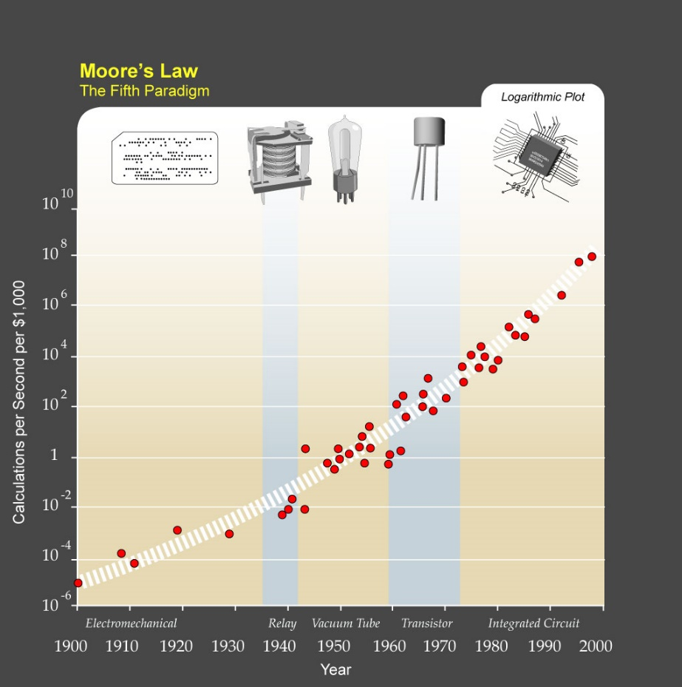
More and more data
Moore’s law to data growth: the exponential growth of hardware processing capabilities has led to a correlative explosion in data.

Slide 11
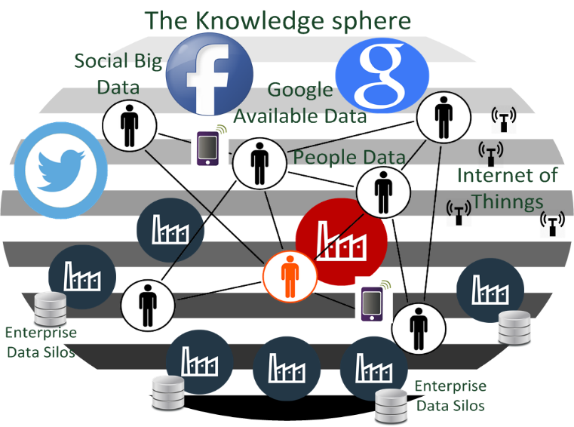
The sources of Data
It is not just computers generating such humongous quantity of data, it’s all sorts of hardware, instruments, or sensors.
For example, a single Boeing jet engine generates 10 terabytes of information for each 30 minutes it operates.

Slide 12


The main topics addressed:
The Semantic Web

Slide 13
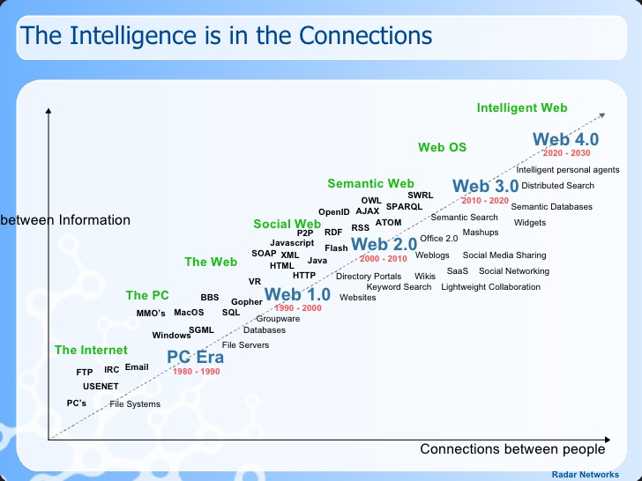
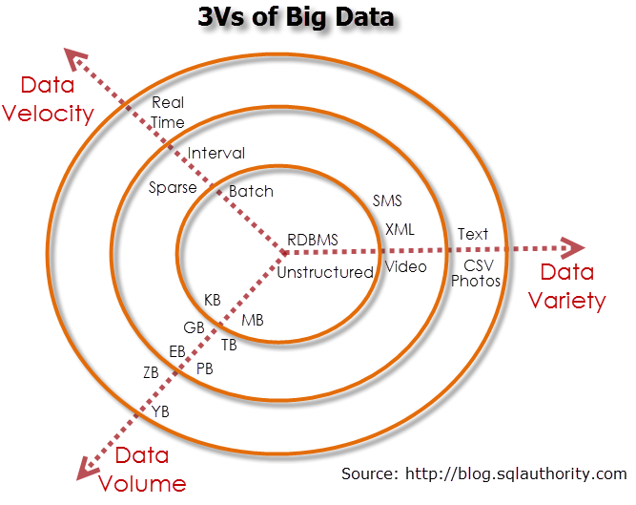
Semantic web and Big Data

Slide 14
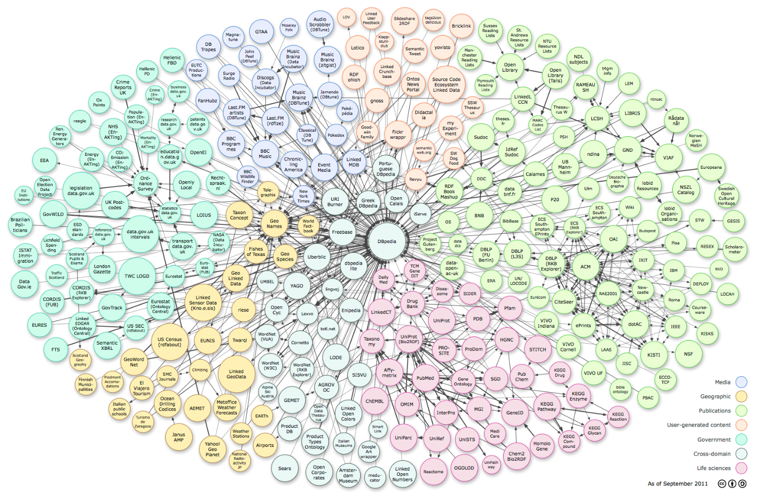
LOD: towards the Semantic Web

Slide 15

Relevance
16.9 billion $
39.4 percent annual growth rate
3.2 billion $
2010
2015

Slide 16
Ontology
Def1. According to Gruber [Gruber1993], an ontology is a an explicit representation of a conceptualization, i.e., a formal definition and representation of the concepts and their relations belonging to a certain domain of interest.
def.2 ….a formal specification of a shared conceptualization
Def3: A set of knowledge terms, including the vocabulary, the semantic interconnections and some simple rules of inference and logic for some particular topic.

Slide 17
Ontology operations
ontology matching is defined as the process of finding relationships or correspondences between entities of different ontologies;
ontology alignment, as a set of correspondences between two or more ontologies;
ontology mapping, as the oriented, or directed, version of an alignment, i.e., it maps the entities of one ontology to at most one entity of another ontology.
Ontology integration and merging are defined as the construction of a new ontology based on the information found in two or more source ontologies; and finally,
ontology reuse the process in which available ontologies are used as input to generate new ontologies

Slide 18
Approach
A multi-strategy methodology to ontology integration and reuse.

Slide 19
Part II
presentation of a multi-strategy approach for ontology integration and reuse

Slide 20
The methodology: overview
It is a multi-strategy methodology for ontology integration and resue;
It consists of a semi-automatic framework, which includes software components developed ad-hoc or third-party components (mostly external APIs) and guideline or methodologies to be performed manually by the user;
It is a comprehsive framework for ontology integration and reuse;
It is based on several modules each implementig a specific task (phase) of the methodology.
The core component is the Aligner, which is based on a decision tree classification function.
Notes:
which includes software components developed ad-hoc and third-party components (mostly APIs, like Jena, Neo4J, etc…)

Slide 21
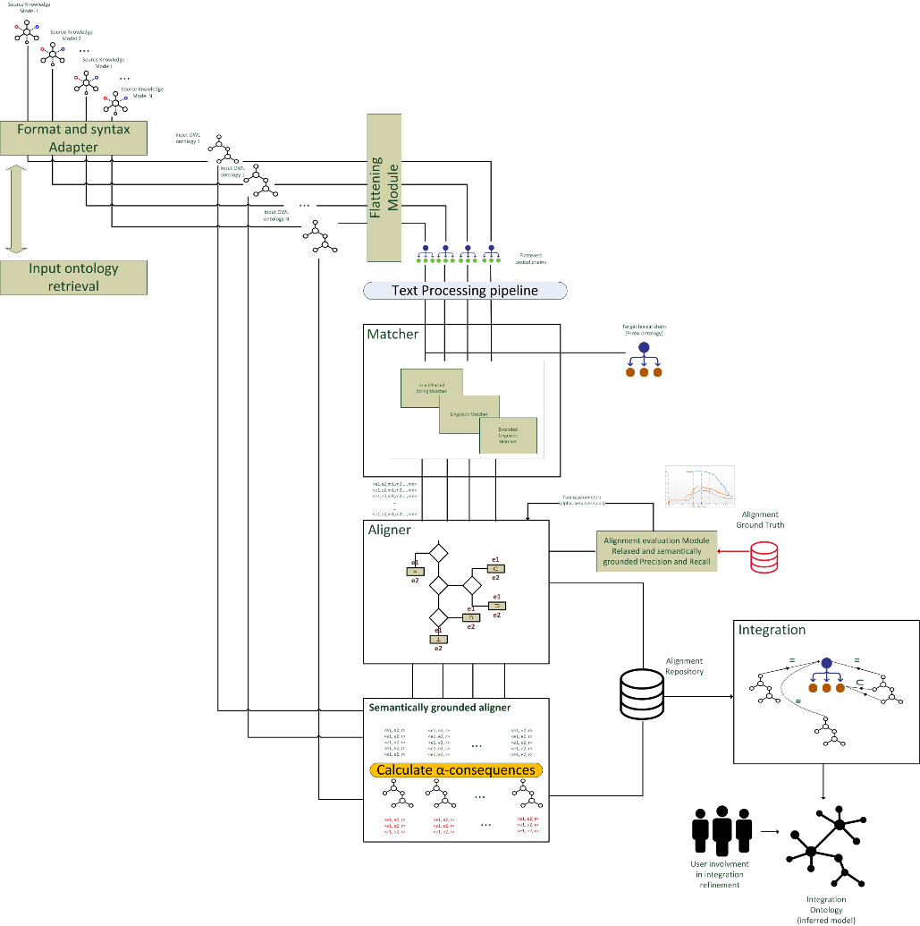
Architecture overview
2: Adaptation modules
3: Matcher module
4: Aligner module
5: Integration module
5: Evaluation
module
1: Input models retrieval module
4b: Semantically-grounded Aligner module
5: User involvement

Slide 22
1. Reference Models Retrieval Module
1: Input models retrieval module
The Reference Models Retrieval module is responsible for:
Identifying the knowledge domain or sub-domains covering the topic under study;
searching and retrieving the source models corresponding to the domain under study from the Internet or other specific repositories.
Search Engines
Standard
Internet
Web directory
Ontology repositories
Source
Models
Retrieval
The contribution of users (with domain expertise) is essential in this phase.

Slide 23
Reference models first selection
Once collected into the corpus, a first selection is carried out ont the retrieved models based on some qualitative criteria, such as:
Language formality;
Domain specificity;
Model Structuring;
Representation language;
Provenance;
Availability.
Corpus
Filter
Candidate
Reference
models

Slide 24
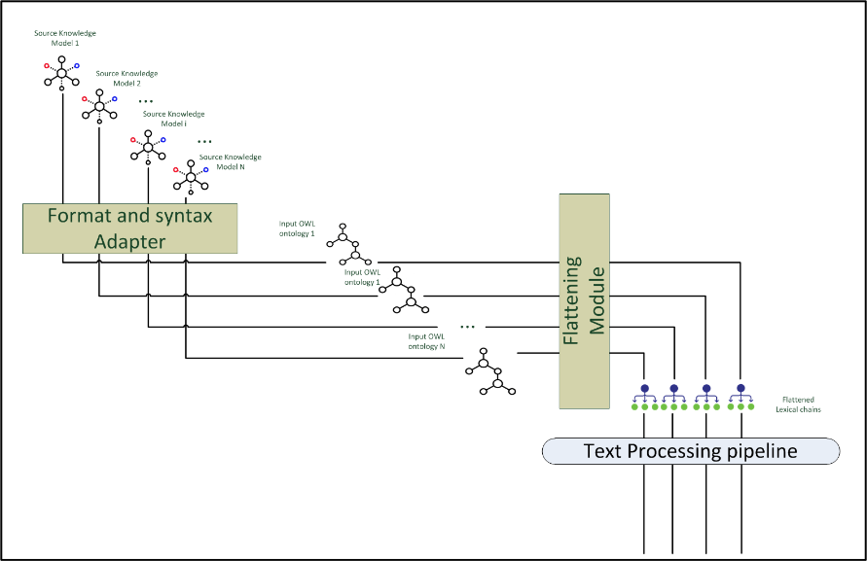
Reference Model Adaptation and Normalization Module
It is responsible for adapting and homogenizing the retrieved source models at a syntactical and representational level.
An adapter for each retrieved reference model;
An adapted model is a lite ontology.
Technically, an adapter is a kind of plugin added to the software framework
2: Adaptation modules

Slide 25
Adapted input ontologies
Source reference models may have different formats:
XML, HTML, SKOS, RDF, OWL-Lite, OWL-DL, OWL-Full)
Adapted input ontologies are in-memory OWL-Lite
ontologies (created through Jena APIs)

Slide 26
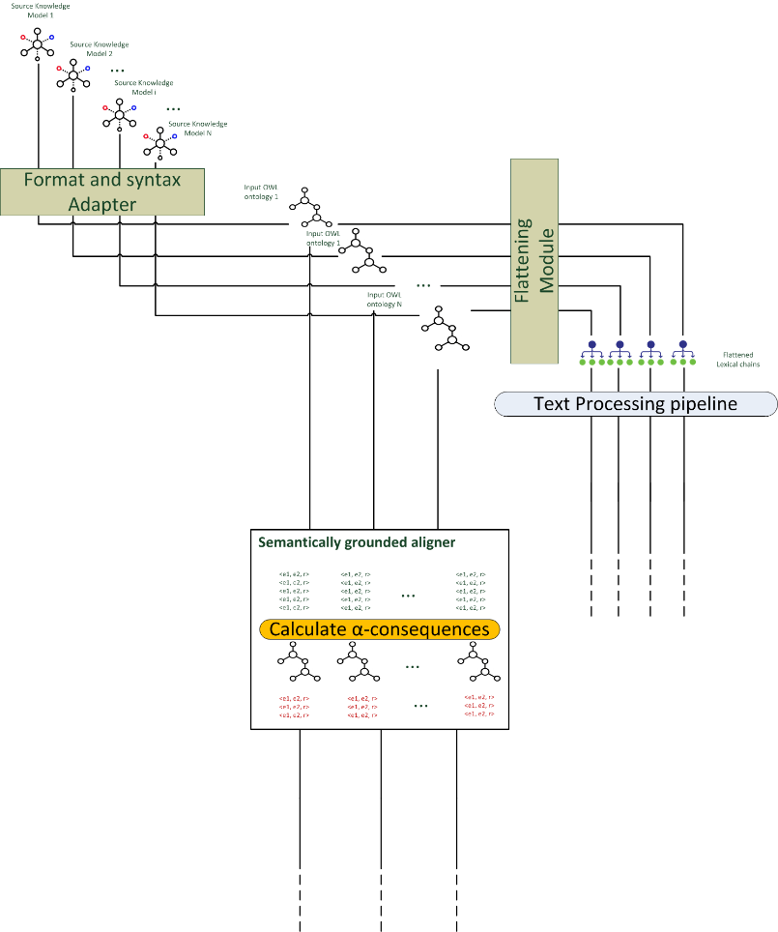
Linguistic vs Semantical analysis
Once adapted input ontologies go through two different paths:
Through the flattening module and the text-processing pipeline, for the linguistic analysis performed by the matcher module; and
Through the Semantically-grounded aligner.

Slide 27
Flattening and text-processing pipeline
Flattening module
Text-processing pipeline
Lower-casing
Tokenization
Lemmatization, singularization
Stop-word elimination
POS-tagging
Name entity
recognition
Notes:
The Flattening module produces a list of linguistic labels, i.e., a lexical chain (hereafter referred as input
lexical chain) gathered from the English labels attached to each class in the adapted input
ontologies.

Slide 28
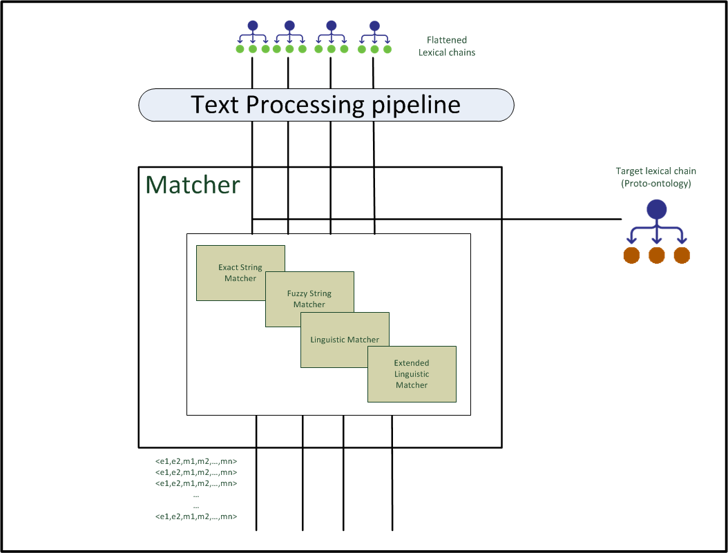
Reference Model Matcher
It is in charge of obtaining a set of similarity measures taking as inputs the terms coming from the source models lexical chains and the terms from the target lexical chain;
It performs lexicographic and linguistic similarity measures, i.e., exact matching, synonymy, cosynonymy, path distance and Wu&Palmer, using external linguistic resource like WordNet.
3: Matcher module
Notes:
The target ontology can be envisioned as the final goal of the integration approach
but at the early phases of the proposed methodology also as a kind of proto-ontology, i.e, a raw set of domain keywords, terms, definitions or in general concepts related to the
knowledge domain under study without a formal structure. It is not an ontology in the
strict sense of the term but it just represents the nucleus of knowledge from where to start
aggregating concepts from the top ranked ontologies matched throughout the framework
components. The contribution of users with domain expertise is important in producing the
target ontology because the choice of terms or concepts involved in this phase will affect
heavily the choice of the knowledge repositories and the input ontologies to be collected in
the reference models corpus. The target ontology will provide the terms against which to
match all the terms in the input lexical chains. As already stated in the previous section, all
concepts in the target ontology represent a kind of glue that put together the equivalent concepts
coming from the other ontologies. Additionally, the target ontology, once converted
in a lexical chain, is important in the extended linguistic analysis because it represents the
target against which to evaluate the semantic coverage of the input ontologies

Slide 29
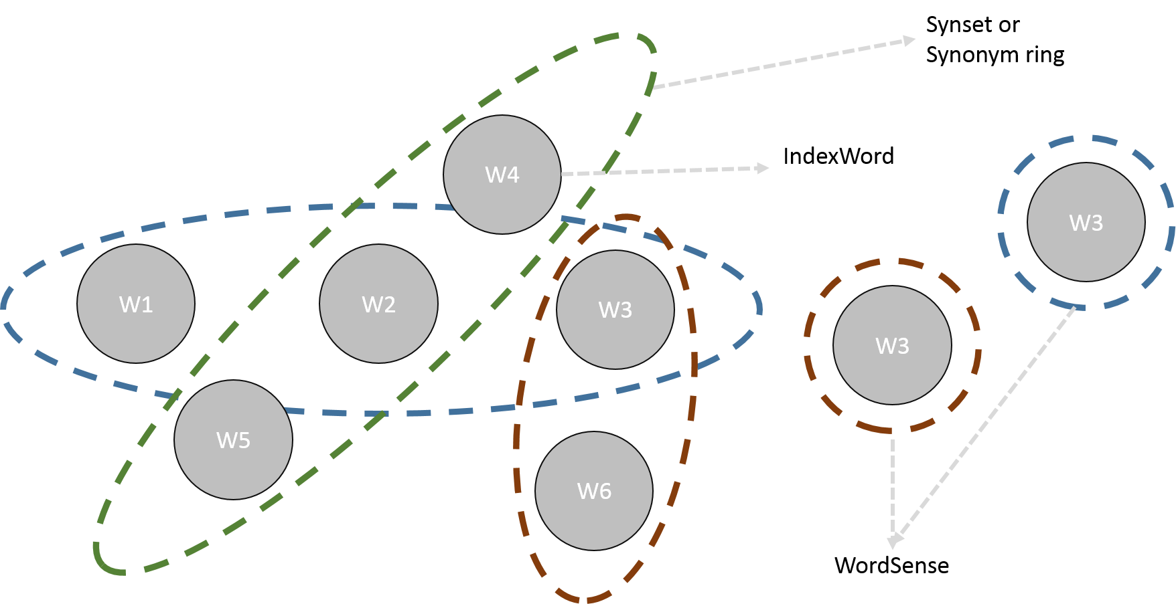
WordNet linguistic database

Slide 30
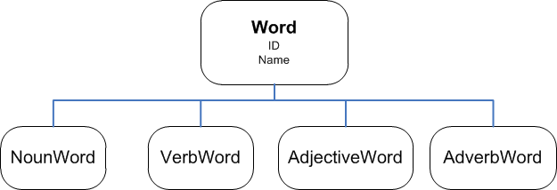
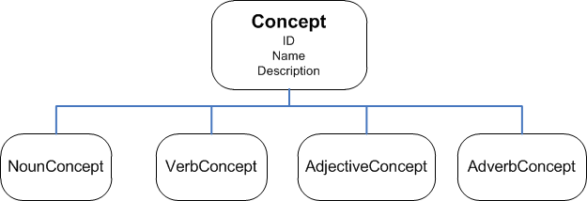
Concept vs Word

Slide 31
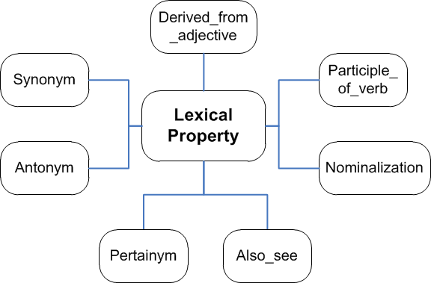
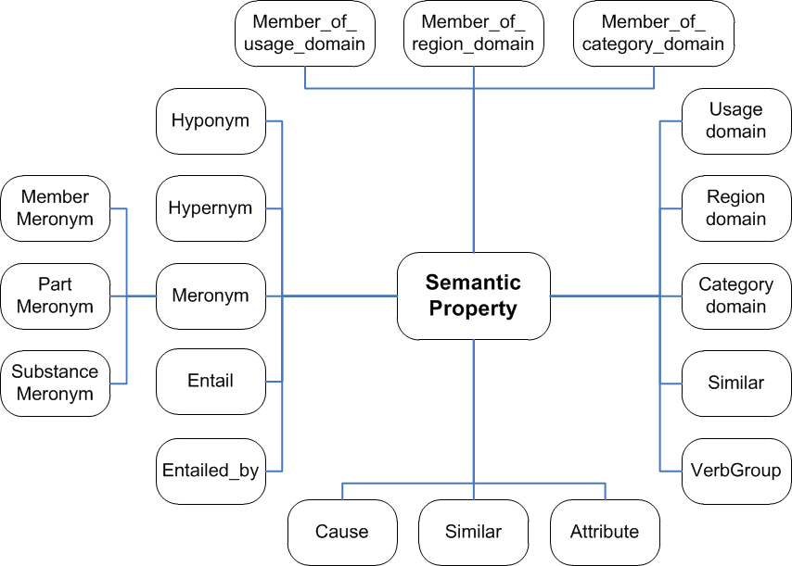
Lexical and semantic relations

Slide 32
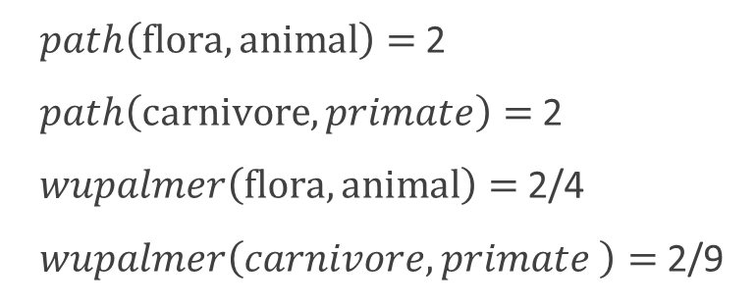
Examples of linguistic similarity measure
Living thing
organism
Chordate
Vertebrate
Mammalian
Placental
Carnivore
Canine
Domestic dog
Primate
Hominide
human
Flora
Phisical Object
Phisical entity
Entity
animal
$path\left(\text{flora}, \text{animal}\right)=$ 2
$path\left(\text{carnivore}, primate\right)=$ 2
$wupalmer\left(\text{flora}, \text{animal}\right)=$ 2/4
$wupalmer\left(carnivore,primate \right)=$ 2/9

Slide 33
Extended Wu & Palmer
The extended versions of Wu & Palmer measures apply when src and dst are multi-word terms. They may be:
Averaged Wu & Palmer similarity, i.e., the average of wup similarities for all multi-words’ tokens;
Minimized Wu & Palmer similarity, i.e., it is the minimum of wup similarities for all multiwords’ tokens.

Slide 34
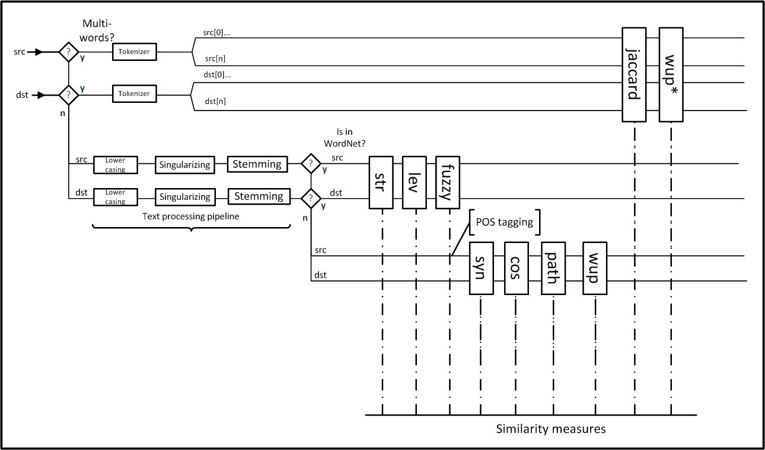
The implementation details of the matching strategy

Slide 35
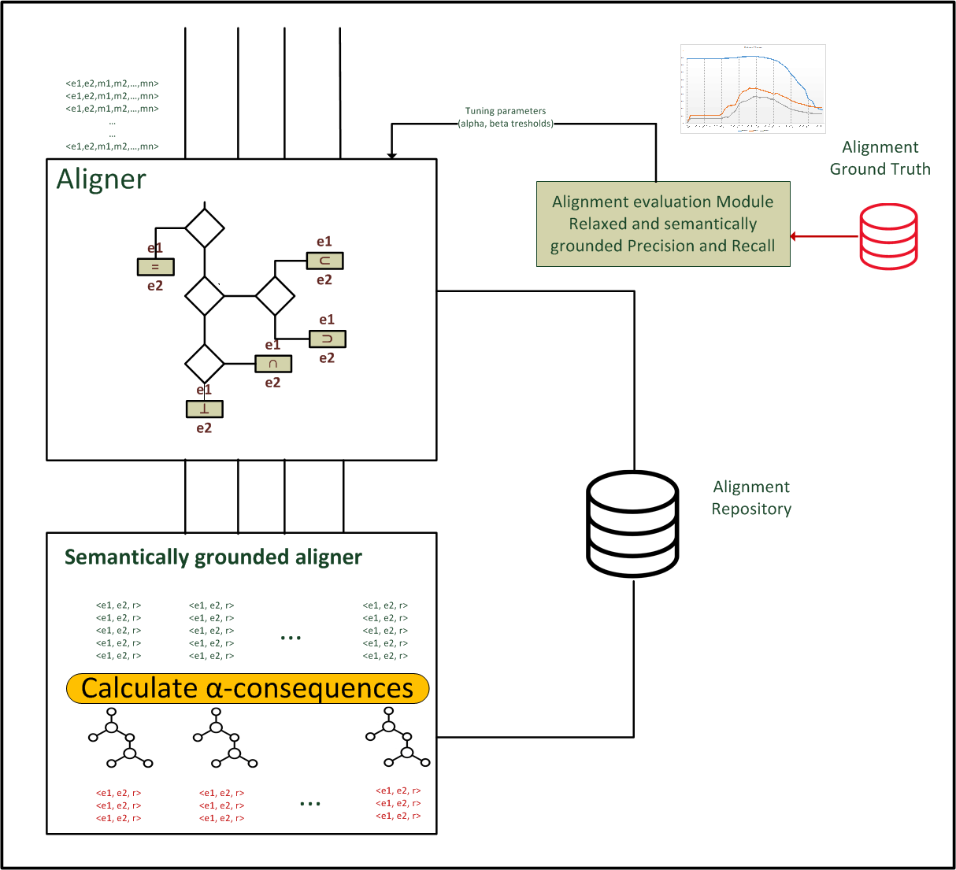
Reference Model Aligner
It is responsible for obtaining a mapping, i.e., an oriented or directed version of the alignment that maps the entities of one input model to one entity of the target model;
It acts as a classifier;
It predicts the classification class where putting the pair of terms according to a decision tree.
4: Aligner module
Notes:
(at this stage only lexicographic and linguistic based).

Slide 36
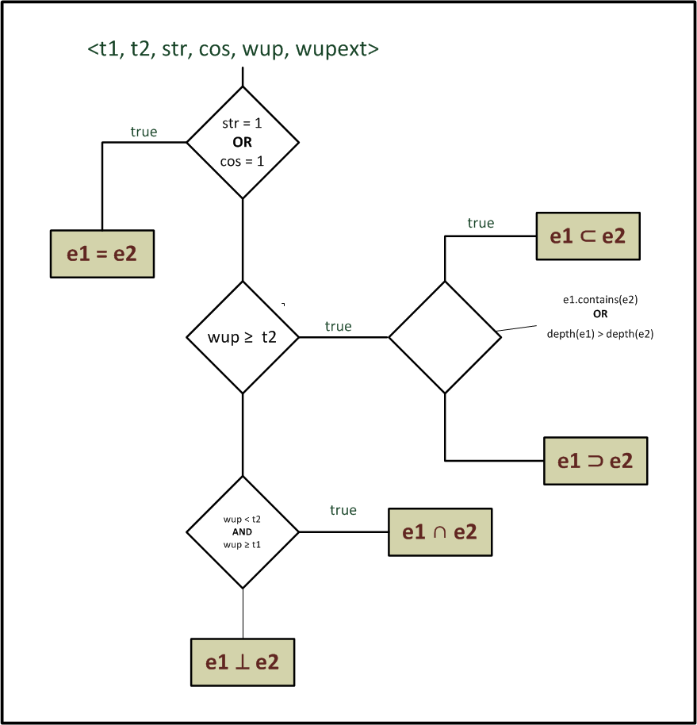
Alignment methodology
The classification classes are:
Equivalent (in symbols: ≡);
Hypernym (in symbols: ⊐);
Hyponym (in symbols: ⊏);
Related (in symbols: ⊓);
Disjointed (in symbols: ⊥),
Unknown.

Slide 37
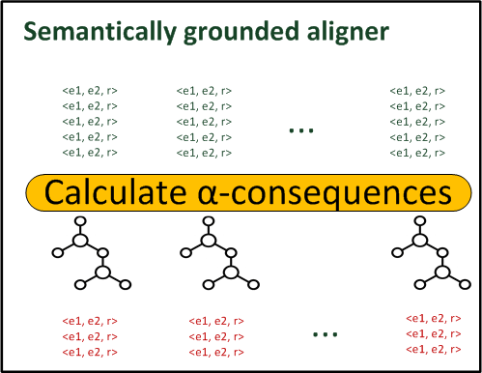
Semantically-grounded aligner
It adds all alpha-consequences to the alignment provided by the Aligner;
Now the structure of ontologies is recovered in order to exploit the inherent semantics in the class-subclassOf hierarchy;
4b: Semantically-grounded Aligner module

Slide 38
Alpha-consequences
classes→ c(t2) ≡ c(ti) c(t2) ⊏ c(ti) c(t2) ⊐ c(ti)
(t1, t2,≡) (t1, ti,≡) (t1, ti,⊏) (t1, ti,⊐)
(t1, t2,⊏) (t1, ti,⊏) (t1, ti,⊏) (t1, ti,⊓)
(t1, t2,⊐) (t1, ti,⊐) (t1, ti,⊓) (t1, ti,⊐)
(t1, t2,⊓) (t1, ti,⊓) (t1, ti,⊓) ?
(t1, t2,⊥) (t1, ti,⊥) ? (t1, ti,⊥)
Table 2.6 a-consequences obtained through the transitive inference

Slide 39
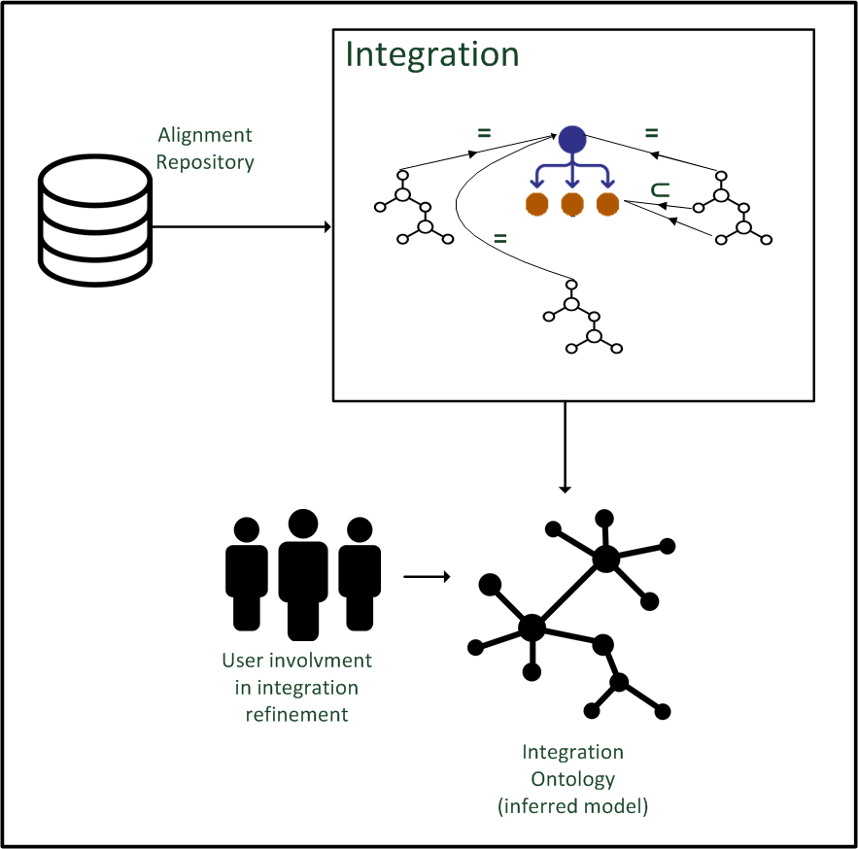
Reference Models Integrator
It is responsible for obtaining the integration ontology, i.e., a global, richer and integrated ontology;
This module must guarantee must no misleading or duplicate concepts, highly abstract or too specific concepts w.r.t. the target ontology concepts, and a well-balanced hierarchy.
5: Integration module
Notes:
The output of the Integrator module (Figure 2.7) is a global, richer and more integrated
ontology (hereafter referred as the integration ontology or the output ontology), abstracting
the local conceptualizations of the input ontologies and, as much as possible, complete,
homogeneous, correct and coherent.

Slide 40
Integration rules
Rule 1: importing all selected ontologies as separate ontology modules;
Rule 2: preserving linguistic annotations in the output ontology;
Rule 3: using human-readable labels for class names;
Rule 4: avoiding unnecessary axioms;
Rule 5: using reasoning capabilities;
Rule 6: keeping ontology’s hierarchy well-balanced.
Notes:
Rule 1: importing all selected ontologies as separate ontology modules. This means
constructing a modularized ontology by using namespaces with associated uris so that
it is clear where the imported ontologies entities come from;
• Rule 2: preserving linguistic annotations in the output ontology. The Integrator must
preserve all annotation available from the selected input ontologies (labels and comments)
in order to enrich the entities merged or integrated in the output ontology. For
example, if two equivalent classes have got a comment, one comment can be concatenated
with the other and used as more complete description of the merged concept;
• Rule 3: using human-readable labels for class names. If available, each class must
be annotated with a readable label coming from the source ontology. If not, a proper
label will be created from the local class name and attached to the class;
• Rule 4: avoiding unnecessary axioms. This means keeping the integrated ontology as
clear as possible and, at the same time, as concise as possible. Thus, all unnecessary
axioms will be neglected. For example, if two classes are predicted as Disjointed by
the Aligner, it is preferable to avoid to explicitly declare them as disjointWith in the
output ontology;
• Rule 5: using reasoning capabilities. This means, for example, using transitive reasoner
for automatically inferring a subClassOf property rather than explicitly assert
it.
• Rule 6: keeping ontology’s hierarchy well-balanced. This means adopting proper
strategies, so that each path descends to the same depth. It would require introducing
middle-level classes between narrower and broader concepts.

Slide 41
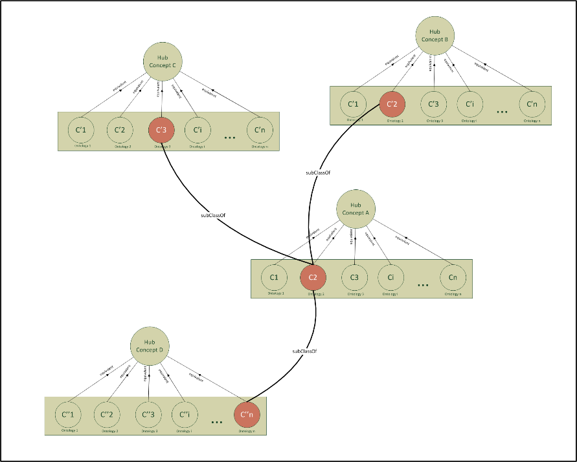
Integration strategy: clustering
The concepts inside the target ontology can be envisioned as hub concepts, i.e., as a glue that holds together all the aligned concepts from the input ontologies;
Each box represents a cluster of concepts equivalent to the hub concept and so equivalent to each other in turn;

Slide 42
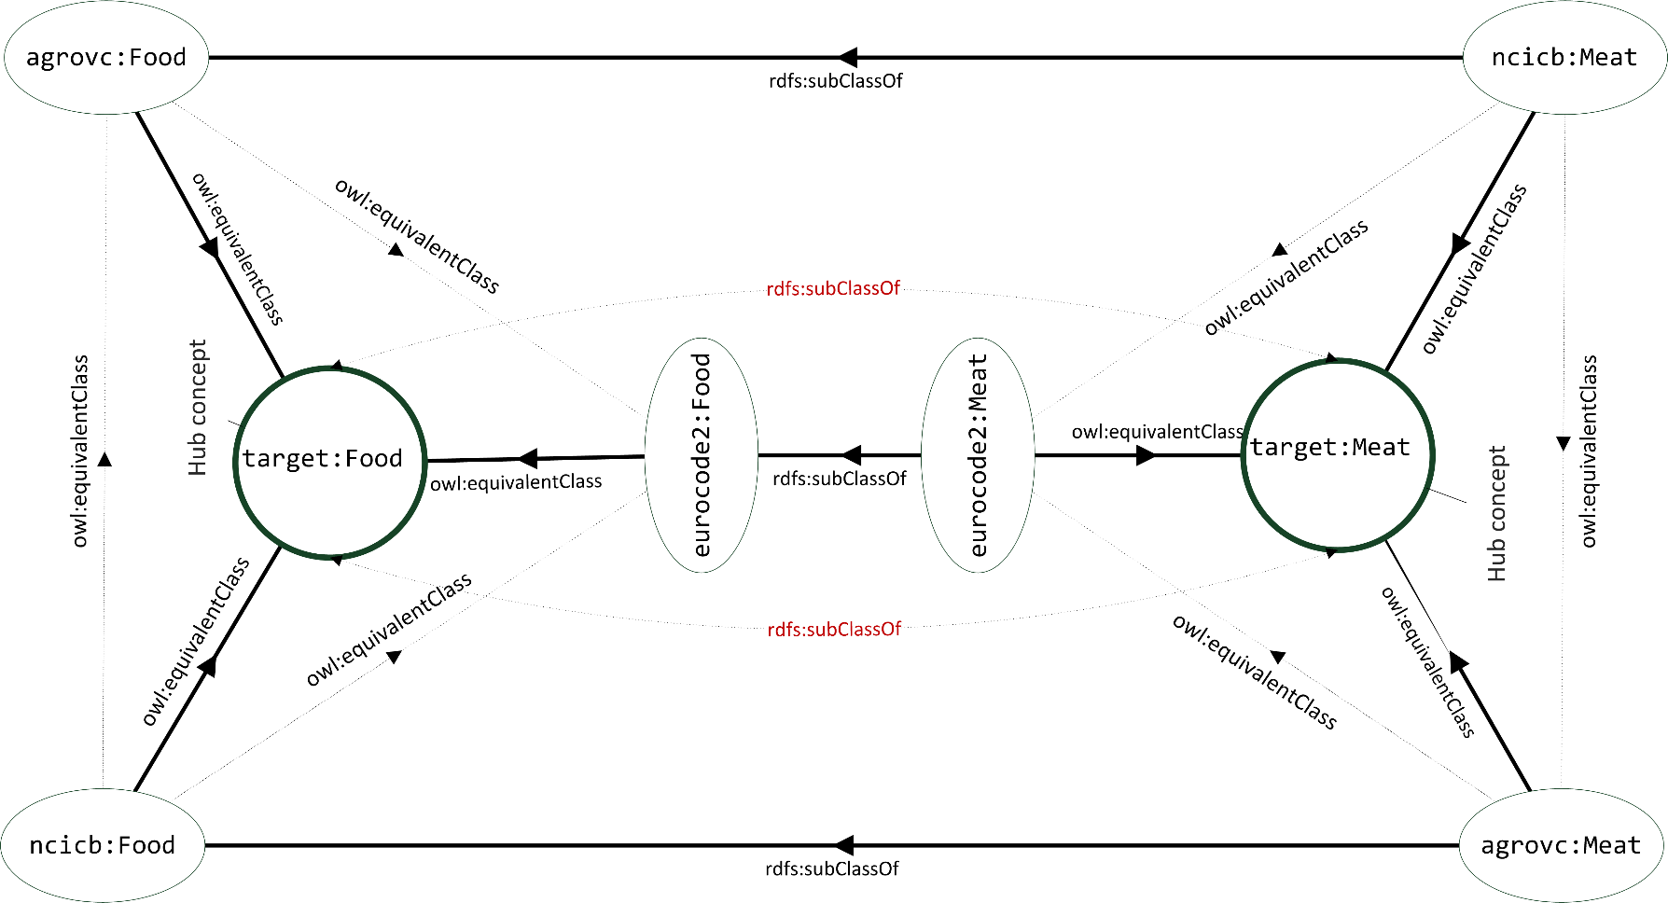
Examples of integration strategy

Slide 43
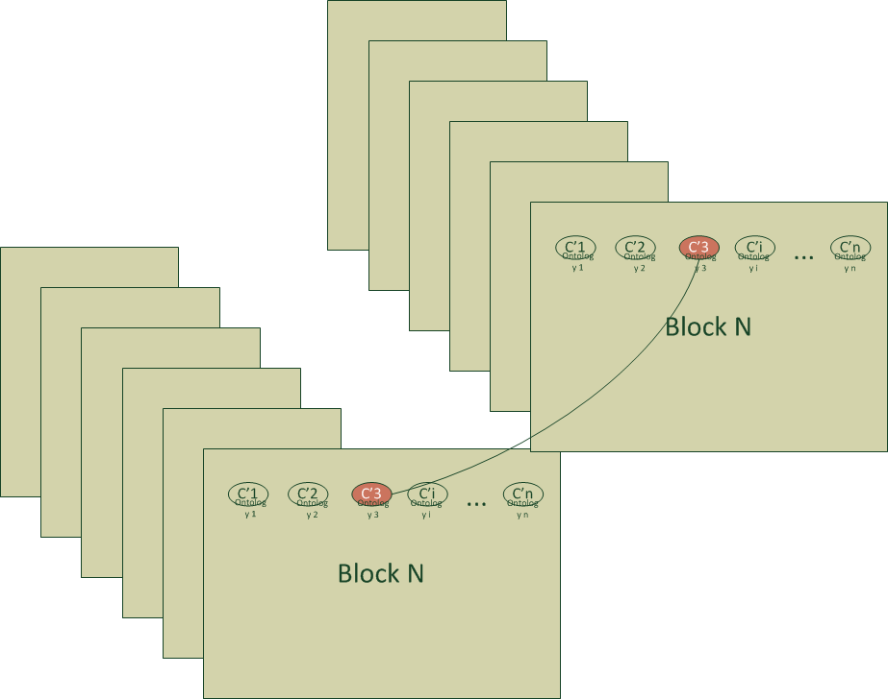
Integration strategy: framing
The blocking or framing technique consists in creating frames of clusters each relating to a knowledge domain or sub-domain, or to a specific aspect of the ontology.
Thus, only the clusters in the same frame are confronted considerably reducing the effort for the integration phase.
Onto2
Onto1
Notes:
A similar approach can be also used for the matching and alignment stages of the framework.

Slide 44
Creating the is-a hierarchy
Equivalence: if one concept is predicted to be equivalent to an hub concept, a new class is created and declared equivalent;
Hyponymy, if one or more concepts are classified as hyponyms w.r.t. a target hub concept, a corresponding class will be created in the integration ontology for each input concept and it will be declared as subClassOf the hub class;
Note that, only direct hyponym relations will be taken into consideration to be converted in class-subClassOf relation in the output ontology.
Notes:
equivalence, if one ormore input concepts are classified as equivalent with respect to a
target hub concept, an ontology class is created for each input concept and another one
for the hub concept. Adopting the criteria defined in section 2.1.5, whenever a class is
created in the integration ontology, it will be named with the linguistic label available
in the input ontology and annotated with the name space prefix of the ontology it
come from. Furthermore, each metadata available in the input ontology will be used
to enrich the description of the hub concept through the rdfs:
omments property.
• hyponymy, if one or more concepts are classified as hyponyms w.r.t. a target hub
concept, a corresponding class will be created in the integration ontology for each
input concept and it will be declared as subClassOf the hub class.

Slide 45
Direct hyponym identification strategy
The following cases are contemplated:
the terms classified as hyponym are present in WordNet;
at least one of the terms is a multi-word (not included in WordNet as multi-word). In this case the Integrator uses the following heuristics, after a POS-tagging operation:
  If the source term (src) is in the form ADJECTIVE-NOUN and the destination term (dst) in the form NOUN, then src is consider a direct hyponym of dst; e.g., orange juice vs. juice;
  If the source term (src) is in the form NOUN1-NOUN2 and the destination term (dst) in the form NOUN and NOUN and NOUN2 are the same term, then src is consider a direct hyponym of dst; e.g., apple cake vs. cake.

Slide 46
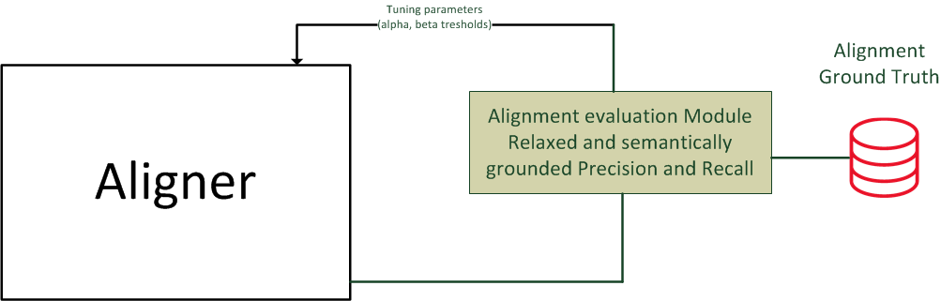
Aligner classifier evaluation
The classifier uses the Wu & Palmer similarity (the actual version and an extended version for multi-word terms), in order to score an alignment;
Uses a thresholoding strategy to categorize the alignment according to three possible cases: hyponym-hypernym(considered as one classification class), related and disjointed;
The thresholding strategy is one of the common approaches used in automated text categorization, i.e., the Scut [Yang2001].
Notes:
Hereafter, the equivalent
class will not be included in the discussion since it is based on other similarity measures
(synonym and co-synonym grades) which present good performance (discussed later) and
do not need to be further investigated.
This scores a validation
set of documents for each category and tunes the threshold over the local pool of score
until the optimal performance of the classifier is obtained for that category, then fix the percategory
thresholds when applying the classifier to new document in the test set.

Slide 47
Precision-Recall curves

Slide 48
Results in numbers
 | Precision | Recall | F1-score
Micro-avg | 0.756 | 0.833 | 0.793
Macro-avg | 0.716 | 0.807 | 0.760

Slide 49
ROC curves for extended Wu&Palmer algo versions

Slide 50
Products
[journal article] E. G. Caldarola, M. Sacco, and W. Terkaj, “Big Data: The Current Wave Front of the Tsunami”, Applied Computer Science, Vol. 10, no. 4, 2014, pp. 7–17. [Available online] http://www.acs.pollub.pl/pdf/v10n4/1.pdf
[journal article] E.G.Caldarola, A. Picariello, D. Castelluccia, “Modern Enterprises in the Bubble: Why Big Data Matters”, in Vol. 1, no. 1, 2015, ACM Software Engineering Notes;
[conference paper] Gianfranco Modoni, Enrico Caldarola, Walter Terkaj, Marco Sacco, The ontology reuse in an industrial scenario: a case study, The Seventh International Conference on Information, Process, and Knowledge Management, eKNOW 2015, Lisbon, Portugal, 2015;
[conference paper] Caldarola E. and Rinaldi A., Big Data: A Survey - The New Paradigms, Methodologies and Tools. In Proceedings of 4th International Conference on Data Management Technologies and Applications (KomIS-2015), Comar, France, pages 362-370, ISBN: 978-989-758-103-8, DOI: 10.5220/0005580103620370

Slide 51
Products
[conference paper] Enrico G. Caldarola, A. Picariello, A. Rinaldi, An Approach to Ontology Integration for Ontology Reuse in Knowledge Based Digital Ecosystems, in Proceedings of the 7th International Conference on Management of computational and collective intElligence in Digital EcoSystems Pages 1-8 ACM New York, NY, USA ©2015 , ISBN: 978-1-4503-3480-8, doi>10.1145/2857218.2857219
[conference paper] Caldarola, E., Picariello, A. and Rinaldi, A., Big Graph-based Data Visualization Experiences - The WordNet Case Study. In Proceedings of the 7th International Joint Conference on Knowledge Discovery, Knowledge Engineering and Knowledge Management (IC3K 2015) - Volume 1: KDIR, pages 104-115 ISBN: 978-989-758-158-8, Copyright 2015 by SCITEPRESS – Science and Technology Publications;
[conference paper, best paper award] Caldarola, E., Picariello, A. and Rinaldi, A., WordNet exploration and visualization in Neo4J.A Tag Cloud-based approach, In proceeding of Eighth International Conference on Information, Process, and Knowledge Management, eKNOW 2016, Venice, Italy;
[conference paper] Enrico G. Caldarola, Antonio M. Rinaldi, Improving the Visualization of WordNet Large Lexical Database through Semantic Tag Clouds, IEEE BigData Congress 2016, San Francisco, June 2016, DOI: 10.1109/BigDataCongress.2016.14;

Slide 52
Products
[conference paper] Enrico G. Caldarola, Antonio M. Rinaldi, An Approach to Ontology Integration for Ontology Reuse, 2016 IEEE 17th International Conference on Information Reuse and Integration (IRI), Pittsburgh, Pennsylvania, USA, 2016. DOI: 10.1109/IRI.2016.58.
[conference paper] Enrico G. Caldarola, Antonio Picariello, Antonio Rinaldi, Marco Sacco, Exploration and Visualization of Big Graphs - The DBpedia Case Study, Proceedings of the 8th International Joint Conference on Knowledge Discovery, Knowledge Engineering and Knowledge Management, Porto - Portugal, Volume: Vol 1. DOI: 10.5220/0006046802570264;
[journal article] Enrico G. Caldarola, Antonio Picariello, A. M. Rinaldi, M. Sacco, Enhancing theWordNet Exploration and Visualization in Neo4J with a Tag Cloud Based Approach, Journal on Advances in Intelligent Systems, vol 9 no 3 & 4, year 2016, http://www.iariajournals.org/intelligent_systems/
[journal article] Daniela Castelluccia, Enrico G. Caldarola, Nicola Boffoli (additional authors: Antonio M. Rinaldi, Marco Sacco and Nicola Ungaro), Environmental Big Data: a systematic mapping study, ACM SIGSOFT Software Engineering Notes archive, Volume 41 Issue 6, November 2016 , Pages 1-4 , doi>10.1145/3011286.3011307;

Slide 53
Products
[journal article] Enrico G. Caldarola, Antonio Picariello, A. M. Rinaldi, Experiences in WordNet Visualization with Labeled Graph Databases, Communications in Computer and Information Science 631, pp. 80–99, 2016., DOI: 10.1007/978-3-319-52758-1 6;
[journal article] Enrico G. Caldarola, A.M. Rinaldi, A Multi-strategy Approach for Ontology Reuse through Matching and Integration Techniques, Advances in Intelligent Systems and Computing, Springer 2017; (in press)

Slide 54
Questions ?
enricogiacinto.caldarola@unina.it

Slide 55
Extended linguistic analysis & Semantic Networks (SNs)
It converts the input and target lexical chains in Semantic Networks (SNs) containing an extended set of concepts w.r.t. the initial set from the lexical chain.
This new set encompasses hyponyms, hypernyms, meronyms, which are retrieved from WordNet. Furthermore, the concepts of the semantic network are linked to each other with the linguistic and semantic relations provided;
The SNs provide a conceptual frame useful to discriminate the pertinent reference models from the other ones throughout a system grading that is able to assign a vote to the model based on their syntactic and semantic content

Slide 56
Global Grade
Syntactic-Semantic Grade (SSG)
+
Semantic Grade (SG)

Slide 57
SSG and SG formula
path length (l) between pairs of terms;
depth (d) of their subsumer (i.e., the first common ancestor), expressed as number of hops.

Slide 58
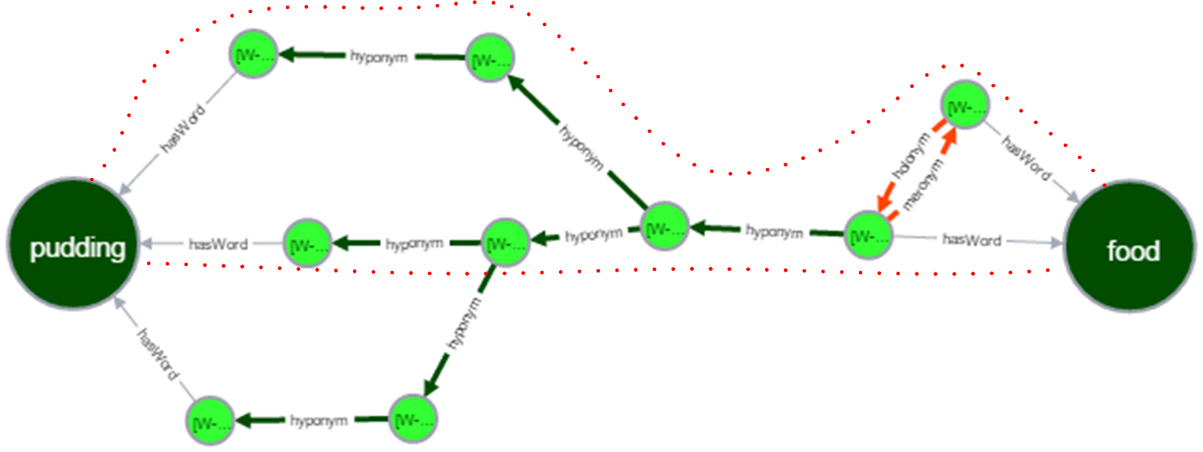
Shortest path

Slide 59
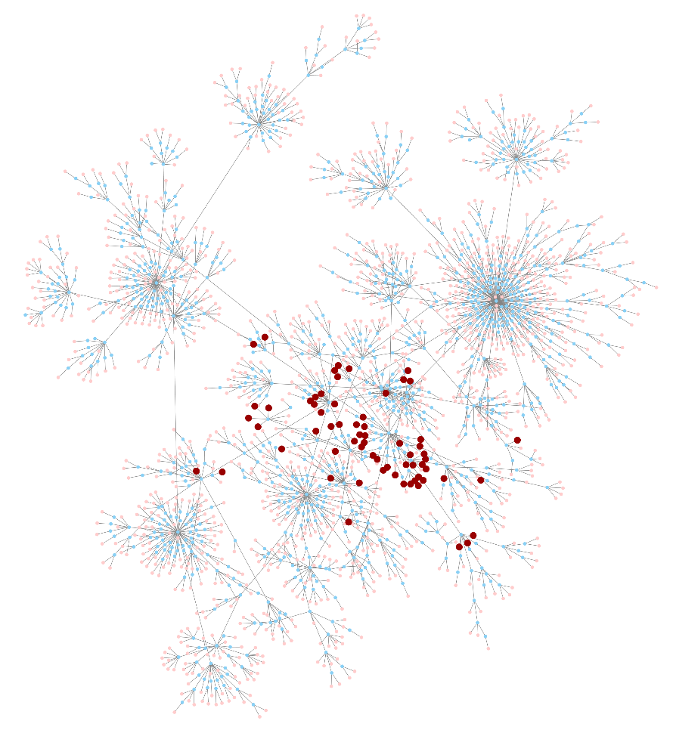
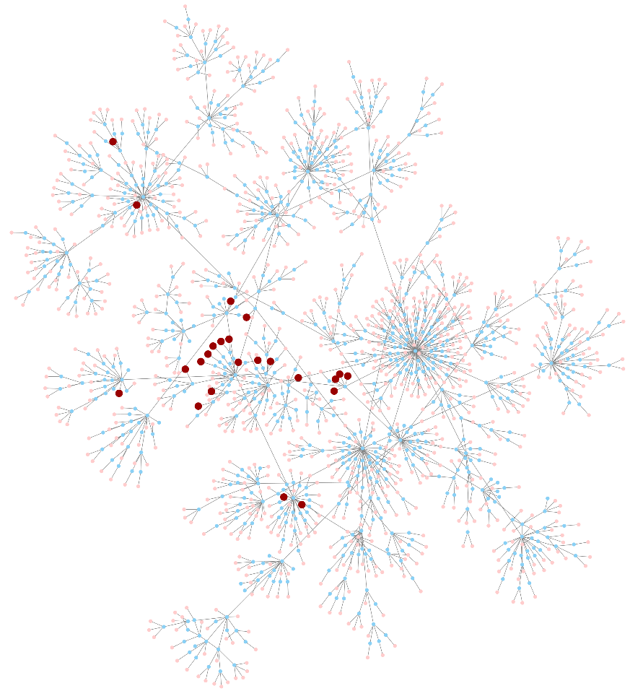
Semantic Network arborescences

Slide 60
A case-study
The methodology proposed in this work has been applied to the food domain, specifically to the production of food, encompassing concepts like food product and food product categories.
Since the food is an umbrella topic involving concepts related to different disciplines and applications, it represents a valid benchmark for the proposed methodology.
Notes:
The term “food” can be found in different knowledge models such as: recipes for dishes
served in a restaurant, biomedical thesaurus, commercial products catalogues and many
others. Thus, the main result expected here is to select the reference models that best fits
the specific domain under study discarding all models which are too generic (upper level
ontologies) or highly specialized w.r.t. to the target

Slide 61
Candidate reference models

Slide 62
Input model metrics and adaptation
The National Cancer Institute Thesaurus (NCIT) has 118941 classes and 46839 individuals while the AGROVC Multi-lingual Thesaurus presents more than 32000 concepts having labels in up to 27 languages.
AGROVC has required further adaptations for a twofold reason: it is written in SKOS language and the classes are identified with an ID.

Slide 63
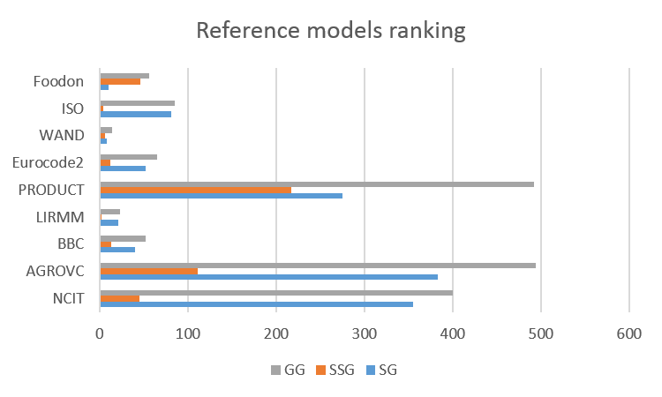
Extended linguistic analysis results
According to the extended linguistic analysis models with a high semantic coverage w.r.t. the target ontology are 1), 2) and 5), but the highest ratio between GG and the number of terms in the corresponding lexical chain is for model 1), 2) and 6)
models 3) and 4) are excluded because of their low number of terms, while model 8) since it is a proprietary model and so not available), thus, these models will be passed to the Integrator.

Slide 64
Global Evaluation of the methodology

Slide 65
Thresholding
The approach uses two thresholds t1 to discriminate between hyponym-hypernym class
(abbreviated as hypo-hyper class) and related, and t2 to discriminate between related and disjointed class.

Slide 66
Decomposition of the polycotomous classifier
There are different decomposition (also known as binarization) techniques in the literature, but the one used in this work is the ordered class binarization [Fürnkranz2002].
It transforms c-class problem into c-1 binary problems;
These are constructed by using the examples of class i (i=1...c−1) as the positive examples and the examples of classes j > i as the negative examples.
In this case starting from the three-class classifier, the ordered binarization leads to two binary classifiers: the first classifies hypo-hyper alignment (positive examples) versus not hypo-hyper alignment (negative examples, i.e., related and disjointed alignments), while the second classifies the related alignment (positive examples) versus disjointed alignment (negative).

Slide 67
Multi-class evaluation through confusion matrix
At this stage of the evaluation, the equivalent and hypernym class are recovered in order to evaluate the whole 5-classes classifier with the values for t1 and t2 found;
A methodology to evaluate the performance of a polycotomous classifier without binarization strategy is by using the confusion matrix;
The diagonal elements represent the number of alignments for which the predicted class is equal to the true class, while off-diagonal elements are those that are mislabeled by the classifier.

Slide 68
Confusion matrix

Slide 69
Color maps
Precision
Recall
In numbers, the precision (recall) measures retrieved from the confusion matrix are:
0,991(0,981) 0,361(0,608) 0,826(0,777) 0,494(0,485) 0,609(0,508) for the
equivalent, hypernym, hyponym, related, disjoint class respectively.

Slide 70
Relaxing P and R
Precision and recall together with the F-score are commonplace measures in information retrieval and they have also been adapted for ontology alignment evaluation [Do2002].
But, they do not discriminate between a bad and a better alignment;
For example, an alignment predicted as related is better than an alignment predicted as disjoint if the true alignment is hyponym or hypernym;
Since in this work the users have to check and correct the final integration ontology that is based on the predicted alignments, the quality of alignment algorithms can be measured through the effort required for transforming the obtained ontology fragment (the one depending on the predicted alignment) into the corrected one.

Slide 71
Edit distance
This effort can be measured as an edit distance, which defines a number of operations by which an object can be corrected (here the operations on correspondences authorized) and assigns a cost to each of these operations (here the effort required to identify and repair some mistake);
The cost function assigns a greater effort for the adding operations (1.0) and a lesser value for the deleting operation (0.25 for true related and 0.5 for true disjoint).

Slide 72
Relaxed P and R color maps
Precision
Recall
In numbers, the relaxed precision (recall) measures retrieved from the confusion matrix are:
0,991(0,981) 0,827(0,709) 0,950(0,912) 0,853(0,789) 0,795(0,850)
for the equivalent, hypernym, hyponym, related, disjoint class respectively.

Slide 73
Semantically-grounded alignment evaluation

Slide 74
References
[Gruber1993] Gruber, T. R. (1993). A translation approach to portable ontology specifications. Knowledge acquisition, 5(2):199–220.
[Yang2001] Yang, Y. (2001). A study of thresholding strategies for text categorization. In Proceedings of the 24th annual international ACM SIGIR conference on Research and development in information retrieval, pages 137–145. ACM;
[Fürnkranz2002] Fürnkranz, J. (2002). Round robin classification. Journal of Machine Learning Research, 2(Mar):721–747.
[Do2002] Do, H.-H., Melnik, S., and Rahm, E. (2002). Comparison of schema matching evaluations. In Net. ObjectDays: International Conference on Object-Oriented and Internet- Based Tec

