Slide 1
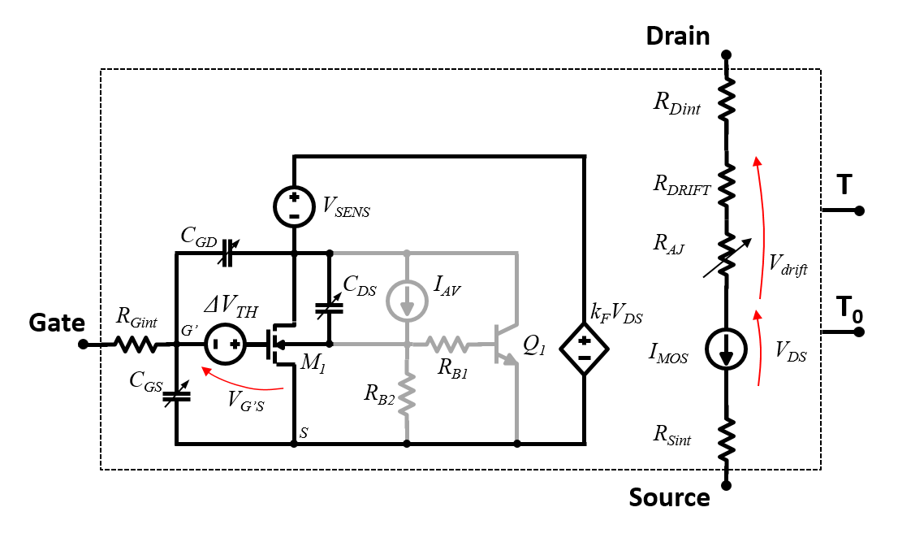
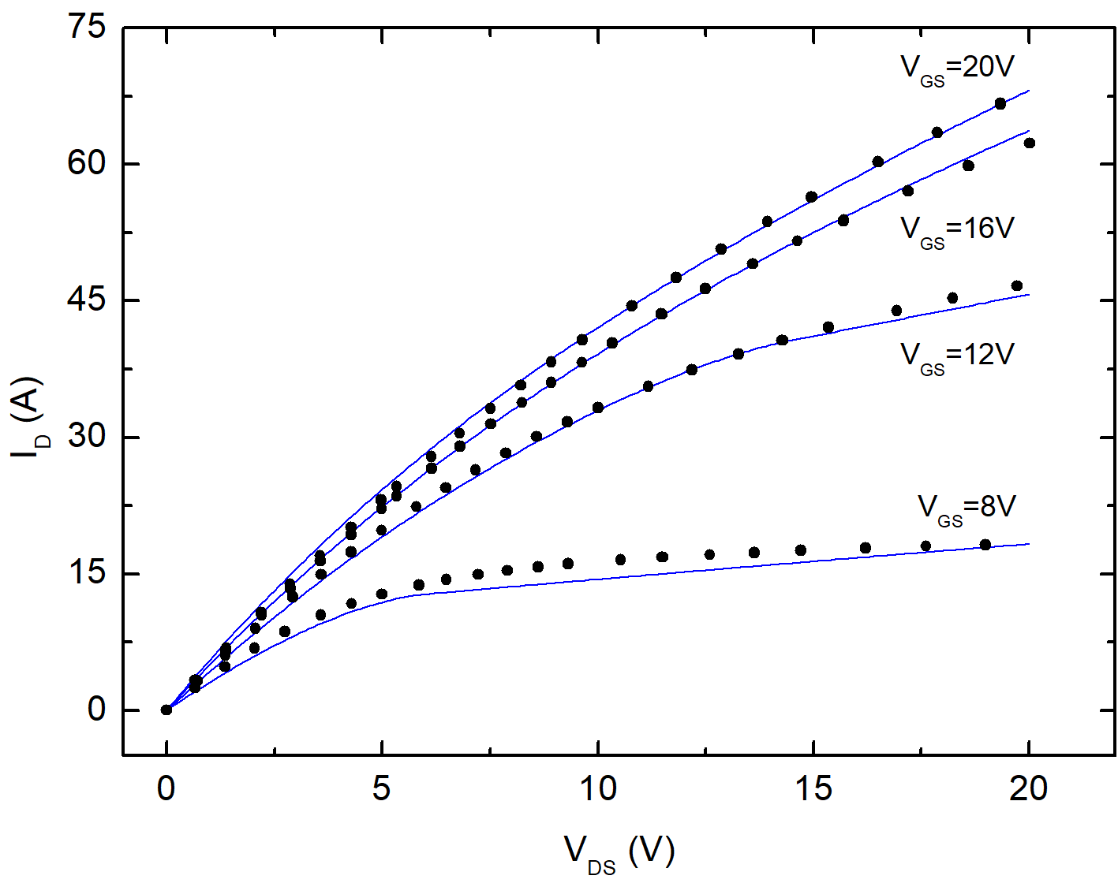
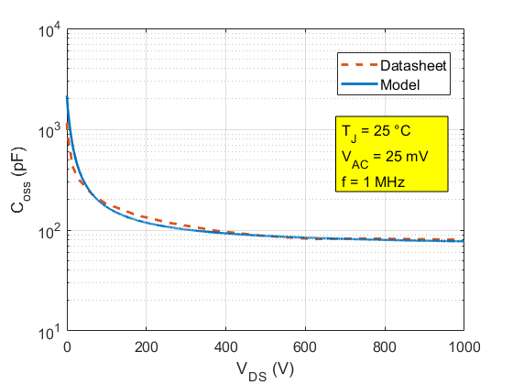
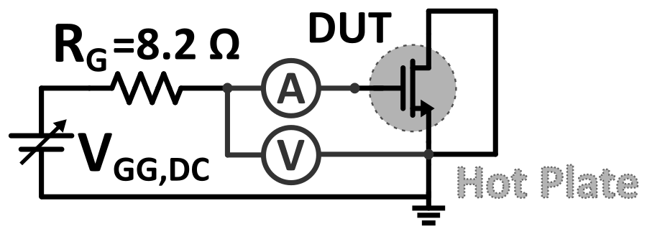





Alessandro Borghese
Tutor: Andrea Irace
XXIX Cycle - II year presentation
Reliability of Power WBG Semiconductor Devices
MOTIVATION
METHODOLOGY
Wide Band Gap WBG power semiconductor devices provide
on-state (R_{on}) vs. off-state (BV) trade-off ➔ ☺ topology simplification
switching speed ➔ ☺ more efficient and compact converters
☹ However, they endure harsh electrothermal conditions
Temperature estimation is of uttermost importance both during design phase (by accurate electrothermal simulations) and during device operation (real time temperature detection).
Increase system lifetime
Detect faulty operating conditions
Prevent catastrophic failures
Statistical Electrothermal Simulation for Lifetime Prediction of Parallel SiC MOSFETs and Modules
1) Static and dynamic model calibration
2) Monte Carlo Simulations
3) Evaluate lifetime reduction
Gate leakage current sensing for in situ temperature monitoring of p-GaN gate HEMTs
1) Experimental verification of temperature sensitivity of gate leakage current
2) Gate design and verification
3) Temperature sensing under real operating conditions
Further activities
Prj1 (confidential): TCAD simulations aimed at optimizing 1200V Si Diodes (conduction and switching performance vs robustness)
Prj2 (confidential): Calibration of SiC MOSFET SPICE model to assist the design of multichip power modules
Prj3 (confidential): Calibration of SPICE models for last generation of Si diodes and IGBTs
Luca Maresca
Michele Riccio
Antonio Pio Catalano
Vincenzo d’Alessandro
Alberto Castellazzi
Tripathi Ravi
Slavo Kicin
Luca de Michielis
Paolo Mirone
Michele Pezzarossa
FUTURE ACTIVITIES
Period abroad: Dec 2020 – Jun 2021. Kyoto University of Advanced Science (JP) - Study and Characterization of Soft Failure Mode of SiC MOSFETs During Short Circuit - Prof. Alberto Castellazzi
Research:
- TCAD simulations of SiC devices
- Prototype of converter based on SiC multichip power module
Conferences:
- ISPSD – Kyoto, May 2021
- ESREF – Bordeaux , Oct 2021
CONTACTS
+39 081 7683100
ALESSANDRO.BORGHESE@UNINA.IT
[1] M. Riccio, A. Borghese, L. Maresca, G. Breglio and A. Irace, "Fully-Coupled Electrothermal Simulation of Wide-Area Reverse Conducting IGBTs," 2019 25th International Workshop on Thermal Investigations of ICs and Systems (THERMINIC), Lecco, Italy, 2019, pp. 1-4, doi: 10.1109/THERMINIC.2019.8923497.
[2] A. Borghese, et al., "Gate leakage current sensing for in situ temperature monitoring of p-GaN gate HEMTs," Microelectronics Reliability, Volume 114, 2020, 113762, ISSN 0026-2714, https://doi.org/10.1016/j.microrel.2020.113762.
[3] A. Borghese, et al., "Statistical Electrothermal Simulation for Lifetime Prediction of Parallel SiC MOSFETs and Modules," 2020 2nd IEEE International Conference on Industrial Electronics for Sustainable Energy Systems (IESES), Cagliari, Italy, 2020, pp. 383-386, doi: 10.1109/IESES45645.2020.9210690.
[4] F. Richardeau et al., "SiC MOSFETs soft and hard failure modes: functional analysis and structural characterization," 2020 32nd International Symposium on Power Semiconductor Devices and ICs (ISPSD), Vienna, Austria, 2020, pp. 170-173, doi: 10.1109/ISPSD46842.2020.9170094.
[5] A. Castellazzi et al., "Gate-damage accumulation and off-line recovery in SiC power MOSFETs with soft short-circuit failure mode," Microelectronics Reliability, Volume 114, 2020, 113943, ISSN 0026-2714, https://doi.org/10.1016/j.microrel.2020.113943.
[6] [Book chapter] L.Maresca et al., “SiC MOSFETs”, in “Power Electronic devices: physics, applications, failure mechanisms and reliability”, F. Iannuzzo, IET.
[7] [Book chapter in preparation] M. Riccio et al., “Optimum module design I: device modeling and extrinsic parameter spread”, in “SiC power module design and assembly: building in performance, robustness and reliability”, A. Castellazzi, A. Irace, IET.

