Slide 1
Project: Cell / Particle Electrophoresis
Shomnath Bhowmick (Msc in Nanoelectronic & mechanics)
PhD 29th cycle (2014 - 2017)
University of Federico II Napoli
(Prof. Giovanni Breglio)
&
IMM- CNR (Napoli) (Dr. Giuseppe Coppola)

Slide 2
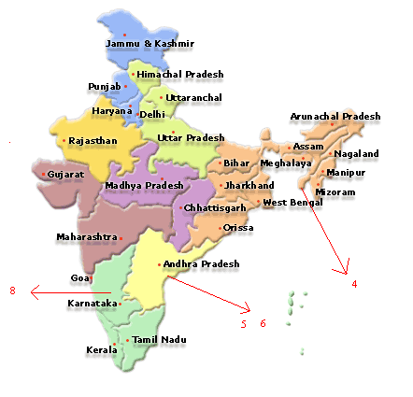
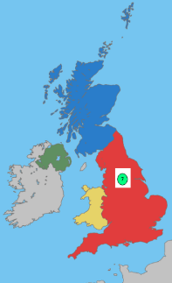
Introduction to Shom
Name: Shomnath Bhowmick
Bachelor Degree : Electronics and Communication from JNTU ,India (2004-2009)
Master's Degree : Nano electronics and Mechanics from Sheffield & Leeds , UK (2009-2011)
Work Experience : MEMS Engineer at i2n technologies private limited in Bangalore, India (2011-2012)
IMM-CNR : Research fellowship on pyroelectric biosensor for pyrojetting (since 2012)

Slide 3
Overview of the Slides
Electrophoresis
Types of Electrophoresis
MOTIVATION
Skill gain & their usage in the work
Activities for year 2014-2015

Slide 4
Electrophoresis
Cell electrophoresis is the study of motion of cells in a fluid under the influence of a spatially electric field.
This electro-kinetic phenomenon was observed for the first time in 1807 by Ferdinand Frederic Reuss (Moscow State University), who noticed that the application of a constant electric field caused clay particles dispersed in water to migrate.
Cell electrophoresis is a field driven technique, which serves two purpose:
To study the surface properties of cells
To separate uniform cell subpopulation from cell mixtures

Slide 5
Types of Electrophoresis based process
Field of interest using Electrophoresis
Analysis of human blood (white blood cell red blood cells)
Detection of malignant cells for early diagnosis of cancer cell.
DNA detection of XY chromosomes
Detection of Protein, particles.
Sperm Sorting
[Gossett, D.R., et al., Label - free cell separation and sorting in microfluidic
systems.Anal Bioanal Chem, 2010. 397 (8): p. 3249 -3267]
Affinity electrophoresis
Capillary electrophoresis
Dielectrophoresis
DNA electrophoresis
Electroblotting
Electrofocusing
Gel electrophoresis
Immunoelectrophoresis
Isotachophoresis
Pulsed field gel electrophoresis

Slide 6
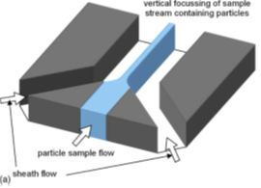
Motivation
Flow Focusing is a fundamental prior step in order to sort, analyse and detect particles or cells.
It allows to align cells in one single line, as they pass through the detection region.
Simplifying 2D- Structure
Multiple inlets One Inlet
Using Filter Static So can be use for one particle size
Using Dielectrophoresis Process
AIM
Using Dielectrophoresis process to modulate filter pores with the help of electric field.
To realize a device suitable for multiple cells analysis

Slide 7
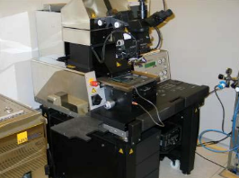
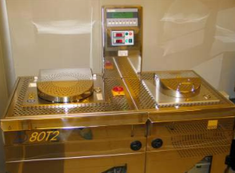
Skills & Experience Achieved At IMM-CNR Napoli
Micro Fluidic device fabrication
Mask preparation using SU8
PDMS (Poly-di-methyl siloxane) chip fabrication
PDMS bonding on glass & pyroelectic crystal.
Photolithography
Spin coating
Photolithography process
Mask aligner
Sputtering thin film deposition.
E-beam deposition of thin film
RIE & PECVD (Oxford and ICP)
Wet and dry oxidation process
KOH & TMAH etching process
Software skills:
COMSOL Multiphysics simulation (joules heating and particle physics)
Solid works

Slide 8
ACTIVIES FOR YEAR 2014-2015
Year | Lecture | Type | Credits | Hours
1 | Euro Progettazione | Ad Hoc Module | 3
1 | An introduction to physics of nanostructure | Ad Hoc Module | 4
1 | Introduction to Photonics | Ms Course | 9
1 | 3 core issues for the internet: things, security & economics | Course | 2
Year | Seminar Title | Date | Credits | Hours
1 | A lung-on-chip to measure O2 affinity of single red blood cells | 11-june-14 |  | 4
1 | Computer generated Holograms | 22-july-14 |  | 2
1 | Photochromic materials: beyond the change of color | 23-july-14 |  | 2
1 | Luce Futuro: giornata di Studio | 01-dec-14 |  | 8
Year | Workshop | Date | Credits | Hours
1 | COMSOL: Structural Mechanics & Thermo Fluid dynamics | 28-Oct-14 |  | 8

Slide 9
Thank you

