Slide 1
Domenico Argenziano Tutor: Alessandro Cilardo XXX Cycle - III year presentation
Cryptographic Extensions for a
GPU-like processor

Slide 2
Background
Ingegneria Informatica MSc.
Computer Architectures group
No fellowship

Slide 3
Summary of activities
Concluded in Nov. 2016 collaboration with Prof. Galdi about Trusted Computing
Worked on a project proposal for Secure-by-design execution
Designed an AVR-based Gateway for secure communication of field bus sensor data
GPU crypto extensions (this presentation)
Experience abroad

Slide 4
Experience abroad
Period Jun-Sept. 2017 spent at Sundance Multiprocessor Technology, Chesham, UK
Tulipp H2020 project
Low-power SoC-based computing for Computer Vision
Attended EMVA 2017 forum in Vienna

Slide 5
Credits table

Slide 6
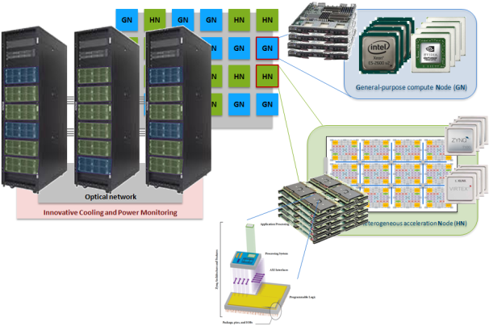
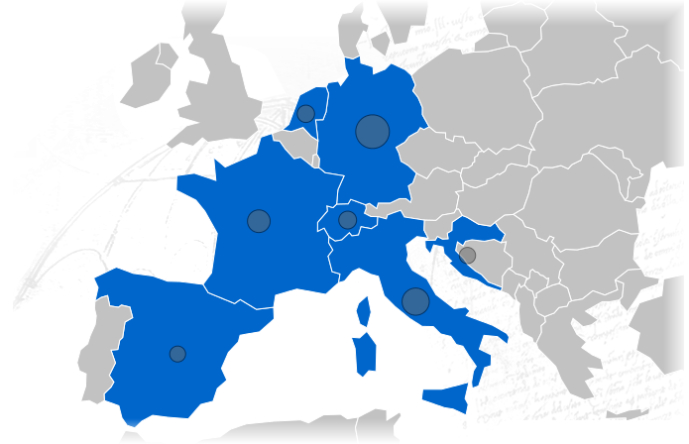
The MANGO project and consortium
MANGO: exploring Manycore Architectures for Next-GeneratiOn HPC systems
One of the 19 large projects selected for exploring innovative HPC solutions (H2020-FETHPC 2014 call)
Universitat Politècnica de València (SPAIN)
CeRICT / University of Naples (ITALY)
Politecnico di Milano (ITALY)
Zagreb University (CROATIA)
Pro Design GmbH (GERMANY)
Thales Communication & Security (FRANCE)
EPFL (SWITZERLAND)
Philips Medical Systems (NETHERLAND)
Eaton Industries SAS (FRANCE)

Slide 7
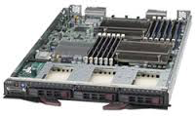
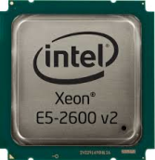
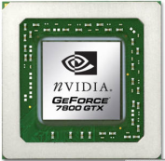
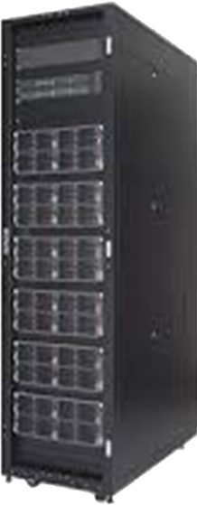
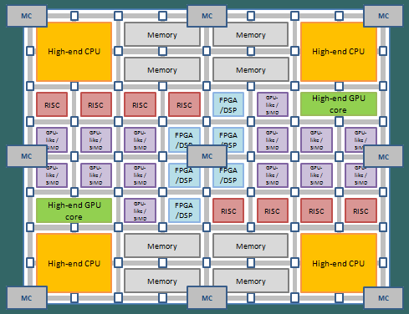
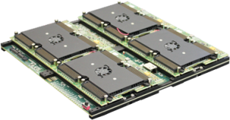
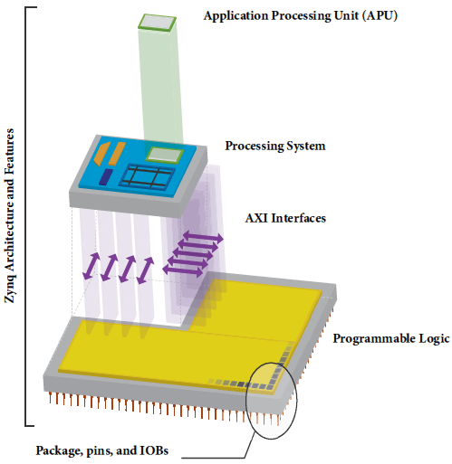
MANGO project overview
GN
HN
GN
GN
HN
HN
General-purpose compute Node (GN)
HN
HN
GN
GN
GN
GN
GN
HN
GN
HN
HN
HN
GN
GN
GN
HN
GN
GN
deeply Heterogeneous acceleration Node (HN)
NoN-IB bridge
Optical network
Innovative Cooling and Power Monitoring

Slide 8
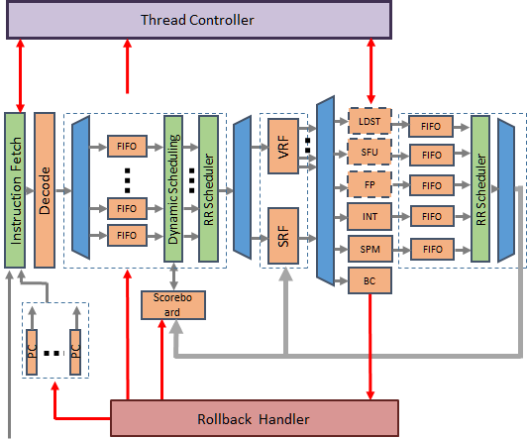
The MANGO GPU-like accelerator
Nu+ (or ν+) GPU-like core
Open source, software-programmable HDL design
Fits both MANGO perspectives:
FPGA-based emulation
FPGA-based computation: provides a parametrized, programmable overlay

Slide 9
GPU processing
GPUs were born for graphics application
Identical computation on several independent data workloads (pixels, vertices, fragments)
GPUs have progressively found application in other fields (such as linear algebra) where similar workloads are present
Most vectorizable problems can benefit from GPU power

Slide 10
Graphics workloads
Several identical, independent computations on different data

Slide 11
A simple pipeline

Slide 12
CPU-like core
Lots of resources dedicated to control logic rather than computing logic
Stalls compensated exploiting ILP

Slide 13
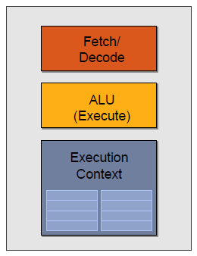
More computing power: multi-core
Good for general purpose parallel computing, but duplicates control logic
Simplify each core, at cost of less ILP (more stalls)

Slide 14
More computing power: multi-core
Same function on different data => SPMD approach
Good for general purpose parallel computing, but duplicates control logic
Simplify each core, at cost of less ILP (more stalls)

Slide 15
SIMD processing approach
Amortizes control/managing cost of instruction threads using multiple ALUs
Requires vector instructions
Scalar threads are grouped into vector threads
Scalar threads execute in lock-step fashion

Slide 16
What about branches?
Lane-level predicated execution =>
Execution masks
if (cond > 0) {
a = 3;
b = 5;
c = 1;
} else {
a = 2;
b = 2;
}

Slide 17
What about stalls?
Fill long latencies interleaving execution of different, independent threads (SIMD threads)
Multiple contexts (e.g. register files)
No fancy control logic
SIMT (Single Instruction Multiple Threads) approach

Slide 18
Multiple SIMT cores

Slide 19
Nu+ microarchitecture
Configurable parameters:
Number of cores
Number of Threads
Number of hw lanes
Number of registers per Thread
Cache set-size
Number of ways
Number of 32-bit words in each line
SPM banks number
Memory
Thread Controller
FIFO full
Load miss / store
Load miss
Blocked threads
Operand
Fetch
Thread Scheduler
Writeback
LDST
FIFO
FIFO
VRF
SFU
FIFO
Dynamic Scheduling
FP
FIFO
Instruction Fetch
RR Scheduler
RR Scheduler
Decode
FIFO
INT
FIFO
FIFO
SRF
SPM
FIFO
BC
Scoreboard
Branch Taken
Restore Scoreboard
PC
PC
Flush FIFOs
Rollback Handler
Restore Thread PC
External Thread Enable

Slide 20
Nu+ crypto extensions
Problem: adding cryptographic extensions while adhering to GPU paradigm
Vectorizable operations (data dependencies)
HW resources dedicated mostly to computing
No complex control logic implemented in HW
Most control logic exposed to SW level

Slide 21
Extensions for asymmetric cryptography
Modular multiplication is the fundamental operation of most public-key cryptosystems
Used in two main kinds of cryptosystems:
Exponentiation-based: RSA, El Gamal, Diffie-Hellman
Elliptic Curve schemes based on prime Finite Fields GF(p)

Slide 22
Modular multiplication
Montgomery reduction is a widespread and efficient approach to perform modular reduction without any trial division.
It can be efficiently integrated with multiplication
Complexity of Montgomery multiplication just slightly above that of simple multiplication

Slide 23
Montgomery multiplication
How is reduction integrated (separated, coarsely or finely integrated)
How multiplication is performed (school-book algorithm, Karatsuba, Toom-Cook, etc…)
Do we scan operands or result?

Slide 24
FIOS Montgomery multiplication
Most computing concentrated inside inner loop

Slide 25
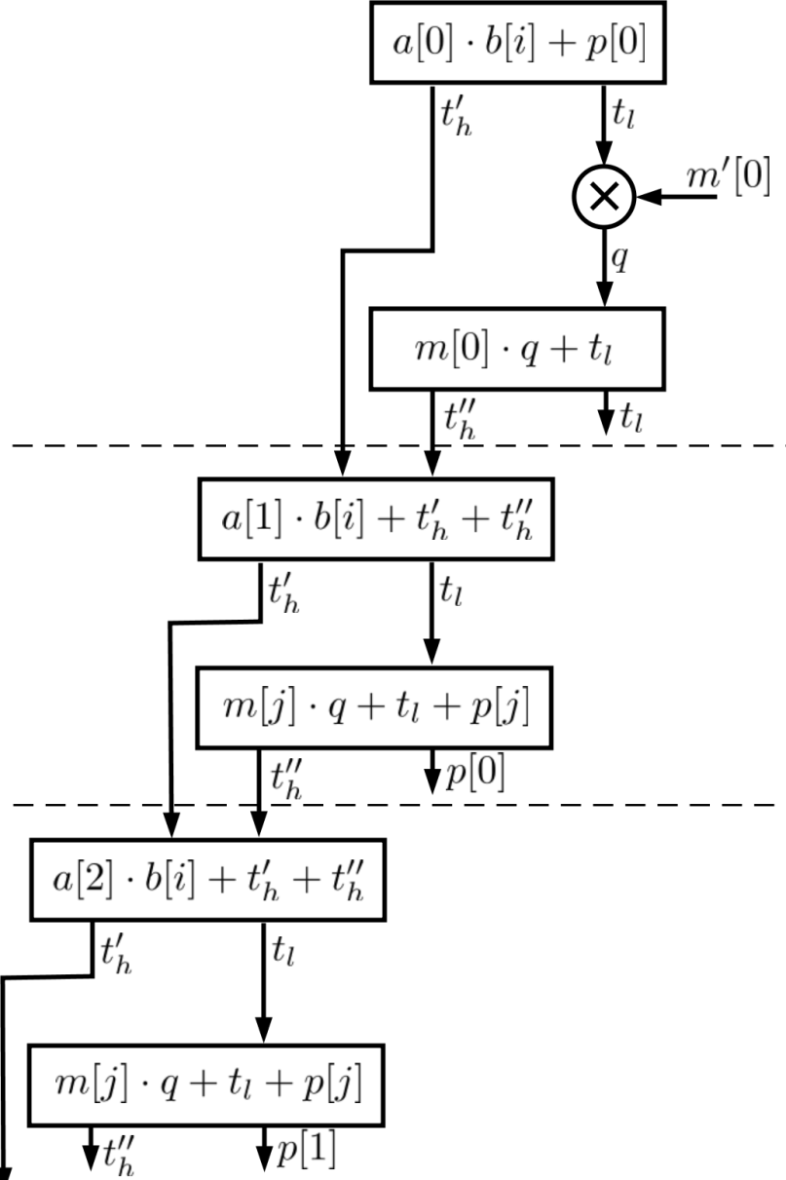
FIOS Montgomery multiplication
Inner loop iteration
Main issue: tight data dependencies hinder vectorization

Slide 26
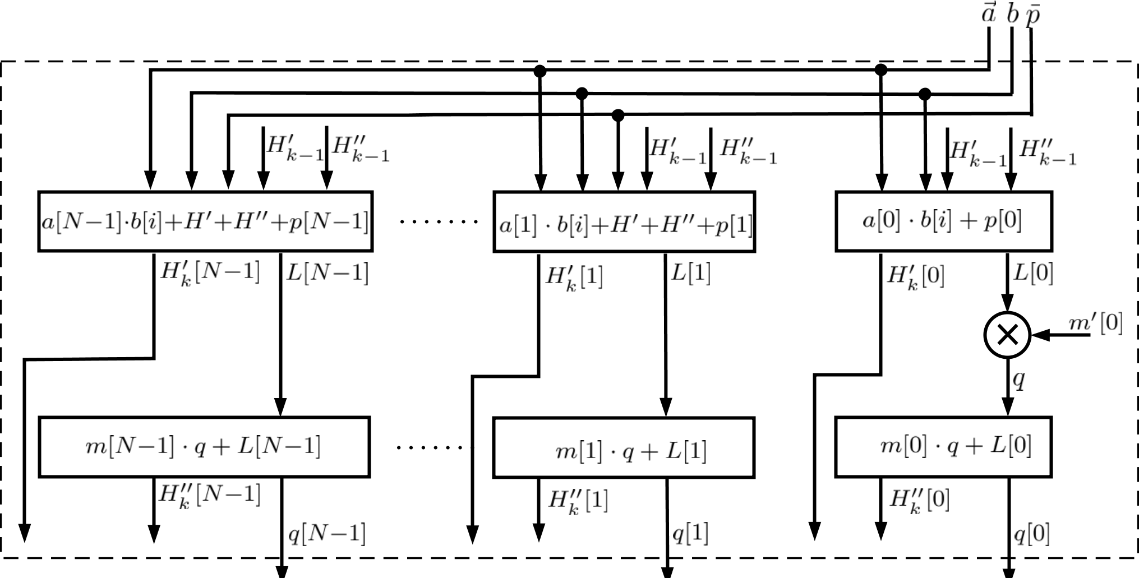
Parallelized inner loop
We broke data dependencies
High data bandwidth requirement => added internal registers

Slide 27
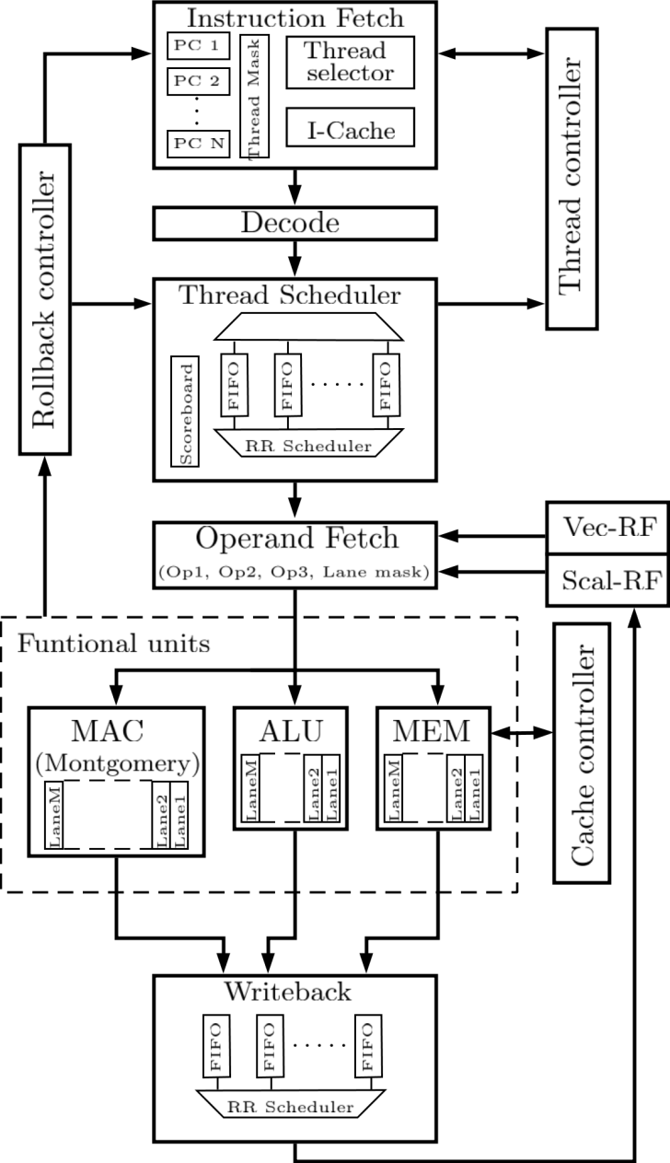
Extended Nu+ core
Units subject to major modification are marked in red
Anyway, most pipeline units have been modified to support new instructions
Three operands (2 vector + 1 scalar) are read during Operand Fetch stage
Functional units not involved in our algorithm are not shown

Slide 28
Extended ISA

Slide 29
Validation
Algorithm for Montgomery multiplication has been written at assembly level
For now, two versions: 256 and 512 bits
Test vectors generated using GMP library
Core simulation performed using Xilinx XSim

Slide 30
Results: area usage
Nu+ core synthetized in Xilinx Vivado for Zynq-7030 SoC
Max core frequency of 200 MHz
4 lanes, 4 threads, 32 bit word, 64 vector and scalar registers
ICache size= 32Kb SPM size= 8Kb
Baseline version: ALU, simple MAC, SPM, Load/Store

Slide 31
Results: performance
 | Cycles/Mult. (256 bits) | Cycles/Mult. (512 bits)
Baseline Nu+ | 558 | -
Extended Nu+ | 212 | 466
[Seo,Liu et al.](A9) | 658 | 2254
[Seo,Liu et al.](A15) | 308 | 1485
[Massolino et al.] | 328 | 1093

Slide 32
Extensions for symmetric cryptography
We focused on the AES standard, the most widespread cipher for symmetric cryptography
Chosen by NIST to supersed old DES standard
One block size: 128 bits
Three possible key sizes: 128, 192 and 256 bits
Worked on AES128 (10 rounds)

Slide 33
AES state matrix
Input block size is 128 bits, divided into 16 bytes
16 bytes are arranged in a 4x4 matrix as below
We store this matrix row-wise

Slide 34
AES encryption algorithm

Slide 35
AES support for Nu+
We produced two version of Nu+ for AES
The main difference is how lookup tables are implemented
(Ver1) Lookup table in ScratchPad memory, separated address space, deterministic access time (useful for twart Timing Side-Channel attacks)
(Ver2) Lookup table in dedicated unit: better performance but more resorces required

Slide 36
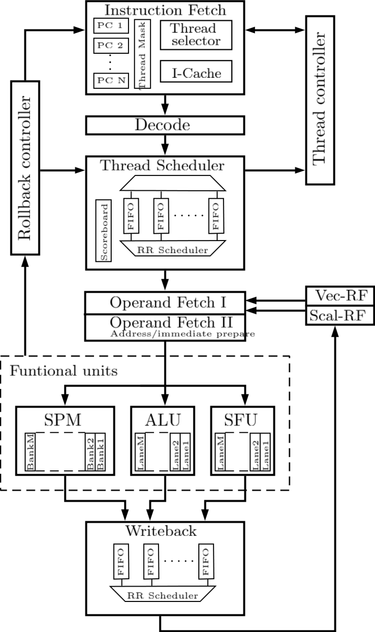
Nu+ extension for AES

Slide 37
AES implementation validation
Algorithm for AES128 has been written at assembly level for both version of Nu+
Test vectors generated using OpenSSL library
Core simulation performed using Xilinx XSim

Slide 38
Result: performance
Lane count = 4
Thread count = 4
Synthesis frequency = 200 MHz (Xilinx Zynq-7030 SoC)
 | Cycle/byte
Nu+ (ver1) | 4.87
Nu+ (ver2) | 0.83
Intel AES-NI | 1.3

Slide 39
Products
Conference paper:
A. Cilardo, D. Argenziano “Extending a GPU-like Processor with Montgomery Multiplication Support”, DATE 2018 (pending approval)

Slide 40
Any questions?

